Slide 1
Substitution vs. Collaboration
How Faculty Conceptions of Human-AI Relationships Shape Pedagogical Choices
Kiera Allison
Assistant Professor, UVA McIntire School of Commerce

Slide 2
"IMPACTS OF AI ON TEACHING WRITING"
Mega-SoTL Investigation of Artificial Intelligence in Teaching and Learning: Faculty Perspectives
Kiera Allison, Sherri Brown, Katherine Miscavige, Rip Verkerke, Breana Bayraktar, Dayna Henry, Jess Taggart
This project is supported by a Fund for Excellence and Innovation (FFEI) grant from the State Council for Higher Education of Virginia (SCHEV).
What anticipated changes and challenges do faculty associate with the emergence of GenAI?
How do faculty think AI will shape the writing they assign?
To what extent do faculty welcome or resist the expected changes?

Slide 3
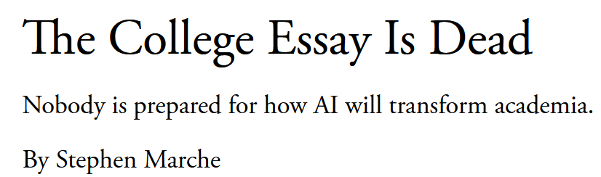

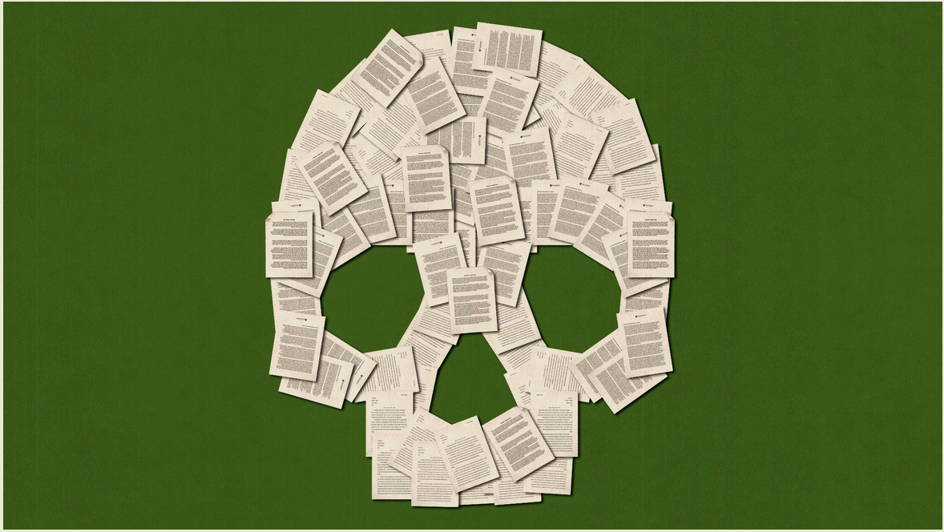
Notes:
THIS NARRATIVE DIDN’T ADEQUATELY CAPTURE HOW TEACHERS ARE PROACTIVELY AND CREATIVELY ADAPTING TO THE CHALLENGES OF GEN AI.

Slide 4
Roadmap
Study overview
Faculty feelings about AI
Making sense of our feelings about AI
  Human-AI relationships (“I don’t like AI”)
  Human-human relationships (“I don’t trust my students with AI”)
  Human-AI-human relationships (“I need my students to trust me rather than/alongside AI”)

Slide 5
Survey (178 respondents across 16 institutions)
How interested are you in integrating AI technology into your teaching?
What do you hope to achieve by integrating AI into your teaching? OR Why aren’t you interested in integrating AI…
What challenges or concerns do you foresee, or have you encountered, in incorporating AI into your teaching?
What is the purpose of student writing in your courses? (Writing to learn, writing to communicate, writing to engage, etc.)
What kinds of writing do you currently use in your courses?
Beyond what you currently use, what kinds of student writing have or would you consider incorporating into your courses? (Select all that apply.)
What specific changes have you made, or do you anticipate making, to your writing assignments?
What is/was the goal of these changes?
Focus groups (4 sessions, 12 participants across 5 institutions)
What specific changes have you made, or do you anticipate making, to your writing assignments?
How do you feel about the changes? Will they enhance or diminish student writing?
How prepared are you to make these changes?
What doesn’t change as a result of AI?
What changes were already underway before AI?
Of the changes you described, which ones would make sense in a world where AI did not exist?

Slide 6
What specific changes have you made, or do you anticipate making, to writing assignments as a result of new generative AI tools?
What is/was the goal of these changes to writing assignments?

Slide 7
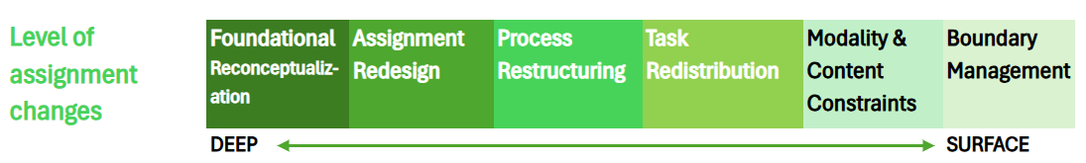
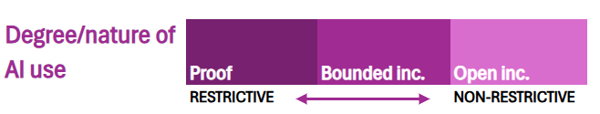
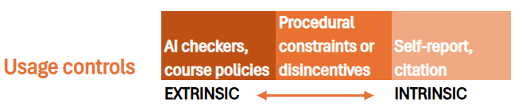
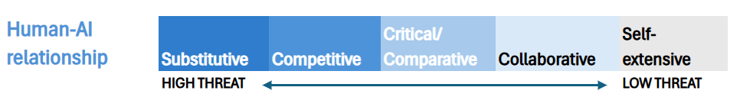
Specific changes

Slide 8
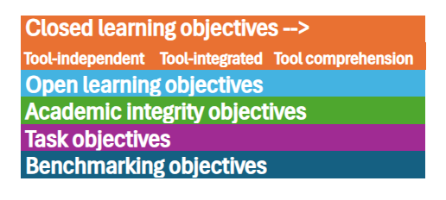
Goals

Slide 9
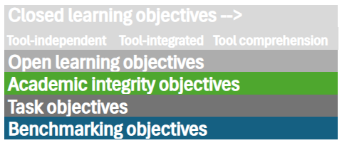
Goals
Notes:
EMPHASIZE ACADEMIC INTEGRITY (SUGGESTS LOWER TRUST → DIVERTING ATTENTION FROM LEARNING), AND BENCHMARKING (COMPETITIVE DIMENSION)

Slide 10
How are you feeling about AI?
Notes:
THE QUESTION WE DIDN’T TECHNICALLY ASK, BUT FACULTY ROBUSTLY ANSWERED

Slide 11
“But like everyone else, I was alarmed at how it would affect the students and also thinking, “I hope I can tell”!...“it is existential. It’s just hard.”…“I consider it an existential event…in my working life.” “AI is terrible at summaries and students still need to read”… “I want to assess the student's writing and thinking - not the machine’s.” “Feeling like you’re spending your weekend responding to a robot”…“told the students to be careful trusting the ai” … “Hate thinking that way about students, but hate even more someone trying to pass off something as original when it’s not”… “pull the wool over my eyes”…
“...I hate AI...” “It’s touching you whether you know it or not.”…“Feel like I’m screaming into the void.”…“I do feel this invisible pressure that this is where [the university] is going and you need to get on board.”…“I had plenty of time to play around with it, get amused, get tired by it.”
Notes:
AFFECTIVE DIMENSION IS NOT REDUCIBLE TO ANY OF OUR EXISTING SCHEME, BUT INTERSECTS WITH SEVERAL OF THEM

Slide 12
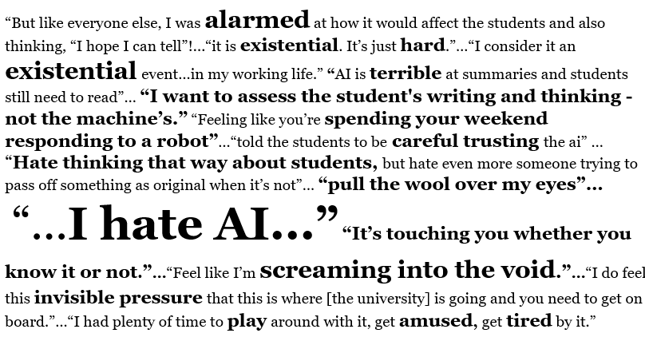
The Algorithm in the Room
Notes:
NEW ENTITY (AI) WITH WHOM WE ARE IN UNCERTAIN RELATIONSHIP, AND WHICH HAS SHIFTED THE ARCHITECTURE OF OUR EXISTING RELATIONSHIPS IN AND BEYOND THE CLASSROOM—WITH STUDENTS, WITH THE INSTITUTION WE WORK FOR.

Slide 13
Notes:
FACULTY, WHEN THEY DESCRIBE HOW THEY’VE ADAPTED THEIR TEACHING AND ASSIGNMENTS, ARE SIMULTANEOUSLY CONSTRUCTING A THEORY OF HOW HUMANS AND AIS WILL COEXIST IN THE WORLD.

Slide 14
“I did feel that education was necessarily going to change. I wondered if I'd still have a job in five years.”
“[H]ow much are we even going to value writing classes how many years in the future? What is that going to look like? Writing as a historical practice?”

Slide 15
“Zone of Proximal Development”
Notes:
JUST BECAUSE AI CAN DO THE THING DOESN’T MEAN HUMANS SHOULDN’T STILL LEARN TO DO THE THING

Slide 16
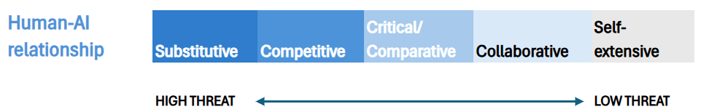
“It’s terrible at synthesis”
“AI doesn't know about the BLUF style of writing [I] require”
“AI is terrible at summaries”
“I show students… ‘Please don’t use it for this, because here’s how it’s going to fail.’…The models will spit out things, even the best, where the voice is identifiable as a machine voice.”

Slide 17
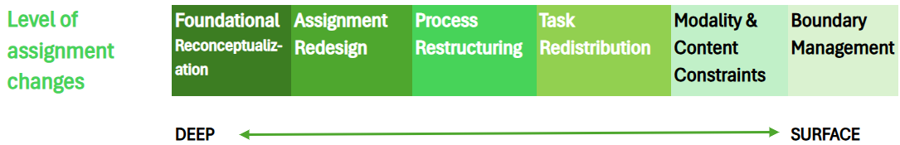
Notes:
IF SUBSTITUTION IS YOUR FRAMEWORK, DOES THAT MANIFEST IN IMPOSING GUARDRAILS…

Slide 18
“I would let [students] push [AI] to the wall and see how far they can take it. If they think they don’t need this class anymore, they can show me… If they can really learn something on their own without me being there, using it actively…that’s a sensible use case. I wasn’t sure if there were justifiable ways to use it to replace me. I prefer not to be replaced, but this is a way for me and AI to collaborate.”
Notes:
OR…
RETHINKING INSTRUCTIONAL PRIORITIES AND THE FUTURE OF THE DISCIPLINE GENERALLY. (SOME INSTRUCTORS ARE INVOLVING STUDENTS IN THAT DIALOGUE.)

Slide 19
Notes:
FACULTY ON THIS SIDE ARE ABLE TO SHIFT FOCUS AWAY FROM ACADEMIC-INTEGRITY MEASURES AND TOWARD THE QUESTION OF HOW MEANINGFULLY TO INTEGRATE AI INTO THE LEARNING PROCESS.

Slide 20
Roadmap
Study overview
Faculty feelings about AI
Making sense of our feelings about AI
  Human-AI relationships (“I don’t like AI”)
  Human-human relationships (“I don’t trust my students with AI”)
  Human-AI-human relationships (“I need my students to trust me rather than/alongside AI”)

Slide 21

Ofir Turel and Shivam Kalhan, “Prejudiced Against the Machine? Implicit Associations and the Transience of Algorithm Aversion,” MIS Quarterly, 47.4 (Dec. 2023): 1369-94.

Slide 22
AI
Untrustworthy
AI
Trustworthy
Me
Untrustworthy
Me
Trustworthy
Expert
Untrustworthy
Expert
Trustworthy
Ofir Turel and Shivam Kalhan, “Prejudiced Against the Machine? Implicit Associations and the Transience of Algorithm Aversion,” MIS Quarterly, 47.4 (Dec. 2023): 1369-94.

Slide 23
AI
Untrustworthy
AI
Trustworthy
Me
Untrustworthy
Me
Trustworthy
Expert
Untrustworthy
Expert
Trustworthy
Ofir Turel and Shivam Kalhan, “Prejudiced Against the Machine? Implicit Associations and the Transience of Algorithm Aversion,” MIS Quarterly, 47.4 (Dec. 2023): 1369-94.

Slide 24
AI
Trustworthy
“[H]umans—given their evolutionary focus on external groups, the decision processes of which are unknown—are likely to unconsciously view AI as a different ‘species’ that might be perceived as untrustworthy” (1373)
Me
Untrustworthy
Me
Trustworthy
Expert
Untrustworthy
Expert
Untrustworthy
Ofir Turel and Shivam Kalhan, “Prejudiced Against the Machine? Implicit Associations and the Transience of Algorithm Aversion,” MIS Quarterly, 47.4 (Dec. 2023): 1369-94.

Slide 25
“while the AI writes well, I find that on actually technical topics it makes mistakes, and students need to know that this is not likely to fool a professional who works in a specific area.”
“I want to see the specific sources they are working with and that the sources actually exist.”
“ChatGPT can be fooled by its own writing by throwing in some details. if students can figure this out, it is really hard for us to detect cheating.”
“If the writing is too good to be true, it is automatically suspect.”
“it seems to completely take over the brain & cognitive processes”
“told the students to be careful trusting the ai”
“You need to use your brain to catch it and its errors”
AI
Untrustworthy
AI
Trustworthy
Me
Untrustworthy
Me
Trustworthy
“I’m not a mind-reader. Not sure if it’s their own thoughts or if they learned from ChatGPT.”
“I am warning students that if I suspect the use of AI in their papers…”
“I have moved to having students complete writing assignments during class in order to ensure they at not using AI tools when I do not want them to use them.”
“identify when students are being disingenuous”
Expert
Untrustworthy
Expert
Untrustworthy

Slide 26
“while the AI writes well, I find that on actually technical topics it makes mistakes, and students need to know that this is not likely to fool a professional who works in a specific area.”
“I want to see the specific sources they are working with and that the sources actually exist.”
“ChatGPT can be fooled by its own writing by throwing in some details. if students can figure this out, it is really hard for us to detect cheating.”
“If the writing is too good to be true, it is automatically suspect.”
“it seems to completely take over the brain & cognitive processes”
“told the students to be careful trusting the ai”
“You need to use your brain to catch it and its errors”
AI
Untrustworthy
AI
Trustworthy
Me
Untrustworthy
Me
Trustworthy
“I’m not a mind-reader. Not sure if it’s their own thoughts or if they learned from ChatGPT.”
“I am warning students that if I suspect the use of AI in their papers…”
“I have moved to having students complete writing assignments during class in order to ensure they at not using AI tools when I do not want them to use them.”
“identify when students are being disingenuous”
Expert
Untrustworthy
Expert
Untrustworthy

Slide 27
“while the AI writes well, I find that on actually technical topics it makes mistakes, and students need to know that this is not likely to fool a professional who works in a specific area.”
“I want to see the specific sources they are working with and that the sources actually exist.”
“ChatGPT can be fooled by its own writing by throwing in some details. if students can figure this out, it is really hard for us to detect cheating.”
“If the writing is too good to be true, it is automatically suspect.”
“it seems to completely take over the brain & cognitive processes”
“told the students to be careful trusting the ai”
“You need to use your brain to catch it and its errors”
AI + students?
Untrustworthy
AI
Trustworthy
Me
Untrustworthy
Me
Trustworthy
“I’m not a mind-reader. Not sure if it’s their own thoughts or if they learned from ChatGPT.”
“I am warning students that if I suspect the use of AI in their papers…”
“I have moved to having students complete writing assignments during class in order to ensure they at not using AI tools when I do not want them to use them.”
“identify when students are being disingenuous”
Expert
Untrustworthy
Expert
Untrustworthy

Slide 28
“The breakdown of the old structure and the reality it held in place creates sort of a vacuum, a ‘low-pressure area’ in the person and the organization, that will attract bad intra- and interpersonal weather from all sides. Old issues that individuals and groups have apparently resolved suddenly return to haunt them. Long-dormant anxieties and antagonisms are stirred up.”
William Bridges, “Managing Organizational Transitions,” Organizational Dynamics (1986): 24-33.
Notes:
IN PERIODS OF ORGANIZATIONAL TRANSITION, HUMAN RELATIONSHIPS SUFFER.

Slide 29
I use more collaborative peer review sessions so that students are accountable to one another and may be more aware of having a human audience ***Having students do group projects in class helps encourage them to interact with each other and engage with the topics rather than take the opportunity to cut and paste from Chat-GPT *** To get to know my students as writers; to encourage students to come up with their own ideas rather than letting AI suggest them; to get students talking to each other and collaborating in the classroom. *** Some of my students have had very few humans interested in their writing previously since computers often graded their essays, so they lack the basic understanding that the purpose of writing is to connect human writers to human audiences. *** They see, when I know and care about the conversation, I can see that AI doesn’t know that. *** And now we can revise it, because you have something you want to say. That care is coming across more than ever. They’re not just creating those ideas, but getting someone to care about those ideas. That’s where I see my irreplaceability. *** I want to offer space to students to integrate AI into their writing if they want without (yet) requiring students to do so. I also wanted to learn from them how they used AI and whether they found it useful… My initial goals were to test the waters a bit (of my tech use and of how students might be using AI), and to explore possible best practices. At this point, I see that transparency is a little unnerving but also important in today's classrooms, and I also see that using this technology has tremendous power for good or ill, so I want to channel my students toward good.
Notes:
INSTRUCTORS UNDERSTAND THAT A) CLASSROOM RELATIONSHIPS NEED WORK, B) THE ONLY THING STANDING BETWEEN THEIR STUDENTS AND AI IS THE STUDENT’S TRUST IN, AND ACCOUNTABILITY TOWARD, OTHER HUMANS

Slide 30
STUDENT
HUMAN
GEN AI

Slide 31
STUDENT
HUMAN
GEN AI

Slide 32
STUDENT
HUMAN
GEN AI
Notes:
COMPETITIVE TRUST MODEL: BUILDING TRUST/ACCOUNTABILITY ALONG THE HUMAN DIMENSION…

Slide 33
STUDENT
HUMAN
GEN AI
Notes:
…TO WEAKEN THE BOND BETWEEN STUDENTS AND AI

Slide 34
STUDENT
HUMAN
GEN AI
Notes:
COLLABORATIVE TRUST MODEL: STUDENTS AND TEACHERS TRUST ONE ANOTHER TO EXPERIMENT RESPONSIBLY WITH THE AI, AND TO BE TRANSPARENT WITH EACH OTHER ABOUT THEIR USE

Slide 35
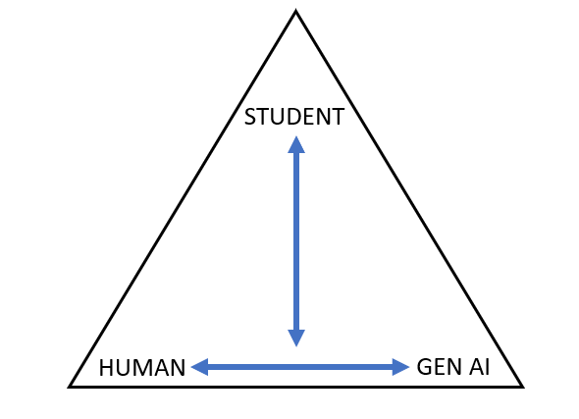
Key questions
Do my feelings about AI – and my way of expressing those feelings to students – align with my values as a teacher?
Do I want students to engage with AI as part of their learning?
  NO → Whom do I want them to trust instead of AI?
  YES → How will I signal that I trust them to use the tools responsibility? What accountability structures will I put in place?

