Slide 1
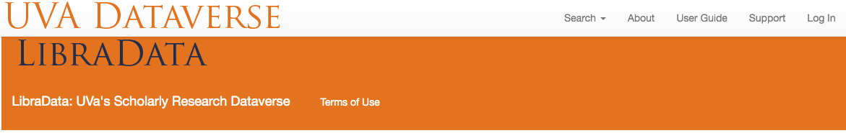
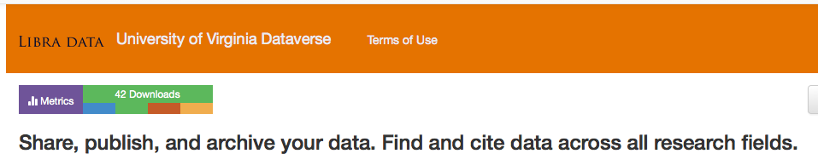

Introduction to LibraData
Sherry Lake
Scholarly Repository Librarian
UVa LibraryshLake@virginia.edu

Slide 2
Prompts: Sharing and Re-using Data
Have you used data from a “repository” in your research?
Why?
Where?
How did you find it?
Was it usable?
Have you shared your research?
Why?
How?
Where?
Notes:
1st I want to hear from you about your use (and not use) of Data Repositories
Have you tried to find data online?

Slide 3
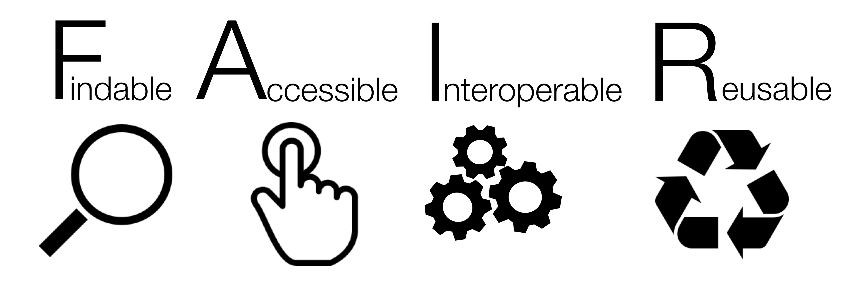










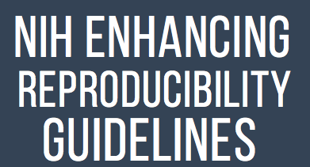



Trends in Open and FAIR Research
Notes:
Funding agencies are establishing open requirements - Open Government Data Bill passed - not just Public funders but private, some who have pushed the Open envelop a couple of years ago with open data requirements and open access to results (articles) based on private research funding. Not just Open Data but Open access to published results (articles).
Journals are requiring data behind the article to be “available”, moving toward sharing in a repository - some specify where. Then there are Data Journals, which contain links to the data and only and abstract or description of the dataset.
The two Newest trend is making research “reproducible”, Improving openness and Reproducible research - means the data, software and description of the methods open (shared).
The FAIR Data Principles useful framework for thinking about sharing data in a way that will enable maximum use and reuse.

Slide 4

Increasing the Access to the Results
of Federally Funded Scientific Research
Memo released February 22, 2013
To ensure that “…direct results of federally funded scientific research are made available… Federal agencies investing in research and development (more than $100M in annual expenditures) must develop plans to support increased public access to the results of research …”
https://obamawhitehouse.archives.gov/sites/default/files/microsites/ostp/ostp_public_access_memo_2013.pdf
Notes:
The original White House memo on increasing the Public Access for research – February 22, 2013. Set the stage for funders (

Slide 5
Public Access to Scientific Publications and Scientific Data in Digital Formats
… “the results of unclassified research that are published in peer-reviewed publications …should be stored for long-term preservation and publicly accessible to search, retrieve, and …”
… “digitally formatted scientific data resulting from unclassified research supported wholly or in part… should be stored and publicly accessible to search, retrieve, and analyze.”
From the Holdren Memo, 2013
Notes:
Holdren Memo, 2013: https://obamawhitehouse.archives.gov/sites/default/files/microsites/ostp/ostp_public_access_memo_2013.pdf

Slide 6
Ensuring Free, Immediate, and Equitable Access to Federally Funded Research
Memo released August 25, 2022
Extends the original 2013 memo to include ALL Federal Agencies: must develop plans to ensure research publications are made freely available without embargo and scientific data underlying publications made freely available at time of publication
https://www.whitehouse.gov/wp-content/uploads/2022/08/08-2022-OSTP-Public-Access-Memo.pdf
Notes:
The original on increasing the Public Access for research – February 22, 2013. Set the stage for US funders
There is much more detail in the memo: https://www.whitehouse.gov/wp-content/uploads/2022/08/08-2022-OSTP-Public-Access-Memo.pdf
All Federal Agencies: update or develop new public access plans – to ensure that all peer-reviewed scholarly publications are made freely available and publicly accessible by default in agency-designated repositories without any embargo or delay after publication.
Scientific data underlying peer-reviewed scholarly publications resulting from federally funded research should be made freely available and publicly accessible by default at the time of publication
develop approaches and timelines for sharing other federally funded scientific data that are not associated with peer-reviewed scholarly publications

Slide 7
Recommended as general repository for journal data sharing and replication requirements
e.g., PLoS, Nature, Elsevier
Fulfills funders’ data sharing policies,
including NIH 2023 policy, as a general repository
Increases visibility and impact by openly sharing your research
Notes:
Benefits of using LibraData include:
Safe management of your data. Depositing your research data in Libra Data not only makes your data discoverable and accessible to a wider audience, but also keeps your data safer. The UVA Library, and UVA’s Information Technology Services, are committed to the durability and sustainability of scholarship deposited in Libra. Libra uses standard data management practices, including security and backup procedures, to provide a reasonable assurance that files will remain retrievable over time. Libra Data will be preserved in the Academic Preservation Trust, of which UVA Library is a founding member and partner.
Fulfillment of journal and grant mandates. More journals and public and private funding agencies are requiring that researchers deposit data created as part of the research process. Publishing your data within Libra Data meets the requirements of these mandates.
Increased visibility and impact of your research data. Sharing your data publicly can increase your research impact and visibility, creating additional opportunities for collaboration and connection within and beyond your existing network. To assist in the sharing process, a persistent identifier (DOI) is created for each Libra Data dataset.

Slide 8
F indable
Assigned DOI
Indexed by Virgo and DataCite, Google Data Search (soon)
A ccessible
Open to ALL not just UVa
Clickable button for download
I nteroperable
Common metadata standards (DDI, DC)
Machine exchange via OAI-PMH
R eusable
CC0 License
Citation Easily Visible
FAIR Guiding Principles: https://www.nature.com/articles/sdata201618
Notes:
How many have heard about FAIR??
The FAIR Data Principles (Findable, Accessible, Interoperable, Reusable) were drafted at a Lorentz Cente 0 rworkshop in Leiden in the Netherlands in 2015.
The principles have since received worldwide recognition by various organizations including FORCE11, National Institutes of Health (NIH) and the European Commission as a useful framework for thinking about sharing data in a way that will enable maximum use and reuse. And more recently have become part of publishing polices by the AGU (American Geophysical union) and Nature.
The principles recommend that data (and/ or metadata) are: ‘findable’ by anyone using common search tools; ‘accessible’ so that the data and metadata can be examined; ‘inter- operable’ so that comparable data can be analyzed and integrated through the use of common vocabulary and formats; and ‘reusable’ by other researchers or the public as a result of robust metadata, provenance information and clear usage licenses
Data can be FAIR along a continuum, they may not have ALL the principles – differing degrees of FAIR.
The ultimate goal of FAIR is to optimize the reuse of data.
information about data reduction or transformation processes to make data more usable, understandable or ‘science-ready’. “Reproducible”

Slide 9
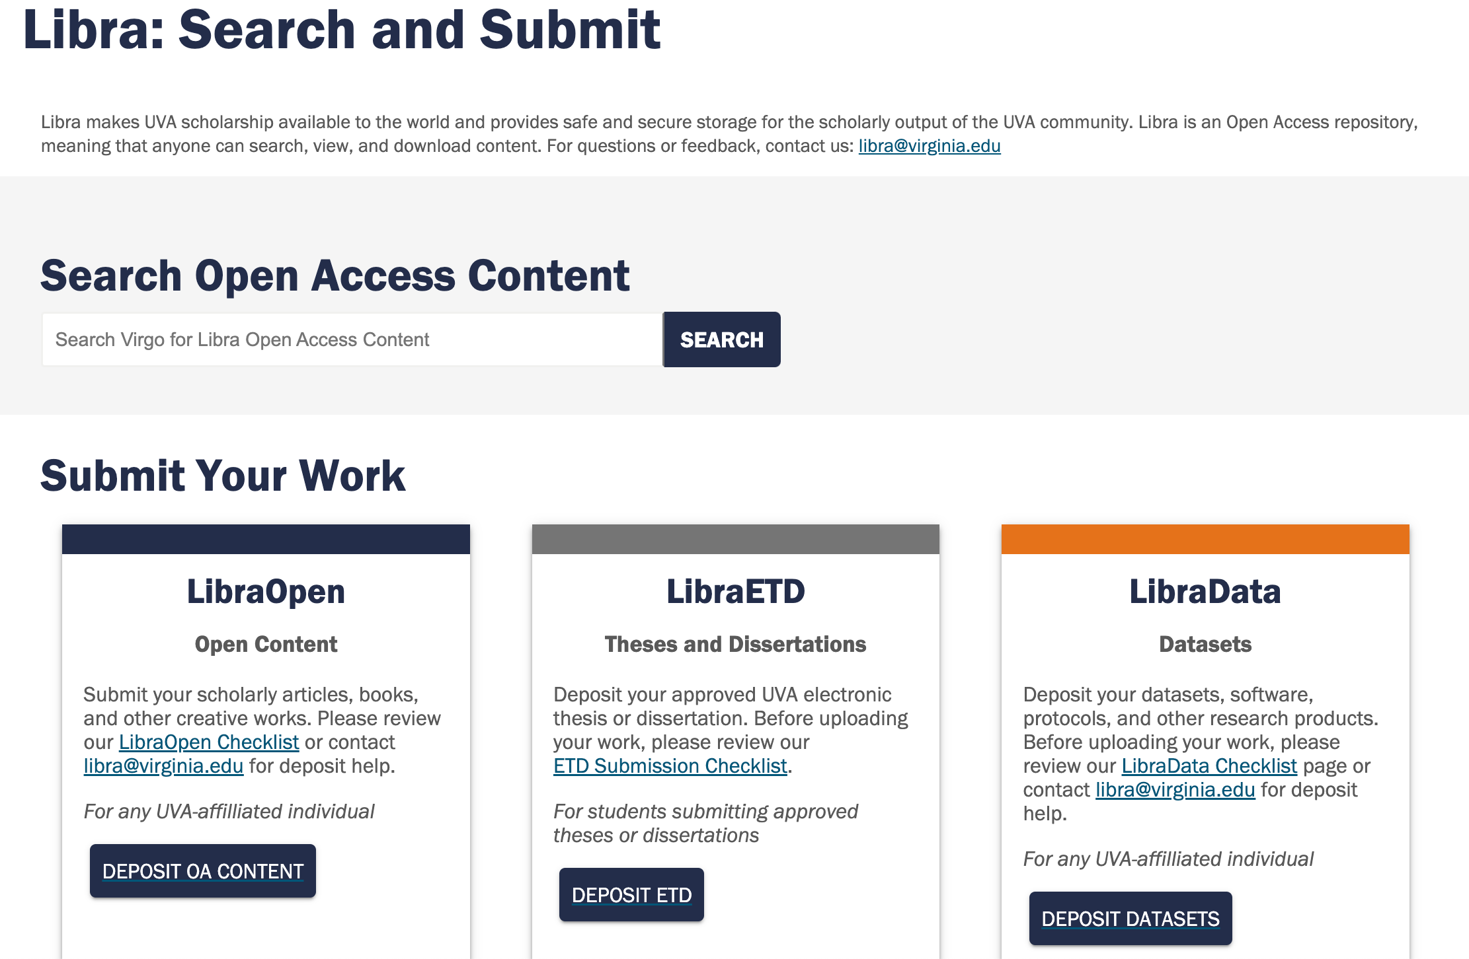
http://libra.virginia.edu
Notes:
Libra Scholarly Repository suite of services which includes works of UVA scholarship such as articles, books, theses, and data.
LibraData is part our Libra suite of repositories. LibraData is a place for UVA researchers to share data publicly. It is UVA's local instance of Dataverse.

Slide 10
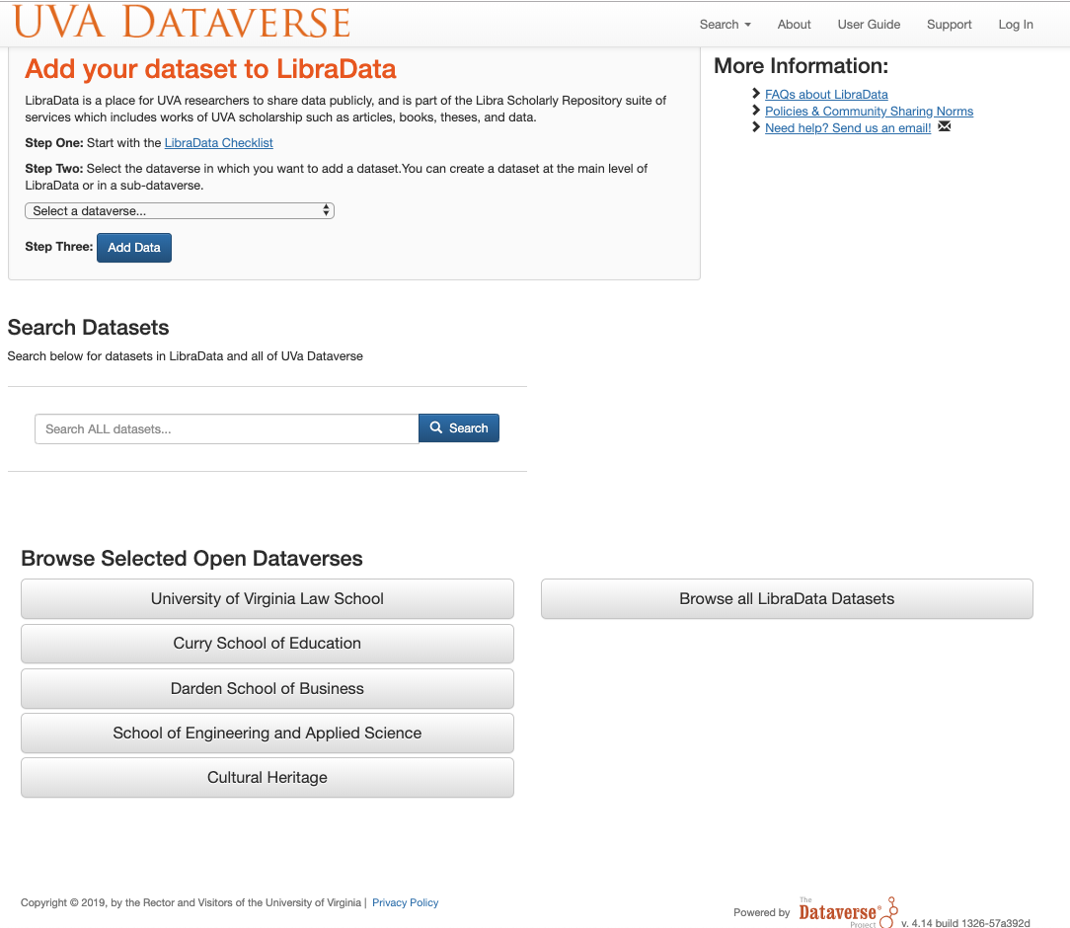
http://dataverse.lib.virginia.edu
Notes:
Benefits of using Libra Data include:
Increased visibility and impact of your research data. Sharing your data publicly can increase your research impact and visibility, creating additional opportunities for collaboration and connection within and beyond your existing network. To assist in the sharing process, a persistent identifier (DOI) is created for each Libra Data dataset.
Safe management of your data. Depositing your research data in Libra Data not only makes your data discoverable and accessible to a wider audience, but also keeps your data safer. The UVA Library, and UVA’s Information Technology Services, are committed to the durability and sustainability of scholarship deposited in Libra. Libra uses standard data management practices, including security and backup procedures, to provide a reasonable assurance that files will remain retrievable over time. Libra Data will be preserved in the Academic Preservation Trust, of which UVA Library is a founding member and partner.
Fulfillment of journal and grant mandates. More journals and public and private funding agenciesare requiring that researchers deposit data created as part of the research process. Publishing your data within Libra Data meets the requirements of these mandates.
Valuable research time saved. Using Libra Data’s easy-to-use interface to deposit, describe, and share your data saves you time and allows you to focus on your research.

Slide 11
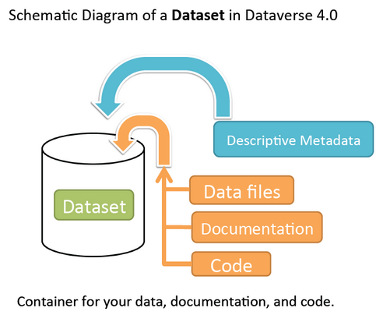
What is a Dataset?
Products of Research
Container for your data, documentation, code and other products of research

Slide 12
Demo: http://dvdev.lib.virginia.edu
Notes:
Make sure demonstrate (on dvdev):
Home page
Guides
Web pages – with policies – deposit license - checklist
UVa login credentials
DOI generation
Citation Visibility
Depositing
Metadata only, URL to other repo
Permissions, others to add
UVa deposit license (popup)
Pre-publish URL for reviewers (but not anonymous)
Other Features
Linking papers & data
Account –
API, Mydata
Search (here or Virgo or Libra page)
Harvesting of Harvard UVa-afflications

Slide 13
Tips: Getting Help
Sends email to Libra@virginia.edu

Slide 14
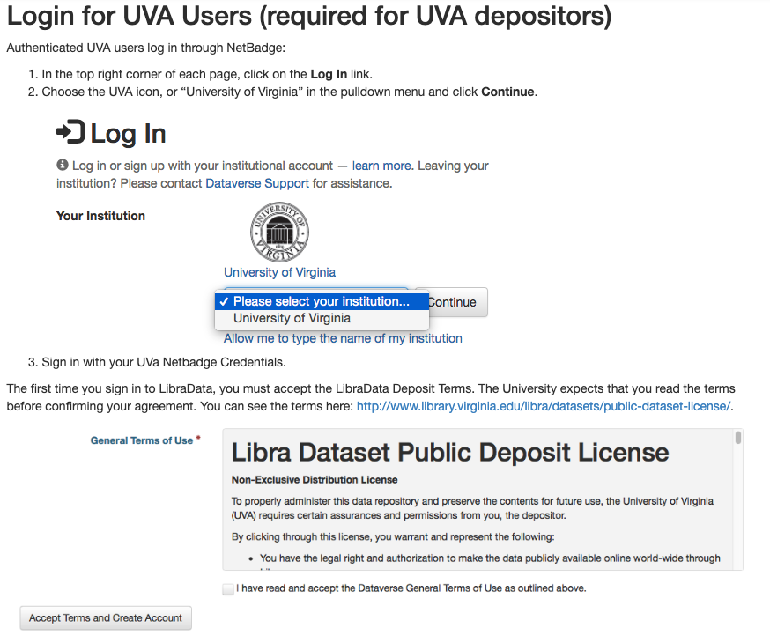
Tips: Logging In

Slide 15
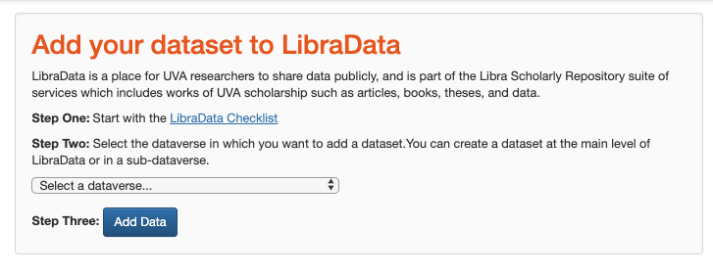
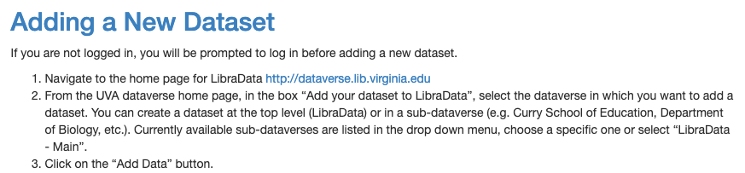
Tips: Adding Data

Slide 16
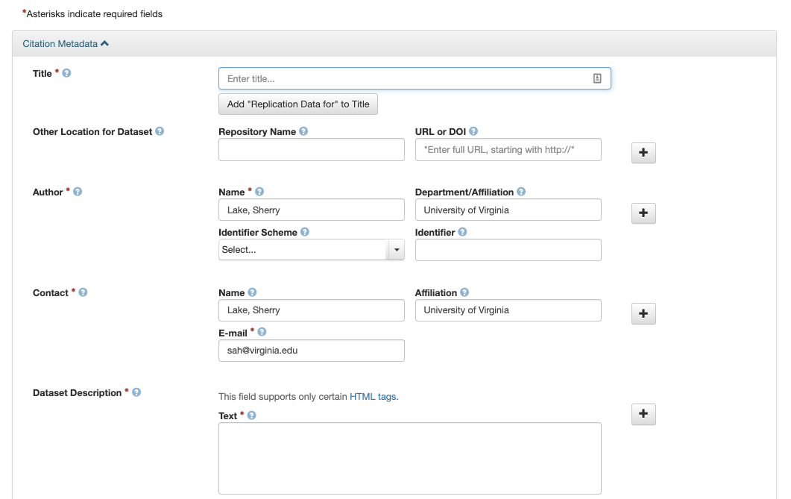
Tips: Entering Metadata – for File Upload
Enter the required fields with an asterisk (e.g., the Dataset Title, Author, Dataset Description, Contact Email, Subject, and Data Creation Date). Scroll down and enter other fields as needed.

Slide 17
Tips: Entering Metadata – with no files
If your data is already in another permanent repository, you do not have to upload the files to LibraData - enter the repository name and DOI in the metadata.

Slide 18
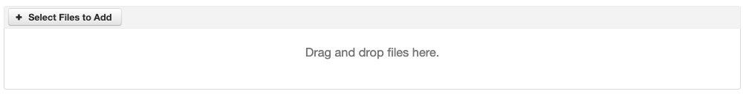
Tips: Uploading Files
Max 6BG per file
Drag and drop files or folders
OR Select files
Keeping Directory Structure
Zip files (compress)
Select or drag the “compressed” file
Compressed files in zip format are unpacked automatically. If the uploaded .zip file contains a folder structure, Dataverse will keep track of this structure. A file’s location within this folder structure is displayed in the file metadata as the File Path. When you download the contents of the dataset, this folder structure will be preserved and files will appear in their original locations.
Keeping Zip file “zipped”
Double zip the file
On a Mac: compress a folder and then in terminal window and run gzip on the compressed file

Slide 19
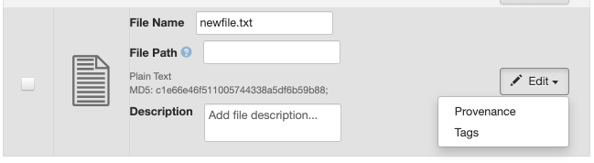
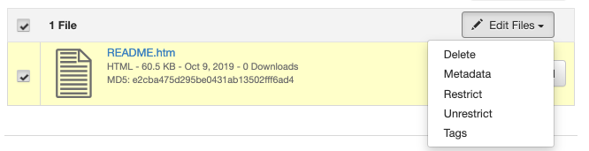
Tips: File Metadata
On Initial Create:
You can change the filename, add a description and add one or more Tags – See Tips: File Tags for more info
After Initial Upload: Select file(s) on dataset page

Slide 20
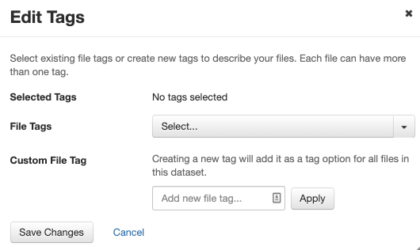
Tips: File Tags
See Tips: File Metadata for selecting “tags” during upload or after.
After upload, you can select more than one file and apply the same tag.

Slide 21
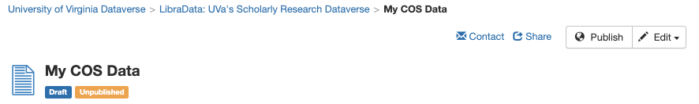
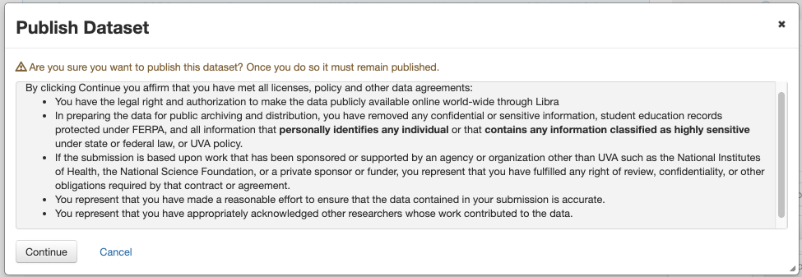
Tips: Publishing a Dataset
A pop-up will appear (see below) to confirm that you are ready to Publish, per the LibraData Deposit license: https://www.library.virginia.edu/libra/datasets/public-dataset-license/

Slide 22
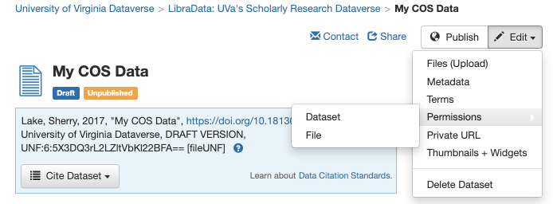
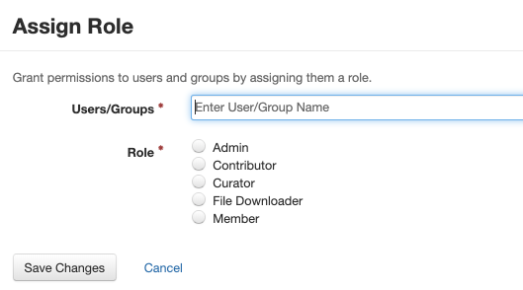
Tips: Setting Permissions
Owners of a dataset can assign roles and permissions to others at the dataset or file-level.
User must have a UVa Dataverse account before a role can be assigned.

Slide 23
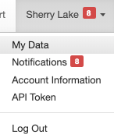
Tips: Displaying Own Datasets
To see all published, draft and unpublished datasets that you have created or have access to edit, go to My Data
Log In
Click your name in the top-right.
Select “My Data”.
Click a dataset link to view.
My Data gives you quick access to update your unpublished datasets. Or you could do a search of your name.

Slide 24
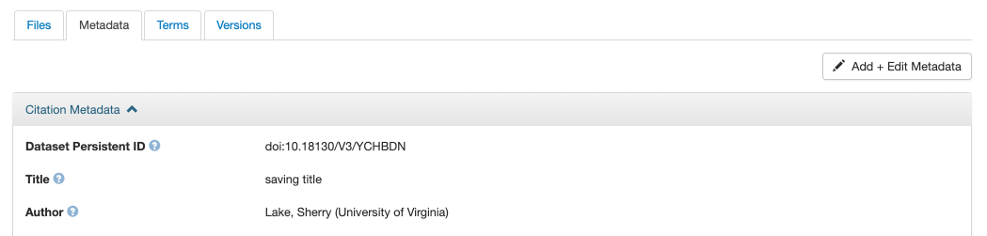
Tips: Updating Metadata - before publishing
Go to your dataset to edit.
Go the Metadata tab.
Select "Add + Edit Metadata".
Fill in any additional fields and click "Save Changes".

Slide 25
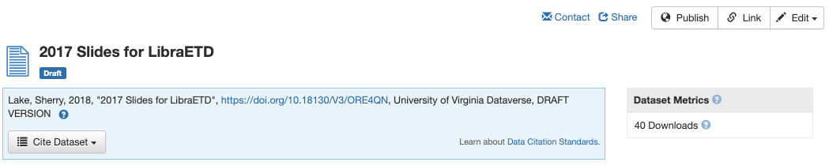
Tips: Updating Metadata - after publishing
See Tips: Updating Metadata – before publishing to edit
If your dataset has been published, any edits will create a new DRAFT version.
You will have to publish again before the changes become public.

Slide 26
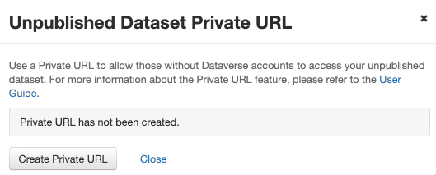
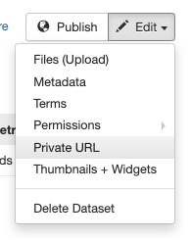
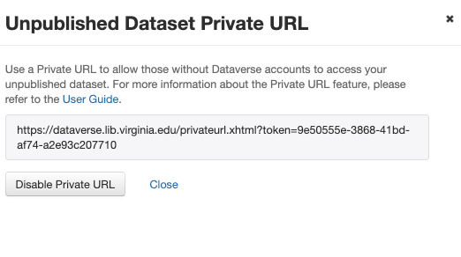
Tips: Sharing Dataset Before Public
You can share your dataset before it is public two ways:
See Tips: Setting Permissions (for UVa Users)
Creating a Private URL - for anyone (see below)
NOTE: The private URL is only good as long as the dataset is DRAFT and as long as it hasn’t been disabled (see below).

Slide 27
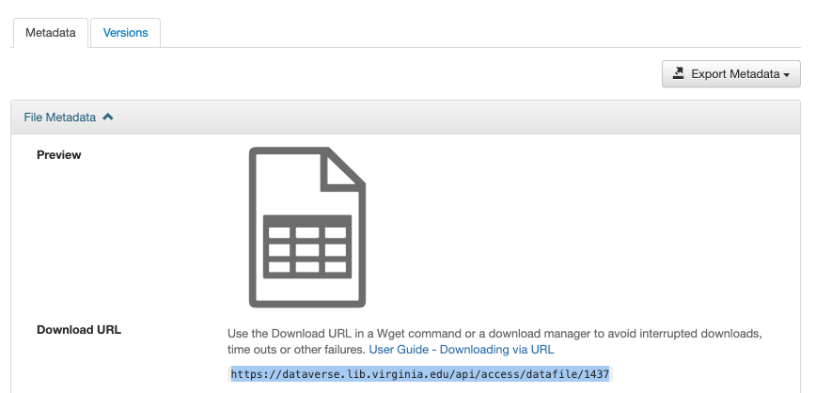
Tips: Permanent File URL
Every published dataset with the default CC-0 license has a permanent DOI which is listed in its citation block.
Files do not have DOIs (at UVa), but public individual files can be accessed via a permanent URL.
From the dataset page, click on the filename. The Download URL is on the file page under the Metadata tab.

Slide 28
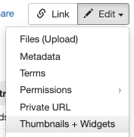
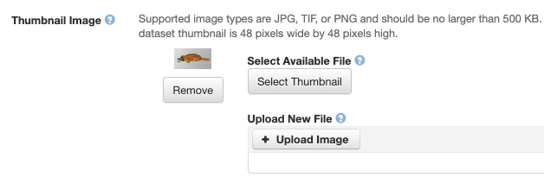
Tips: Setting Dataset Thumbnail Image
The thumbnail for a dataset appears on the search result card for that dataset and on the dataset page itself.
Thumbnails are set by one of the following:
If a dataset contains one or more data files that Dataverse recognizes as an image, then one of those images is automatically selected as the dataset thumbnail.
Dataset owner manually sets the thumbnail from one of the dataset files
Data owner uploads an image for the thumbnail only (not part of the dataset)

Slide 29
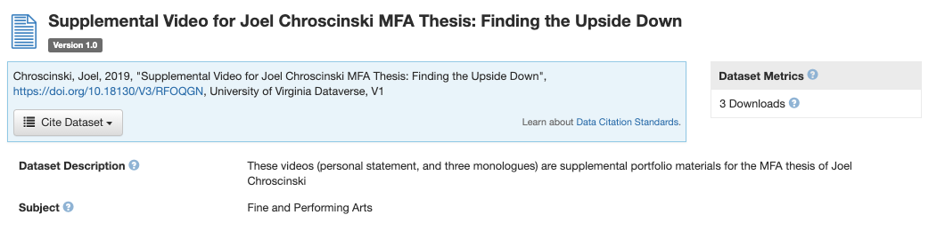
Tips: What is the Citation for my Dataset?
The citation for the dataset at the top of the dataset page in a blue box.
The Cite Dataset button that offers the option to download the citation as EndNote XML, RIS Format, or BibTeX Format.

Slide 30
For more information…
LibraData Help:
For your final, publishable products of research
Guides
https://guides.lib.virginia.edu/LibraDataUserGuide
LibraData Deposit Checklist
http://www.library.virginia.edu/libra/datasets/libra-data-deposit-checklist/
Dataset Questions/Answers
http://www.library.virginia.edu/libra/datasets/libradata-faq/

Slide 31
Library Services
Scholarly Communication
Open Repositories
LibraData - data repository for funder and journal requirements
LibraOpen – other scholarly output
LibraETD – student works (theses/dissertations/capstones)
Copyright/License Advising
Aperio Open Access Press (http://aperio.press)
Notes:
LibraData - UVa’s Open Data repository to comply with sharing requirements (funders AND publishers)
Based on Dataverse open source software developed and used at Harvard
LibraOpen place to put “allowable” version of articles, but ANY output accepted.

Slide 32
Library Services
Research Data Services
Research Management
Data Management Plans (DMPs)
Reproducible Practices
Data Discovery
Data Analysis, Visualization & Computation
Notes:
The Library has you covered across your research life cycle, from finding, collecting, analyzing your research to disseminating your research – all with an eye toward OPEN!
Open as possible, as closed as necessary.

Slide 33

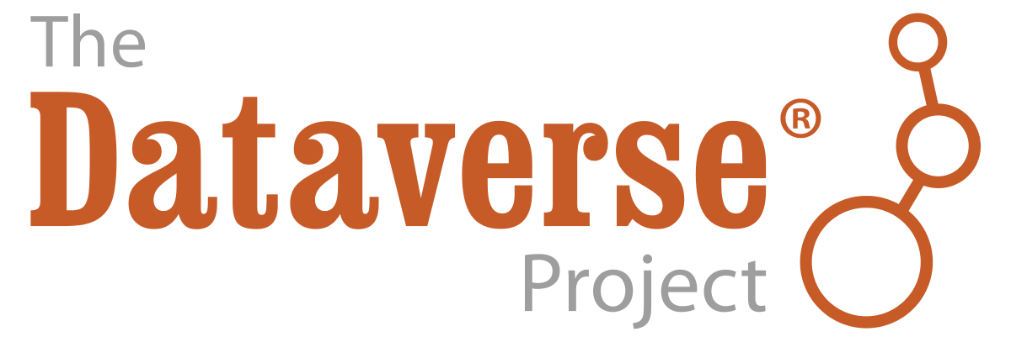
Questions?
http://dataverse.lib.virginia.edu
Sherry Lake
Scholarly Repository Librarian
libra@virginia.edu

