Slide 1
Designing Posters
Individual images and examples & materials from other sources are not included in any licensing of these materials. Blue dino is a GWL icon & not CC-BY.
Kelly J Cunningham, PhD
Director, Graduate Writing Lab
School of Engineering & Applied Science, University of Virginia
gradwritinglab@virginia.edu | bit.ly/SEASGWL

Slide 2
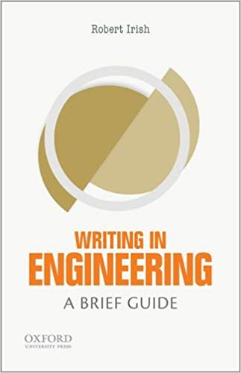
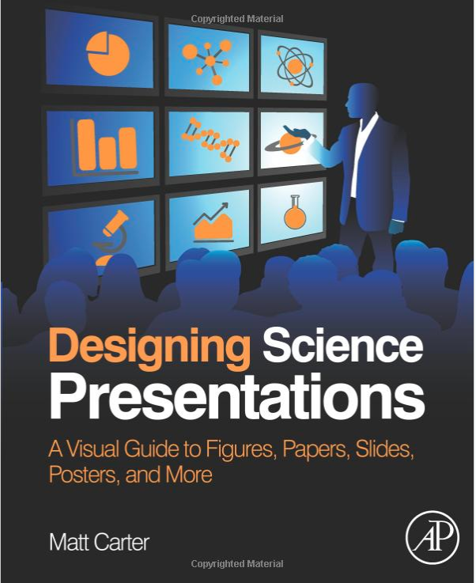
Notes:
Key texts
The one on left- writing in engineering is small portable concise book
The one on right – designing science presentations is a visually focused ebook- free uva library access (link under refs at end)

Slide 3
This workshop draws extensively on a number of resources
Carter, M. (2013) Designing Science Presentations: A Visual Guide to Figures, Papers, Slides, Posters, and More. https://doi.org/10.1016/C2010-0-67985-5 https://www.sciencedirect.com/book/9780123859693/designing-science-presentations
Irish, R. (2015) Writing in Engineering a Brief Guide
BETTER POSTERS Incredibly useful blog about academic posters with numerous posts that include tips for creating, presenting and revising posters, stand out examples, critiques and before and afters/makeovers of posters; be sure to check out the link round up posts for many more resources
To a lesser extent or follow up resources:
https://blogs.lse.ac.uk/impactofsocialsciences/2018/05/11/how-to-design-an-award-winning-conference-poster/
HOW TO DESIGN AN AWARD WINNING CONFERENCE POSTER An article outlining key steps and practical perspectives for designing your poster
DESIGNING CONFERENCE POSTERS multipost resource by Colin Purrington with extensive linked list of poster resources, tips, templates, software suggestions and more
Additional sources are cited throughout
No image, example, or cited information is included in liscensing

Slide 4
Areas
Posters in Context
Purpose & Approach
Audience
Context
Size & Text
Poster Size
Fonts
Visuals & Design
Layout
Principles
Grouping
Color
Message
Prepping with design & Words
Practical Tips
Be intentional with your choices

Slide 5
Posters in Context

Slide 6
Purpose, message & type
How do you see that particular poster fair?
  Poster standalone?
  You always with your poster?
  Ppl try to glean info from lots of posters quickly? – billboard

Slide 7
Posters do not have to
Be of complete studies
Talk about the level of detail a paper does
Come from paper level data
Have everything written out in detail

Slide 8
Posters can
Focus on a single aspect of your work
Invite conversation
Present unfinished work
Be smaller in scope than a paper
Be like a visual abstract
Be results focused
Be methods focused
Present a program or other content that doesn’t fit a research paper

Slide 9
Check your guidelines
How long will your poster be up?
What time of day will it be?
Will you be with your poster the whole time?
Are there rules you should pay attention to?
Are poster fairs thematic?
How big is the poster fair?
Are there awards? How does judging work?

Slide 10
Even more on context?
Talk to previous attendees & presenters
Look at conference pictures
Check conference schedules
Who attends this conference & why?
Is the poster fair during some kind of refreshments or cocktail event?

Slide 11
Audience
Who usually attends the poster fair?
What groups?
  Specialists in your field
  Related fields
  Rivals
  Grad students
  General public
  Employers/industry
What are their purposes for seeing your poster?

Slide 12
Tailor content & design to your audience/purpose/context
Audience | Purpose | Context | considerations
Academic- near & adjacent fields | Get feedback on your next steps | Academic conference grad student poster fair
Broad engineering | Share your key findings/win $$ | UVERS
Potential employers | Show off your skills & passion | Recruiting fair
General public | Engage them with engineering | STEM library event
Highschool seniors | Encourage them to apply to UVA engineering | College exploration fair
Graduating undergrads | Encourage them to apply to grad school | Undergrad next steps fair

Slide 13
Tailor content & design to your audience/purpose/context
Audience | Purpose | Context | considerations
Academic- near & adjacent fields | Get feedback on your next steps | Academic conference grad student poster fair | What do you want to discuss? What’s proposed? | Feedback mechanisms?
Broad engineering | Share your key findings/win $$ | UVERS | Key findings & purpose? | See https://mitcommlab.mit.edu/nse/commkit/poster/ for ex
Potential employers | Show off your skills & passion | Recruiting fair
General public | Engage them with engineering | STEM library event | Broader, less precise language | Connect to broader context; more on impact
Highschool seniors | Encourage them to apply to UVA engineering | College exploration fair | Why engineering might be interesting | What might it enable them to do?
Graduating undergrads | Encourage them to apply to grad school | Undergrad next steps fair | Why UVA/your prgm might be interesting? | ?
Notes:
See https://mitcommlab.mit.edu/nse/commkit/poster/ for side by side same project 2 contexts – check titles especially

Slide 14
Titles
Main idea summary
Draws viewers in
Readable at 15’ or more (1” min, high contrast)
“consider making your title broad to the point that if you made it even a little broader, it would either no longer be an interesting idea or a true representation of your work.”- MIT CommKit
https://mitcommlab.mit.edu/eecs/commkit/poster/

Slide 15
Titles
Key nouns & verbs
Generalize
Link together as concisely as possible
Ex.
Old Title:
  Novel Method for imaging temperature and electric current variations across a wide-field of view on GaN HEMTs using Nitrogen Vacancy Centers
    Nouns: temperature, electric current, wide field
    Verbs: imaging
New Title:
  Wide-field Temperature and Electrical Current Imaging
https://mitcommlab.mit.edu/eecs/commkit/poster/

Slide 16
Titles- more examples
Old: A method for performing diagnostics of resiliently mounted rotational machinery utilizing voltage and vibration measurements made during spin-down transients as the rotor slowed from rated speed to stand-still
  New: Using Spin-down Transients for Diagnostics of Resiliently Mounted Machines
  https://mitcommlab.mit.edu/cheme/commkit/poster/

Slide 17
Layout & composition

Slide 18
Layout & composition
Purpose, context, audience dependent
Clarity & organization
  Reading/presenting order
  Left to right, top to bottom
BUT- No one is going to read your poster all the way through

Slide 19

Image>Text
20% text, 40% image, 40% blank space
  -Irish (2015)
20% text, 80% image
  MITCommKits
10% title, 10% text, 80% figures
  MIT NSE CommKit
https://mitcommlab.mit.edu/nse/commkit/poster/
Notes:
The blue box is 20% of a 3x4
https://mitcommlab.mit.edu/nse/commkit/poster/

Slide 20
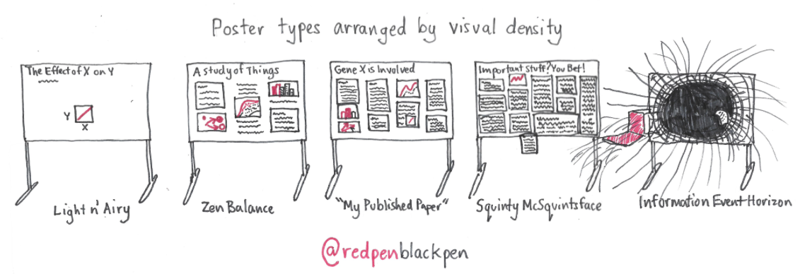
Content
https://twitter.com/redpenblackpen/status/1050417709106704384

Slide 21
Content Inclusion
Know your context, audience & purpose
Identify 1 main message & appropriate scope
Test all content vs the above
Can you clearly convey it in a figure/image/diagram?
If not- what is the core message? Write in bullets
Broader audience = less precise info (still accurate)
Level of detail poster<talk<paper

Slide 22
Layout
Many options & choices
What can be seen overheads & in context?
What is most important?
What will draw interest?
Don’t HAVE to do IMRD or columns
Consideration & strategic use of
  Hierarchy
  Proportions
  Eye level area
  Size & location
What is most important?

Slide 23
Woohoo Look at This!
Nope, not me, don’t look here

Slide 24
Woohoo Look at This!
And This!
And This!
And This!
And This!
And This!
And This!
And This!
And This!
And This!
And This!
And This!
Notes:
Need focus, hierarchy of info, direction, and one key message

Slide 25
Woohoo Look at This!
And This!
And This!
And This!
And This!
And This!
And This!
And This!
And This!
And This!
And This!
And This!
And This!
And This!
And This!
And This!
Notes:
Not overkill, not many small things- even lots of small images can be problematic
Even organizing and grouping may not fix too much info and confusion

Slide 26
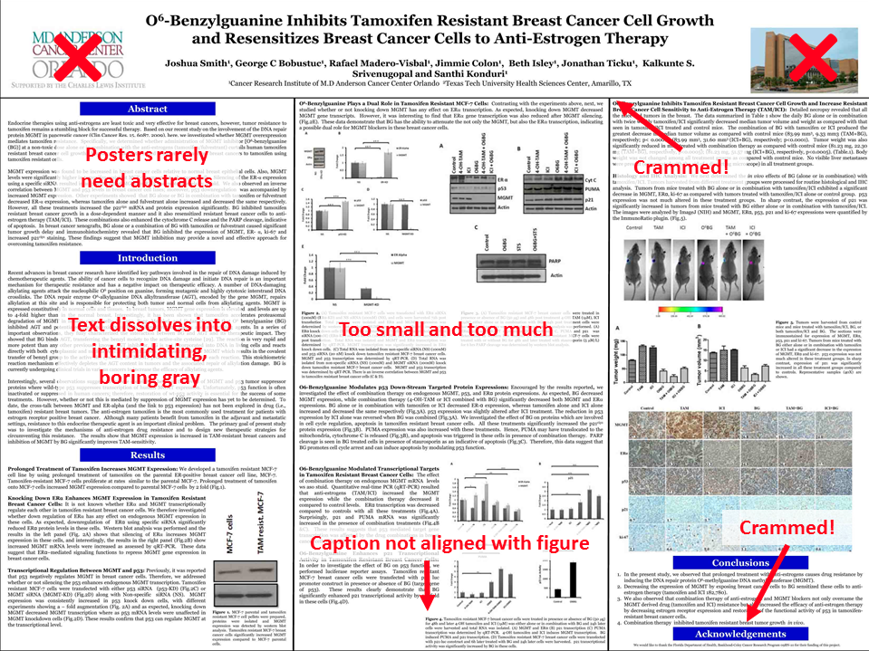
http://betterposters.blogspot.com/2011/04/critique-breast-cancer-inhibition.html
Notes:
Can go so wrong

Slide 27
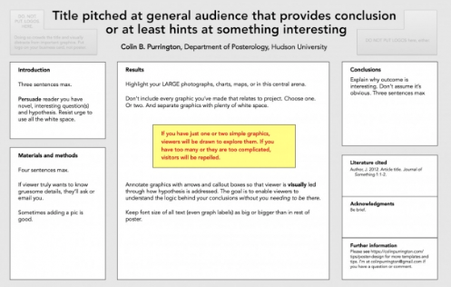
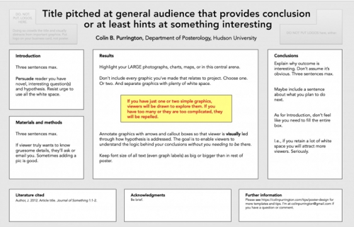
Traditional
https://colinpurrington.com/tips/poster-design/
Notes:
bored

Slide 28
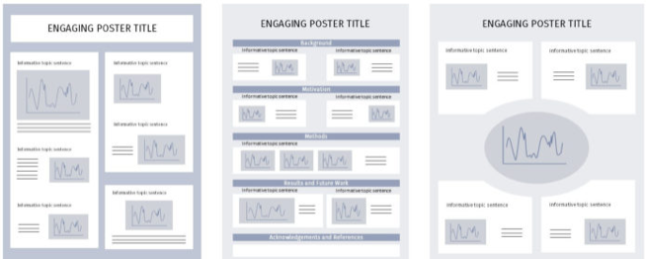
Other traditional ideas
https://mitcommlab.mit.edu/nse/commkit/poster/
Notes:
You would never have pixelated images like this on your poster….

Slide 29
Breathing room for all text
Align left, ragged right
Align bullets & content where possible to create shapes
Bullets over paragraphs

Slide 30
More bad ideas
Intro
Do not make me try to read a paragraph or any kind of text that spans the width of a 4 foot poster in the body of the poster. Nope. Not a good idea. It just ends up being ridiculous. It’s not only difficult to track text, but then you have people going back and forth like human type writers. Not practical for the situation or the way people read and process text. No full width paragraphs. Also- no intro paragraphs needed. Bullets. Just bullets is great.
Things & Stuff
Crowded, can’t breath. Give me some space please. Typing more things here. Give me some space please. Typing more things here. Give me some space please. Typing more things here. Give me some space please. Typing more things here. Give me some space please Also- Don’t center a paragraph. Typing more things here. Give me some space please. Typing more things here. Give me some space please. Typing more things here. Give me some space please. Typing more things here. Give me some space please. Typing more things here. Give me some space please. Typing more things here. Give me some space please. Typing more things here.
Things & Stuff
Nope, nope.
Justified- where it stretched the text to make a box shape- not your friend. You can end up with weird stuff and it can be difficult to read. Left aligned and ragged right is fine. We can read that.
me some space please. Typing more things here. Give me some space please. Typing more things here. Give me some space please. Typing more things here. Give me some space please. Typing more things here. Give me some space please. Typing more things here. Give me some space please. Typing more things here. Give me some space please. Typing more things here. Give me some space please. Typing more things here. Give me some space please. Typing more things here. Give me some space please. Typing more things here.
References
References just as big as everything else
More things you don’t need to give lots of space to
References just as big as everything else
More things you don’t need to give lots of space to
References just as big as everything else
More things you don’t need to give lots of space to
References just as big as everything else
More things you don’t need to give lots of space to
References just as big as everything else
More things you don’t need to give lots of space to
Nope, not me, don’t look here

Slide 31
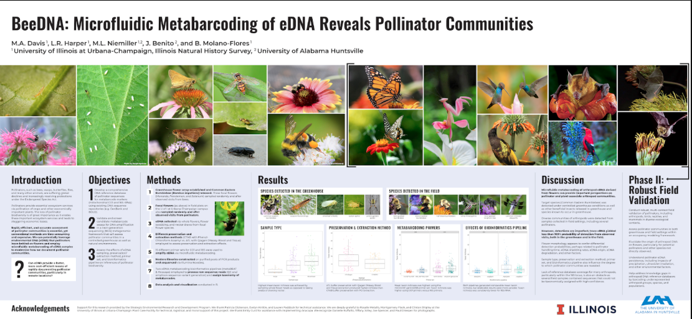
http://betterposters.blogspot.com/2020/01/critique-bee-dna.html
Notes:
This is probably a 4x8
Look at a lot of posters- especially sites like betterposters blog – to see the range of possibilities
The best option for you may not be an imrd 3 column set up
For all of the examples click the link t o learn more about the poster

Slide 32
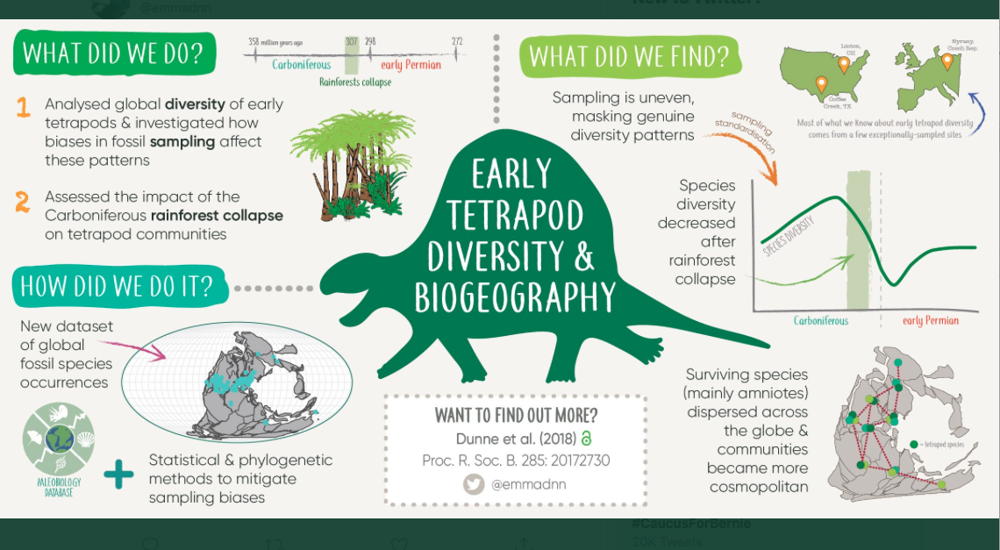
Visual abstract as poster
https://twitter.com/iamscicomm/status/1111292730926338049

Slide 33
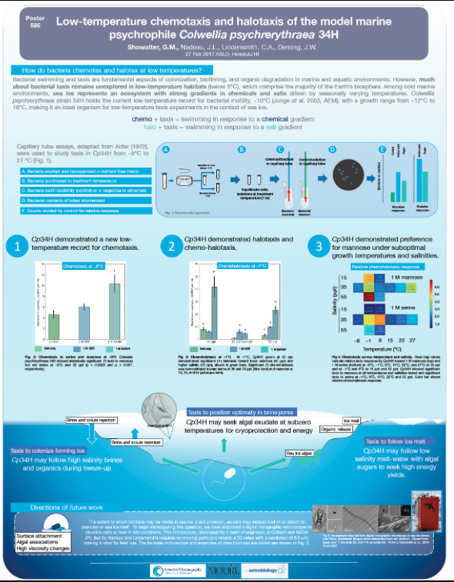
https://betterposters.blogspot.com/2017/11/critique-life-in-cold.html

Slide 34
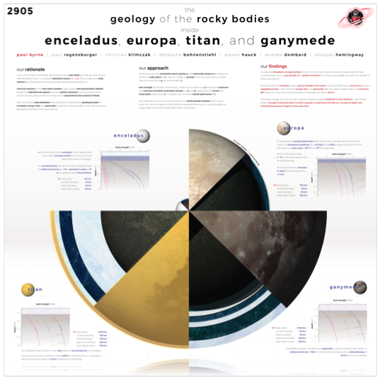
Infographic Approaches – central image
https://www.planetary.org/blogs/guest-blogs/design-sci-poster.html
Notes:
Issue with infographics- can overload info, can lack reading pattern, reqs design to make it work well at all
These have been some of the better ones but can go wrong easily
Info graphics as posters are often informational, or look up, or meant for ppl to look at over time or while waiting and it takes additional effort to use infographics in a way that supplies a key message and story for a research poster
Note- some ppl also partner with a graphic designer, or undergrad graphic design or data viz course- not very common but a possibility-

Slide 35

Minimalist
RQ at top
Discrete well placed QR code
Answer at bottom
https://jamesohanlonresearch.wordpress.com/2015/01/09/conference-posters-less-is-more/
Additional interview: https://crastina.se/the-best-poster-ever-made-interview-james-ohanlon-macquarie-university/

Slide 36
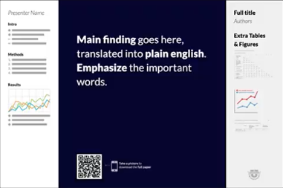
Billboard
Key take away- short, simple, imprecise
Presenter free walk through->
<-Cheat sheet/more detailed graphs etc.
Key visual or icon (optional)
QR code for more
Mike Morrison #betterposters @mikemorrison
Notes:
Be sure to watch the video as to the why behind the design as well as the many critiques and improvements- exs below (video is in the resources at end- watch it if you plan to try this)
Also note the 2019 mike morrison #betterposters came years after the well established better posters blog and they are completely different
http://betterposters.blogspot.com/2019/06/link-roundup-for-june-2019.html https://derekcrowe.net/butterposter
http://betterposters.blogspot.com/2019/05/the-morrison-billboard-poster-part-2.html http://betterposters.blogspot.com/2019/04/critique-morrison-billboard-poster.html
http://betterposters.blogspot.com/2019/04/critique-morrison-billboard-poster.html

Slide 37
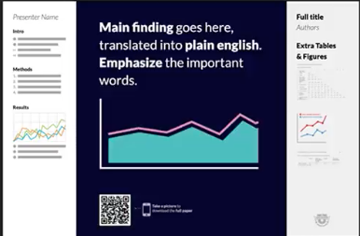
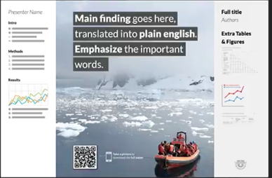
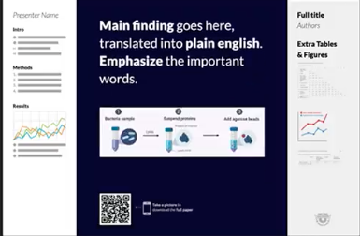
Billboard
Mike Morrison #betterposters @mikemorrison

Slide 38
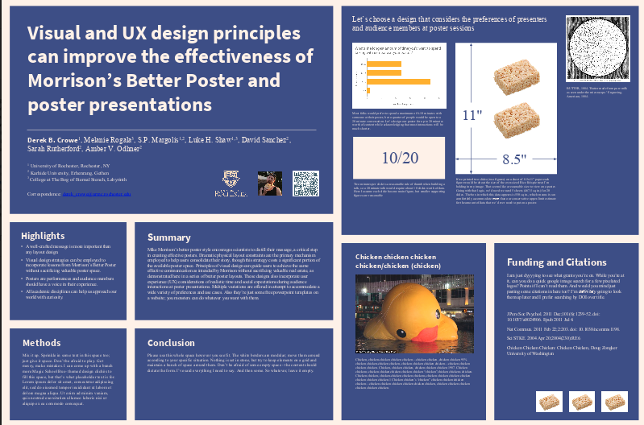
Butter Posters
https://derekcrowe.net/butterposter
Notes:
https://derekcrowe.net/butterposter

Slide 39
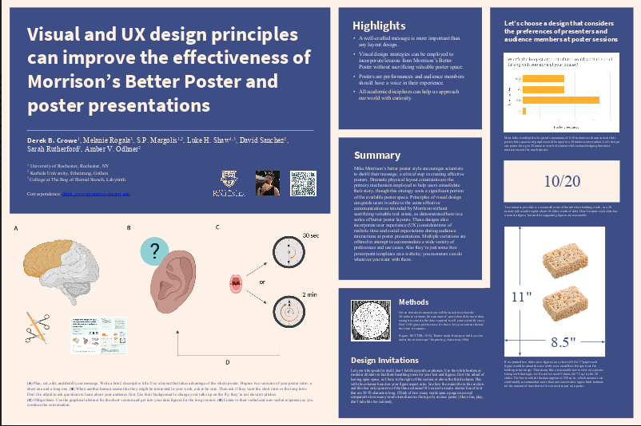
Butter Posters
https://derekcrowe.net/butterposter
Notes:
https://derekcrowe.net/butterposter
Visual abstract lower left

Slide 40
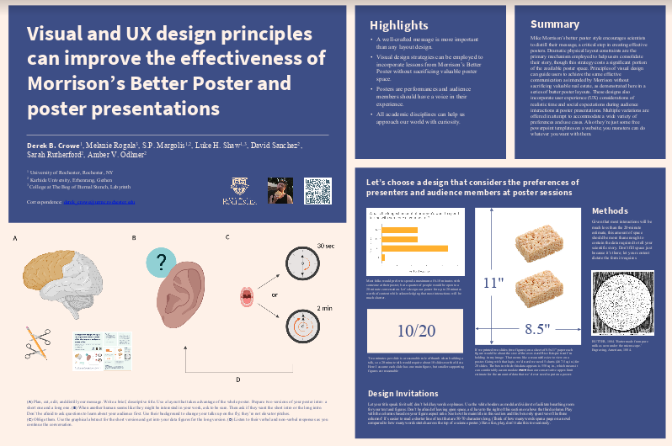
Butter Posters
https://derekcrowe.net/butterposter
Notes:
https://derekcrowe.net/butterposter
Visual abstract lower left

Slide 41
Draw your poster by hand first
Bring ideas & evidence together
Use layout strategically

Slide 42
Which to choose?
Depends on your
  Purpose, Audience, Context, key message, how it will be used
  Resources
  Content
Can
  Come up with new layouts
  Combine aspects
  Use combo of hand drawing & digital production
Templates are not necessarily helpful

Slide 43
Size

Slide 44
Poster Size

Slide 45
Check your guide lines
How big should posters be?
  Specific size, specific size range, a few options?
How big will the hanging area be?
What kind of display will it be?
  Easel w/ or w/out board, partition, wall, other stand, digital display
What orientation of poster is required or recommended?
READ COMPLETE GUIDELINES

Slide 46

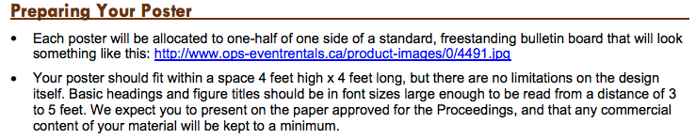
Example Poster Size guidelines
Notes:
2 diff bmes

Slide 47
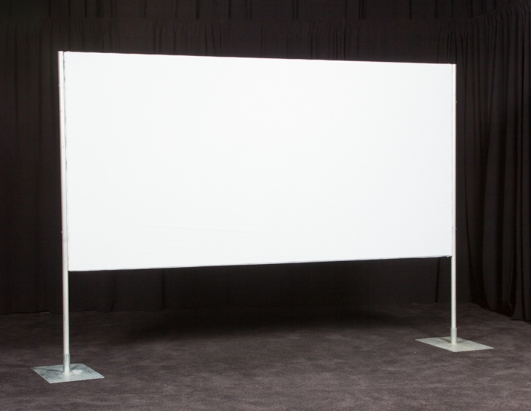
A poster stand might look like this…

Slide 48
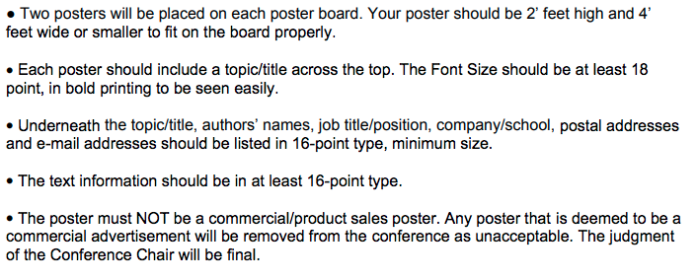
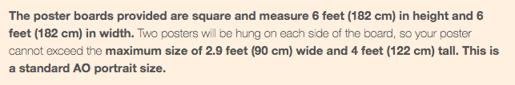
Sometimes you get posters size, sometimes board size
Notes:
Guidelines should function as links back to the source- click image for source
But also, just look at your guidelines as a start

Slide 49
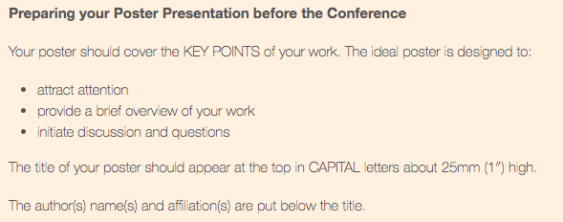

Slide 51
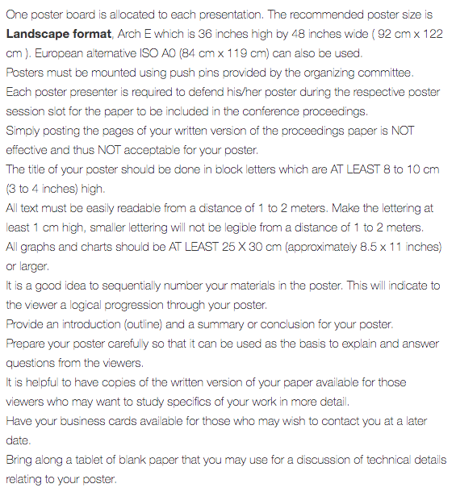

Slide 52
Also consider
Printing
  Availability
  Cost
  Who is printing it
Travel & Practicality

Slide 53
What does it look like?

Slide 54






4’x8’
Notes:
There are 1”=1’ scale in the shape attributes box.
Really, we might hang posters a little bit higher than this- and if you hang your poster, tryt o get the title above everyone’s head if you can and adjust eye level for key content

Slide 55
4’x4’
Notes:
There are 1”=1’ scale in the shape attributes box.

Slide 56
3.75’x3.75’
Notes:
There are 1”=1’ scale in the shape attributes box.

Slide 57
4’x5’

Slide 58
3’x4’ – (UVERS size)

Slide 59
4’x3’

Slide 60
4’x2.9’ (AO)

Slide 61
5’ x 4’

Slide 62
Use readable size text

Slide 63
How small can the type be?
at least 24pt for normal text, 48pt for headings, and 72pt for titles.
  larger min for some fonts 40pt, 100pt, and 160pt
  https://phdposters.com/howto
Min 36 pt, min 48 on headings
  https://writing.colostate.edu/guides/page.cfm?pageid=1529&guideid=78
Min: body 24, heading 36, captions 18, author 56, title 85. line spacing 1.25-1.5- these are minimums for 4 foot distance
  https://www.makesigns.com/tutorials/poster-design-layout.aspx
never use less than a size 24 point font, and make sure the main points can be read at eye level.
  https://chemistry.as.virginia.edu/how-prepare-and-present-scientific-poster
Note some suggest minimums need to account for at least 5 foot viewing distance
Notes:
From various guides and guidelines

Slide 64
How small can the type be?
The title of your poster should be done in block letters which are AT LEAST 8 to 10 cm (3 to 4 inches) high.
All text must be easily readable from a distance of 1 to 2 meters. Make the lettering at least 1 cm high, smaller lettering will not be legible from a distance of 1 to 2 meters.
All graphs and charts should be AT LEAST 25 X 30 cm (approximately 8.5 x 11 inches) or larger.
  https://site.ieee.org/ius-2018/technical-program/presentation-guidelines/poster-presentation-guidelines/
Readable 2-3 meters, catch interest at 5-6 meters https://visual.ly/community/infographic/science/how-design-better-research-posters

Slide 65
So how do I choose sizes?
Possible minimum guidelines
4-5’ reading distance
32-36 min overall
48 min headings (incl sub)
1-2 meters (IEEE)
1 cm high min (~54pt)
3-4” title (~288+pt)
3x4’ poster
Readable in letter print out
Context
  Size depends in part on reading distance
Purpose
  When & how will people look at the poster?
Bigger tends to be better than too small
  But be careful
Use actual size scale to help w/ font size choices
Notes:
Not the 3x4 print to letter may let you get away with some even smaller type so keep that as your minmin.
Also, refs- those, make those tiny, we aren’t reading them, the 32 pt rule need not apply
Stuff we will read though- figure captions, keep those readable

Slide 66
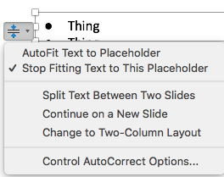
PPT might change your font size…
Put too much in a text box
Ppt might start making it smaller to ‘fit’
To turn it off in an item click the two arrows near the item

Slide 67
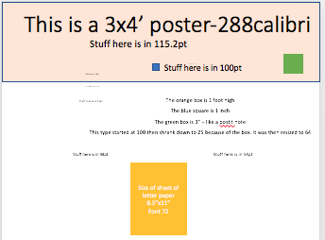
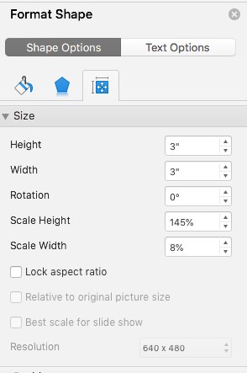
Size
Add scaled shapes for sense of size when planning
Print fit to paper
  Readable in print out on 8.5x11” (letter size)
Beware ppt resizing
Notes:
See handout for scale and up to date image

Slide 68
These are all 24 pt
This is some text. - Franklin Gothic
This is some text. - Franklin Gothic Condensed Medium
This is some text. - Arial
This is some text. - Arial Narrow
This is some text. - Times New Roman
This is some text. - Garamond
This is some text. - Abadi
This is some text. - American Type Writer
This is some text. - Braggadocio
This is some text. - Gloucester MT
This is some text. - Wide Latin
This is some text. - Zapfino

Slide 69
Focus on clear readable fonts
Avoid very thin fonts
Keep in mind associations
Danger
Danger
Danger
Danger
Danger
Danger
Danger
Danger
Danger
Danger
Danger
Danger
Danger
Notes:
Thin lined fonts can be difficult to read from distance in print- esp light on dark background
Capitalize on how people already associate fonts
See also https://fabrikbrands.com/font-psychology-and-typography-inspiration-in-logo-design/
And similar

Slide 70
Fonts have variations
Franklin Gothic
Franklin Gothic Condensed Demi
Franklin Gothic Condensed Medium
Franklin Gothic Heavy
Condensed or narrow fonts may let you fit more text in

Slide 71
Serif
Sans Serif
n n
Has the little feet
Creates lines for eyes to follow
Good for body text
Use in paper, body
Avoid in headings
No little feet
Good for headings
Avoid as body text in papers
Notes:
Sans serif- more common posters- esp headings

Slide 72
Deemphasize noncritical info
Use font color & size
  References
  Smaller, light gray type
Use position
  Lower right bottom corner
  Lower edges
Consider if the info needs to be on poster or if it could be on handout/website as supplemental: more details, references
This is not important.

Slide 73
In text blocks
Align left (usually) w/ragged right
Check for ‘widows & orphans’ –
  1-2 words on line by themselves
  Bits of text extending to next page/column
Consider line spacing
Strategic Intentional Use of Text Features (also sparingly)
  Bold
  All Caps

Slide 74
Text Take Aways
Don’t use all the fonts
Keep it readable and clear
Size varies with font type – check your scale
Make intentional choices for you audience, context, purpose, message
Consider printing & practical reality (ie. thin lines may not be visible

Slide 75
Should we use word art?

Slide 76
Visual Choices & Considerations

Slide 77

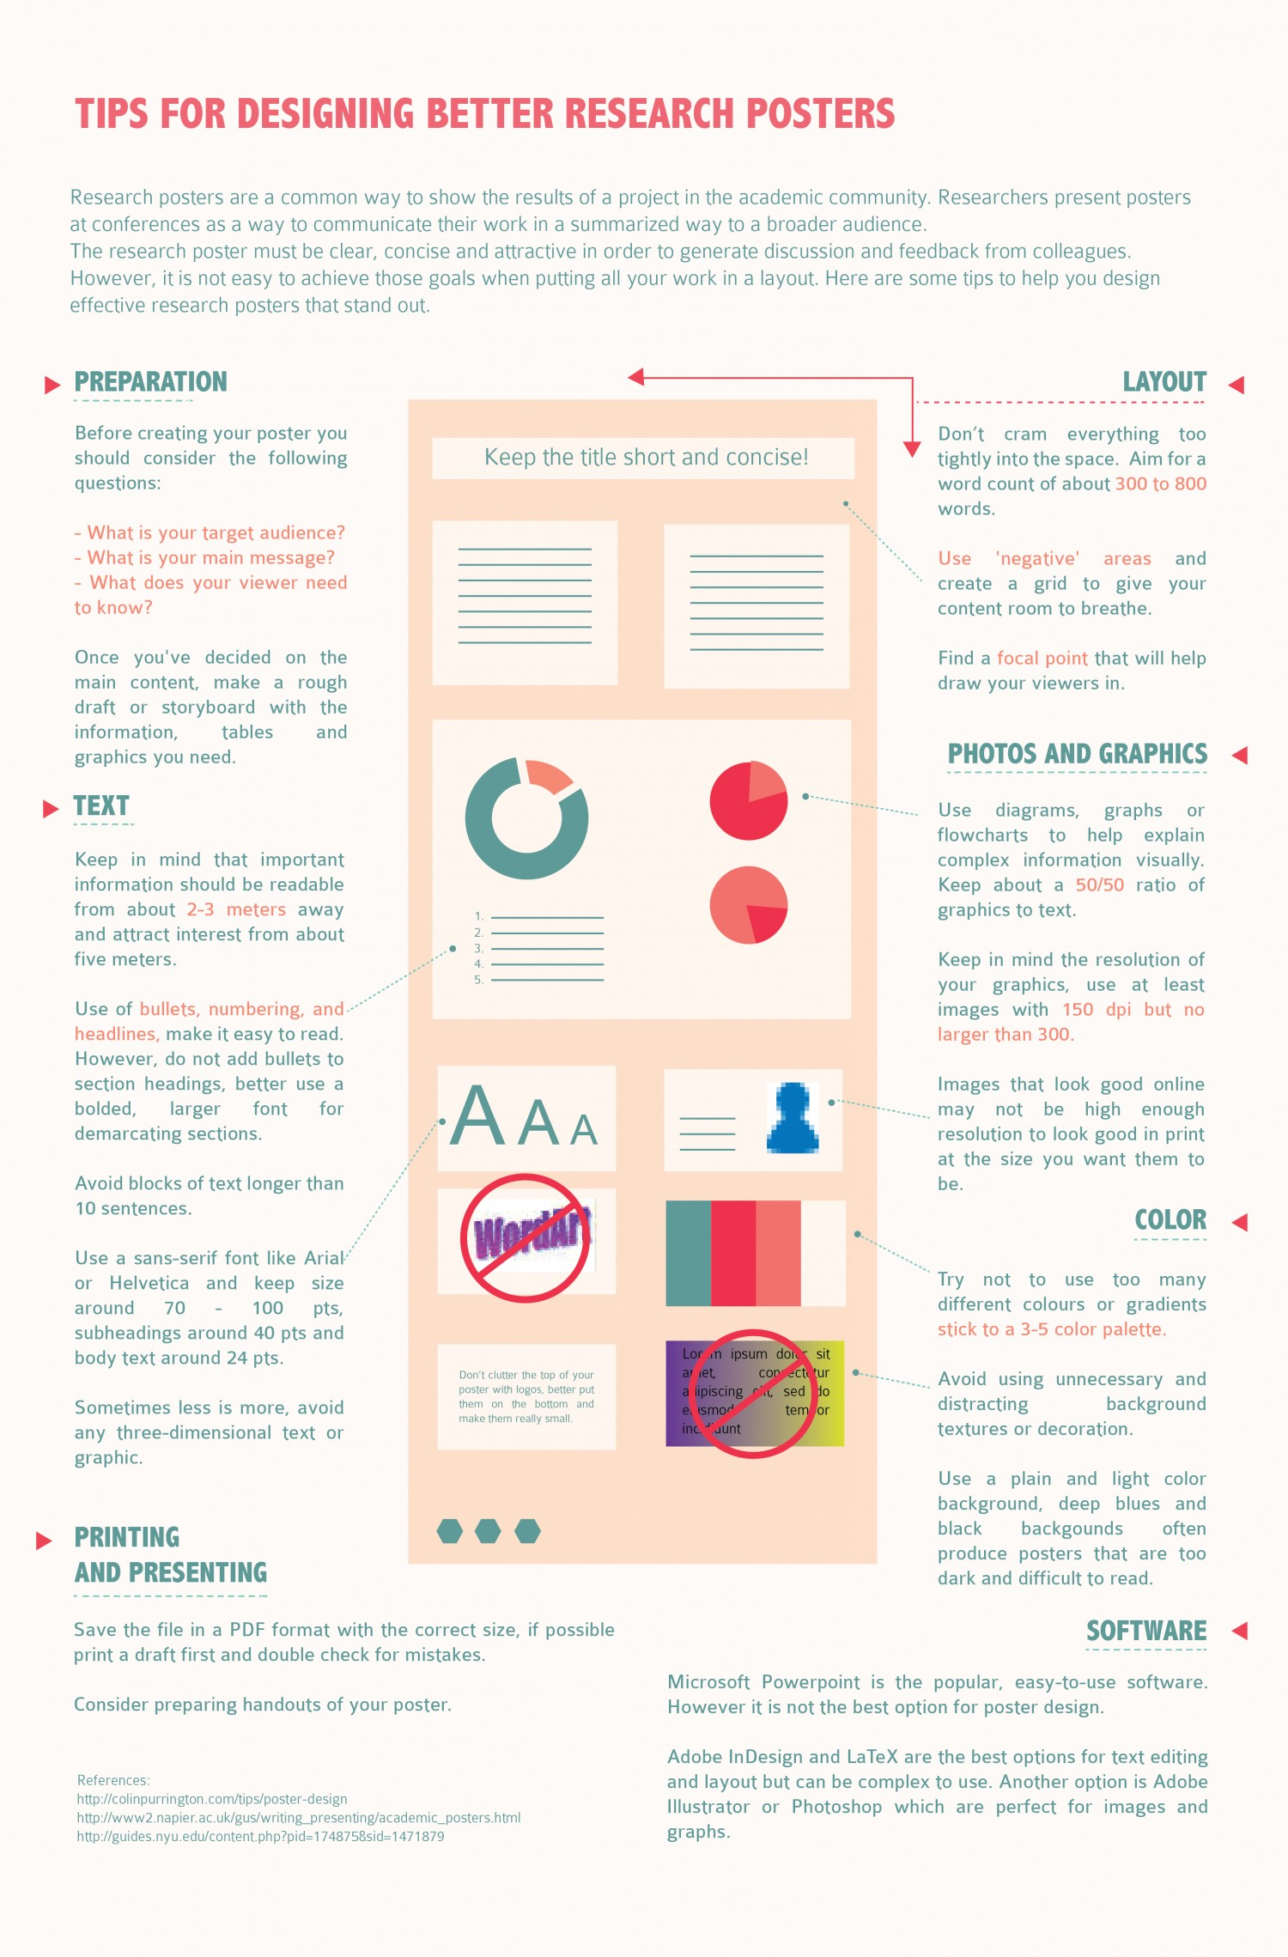
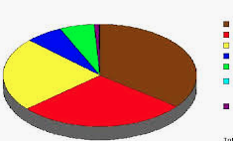
This is a Poster About POSTERS made just for your for this presentation and it’s great
My name who made the poster, the place where I madeit, another place I’m affiliated with, my home town, some other stuff too
Here is the first box on my poster and it has information in it that I felt like I had to put here. It’s like referenced and stuff and there are so many things to go in this box. Maybe if I type enough here, I won’t hav eto talk to anyone because they will just be like reading this box and it’ll be fine. No one is gonna come look at my poster any way. But maybe they will, but I don’t want to stand there. It’s a poster. Why do I have to make this. I’ll just copy/paste some stuff I already have.
Ok, I have to say every detail in my methods. So I’ll past my methods, pastey paste. I’ll put in that 1 diagram and that table of 64 unorganized things and every single equation I can find. I’ll past my methods, pastey paste. I’ll put in that 1 diagram and that table of 64 unorganized things and every single equation I can find. I’ll past my methods, pastey paste. I’ll put in that 1 diagram and that table of 64 unorganized things and every single equation I can find.
I’ll write some more stuff here. Who am I kidding, I have an hour before the print shop closes. I’m just gonna paste some more here. Yup paste, paste. Uhh… yeah, my intro should fill this box I think. Intro stuff intro stuff. It doesn’t fit, but I’ll make it, more intro stuff. I put all my intro here. Yup all of it. It fit just fine. Except reference.
Reference 1
Reference 2
Reference 3
Reference 4
Reference 5
I’ll past my methods, pastey paste. I’ll put in that 1 diagram and that table of 64 unorganized things and every single equation I can find. I’ll past my methods, pastey paste. I’ll put in that 1 diagram and that table of 64 unorganized things and every single equation I can find. I’ll past my methods, pastey paste. I’ll put in that 1 diagram and that table of 64 unorganized things and every single equation I can find. I’ll past my methods, pastey paste. I’ll put in that 1 diagram and that table of 64 unorganized things and every single equation I can find.
I’ll past my methods, pastey paste. I’ll put in that 1 diagram and that table of 64 unorganized things and every single equation I can find. I’ll past my methods, pastey paste. I’ll put in that 1 diagram and that table of 64 unorganized things and every single equation I can find.
Here ar emy results, let me write them down for you. See look I included a figure. Nope no title, key or caption but I have. Apicture there and stuff lalala. Like my results….
This research was funded by change I found in my roommate’s couch, and under the table at the coffee shop and while waiting for the bus. Oh and my advisor has a grant so I should put that here too.
Also I’d like to thank everyone I ever met and a bunch of people I barely know who I was told I should maybe put in the acknowledgements or I’m really just not sure about who to put here and I’m afraid of offending someone and other people have lso many people in the akcnowledgements I feel like I should too. So also acknowledge oh right my advisor, my lab, my freshmen year PE teacher, my cat, fluffy, for typing on the keyboard for me, that squirrel that stole my lunch and the cricket that refuses to let me sleep
This is my most really important thing, shhhhhhhh.
Notes:
Yours will probably not look like this

Slide 78
Be intentional

Slide 79
Grouping
Notes:
Gestalt grouping principles, etc.- read up on them for more

Slide 80
Similarity- Size

Slide 81
Similarity- Shape

Slide 82
Similarity- Size & Shape

Slide 83
Similarity: Color Groups before Shape
Notes:
Use this to your advantage to strategically group things by color- headings, variables, highlighting

Slide 84
Enclosure

Slide 85
Proximity
Notes:
Used most in posters

Slide 86
Proximity is enough
Notes:
This means we don’t have to fit everything in boxes- we saw this in examples

Slide 87
Enclosure + Proximity

Slide 88
Enclosure + Proximity
Notes:
Enclosure can be very subtle and work well, modern trend in posters is subtle enclosure if used- not thick bold high contrast lines or big bright boxes- think more thin gray or dashed/dotted lines

Slide 89
Proximity Uses
Group text & visuals
Separate sections
Bullets
  Less space between multiple lines of the same point
  More space between different points
Goal
  Grouped items closer
  Separate items further

Slide 90
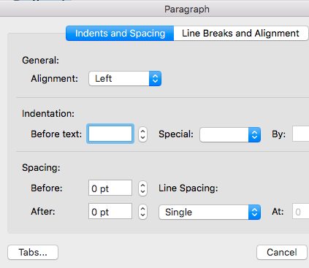
Default
Bullet 1
Bullet 2
Bullet 3
  Bullet 3 sub
  Bullet 3 sub2
Bullet 4
Bullet 5 is really long like so long that it is eventually going to go on to another line. Yup here’s that line.

Slide 91
Default
Bullet 1
Bullet 2
Bullet 3
  Bullet 3 sub
  Bullet 3 sub2
Bullet 4
Bullet 5 is really long like so long that it is eventually going to go on to another line. Yup here’s that line.

Slide 92
Bullet 1
Bullet 2
Bullet 3
  Bullet 3 sub
  Bullet 3 sub2
Bullet 4
Bullet 5 is really long like so long that it is eventually going to go on to another line. Yup here’s that line.
Bullet 5 is really long like so long that it is eventually going to go on to another line. Yup here’s that line.

Slide 93
Bullet 1
Bullet 2
Bullet 3
  Bullet 3 sub
  Bullet 3 sub2
Bullet 4
Bullet 5 is really long like so long that it is eventually going to go on to another line. Yup here’s that line.
Bullet 5 is really long like so long that it is eventually going to go on to another line. Yup here’s that line.

Slide 94
Continuity
Notes:
We see the graph as a square
Don’t need to put it in a box

Slide 95
Continuity
Notes:
We see the square
Don’t need to put it in a box
For more look into gestalt grouping principles- basics in design fields, cog psych, etc.
Online there are examples of this applied well in posters- the ebook ref’d also has some on this

Slide 96
For Posters
Color
Proximity
Size - Headings
Closure

Slide 97
Color

Slide 98
Color
is
complex
Notes:
Primaries- difficult to work with
Contrast
Red/blue blur
*********check your print colors & your color set up!!!!!!!!- are you mixing light or ink?

Slide 99
Use
Colors
& Backgrounds
Wisely

Slide 100
Think about how colors work together
Hue (which color), value (light/dark)
Contrast
Red/blue blur
Notes:
Tint/shade/tone

Slide 101
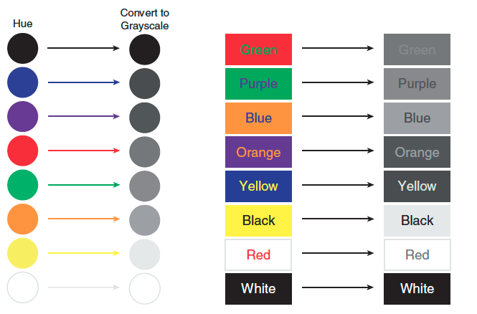
Contrast: Convert Colors to Gray Scale to Check
image from c4 of designing science presentations
Notes:
From c4 of designing science presentations

Slide 102
Color
is
complex
Notes:
Primaries- difficult to work with
Contrast
Red/blue blur
*********check your print colors & your color set up!!!!!!!!- are you mixing light or ink?

Slide 103
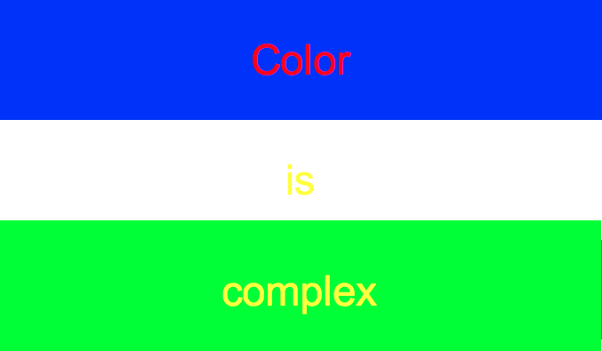

Slide 104
To check Contrast
Convert to gray scale
Use an online checker

Slide 105
Some colors Pop Out & others Recede

Slide 106
Warm colors seem to be in foreground vs cool colors
Notes:
Use to make things pop
Red line is behind the blue but looks infront- see c4 of book for more

Slide 107
Warm colors pop out from cool colors

Slide 108
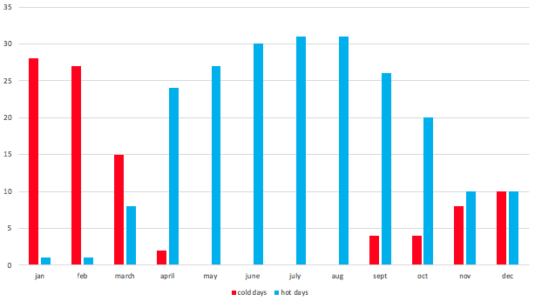
Be mindful of color associations- use them
Notes:
This is a temp chart….

Slide 109
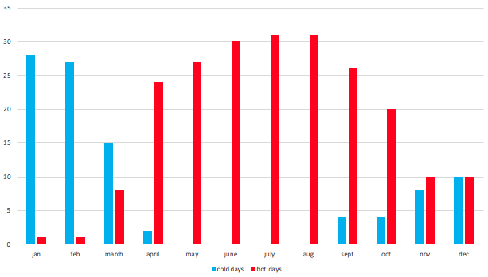
Be mindful of color associations- use them
Notes:
Use what your audience already knows/thinks/associations
Ie. red is hot, blue is cold
Less work to get the message

Slide 110
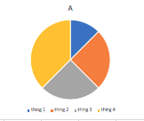
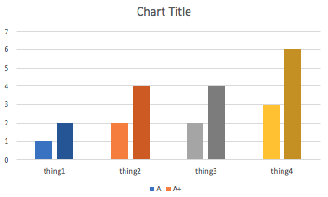
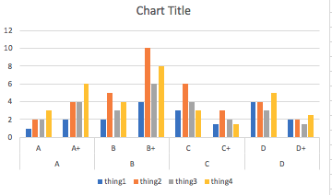
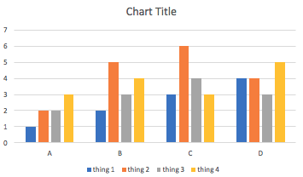
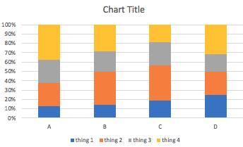
All about Water
Intro
Results
Writey write stuff. Writey write..
Things & stuff
Stuff and things.
Methods
Thing 1
Thing 2
Thing 3
Thing 4
Conclusion
Things & stuff
Stuff and things.
Important stuff & things
Notes:
Use colors that relate to your content if possible

Slide 111
All about Water
Intro
Results
Writey write stuff. Writey write..
Things & stuff
Stuff and things.
Methods
Thing 1
Thing 2
Thing 3
Thing 4
Conclusion
Things & stuff
Stuff and things.
Important stuff & things
Notes:
Use colors that relate to your content if possible
It doesn’t need to be quite this obvious, but color can play a very strong role in interpretation

Slide 112
Choosing colors
Be mindful of constraints
  Contrast
  Colorblind friendly palettes
Have an image? Choose colors from it for consistency (eye dropper)
No clue?- use established palettes
  university branding color palettes – ex. https://brand.virginia.edu
  Color brewer
  Color chooser

Slide 113
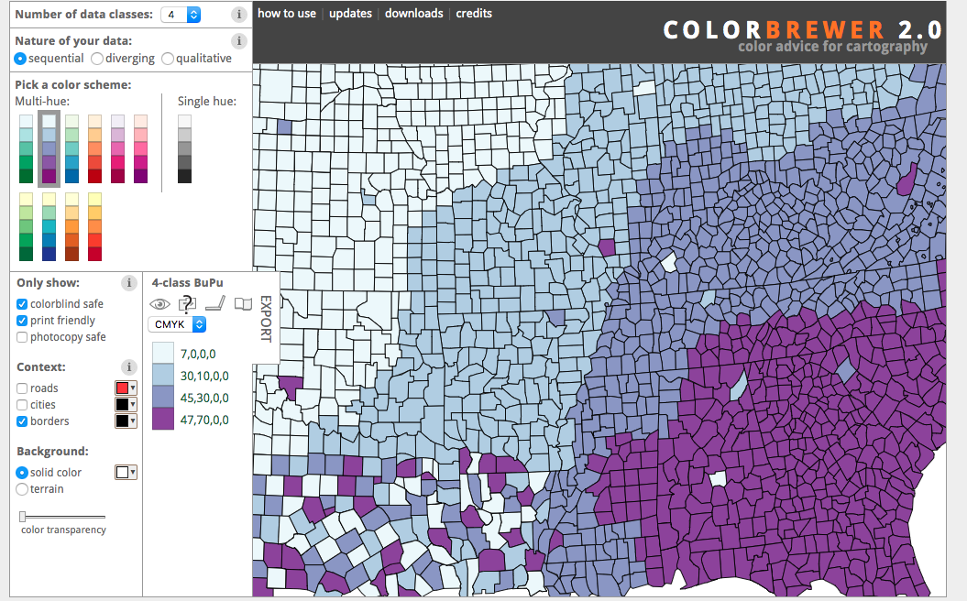
Notes:
Color brewer- use for choosing color palette
Also works w ggplot 2 in R
Other similar tools out there for choosing colors

Slide 114
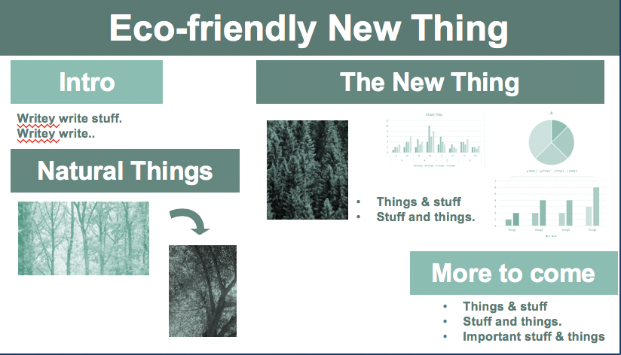
1 hue : multiple tints/shades
Unified
Useful for showing related variations
Consistency similarity
Notes:
Within a data viz- multiple tints/shades can show levels of a single variable

Slide 115
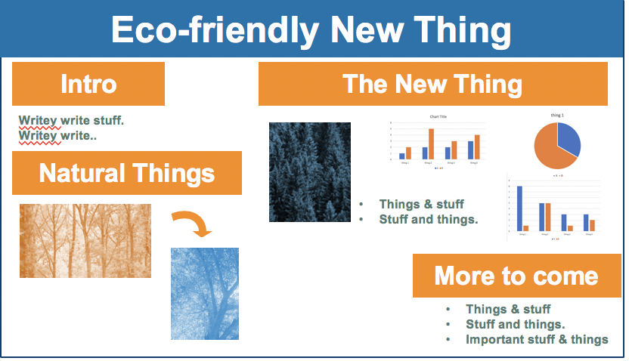
Complementary Colors
Enhance difference
Notes:
Complementary- show opposition/differences- useful for comparisons – hot/cold
Complementary- opposite sides of color wheel
Just 1 way of thinking about color

Slide 116
On Color- Why?
Highlight, direct, connect
Color groups
  Use it to show characteristics, variables, etc. provide consistency
Help direct viewer attention
Help group or differentiate
Set tone, mood consistency
Use associations
Maintain contrast

Slide 117
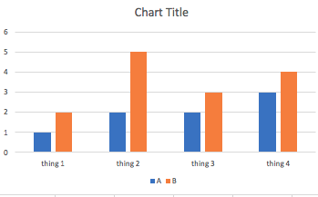
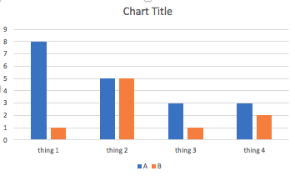
Maintain color for variables or samples
Notes:
Enables comparison across diff parts of poster
Helps us track a particular variable or sample throughout your research story- think color is designating a character in your story or a characteristic

Slide 118
Choose color from an image
For background, accent or text colors
Can build whole palette on an image
Use eyedropper tool
Notes:
That square cray fish example at the beginning did this

Slide 119

Flooding is Bad
This is water. Lots of water.
Notes:
Vs choose a color from the photo using the dropper- not only for shapes, but for text as well
Can develop whole palettes around images

Slide 120
Flooding is Bad
This is water. Lots of water.

Slide 121
Flooding is Bad
This is water. Lots of water.
Notes:
Vs choose a color from the photo using the dropper

Slide 122
Flooding is Bad
This is water. Lots of water.
Notes:
Vs choose a color from the photo using the dropper

Slide 123
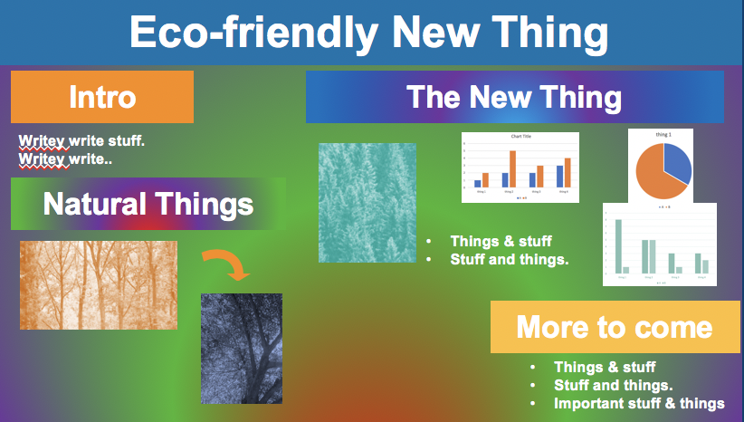
Not all the colors
Choose a few strategically
  2 core is good start
  Accent colors
  3-5 max
Notes:
And in choosing those- keep in mind their relationship to one another and contrast and other constraints

Slide 124
Using Images/Figures/Visuals

Slide 125







Use relevant key visuals
Range of options for visuals
Choose wisely
Include scale for real images
Notes:
Also wide range of ways to display data- choose wisely- see data viz resources for more
If you are using actual images like photos- include scale
Consider positioning, cropping, rule of thirds, layout, direction, etc.

Slide 126
Use relevant key visuals
How does it work for this purpose, with this audience, in this context?
What does the visual/figure/diagram add?
What is the quick main message of including this visual?
How does it fit the overall message?
How would a viewer understand it?
How might I use it?

Slide 127
Color may change w/ file type + printing

Slide 128
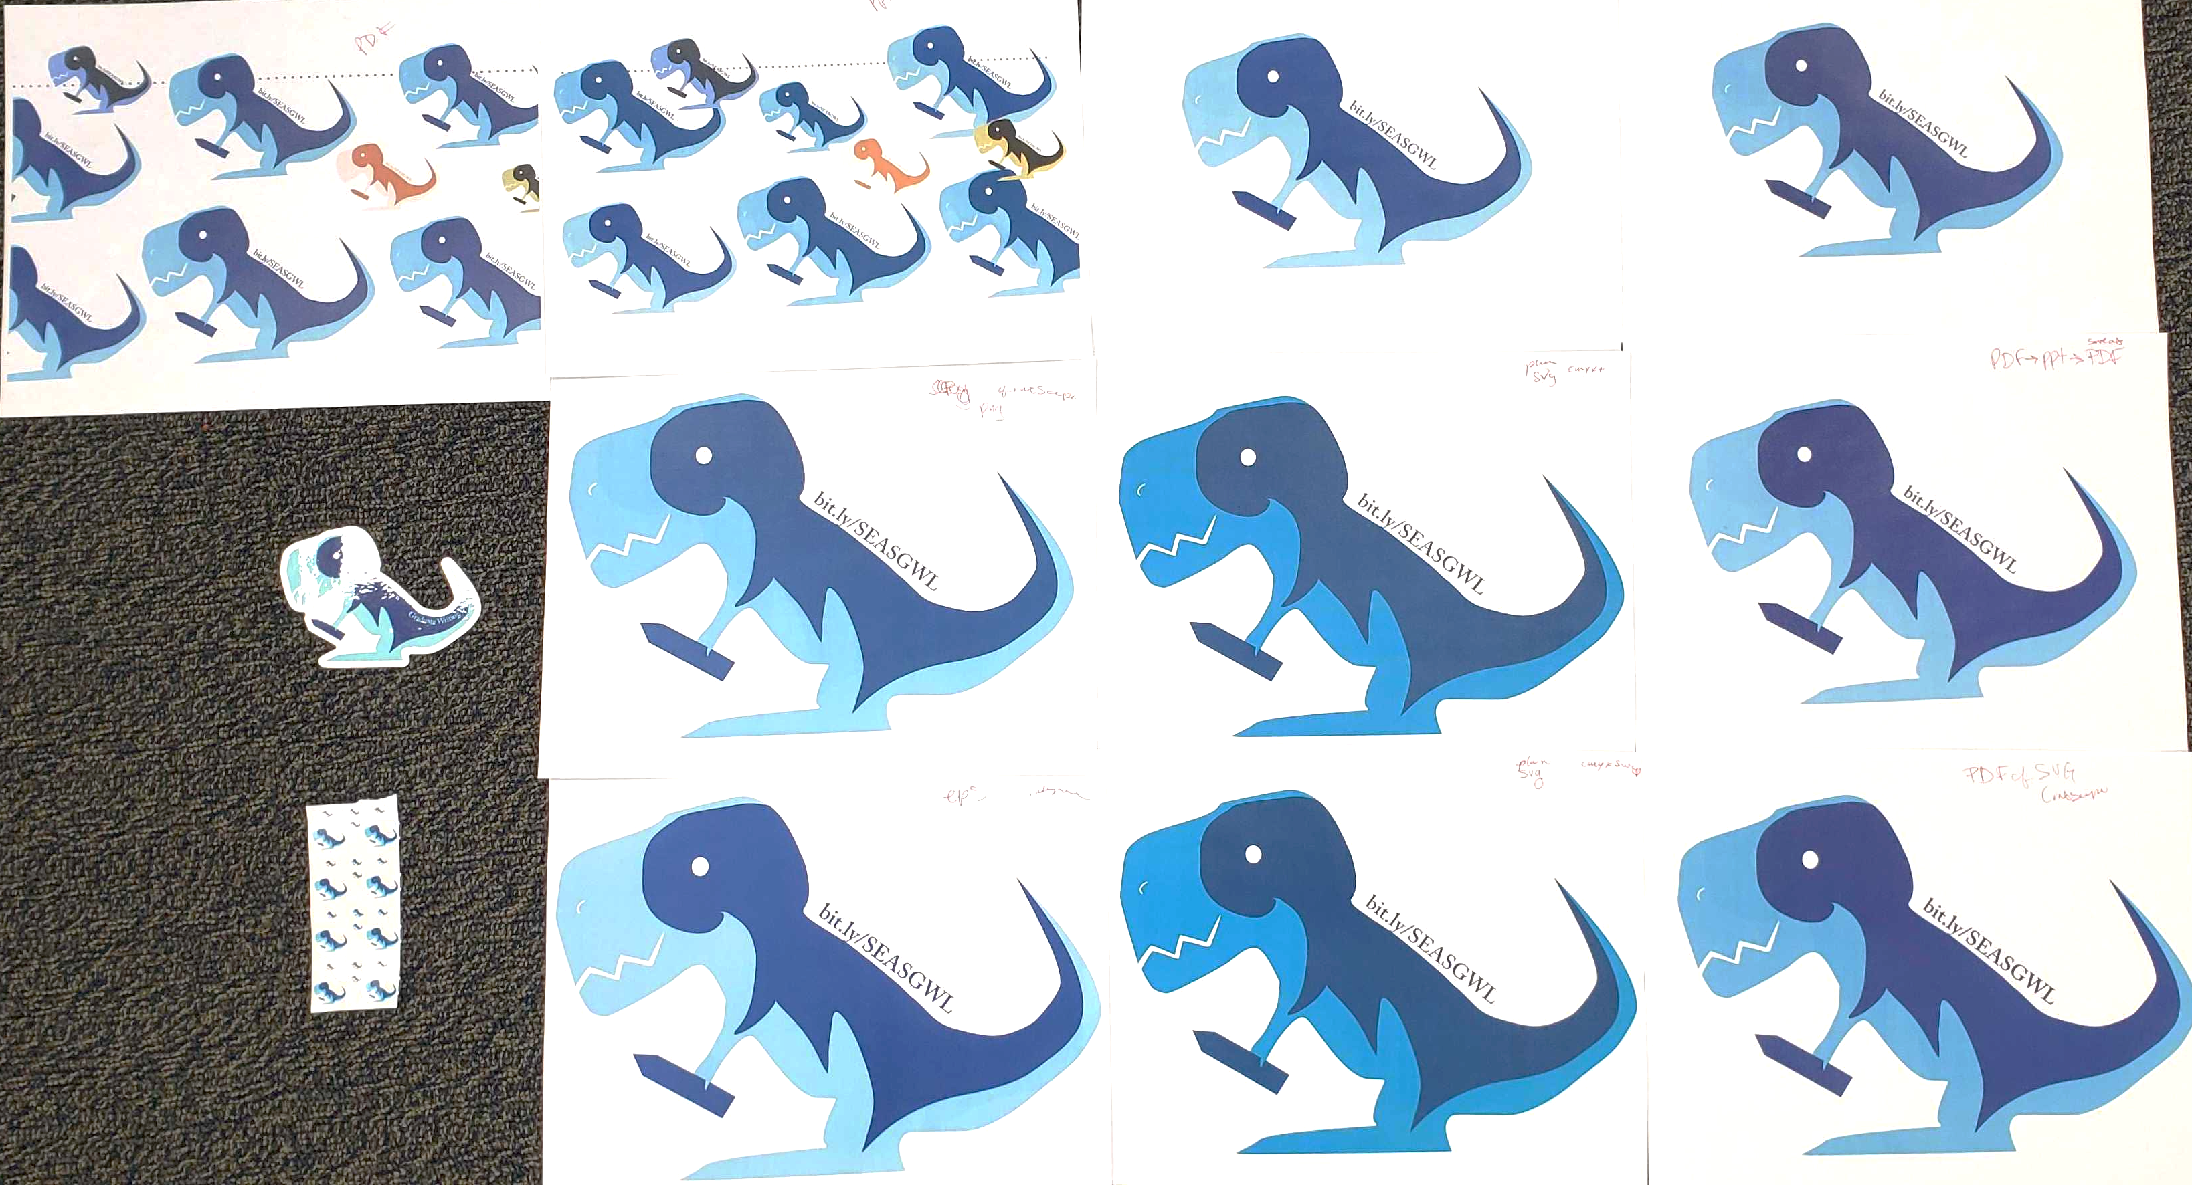
Ppt->pdf
ppt
Pdf->ppt
Pdf->ppt->print to pdf
SVG (CMYK+)
Pdf->ppt->save to pdf
png
pdf + color info to printer
EPS
PDF
Png->word->color laser on avery label
SVG (CMYK->SWOP)
Notes:
Original file in inkscape- svg, png, eps, pdf all saved from inkscape (png exported from inkscape)
Ppt is all file forms put into ppt, then printed from ppt
Save as pdf to retain size (if using ppt print dialogue be ware the different fitting options)
These are all printed on the same printer
Note the sticker was a pdf sent to a professional printer with UVA standard color definitions and it still printed unexpected colors
This is all on mac

Slide 129
Avoid Pixelated Images
Get print-ready logo files
300 dpi or vector
Be careful of
  Scaling
  Compression
  Web graphics
  Etc.

Slide 130
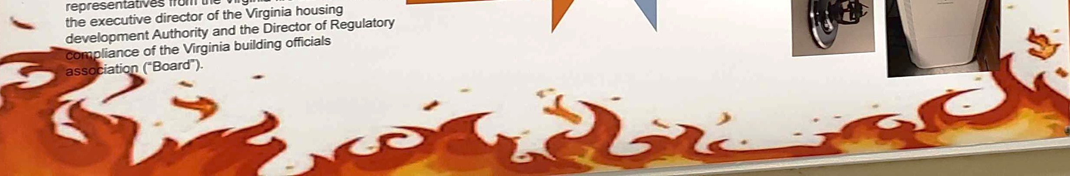
Notes:
Pixelated flames

Slide 131
Don’t Stretch or Warp Images
Maintain aspect ratios
  Lock, shift resize

Slide 132
More to Consider

Slide 133
Extras
Activities
  How could your poster be interactive or accompanied by an activity
Sound
3-d (w/basic images & glasses)
Embedded tech (mount a tablet?)
QR codes
Handouts/postcards/etc.

Slide 134
Connecting Presenter & Poster
Your photo on poster
Wearable poster- poster on you (shirt, bag, etc.)
Poster on your name badge
Hand out mini poster w/contact info &/or poster time/location
  Business card, postcard, moo minicards, stickers
  Include social media info if public & professional
Advertise your poster
  Ex. twitter conference hashtag
QR code to more info/your website
Link to preprint
Poster on your website
Notes:
Check what is appropriate for your context & situation

Slide 135
Practical

Slide 136
Software
PowerPoint- note color conversion
Canva
Adobe InDesign
Adobe Illustrator
Inkscape
CorelDRAW
Notes:
Vector handling preferred
Inkscape is free but results may vary based on device
Canva- have not used, some like it- free version templates only? Paid is like $120 annually?
Adobe products might be on some computers around campus?

Slide 137
Set Up your document
Color: CMYK print, RGB screens
Size & orientation
Colors
Fonts
High qual logos
Graphics, figures, etc.

Slide 138
Consider printing realities
Resolution/vector
Contrast
Print color
Fine lines
Light on dark background
Ink saturation & medium

Slide 139
Consider printing realities
Paper, digital, fabric
  If fabric- check others experience, wrinkles, creases, sagging
  Consider mounting at least top and bottom edges (stick)
One time or multi use
Cost? – you, dept., grant, conference?
Travel
  Shipping? Tube? Foldable? Print on site?
Pdf vs ppt vs etc.- vs your printer: maintain fonts etc?
Pdf it
Notes:
Fabric- spoon flower, but sagging

Slide 140
Check it twice & then again
Get Feedback on multiple drafts by multiple people
  PRGs, 1on1, research group, post-it party
Proof & have others proof
Print small versions first
  Check carefully
Check print colors

Slide 141
Practical things for day of
Comfortable shoes
Water
Clear tacks/hanging just in case
Repair kit
Demo/laptop/ other things
Business card/mini posters/handouts etc
Notes/notebook
Activities/extras
Post-it notes
Pens

Slide 142
Poster Repair kit
Clear tape (to tape rips from the back)
Pens/marker in colors matching poster (fix typos)
Correction tape/white out
Extra paper/post it for bigger corrections if needed
Cloth to clear finger prints from glossy poster

Slide 143
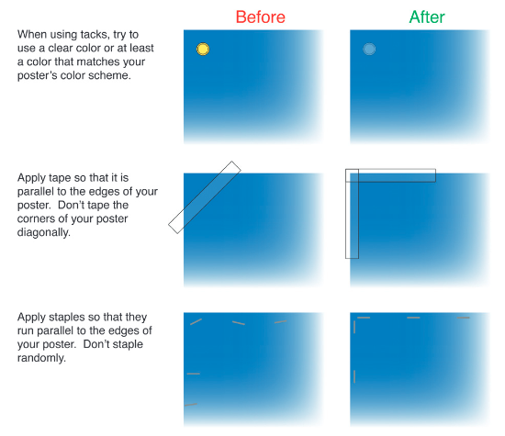
Don’t distract
Carter, M. (2013)

Slide 144
Messaging
Billboard/Tweet Style Audience capture
  Capture interest, passerby gain something
    Crisp clear title, strong purpose, powerful central image
    See also #betterposters billboard messaging
Summary:
  Key points in 2 mins
    Reading path, headings, visuals
    Get the message, not much text
Story:
  Sufficient info for the interested/technically minded
  Sufficient detail to support conversation
Irish (2015)

Slide 145
Presenting
20 (-30) second pitch
  Key message, capture interest
2 minute summary
  Key message as a story
5 minute max (optional)
  More details, vary by audience background
  Full walk through

Slide 146
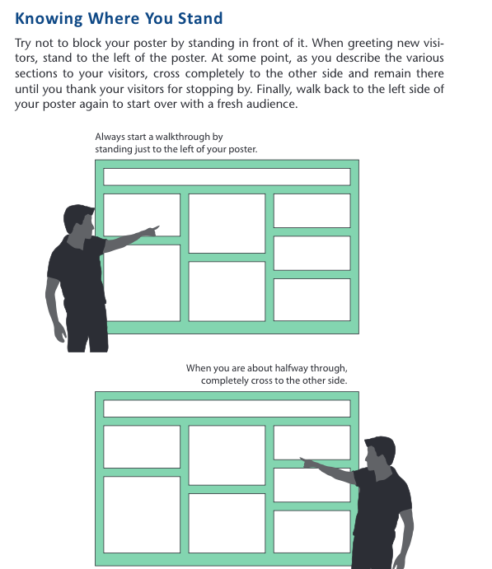
When presenting: Start on left – transition to right
Image from Designing Science Presentations book
Notes:
Think through where to stand when presenting- especially depending on size and layout- avoid needing to cross poster multiple times if possible

Slide 147
How could we improve these?

Slide 148

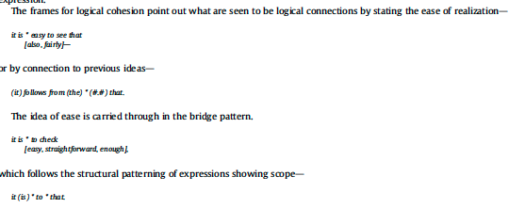











A PHRASEOLOGICAL EXPLORATION OF RECENT MATHEMATICS RESEARCH ARTICLES THROUGH KEY PHRASE FRAMES
Kelly J Cunningham, PhD
Intro Graduate English for Academic Purposes instructors often work with students from multiple disciplines at once. Previous research has sought to identify and define differences between some of these fields (e.g. Peacock, 2002) by considering for example how knowledge is constructed (e.g. Gray, 2013) or the common field specific multiword expressions (e.g. Hyland, 2008). These studies, however, often fail to provide instructors with adequate guidance for working with students from mathematics. Instructors who have mathematicians in their graduate writing courses can likely attest that even within the highly controlled genre of published research articles, mathematics seems different. While fine distinctions can be drawn between other scientific disciplines, the publications of many major fields maintain at least the residue of the IMRD structure. Instructors can draw on this structure and the multitude of articles detailing its purposes, moves, and steps to teach a large percentage of their other students. However, when it comes to working with their mathematics students, these instructors are not able to draw from the same depth of research. One of the aims of the present study is to offer these instructors, and those teaching ESP courses for mathematicians, a greater understanding of these mathematics research texts and the language within them from a phraseological standpoint. An additional aim of this study is to introduce and show the promise of aphraseological form, the key phrase frame, for research that can aid not only in informing our teaching and understanding of discipline-specific language and texts but also in sparking new areas of research techniques. 1.1. Formulaicity and writing in mathematics The writing of math is inextricably linked to the doing of math. Inherently contained within a mathematical text, such as a research article, is the math itself and the statements and proofs that represent it. In such, analysis of the language of a mathematics research article is likely to bring to light elements of article writing and also proof and statement writing. It may also be that elements of proof and statement writing carry over to the other areas of the article. At the time of writing, the language of mathematics research articles has only begun to be linguistically described through a few recent studies. With the notable exception of the work of Ganesalingam (2013) on the syntax and parsing of mathematics and that situated in systemic functional linguistics (Burton & Morgan, 2000; Morgan, 1998), the majority of research on mathematical texts have been limited to applying frameworks from the research articles of other disciplines to those in mathematics (e.g. McGrath & Kuteeva, 2012). The problem arises that frameworks developed for other disciplines often do not transfer well to the domain of mathematics writing. This is easily seen when porting move-step schemes (Swales & Najjar, 1987; Swales, 1990) created for traditional IMRD structured articles. Behnam and Golpour (2014) note that mathematics abstracts avoid the expected use of moves of other research articles. Graves, Moghaddasi, and Hashim (2014) in studying mathematics research article introductions note mathematics writing's deviation from the expected moves and developed a new moved‘establishing presumptions’d in response. With the analysis of mathematics research articles largely limited to investigations of abstracts, introductions and stance and limited to borrowing frameworks and categories not designed for the genre, our understanding of these texts and the language that builds them remains incomplete. Mathematics as a language is often seen to display a preference for a concise symbolic orthography over prose. Additionally, while it has been suggested that all language exhibits a degree of formulaicity (Nattinger & DeCarrico, 1992; Schmitt & Carter, 2004), mathematics is particularly formulaic. The formulaic nature of mathematics is present not simply in the use of mathematical formulae, but also in the use of symbolic shorthand for prose. For instance, the expressions such that, if and only if, for all, and there exists each have a simplified notation (H, iff,c, andd, respectively) that removes the need to write out such expressions. This symbolic notation leads to uniformity and interpretability. The notation often comes with a specific learned meaning and verbal equivalent when read that seems to be evidence of their being processed as single units. These units may then be formulaic sequences, prefabricated language segments treated as wholes in one's memory (Wray, 1999). A common way to identify multiword units of language of interest in a study is through frequency and range criteria. However, the specific parameters used to identify multiword units, often segments of three to five continuous words, have varied across studies. For instance, in terms of frequency, cut offs have been placed at 10 (Biber, Johansson, Leech, Conrad, & Finegan, 1999; Simpson-Vlach & Ellis, 2010), 20 (Hyland, 2008) or 40 (Biber, Conrad, & Cortes, 2004) times per million words in lexical bundle studies, a specific subset of multiword unit investigation. In identifying range, studies have required expressions to appear across a given number of texts, such as six texts (Biber et al., 1999), a given percentage of texts, perhaps 10% (Hyland, 2008), or across a number of subcorpora, such as in four out of five genres or three out of four academic divisions (Simpson-Vlach & Ellis, 2010). The combination of such parameters identifies multiword expressions that are prevalent in the corpus, but not simply frequently used by a single author. Studies on frequent multiword expressions in academic language abound. These have included investigations of multiword units of language across different registers such as spoken andwritten language (Biber et al., 2004; Simpson-Vlach & Ellis, 2010), published and studentwriting (Cortes, 2004), and British and American English (Liu, 2012). The resulting lists of expressions are then often categorized by structure and function to further understand the language of the corpus. Some research has even tied the use of specificmultiword units to themoves and steps in research articles (e.g. Cortes, 2013). Such functional categorization is critical in not only helping us understand the language used, but also in making the research more useful for teaching (Simpson-Vlach & Ellis, 2010). Studies have shown that grammar patterns (Groom, 2005) and lexical bundles (Cortes, 2004;Hyland, 2008) vary systematically across disciplines. However, while multiword expressions may offer insight intomathematicswriting, similar investigations involving the language ofmathematics have been limited to classroom and educational discourse below the graduate level (e.g. Gardella & Tong, 2002; Gueunier & Larcheveque, 1972; Herbel-Eisenmann & Wagner, 2010; Herbel-Eisenmann, Wagner, & Cortes, 2010; Jingzi & Normandia, 2007; Morgan, 2005). 1.2. Phrase frames and keyness Although continuous multiword expressions provide one phraseological path for beginning the study of mathematics research articles, another related phraseological form, the phrase frame, may provide a more comprehensive understanding of the language of these texts. The approach taken in the present study of mathematics texts is through phrase frames as Fuster-Marquez and Pennock-Speck (2015) have suggested that the identification of phrase frames distinctive to a particular genre can be useful to the teaching of English for specific purposes. Rather than being a continuous multiword expression, a phrase frame is a piece of language made up of several words and a blank. Much like simpler formulae of mathematics, phrase frames allow for an element, often a word, to be ‘plugged in’ a standardized functional piece of language. 1.2. Phrase frames and keyness Although continuous multiword expressions provide one phraseological path for beginning the study of mathematics research articles, another related phraseological form, the phrase frame, may provide a more comprehensive understanding of the language of these texts. The approach taken in the present study of mathematics texts is through phrase frames as Fuster-Marquez and Pennock-Speck (2015) have suggested that the identification of phrase frames distinctive to a particular genre can be useful to the teaching of English for specific purposes. Rather than being a continuous multiword expression, a phrase frame is a piece of language made up of several words and a blank. Much like simpler formulae of mathematics, phrase frames allow for an element, often a word, to be ‘plugged in’ a standardized functional piece of language. Phrase frames, as identified and defined by kfNgram (Fletcher, 2012), are sets of ngrams (a continuous string of n words) that differ by a single slot. This variable slot is denoted by a *. Thus, the frame we * to show that would include the ngrams we want to show that, we need to show that, we hope to show that. Words that occur in the slot marked by * can be referred to as fillers. Hence, frames can also be discussed in terms of a frame with a set of fillers. For instance, the example frame we * to show that has the fillers want, need, and hope. Frames can be interesting for a number of reasons. Much like the formulae of mathematics, these frames may have constraints determining the elements on which they may operate. For instance, the fillers of a given frame might show semantic relationships in particular contexts. Consider the frame you did a * job as found in teacher feedback on student writing. The fillers likely include only positive words such as good, great and wonderful. An understanding of the functions and forms of such frames could be useful in teaching students how the language works and what expectations certain linguistic forms bring. Additionally, frames, like other multiword expressions, may be functionally classified or reveal the communicative purposes of a text, thus providing insight into a particular genre, text type, register or discipline. R€omer (2010) suggests that phrase frames, their internal variation, functions and distribution across texts can offer a ‘phraseological profile’ of a text type. The basic structure of a phrase frame varies from study to study. This variation primarily concerns where a variable slot is allowed to occur. R€omer (2010), for instance, only considers frames with open slots in medial positions such as A*CD and AB*D. The present study maintains the kfNgram (Fletcher, 2012) definition of a frame allowing for variation in any slot (ex. *BCD, A*CD, AB*D, ABC*) and viewing the phrase frame as a starting place for understanding the text. Following many phraseological and corpus studies, the present study will employ measures of both frequency and range in determining phrase frames of interest. Similarly, the frames will be categorized by function to give insight into the discipline. However, one additional measure will be added to the present study, an element of ‘keyness’, that will serve to identify phrase frames distinctive of mathematics texts. Keyness is usually discussed in the context of single keywords. Scott (1997, p. 236) defines keywords as those which occur with “unusual frequency” in a particular domain or text and key keywords as those key across “a large number of texts of a given type” (p. 237). Baker (2004) notes that keyword lists, like any other quantitatively derived language patterns, must still be interpreted in context by the researcher. The present study extends this concept of keyness to phrase frames. Similar to Fuster-Marquez and Pennock-Speck’s (2015) target phrase frames, identifying key phrase frames will allow for an understanding of the frame distinctive of mathematics texts. By coupling keyness with frequency and range criteria, the key phrase frames in the present study may be more similar to Scott’s (1997) key keywords. Since the focus of the present study is on exploring writing inmathematics, the search for key phrase frames will begin in the mathematics texts using frequency and range cut offs before employing a measure of keyness that compares the frequency of each frame against its frequency in a broader academic reference corpus. While this comparison to a reference corpus is similar to the procedures of target phrase frame identification by Fuster-Marquez and Pennock-Speck (2015), the present study quantifies this comparison and does not include a parameter of semantic consistency of frame fillers in determining key phrase frames. The resultant set of phrase frames are those prevalent in and distinctive to mathematics texts. It is these key phrase frames that will serve as the focus of the present study. Measures of frequency, range and keyness will be employed in pursuit of the following aims: 1) to use phraseology, specifically frames, to better understand the writing of mathematics research articles, 2) show the potential of key phrase frames for understanding subgenres/registers and for teaching, 3) and specifically provide phraseological understanding of mathematics research articles for the purposes of teaching and learning English for mathematics. There is obvious overlap among these three aims. It is hoped that the understanding gleaned here about mathematics research articles will be particularly helpful for those working with writing classes of mixed-discipline graduate students where instructors may lack resources for understanding these texts. Both the phraseological patterns described here and the disciplinary insights obtained should give instructors a more informed perspective for working with graduate mathematics students. Further, the type of analysis presented here and the extension of the key frame analysis will also demonstrate the opportunities such analysis holds for both teaching and research.
METHODS 2. Methods 2.1. Corpus The corpus for this study consisted of a total of 128 recently published mathematics research articles collected from eight broad, nonspecialty, highly rated mathematics journals. The PDF of each article was downloaded and the text copied and pasted into a plain text file. Each file was further prepared by removing elements not of interest to this study that might otherwise interfere with the analysis: header, abstract, references and appendices. Thus, the analyzed text files consisted primarily of the main body text of each article. Unlike McGrath and Kuteeva (2012), mathematical symbols were not removed, being instead viewed as integral parts of the text. The resulting corpus contained 2,289,670 tokens as counted in kfngram on default settings. The breakdown of the corpus can be seen in Table 1. K.J. Cunningham / Journal of English for Academic Purposes 25 (2017) 71e83 73 2.2. Procedure The procedure is broken into four main sections. The first three sections detail the steps taken to identify key phrase frames. First, the majority of phrase frames in the corpus were identified using a bottom-up approach. Then frequency and range cut offs were used as the first step in data reduction and identifying key phrase frames. After this, measures of keyness were applied as the frequency in the mathematics corpus was compared to a reference corpus. These key phrase frames were then coded for slot position, form and function. 2.2.1. Phrase frame identification After the corpus was prepared, the phrase-frames were extracted using kfNgram (Fletcher, 2012), a free windows-based linguistic analysis software. This initial extraction involved two steps. First, ngrams of size five and six were generated. Following R€omer (2009), instead of generating all five and six-grams in the corpus, only ngrams occurring at least three times in the corpus were generated by setting the floor in kfNgram to three. This eased the computational burden, allowing for the program to run smoothly, and was the first stage in data reduction. Because of the aim to find key phrase frames and to identify structures of use in teaching, using a floor of threewas deemed acceptable. The generated ngrams were then used as a basis for creating phrase-frames of length five and six (five and six-grams with a single variable slot). In this second step, the software identified ngrams that overlapped by one word and synthesized them into a frame. For example, the ngrams we will show that (71), we will see that (60), and we will find that (10) would generate the frame we will * that with the fillers show (71), see (60) and find (10). Due to the cut off, highly variable phrase frames with only very low frequency fillers (those occurring only once or twice) were not captured. This was deemed acceptable for the present study in part because such highly variable frames might be more difficult to incorporate in EAP or ESP instruction without further analysis. The total number of occurrences of each frame was also recorded. Given the method of generating the frames, the counts used also do not include instances of the frame where it contained a filler that occurred only once or twice in the corpus, offering a more conservative frequency than might be obtained otherwise. Frames made up of only symbols, punctuation or copyright notices were not carried through for analysis since they would be unlikely to be of use in an EAP or ESP course. 2.2.2. Frequency and range criteria Further data reduction and analysis was carried out in Excel. The raw count of each frame was normed to occurrences per million words. To be considered for analysis of keyness, frames had to meet a frequency cutoff of 20 occurrences per million words. Additionally, frames needed to show wide distribution amongst the texts in the corpus, here arbitrarily defined as being found in 75% (six of the eight) journals in the corpus, similar to the Simpson-Vlach and Ellis (2010) parameter of occurring in three of four divisions. This range identification was done in AntConc 3.2.4m (Anthony, 2014) by searching eight files each containing all articles for one journal and viewing the concordance plots. 2.2.3. Identifying key phrase frames The next step in the analysis was to determine keyness in order to identify those frames distinctive of mathematical research articles. The normed frequency of each frame as determined above was compared to the frame's normed frequency in the academic section of the Corpus of Contemporary American English (COCA) (Davies, 2008). Specifically, each frame was searched in the academic section of COCA, which at the time of analysis consisted of over 91 million words from peer reviewed academic articles from over 100 journals across a range of disciplines from 1990 to 2012. The raw number of occurrences of the frame in COCA was recorded and then normed to 1 million words. While this comparison to a reference corpus is similar to the procedures of target phrase frame identification by Fuster-Marquez and Pennock-Speck (2015), the present study quantifies this comparison. Similar to Fuster-Marquez and Pennock-Speck (2015) and given the goal to identify frames distinctive of mathematics texts (those occurring at much higher rates in the mathematics corpus), frames with higher frequencies in COCA were not carried through for further analysis. Due to the ease of computing keyness and the slowness of computing the fisher exact test for significant difference, keyness was computed first. Then a striated selection of those frames meeting the stringent keyness cut offs were tested with Fisher's exact test as a secondary measure of difference. Table 1 Corpus of mathematics research article texts by journal. Journal Years included Number of articles Number of tokens Journal of the London Mathematical Society 2014e2015 16 189,419 Duke Mathematical Journal 2013e2015 16 220,554 Journal des Mathematiques Pures et Appliques 2014e2015 16 241,985 American Journal of Mathematics 2013e2015 16 245,269 Acta Mathematica 2012e2015 16 274,591 Inventiones Mathematicae 2013e2014 16 302,647 Annals of Mathematics 2014e2015 16 342,942 Journal of the American Mathematical Society 2012e2014 16 472,263 Total 2012e2015 128 2,289,670 74 K.J. Cunningham / Journal of English for Academic Purposes 25 (2017) 71e83 First, each frame's normed frequency in the mathematics corpus was compared to that in COCA using the symmetric mean absolute percentage error (sMAPE). The sMAPE, using the definition from Z. Chen and Yang (2004) and modifying it for a single observation as in the present case, is the difference of the two values over the average of the two values. That is (MATHCOCA)/(( COCA ﬂ MATH)/2). The sMAPE has a maximum value of 2, provided at least one of the frequencies in the corpora is not 0 (Z. Chen & Yang, 2004). Using sMAPE avoids the potential problem of dividing by zero found with relative error when the reference value is zero. In the present study, an arbitrary cut off at sMAPE . 1.95 was chosen so that included frames occurred approximately 100 times more frequently in the math corpus than in COCA. Only frames meeting these criteria were analyzed further. 2.2.4. Position, structure and functional analysis The resulting frames were coded for slot positiondinitial, medial or finaldand for structure using the common patterns for academic four-word lexical bundles from Biber et al. (1999) as used in Hyland (2008) as a starting point. These categories were applied with only slight modifications to accommodate the five and six-word phrase frames. As noted by Y. H. Chen and Baker (2010) and Cortes (2004) longer lexical bundles often show containment of or overlap with shorter bundles. The same is seen with phrase frames. Thus following the position and structure coding, the phraseframes were examined for overlap and simplification. During this stage some patterns were combined. For instance, * the proof of theorem and the proof of theorem * might be combined in notation to * the proof of theorem *. Additionally, frames with salient patterns of a mathematical variable or symbol in a given slot were collapsed into a single pattern. For example, the patterns * let z be a and * let x be a would be collapsed into a single pattern * let variable be a. After the phrase-frames were condensed, they were grouped and analyzed for theme and function. Exploratory analysis through concordancing was used to identify additional salient contextual or functional information to assist with grouping or understanding the frames further. Examples of this largely qualitative analysis are offered throughout the presentation of the functional groupings in section 3 to demonstrate the potential of phrase frames as a starting point for text exploration. Finally, a more practical unified list of common condensed patterns was constructed to highlight some of the most prominent fillers and extensions. This list is not a comprehensive list of all key phrase frames in the corpus but rather a simplified overview with examples from each category.

Slide 149

https://www.print.iastate.edu/PrintingResources/DesignTemplates/
Notes:
This is an actual university poster template
Title 80, content 40

Slide 150

https://www.print.iastate.edu/PrintingResources/DesignTemplates/
Notes:
This is an actual university poster template
Title 80, content 40
Adding scaling features- green sq postit note 3”
Little blue square is 1”
Light green box is 4” height

Slide 151
20%
https://www.print.iastate.edu/PrintingResources/DesignTemplates/
Notes:
This is an actual university poster template
Title 80, content 40
Adding scaling features- green sq postit note 3”
Little blue square is 1”
Light green box is 4” height

Slide 152

https://ecologyforlifeblog.wordpress.com/2019/08/27/my-advice-for-creating-an-academic-poster/ <-also lists useful link at end of post
http://betterposters.blogspot.com/2019/10/critique-agricultural-landscapes.html

Slide 153

https://ecologyforlifeblog.wordpress.com/2019/08/27/my-advice-for-creating-an-academic-poster/ <-also lists useful link at end of post
http://betterposters.blogspot.com/2019/10/critique-agricultural-landscapes.html

Slide 154
Consider purpose, context, audience
Maintain 1 key main message
Make intentional design choices
Get feedback from multiple sources on drafts
Print & proof – multiple times, multiple people

Slide 155
Resources & references
https://blogs.lse.ac.uk/impactofsocialsciences/2018/05/11/how-to-design-an-award-winning-conference-poster/
BETTER POSTERS Incredibly useful blog about academic posters with numerous posts that include tips for creating, presenting and revising posters, stand out examples, critiques and before and afters/makeovers of posters; be sure to check out the link round up posts for many more resources
HOW TO DESIGN AN AWARD WINNING CONFERENCE POSTER An article outlining key steps and practical perspectives for designing your poster
DESIGNING CONFERENCE POSTERS multipost resource by Colin Purrington with extensive linked list of poster resources, tips, templates, software suggestions and more

Slide 156
MIT COMMKIT ON POSTERS - scroll to the bottom for annotated examples; discipline specific guide from BIOLOGICAL ENGINEERING, ELECTRICAL ENGINEERING/COMPUTER SCIENCE and CHEMICAL ENGINEERING
INFOGRAPHIC: TIPS FOR DESIGNING BETTER RESEARCH POSTERS
HOW TO CREATE A BETTER POSTER IN LESS TIME - animated explanation of a new style of poster design, see also BETTER POSTER'S CRITIQUE OF THIS DESIGN, - see web for more like butter posters etc.
ALTERNATIVE POSTER TEMPLATES (ppt download) from American College of Chest Physicians
Six Insights to Make Better Academic Conference Posters https://journals.sagepub.com/doi/full/10.1177/1609406919862370
https://methodos.hypotheses.org/1460

Slide 157
For data Viz- Alberto Cairo, blog
https://www.nature.com/articles/nclimate3162

Slide 158
Refs
Carter, M. (2013) Designing Science Presentations: A Visual Guide to Figures, Papers, Slides, Posters, and More. https://doi.org/10.1016/C2010-0-67985-5 https://www.sciencedirect.com/book/9780123859693/designing-science-presentations
Irish, R. (2015) Writing in Engineering a Brief Guide

Slide 159
Resources bonus- ppt
https://grad.uc.edu/content/dam/refresh/grad-62/docs/prof-devel/expo/Creating-Poster-Presentations-Using-PowerPoint-2010.pdf
https://libguides.tru.ca/academicposters/size
Mortal Sins in Poster Presentations or How to Give the Poster No One Remembers https://web.archive.org/web/20150906151920/http://www.sicb.org/newsletters/fa97nl/sicb/poster.html

Slide 160
bit.ly/SEASGWL
gradwritinglab@virginia.edu

