Slide 1
Writing Introductions
This presentation is CC-BY and must include proper citation & doi. Individual images and examples in the presentation are not CC-BY. Blue dino is a GWL icon.
Kelly J Cunningham, PhD
Director, Graduate Writing Lab
School of Engineering & Applied Science | University of Virginia
kellyc@virginia.edu | bit.ly/SEASGWL

Slide 2
Focus
Overview to Intros
Purposes of Intros
Language to achieve these purposes
Ways to refine

Slide 3
Why Intros?
Situate your work in larger conversation
Acclimate the reader to your work
Convince the audience your paper is worth reading
Provide needed background to understand your study

Slide 4
Challenges with Intros
Many choices
Must change for the audience & context
First in paper but one of the last sections to write
Match with conclusion

Slide 5
Intro
Lit Review
Focus on edges/boundaries
What we don’t know
Why that’s important
Convince reader of importance of problem
Bigger picture (wall)
What we do know
P. 56 https://ebookcentral-proquest-com.proxy01.its.virginia.edu/lib/uva/reader.action?docID=845932
Notes:
P. 56 https://ebookcentral-proquest-com.proxy01.its.virginia.edu/lib/uva/reader.action?docID=845932
Check this book, but here think lit review as standalone lit review, not the lit review in a paper?
Note that if you hear of intros as showing motivation for the study, they do not mean your personal motivation. The intro often has little to do with that, the intro is all about convincing the audience that your study is needed/important/warranted etc. and getting the reader from where they are to your study.

Slide 6
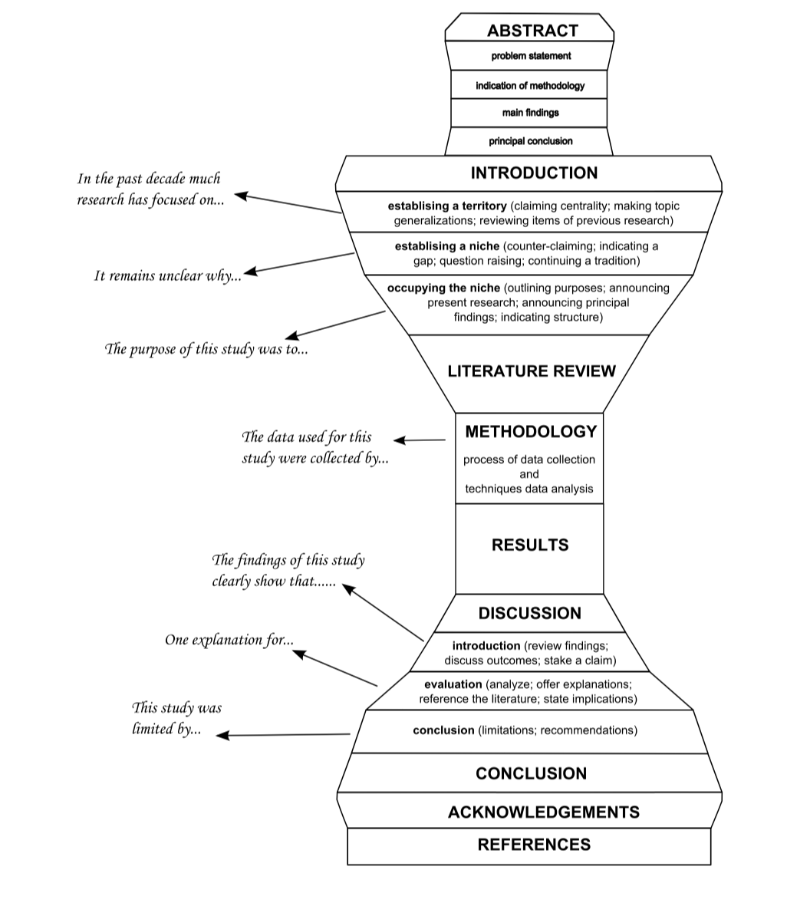
Intro as Funnel
Where the reader is at
Your study
http://languages.ait.ac.th/wp-content/uploads/sites/18/2018/08/Writing-Research-Articles-for-Publication1.pdf

Slide 7
We did X.: We applied a cement compound.
Who cares? Why should I care?

Slide 8
We did X.
To learn A, we did X.

Slide 9
Think about the reader
To learn A, we did X.
But why should I care about A?
If we know A, we can do B.
And B is important because?
B is an important part of familiar problem C. If we can B, we might actually be closer to solving C.
Oh C! I know about C. You’re telling me your research might help us with part of C? Maybe I should hear more
Notes:
Start where the reader is

Slide 10
Think about the reader
To learn A, we did X. – To patch the hole we applied a cement compound
But why should I care about A?
If we know A, we can do B. – patching the hole could restore the integrity of the wall.
And B is important because?
B is an important part of familiar problem C. If we can B, we might actually be closer to solving C. – restoring the integrity of the wall is necessary to keep the town from flooding.
Oh C! I know about C. You’re telling me your research might help us with part of C? Maybe I should hear more
Notes:
Start where the reader is

Slide 11
Think about the reader
To learn A, we did X.
But why should I care about A?
If we know A, we can do B.
And B is important because?
B is an important part of familiar problem C. If we can B, we might actually be closer to solving C.
Oh C! I know about C. You’re telling me your research might help us with part of C? Maybe I should hear more
Notes:
Start where the reader is

Slide 12
Think about the reader
To learn A, we did X.
Your research
But why should I care about A?
If we know A, we can do B.
And B is important because?
B is an important part of familiar problem C. If we can B, we might actually be closer to solving C.
Oh C! I know about C. You’re telling me your research might help us with part of C? Maybe I should hear more
Reader is here
Notes:
Start where the reader is

Slide 13
Start where the reader is at
We both care about solving C.
Situation/
Context
A key part of solving problem C is B. If we can B, we might actually be closer to solving C.
But B is complicated and right now we can’t do it because no one has figured out A.
Problem/
Gap
If we know A, we can do B and potentially get closer to solving C.
To learn A, we did X.
Solution/
Fill Gap
Notes:
Flip it and start where the reader is at

Slide 14
Frame your study as addressing a problem the audience is interested in
Notes:
This is also helpful in choosing a journal- look at your problem statements- who is interested in this?

Slide 15
Intro as Funnel
Where the reader is at
Where the reader is at
Your study
Your study
Notes:
If the reader is further away, you’ll have to start broader and you’ll likely have a longer intro

Slide 16
Intro as Funnel
Where the reader is at
Where the reader is at
Your study
Your study
Notes:
If the reader is further away, you’ll have to start broader and you’ll likely have a longer intro
For big broad journals expect an intro tha starts broader

Slide 17
Intro as Funnel
Where the reader is at
Where the reader is at
Your study
Your study
Notes:
If the reader is further away, you’ll have to start broader and you’ll likely have a longer intro
For niche journals, you can start closer

Slide 18
Unfamiliar popular audience
Major Cross Cutting Journal
Field journal
Subfield journal
Area journal
Specialist niche journal
Your lab group
Your study
Notes:
If the reader is further away, you’ll have to start broader and you’ll likely have a longer intro
For short papers for niche audiences the intro will be shorter
Not to scale

Slide 19
Reader
Reader
Your study
Your study
Notes:
If the reader is further away, you’ll have to start broader and you’ll likely have a longer intro
You tend to have multiple audience choices and even more options for where to begin
Use your publication venue to help guide you- who do they say they target? What is the journal about? Its goals?
Your intro will likely need to be adjusted if you switch venues

Slide 20
Reader
Reader
Reader
Your study
Reader
Reader
Notes:
If the reader is further away, you’ll have to start broader and you’ll likely have a longer intro
You tend to have multiple audience choices and even more options for where to begin
Different angels to start from
Choose something familiar to your context/audience- modelling journal start with and frame problem for a modelling audience vs in a journal on the topic you are modelling, you might start out talking about the topic and then show how modelling helps

Slide 21
Method/
modelling
Discipline/field/
knowledge area/domain
Your
study
Application/
practitioners
Notes:
Overly simplified
There are usually more than one angle for your study and multiple audiences to consider
Your study could probably be submitted toa range of journals
You need to carefully consider the scope and audience of a journal in order to write an intro that will help your study fit in that journal

Slide 22
Method/
modelling
Discipline/field/area
Your
study
Application/
practitioners
Notes:
What angle to approach from?
Depends on the journal

Slide 23
Reader
Reader
Reader
Reader
Reader
Reader
Reader
Reader
Reader
Reader
Your study
Notes:
Once you figure that out you keep fine tuning
If the reader is further away, you’ll have to start broader and you’ll likely have a longer intro
You tend to have multiple audience choices and even more options for where to begin
What audience do you want to capture? Who do you want to invite to your work?

Slide 24
Start where the audience is- consider the journal
Example
The goals of this study were to:
(i) develop methods to construct subject-specific biomechanical models from magnetic resonance (MR) images,
(ii) create models of three lower-extremity cadaveric specimens, and
(iii) quantify the accuracy of muscle-tendon lengths and moment arms estimated using these models.
Allison S. Arnold, Silvia Salinas, Deanna J. Hakawa & Scott L. Delp (2000)
Accuracy of Muscle Moment Arms Estimated from MRI-Based Musculoskeletal Models of the
Lower Extremity, Computer Aided Surgery, 5:2, 108-119, DOI: 10.3109/10929080009148877

Slide 25
Journal: Computer Aided Surgery
Surgeons frequently lengthen “tight” muscles in persons with cerebral palsy in an attempt to improve ambulation. For example, children who walk with excessive flexion of their knees often have their hamstrings lengthened in an effort to diminish the crouched posture, increase the efficiency of movement, and prevent the progression of deformities. Exaggerated hip flexion during walking is commonly treated by surgical lengthening of the psoas muscle at the pelvic brim. Unfortunately, the outcomes of soft-tissue procedures to correct crouch gait and other movement abnormalities in persons with neuromuscular disorders are unpredictable and sometimes unsatisfactory. We believe that analyses of the muscle-tendon lengths during movement may help distinguish patients who have short muscles from those who do not have short muscles, and thus may provide a more effective means to identify candidates who would benefit from surgery.
Allison S. Arnold, Silvia Salinas, Deanna J. Hakawa & Scott L. Delp (2000)
Accuracy of Muscle Moment Arms Estimated from MRI-Based Musculoskeletal Models of the
Lower Extremity, Computer Aided Surgery, 5:2, 108-119, DOI: 10.3109/10929080009148877

Slide 26

Big Picture Ways of Looking at Intros
Baby-Werewolf-Silver Bullet
http://ecoevoevoeco.blogspot.com/2014/10/how-to-writepresent-science-baby.html
Notes:
http://ecoevoevoeco.blogspot.com/2014/10/how-to-writepresent-science-baby.html
Baby- make ppl care about something and determine on their own that it is important; don’t say that it is cute or important
Werewolf- show a threat to the baby, but don’t have to say it is scary, add info and detail to let that come form the reader
Silver bullet- explain how your work has the potential to slay/wound/identify/rid us of the werewolf

Slide 27
Intro as Funnel
Where the reader is at
Where the reader is at
Your study
Your study
Notes:
If the reader is further away, you’ll have to start broader and you’ll likely have a longer intro

Slide 28
Intro as Funnel
Where the reader is at
Surgeons frequently lengthen “tight” muscles in persons with cerebral palsy in an attempt to improve ambulation. For example, children who walk with excessive flexion of their knees often have their hamstrings lengthened in an effort to diminish the crouched posture, increase the efficiency of movement, and prevent the progression of deformities. Exaggerated hip flexion during walking is commonly treated by surgical lengthening of the psoas muscle at the pelvic brim.
Unfortunately, the outcomes of soft-tissue procedures to correct crouch gait and other movement abnormalities in persons with neuromuscular disorders are unpredictable and sometimes unsatisfactory.
We believe that analyses of the muscle-tendon lengths during movement may help distinguish patients who have short muscles from those who do not have short muscles, and thus may provide a more effective means to identify candidates who would benefit from surgery
Notes:
If the reader is further away, you’ll have to start broader and you’ll likely have a longer intro

Slide 29
Key Purposes in the Intro
Concepts from Swales (1990 & later)
Adapted from http://www.cs.tut.fi/kurssit/SGN-16006/academic_writing/cars_model_handout.pdf
Addition language examples from the Academic Phrasebank

Slide 30

Break it Down: Key purposes- Moves & Steps
Moves- key purposes you need to achieve (goals)
Steps- how you get there/accomplish these purposes (strategies)
Move A
Move B
Step A1
Step A2
Step A3
Step B1
Step B2
Step B3
Step A2
Step A2
Step A1
Move A
Notes:
Purposes- ie things your audience expects you to do (with language) in the intro
Steps- more specific ways to achieve those purposes with language
You need to move to a goal and you do it by taking steps
This concept comes from Swales 1990- expanded through many other sources since then
You can apply a similar methodology to a wide range of writing types and narrow your analysis to more specific text types as your would with any study population
The blue dinosaur is a GWL icon, not for other uses

Slide 31
Moves & Steps
are not necessarily sequential
may be cyclical
may be very common or optional
Prevalence and order may vary by context
Type of paper/work (ex. experimental, modelling, etc)
Publication venue
Discipline
Things we tend to & readers often expect to see in intros

Slide 32
Move 1: Establishing a Territory (context/situation)

Slide 33
Move 1- establish a territory
Demonstrate relevance
Help the audience understand the topic & follow your work
Bigger picture
Meet the audience
Notes:
From Swales
Adapted from http://www.cs.tut.fi/kurssit/SGN-16006/academic_writing/cars_model_handout.pdf & https://libguides.usc.edu/writingguide/CARS
Think- where are we? Oirient the reader in the space/context/field, connect with the reader

Slide 34
Move 1- establish a territory
Step 1: Claiming Centrality
State that the research is useful, relevant, important, worth investigating
Part of a significant research area
Often in a topic sentence
Language
Has been studied extensively, increasingly interested in, long-standing, central issue
Notes:
From Swales
Adapted from http://www.cs.tut.fi/kurssit/SGN-16006/academic_writing/cars_model_handout.pdf & https://libguides.usc.edu/writingguide/CARS
Think- where are we? Oirient the reader in the space/context/field, connect with the reader

Slide 35
A key aspect of X is…
A primary concern of X is…
Studies on X represent a growing field
X plays a key/vital/essential role in …
X is a key part of/ issue in/ factor in/ element of/ mechanism for…
See academic phrasebank for more
Notes:
From the Academic phrasebank

Slide 36
THE UBIQUITOUS use of light-emitting diodes (LED) for lighting purposes has motivated researchers to consider visible light communications (VLC) technology in future developments of indoor wireless access networks because of its potential to establish high throughput, secure, and low latency data transmission [2]–[4]. Hosseinianfar, H., & Brandt-Pearce, M. (2020). Cooperative Passive Pedestrian Detection and Localization Using a Visible Light Communication Access Network. IEEE Open Journal of the Communications Society, 1, 1325-1335.

Slide 37
In the last few years, researchers have found or argued that explanations in recommendation systems could be very beneficial. Zhang, Y., Lai, G., Zhang, M., Zhang, Y., Liu, Y., & Ma, S. (2014, July). Explicit factor models for explainable recommendation based on phrase-level sentiment analysis. In Proceedings of the 37th international ACM SIGIR conference on Research & development in information retrieval (pp. 83-92).

Slide 38
Move 1- establish a territory
Step 2: Make Topic Generalization
About the current state of knowledge
Consensus, practice, phenomena
Language
XYZ is well known/known to/has been well documented/ generally accepted
Often, commonly, tend to, standard procedure
Notes:
From Swales
Adapted from http://www.cs.tut.fi/kurssit/SGN-16006/academic_writing/cars_model_handout.pdf & https://libguides.usc.edu/writingguide/CARS

Slide 39
From a communications perspective, most research studies address the LOS blockage problem by introducing robust multiplexing techniques. Hosseinianfar, H., & Brandt-Pearce, M. (2020). Cooperative Passive Pedestrian Detection and Localization Using a Visible Light Communication Access Network. IEEE Open Journal of the Communications Society, 1, 1325-1335.
The properties of individual fibers have been studied in isolation over the last four decades (e.g., Gordon et al., 1966; Denoth et al., 2002). Blemker, S. S., Pinsky, P. M., & Delp, S. L. (2005). A 3D model of muscle reveals the causes of nonuniform strains in the biceps brachii. Journal of biomechanics, 38(4), 657-665
.

Slide 40
Move 1- establish a territory
Step 3: Review previous research
What has been found specifically
Language
Recent/several studies have found/reported/shown/investigated
It has been noted/shown/reported/shown/established/proposed
Language from academic phrasebank
Notes:
From Swales
Adapted from http://www.cs.tut.fi/kurssit/SGN-16006/academic_writing/cars_model_handout.pdf & https://libguides.usc.edu/writingguide/CARS

Slide 41
Such algorithms have demonstrated their applicability by, for example, classifying tissue-specific metabolic activity in the human network and by identifying novel drug targets in Mycobacteriumtuberculosis (Shlomietal.,2008; Colijnetal.,2009). Blazier, A. S., & Papin, J. A. (2012). Integration of expression data in genome-scale metabolic network reconstructions. Frontiers in physiology, 3, 299.

Slide 42
Move 2: Establishing a Niche (identify gap/problem)

Slide 43
Move 2- establish a niche
Carve out the small area where your research fits
Narrow the focus & identify importance
Show that this will be novel
Language: often signals contrast or negative evaluation
However, but, yet, nevertheless, although
Few, less, little, no, none, not
Fail, ignore, lack, prevent, neglect, overlook, question, challenge, limit
Scarce, inconclusive, uncertain, unclear, difficult, inefficient, restricted
http://www.cs.tut.fi/kurssit/SGN-16006/academic_writing/cars_model_handout.pdf
Notes:
From Swales
Adapted from http://www.cs.tut.fi/kurssit/SGN-16006/academic_writing/cars_model_handout.pdf & https://libguides.usc.edu/writingguide/CARS

Slide 44
Move 2- establish a niche
Step 1A: Counter-Claim
Introduce opposing perspective or weakness
Often after Move 1, s3
Review previous work (m1s3) then point out weakness
Language
However
Challenged, failed, but
Notes:
From Swales
Adapted from http://www.cs.tut.fi/kurssit/SGN-16006/academic_writing/cars_model_handout.pdf & https://libguides.usc.edu/writingguide/CARS

Slide 45
Language examples
However,
X may cause..
X is limited by..
X suffers from
X is too expensive
X has accentuated the problem
X could be a contributing factor to
Determining X is technically challenging…
From the academic phrasebank

Slide 46
Meanwhile, Latent Factor Models (LFM) such as Matrix Factorization (MF) [14] techniques have gained much attention from the research community and industry due to their good prediction accuracy on some benchmark datasets. However, recommender systems based on these algorithms encounter some important problems in practical applications. Zhang, Y., Lai, G., Zhang, M., Zhang, Y., Liu, Y., & Ma, S. (2014, July). Explicit factor models for explainable recommendation based on phrase-level sentiment analysis. In Proceedings of the 37th international ACM SIGIR conference on Research & development in information retrieval (pp. 83-92).

Slide 47
Move 2- establish a niche
Step 1B: Indicating a Gap (in previous work)
Language
However, less attention; but little; no; despite; inconclusive; limited; not completely; few studies
Often after move 1 s2
Step 1C: Raising a Question (about previous work)
Language
However, not clear, in spite of, question remains…
Notes:
From Swales
Adapted from http://www.cs.tut.fi/kurssit/SGN-16006/academic_writing/cars_model_handout.pdf & https://libguides.usc.edu/writingguide/CARS

Slide 48
Language examples
To date there has been little agreement on…
Few studies have/little research has – explored/focused on/controlled for/ examined/attempted to…

Slide 49
These studies have provided some useful clinical insights. However, it is not clear how variations in size, age, or bone geometry affect the accuracy of muscle-tendon length calculations. Allison S. Arnold, Silvia Salinas, Deanna J. Hakawa & Scott L. Delp (2000) Accuracy of Muscle Moment Arms Estimated from MRI-Based Musculoskeletal Models of the Lower Extremity, Computer Aided Surgery, 5:2, 108-119, DOI: 10.3109/10929080009148877
Thus, there is a gap that needs to be closed in the community’s understanding of the behaviour of membranes in the presence of ions other than sodium and chloride, or group 1 cations and group 17 anions, in general. Geise, G. M., Cassady, H. J., Paul, D. R., Logan, B. E., & Hickner, M. A. (2014). Specific ion effects on membrane potential and the permselectivity of ion exchange membranes. Physical Chemistry Chemical Physics, 16(39), 21673-21681.

Slide 50
Move 2- establish a niche
Step 1D: Continuing a Tradition
Therefore, consequently, thus
Additional studies are needed;
Notes:
From Swales
Adapted from http://www.cs.tut.fi/kurssit/SGN-16006/academic_writing/cars_model_handout.pdf & https://libguides.usc.edu/writingguide/CARS

Slide 51
Move 3: Occupy the Niche (solution)

Slide 52
Move 3- Occupy the Niche
Fill the gap, answer a question, etc. that was established in move 2
Identify study purpose
Identify value/contribution/significance
Notes:
From Swales
Adapted from http://www.cs.tut.fi/kurssit/SGN-16006/academic_writing/cars_model_handout.pdf & https://libguides.usc.edu/writingguide/CARS

Slide 53
Move 3- Occupy the Niche
Step 1A: Outlining Purposes (why?)
State main purpose/aim of study
Language tendencies
Present tense: when referring to written product (article, paper, thesis)
Past tense: when referring to abstract concepts (study, investigation, experiment)
Notes:
From Swales
Adapted from http://www.cs.tut.fi/kurssit/SGN-16006/academic_writing/cars_model_handout.pdf & https://libguides.usc.edu/writingguide/CARS

Slide 54
The purpose of this work was to uncover the features of the biceps architecture that contribute to the nonuniform strains. Blemker, S. S., Pinsky, P. M., & Delp, S. L. (2005). A 3D model of muscle reveals the causes of nonuniform strains in the biceps brachii. Journal of biomechanics, 38(4), 657-665.
The goals of this study were to (i) determine relative volumes and lengths of lower limb muscles in this population, (ii) determine how muscles and bones scale with each other, and (iii) determine how lower limb muscle volume scales with the subject parameters of mass and height. Handsfield, G. G., Meyer, C. H., Hart, J. M., Abel, M. F., & Blemker, S. S. (2014). Relationships of 35 lower limb muscles to height and body mass quantified using MRI. Journal of biomechanics, 47(3), 631-638.

Slide 55
Present vs past tense
In this paper, we aim to tackle the above issues by introducing a new framework called Translation-based Recommendation (TransRec). He, R., Kang, W. C., & McAuley, J. (2017, August). Translation-based recommendation. In Proceedings of the eleventh ACM conference on recommender systems (pp. 161-169).
In this model, we used a new set of parameters to characterize tissue deformations that represents transverse properties of the tissue in a novel and intuitive manner.

Slide 56
Move 3- Occupy the Niche
Step 1B: Announcing Present research (what? How? Where? When?)
What the research sets out to do/accomplish
Language tendencies
We- suggest, propose, attempt, provide, describe, present
This paper/research/study/thesis or the present study – evaluates, presents, focuses on, tested, introduces…
Notes:
From Swales
Adapted from http://www.cs.tut.fi/kurssit/SGN-16006/academic_writing/cars_model_handout.pdf & https://libguides.usc.edu/writingguide/CARS

Slide 57
Here we report permselectivity data for a series of commercially available CEMs and AEMs measured using sodium chloride, ammonium bicarbonate, ammonium chloride, and sodium bicarbonate electrolytes in order to determine how membrane permselectivity depends on the properties of these different ions in aqueous solutions. Geise, G. M., Cassady, H. J., Paul, D. R., Logan, B. E., & Hickner, M. A. (2014). Specific ion effects on membrane potential and the permselectivity of ion exchange membranes. Physical Chemistry Chemical Physics, 16(39), 21673-21681.

Slide 58
Move 3- Occupy the Niche
Step 2: Announcing main findings (optional & context dependent)
Reports key results – only in some disciplines/contexts
Language tendencies
This approach provides…
Our results indicate…
We argue…
Note- in CS it may be more common to focus on the added value or contributions of the study
Notes:
From Swales
Adapted from http://www.cs.tut.fi/kurssit/SGN-16006/academic_writing/cars_model_handout.pdf & https://libguides.usc.edu/writingguide/CARS

Slide 59
Move 3- Occupy the Niche
Step 3: Indicating Structure of the Paper
Note: NOT “the methods section talks about the methods, the results will be presented in the results section”
Language tendencies
The paper is structured as follows…
The reminder of the paper is divided into 5 sections
Notes:
From Swales
Adapted from http://www.cs.tut.fi/kurssit/SGN-16006/academic_writing/cars_model_handout.pdf & https://libguides.usc.edu/writingguide/CARS
More useful if you have subsections, or multiple things that go beyond imrd

Slide 60
In the rest of this paper, we first review some related work (Section 2) and provide detailed expositions of our approach, including the algorithm for model learning (Section 3). Then we describe the online experimental settings and results for verifying the performance of the proposed approach in terms of rating prediction and top-K recommendation (Section 4), as well as online experiments for testing the effect of intuitional explanations (Section 5). Zhang, Y., Lai, G., Zhang, M., Zhang, Y., Liu, Y., & Ma, S. (2014, July). Explicit factor models for explainable recommendation based on phrase-level sentiment analysis. In Proceedings of the 37th international ACM SIGIR conference on Research & development in information retrieval (pp. 83-92).

Slide 61
Move 3- Occupy the Niche
Step 3: Evaluate Findings
Identify the value, contribution, significance
Ex. The proposed ABC not only XYZ but also…
Notes:
From Swales
Adapted from http://www.cs.tut.fi/kurssit/SGN-16006/academic_writing/cars_model_handout.pdf & https://libguides.usc.edu/writingguide/CARS

Slide 62
This new representation addresses two major limitations of models that characterize muscles with a series of line segments: (i) their limited capacity for representing muscles with complex geometry and (ii) their assumption that all fibers within each muscle compartment have the same length and moment arm. Blemker, S. S., & Delp, S. L. (2005). Three-dimensional representation of complex muscle architectures and geometries. Annals of biomedical engineering, 33(5), 661-673.
The advantages of such an approach are three-fold: (1)…He, R., Kang, W. C., & McAuley, J. (2017, August). Translation-based recommendation. In Proceedings of the eleventh ACM conference on recommender systems (pp. 161-169).

Slide 63
Note- value added highlighted in CS
We developed a method
Our results show
Nature of the research & the results may be intertwined
Contributions
This paper makes 3 important contributions to blahblahblah. First,….Second, … Third, …
This paper contributes to blahblah in the following ways
1. We show…
We are the first to…We quantify the benefits of…
Shehzad, W. (2010). Announcement of the principal findings and value addition in computer science research papers. Ibérica, Revista de la Asociación Europea de Lenguas para Fines Específicos, (19), 97-118.
Notes:
Efficient, better, achieve, important, improve, effective, increased, rather than
Often very boosting, explicit, organized, author crediting – we/our
From - Shehzad, W. (2010). Announcement of the principal findings and value addition in computer science research papers. Ibérica, Revista de la Asociación Europea de Lenguas para Fines Específicos, (19), 97-118.
Note this is an old 2010 study, so practices may have changed. See th rest of the study for more details

Slide 64
Moves Overview
Move 1- establish territory (situation/context)
Orient the reader and show the research is useful, relevant, important, & worthwhile while connecting with current research and larger field
Move 2- establish niche (problem/gap)
Narrow the focus to carve out the small area where your research fits & show that this is an important area
Move 3- occupy the niche (solution/fill gap)
Fill the gap, answer question & identify value/contribution/significance of research

Slide 65
Practice: Which move? See pdf- move examples intros workshop

Slide 66
Which Move? 1, 2, 3
Thus, the overall performance of woodchip biofilters under unsteady conditions is unclear.
To treat runoff, low impact development infrastructure such as biofilters have been increasingly incorporated into urban and agricultural landscapes.
However, few reports were published on long wavelength Laser (wavelength of 1064 nm, pulse duration of 100 ns) and Zn target (99.99% purity) applied in the growth of ZnO by PLD.
Notes:
Zinc
zinc oxide
Pulsed laser deposition

Slide 67
Which Move? 1, 2, 3
Thus, the overall performance of woodchip biofilters under unsteady conditions is unclear. 2
To treat runoff, low impact development infrastructure such as biofilters have been increasingly incorporated into urban and agricultural landscapes. 1
However, few reports were published on long wavelength Laser (wavelength of 1064 nm, pulse duration of 100 ns) and Zn target (99.99% purity) applied in the growth of ZnO by PLD. 2

Slide 68
Which Move? 1, 2, 3
To explore the effects of fascicle geometry and passive structures on the strain distributions, a model that incorporates the fiber properties, volume preservation, shear properties, and detailed fascicle geometry of the biceps muscle is needed.
The purpose of this work was to uncover the features of the biceps architecture that contribute to the nonuniform strains.

Slide 69
Which Move? 1, 2, 3
To explore the effects of fascicle geometry and passive structures on the strain distributions, a model that incorporates the fiber properties, volume preservation, shear properties, and detailed fascicle geometry of the biceps muscle is needed. 2
The purpose of this work was to uncover the features of the biceps architecture that contribute to the nonuniform strains. 3

Slide 70
Which Move? 1, 2, 3
In this work, we develop new techniques for constructing designated-verier SNARGs1
A sandbox is a security mechanism that separates applications from the rest of the system and prevents vulnerabilities in one component from compromising others.
In summary, this paper makes the following contributions:

Slide 71
Which Move? 1, 2, 3
In this work, we develop new techniques for constructing designated-verier SNARGs1… 3
A sandbox is a security mechanism that separates applications from the rest of the system and prevents vulnerabilities in one component from compromising others. 1
In summary, this paper makes the following contributions: 3

Slide 72
Moves can & often do cycle

Slide 73
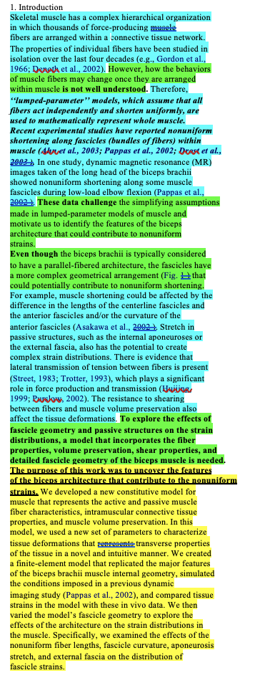
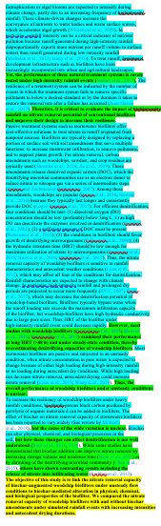
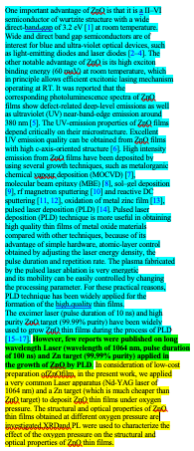
BME/MAE- biomechanics
CEE- Water Research
MSE- Jrnl of Materials Sci
Move 1
Move 1
Move 1
Move 2
Move 2
Move 1
Move 1
Move 2
Move 2
Move 1
Move 1
Move 2
Move 2
Move 3
Move 2
Move 1
Move 3
Move 2
Move 1
Move 2
Move 3
498/4344 words (11.5%)
831/5580 words (14.9%)
409/2878 words (14.2%)

Slide 74
BME/MAE- biomechanics
CEE- Water Research
MSE- Jrnl of Materials Sci
Move 1
Move 1
Move 1
Move 2
Move 2
Move 1
Move 1
Move 2
Move 2
Move 1
Move 1
Move 2
Move 2
Move 3
Move 2
Move 1
Move 3
Move 2
Move 1
Move 2
Move 3
498/4344 words (11.5%)
831/5580 words (14.9%)
409/2878 words (14.2%)

Slide 75
BME/MAE- biomechanics
CEE- Water Research
MSE- Jrnl of Materials Sci
Move 1
Move 1
Move 1
Move 2
Move 2
Move 1
Move 1
Move 2
Move 2
Move 1
Move 1
Move 2
Move 2
Move 3
Move 2
Move 1
Move 3
Move 2
Move 1
Move 2
Move 3
498/4344 words (11.5%)
831/5580 words (14.9%)
409/2878 words (14.2%)

Slide 76
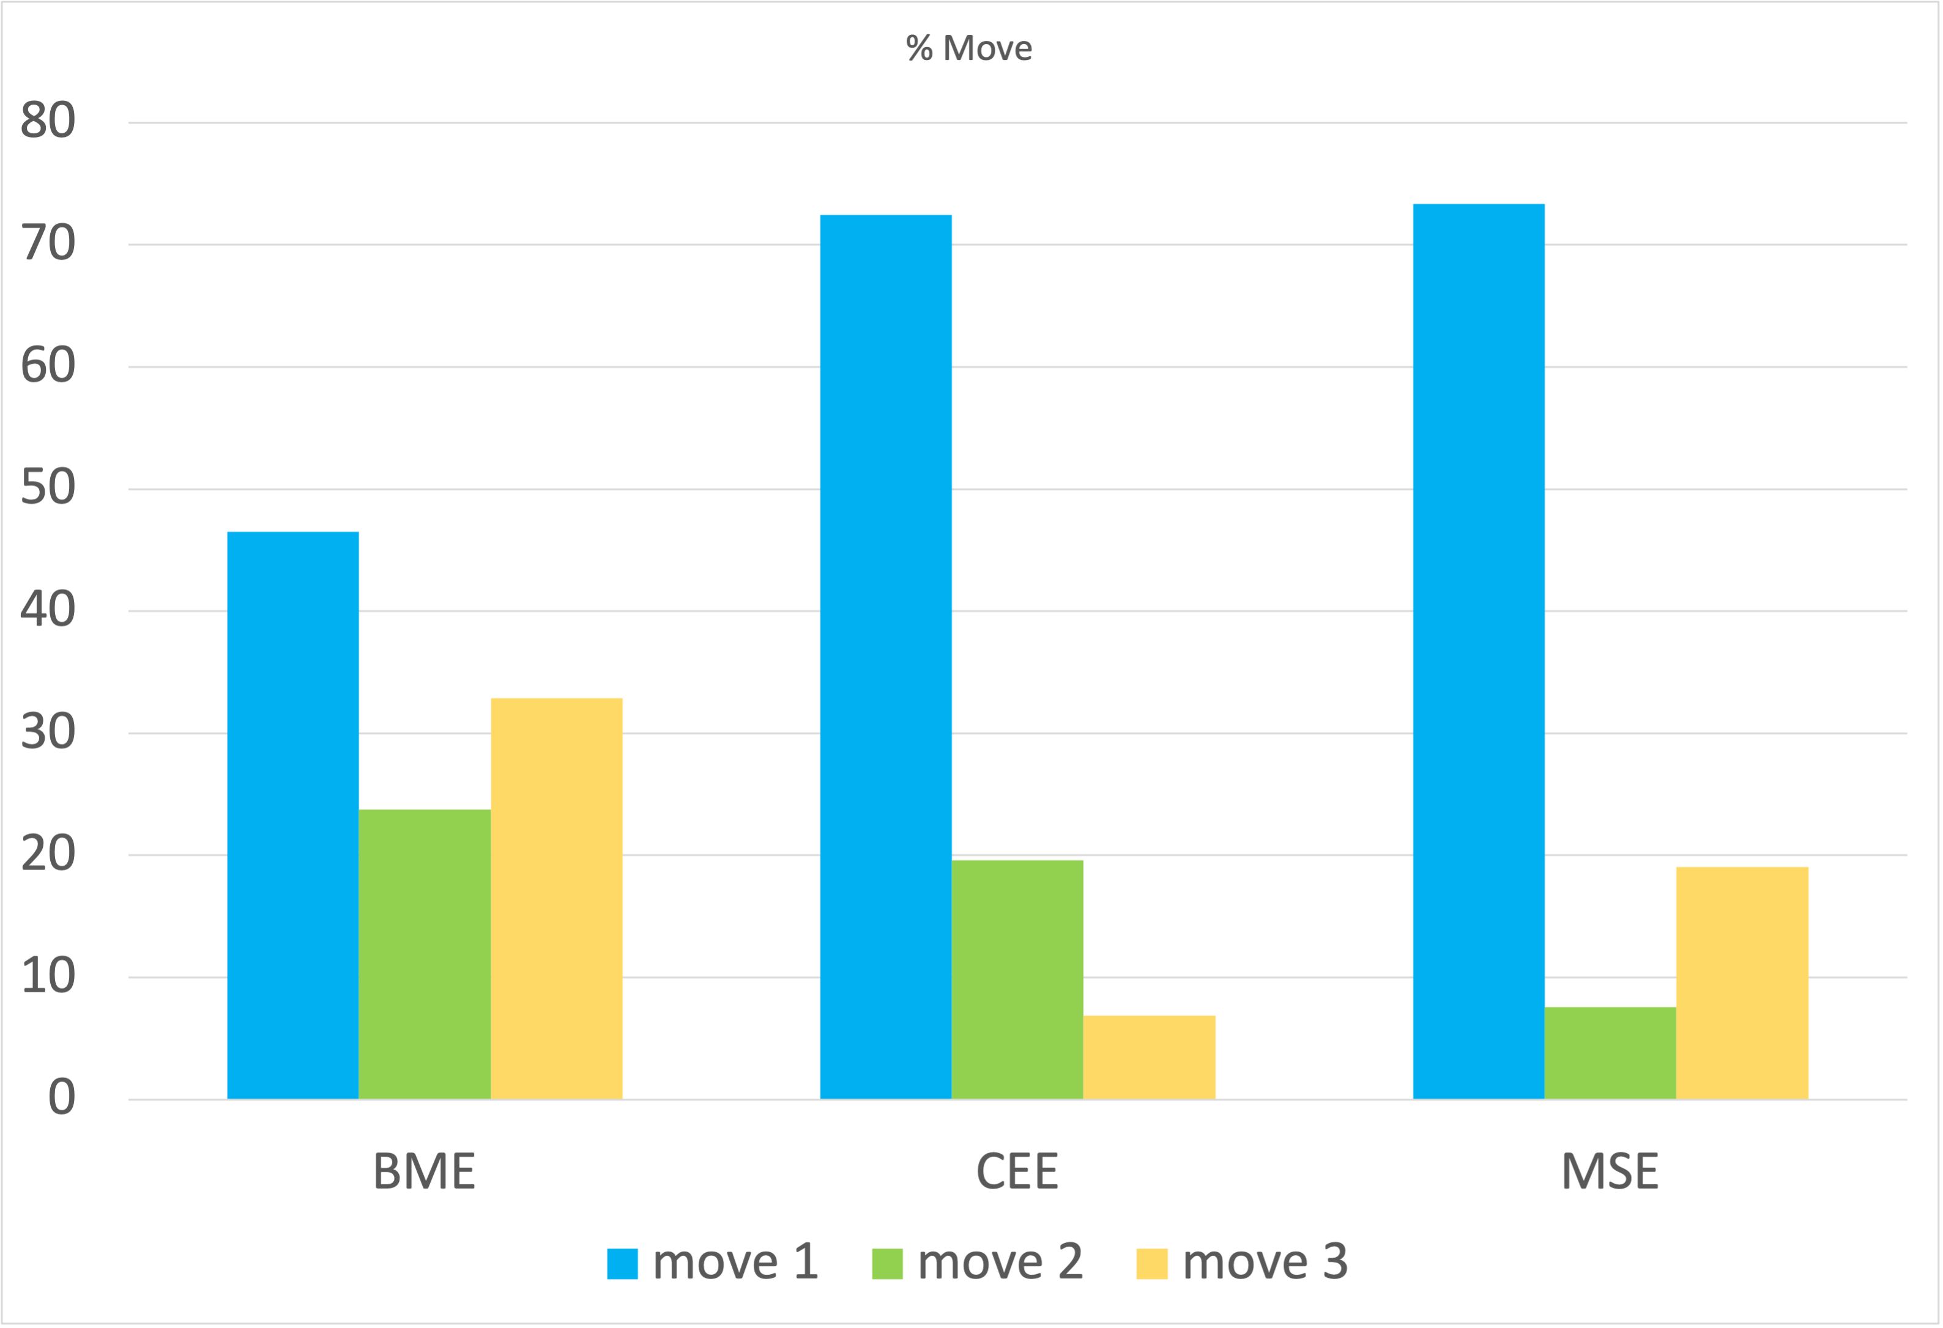
498/4344 words (11.5%)
831/5580 words (14.9%)
409/2878 words (14.2%)
Notes:
Number of words per move: move 1 move 2 move 3 total BME 225 115 159 484 CEE 602 163 57 831 MSE 300 31 78 409
Percent of words in intro per move :move 1 move 2 move 3 BME 46 24 33 CEE 72 20 7 MSE 73 8 19

Slide 77
Other set ups

Slide 78
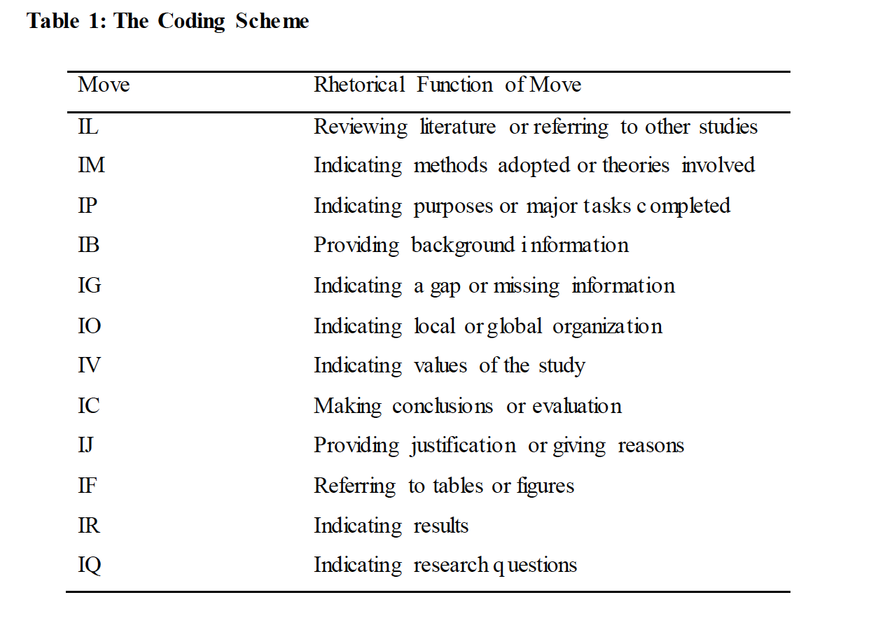
Moves- suggested for CS
Major Moves
Optional Moves
Lin & Kuo 2014 “The Rhetorical Functions of Lexical Bundles in Computer Science Research Article Introductions” The Asian Esp Journal
Notes:
Lin & Kuo 2014 “The Rhetorical Functions of Lexical Bundles in Computer Science Research Article Introductions” The Asian Esp Journal
Based on only 3 journals- IEEE Transactions on Computers, IEEE Transactions on Pattern Analysis and Machine Intelligence, and Computational Linguistics,

Slide 79
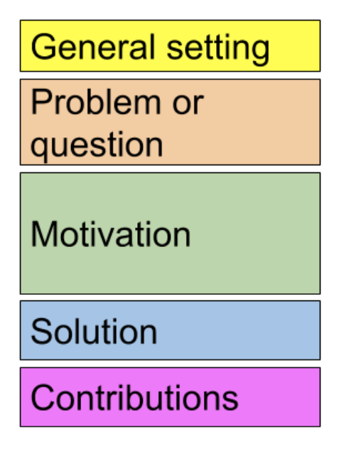
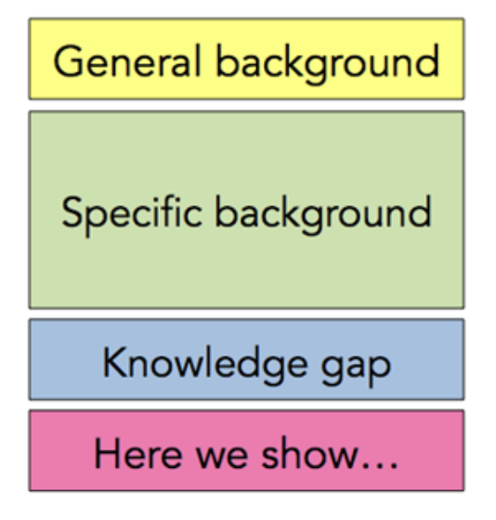
Background as needed
Mit CommKit
Mechanical
Biological
Mit CommKit
EE & CS
Notes:
https://mitcommlab.mit.edu/eecs/commkit/journal-article-introduction/
https://mitcommlab.mit.edu/be/commkit/journal-article-introduction/

Slide 80
Openers : 1st sent to paragraph

Slide 81
Openers
Establishes expectations
Generates Momentum
ID the problem
Intro key ‘characters’
Target an audience
Make clear what the paper is about
Frame the problem
Schimel (2011) Writing Science: How to Write Papers that get Cited & Proposals that get funded

Slide 82
Openers
Quick opener: Short paper, narrow audience
Longer Opener: broader audience
Must convince the audience this is
for them
Interesting
Important
Start where the audience is & bring them to your work
Schimel (2011) Writing Science: How to Write Papers that get Cited & Proposals that get funded

Slide 83
Skeletal muscle has a complex hierarchical organization
in which thousands of force-producing muscle
fibers are arranged within a connective tissue network.
The properties of individual fibers have been studied in
isolation over the last four decades (e.g., Gordon et al.,
1966; Denoth et al., 2002). However, how the behaviors
of muscle fibers may change once they are arranged
within muscle is not well understood
Blemker, S. S., Pinsky, P. M., & Delp, S. L. (2005). A 3D model of muscle reveals the causes of nonuniform strains in the biceps brachii. Journal of biomechanics, 38(4), 657-665.
Notes:
Example
Sets up expectations
What do you expect to come next

Slide 84
The goal is not getting published The goal is getting cited
p.45
Schimel (2011) Writing Science: How to Write Papers that get Cited & Proposals that get funded

Slide 85
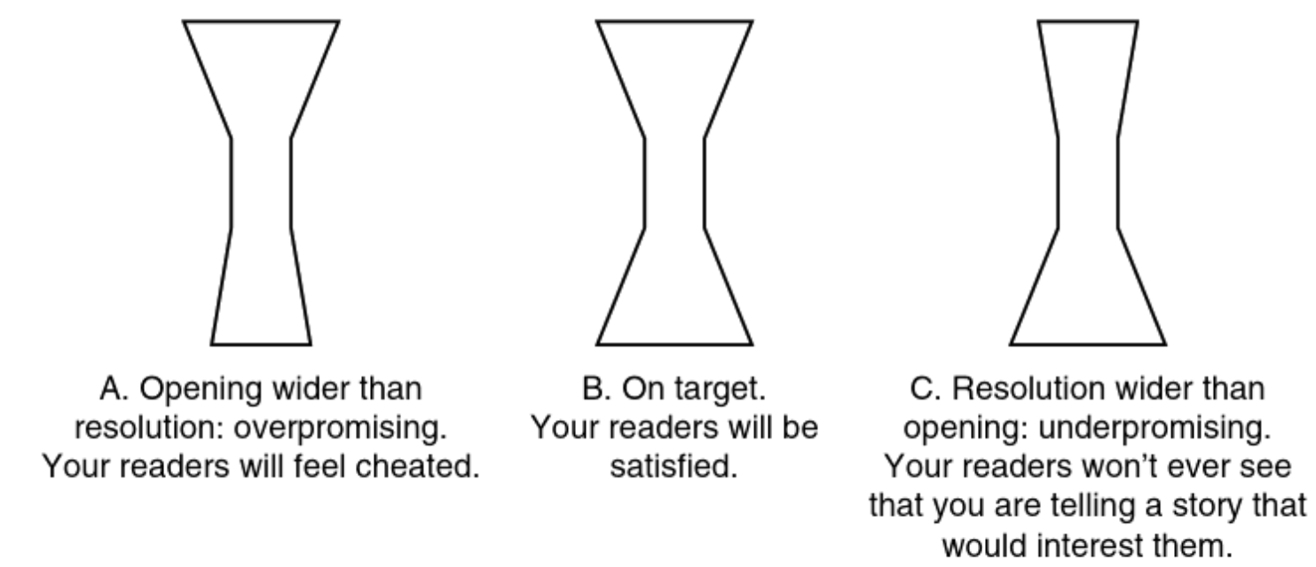
Match your intro & conclusion to deliver what you promise
https://ebookcentral-proquest-com.proxy01.its.virginia.edu/lib/uva/reader.action?docID=845932 – figure 5.1
Notes:
https://ebookcentral-proquest-com.proxy01.its.virginia.edu/lib/uva/reader.action?docID=845932 – figure 5.1
Match intro and conclusion & deliver what you promise

Slide 86
Consider the intro & conclusion together
Do they match?
Does the conclusion address what you brought up in the intro?
Are reader expectations met?
Intro & conclusion writing/revising can be a cyclical process

Slide 87
Common issues

Slide 88
Issues with openers
Quick changes in direction
Difficult to follow
Misdirection
Misleading, won’t meet expectations, disconnect
No direction
Aimless, unsure of what is coming
https://ebookcentral-proquest-com.proxy01.its.virginia.edu/lib/uva/reader.action?docID=845932
Notes:
https://ebookcentral-proquest-com.proxy01.its.virginia.edu/lib/uva/reader.action?docID=845932

Slide 89
Issue: Lack of direction
Explaining commonly understood concepts
Common advice from Journal Editors
Delete you first sentence, maybe 1st 2 sentences
Often too broad
https://ebookcentral-proquest-com.proxy01.its.virginia.edu/lib/uva/reader.action?docID=845932
Notes:
https://ebookcentral-proquest-com.proxy01.its.virginia.edu/lib/uva/reader.action?docID=845932

Slide 90
Issue: offer solution before defining problem
To avoid this issue:
Do not assume the audience knows the problem
Define the problem before offering a solution
https://ebookcentral-proquest-com.proxy01.its.virginia.edu/lib/uva/reader.action?docID=845932
Notes:
https://ebookcentral-proquest-com.proxy01.its.virginia.edu/lib/uva/reader.action?docID=845932

Slide 91
Issues in early versions
Little is known about topic A
Unconvincing, often followed by explanation of topic A
Fuzzy- how much is little?
Not concrete
Our objectives were blahblahblah
https://ebookcentral-proquest-com.proxy01.its.virginia.edu/lib/uva/reader.action?docID=845932
Notes:
https://ebookcentral-proquest-com.proxy01.its.virginia.edu/lib/uva/reader.action?docID=845932 p. 54

Slide 92
How to solve it?
Be concrete,
Narrow appropriately
Link together
Engage curiosity
Show something is important rather than simply stating that it is
https://ebookcentral-proquest-com.proxy01.its.virginia.edu/lib/uva/reader.action?docID=845932

Slide 93
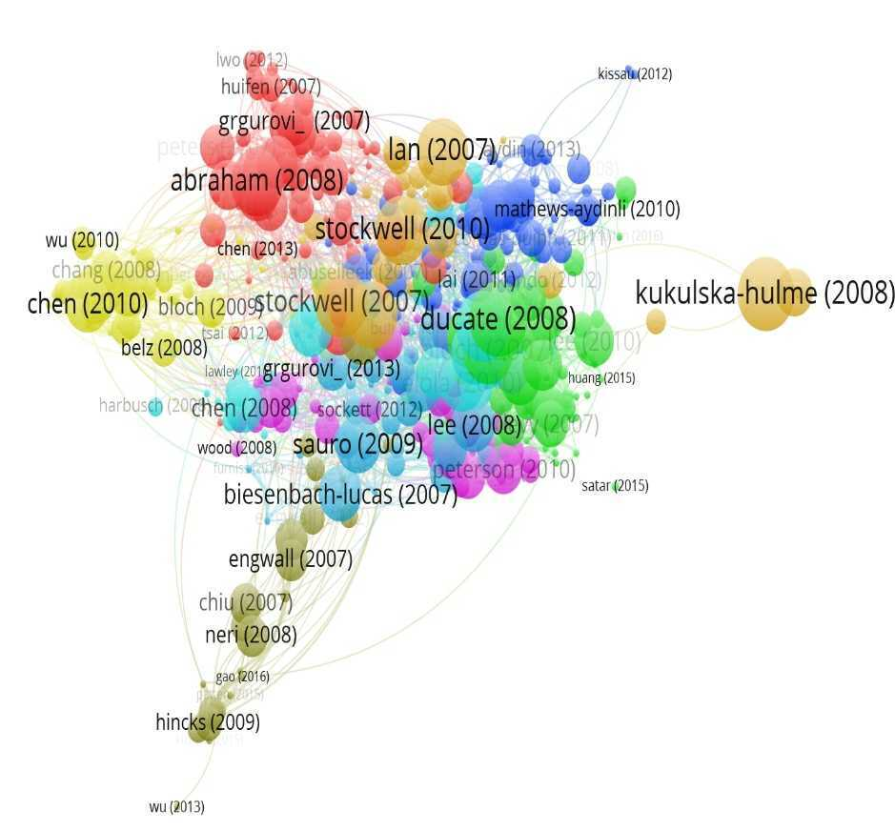
Issue: not citing relevant literature
(issue discussed at editors Panel Sp 2021)
vosviewer generated diagram from Cunningham & Link (2017) International Interdisciplinary InterConnected: a decade of CALL research through bibliometric connections, TSLL
Notes:
Citations are markers of ongoing conversation and positioning within fields and subfields
You need to show you are a part of the right conversations
Cannot be disconnected, then you are just talking to yourself.

Slide 94
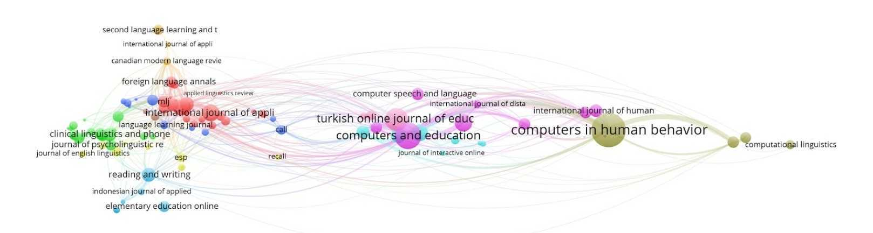
Remember- Why Intros?
Situate your work in larger conversation
vosviewer generated diagram from Cunningham & Link (2017) International Interdisciplinary InterConnected: a decade of CALL research through bibliometric connections, TSLL – a bibliometric map of journals related to CALL/edtech showing citations as connections, representing 38388 articles in 202 journals
Notes:
Image- vosviewer generated diagram from Cunningham & Link (2017) International Interdisciplinary InterConnected: a decade of CALL research through bibliometric connections, TSLL – a bibliometric map of journals related to CALL/edtech showing citations as connections, representing 38388 articles in 202 journals

Slide 95
Papers in a Subfield tend to cite similarly
Cunningham & Link (2017) International Interdisciplinary InterConnected: a decade of CALL research through bibliometric connections, TSLL – a bibliometric visualization generated in VosViewer with bibliometric coupling- clustering articles by shared references – CALL articles 2007-2017 – the clustering reveals key subfields
Notes:
Image- Cunningham & Link (2017) International Interdisciplinary InterConnected: a decade of CALL research through bibliometric connections, TSLL – a bibliometric visualization generated in VosViewer with bibliometric coupling- clustering articles by shared references – CALL articles 2007-2017 – the clustering reveals key subfields
Thus, a marker of being part of a subfield is often citing articles that other articles in your subfield also cite. Readers immersed in a subfield are likely to notice if you miss citing key relevant research in the area

Slide 96
Issue: not citing relevant literature
(issue discussed at editors Panel Sp 2021)
Expected literature is missing
Fix it:
Search the base constructs, not your RQ
Cite
What fits logically in the story you are telling
What is necessary to understand your study
Consider the audience & context
Look through past issues of the journal
Notes:
Citations are markers of ongoing conversation and positioning within fields and subfields
You need to show you are a part of the right conversations
Cannot be disconnected, then you are just talking to yourself.
Depending on what you are connecting to it can show where you fit or maybe don’t fit
If all your citations are from somewhere else, it may look odd for another journal
Also consider those threads as supporting your article
Also don’t want to miss something and say that no literature exists on abc

Slide 97
More to Consider

Slide 98
Variation by Discipline & Methods
May vary
Length
Order & use of moves/steps
Always check similar types of articles in your target context

Slide 99
Going Further- Self Study
Analyze an Article
Gather articles of a similar type from a Journal
How long are the intros?
Which moves & steps do they use? In what order?
What language is used for each move?
What are the openers? How do they signal the issue and audience?
Notes:
Base your type of methods. If you are doing a modelling paper, look for modelling papers in that journal rather than a survey study or experimental study

Slide 100
What words to use?
Academic Phrasebank-Examples of some of the phrases used in British dissertations organized according to the main sections of a research paper and the functions in academic writing
Free website, 5$ searchable pdf includes American English
Notes:
Academic phrase bank- mentioned in previous workshops, this pdf with phrases by function and section of research paper is probably one of the more useful list based resources- caution- British dissertations, phrases may be different in American varieties of English

Slide 101

Academic Phrasebank
Phrases by article section & function
General functions

Slide 102
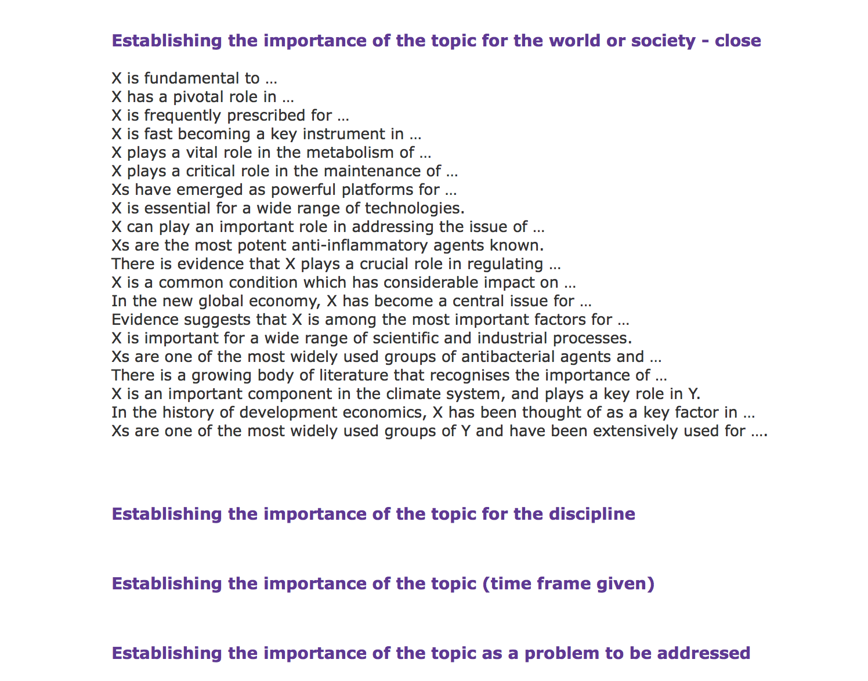
Academic Phrasebank
Notes:
After selecting a section on the top, scroll down
There are different functions listed
Clicking a function will give a list of phrases used for that function
The pdf includes tables of common language frames

Slide 103
Resources to Help
Writing in Boxes
Pdfs & web pages, books
See resources at the very end of slide deck on
Intros
Lit reviews
Research article writing
Corpus software

Slide 104

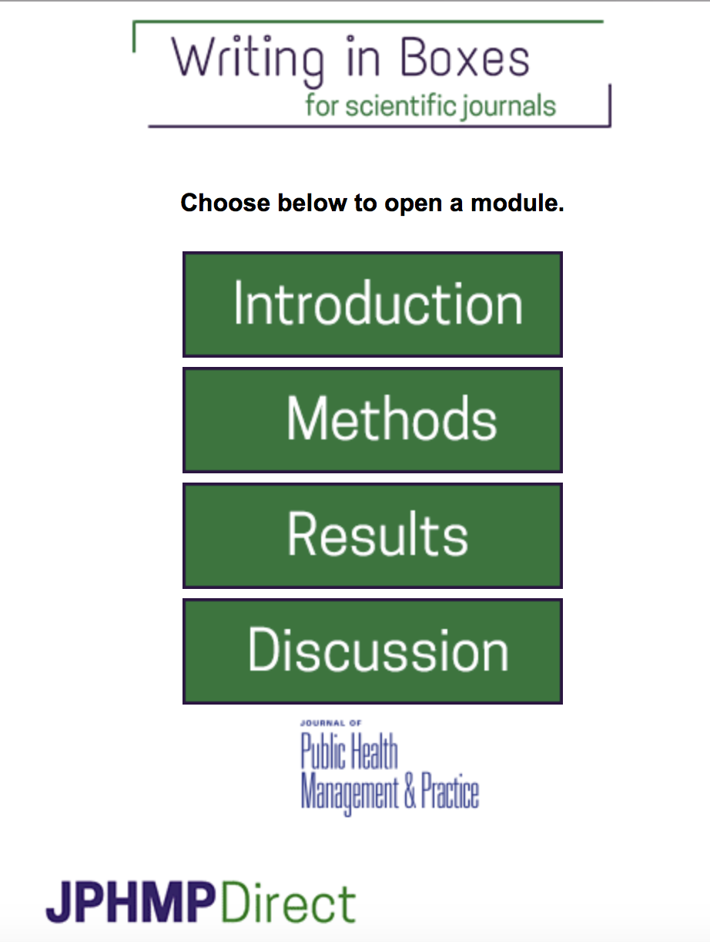
Writing in Boxes - https://jphmpdirect.com/elearning-module/
Notes:
Walks you through key info you need for your intro (or any section) , has you type it in and helps build a skeleton for your paper.

Slide 105
Intros
Reader
Guide the reader from where they are to your study
Employ key strategies
Territory/context/situation
Niche/gap/problem
Occupy/fill/solve
Become part of the conversation
Your study

Slide 106
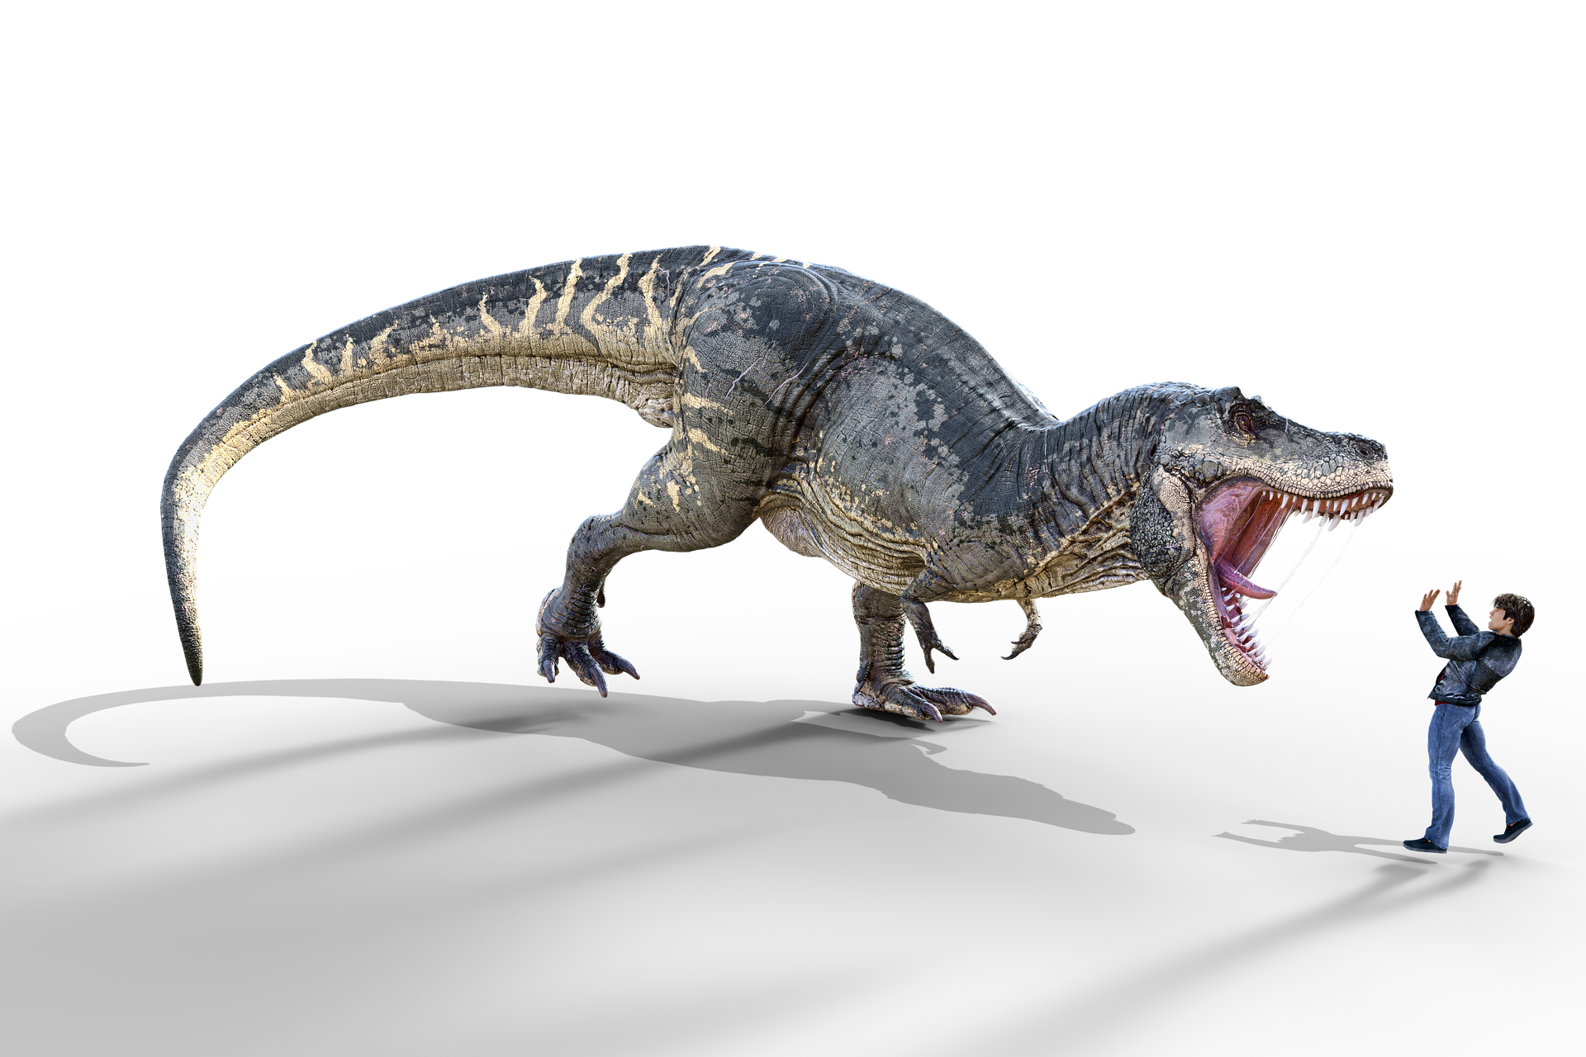
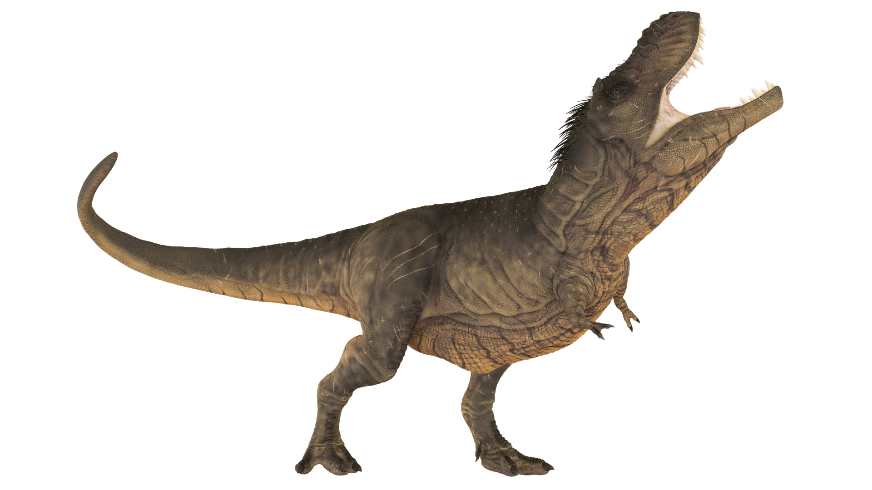
Writing Can be Scary
& lonely

Slide 107
But it doesn’t have to be
Notes:
Blue dino is a GWL icon. This and other images in this presentation are not included in the CC-BY

Slide 108
bit.ly/SEASGWL
gradwritinglab@virginia.edu

Slide 109
Intros Resources
WRITING SCIENCE: HOW TO WRITE PAPERS THAT GET CITED & PROPOSALS THAT GET FUNDED- Schimel (2012) - ebook through UVA library – very useful for the ‘story’ aspect of research article writing; useful chapters on writing intros
Intros specific:
HOW TO WRITE/PRESENT SCIENCE: BABY-WEREWOLF-SILVER BULLET An eco-evo evo-eco blog post on setting up your scientific presentation or paper. Very useful for setting up introductions, conceptualizing your larger argument or thinking through the big picture of your presentation.
THE INTRODUCTION SECTION -a pdf overview of the CARS model of moves and steps in research article introductions from Helsinki University of Technology
ORGANIZING YOU SOCIAL SCIENCES RESEARCH PAPER: THE CARS MODEL A nice library guide with an overview of introductions. May need some adaptation for engineering but good place to start
MIT CommKits

Slide 110
MIT CommKit: Introductions by area
Nuclear science & engineering – most detail
Mechanical engineering
Electrical engineering & Computer Science- slightly different
Broad Institute (human health genomics)
Biological engineering
Look at more than 1 discipline- most have similar info with varied level of detail provided. Bottom of each page has sample annotated examples

Slide 111
Lit Review resources
LITERATURE REVIEW WRITING GUIDE - from the University of Waterloo on writeonline.ca, a well organized multipart step by step guide for planning, writing & revising lit reviews; includes a section outlining the key parts of a lit review and tips for writing.
LITERATURE REVIEWS - posts from Raul Pacheo-Vega on various strategies and stages of writing a literature review
GRADUATE RESEARCH ADVANCED SKILLS PROGRAM RESOURCES from Curtin University in Australia. Includes videos, handouts, slides, etc. for a number of workshops on research writing topics including Lit Reviews and abstracts

Slide 112
Whole Article Resources
Whole article resources:
WRITING RESEARCH ARTICLES FOR PUBLICATION - (pdf)- Burrows (2011) from Asian Institute of Technology, includes overviews of sections, perspectives, common issues, language, and engineering examples throughout
WRITING IN BOXES An interactive tutorial and tool to get you started on writing the different sections of an IMRD article from JPHMP Direct; outlines what goes in each section; includes a video overview of how the tool works. While it is public health specific, you can adapt it to your field as well.
SCIENTIFIC WRITING TOOLKIT Many links, articles and tutorials for research writing and planning from the council of state and territorial epidemiologists
WRITING AN IMRAD REPORT Very basic overview of sections
HOW TO WRITE A PAPER (ASHBY, 2005)
MIT CommKits - BIOLOGICAL ENGINEERING, ELECTRICAL ENGINEERING/COMPUTER SCIENCE and CHEMICAL ENGINEERING - have clear simplified overviews for each section of a research article that work across disciplines
STYLE AND ETHICS OF COMMUNICATION IN SCIENCE AND ENGINEERING (ebook/pdf, free access through UVA library) covers issues in writing, scientific publishing, dissertations, proposals & grant applications, oral communication, authorship, record keeping, ownership; authors from biomedical sciences & engineering background

Slide 113

AntConc (free software)
You give the program .txts of the type of writing to explore
Ex. Chemical engineering research paper abstracts
Concordance/KWIC lines, Plots, Collocations, N-Grams
Find common phrases, patterns of use, etc
Big picture view of where terms/phrases occur in the text
Terms/usage in context: what prepositions w/this verb?
Slides, tutorials, download links in collab
Notes:
See slides in collab & online tutorials
Refer to 2 other workshops on this software

Slide 114
AntConc
Use in conjunction with AntCorGen to quickly grab research articles segmented by section
Compare intros to other sections, etc.

