Slide 1
Equity and Inclusion Training

Slide 2
Goal of this training
Albemarle County staff is comfortable with inclusive language and recognizes the importance of using this type of language.
Staff can begin to apply equity knowledge to their work.
Notes:
Albemarle County staff enhances their ability to think through equity impacts and articulating data in a way that does not stigmatize or harm communities.

Slide 3
Overview
Key concepts
Local Historical context
Inclusive Language
Implicit Bias
Additional Terminology
COVID-19 and its impact
Looking Ahead

Slide 4
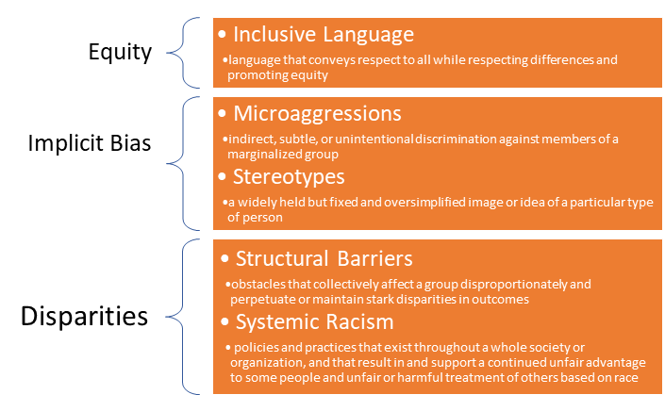
Key Concepts
Notes:
Equity is the central, overarching concept that is important to us. Equity does not just happen, it takes deliberate, continuous effort to attain. When interacting with residents of Albemarle county and stakeholders, County government officials need to be conscious of the impact of their words rather than intent. For this reason, we have framed our equity training around the use of inclusive language and its importance to equity outcomes. Inclusive language is critical to equity efforts because it conveys respect to all people while acknowledging differences. With this in mind, we have defined some other important concepts and their relationship to equity and inclusive language.

Slide 5
Interactive Exercise
Write down what you think equity and inclusion would look like in Albemarle county as you currently understand it.
Hold onto your response for later review

Slide 6
Equity in Albemarle County
How can government organizations take steps to become more equitable?
Examples from Renton, WA
  Targeted outreach to certain demographics for services
  More procurement contracts for women and minority owned businesses
  Producing important court and county documents in multiple language

Slide 7
Local History
Charlottesville and Albemarle County
Legacy of slavery
Past policies that entrench inequity
  Jim Crow Laws
  Massive Resistance
  Urban Renewal
  Racist Covenants

Slide 8
Inclusive Language- Introduction
"As long as we have had the spoken word, language has been one of the first tools deployed in efforts to oppress others. Words are how we process the world, how we form our societies, how we codify our morals. “- Ijeoma Oluo, So You Want to Talk About Race (p. 138).
What is inclusive language?
Inclusive language “acknowledges diversity, conveys respect to all people, is sensitive to differences and promotes equitable opportunities.”
Why do we need it?
Having a handle on the appropriate and equitable way to refer to populations allows government staff to navigate conversations and presentations without causing harm or stigmatizing those groups of people.

Slide 9
Inclusive Language- General Guidelines
Avoid terms that are dehumanizing, isolating, or polarizing
  Polarize: to break up into opposing factions or groupings
When in doubt, ask the individual or group how they would like to be referred to, if you have the chance
If you don’t have a chance, use the language of the majority group
When speaking or writing, address the problem without assigning blame to the person
A sincere effort is key
Continue to use any terminology that you know to be correct, if any of this information is contrary

Slide 10
Inclusive Language- Examples
Instead of ‘disadvantaged’ or ‘poor’ neighborhoods or people...
Try...
‘low income neighborhood’ or ‘people with income below the poverty line’.
(addressing the problem...not blaming the person & person first, humanizing language)
Instead of ‘homosexual’....
Try....
‘Gay’ or ‘lesbian’
(avoiding terms that are polarizing/isolating/dehumanizing)
Find a list of resources for additional inclusive language here.

Slide 11
Bias
Bias - Tendency towards or against a group, an individual, an idea, or a thing. (UCSF Office of Diversity and Outreach, n.d.)
Types:
Conscious or explicit - direct and acknowledged facet of belief system
Unconscious or implicit - unacknowledged, often inconsistent with explicit facets of belief system; often goes unrecognized but stays active in decision making through priming
Structural racism, gender, age, and health prejudices are often the foundation of implicit biases
Notes:
We rely on our brains to make connections and identify patterns. Word association games, “when I say mug, you say coffee” for example. We each have our own specific associations but we have also learned to operate within the structures of society. Some of our implicit biases come from the environment that we grew up in. Taking ownership of our biases is an important step in mitigating their impact on others.

Slide 12
Implicit Bias Activity
Implicit Association Test (IAT)
Complete the following activity
Test Yourself for Hidden Bias | Learning for Justice
Choose from a variety of IATs, there are multiple options!
Engage fully and be open to learning something about yourself. Participation is not mandatory but is encouraged.
The are not necessarily an accurate diagnostic of your implicit biases. Instead, the test is a learning tool, and can be used to understand implicit bias more clearly and personally (see Ethical Considerations web page for more information on how the IAT can be used)
Notes:
https://implicit.harvard.edu/implicit/takeatest.html

Slide 13
Implicit Bias and Language
Language used to identify a group of people in order to convey information can perpetuate stereotypes when it:
Is limiting to the individuals being referred to
Retains harmful associations
List of Phrases to avoid
Mitigate the effects of implicit biases through:
Education and awareness of your own implicit biases
Continuously self-monitor
Maintain accountability and room for growth
Strategies for mitigating bias

Slide 14
Other terminology
In addition to what we have learned about implicit bias, there are other terms that are important to understand when thinking about equity
Microaggressions include both verbal and non-verbal communications can show bias towards or target historically marginalized groups
  Example: Continuing to use misuse pronouns even after someone has specified their preferred pronouns
Privilege gives unearned advantages to benefit members of a dominant group, often to the detriment of others
  Example: Privilege can take many forms such as having people of your own race and/or ethnicity represented as the default in movies, TV shows, and commercials
Cultural appropriation is the adoption or theft of cultural elements by members of another culture, often without respecting or understanding the original significance of the item in question
  Example: A non-indigenous person dressing up in traditional Native American clothing and attire for Halloween
Systemic racism is a broad form of racism that is embedded in formal and informal institutions in a society, often resulting in the discrimination of a particular groups across many parts of society
  Example: A criminal justice system that disproportionately incarcerates people belonging to Black and African-American communities

Slide 15
Current Topics: COVID-19 Pandemic and Equity
Discussing the impact of the pandemic on how we think about equity
Macro scale
  National level- How has the national response plan thought about equity? What else could be done?
  Charlottesville and Albemarle County- Are the City and the County able to adequately address the needs of different marginalized groups?
Micro scale
  Individuals- In what ways have different people been impacted by the pandemic?
  Marginalized groups-Are marginalized groups being disproportionately affected? (by number of cases, number of fatalities, access to vaccines, etc)

Slide 16
COVID-19
How has the pandemic affected different groups?
  Race
  Gender
  Class
What sort of trauma have people experienced?
  Economic
  Social
  Health
How can future pandemics be addressed from a more equitable standpoint
  Vaccinations
  Accessibility
Better understanding how different groups have been impacted and the sort of trauma that they have experienced will go a long way towards implementing more equitable solutions in the future

Slide 17
Thinking Ahead
How will equity inform the county’s work in the future?
Using equity and an equity lens to consider future plans
Using inclusive language to address key demographics without triggering implicit biases
Being aware of implicit biases when speaking or writing about future plans and the impacts it may have on certain demographics

Slide 18
Final Interactive Activity
Given what you just learned, please write what you think equity could look like in Albemarle, and compare this answer with the answer you wrote for the first activity.

Slide 19
Summary
What have we learned from this module?
Equity
  What it is
  Approaching future plans in Albemarle County with an equity lens
Inclusive Language
  What it is
  Guidelines for how to approach using inclusive language in our work
Main Takeaway
Being aware of what implicit bias is, and how this impacts the work being done in Albemarle County. Being aware of implicit biases can inform the language we use when approaching future work plans in order to avoid biases.

Slide 20
Conclusions and Final Thoughts
Throughout this module, we have learned equity and what it’s important in the context of local government
Additionally, other topics such as implicit bias and the impacts of COVID-19 on equity have also been explored
It is important to keep in mind that talking about these issues is not always easy and this topic can be sensitive at times
Having a better understanding of equity is not only beneficial for our own interactions with others but also helps to create a more inclusive environment that promotes diversity
While there is always more that can be learned, this module has provided the basic tools needed to better understand why equity is relevant and how it can be applied in daily life

Slide 21
Inclusive Language- Resources
Northwestern University-Language Guide
UNHCR Refugee Differences - Videos
LGBTQ Terminology Handbook
DC Fiscal Policy Institute- Talking about Poverty, Race, and Class
Article on Rhetoric About Immigration
Article and Research about the term ‘Latinx’
Article on Autism, Person-First, and Identity-First Language
Disability etiquette for in-person and virtual communication
APA Style writing guide for Racial and Ethnic Identity
APA Style - General Principles for Reducing Bias

Slide 22
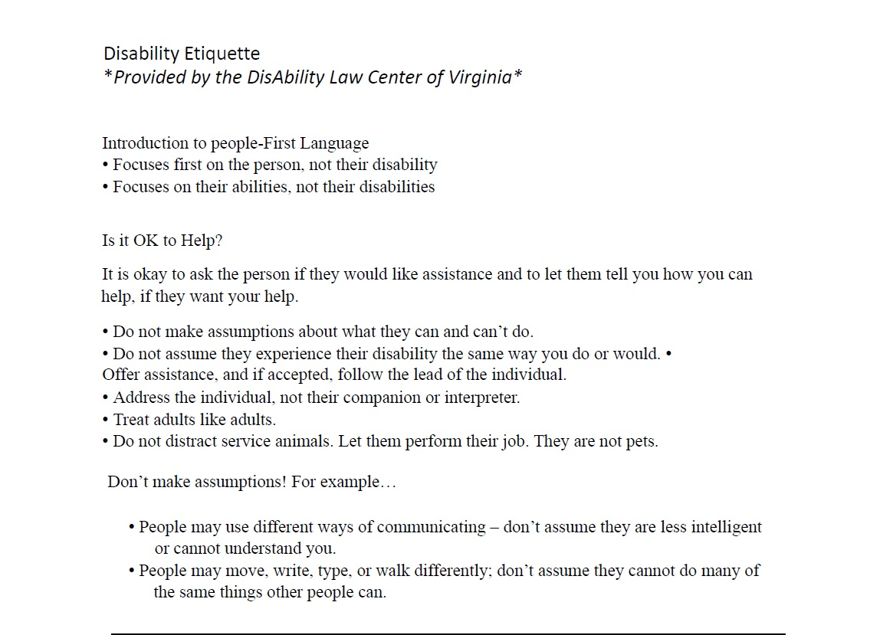
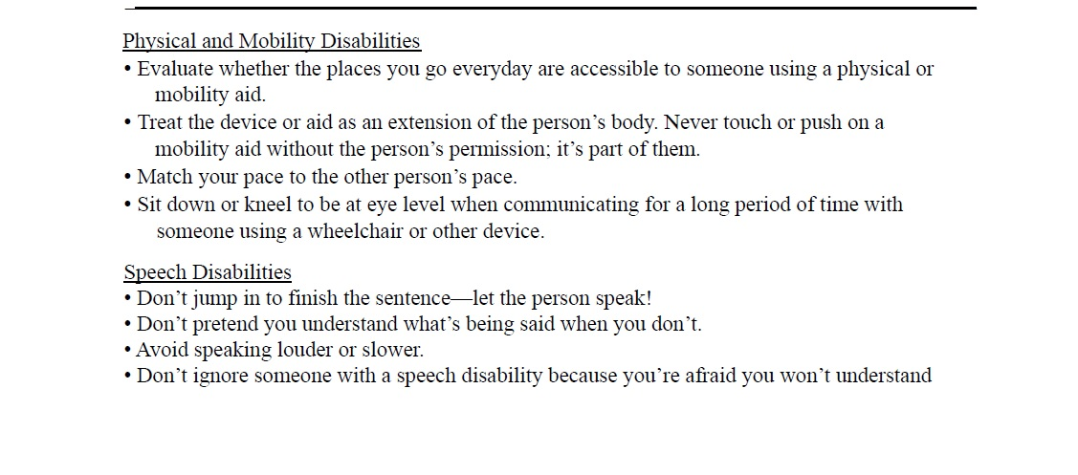
More on the next slide!

Slide 23
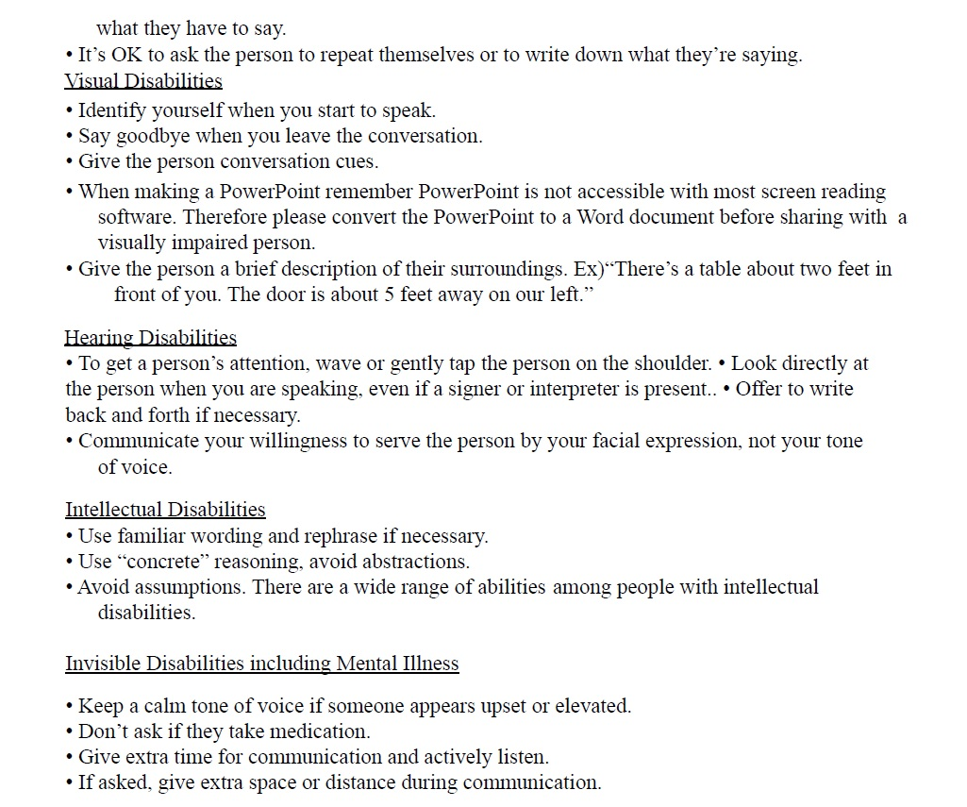

Slide 24
Inclusive Language-References
Counseling@Northwestern. (2019, October 16). Inclusive Language Guide. NU-MAC. https://counseling.northwestern.edu/blog/inclusive-language-guide/
Definition of POLARIZE. (n.d.). Retrieved May 9, 2021, from https://www.merriam-webster.com/dictionary/polarize
GLAAD & Movement Advancement Project (MAP). (2012). An Ally's Guide to Terminology. n.a. https://www.glaad.org/sites/default/files/allys-guide-to-terminology_1.pdf
Luis Noe-Bustamante, Lauren Mora, and Mark Hugo Lopez. (2020, August 11). Latinx Used by Just 3% of U.S. Hispanics. About One-in-Four Have Heard of It. Pew Research Center’s Hispanic Trends Project. https://www.pewresearch.org/hispanic/2020/08/11/about-one-in-four-u-s-hispanics-have-heard-of-latinx-but-just-3-use-it/
Molly Callahan. (2018, July 12). Unpacking the debate over person-first vs. Identity-first language in the autism community. News@Northeastern. https://news.northeastern.edu/2018/07/12/unpacking-the-debate-over-person-first-vs-identity-first-language-in-the-autism-community/
Refugees, U. N. H. C. R. (n.d.). Teaching about refugees. UNHCR. Retrieved April 20, 2021, from https://www.unhcr.org/teaching-about-refugees.html
Shereen Marisol Meraji. (n.d.). “Hispanic,” “Latino,” Or “Latinx”? Survey Says ... NPR.Org. Retrieved April 20, 2021, from https://www.npr.org/sections/codeswitch/2020/08/11/901398248/hispanic-latino-or-latinx-survey-says
Zaveri, M. (2020, February 13). This Lawmaker Wants to Remove the Words ‘Illegal Alien’ From the Law. The New York Times. https://www.nytimes.com/2020/02/13/us/politics/colorado-illegal-immigrants.html
DLCV. (2020). Disability Etiquette. Richmond; DisAbility Law Center of Virginia.
Oluo, I. (2019). So You Want to Talk About Race. Seal Press.

Slide 25
References continued
UCSF Office of Diversity and Outreach. (n.d.). Unconscious Bias. Programs and Services | Office of Diversity and Outreach. Retrieved May 8, 2021, from https://diversity.ucsf.edu/resources/unconscious-bias

