Slide 1
Integrating Sources in
Engineering Writing
Brooke Dinsmore
Graduate Writing Consultant
Graduate Writing Lab
UVA Engineering

Slide 2
Workshop Sources
Chapter 8: Managing Sources in Writing in Engineering: A Brief Guide by Robert Irish (2015)
"Paraphrasing and Summarizing Workshop.” adapted from the University of Guelph Graduate Writing Camp materials by Thompson, Natalie and Kiera Mahoney. For the University of Virginia Graduate Writing Lab 2020.
Hosseinianfar, Hamid, and Maite Brandt-Pearce. "Cooperative Passive Pedestrian Detection and Localization Using a Visible Light Communication Access Network." IEEE Open Journal of the Communications Society 1 (2020): 1325-1335.
Blemker, Silvia S., and Scott L. Delp. "Three-dimensional representation of complex muscle architectures and geometries." Annals of biomedical engineering 33.5 (2005): 661-673.
Besaleva, Lilya and Alfred Weaver. ”Social Networks to the Rescue! The Power of Crowdsourced Data in Emergency Response," International Conference on Health Informatics and Medical Systems," Las Vegas, NV, July 27-30, 2015.
The Citation Project. http://www.citationproject.net/

Slide 3
Workshop Agenda
01
Why do engineers use outside sources?
02
How do you integrate sources in sentences
03
How to use sources to support your claims
General principles for integrating sources
Summarizing and paraphrasing
Using models for organizing sources in articles and proposals

Slide 4
Why do engineers use outside sources in their writing?

Slide 5
Engineers use sources to:
Enter an ongoing scientific conversation.
Show they’re up to date in their field.
Demonstrate what their contribution is.
Lend authority to their own writing and research
Chapter 8: Managing Sources in Writing in Engineering: A Brief Guide by Robert Irish (2015)

Slide 6
Four Types of References
Previous designs (patents, reference designs)
Existing research (research articles or standard reference sources)
Handbooks and codes
Components and parts
Chapter 8: Managing Sources in Writing in Engineering: A Brief Guide by Robert Irish (2015), Slide content adapted from Thompson, Natalie and Kiera Mahoney. "Paraphrasing and Summarizing Workshop.” University of Virginia Graduate Writing Lab.

Slide 7
Part 2: How to integrate sources at the sentence level

Slide 8
How do engineers integrate others work?
If you learned citation practices—summarizing, paraphrasing, or quoting—in a non-scientific context, you might have been taught that the point of citing a source is to expand on or explain it.
In engineering writing, we condense sources in order to use them for a specific purpose and audience. Irish refers to this as the “compressive” process of citation (208).
Engineers paraphrase specific aspects of a source, compressing the source to make it a useful reference and a source of authority in their own research writing. In scientific writing, we paraphrase instead of using quotes.
Chapter 8: Managing Sources in Writing in Engineering: A Brief Guide by Robert Irish (2015), Slide format adapted from Thompson, Natalie and Kiera Mahoney. "Paraphrasing and Summarizing Workshop.” University of Virginia Graduate Writing Lab.

Slide 9
What is important for these people in this situation?
Compression is always for a purpose and an audience.

Slide 10
Compressing sources for writing has two steps
SUMMARIZING
SELECTING
1
2
Slide content adapted from Thompson, Natalie and Kiera Mahoney. "Paraphrasing and Summarizing Workshop.” University of Virginia Graduate Writing Lab.

Slide 11
Summarizing
Identify the main claim and write it in your own words
Explain the main arguments that support this claim
Include necessary context (circumstances of research, methods, etc).
Separate out the summary from your interpretation
Chapter 8: Managing Sources in Writing in Engineering: A Brief Guide by Robert Irish (2015)

Slide 12
Occasionally, you may provide a full summary of an article or project for your audience.
Example:
Another highly cited and exemplary work is the technology developed in Earthquake Shakes Twitter Users: Real-time Event Detection by Social Sensors [21] from The University of Tokyo where Twitter is used for earthquake detection and reporting. In that work, the micro-blogging service is used as a source of immediate textual responses to an earthquake, which are then analyzed, and a conclusion about the occurrence of an earthquake is made. In places with very technologically savvy users such as Japan, that system was even capable of detecting real earthquake events with a probability as high as 96%.
HOWEVER, most of the time a full summary provides more information than your audience needs to know.
The majority the time, you’ll need to select relevant information to paraphrase.
Besaleva, Lilya and Alfred Weaver. ”Social Networks to the Rescue! The Power of Crowdsourced Data in Emergency Response," International Conference on Health Informatics and Medical Systems," Las Vegas, NV, July 27-30, 2015
Notes:
NOTE - shows us two methods of paraphrasing - including author’s name and not including author’s name; also shows us that we can combine two sources at once

Slide 13
Paraphrases restate a phrase, clause, or one or two sentences while using no more than 20% of the language of the original source.
The Citation Project
Notes:
This doesn’t include technical language

Slide 14
Guidelines for Paraphrasing
Paraphrases MUST…
1. Change the order and structure of sentences
2. Use synonyms or different forms of words
3. Preserve the author’s meaning or intent
4. Cite the source accurately
Paraphrases SHOULD…
Show the relationships between the different sources you cite, and between your own sources and your project
The Citation Project. http://www.citationproject.net/; Slide format adapted from Thompson, Natalie and Kiera Mahoney. "Paraphrasing and Summarizing Workshop.” University of Virginia Graduate Writing Lab.

Slide 15
Avoiding Plagiarism + Patchwriting
Plagiarism "occurs when a writer deliberately uses someone else's language, ideas, or other original material without acknowledging its source"
Council of Writing Program Administrators, 2003
“restating a phrase, clause, or one or more sentences while staying close to the language or syntax of the source”
The Citation Project, “What Is Plagiarism?”
“copying from a source text and then deleting some words, altering grammatical structures, or plugging in one-for-one synonym substitutes”
Howard, Rebecca Moore. “A Plagiarism Pentimento.” Journal of Teaching Writing 11.3 (Summer 1993): 233-46.
Plagiarism
Patchwriting
Slide content adapted from Thompson, Natalie and Kiera Mahoney. "Paraphrasing and Summarizing Workshop.” University of Virginia Graduate Writing Lab.

Slide 16
Paraphrases MUST change the order and structure of sentences
This new 3D formulation for representing muscle can characterize muscles with complex geometry and represent the variation in moment arms among fibers in a muscle. In contrast to line-segments path representations, 3D models can represent complex path motion through multiple degrees of freedom without the need for defining via points or wrapping surfaces.
3D models are better than line-segments-based models at representing the complex path motion of muscles. 3D models can represent variation in movement among the fibers in a muscle and characterize muscles with complicated geometry without the need for wrapping surfaces or defining via points.
Blemker, Silvia S., and Scott L. Delp. "Three-dimensional representation of complex muscle architectures and geometries." Annals of biomedical engineering 33.5 (2005): 661-673.
Notes:
This new 3D formulation for representing muscle can characterize muscles with complex geometry and represent the variation in moment arms among fibers in a muscle.

Slide 17
Paraphrases MUST use synonyms or different forms of words
This new representation addresses two major limitations of models that characterize muscles with a series of line segments: (i) their limited capacity for representing muscles with complex geometry and (ii) their assumption that all fibers within each muscle compartment have the same length and moment arm.
Line-segment models have two major weaknesses that are addressed by 3D models. First, line-segment models are of limited use in representing muscles with complicated geometry. Second, line-segment models assume that all muscle fibers within each compartment have identical lengths and moment arms.
Blemker, Silvia S., and Scott L. Delp. "Three-dimensional representation of complex muscle architectures and geometries." Annals of biomedical engineering 33.5 (2005): 661-673.
Notes:
This new representation addresses two major limitations of models that characterize muscles with a series of line segments: (i) their limited capacity for representing muscles with complex geometry and (ii) their assumption that all fibers within each muscle compartment have the same length and moment arm.

Slide 18
Paraphrases MUST:
Preserve meaning/intent
Check and compare:
Cite the source accurately
Put the citation immediately after the paraphrased information
List the correctly formatted citation in the works referenced list
Did you get the ideas right?
If you are using the source in a way that contradicts the original intent, acknowledge this in the text (“I disagree with so and so’s assumption”)
The Citation Project. http://www.citationproject.net/

Slide 19
Paraphrases SHOULD show the relationships between sources AND between sources and your own project
AVOID list summaries
The first author says many different things about his subject. First, she says… Then, she says… The second study’s authors also say many different things. First, they say… Then they say…
Instead
Use signal phrases and reporting verbs appropriate to your discipline and subfield!
The Citation Project. http://www.citationproject.net/

Slide 20
COMMON SIGNAL PHRASES
• They state/recommend/prove/ argue/ demonstrate that …
• A solution, according to [author’s name], is to …
• Their defense/theory/argument is …
• Model X accomplishes Y goal without Z problems (citation).
• ABC Method is now successful in most situations (citation).
• While Author A does X, Authors B and C find Y is more successful…
•Author A finds X in X subjects, while recent studies have added an examination of Y to accomplish Z…
Content adapted from Thompson, Natalie and Kiera Mahoney. "Paraphrasing and Summarizing Workshop.” University of Virginia Graduate Writing Lab.

Slide 21
Signal phrases and reporting verbs vary by discipline and subfield.

Slide 22
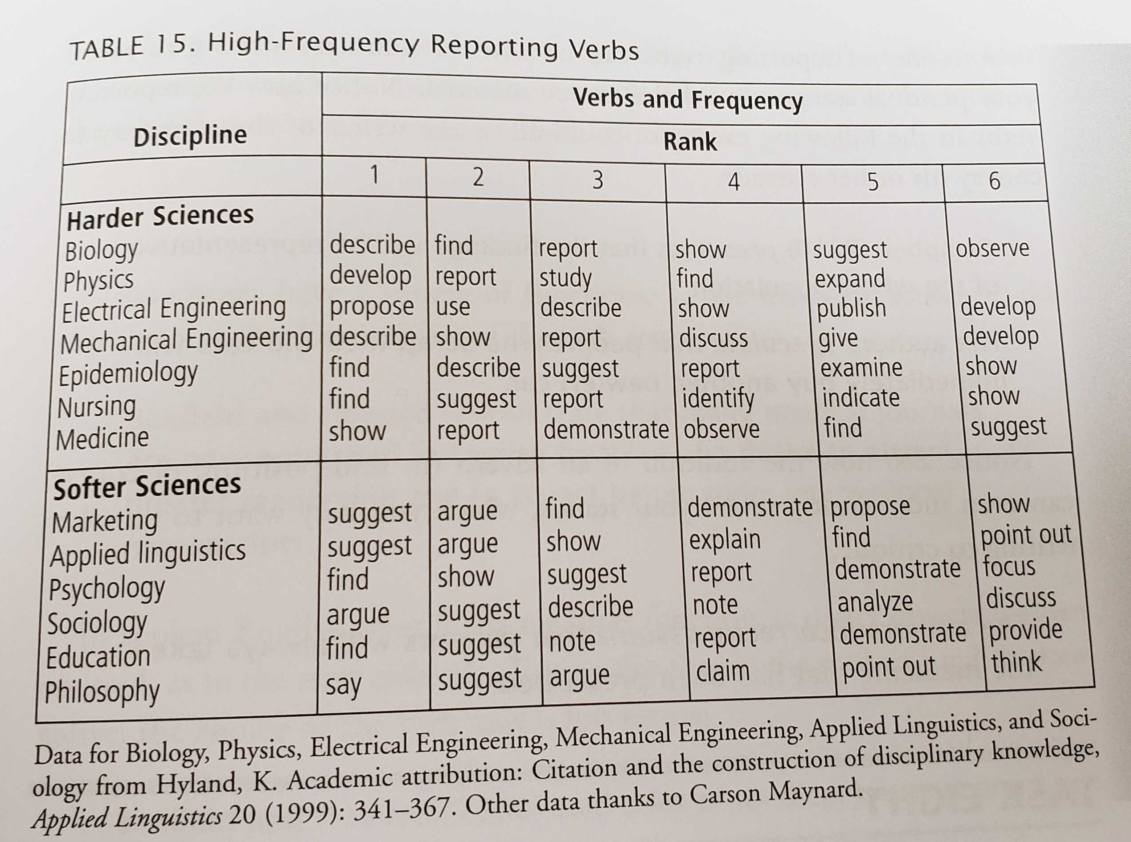
Reporting verbs in engineering:
Propose
Use
Describe
Show
Publish
Develop
Report
Discuss
Give
From Swales & Feak, p. 213; Slide content adapted from Thompson, Natalie and Kiera Mahoney. "Paraphrasing and Summarizing Workshop.” University of Virginia Graduate Writing Lab.
Notes:
This new representation addresses two major limitations of models that characterize muscles with a series of line segments: (i) their limited capacity for representing muscles with complex geometry and (ii) their assumption that all fibers within each muscle compartment have the same length and moment arm.

Slide 23
Practice exercise: I’ll share three examples of paraphrasing and their original text. Message in the chat: (1) What is wrong with the reference? (2) What would you change to improve it?

Slide 24
In this article, cooperative signal processing algorithms are proposed that exploit LOS link blockage information between mobile device optical transceivers and VLC system transceivers on the ceiling to detect and estimate the location and size of a single pedestrian inside the room. Simulation results show that, for a large range of simulation parameters, the detection accuracy remains over 90% and the RMS errors in estimating the center and radius of the object can be as low as a few centimeters
Hosseinianfar and Brandt-Pearce propose cooperative signal processing algorithms that use LOS link blockage information between mobile device optical transceivers and VLC system transceivers on the ceiling to produce the estimated location and size of a single pedestrian inside the room. Their detection accuracy remains over 90%.
Hosseinianfar, Hamid, and Maite Brandt-Pearce. "Cooperative Passive Pedestrian Detection and Localization Using a Visible Light Communication Access Network." IEEE Open Journal of the Communications Society 1 (2020): 1325-1335.
Notes:
PATCH WRITING BORDERING ON PLAIGAIRISM

Slide 25
In this article, cooperative signal processing algorithms are proposed that exploit LOS link blockage information between mobile device optical transceivers and VLC system transceivers on the ceiling to detect and estimate the location and size of a single pedestrian inside the room. Simulation results show that, for a large range of simulation parameters, the detection accuracy remains over 90% and the RMS errors in estimating the center and radius of the object can be as low as a few centimeters
Hosseinianfar and Brandt-Pearce propose cooperative signal processing algorithms that use LOS link blockage information between mobile device optical transceivers and VLC system transceivers on the ceiling to produce the estimated location and size of a single pedestrian inside the room. Their detection accuracy remains over 90%.
Notes:
PATCH WRITING BORDERING ON PLAIGAIRISM

Slide 26
Another very new trend is building NASA-style mission control centers (MCC) for social media. As information coming from networking websites could be so vast, both in terms of numbers of entries but also in their interconnections, it has become increasingly difficult to maintain a constantly up-to-date stream of easily comprehensible data about the latest events. Therefore, growing numbers of global organizations are building multimillion-dollar control centers: dedicated physical hubs for monitoring and responding to the torrent of social commentary and queries flooding in via Facebook, Twitter and other channels.
A new trend in disaster response is the building of mission control centers that help monitor, analyze and respond to questions and information coming in from Facebook, Twitter and other social medias sites during natural disasters. These efforts by city governments are misguided because social media data is too high in volume and too interconnected to produce up-to-date and comprehensive narratives without spending millions of dollars [2].
Besaleva, Lilya and Alfred Weaver. ”Social Networks to the Rescue! The Power of Crowdsourced Data in Emergency Response," International Conference on Health Informatics and Medical Systems," Las Vegas, NV, July 27-30, 2015
Notes:
DOESN’T MAINTAIN MEANING/INTENT OF SOURCE – changes to have negative context; would need to move citation and state that you disagree with source. “show” “propose”

Slide 27
Another very new trend is building NASA-style mission control centers (MCC) for social media. As information coming from networking websites could be so vast, both in terms of numbers of entries but also in their interconnections, it has become increasingly difficult to maintain a constantly up-to-date stream of easily comprehensible data about the latest events. Therefore, growing numbers of global organizations are building multimillion-dollar control centers: dedicated physical hubs for monitoring and responding to the torrent of social commentary and queries flooding in via Facebook, Twitter and other channels.
A new trend in disaster response is the building of mission control centers that help monitor, analyze and respond to questions and information coming in from Facebook, Twitter and other social medias sites during natural disasters. These efforts by city governments are misguided because social media data is too high in volume and too interconnected to produce up-to-date and comprehensive narratives without spending millions of dollars [2].
Notes:
DOESN’T MAINTAIN MEANING/INTENT OF SOURCE – changes to have negative context; would need to move citation and state that you disagree with source. “show” “propose”

Slide 28
We found that fiber moment arms have a considerable variation within each muscle, indicating that the common assumption that all fiber lengths and excursions within muscle are the same may not be valid, at least for the muscles examined here.
Blemker and Delp (2005) suggest that the assumption that the lengths of fibers are all the same within a muscle isn’t valid for all types of muscles. Their model demonstrates that fiber moment arms vary considerably within the muscles they examined.
Blemker, Silvia S., and Scott L. Delp. "Three-dimensional representation of complex muscle architectures and geometries." Annals of biomedical engineering 33.5 (2005): 661-673.

Slide 29
We found that fiber moment arms have a considerable variation within each muscle, indicating that the common assumption that all fiber lengths and excursions within muscle are the same may not be valid, at least for the muscles examined here.
Blemker and Delp (2005) suggest that the assumption that the lengths of fibers are all the same within a muscle isn’t valid for all types of muscles. Their model demonstrates that fiber moment arms vary considerably within the muscles they examined.
Notes:
Paraphrase is technically correct – suggest is not a great word here – not a engineering verb in part becaseu this isn’t a suggestion, model proves it. Stronger action verb could be used -

Slide 30
Part 3: How to use sources to develop and support your claims

Slide 31
What types of writing have you used sources in?
(Share your answers in the chat!)

Slide 32
One way to learn these conventions is to find models.
Different types of writing use sources in different ways
Different disciplines (and subfields) have different conventions.

Slide 33
What’s a model?
Successful example of a genre of writing that has a similar audience
Successful application for a grant you’re applying for
Dissertation proposal from someone who has the same advisor or a similar committee to you
An article in a journal you’re attempting to publish in

Slide 34
How to reverse outline a model
Paragraph | Types of Sources | Purpose of References
Notes:
Three model articles from different engineering disciplines

Slide 35
Social Networks to the Rescue! The Power of Crowdsourced Data in Emergency Response
Liliya I. Besaleva and Alfred C. Weaver, Department of Computer Science, University of Virginia
International Conference on Health Informatics and Medical Systems
Paragraph | Types of Sources | Purpose of References
The influence of social media is growing rapidly. According to the Search Engine Journal (SEJ) [19], as of 2012 nearly 91% of American adults who are online use social media for a variety of purposes ranging from private to business matters. With the rise of Web 2.0 social networking sites such as Facebook, Twitter, LinkedIn, Google+, and more are starting to be considered mainstream sources [16] of information and entertainment for hundreds of millions of people around the globe. And while the overall growth rate of content creation and active usage is starting to slow down as a part of the natural process of maturation of the web, two exceptions to the rule are social networking sites and mobile applications, both of which continue to grow rapidly [7]. Information is available in a variety of formats and versions for both mobile and desktop devices. Thus, the possibilities for their use have grown far beyond their initial entertainment, socialization and recreational purposes. From raising awareness about important social issues, to creating precise demographic profiles of millions of web users for the purpose of targeted advertising, to winning political campaigns, the power of online networking is significant, and the knowledge it offers is immense. The problem many institutions have is that with all this information available, choosing the most useful pieces of it becomes a challenging task. | 2 public-facing reports; 1 conference paper | Provides background on topic; references summarize broad societal trends and provide statistics of prevalence (social media)
Notes:
Three model articles from different engineering disciplines

Slide 36
Practice exercise: I’ll share two examples of reverse outlined introductions Message in the chat: (1) What does the reverse outline show about how the model uses sources?

Slide 37
Social Networks to the Rescue! The Power of Crowdsourced Data in Emergency Response
Liliya I. Besaleva and Alfred C. Weaver, Department of Computer Science, University of Virginia
International Conference on Health Informatics and Medical Systems
Paragraph | Types of Sources | Purpose of references
Introduction
Paragraph 1 | 2 public-facing reports; 1 conference paper | Provides background on topic - references summarize trends and provide facts and figures on prevalence of social media
Paragraph 2 | 1 newspaper article; 1 book | Uses two sources to provide example of what can happen without the technology the paper is providing (Hurricane Katrina to illustrate how disasters can cause deaths without coordination) - sources answer so what question, motivate paper
Paragraph 3 | Journal article and book | Two sources provide examples of previous adaptations of social media for disasters - more background - people are already using the technology they’re developing
Paragraph 4 | Public facing report from organization | Provides example where technology was adopted to improve response to disaster (Hurricane Sandy)
Section 2: Applications of Social Media
Paragraph 5 | Journal articles | Provide example of how social media data has been used successfully for a different application

Slide 38
Cooperative Passive Pedestrian Detection and Localization Using a Visible Light Communication Access Network
Hamid Hosseinianfar and Maite Brandt-Pearce, Department of Electrical and Computer Engineering, University of Virginia
IEEE Open Journal of the Communications Society
Paragraph | Types of Sources | Purpose of references
Introduction
Paragraph 1 | Conference papers and journal articles | Cites examples of researchers who have developed applications using the technology in question (VLC), cites a source identifying a problem with the existing method of using this technology (line of sight blockages)
Paragraph 2 | 2 journal articles | Provides two examples of previous researchers’ techniques for addressing the problem identified in the first paragraph; both require a shared method (localization)
Paragraph 3 | Journal article and conference paper | Sources show that a previous method for localization is less efficient than the method the paper explores
Paragraph 4 | Journal articles | These two previous studies that developed a localization method using VLC; notes weaknesses of approaches - this is where they will be making an intervention
Paragraph 5 | No citations | Describes the intervention they will be making
Notes:
Give everyone a couple minutes to read over information
Q for group: What could I take away from this model? What have you learned about how this type of writing in this discipline uses sources? How does this genre differ from the others?

Slide 39
Background sources illustrate the prevalence of the problem and/or demonstrate the implications of article’s intervention in the problem
Specific Description of Intervention
Sources demonstrate where/how the intervention is taking place and signal who you are engaging in a conversation with
Notes:
Sources share a common structure
Types of writing will differ in how much of each part they have; how detailed each section is

Slide 40
How to use a model to create templates
What’s a template?
A sentence form for integrating a source, developed from a particularly strong sample sentence.

Slide 41
Example: indicating a gap
Original Sentences: We recently demonstrated a role of very small embryonic-like stem cells (VSELs) in mouse pancreas regeneration after partial pancreatectomy, in agreement with earlier studies reporting the presence of VSELs in adult pancreas and their mobilization in response to streptozocin treatment. However, a careful review of the literature reveals that a study by Xiao and colleagues seems to have sealed the controversy about pancreas regeneration.
Template: [X Person or Studies] recently demonstrated _______________, in agreement with [Y Person or Studies], which reported ____________ . However, a review of the literature reveals that __________________ .
From “Very Small Embryonic-Like Stem Cells Are Involved in Pancreatic Regeneration and their Dysfunction with Age May Lead to Diabetes and Cancer.” In Stem Cell Research & Therapy 6.96 by Deepa Bhartiya and Hiren Patel

Slide 42
More resources for finding, summarizing and integrating sources!

Slide 43
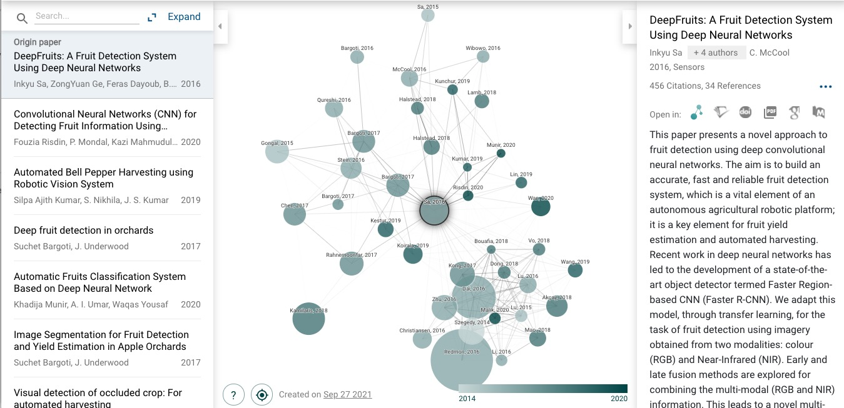
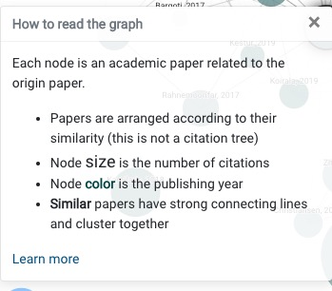
Connected Papers

Slide 44

Scholarcy
Creates a summary flashcard and extracts tables and figures Good for note-taking while doing literature sources

Slide 45


Scite_

Slide 46
Citation Managers
Common citation managers include: Zotero, Mendeley, Endnote, Refworks How do I decide what citation manager to use? Ask around your lab or advising group Reference a comparison guide like this one by the UVA library (which links to a couple more!) Attend a training on citation managers by the UVA library Talk with one of our consultants (Brooke – Zotero!)

Slide 47
Thank you again for coming - Any questions?

