Slide 1
Revising Your Own Writing
This work is CC-BY and use must include full citation & DOI. Individual images, examples, and materials from other sources are not CC-BY. The blue dinosaur icon is a GWL icon and not CC-BY.
Natalie Thompson
Consultant, Graduate Writing Lab
School of Engineering & Applied Science, University of Virginia
gradwritinglab@virginia.edu | bit.ly/SEASGWL
Notes:
Contains images that require alt text, including text-based screenshots.
None of the images, screenshots, or examples may be extracted for other use. CC-BY license does not apply to these components individually.
The dinosaur image is a GWL icon.

Slide 2
Overview: Self-Editing and Revision
Principles and mindset for revising
Feedback from others: overview
Global vs. local concerns
Revising your own writing
Tips and tricks for getting started
Strategies for revising organization and structure
Figures and tables
Editing and proofreading strategies
Corpus tools
Developing your system

Slide 3
Principles and Mindset

Slide 4
What is Revision?
One essential part of any writing process
Often not formally taught, or even modeled
Substantive revision is often confused with editing or proofreading
“Re-vision”: (re-envisioning your piece of writing, not just editing pieces of a static text)

Slide 5
Revision Mindset
Separate writing and revising
Break revision into steps
Do what you can, when you can
Toolbox: feedback, revision, editing, and proofreading
Every good writer goes through many drafts (even if we don’t see them do it)

Slide 6


  Write first, revise later!
CAUTION
CAUTION
CAUTION
CAUTION
CAUTION
CAUTION
CAUTION
CAUTION
CAUTION
Micro Biz Mag: www.microbizmag.co.uk/burnout-statistics-uk/
It’s hard to write when you feel like you have to edit your writing at the same time.
  Don’t let yourself get caught up in creating perfection when you’re trying to JUST WRITE!
Get all your ideas out, in whatever way you can, and then come back later (after a coffee break!) to work on organizing and refining them.
Notes:
Everything we’ll discuss here IS MOSTLY FOR THE REVISION PART OF THE WRITING PROCESS
Image: A photograph depicting occupational burnout. Photo was created by Micro Biz Mag for use in a post on the topic of burnout and is now under Creative Commons Licensing with a request that any usage is attributed with a link to the source at: www.microbizmag.co.uk/burnout-statistics-uk/

Slide 7

Writing vs. Revising
Mentally, and even literally, try to separate your “writing” self from your “revising” self
Find the power of a “shitty first draft”! Train yourself: create habits and rituals
Motivation tips & tricks help with revising too
Lamott, Anne. Bird by bird: Some instructions on writing and life. Anchor, 1995.
Notes:
Try tangible differences to help create routine
Be intentional about whether your goal is to get words on a page or work through what you have
Image: someone at a desk with a “writing hat” vs. someone on a couch with an “editing hat”

Slide 8
Example: Pre-game Rituals
Twyla Tharpe, The Creative Habit
“I begin each day of my life with a ritual; I wake up at 5:30 A.M., put on my workout clothes, my leg warmers, my sweatshirts, and my hat. I walk outside my Manhattan home, hail a taxi, and tell the driver to take me to the Pumping Iron gym at 91st street and First Avenue, where I workout for two hours. The ritual is not the stretching and weight training I put my body through each morning at the gym; the ritual is the cab. The moment I tell the driver where to go I have completed the ritual.
It’s a simple act, but doing it the same way each morning habitualizes it — makes it repeatable, easy to do. It reduces the chance that I would skip it or do it differently. It is one more item in my arsenal of routines, and one less thing to think about.”
More on rituals and motivation: https://jamesclear.com/motivation
Notes:
Possibly even more difficult if you work from home, if you have to do EVERYTHING in the same place. But could you sit on the other side of your desk? Revise at a different time of day? Revise after your GWL 1-on-1 zoom appointment, during which you re-set your mindset?
OR, something like a pre-game song: differentiate writing from revising
Tharp, T., & Reiter, M. (2003). The Creative Habit: Learn It and Use It for Life : A Practical Guide. New York: Simon & Schuster.

Slide 9
Your Writing Rituals
What rituals have you developed around writing?
What’s the difference between your helpful rituals and unhelpful habits?
Type your answers in the chat—or feel free to unmute yourself and chime in!

Slide 10
Self Editing is HARD
Expect to cycle through many (6+) drafts. It’s a process!
Break it down into steps:
  prioritize global concerns before small local problems
  Decide on the focus/goals for each round of revision
  Take time between steps!
Self-editing is important—but we always need feedback from others as well!

Slide 11
Stage of Work
Ideas Outline Rough draft Revised draft Just about to submit
 | Organization
 | What to include
 |  | Level of detail
 |  |  | Clarity
 |  |  | Conciseness or Cutting for word count
 |  |  | Flow
 |  |  |  |  | Language use & vocabulary
 |  |  |  |  | Grammatical concerns
 |  |  |  |  |  | Last looks Editing/proofing (hire an editor) | Last looks Editing/proofing (hire an editor)
Feedback
Notes:
animations

Slide 12
Feedback
Experiences

Slide 13
Big Principles for Feedback
Ask for the kind (and volume) of feedback you need
Communicate how you’ll use the feedback
Decide when to employ feedback from others (faculty, peers)

Slide 14
Your Experiences: Feedback from Others
What kinds of feedback have you received on your writing?
What was helpful and what wasn’t?
Who can you go to for different concerns, types of feedback, or for different rounds of edits?
Type your answers in the chat—or feel free to unmute yourself and chime in!

Slide 15
Types of Feedback
Expert-based
  How does the piece of writing fit in with current literature in the field?
  Are there important pieces/references missing?
  Is the analysis correct?
Criterion-based/evaluative
  What is the quality of the content?
  How well is the writing organized; how clear is the language?
Reader-based
  What is happening to you, moment by moment, as you’re reading?
Patricia Goodson, Becoming an Academic Writer (2017) (see pp. 90-91) and Peter Elbow, Writing With Power (1998)

Slide 16
Your Experiences: Types of Feedback
What level of revision do people usually address when they give you feedback?
  Proofreading or editing concerns?
  Substantive revision suggestions?
What types of feedback do you usually get?
Are you used to providing substantive or reader-based feedback on your own writing?
You can ask for the type of feedback you need—which might differ at different points in your writing process
Type your answers in the chat—or feel free to unmute yourself and chime in!
Notes:
Say aloud:
A lot of academics might only have experience providing evaluative feedback!
You can learn the skill of giving reader-based feedback. Learning how to give helpful feedback to others and adapt your feedback to what they ask for will improve the feedback you give yourself. Giving someone the level and kind of feedback they need at a certain point in their writing process is a SKILL.

Slide 17
Global and Local Concerns

Slide 18
Global Concerns
Content
  Are the important things here? Are there irrelevant things that you should cut? Do you need to expand or condense?
Organization and structure
  Does this part make sense here? Should you rearrange? Is each section doing what it should do? Is some content in the wrong section?
Paragraph or section level
  Is each paragraph just one main idea? Are transitions effective? Are topic sentences clear and helpful?
Tackle these first

Slide 19
Local Concerns
Structure within paragraphs
Appropriate level of detail
Sentence-level clarity
Grammar and vocabulary:
  Sentence structure and clarity
  Active/passive voice, consistent tense
  Articles, prepositions
Formatting, citations
Proofreading
Tackle these later

Slide 20
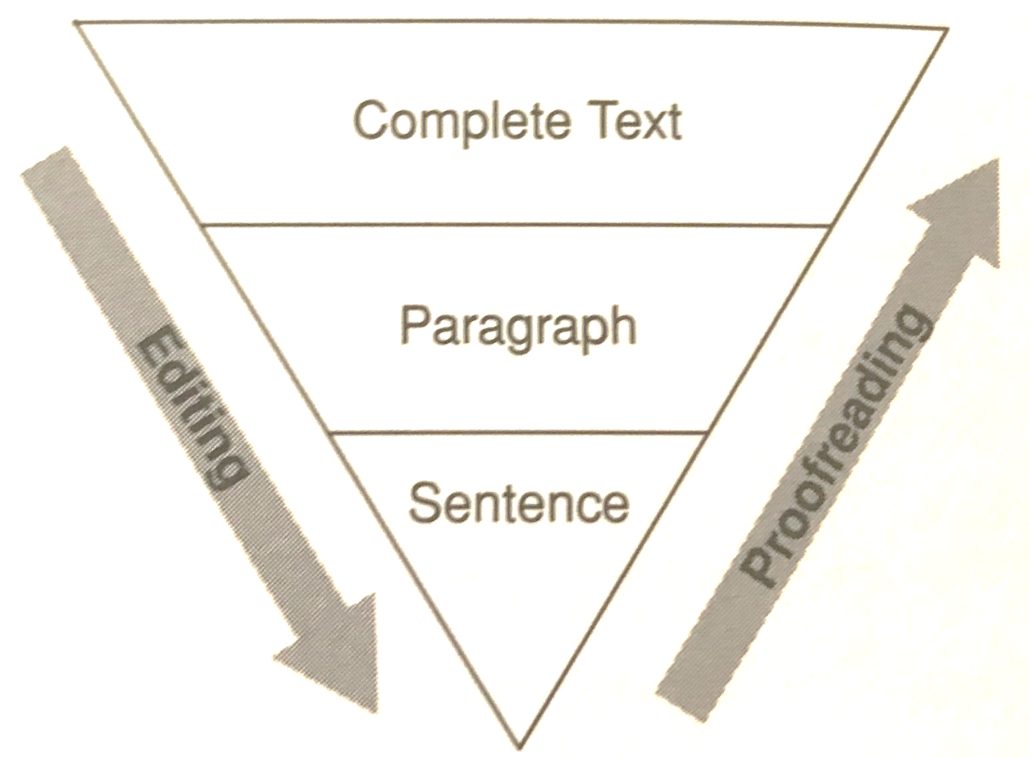
Revising
vs. Editing
vs. Proofreading
From Patricia Goodson, Becoming an Academic Writer, p. 108

Slide 21
Sample Workflow
From “Revising and Reviewing a Manuscript” in Scientific Writing and Communication by Angelika Hofmann, p. 359.
FIRST REVISION:
Check the first draft for content and content location.
Check logical organization of sections and subsections.
Revise for style only after you are satisfied with the content and organization.
Condense where possible.
Proofread your manuscript.
SUBSEQUENT REVISIONS:
Let some time elapse between revisions. Count on ≥ 6 drafts.
Recheck the first draft for content, logical organization, and style, and revise if needed.
Give complete copies of revised manuscript to your coauthors.
Show your manuscript also to a colleague in a related field and a friend in a different discipline.
Ask for comments and constructive criticism in writing.
Be prepared to accept the criticism.
Check for grammatical and other errors before finalizing your manuscript.
REVIEWING A MANUSCRIPT:
When reviewing someone else’s manuscript, be as specific as possible and point out both strengths and weaknesses.
Always treat the author with respect.

Slide 22
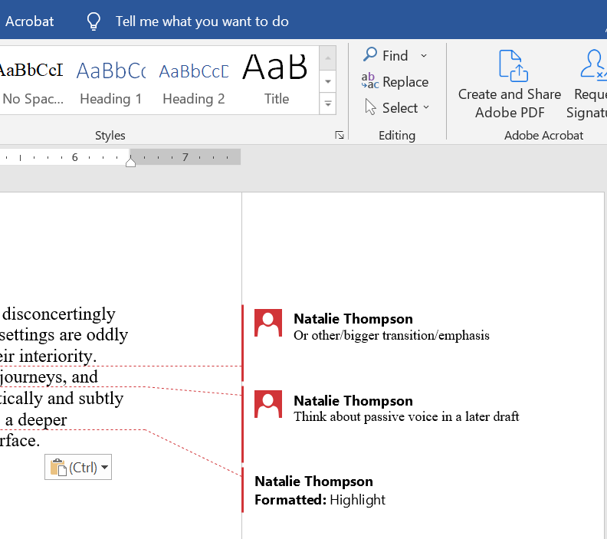
Prioritize your revision and editing tasks
Note things to do later

Slide 23
Revision

Slide 24
Awareness and Self-Editing
It’s hard to edit what you can’t recognize as a problem
Identify your own level of comfort/knowledge with various aspects of the writing process
Try to read your own work with fresh eyes (we have tips!)
There might be some aspects of your writing that you can and should self-edit—and some aspects where you need someone else to help identify problems you can’t see.
You can get better at self-editing!

Slide 25
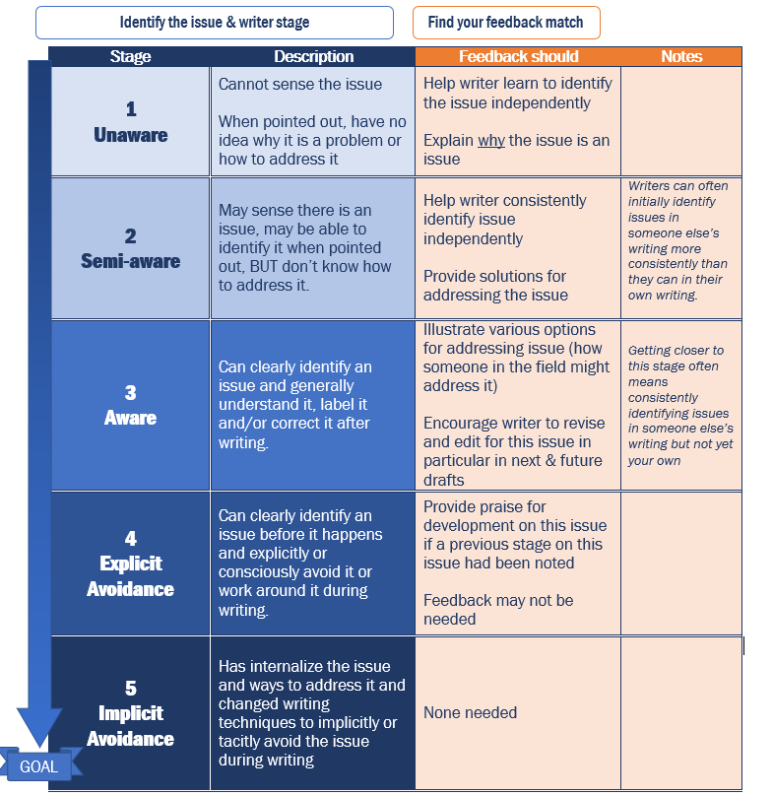
Levels of Awareness
Identify your level of awareness for different types of issues (organization and structure, content placement, sentence clarity, grammar, etc.
Work on noticing that aspect of your writing and others’ writing
Learn rules and tips about that aspect of writing
Begin correcting problems
Eventually, correct and avoid these issues on your own
Adapted from Campbell & Kennell (Nov. 2018) Working with Graduate Student Writers Faculty Guide, Purdue Writing Lab-p. 20-21. by Kelly J Cunningham Feb. 2019 for the Graduate Writing Lab, School of Engineering & Applied Science, University of Virginia, https://libraopen.lib.virginia.edu/public_view/h128nd97r
GOAL
Notes:
DOI for feedback optimization chart: https://libraopen.lib.virginia.edu/public_view/h128nd97r

Slide 26
Tips: Estranging Yourself from Your Writing
Take time between drafts
Literally, put yourself in a different place
Make a list: who is your audience? What are they like? What do they know?
Think about your reader
    Bored? Irritated? Reading 10 articles like yours as quickly as possible?
Ask yourself questions as you read through a draft (What have I learned here? What do I still need to know?)

Slide 27
Getting Started

Slide 28
Read it Out Loud
For both global and local concerns
Helps distance you from your writing and see it in a fresh way
You’ll hear leaps in logic and structure as well as small grammar and clarity problems
You’ll read ALL the words, instead of skipping over words when reading silently

Slide 29
Read it Out Loud
Ask your friend or peer to read aloud
Read your draft aloud to your friend
Come to the GWL and read aloud!
Have your computer read to you

Slide 30
Software for Reading Aloud
Accessibility options built in to many kinds of software
MS Office
Adobe acrobat
iOs
Google docs
Voice Dream: scan, read, and write

Slide 31
Revising for Organization and Structure

Slide 32
Reverse Outlining
After your first draft, look at each section and paragraph to see what the real structure/organization is
What does each paragraph say?
What does each paragraph do for your paper?
Working on organization

Slide 33
Reverse Outlining Procedures
Texas A&M's University Writing Center on Reverse Outlines:
short video
Reverse Outlining (aka “Paragraph re-planning”): article guide to reverse outlining

Slide 34
Cut it Up
Physically cut up your paper by concept or paragraph
Rearrange in different ways
May also write on back of each what they piece is about
Could also do in Scrivener or other app
Working on organization

Slide 35
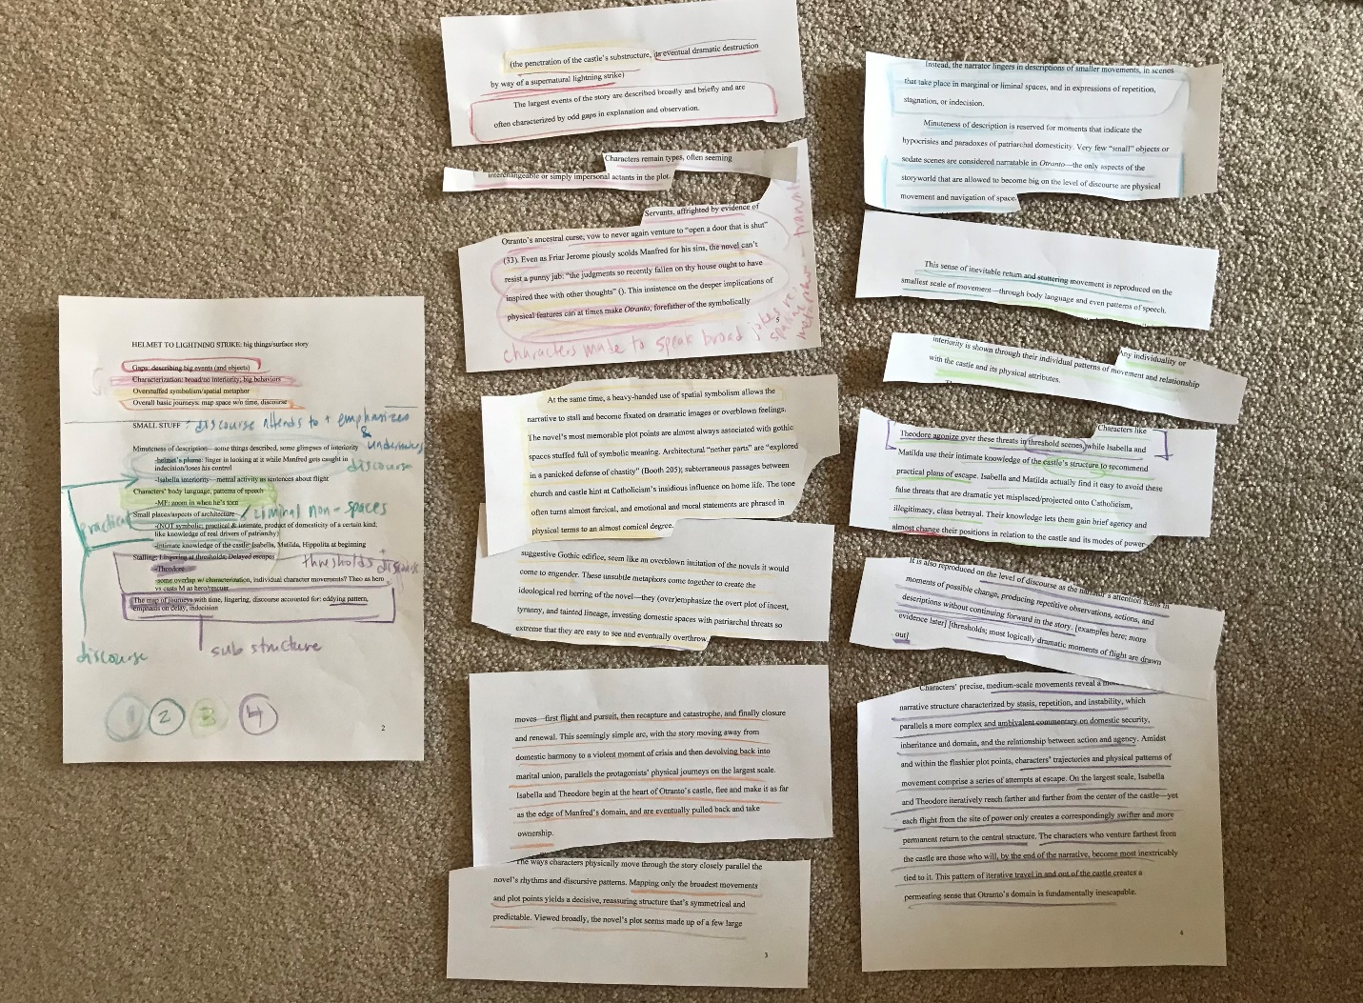
Notes:
Image: a piece of writing cut up and color coded

Slide 36
Content by Section
Intro: clear gap/problem/research question (RQ)/purpose? Should you delete your first sentence?
Methods: clearly aligned to purpose/RQ? Enough info for reproducibility if expected?
Results: what happened? With details and well organized
Discussion: why might that have happened?
Conclusion: answers to RQs, back to big picture, implications, significance, future work
The research article structure gives us some guidelines

Slide 37
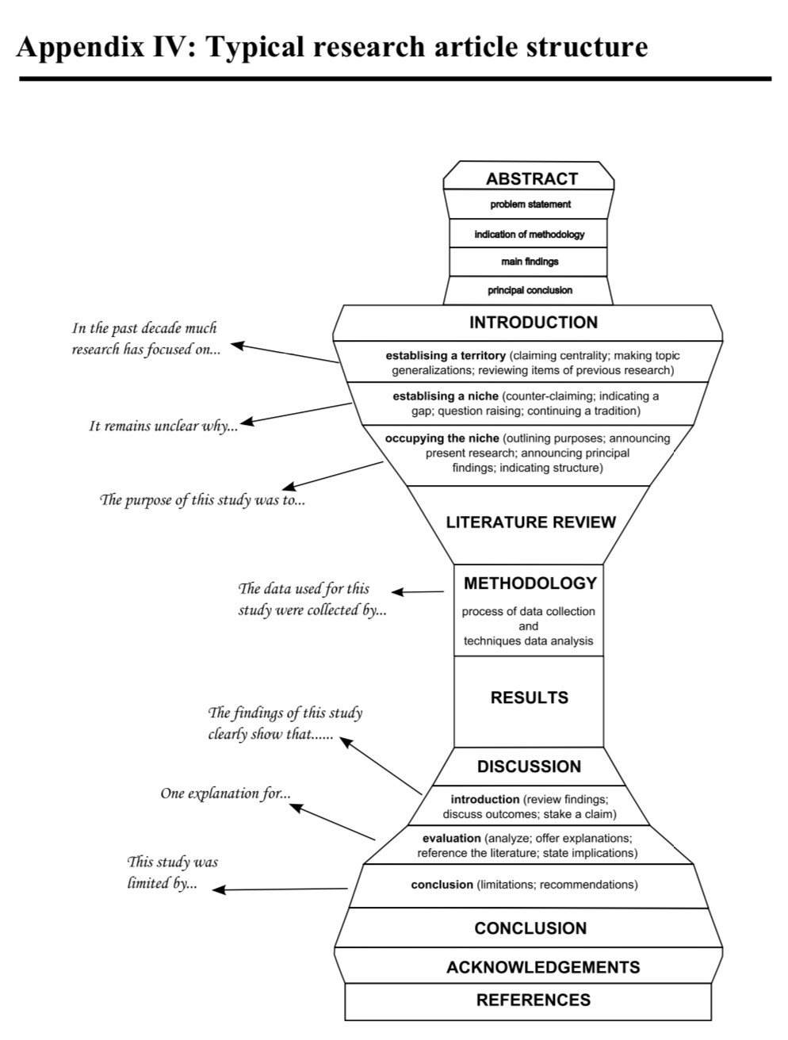
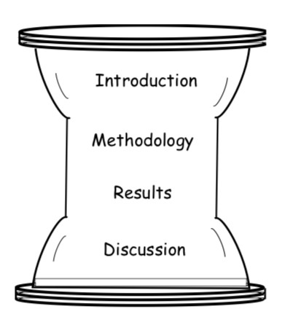
Content and Structure
Images from Writing Research Articles for Publication, AIT: http://languages.ait.ac.th/wp-content/uploads/sites/18/2018/08/Writing-Research-Articles-for-Publication1.pdf
Notes:
Images: the general funnel structure of a research article (hourglass shape) and a more detailed version
Hourglass structure images:
Burrows, T. (2011). Writing research articles for publication. Unpublished manuscript, the Asian Institute of Technology Language Center, Khlong Luang, Thailand. languages.ait.ac.th/wp-content/uploads/sites/18/2018/08/Writing-Research-Articles-for-Publication1.pdf

Slide 38
Intro & Conclusion Matching
Does the intro still match what the paper does?
Does the conclusion bring back in the issues from the intro & the RQs?
Look at them side by side
Read the intro then the conclusion—does it work?
Do you have a complete story?

Slide 39
Figures and Tables

Slide 40
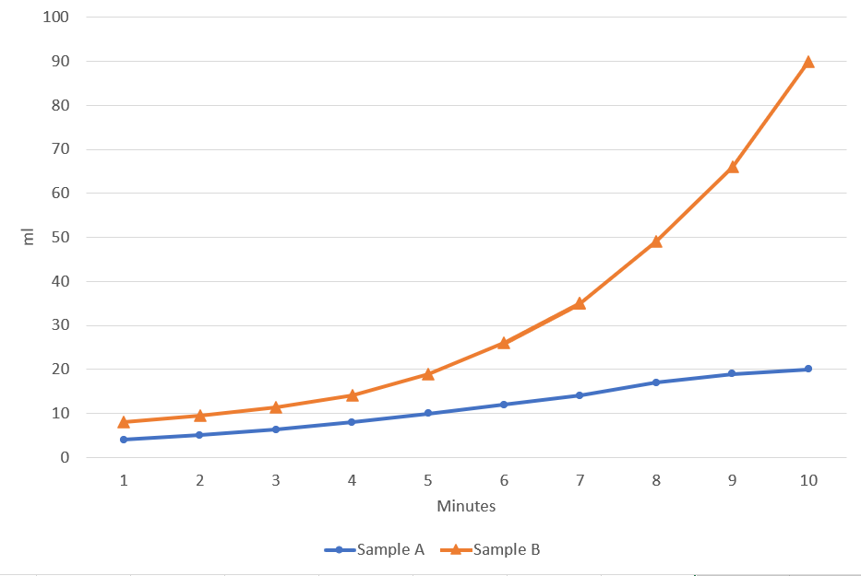
Figures
Figure can stand alone; is self-explanatory
Colors (or shapes) are meaningful, clearly labeled, and distinct from one another
Figure is referenced meaningfully in the body of the paper:
DISCUSSION
For RQ1, results are consistent with our hypothesis. As Figure 1 shows, verifiable observations…
UNITS ARE CLEAR
AXES ARE CLEARLY LABELED
Headings, labels, and key terms are consistent in the figure, caption, and text
CAPTION: Contains neither too little nor too much information/detail
Conveys a clear, concise, easy-to-see message for the reader
(NOT: “here’s what the graph looked like…”)
Notes:
Image: a line graph using distinct colors and shapes

Slide 41
Tables
 | COLUMN | ORDER | IS | INTENTIONAL
 |  |  |  | (not random)
 |  | 3.14
organizational choices
and choice of values
tell a clear, concise story
Notes:
All the same rules as for figures (stand alone, self-explanatory, units and labels clear, key terms and headings consistent with text, caption is concise and conveys MESSAGE, not description of values)

Slide 42
Editing and Proofreading

Slide 43
Local Concerns: Editing
Transitions
Organization and clarity within paragraphs (come to our “Perfecting Paragraphs” workshop)
Sentence level clarity (come to The Clarity Workshop and Sentences/Punctuation Refresher)
Final proofreading for errors and typos
Last thing: style sheet and formatting specific to your publication

Slide 44
Example Editing Checklist: Articles
From The University of Guelph Writing Center

Slide 45
Article Decision Tree
Is the noun…
General or Specific?
-First mention, unknown to audience: I used a beaker
-Generalizations: mice are common lab subjects
-Unique/only 1 exists: the sun, the beginning, The UN
-Specified: the ones on top, the beaker I got for my birthday
-Previously mentioned: the beaker was then…
-Shared knowledge (you & audience): it’s in the cabinet
Countable or Noncountable?
Experiments
Studies
Authors
Cookies
Research
Homework
Rice
Singular or Plural ?
Singular or Plural ?
Experiment
Study
Author
Cookie
Experiments
Studies
Authors
Cookies
Research
Homework
Rice
Researches
Homeworks
Rices
Noncount = no plural forms
A/AN
<NO ARTICLE>
THE
Simplified Article Decision Tree with notes | UVA Engineering Graduate Writing Lab 2019 bit.ly/SEASGWL | https://libraopen.lib.virginia.edu/public_view/cr56n116m
Notes:
Simplified Article Decision Tree with notes, UVA Engineering Graduate Writing Lab 2019, bit.ly/SEASGWL
Permanent doi: https://libraopen.lib.virginia.edu/public_view/cr56n116m

Slide 46
Backwards Re-Read
Read each sentence of your paper, starting at the last sentence and working backwards
Helps you get distance from your writing and notice issues
Great for proofreading
Working on local issues
with new perspective

Slide 47
Backwards Re-Read: Try it!
Volatile organic compounds (VOCs) released from many manmade and natural sources Manmade sources ranged from cars and industrial sources to construction materials, heaters, and other consumer products. Nautral sources responsible for biogenic VOC emissions include mainly trees fungi and microorganisms. Exact distribution of manmade natural sources of VOCs has not been determined, but clearly depends at local and environment.
Adapted from Example 6-1 in Hofmann, p. 96
Notes:
Example adapted from “Chapter 6: From Sentences to Paragraphs” in Scientific Writing and Communication by Angelika Hofmann (2017)

Slide 48
Backwards Re-Read: Try it!
Volatile organic compounds (VOCs) are released from many manmade and natural sources. Manmade sources range from cars and industrial sources to construction materials, heaters, and other consumer products. Natural sources responsible for biogenic VOC emissions include mainly trees as well as fungi and microorganisms. The exact distribution of manmade versus natural sources of VOCs has not been determined, but clearly depends on locale and environment.
Hofmann p. 96
Notes:
Example adapted from “Chapter 6: From Sentences to Paragraphs” in Scientific Writing and Communication by Angelika Hofmann (2017)

Slide 49
Tools for Disciplinary Norms and Conventions

Slide 50
Corpus Software
Build your own corpus (group) of pieces of writing to search within
  Use free software like AntConc
Search your own writing for articles, key terms, etc.
Search journal articles in your field for common phrases, check for spellings, determine usage
Use a pre-built corpus like Corpus of Contemporary American English (COCA) to check term usage, frequency, context
Check your writing and check a corpus of writing in your discipline

Slide 51
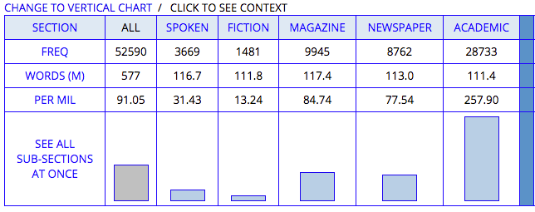
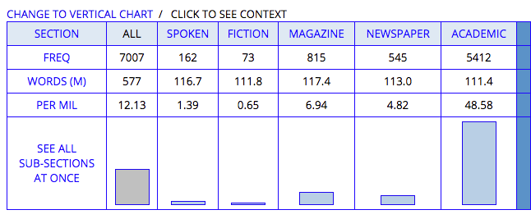
Example: search in COCA Corpus
“In addition”
“Additionally”

Slide 52
“In addition” was used more than “Additionally”
“In addition”
“Additionally”

Slide 53
Create Your System

Slide 54
Make Your Own Checklist
Early revisions: stick with global issues; ignore sentence-level or local problems
Mid-process peer editing: give your buddy a list of your concerns
Use each journal’s guidelines as a checklist—see their guidelines early and create a style sheet for your own quick reference
Final check: look for typos and formatting issues
What should I look for at each stage of revision?

Slide 55
Example Checklist
From “Revising and Reviewing a Manuscript” in Scientific Writing and Communication by Angelika Hofmann. p. 357-9.
CONTENT
Purpose and Interpretation
Is the overall purpose of the paper and/or central question clear?
Does the interpretation of the findings answer the overall question of the paper?
Support
Is there sufficient evidence to support the answer?
Is every paragraph and sentence in the paper relevant to the overall question?
Are there portions of the text that could be omitted? _____________________
Overall
Does the paper advance the field?
Does it provide interesting and important insights into the topic of interest?
Have power positions been considered (especially in the Introduction, Results, and Discussion)?
Individual Sections
Title:
Is the title strong?
Abstract:
Does the abstract adequately summarize the paper?
Have all necessary elements been included (Question, Experimental approach, Results, Conclusion)?
Is the abstract concise?
Introduction:
Does the introduction clearly state the overall question of the paper?
Does the question follow the unknown?
Are all elements (known, unknown, question, experimental approach) clearly signaled?
Has the topic been reviewed? _________________________________
Materials and Methods:
Have all experiments been described adequately?
Results:
Is the main finding presented?
Are there errors in factual information, logic, analysis, statistics, or mathematics?
Are all figures and tables explained sufficiently?
Discussion:
Is the overall interpretation of the results clearly stated?
Did the writer adequately summarize and discuss the topic?
Has a clear conclusion been provided?
References
Have references been cited where needed?
Are sources cited adequately and appropriately?
Are all the citations in the text listed in the References section?
FORMAT AND ORGANIZATION
Overall format and organization
Is the overall format and organization of the paper clear and effective?
Are there unclear portions? _______________________
Could the clarity be improved by changes in the order of the paper? _________________
Does the language seem appropriate for its intended audience?
Individual sections
Introduction:
Does the introduction follow a funnel structure?
Materials and Methods:
Are experiments organized logically?
Results:
Is the main finding presented in the first paragraph?
Are all figures and tables labeled properly?
Discussion:
Is the overall interpretation of the results clearly stated in the first paragraph?
Is the significance clearly stated in the last/concluding paragraph?
Is the discussion ordered in a way that is logical, clear, and easy to follow?
STYLE AND COMPOSITION
Are the transitions between sections and paragraphs logical?
Are key words repeated exactly?
Are the paragraphs and sentences cohesive?
Has word location been considered?
Are there any grammar, punctuation, or spelling problems? ________________________
Is the style concise?
Are there any wordy passages? __________________________
What other problems exist? __________________________
OVERALL QUALITY
What are the paper’s main strengths? _________________
What are the paper’s main weaknesses? ___________________
What specific recommendations can you make concerning the revision of this paper? _____________________________________

Slide 56
Sources of Feedback (Supplement Your Self-Editing)
Your peers, in your field/sub-field or outside of it (set up a buddy system)
  Exchange papers
  Exchange other services
Paid editors and copyeditors
Your advisor/PI
Sometimes, a writing buddy who agrees NOT to give you any feedback at all can be the most valuable (ask for what you need)

Slide 57
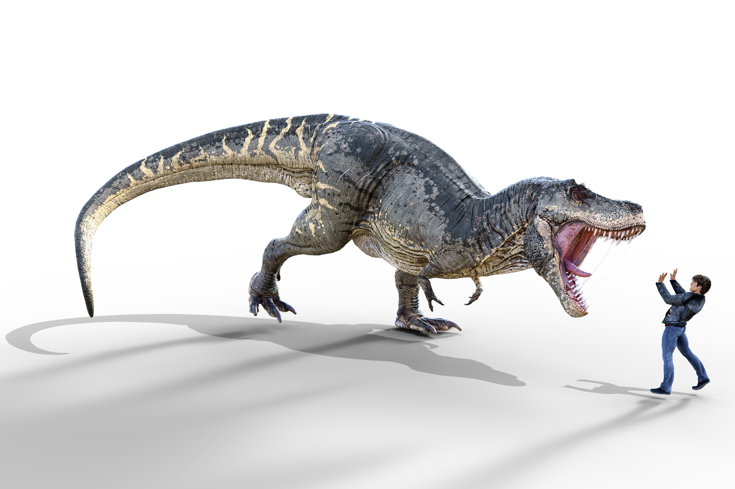
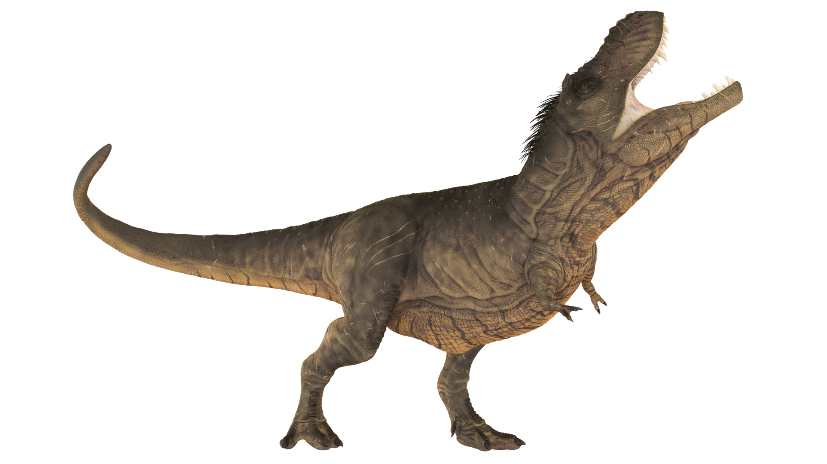
Writing Can be Scary
& lonely
Notes:
Image: scary dinosaur and intimidated writer

Slide 58
But it doesn’t have to be
Notes:
Image: friendly GWL logo dinosaur with pencil in hand

Slide 59
References
Elbow, P. (1998). Writing With Power: Techniques for Mastering the Writing Process (2nd ed.). New York: Oxford University Press.
Goodson, P. (2017). Becoming an Academic Writer: 50 Exercises for Paced, Productive, and Powerful Writing (Second ed.). Thousand Oaks, California: SAGE Publications, Inc.
Hofmann, A. H. (2017). Scientific Writing and Communication: Papers, Proposals, and Presentations (Third ed.). New York: Oxford University Press.
Irish, R. (2015). Writing in Engineering: A Brief Guide. New York: Oxford University Press.
Tharp, T., & Reiter, M. (2003). The Creative Habit: Learn It and Use It for Life : A Practical Guide. New York: Simon & Schuster.

Slide 60
Top Suggestions for Further Reading
Robert Irish, Writing in Engineering: A Brief Guide
Concise and readable guide; includes examples from industry writing.
Angelika Hofmann, Scientific Writing and Communication: Papers, Proposals, and Presentations
Includes principles, advice down to the sentence and word level, tips for English Language Learners, lots of examples, and practice problems. Sections on grant proposals and job application writing in addition to scientific manuscripts. Examples are often biology-oriented but lessons are applicable to any scientific writing.
Patricia Goodson, Becoming an Academic Writer: 50 Exercises for Paced, Productive, and Powerful Writing

Slide 61
Graduate Writing Lab
School of Engineering & Applied Science, University of Virginia
bit.ly/SEASGWL
gradwritinglab@virginia.edu

