Slide 1

Privacy and Surveillance in Digital Courseware
Open Education Conference 2020
Judith Thomas
Notes:
Shout out to SPARC, in particular the open education leadership program, Tanya Spilovy and Nicole Allen, and my mentor Steven Bell.

Slide 2
“The Internet is a surveillance state. Whether we admit it to ourselves or not, and whether we like it or not, we are being tracked all the time.”
Bruce Schneier, CNN, 3/16/2013
Notes:
Welcome to the surveillance state.
Surveillance state: this is not news to us any more.
Surveillance is now the dominant business model of the internet
Our online interactions are tracked, using what Shoshana Zuboff calls our behavioral surplus. This data is then analyzed and used for various purposes largely outside of our control.

Slide 3
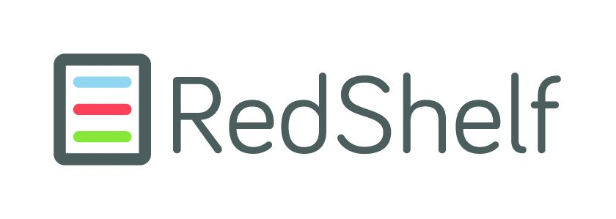

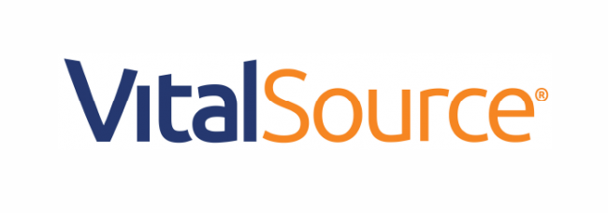
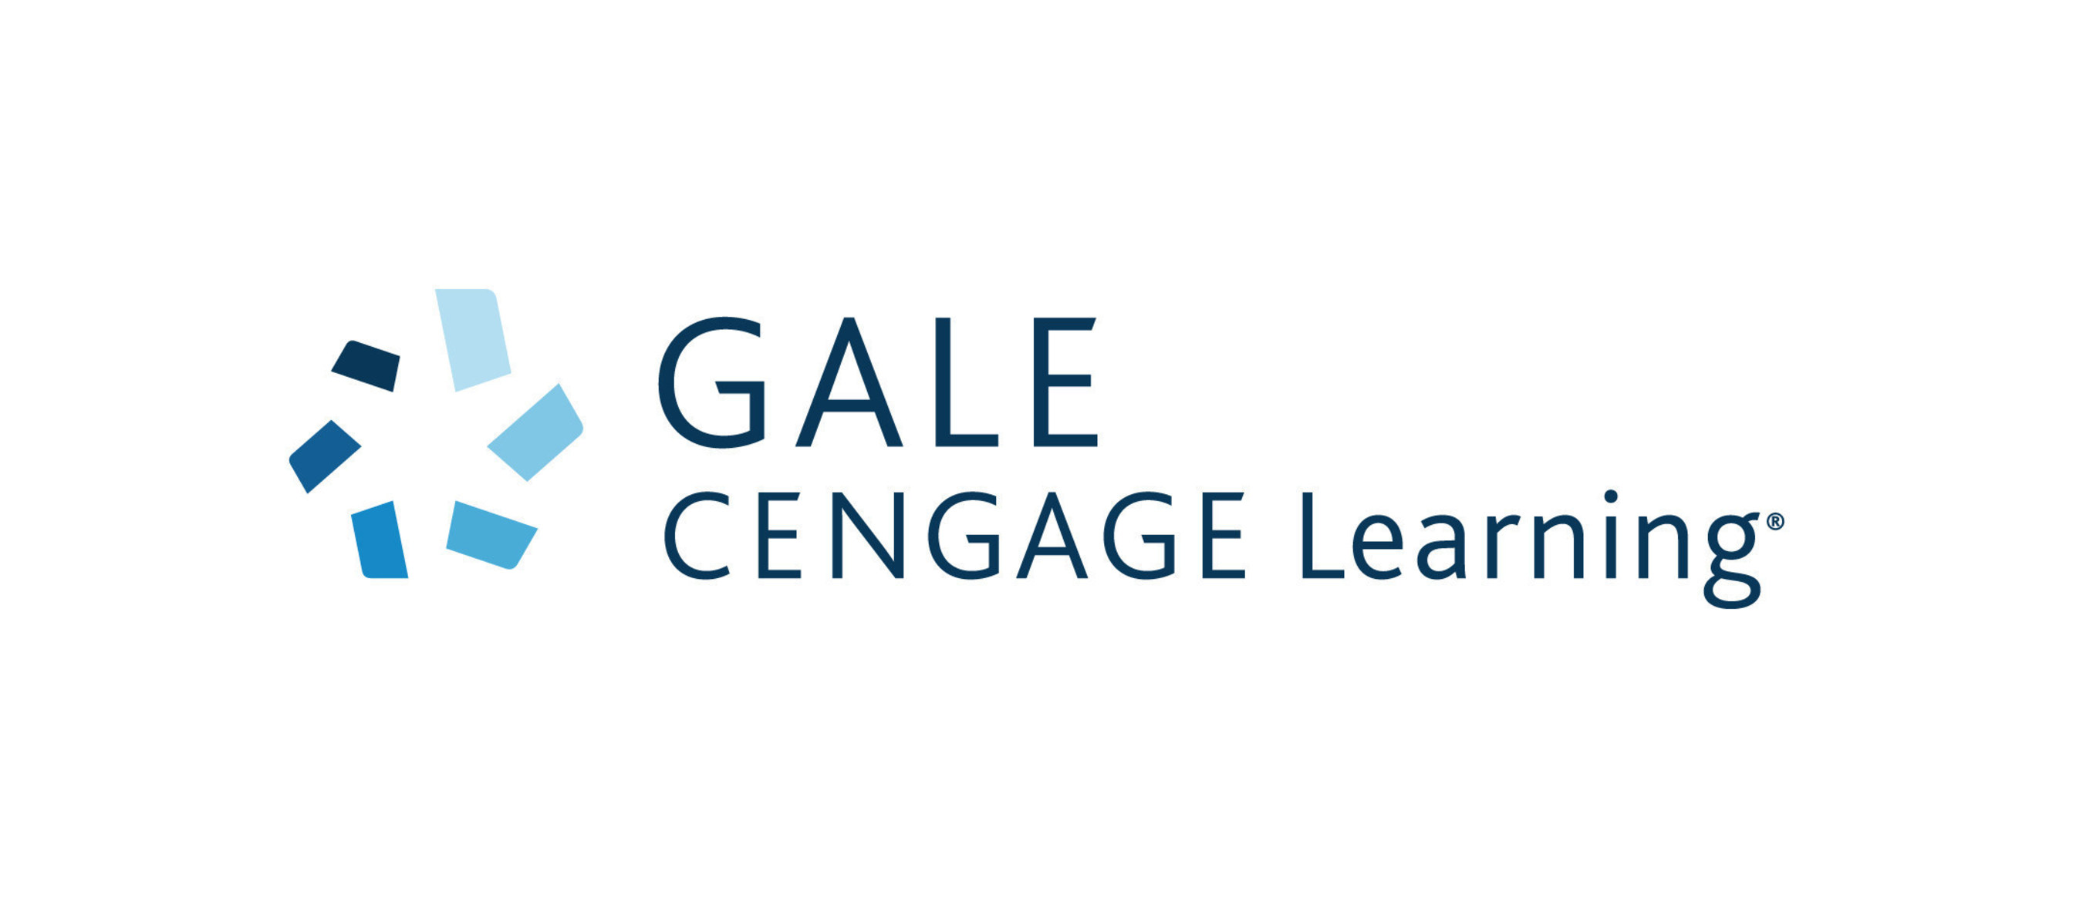

Academic publishers are “transforming themselves into data analytics companies built atop their content, effectively adding ways to monetize it.”
Claudio Aspesi & SPARC “The Academic Publishing Industry In 2018.”
Notes:
In this context, we’ll look at digital course materials offered by the major courseware publishers, licensed either directly by the student or by the institution,.

Slide 4
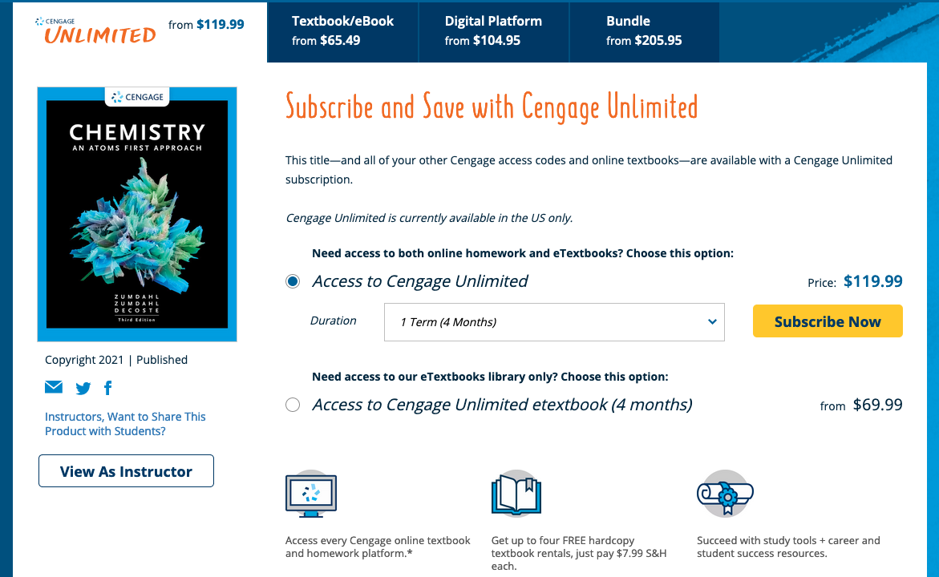
WHEN?
Students can separately license electronic resources
Notes:
The exact mechanism and the details of the student experience vary from vendor to vendor, and from institution to institution, but this is generally how it works:
Students can access content on an individual basis, either directly through the publisher portal or from an agent like the bookstore.

Slide 5
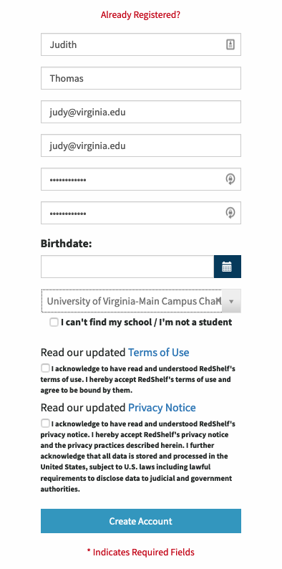

“Variously known as inclusive access, innovative pricing, or other names specific to the publisher, [these are] contracts between publishers and institutions that set in place the conditions and discounts under which students are automatically charged on their tuition … for each assigned course material.”
Kaitlyn ViteZ. “Automatic Textbook Billing. An Offer Students Can’t Refuse?” U.S. PIRG Education Fund, Feb. 2020
Students can gain access via an institutional license
Notes:
Students can also gain access through an institutional license, often an "automatic billing” license, frequently made available through the learning management system.
Whether they have separately licensed or are going through inst. portal, they click through a privacy statement.
Important to note that access to this kind of courseware bypasses the library. Publishers do not offer licenses to libraries for these kinds of digital course materials.

Slide 6

Photo by Jason Dent on Unsplash
Notes:
We will talk about the privacy statements that students have to agree to. The ones I looked at are similar and cover much the same ground

Slide 7
Personally identifiable information (PII) – contributed by user or collected from the institution
Technical information – usually through cookies
Transactional information – generated through use of the website and the product, can include notes, comments, highlights, study guides, etc.
Various kinds of info from the school; 3rd party providers; social media
What do they collect and analyze?
Notes:
You can see that with just these 4 bullet points, the amount of data collected on an individual student can be significant.

Slide 8
Account administration
Developing and customizing content and services
Promotion and advertising (in some cases, directed to students)
Depending on the institution and license, learning analytics
Fraud prevention
“As otherwise reasonable and appropriate to the legitimate business needs of [the company] related to the Products."
For what purposes?
Notes:
All of the privacy notices include variations of and lots of details about stated purposes.

Slide 9
The licensing institution (in the case of an institutional or IA license)
“Trusted parties or affiliates”
The government, in response to a court order
With various entities, to prevent fraud
With new owners/affiliates, in the event of a company sale
In some cases, with 3rd parties, for marketing
With whom do they share it
Notes:
The licensing institution (in the case of an institutional or IA license)
“Trusted parties or affiliates” within a network of service providers, usually they are ostensibly bound by the same privacy restrictions, particularly on PII.
The government, in response to a court order.
With various entities, To prevent fraud
With new owners, in the event of a company sale
In some cases, with 3rd parties, for marketing.
Here’s an example of a third party connection: Cengage offers connection with Facebook Connect. Then collects available data from FB and aggregates it.
All of the vendors say that they don’t sell the data.

Slide 10
From VitalSource:
“We may use third-party web analytics services (such as those of Google Analytics, New Relic, and Hotjar) on our Services to collect and analyze usage information through cookies and similar tools; engage in auditing, research, or reporting; assist with fraud prevention, and provide certain features to you. To prevent Google Analytics from using your information for analytics, you may install the Google Analytics Opt-out Browser Add-on”
ANALYTICS:
STUDENT DATA ON THE MOVE
Notes:
Note that 3-rd party analytics are used to process the information and that it is incumbent on the student to prevent Google Analytics from making further use of their data.
Educational data analytics – rich and growing bibliography
Within the data sciences, data ethics, learning analytics communities, there is growing concern that big data analysis has the potential to reinforce stereotypes, perpetuates social prejudices.
Student data is analyzed via algorithms over which they have no control, either within the black box of vendor analytics or within the learning management systems at their own institutions.
No student agency in the management of this aspect of their digital identities.

Slide 11
All the agreements contain ambiguous language that gives the publishers latitude in making decisions about the collected data.
“…we limit the use, collection, and disclosure of your PII to deliver the service or information requested by you or your institution”
“We use the information to “…maintain and improve the products”
We reserve ”the right to disclose non-identifiable information with third parties”
Notes:
How much latitude is there for the publishers in these privacy documents?. At first glance the wording seems fairly specific, but on closer scrutiny it’s clear that they all contain the kind of ambiguous language that gives the collector latitude in making decisions about student data. You are asked to trust the vendors judgment – their decisions about what’s necessary to perform the service and develop the product.

Slide 12
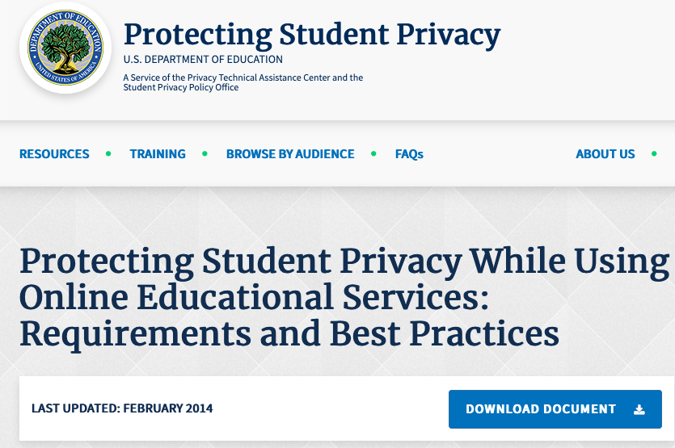
Notes:
Those targeting K12 have clearly given consideration to the best practices for protecting student privacy offered by the dept. of Ed. Another subject – insufficient though they may be.
My issue is actually less with the companies per se than with context for this kind behavior – legislative, economic, cultural – and the attendant dangers, the inequities, lack of autonomy and choice – that lie below the surface of these practices.

Slide 13

Notes:
See Ceceilia’s Parks discussion of FERPA. Inadequate to the task.

Slide 14
So many times people, especially people that don't work with the data every day, think that data are objective, and they're not. They're a complete subjective reflection of our own reality, and our own reality has student success gaps with our minoritized students. And so, all of our predictive analytics are going to reflect that….” Loralyn Taylor, in “The Ethical Issues Around Learning Analytics,” Educause Exchange, 10/7/20 | “…analytics is good for understanding sort of the behavior of groups more than it's useful for understanding the behavior of an individual within a group. It's an inference about a population parameter, it's not an inference about a person. …And the reason I think that the models don't predict accurately, is they don't capture things like student effort, they don't capture a student's engagement…they don't capture students' grit and determination.” Robert Carpenter, in “The Ethical Issues Around Learning Analytics,” Educause Exchange, 10/7/20

Slide 15

DE-IDENTIFICATION / ANONYMIZATION:
Removing or masking data that can be linked to an individual
Notes:
De-identification of personal data PII is the top privacy strategy. All of the vendors say that they anonymize personal information.
Note: there is no federal regulation of anonymized data, because it supposedly cannot be used to ID an individual. Growing evidence that some anonymized data can be traced back under certain circumstances to the individual to from whom it was gleaned.
Much attention now in legal and technology sectors on issues relating to re-identification of de-identified data.

Slide 16

Photo by Jason Tuinstra on Unsplash
Notes:
Take claims of de-identification with a grain of salt

Slide 17


DATA SECURITY:
There are no guarantees

Slide 18
RedShelf | VitalSource | Cengage | McGraw-Hill
RedShelf cannot, however, ensure or warrant the security of any information End User transmits to RedShelf, and End User does so at his/her own risk. …RedShelf makes commercially reasonable efforts to ensure the security of our systems. However, please note that RedShelf does not guarantee that such information will not be accessed, disclosed, altered, or destroyed by breach of any of our physical, technical, or managerial safeguards. | VitalSource has security measures in place to protect against loss, misuse, or alteration of your Information. Despite these efforts, VitalSource cannot guarantee that unauthorized access or disclosure of Information will never happen. If you have concerns, do not use the Products. | Cengage implements reasonable technical, physical and administrative safeguards designed to protect your Personal Information from unauthorized access, use, or disclosure. We also contractually require that our suppliers protect such information from unauthorized access, use, and disclosure. The Internet, however, cannot be guaranteed to be 100% secure…we cannot ensure or warrant the security of any Personal Information you provide to us. | McGraw Hill takes reasonable precautions to protect your information. When you submit personal information via the website, your information is protected both online and off-line. McGraw Hill utilizes reasonable security measures to protect the security and confidentiality of your PII from unauthorized access and use.
Notes:
These excerpts from privacy notices say the same thing: they cannot guarantee the security of the data.
This is not a surprise: we hear every week about the unauthorized release of confidential data.
Pearson data breach went public in august 2019. Hundreds of thousands of student names, email addresses, dates of birth were hacked .

Slide 19
What about opting out?
Lose access to content
For IA licenses: cumbersome, difficult process
Photo by Joshua Ness on Unsplash
Notes:
Here is the ethical core of the matter: But what if students want to opt out? All of the vendors offer opt out options and provide instructions for how to opt out of direct marketing, to revoke consent for processing, to ask to be forgotten.
In all cases, opting out,means losing access to the content: if students want to access required materials, they must submit to data gathering.
Degree to which this affects institutional policies or decisions depends on whether you accept this situation as ethical, as justifiable.

Slide 20

Should students have to submit to data gathering in order to use their course materials?
Should institutions be outsourcing core elements of the academic infrastructure to corporate entities with minimal control over what data is collected and how it’s analyzed?
IT’S A MATTER OF ETHICS
Notes:
Think about the ALA Code of Ethics: The library profession has a long-standing ethic of facilitating, not monitoring, access to information. How do we achieve this: In part by not collecting it. Libraries have stood up to the threat to reader privacy from the Patriot Act Section 215. Library acquisitions staff - at least in my institution – scrutinize electroonic resource licenses carefully, do everything they can to minimize intrusion on privacy. However, the library is bypassed here. Who is looking at this picture when access to resources bypasses the library? Varies across institutions.
Do Students Care? Evidence exists that they do care. But even if they don’t; if they are all inured to the ubiquitous collection of their data, to the barrage of click-throughs, should that matter to the institution, considering the ethics involved?
Faculty are in a bind. Many are desperate for the textbooks and ancillaries provided through inclusive access which satisfy their primary need for content that is affordable and will ease their teaching burden. Barring a strong alternative, that is, course-appropriate OER and a range of ancillary products, they are likely to continue to regard commercial solutions as their best option.

Slide 21
Include mention of privacy and surveillance in your OER outreach
Talk to those on campus with responsibility for: textbook licensing; information security; learning analytics; FERPA compliance
Discuss it with your library’s electronic resources/collections experts
Mobilize students
What’s to be done?
Notes:
We’re used to talking affordability, pedagogy, especially through the lens of social justice. Come for the savings, stay for the pedagogy. It’s time to include mention the privacy issues, talk about corporate control of student data, no way for students to opt out of data gathering.
My opinion:
This is not going in the right direction: Students should be informed about their rights; should have the option to opt out of data collection, should be involved in decisions about learning analytics at their institutions, and the university with students should be making the call of how and whether student data is collected analyzed and used by outside entities. They should be investing in the creation and use of open educational resources.

Slide 22
“If the digital future is to be our home, then it is we who must make it so. We will need to know. We will need to decide. We will need to decide who decides. This is our fight for a human future.”
Shoshana Zuboff, The Age of Surveillance Capitalism

Slide 23
THANK YOU

Slide 24
CITED WORKS – Privacy and Surveillance, Judith Thomas
Aspesi, Claudio & SPARC. “The Academic Publishing Industry In 2018.” Landscape Analysis, 29 Mar. 2019.
Butterfield, Paul, and Cheryl Cuillier. “Inclusive Access Talking Points.” Open Textbook Network, https://docs.google.com/document/d/1XpZ-KhI3BvqenjR18sjDPCyD9Sf-IgBGGaCCb_WsoOc/edit?usp=embed_facebook.&usp=embed_facebook. Accessed 22 Oct. 2020.
Carpenter, Bob, et al. “The Ethical Issues Around Learning Analytics.” Educause Review, Oct. 2020, https://er.educause.edu/podcasts/educause-exchange/the-ethical-issues-around-learning-analytics
Parks, Cecelia. “Beyond Compliance: Students and FERPA in the Age of Big Data.” Journal of Intellectual Freedom & Privacy, vol. 2, no. 2, 2, Oct. 2017, pp. 23–33. journals.ala.org, doi:10.5860/jifp.v2i2.6253.
Schneier, Bruce. News: “Surveillance Is the Business Model of the Internet.” https://www.schneier.com/news/archives/2017/07/surveillance_is_the_.html. Accessed 16 Oct. 2020.
Vitez, Kaitlyn. Automatic Textbook Billing. An Offer Students Can’t Refuse? U.S. PIRG Education Fund, Feb. 2020, https://uspirg.org/feature/usp/automatic-textbook-billing.
Zuboff, Shoshana. The Age of Surveillance Capitalism: The Fight for a Human Future At the New Frontier of Power. PublicAffairs, 2019.
.

