Slide 1

GWL GRFP Prep Series
Planning and Drafting Your
NSF GRFP Application
This work is CC-BY and must include full citation & DOI. Individual images and examples & materials from other sources are not CC-BY. Blue dino is a GWL icon & not CC-BY.
Kelly J Cunningham, PhD
Director, Graduate Writing Lab
School of Engineering & Applied Science, University of Virginia
July 2022 version
gradwritinglab@virginia.edu | bit.ly/GWLGRFP
Notes:
Contains images that require alt text, including text based screenshots
None of the images, screenshots or examples may be extracted for other use. CC-BY license does not apply to these components individually
The dinosaur image is a GWL icon

Slide 2
NSF Graduate Research Fellowship Program (GRFP, NSF Fellowship)

Slide 3
READ THE PROGRAM SOLICITATION IN FULL
GRFP Program Solicitation
This is the call for proposals from the NSF. It has all of the details and tells you what they are looking for, eligibility, how to win, how applications are scored, key deadlines, etc.
Notes:
To find the current year program solicitation, look at the NSF program page, scroll down to program solicitation, and click on the numbered document. They typically release the new program solicitation towards the end of July each year but it can vary. Usually there are few changes, but sometimes there are surprises. So while reading the past year or two of solicitations can help in prepping your application, you must ALWAYS carefully read the new solicitation in full and highlight key points. They sometimes bury these in the details of paragraphs, so you really need to read the whole thing. They outline who is eligible, what to submit and how to win.
Examples of changes we have seen year to year
Formatting changes from 12 pt to 11 pt
Changes to eligibility criteria
The last minute addition of areas of interest-
Please note that even though the 2020 solicitation mentioned especially encouraging some areas like AI to apply, they still welcomed all usual applications. So if you see something like this, the general principal is highlight if your work fits it but don’t be discouraged if your work doesn’t. this is different from some other grant applications.

Slide 4
Keep your audience in mind!
In 5 mins,
you must convince
a tired reviewer
who is not an
expert in your field
to fund your proposal
Notes:
Reviewers have 15-25 applications

Slide 5
Application Components
Notes:
Pare down application components

Slide 6
A complete application will include:
Personal, Relevant Background, and Future Goals Statement (3 pages)
Graduate Research Statement (2 pages)
3 reference letters
Unofficial transcripts
Fastlane Application (Resume/CV content)
Always double check guidelines & components with the NSF program solicitation for your year

Slide 7
Use components strategically to convey a cohesive story All components should showcase -intellectual merit -broader impacts
Notes:
Intellectual. Merit & broader impacts are the 2 judging criteria
You have limited space so chose carefully what to include where to avoid wasting space
Make sure all the pieces go together to tell one clear focused story of who you are as a researcher/scientist/engineer
It is important that the pieces match but give a multifaceted view of you
You are more than any application could convey on its own, so you will have to choose what to share through these materials with the reviewers, keeping in mind that they can only judge based on what you give them.

Slide 8
Reference Letters
3 letters required
4/5 spots in ranking order, with the top 3 used
Use your advisor as a reference writer
Choose people that can speak to both your intellectual merit and your broader impact
If research is interdisciplinary, consider getting recommendations from various disciplines
See our Reference Letters Guide for more
Notes:
Choose references that speak to different parts of your application
Typically references are academics/professors
Maybe 1 from an outreach activity that features in your essays
Typically NOT industry

Slide 9
References- GRFP Mentors
Who did you ask?

Slide 10
Transcripts & other background info
Get your undergraduate transcript early in case there are issues accessing your old accounts
Summer classes & study abroad transcripts also needed
Upload early in case there are file size issues
Notes:
Move to end?

Slide 11
Personal & Research Statements

Slide 12


Your reviewers
Tired
Bored
Disengaged
Busy
Not in your specific field
Reading 20-30 applications
Notes:
See also reviewer panel

Slide 13
Your reviewer
Be clear & engaging
Use meaningful headings
Use white space
Include images
Revise for the reader
Make it easy to rate you well
Tired
Bored
Disengaged
Busy
Not in your specific field
Reading 20-30 applications
Notes:
See also reviewer panel

Slide 14
Consider including a figure to stand out
Give the reader a break
Memorable
Offer clarity
Examples:
Procedure diagram
Preliminary results data
Photo of something you built/developed

Slide 15
Example figures from a research statement

Slide 16
Make sure your app gets considered...
Follow the specific font, size, format, and margin requirements
Check the full program solicitation after the end of July for the current year guidelines
The requirements sometimes change from year to year
Ex. 2019 apps 12 pt font, 2020 11 pt font
Follow all guidelines exactly
Your application will be rejected for things like the wrong font size
Make sure your documents match
Do not rely on online templates
We have seen mismatched templates leading to application rejection
Compliance with these guidelines will be judged based on the document as it appears in the GRFP Application Module after it is uploaded. Applicants are strongly encouraged to proofread and upload their documents early to ensure compliance and avoid potential formatting issues caused by the PDF conversion process. Applications that are not compliant with these format requirements will be returned without review.
Notes:
See the solicitation for the complete and most up to date guidelines
They really will return your submission without review if you do not follow the guidelines
Be wary of online templates and always check and double check vs the solicitation guidelines
Also be sure to check your pdf after upload as this is the version they will be judging

Slide 17
Personal, Relevant Background, and Future Goals Statement (3 pages) Personal Statement

Slide 18
Personal Statement - 3 pages
Important questions to ask yourself before writing the statement (more on website):
What examples of leadership skills and unique characteristics do you bring to your chosen field?
What are all of your applicable experiences? What were the key questions, methodology, findings, and conclusions?
How did your activities address the Intellectual Merit and Broader Impacts criteria?
What is your bigger why for graduate school?

Slide 19
No Examples until You Draft *Do not read example personal statements until after drafting your own*
Notes:
There isn’t a standard way these are written and they should be unique to you

Slide 20
Personal Statement – preparing to write
List all relevant experience (bullets, word web, whiteboard)
On your own or with someone who knows you
Reflect on
Why you did each thing
What you got out of it
Why you are pursuing your graduate degree
What were key experiences that led to where you are today (researchwise) & where you are going?- circle these
How did your activities address the Intellectual Merit and Broader Impacts criteria?
Notes:
Having your master list of experiences can help you think about the different stories you could tell, experiences you could include
If you pivot later, you can use this list as a reference to find experiences that best fit the larger story you are telling.

Slide 21
Personal Statement – Connect the Dots
ID a few key experiences you can talk about in detail
Put these experience together into a cohesive story that shows
where you’ve been & who you are
how your grad degree is your logical next step to your future

Slide 22
Personal Statement- GRFP Mentors
How did you get started?

Slide 23
Personal Statement
The GRFP funds YOU
Tell a story and connect with research statement
Figure out what makes you unique
Focus on the why (less on the what)
Articulate the importance of each experience and how it contributes to your role in the scientific community
Explain the meaning of your experiences
Why should NSF fund you specifically?
Notes:
Professional mission statement exercise → develop clarity on why you’re here besides enjoyment. What’s your “why”?

Slide 24
Personal Statement
Show passion for science, research, engineering, your area
First person (I/my) is OK & expected
Tend to use somewhat ‘academic’ or formal written language
Use concrete example and explain
Notes:
Professional mission statement exercise → develop clarity on why you’re here besides enjoyment. What’s your “why”?

Slide 25
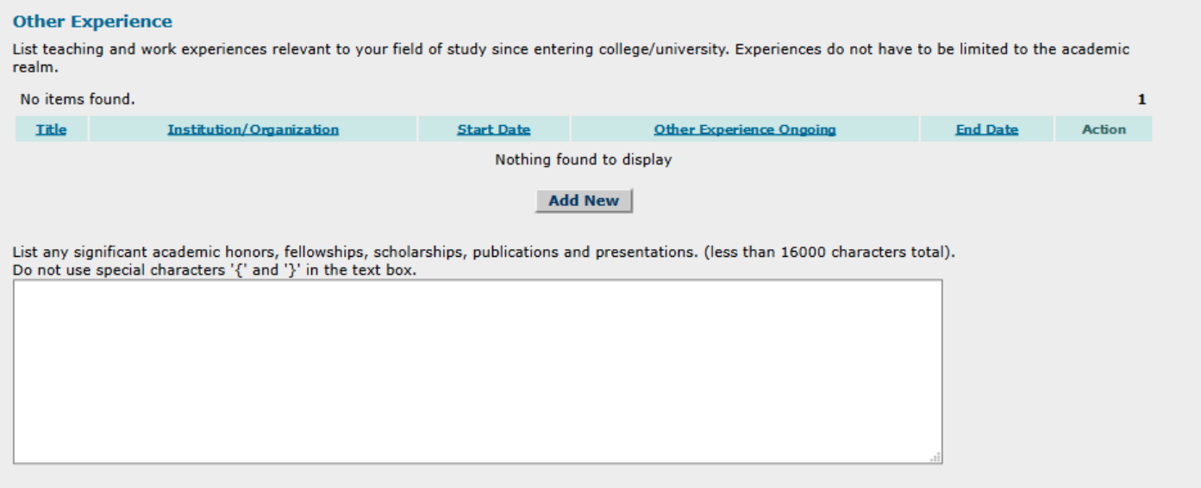
Fastlane Application – Helpful Tip
Box for any experiences, honors, achievements that don’t fit into your personal statement!

Slide 26
Graduate Research Statement (2 pages) Research Statement, Research Plan, Research Proposal, Proposal

Slide 27
Research Statement- 2 pages
What motivates the project,
How the project will get done,
Include back up plans
How you will deal with challenges/setbacks
What the outcome will mean relative to field/motivation
Notes:
They fund YOU not the project, so it is OK if the project changes
Pick something that you can write well about and that will be convincing and transformative

Slide 28
Research Statement- 2 pages
Demonstrate your ability to develop
a research question, hypothesis, and
the knowledge/resources to execute it
You know XYZ, you have courses in ABC
Access to equipment, expertise, facilities at/through UVA/your lab
Keep the scope feasible for a graduate project
Show that your proposed research is creative, original, and transformative

Slide 29
Research Statement- 2 pages
Define a research question
Reflect on how it relates to
Broader impacts
Intellectual merit
Talk with your advisor
Notes:
Consider starting by

Slide 30
Research Statement- 2 pages
Get feedback from your advisor
Send them outlines/drafts
Expect early drafts to come back with lots of red
The final version will likely look very different

Slide 31
Research Statement- 2 pages
Concise
Broad Scientific Audience
Do not assume the audience knows
Define terms clearly
Accuracy over precision
Typical Language
I hypothesize/I will/I plan to
My research is unique in that…

Slide 32
Possible overview
Intro
Background- (very short, key info needed to understand the rest)
Motivation (why important in a way that matters to audience)
Plan
Research question, aims, hypothesis
Methods/approach
Preliminary results (if applicable), anticipated outcomes, alternative
Intellectual merit (novelty, add to the field, etc.)
Broader Impacts (change society for the better, applications)
Conclusion (may include significance)
Notes:
See also mit commkits and additional resources https://mitcommlab.mit.edu/cheme/commkit/nsf-fellowship-research-proposal/
You can look at examples as well
Passion and connection in personal statement
In research statement, focus on the research

Slide 33
BME Example
Background
Aim 1 (cont.)
Aim 2. .
Aim 1
Figure
Fig.
Fig.
Intellectual Merit
Broader Impacts
References
Notes:
These are section headers from a winning proposal showing how much space on the page each section took up- each was new section and paragraph with clear bolded heading

Slide 34
SIE Example
Motivation
Objective 2 (cont.)
Objective 3
Problem
Intellectual Merit
Research Plan
Broader Impacts
Objective 1
Objective 2
Fig.
References

Slide 35
Research Statement- GRFP Mentors
Organization/sections?
Figures? What kind?

Slide 36
When revising both statements
Pay attention to formatting
Use headings and bold
Move from known to new info at sentence and paragraph level
Make sure 1st and last sentence of each paragraph is clear, important, and meaningful

Slide 37
In each statement, address
Intellectual Merit and Broader Impacts
under separate headings
Notes:
provide reviewers with the information necessary to evaluate the application with respect to both Criteria

Slide 38
The Core of GRFP:
Intellectual Merit & Broader Impacts

Slide 39
Applicant Ratings
Intellectual Merit & Broader Impacts
Rated on scale
Excellent, Very Good, Good, Less Good, Fair
Mandatory to leave comments that explain the rating
Not uncommon to pull ideas, phrases, sentences from the statements
Ratings consider the entire application

Slide 40
Intellectual Merit
The potential to advance knowledge within your field or across different fields
How innovative is your proposed research? Demonstrate creativity.
Previous research experience, your dedication to advancing science through research, coursework
Highlight your unique set of “intellectual merit”
Notes:
Intellectual merit should come out naturally in your statements (Research statement and Personal

Slide 41
Intellectual Merit
Creative, innovative, transformative research plan
Verifiable past research experience
References, publications, presentations
Awards, honors, grants, etc.
Skills, dedication to research/science/engineering, coursework, etc.
Notes:
Intellectual merit should come out naturally in your statements

Slide 42
Intellectual Merit
Include throughout both statements
AND
In standalone section in each statement
Also shown throughout components
References, application list of awards, publications, presentations
Notes:
Intellectual merit should come out naturally in your statements

Slide 43
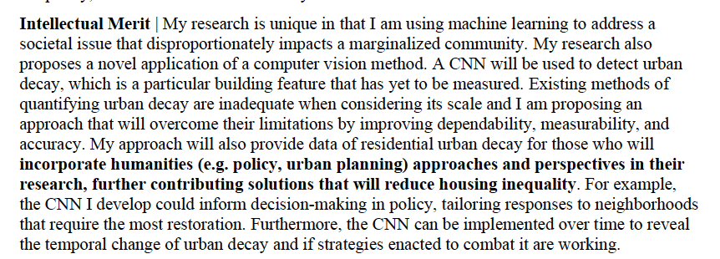
Intellectual Merit- Section Example
Ciara Horne (SIE), Research Statement:
Show novelty
Notes:
Intellectual merit should come out naturally in your statements

Slide 44

Intellectual Merit- Section Example
Wisam Fares (BME), Research Statement:
Show novelty
Notes:
Intellectual merit should come out naturally in your statements (Research statement and Persona

Slide 45
Intellectual Merit- Section Example
Ciara Horne (SIE), Research Statement:
Show use of data for other research/fields
Examples & Explanation
Notes:
Intellectual merit should come out naturally in your statements (Research statement and Persona

Slide 46
Intellectual Merit- GRFP Mentors
What did you include?

Slide 47
Broader Impacts
The potential to benefit society and contribute to the achievement of specific, desired societal outcomes
Achieves societal and communal goals (NSF document)
Communicating the relevance of science and NSF’s commitment to public outreach
Can be through your own research or other daily tasks
Notes:
GO READ THAT NSF DOCUMENT- it has clear parts, definitions, and examples

Slide 48
Broader Impacts
Promote teaching, training, learning
Broaden participation of underrepresented groups
(e.g. gender, ethnicity, disability, geographic, etc.)
Enhance infrastructure for research and education- facilities, instrumentation, networks, partnerships
Share results broadly to enhance scientific & technological understanding
Partner with museums, science centers; public/general audience presentations or writing; radio/library; integrate in teaching/practice; inform policy; multi/interdisciplinary conferences; media/resource development
Benefit society
Notes:
Short version of one of the listing in that nsf document linked on the previous page

Slide 49
Broader Impacts
Include throughout both statements
AND
In standalone section in each statement
Also shown throughout components
References, application list of awards, publications (editorial, magazine), presentations (pub talk, library talk), outreach activities, teaching, mentoring
Notes:
Intellectual merit should come out naturally in your statements (Research statement and Persona

Slide 50
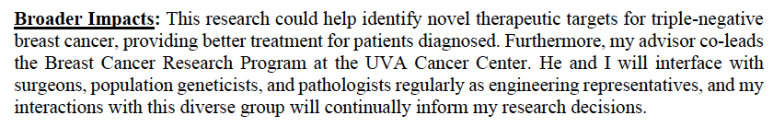
Broader Impacts- Example sections
Wisam Fares (BME)
Research Statement
Notes:
Application of research-> better treatments
Highlight existing and on going connections
How those connections bring findings to practice and to other fields
And how such connections will feed back into the student research

Slide 51
Broader Impacts- GRFP Mentors
What did you include?

Slide 52
Review Criteria
What is the potential of the proposed activity to:
Advance knowledge and understanding within your field and/or across different fields? (Intellectual Merit)
Benefit society or advance desired societal outcomes? (Broader Impacts)
Notes:
Straight from the NSF solicitation

Slide 53
Review Criteria (cont)
2. To what extent do the proposed activities suggest and explore creative, original, or potentially transformative concepts?
Highlight what makes you/your proposal unique
3. Is this plan well-reasoned, organized, and based on sound rationale? Does the plan include a mechanism to assess success?
Be realistic and demonstrate feasibility of proposal

Slide 54
Review Criteria (cont)
4. How well qualified is the individual (you), team (your lab), or organization (UVa, department) to conduct the proposed activities?
Your achievements, highlight your advisor/lab/ departments’ accomplishments
5. Are there adequate resources available to you to carry out proposed activities?
Why are you in the best place to do the work proposed?

Slide 55
How applications are reviewed/rated
Individual reviewers will read it separately and come together to discuss applicants
Judges are from your general field, but are not necessarily familiar with your very specific research field → Write to a broad scientific audience
Each reviewer has ~20 applications
(examples)

Slide 56
Examples

Slide 57
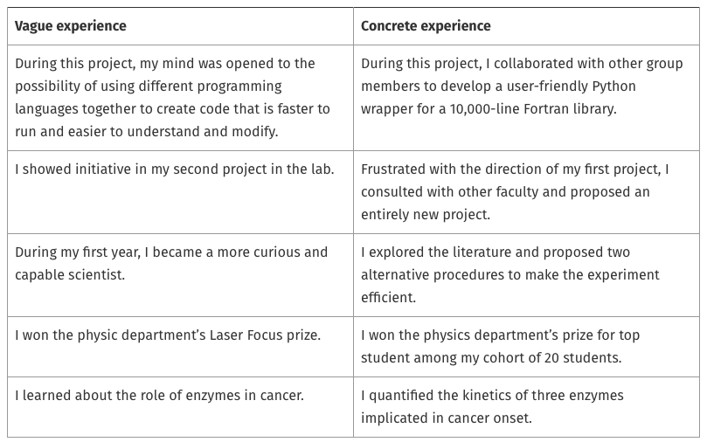
Be specific and give concrete examples
https://mitcommlab.mit.edu/broad/commkit/nsf-personal-statement/

Slide 58
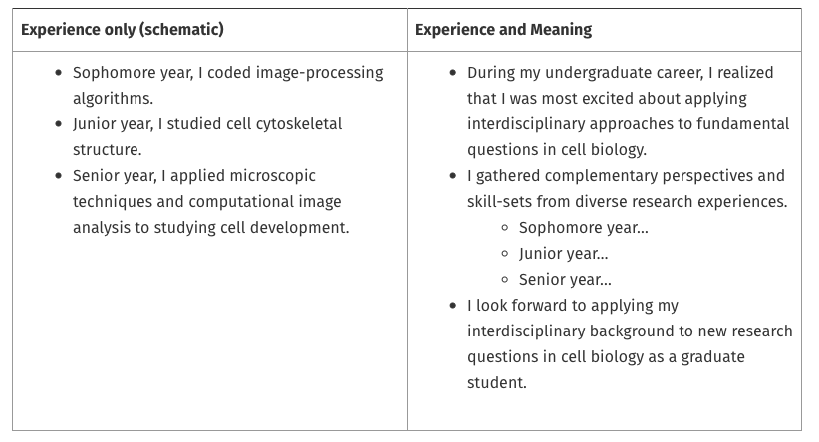
Highlight the why, not just the what
https://mitcommlab.mit.edu/broad/commkit/nsf-personal-statement/

Slide 59
Tips & Resources

Slide 60
Deadlines- check your program solicitation
Examples of deadlines:
5 pm (local time of your mailing address) on the following dates:
October 17, 2022- Life Sciences
October 18, 2022- Computer and Information Science and Engineering, Materials Research, Psychology, Social, Behavioral and Economic Sciences, STEM Education and Learning
October 20, 2022- Engineering
October 21, 2022- Chemistry, Geosciences, Mathematical Sciences, Physics and Astronomy
Notes:
SUBMIT EARLY!!!! Fastlane may have technical issues

Slide 61
Current Timeline Suggestion
June-August:
Outline your Personal Statement/Research Plan
Solid draft of Personal Statement/Research Plan
Send this to your references!
Talk to references
Late July-September:
Get feedback
Revise, revise, revise
October:
Revise/Edit your statements
Follow up with your references
SUBMIT A DAY or 2 EARLY (a week early if you can)
See a more detailed timeline

Slide 62
General Application Advice
Show that you are capable and enthusiastic about the work
Develop a consistent theme & cohesive story
Tie in intellectual merit & broader impacts throughout essays
Read the full GRFP solicitation (this may not be the current link)
don’t skip the details
Take advantage of UVA resources:
Graduate Writing Lab
Office of Citizen Scholar Development (fellowships office)
PhD+
Notes:
Always read through the full solicitation for your program year

Slide 63
GWL GRFP Support Resources
Events
Groups
1on1s
Drop In hours
Online Resources
Examples

Slide 64
What Questions do you have?
Kelly J Cunningham, PhD
Director, Graduate Writing Lab
School of Engineering & Applied Science, University of Virginia
July 2022 version
kjc5z@virginia.edu | bit.ly/GWLGRFP

Slide 65
Major contributors to these materials
Katie Pelland (BME)
Kyoko Yoshida (BME)
Grace Bingham (BME)
Brooke McGirr (CHE)
Bethany Gordon (CEE)
Kelly Cunningham (GWL)
May include elements developed from Summer 2020 mentors panel: Panelists- Laura Dunphy, Wisam Fares, Juliet Simpson, Grace Bingham.
Last updated July 2022 (minor updates from July 2021 version) by Kelly Cunningham

Slide 66
Additional resources on end & hidden slides
Planning and Drafting Your
NSF GRFP Application
Kelly J Cunningham, PhD
Director, Graduate Writing Lab
School of Engineering & Applied Science, University of Virginia
July 2022 version
gradwritinglab@virginia.edu | bit.ly/GWLGRFP

Slide 67
Non Uva Online Resources
Alex Lang’s Website
GWL Guide to NSF GRFP Reference Letters
NSF GRFP 2021 Solicitation
NSF GRFP FAQs

Slide 68
Use many sources of feedback
Research statement: advisor, faculty, people in your lab/engineering, students, postdocs
Personal statements: students, friends, family
have people read your drafts
Notes:
expect that first research draft to come back with lots of red

