Slide 1
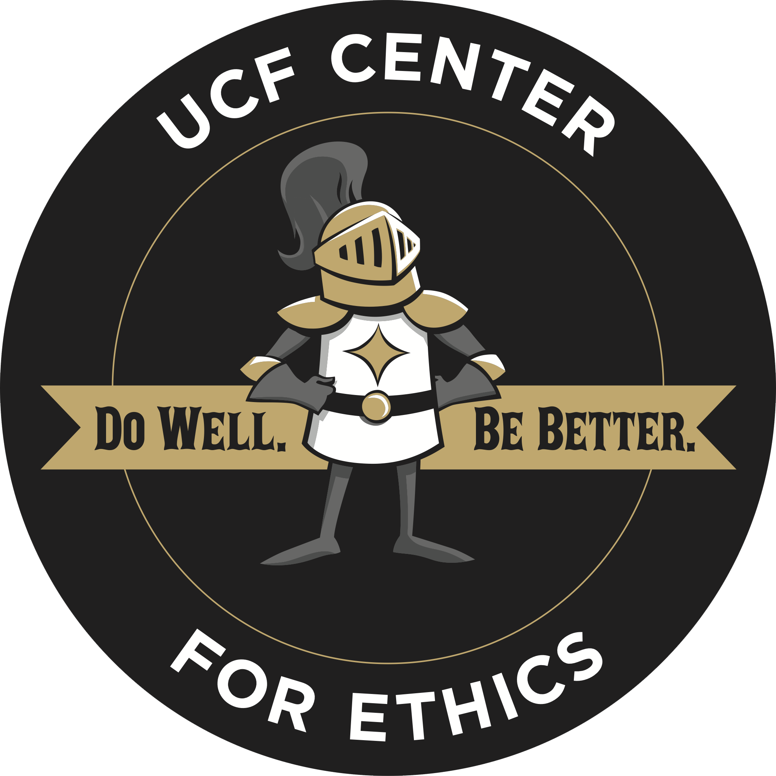

Ethics and Compliance as Tensions in Responsible Research
Responsible conduct of research (“RCR”) is often discussed in terms of compliance with rules and regulation.
Ethics looks at the broader landscape: - Why we should follow such rules? - How might rules evolve? - What is the contextual nature of responsible conduct?
Research Integrity
Broader
Impacts
Embedded Ethics
Workshop on Promising Practices and Innovative Programs
in the Responsible Conduct of Research (RCR)
National Academy of Engineering
January 13-14, 2021
Jonathan Beever, Ph.D.
ethicscenter.research.ucf.edu

Slide 2
Ethics and Compliance as Tensions in Responsible Research
What innovative RCR program(s) or promising practices have you implemented at your institution?
Broad scope:
integrating RCR content into philosophy and STEM ethics courses at both undergraduate and graduate levels, and integrating philosophical ethics content into RCR trainings and workshops
bridging gaps between normative theoretic and compliance-based approaches to ethics and responsible research.
Broad approach:
the UCF Center for Ethics emphasizes faculty-led ethics research and programming for faculty and students
moves beyond the box-checking compliance training models of responsible conduct in research
Workshop on Promising Practices and Innovative Programs
in the Responsible Conduct of Research (RCR)
National Academy of Engineering
January 13-14, 2021
Jonathan Beever, Ph.D.
ethicscenter.research.ucf.edu
Notes:
Faculty leadership complementing administrative oversight is a vital part of this innovative approach to RCR. This developing effort is driven by faculty expertise and leadership in the newly-established Center for Ethics (C4E) which leads research and stakeholder discussions and reports to our Office of Research. This approach is built on the backbone of ethics-in-the-disciplines (EID) and ethics-across-the-curriculum (EAC) research models through ethics courses within disciplines and from philosophy to bring shared epistemic and ethical expertise to bear on RCR education, as a means of cultivating ethics literacy.
For example: research integrity and personal integrity workshops pair to identify practices and critical conceptual analysis

Slide 3
Ethics and Compliance as Tensions in Responsible Research
What are the most important goal(s) of your institution’s innovative RCR programs or promising practices?
(1) To balance out the current compliance model with faculty engagement in RCR research and teaching.
(2) To take back “ethics” as a concept.
(3) To lean on institutional strengths in instructional design, power of scale, and partnerships.
Workshop on Promising Practices and Innovative Programs
in the Responsible Conduct of Research (RCR)
National Academy of Engineering
January 13-14, 2021
Jonathan Beever, Ph.D.
ethicscenter.research.ucf.edu

Slide 4
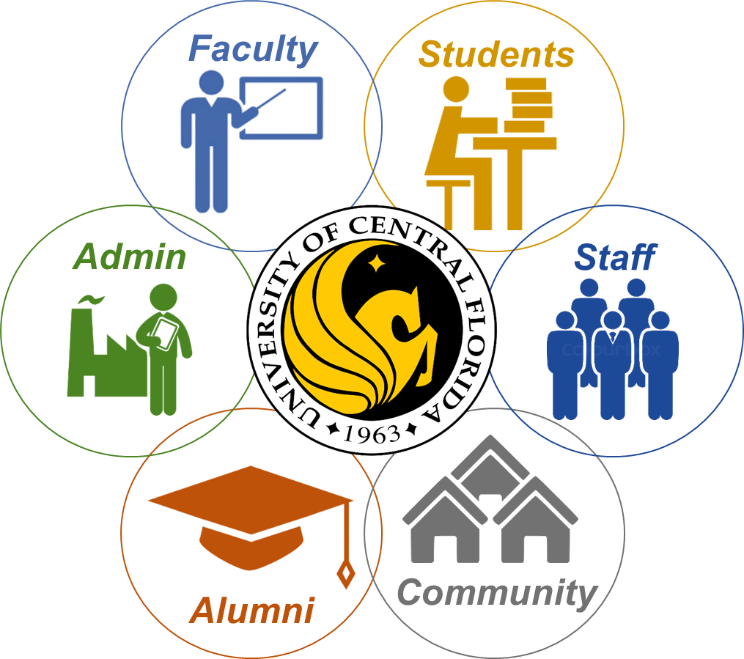
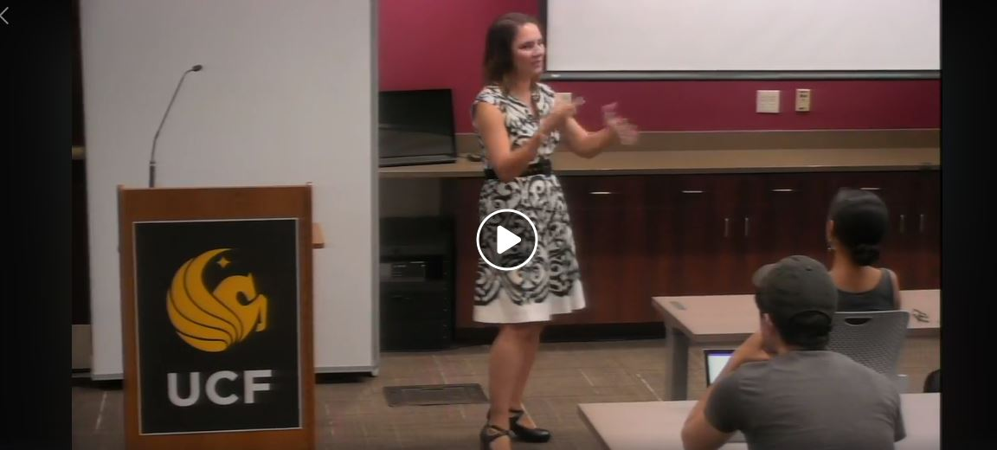
Ethics and Compliance as Tensions in Responsible Research
What evidence do you have to suggest that you are succeeding in achieving your goal(s)?
Broad stakeholder engagement:
Student workshops (2017 - present);
Faculty (2017 - present);
Deans and Directors (2018);
Faculty Excellence (2018);
Public ethics lectures by external experts (annual);
Academic Integrity workshops, College of Graduate Studies (2016-present);
Theoretical and Applied Ethics Certificate Program;
Undergraduate and graduate coursework in ethics;
Institutional service roles related to ethics and responsible conduct.
Ongoing research:
- Data mining and analysis of information on courses, degrees, certificates, stakeholder perspectives;
Analysis of individual attitudes toward ethical and responsible conduct.
NSF-funded Ethical and Responsible Research Institutional Transformation grant, “Institutional Transformation: Intersections of Moral Foundations and Ethics Frameworks in STEM Enculturation“ (2020-2025), Beever (PI), Klonoff, Kuebler, Pinkert.
Workshop on Promising Practices and Innovative Programs
in the Responsible Conduct of Research (RCR)
National Academy of Engineering
January 13-14, 2021
Jonathan Beever, Ph.D.
ethicscenter.research.ucf.edu

