Slide 1
Reading Strategies
Brooke Dinsmore (bd3tz@virginia.edu)
GWL Writing Consultant
PhD Candidate, Sociology Department
UVA Engineering Graduate Writing Lab
This work is CC-BY and must include full citation & doi. Individual images and examples & materials from other sources are not CC-BY.
01

Slide 2
Sources
Luker, Kristin. 2009. Salsa Dancing into the Social Sciences. Harvard University Press.
Keshav, Satish. 2007. “How to Read a Paper.” ACM SIGCOMM Computer Communication Review 37(3):83-84.
Pacheco-Vega, Raul. 2017. “Carving Time to Read.” http://www.raulpacheco.org/2017/12/carving-time-to-read-the-aic-and-conceptual-synthesis-excel-dump-combination-method/.
Pacheco-Vega, Raul. 2018. “Note-Taking Techniques.” http://www.raulpacheco.org/2018/11/note-taking-techniques-i-the-index-card-method/.
Pain, Elizabeth. 2016. “How to (Seriously) Read a Scientific Paper.” Science. https://www.science.org/content/article/how-seriously-read-scientific-paper.

Slide 3
Workshop Agenda
Why do we need reading strategies?
Organizing your reading
Tips for reading and note-taking

Slide 4

Why do we need reading strategies?

Slide 5
Respond “yes!” in the chat if you’ve ever experienced the following problems…

Slide 6
Feeling overwhelmed by the amount of reading you have to do

Slide 7
Spending too much time adding citations to a paper

Slide 8
Having to go back and reference an article because your initial notes weren’t helpful

Slide 9
Feeling like you have too many sources for a paper or assignment and not knowing where to start

Slide 10
Feeling like you have too little sources for a paper or assignment and not knowing where to start

Slide 11
Feeling like you can’t possibly keep up with the new research in your field

Slide 12
Why are these common problems?
Kristen Luker argues that we live in an age of info-glut where “the extent of information available has begun to overwhelm the human capacity to process it.”
Her warning to graduate students right now? You cannot survive in this world of info-glut unless you work smarter not harder.
Source: Luker, Kristin. 2009. Salsa Dancing into the Social Sciences. Harvard University Press.

Slide 13
Find the reading strategies that work best for you
Including strategies for:
Organizing your sources and your time
Reading thoroughly more quickly
Taking notes that continue to be useful over time
More quickly synthesizing information

Slide 14
Part 2: Organizing your reading

Slide 15
Organizing Strategy #1: use a citation manager to store both source information AND pdf’s
Keeping your source information and PDFs in one place:
Saves you time
Makes the transition between reading and writing more smooth

Slide 16
Software Options:
Endnote
Mendeley
Zotero
Tip: Ask your advisor or others in your lab what software they use!

Slide 17
Organize your files
Each of these software offers two options for organizing your files:
Folders
Tagging system

Slide 18
Organizing Strategy #2: Have a “To be read” tag or folder
Whenever you run across a new relevant article, save it to this folder
Advantages:
Stay on top of relevant research
Reduce distractions – set aside time to read these articles
Helps maintain organization system

Slide 19
Organizing Strategy #3: Stay on top of new research (even when you’re not working on a paper)
Keep running lists of researchers, articles, and journals that repeatedly come up in your work
Stay on top of new work by subscribing to Table of Content alerts through Journal websites
Subscribe to search terms in Scopus or Web of Science
Follow researchers on Twitter or ResearchGate

Slide 20
Part 3:Strategies for reading

Slide 21
Reading Strategy #1: Identify when you are most productive at reading (and writing) & schedule your time accordingly

Slide 22
Different ways for organizing reading time
Set goals: how many articles do you need to read a day to meet a deadline
Schedule reading appointments on your calendar
Always have your reading available: Can you read on the bus or while working out? While waiting for an appointment?
Listen to your reading: Use Speechify or another text to speech app or extension to listen to your reading during other activities
Purposefully limit your time reading for classes
Try out the Pomodoro Technique

Slide 23
Reading Strategy #2: Read strategically
Don’t read every article the same way
Determine how important the article is; how much of this information will be relevant for your work?
Adopt a strategy that matches that level of importance

Slide 24
The Three Pass Approach
First pass: get a bird’s eye view of the paper and decide if you need to do any more passes
1. Read title, abstract and introduction
2. Read section headings and subheadings
3. Glance at mathematical content or figures
4. Read the conclusions
5. Glance at references – have you read these papers?
The goal of the first pass is to answer the five C’s: category, context, correctness, contributions and clarity
Source: Keshav, Satish. 2007. “How to Read a Paper.” ACM SIGCOMM Computer Communication Review 37(3):83-84.

Slide 25
The Second Pass
If you determine after the first pass that you should read the paper in more depth, then do a second pass
Read through the whole paper. The goal of this pass is to understand both the content of the argument and the evidence supporting it.
Pay careful attention to figures, diagrams and graphs
Mark relevant unread references for future reading
Source: Keshav, Satish. 2007. “How to Read a Paper.” ACM SIGCOMM Computer Communication Review 37(3):83-84.

Slide 26
The Third Pass
“The key to the third pass is to attempt to virtually re-implement the paper: that is, making the same assumptions as the authors, re-create the work. By comparing this re-creation with the actual paper, you can easily identify not only a paper’s innovations, but also its hidden failings and assumptions” (2)
The third pass is unnecessary most of the time. Except for:
The most relevant work to your own – especially work with different assumptions or conclusions than your own!
Work you are reviewing as a peer reviewer
Source: Keshav, Satish. 2007. “How to Read a Paper.” ACM SIGCOMM Computer Communication Review 37(3):83-84.

Slide 27
The AIC or AIFC Approach
Similar to the first pass method!
Read the abstract, introduction and conclusion
Or
Read the abstract, introduction, figures and conclusion
Helpful for identifying if you should read the paper in greater depth!
Source: Pacheco-Vega, Raul. 2017. “Carving Time to Read.” http://www.raulpacheco.org/2017/12/carving-time-to-read-the-aic-and-conceptual-synthesis-excel-dump-combination-method/.

Slide 28
Reading Strategy #3: Don’t Get Stumped by Jargon
Look it up online
Find a review article or textbook chapter to give you the necessary background
Is it necessary that you understand the jargon being used? "Do I need to understand what that means in order to get what I need from this paper?"
Ask a colleague
Don’t finish reading the paper!
Source: Pain, Elizabeth. 2016. “How to (Seriously) Read a Scientific Paper.” Science. https://www.science.org/content/article/how-seriously-read-scientific-paper.

Slide 29
Reading Strategy #4:Normalize getting overwhelmed
It happens to all of us! Some papers are the results of years of work.
Beware of imposter syndrome: don’t compare others’ finished products to your drafts!
Break the paper down into chunks and read over the course of a few days
Some papers are just badly written – is there a better written paper that gets at the same content?
Know your limits – do you need a collaborator?
Source: Pain, Elizabeth. 2016. “How to (Seriously) Read a Scientific Paper.” Science. https://www.science.org/content/article/how-seriously-read-scientific-paper.

Slide 30
What reading strategies are you most likely to use? Share your answer in the chat!
Organizing your reading time
The three-pass method
The AIFC approach
Strategies for overcoming jargon

Slide 31
Is there a reading strategy (not covered here) that you’d like to share with the group?

Slide 32
Part 4:Strategies for note-taking

Slide 33
What goal are you working towards?
How you take notes may vary!

Slide 34
Note-taking for introductions and literature review
The goal is synthesis!
Adopt a note-taking method that moves you towards your goal by:
Recording main points
Identifying relationships between texts

Slide 35
Note-taking Strategy #1: The Cornell Method
Originally developed for taking notes during a lecture
Moves you towards synthesis
Useful if you like to take notes by pen and paper – but also many different Word templates online!

Slide 36
Main Ideas | Details
Then this! | Fill this part out first
Summary
Last this!

Slide 37
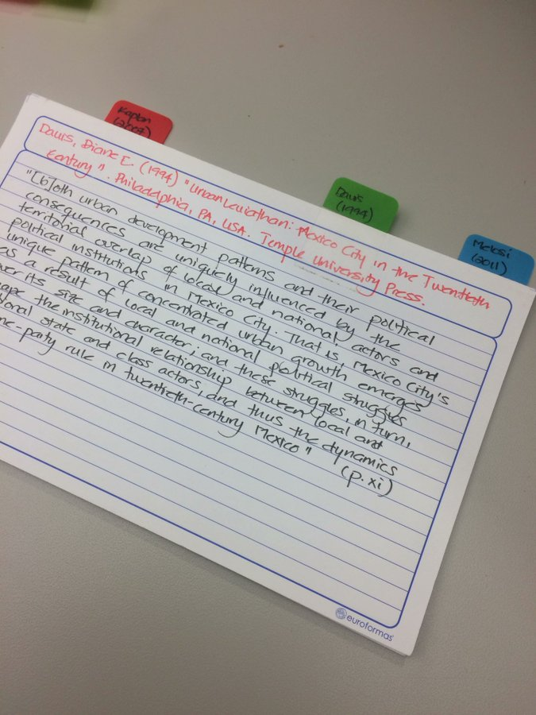
Note-taking Strategy #2: The Index Card Method
For every article you read, keep two index cards:
One with key quotes and their page numbers
One with a summary of the overall claim/finding, etc.
Allows you to sort through physical cards when working on literature review
Source: Pacheco-Vega, Raul. 2018. “Note-Taking Techniques.” http://www.raulpacheco.org/2018/11/note-taking-techniques-i-the-index-card-method/.

Slide 38
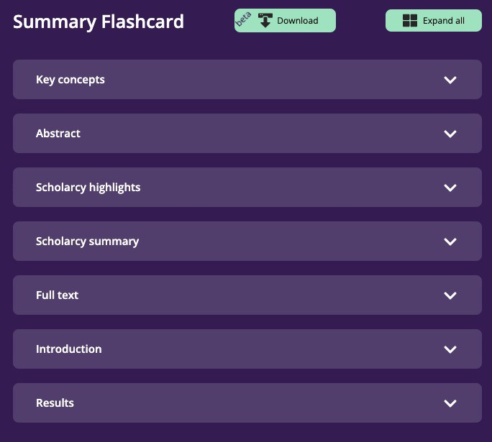
Scholarcy
Creates a summary flashcard and extracts tables and figures

Slide 39
Note-taking Strategy #3: Outline and Excerpt
Step 1: Before reading an article, create an outline in a Google or Word Doc by copying over the headings and subheadings
Step 2: While you read, copy and paste key quotes into the sections of the word document. Aim to move over quotes that summarize each section as well as quotes that are more relevant to your own.

Slide 40
Use an App for Excerpting
Liquid Text
Allows you to take notes and highlight directly on PDFs
When you finish organizing notes and excerpts, you can download them into a PDF or DocX

Slide 41
Note-taking Strategy #4:Synthesize using a Literature Matrix
Create an Excel document to organize your readings by relevant categories
Can be useful for either cataloging overall patterns in a new body of literature or for keeping track of specific findings

Slide 42
Synthesis Example #1
Author | Method | Main finding | Cross-References | Quotes | Page | Journal/Conference

Slide 43
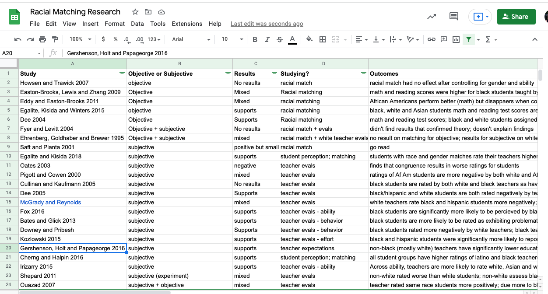
Synthesis Example #2

Slide 44
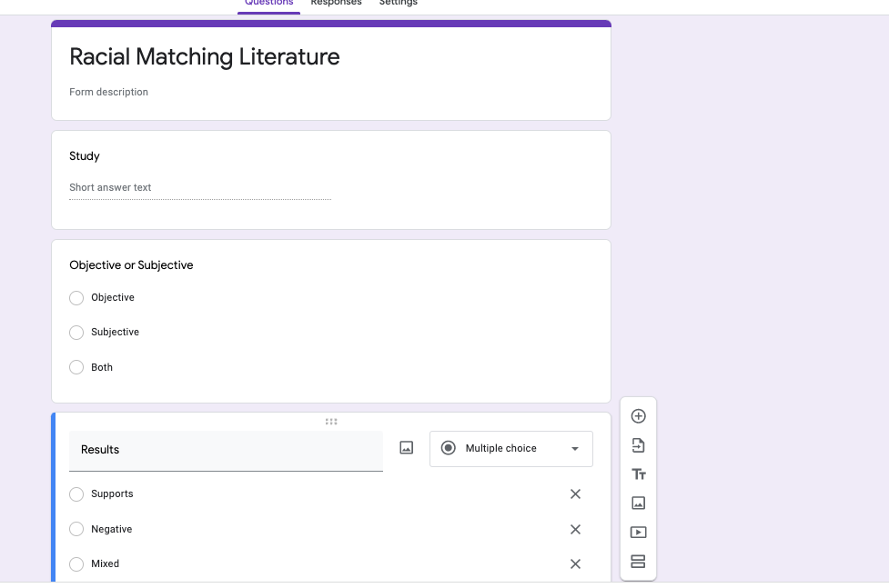
Use a Google Form to create a Synthesis

Slide 45
Part 5:Additional Resources

Slide 46
Apps for Organizing
DevonThinkPro – upload, annotate and organize documents. Can store both your PDFs and your notes on them. Uses both folders and tags. Can upload paper files.
Scrivener – Compose smaller sections of text and then reorganize. Put your notes and your writing in the same application and see them side by side.
ResearchRabbit – Create collections of literature, visualize relationships between sources, receive recommendations for related literature

Slide 47
Apps for Note-Taking
LiquidText
Goodnotes – take handwritten notes that you can then search using an Ipad
Notability – take handwritten notes on an Ipad and annotate PDFs

