Slide 1
PowerPoint Tips
Keira Mahoney
Maria Panepinto
Graduate Writing Lab
School of Engineering & Applied Science, University of Virginia
This work is CC-BY and must include full citation & DOI. Individual images and examples & materials from other sources are not CC-BY. Blue dino is a GWL icon & not CC-BY.

Slide 2
What will we talk about today?
PPT tools
Things you may not know PPT can do
How to make nice slides
What makes a good slide
What makes a bad slide
If you have nice slides your presentation will probably be better

Slide 3
Why is it important to have nice slides?
So people understand your talk
So people aren’t overwhelmed
Keeps you organized
Makes an impact on the audience

Slide 4
General Things
Not too many words
Look clean
Not overwhelming
Choose colors that work
Don’t read off slides
Make PPT work for you, not against you

Slide 5
Master Slides

Slide 6
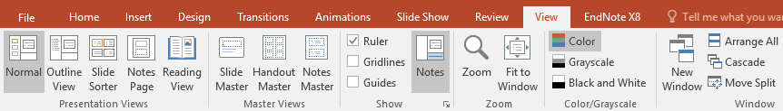
What do master slides do?
Set the format of all slides
Font (and size)
Color Scheme
Layout design
Slide numbering
View tab → Slide Master

Slide 7
Saving templates
Master slide templates can be saved to use in future presentations
File → Save As (in master view)

Slide 8
Color Palettes

Slide 9
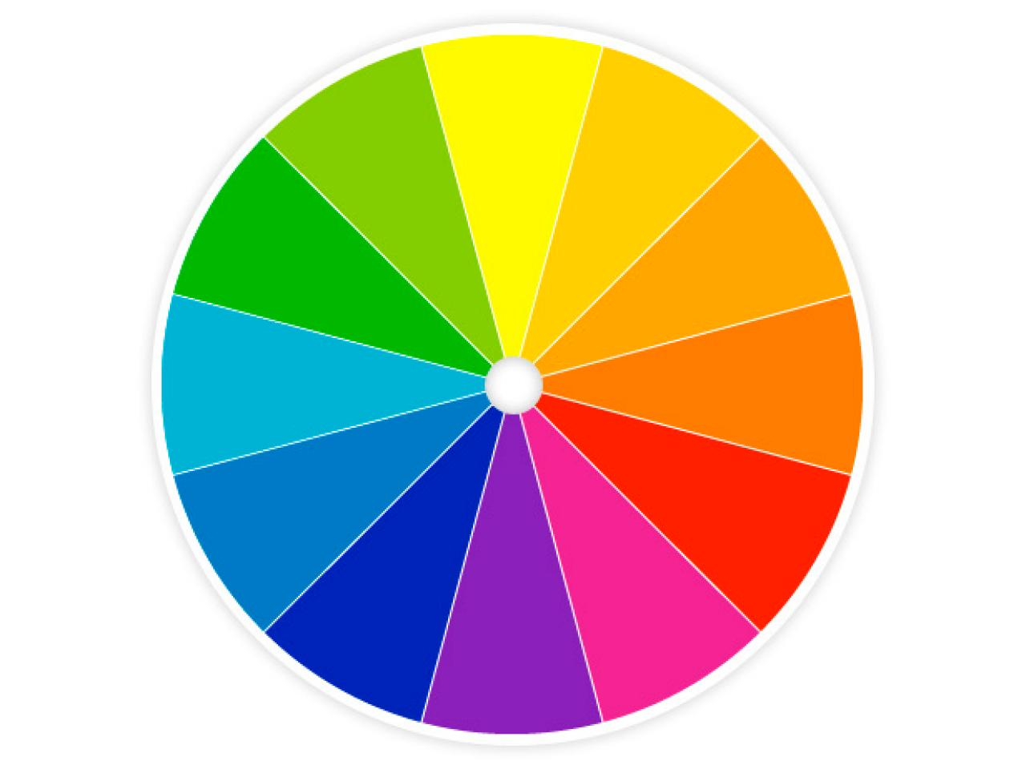
Colors
Choose contrasting colors
Projector washes out colors

Slide 10


Slide 12
Figures

Slide 13
Editing Figures
Alignment/Distribution
Background removal
Color change
Crop
Notes:
I attached this image of a MS2 so that we can play with it during the presentation

Slide 14
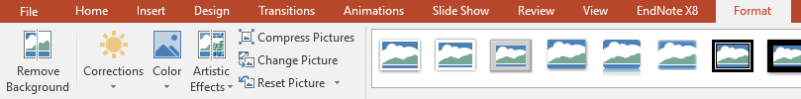
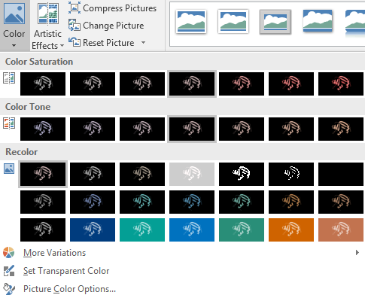

Removing background from images
Both ways
Use this protein picture as example?

Slide 15
Text

Slide 16
Text
Minimal text

Slide 17
Text Options
Textboxes
Right click corner → use as default
Format shape → textbox → do not autofit
Font Choice
Generally sans serif
Font size
Bigger = more important; sets focus

Slide 18
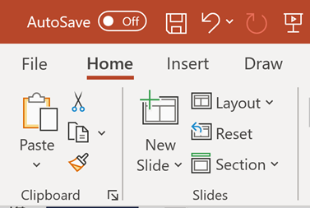
Format painter
Easily change format of text boxes between slides
Font
Sizes
Spacing
Color
Etc.

Slide 19
Animations

Slide 20
To use or not to use?
Animations can be useful
But should be minimal
Serve a purpose
Direct attention
Many options
But should mostly be using “Appear”, “Fade” and “Disappear” unless another animation is essential

Slide 21
When to use
Mass Spectrometry
Single Ion Selection
Dissociate
Example of appear animation
MS¹
Data Acquisition
m/z
MS²

Slide 22
When to use
Other useful animations

Slide 23
When NOT to use
not helpful
When they don’t have a clear purpose
very distracting

Slide 24
References

Slide 25
Option 1
Put full citation at bottom of slide without referencing in-text
Useful if whole slide is one source
Panepinto, MC. (2020) Imaginary Journal. 1995-2020.

Slide 26
Option 2
Reference each bullet/piece of info¹
This depends on your citation style²
1. Panepinto, MC. (2020) Imaginary Journal. 1995-2020.
2. Mahoney, KE. (2020) Cool Journal. 1111-1115.

Slide 27
Option 3
Reference slide at the end
In-text references needed (Panepinto, 2020)
More difficult to reuse slides

Slide 28
Miscellaneous

Slide 29
Presentation Time
Presenter view
Notes
Sizes
Status bar
Recording
Hidden slides
Don’t just read slides

Slide 30
Other things
Changing slide size for posters
Exporting as image/pdf
If using a laser pointer
Red pointers will generally not work on LED screens
Use a presentation remote
Also make sure to charge it before presenting & have extra batteries
Test on a projector prior to presenting

Slide 31
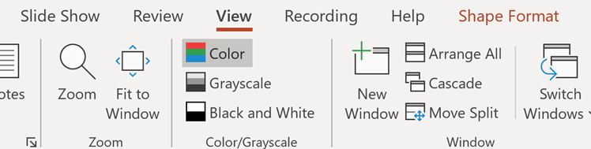
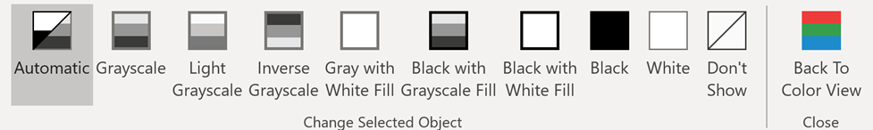
Grayscale for handouts & color checking

