Slide 1

Writing Abstracts
Kelly Dunham & Keira Mahoney
PhD candidate, Analytical Chemistry
Consultant, Graduate Writing Lab
School of Engineering & Applied Science, University of Virginia
This work is CC-BY and must include full citation & DOI. Individual images and examples & materials from other sources are not CC-BY. Blue dino is a GWL icon & not CC-BY.

Slide 2
Different types of abstract
Journal articles (~100-250 words)
Research papers
Reviews
Notes
Conference abstract (varies;~200-2000 words)
Posters
Presentations
Papers
Graphical and video abstracts

Slide 3
What is a (good) paper abstract?
One to two paragraphs (~100-300 words)
introducing your research in an accurate, clear, and compelling way
Your abstract will be the most read part of you paper
You want to advertise your work well!

Slide 4
Before you start the abstract
Finish your research
Write your paper
Go through preliminary edits of your paper

Slide 5
Typical way to write a paper
Make Figures
Write Methods (can be done at any time)
Write Results (including Figure captions)
Write Introduction
Write Discussion (sometimes combined with Results)
Write Conclusion
Write Abstract -> last step; sometimes the hardest

Slide 6
Starting your abstract

Slide 7
Questions to get you started
Introduction (1-3 Sentences) | Why is the problem you studied important to the audience?
Research Gap (1 Sentence) | What information is missing from the field that you needed to address?
Methodology (1-3 Sentences) | How did you go about obtaining this information? What instruments/models/sample sets etc. did you use to find the information?
Results (1-3 Sentences) | What were your key findings?
Conclusions (1-2 Sentences) | What did you conclude based on these findings and what are the broader implications?

Slide 8
Introduction
Big picture and research gap clearly identified
See why the research was needed
See how research connects to the larger field
Connect your research to the knowledge level and interests of the target audience
WHY did you do it?

Slide 9
Audience
The problem addressed by the research

Slide 10
Someone in an
unrelated field
Someone in a related field
Unfamiliar with your specialty
but familiar with the subfield
In your field and
familiar with your specialty
Intimately involved in your specialty

Slide 11
Exercise 1: Which intro? 1 or 2?
1) This experiment will determine what will make enzymes affective and what will make them ineffective.
2) This experiment was performed to determine the factors that positively influence enzyme reaction rates in cellular activities since some enzymes seem to be more effective than others.
University of Richmond Writing Center: Writer’s Web http://writing2.richmond.edu/writing/wweb/biology/abstract.html

Slide 12
Exercise 1: Which intro? 1 or 2?
1) This experiment will determine what will make enzymes affective and what will make them ineffective.
2) This experiment was performed to determine the factors that positively influence enzyme reaction rates in cellular activities since some enzymes seem to be more effective than others.
Provides more information to reader why these experiments were done

Slide 13
Methods
Methods and/or design clear
Easy to see what was done and how it relates to the purpose
Explain what you did and how you went about it
HOW did you do it?

Slide 14
Level of detail
Include a general description
Instrumentation
Methods
Models
No specific protocols or excessive detail

Slide 15
Exercise 1: Which methods? 1 or 2?
1) Catecholase enzyme activity was measured through its absorption rate in a spectrophotometer, using light with a wavelength of 540 nm. We compared the absorbance rates in samples with varying enzyme concentrations and a constant pH of 7, and with samples with constant enzyme concentration and varying pH levels.

Slide 16
Exercise 1: Which methods? 1 or 2?
2) We tested different samples of enzymes in a spectrophotometer and recorded their absorption rates. Six samples were placed in the spectrophotometer but two contained no enzyme; these acted as blanks for the other samples. The four remaining samples contained Catecholase ranging from 0.5 mL to 1.75 mL. The second half of the experiment contained four test tubes with a constant amount of Catecholase, but the pH levels ranged from four to eight.

Slide 17
Exercise 1: Which methods? 1 or 2?
First one describes methods better, also more concise
More detailed overview of experiments
“Wavelength of 540 nm”
Do not need to put very precise details
“The four remaining samples contained Catecholase ranging from 0.5 mL to 1.75 mL. The second half of the experiment contained four test tubes with a constant amount of Catecholase, but the pH levels ranged from four to eight.”

Slide 18
Results
Specific, clear, key results presented
Match the purpose and methods
Research may be citable from abstract
Summarize 1-2 major findings
WHAT did you find?

Slide 19
Exercise 1: Which results? 1 or 2?
1) The samples with the highest enzyme concentration had the greatest absorption rate of 95 percent compared to the sample with the lowest concentration and an absorption rate of 24 percent.
2) It was found that if the enzyme was present in large amounts, then the absorption rate was high, and if the pH level ranged from 6 to eight then the absorption rate was high.

Slide 20
Exercise 1: Which results? 1 or 2?
1) The samples with the highest enzyme concentration had the greatest absorption rate of 95 percent compared to the sample with the lowest concentration and an absorption rate of 24 percent.
2) It was found that if the enzyme was present in large amounts, then the absorption rate was high, and if the pH level ranged from 6 to eight then the absorption rate was high.
2nd is not very clear, would not be citable.

Slide 21
Conclusions
Clear interpretation of results
The research question is answered or aims are clearly met
Meaning and impact of results are clear
Interpret results and explain implications/applications of your work
WHAT does it mean?

Slide 22
Exercise 1: Which conclusion? 1 or 2?
1) Therefore, it can be said that enzymes work well in neutral pH levels and in large amounts.
2) The samples with a pH between six and eight had the greatest absorption rate of 70 percent compared to an absorption rate of 15 percent with a pH of 4; this suggests that Catecholase is most effective in a neutral pH ranging from six to eight.

Slide 23
Exercise 1: Which conclusion? 1 or 2?
1) Therefore, it can be said that enzymes work well in neutral pH levels and in large amounts.
2) The samples with a pH between six and eight had the greatest absorption rate of 70 percent compared to an absorption rate of 15 percent with a pH of 4; this suggests that Catecholase is most effective in a neutral pH ranging from six to eight.
2nd interprets and describes results better

Slide 24
Importance
Keep overall importance general
Do not exaggerate or provide unclear ideas that are not included in the paper
WHY does it matter?

Slide 25
Selective area epitaxy of magnesium oxide thin films on gallium nitride surfaces. Losego and Paisley. 2015. J. Mater. Res., DOI: 10.1557/jmr.2015.332. Selective area growth of thin films reduces the number of steps in microfabrication processing and enables novel device structures. Here, we report, for the first time, selective area epitaxy of an oxide material on a GaN surface. Chlorination of the GaN surface via wet chemical processing is found effective to disrupt Mg adsorption and selectively prevent molecular beam epitaxy growth of MgO. MgO films grown on neighboring, non-chlorinated surfaces are epitaxial with a (111) MgOII(0001) GaN crystallographic relationship. Better than 3 µm lateral resolution for the selective area growth of MgO on GaN is demonstrated. 95 words
Exercise 2
Notes:
Have identify which sentences are the introduction, methods, results, conclusion
Point out that this is a good example of how methods can flow into results (the use of the word “revealing”)

Slide 26
Other formatting tips

Slide 27
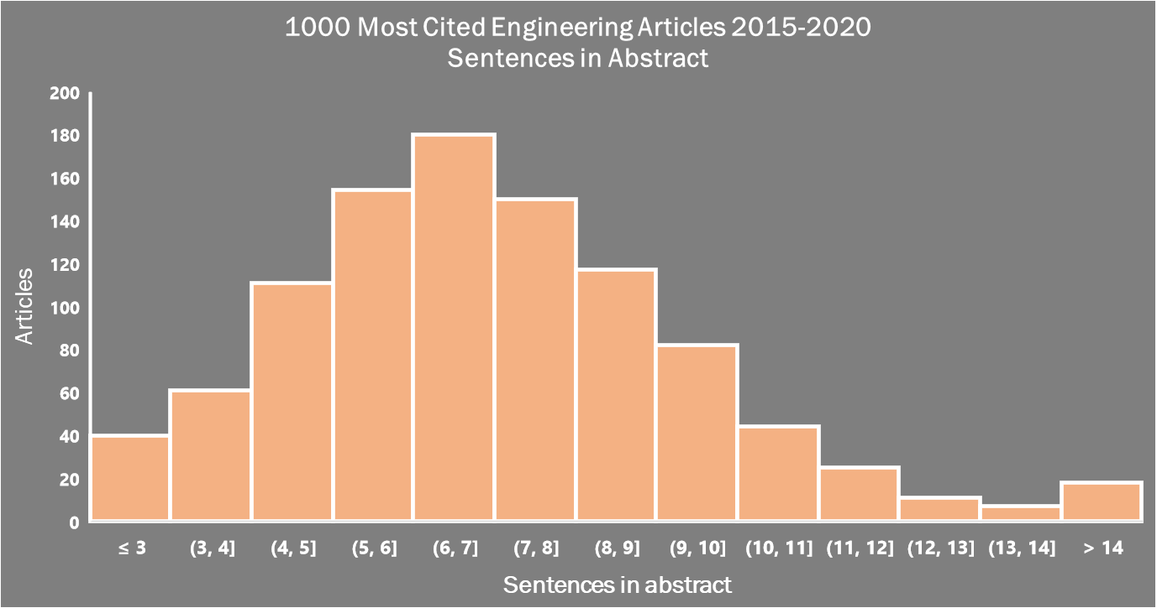
≤3
4
5
6
7
8
9
10
11
12
13
14
≥15

Slide 28
Berger, Valenca, Miao, Ravi, Mahendra, and Mohanty. 2019. Biochar increases nitrate removal capacity of woodchip biofilters during high-intensity rainfall. Water Research. 165 (2019) 115008 Stormwater biofilters have been increasingly used to mitigate the impact of climate change on the export of contaminants including nitrate to water bodies. Yet, their performance is rarely tested under high intensity rainfall events, which are predicted to occur more frequently under climate change scenarios. We examined the potential of biochar to improve the resilience of woodchip biofilters under simulated high-intensity rainfall events and linked denitrification to biochar-mediated changes in hydrological (physical), chemical, and biological properties of woodchip biofilters. Results showed that nitrate removal capacity of woodchip biofilters decreased with increases in rainfall intensity or duration and decreases in antecedent drying time. However, adding biochar to woodchips significantly decreased the exhaustion rate of woodchips, only when the hydraulic residence time (HRT) was less than 5 h. At longer HRT (>5 h), the benefits of biochar became less apparent. We attributed the improved denitrification during high nitrate loading to biochar's ability to decrease dissolved oxygen in pore water and increase water holding capacity and retention of dissolved organic carbon and nitrate, all of which could increase nitrate utilization. Biochar increased the net microbial biomass but did not affect the relative abundance of denitrifying genes, which indicates that a shift in microbial biomass could not fully explain the observed increase in nitrate removal in biochar-augmented woodchip biofilters. Overall, the results showed that biochar could increase the resiliency of woodchip biofilters for denitrification in high intensity rainfall events, a worst-case scenario, thereby mitigating the water quality degradation during climate change.
Exercise 3
247 words

Slide 29
Berger, Valenca, Miao, Ravi, Mahendra, and Mohanty. 2019. Biochar increases nitrate removal capacity of woodchip biofilters during high-intensity rainfall. Water Research 165 (2019) 115008 Stormwater biofilters have been increasingly used to mitigate the impact of climate change on the export of contaminants including nitrate to water bodies. Yet, their performance is rarely tested under high intensity rainfall events, which are predicted to occur more frequently under climate change scenarios. We examined the potential of biochar to improve the resilience of woodchip biofilters under simulated high-intensity rainfall events and linked denitrification to biochar-mediated changes in hydrological (physical), chemical, and biological properties of woodchip biofilters. Results showed that nitrate removal capacity of woodchip biofilters decreased with increases in rainfall intensity or duration and decreases in antecedent drying time. However, adding biochar to woodchips significantly decreased the exhaustion rate of woodchips, only when the hydraulic residence time (HRT) was less than 5 h. At longer HRT (>5 h), the benefits of biochar became less apparent. We attributed the improved denitrification during high nitrate loading to biochar's ability to decrease dissolved oxygen in pore water and increase water holding capacity and retention of dissolved organic carbon and nitrate, all of which could increase nitrate utilization. Biochar increased the net microbial biomass but did not affect the relative abundance of denitrifying genes, which indicates that a shift in microbial biomass could not fully explain the observed increase in nitrate removal in biochar-augmented woodchip biofilters. Overall, the results showed that biochar could increase the resiliency of woodchip biofilters for denitrification in high intensity rainfall events, a worst-case scenario, thereby mitigating the water quality degradation during climate change.
Exercise 3
8 sentences; 247 words

Slide 30
Berger, Valenca, Miao, Ravi, Mahendra, and Mohanty. 2019. Biochar increases nitrate removal capacity of woodchip biofilters during high-intensity rainfall. Water Research 165 (2019) 115008 Introduction (1), Research Gap (1), Methods (1), Results (3), Conclusion (2) Stormwater biofilters have been increasingly used to mitigate the impact of climate change on the export of contaminants including nitrate to water bodies. Yet, their performance is rarely tested under high intensity rainfall events, which are predicted to occur more frequently under climate change scenarios. We examined the potential of biochar to improve the resilience of woodchip biofilters under simulated high-intensity rainfall events and linked denitrification to biochar-mediated changes in hydrological (physical), chemical, and biological properties of woodchip biofilters. Results showed that nitrate removal capacity of woodchip biofilters decreased with increases in rainfall intensity or duration and decreases in antecedent drying time. However, adding biochar to woodchips significantly decreased the exhaustion rate of woodchips, only when the hydraulic residence time (HRT) was less than 5 h. At longer HRT (>5 h), the benefits of biochar became less apparent. We attributed the improved denitrification during high nitrate loading to biochar's ability to decrease dissolved oxygen in pore water and increase water holding capacity and retention of dissolved organic carbon and nitrate, all of which could increase nitrate utilization. Biochar increased the net microbial biomass but did not affect the relative abundance of denitrifying genes, which indicates that a shift in microbial biomass could not fully explain the observed increase in nitrate removal in biochar-augmented woodchip biofilters. Overall, the results showed that biochar could increase the resiliency of woodchip biofilters for denitrification in high intensity rainfall events, a worst-case scenario, thereby mitigating the water quality degradation during climate change.
Exercise 2

Slide 31
Questions to get you started
Introduction (1-3 Sentences) | Why is the problem you studied important to the audience?
Research Gap (1 Sentence) | What information is missing from the field that you needed to address?
Methodology (1-3 Sentences) | How did you go about obtaining this information? What instruments/models/sample sets etc. did you use to find the information?
Results (1-3 Sentences) | What were your key findings?
Conclusions (1-2 Sentences) | What did you conclude based on these findings and what are the broader implications?

Slide 32
S. L. Kappel, M. L. Rank, H. O. Toft, M. Andersen and P. Kidmose, "Dry-Contact Electrode Ear-EEG," in IEEE Transactions on Biomedical Engineering, vol. 66, no. 1, pp. 150-158, Jan. 2019.
Objective: Ear-EEG is a recording method in which EEG signals are acquired from electrodes placed on an earpiece inserted into the ear. Thereby, ear-EEG provides a noninvasive and discreet way of recording EEG, and has the potential to be used for long-term brain monitoring in real-life environments. Whereas previously reported ear-EEG recordings have been performed with wet electrodes, the objective of this study was to develop and evaluate dry-contact electrode ear-EEG. Methods: To achieve a well-functioning dry-contact interface, a new ear-EEG platform was developed. The platform comprised actively shielded and nanostructured electrodes embedded in an individualized soft-earpiece. The platform was evaluated in a study of 12 subjects and four EEG paradigms: auditory steady-state response, steady-state visual evoked potential, mismatch negativity, and alpha-band modulation. Results: Recordings from the prototyped dry-contact ear-EEG platform were compared to conventional scalp EEG recordings. When all electrodes were referenced to a common scalp electrode (Cz), the performance was on par with scalp EEG measured close to the ear. With both the measuring electrode and the reference electrode located within the ear, statistically significant (p <; 0.05) responses were measured for all paradigms, although for mismatch negativity, it was necessary to use a reference located in the opposite ear, to obtain a statistically significant response. Conclusion: The study demonstrated that dry-contact electrode ear-EEG is a feasible technology for EEG recording. Significance: The prototyped dry-contact ear-EEG platform represents an important technological advancement of the method in terms of user-friendliness, because it eliminates the need for gel in the electrode-skin interface.

Slide 33
Revising your abstract

Slide 34
Length
Structure sentences to communicate information concisely
Cut the fluff

Slide 35
Organization
Clear and logical organization
Content is well balanced
One sentence flows into the next one logically
Transition words to connect ideas together

Slide 36
Questions to get you started
Introduction (1-3 Sentences) | Why is the problem you studied important to the audience?
Research Gap (1 Sentence) | What information is missing from the field that you needed to address?
Methodology (1-3 Sentences) | How did you go about obtaining this information? What instruments/models/sample sets etc. did you use to find the information?
Results (1-3 Sentences) | What were your key findings?
Conclusions (1-2 Sentences) | What did you conclude based on these findings and what are the broader implications?

Slide 37
Clarity and Word Choice
Free of punctuation errors and grammar mistakes
Word choice is skillfully precise and appropriate for the context and audience
Words that will be understood by your audience
Define acronyms (avoid if possible)

Slide 38
Berger, Valenca, Miao, Ravi, Mahendra, and Mohanty. 2019. Biochar increases nitrate removal capacity of woodchip biofilters during high-intensity rainfall. Water Research 165 (2019) 115008 Stormwater biofilters have been increasingly used to mitigate the impact of climate change on the export of contaminants including nitrate to water bodies. Yet, their performance is rarely tested under high intensity rainfall events, which are predicted to occur more frequently under climate change scenarios. We examined the potential of biochar to improve the resilience of woodchip biofilters under simulated high-intensity rainfall events and linked denitrification to biochar-mediated changes in hydrological (physical), chemical, and biological properties of woodchip biofilters. Results showed that nitrate removal capacity of woodchip biofilters decreased with increases in rainfall intensity or duration and decreases in antecedent drying time. However, adding biochar to woodchips significantly decreased the exhaustion rate of woodchips, only when the hydraulic residence time (HRT) was less than 5 h. At longer HRT (>5 h), the benefits of biochar became less apparent. We attributed the improved denitrification during high nitrate loading to biochar's ability to decrease dissolved oxygen in pore water and increase water holding capacity and retention of dissolved organic carbon and nitrate, all of which could increase nitrate utilization. Biochar increased the net microbial biomass but did not affect the relative abundance of denitrifying genes, which indicates that a shift in microbial biomass could not fully explain the observed increase in nitrate removal in biochar-augmented woodchip biofilters. Overall, the results showed that biochar could increase the resiliency of woodchip biofilters for denitrification in high intensity rainfall events, a worst-case scenario, thereby mitigating the water quality degradation during climate change.
Exercise 3
Use thoughtful transitions

Slide 39
Polishing steps

Slide 40
Search optimization
Search algorithms use keywords, title, and abstract to locate papers
Make sure major search terms are included in your abstract
Define all abbreviations

Slide 41
Citations
Generally only included when the paper is a major extension or rebuttal of the cited piece
You must also cite the paper in your article
Specific journals/disciplines have different policies, so make sure to check before submitting

Slide 42
Resources
Include any resources provided in the paper
software packages, repository information, etc.
Unless there is a separate section in the journal for that information

Slide 43
Additional types of abstracts

Slide 44
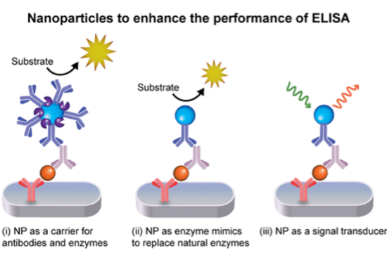
Graphical Abstract Figure
Also, referred to as a “table of contents figure”
Image like a thumbnail
Accompanies abstract and promotes article with a visual experience
Gao et al. 2019. ACS Applied Nano materials. https://doi.org/10.1021/acsanm.9b02003

Slide 45
Graphical abstract
Keep them simple, but not too simple
Tell a clear scientific story
Good graphic abstracts are:
Well-defined, informative, and appealing
CCS Chemistry Guidelines for Table of Contents Graphics
https://www.chinesechemsoc.org/pb-assets/css-documents/CCSC%20TOC%20Guidelines%20FINAL-1599077939047.pdf

Slide 46
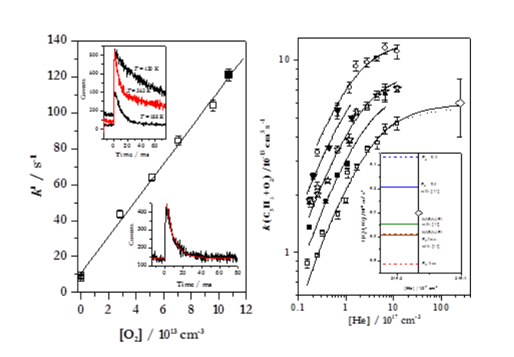
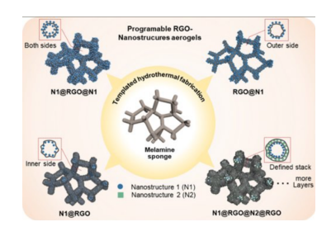
Graphical abstracts: Which one is better?
CCS Chemistry Guidelines for Table of Contents Graphics
https://www.chinesechemsoc.org/pb-assets/css-documents/CCSC%20TOC%20Guidelines%20FINAL-1599077939047.pdf

Slide 47
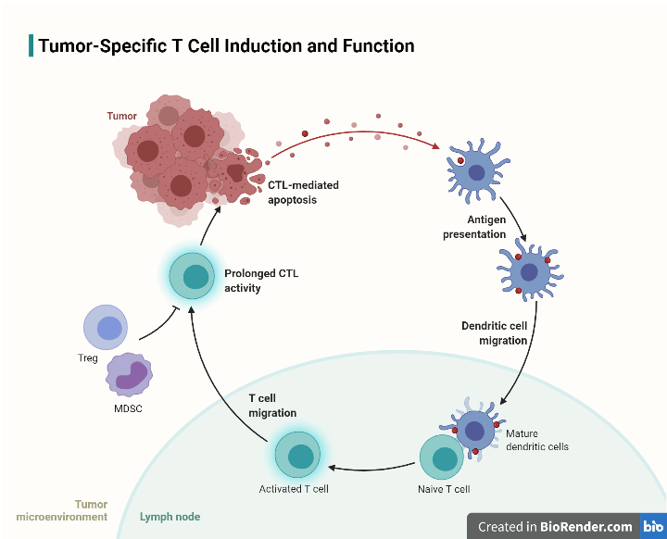
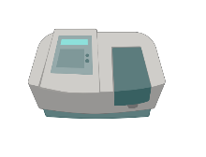
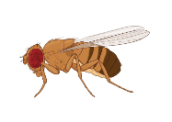
What if I’m not a great artist?
Use websites like BioRender for cartoons
ChemDraw for chemical structures
Adobe Illustrator

Slide 48

Video Abstracts
Like a graphical abstract, except a video
Expected for video journals
JoVE and Cell
Great to promote your article (your website or twitter)

Slide 49

Video Abstract Example
Lucian Livadaru et al 2010 New J. Phys. 12 083018

Slide 50
Tips for making a Video Abstract
Make it short (2-5 mins)
Write a script/outline
Ask library for video equipment and video editing software advice
The University of Oklahoma University Libraries has a helpful website
https://libraries.ou.edu/content/make-video-abstract-your-research

Slide 51
Final advice

Slide 52
Ask someone for comments!
Revise, revise, revise
1st draft is never your final draft
Ask your advisor or lab mates for comments
Make an appointment with a GWL consultant!
Great for unbiased feedback from a general audience

Slide 53
Questions to get you started
Introduction (1-3 Sentences) | Why is the problem you studied important to the audience?
Research Gap (1 Sentence) | What information is missing from the field that you needed to address?
Methodology (1-3 Sentences) | How did you go about obtaining this information? What instruments/models/sample sets etc. did you use to find the information?
Results (1-3 Sentences) | What were your key findings?
Conclusions (1-2 Sentences) | What did you conclude based on these findings and what are the broader implications?

