Slide 1
Leveraging a token economy to motivate concept practice in a fluid dynamics classroom.
Sanha Kim ª, Steven Caliari ª, and Roseanne Ford ª
Department of Chemical Engineering
May 1st, 2024

Slide 2
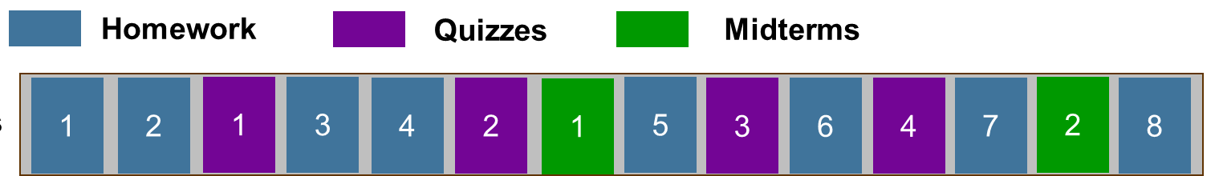
Promoting student motivation to practice concepts without relying on assessments
AUTONOMY
EXTERNAL FACTORS
Extra-curriculars
Part-time
employment
COMPETENCE
RELATEDNESS
CLASSWORK
MOTIVATION
Professional development
If effective habits of practicing concepts can give students the ability to influence their grade performance, they would likely be more motivated to do this activity.
Zuckerman, M. et al. Personality and Social Psychology Bulletin, 1978; Black, A. E. & Deci, E. L. Science Education, 2000.
Notes:
Goal of any core curriculum class is to maximize the number of practice opportunities students encounter for a concept. Convention is to pack all this into homework, quizzes, and exams but are there ways to motivate students to attempt conceptual practice without an assignment.
From the students’ perspectives this dense classwork schedule poses more challenges than just problem sets. The strict schedule around when all these assessments are administered can be vulnerable to external factors that may prevent students from exhibiting their best performance. And this relationship might be where we can promote practice motivation.
Self-determination theory of motivation

Slide 3

Offering and managing motivational rewards through a token economy (TE)
Stages of Token Economy Interaction
Motivated to earn more tokens
Student exercises target behavior
Verified by instructor
Student purchases a reward
Student acquires token(s) from instructor
Instructor confirms transaction rules are met
Student exchanges token(s) with instructor
Opens the opportunity for
Ivy, J. N. et al. Behavior Modification 2017; Heiniger, S. N. et al. Beyond Behavior 2022
Notes:
One strategy that my team and I believe helps neatly organize these processes is a token economy. Under

Slide 4



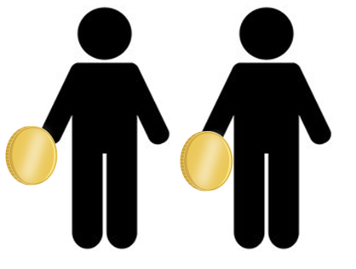


Integrating the TE system to the classroom
Tracking token transactions and balances.
Tokens are not transferrable between students.
Translating non-assignment concept practice as the target behavior.
  Is the overall process to acquire a token accessible for all students?
Gomez C. J. et al. J. Scholarship of Teaching and Learning, 2020; Rivera, C. J. College Teaching, 2019
Notes:
Intrinsic vs extrinsic motivation

Slide 5

How our TE motivated students to revisit and practice concepts
Token Production Schedule*
Token Exchange*
Reward
All students begin the course with a starting balance of 3 tokens.
Completing a class participation “milestone” adds 1 token to their balance
Tokens purchase opportunities to reattempt homework & quizzes.
Reattempts refund back half the missed points for that assessment.
Students must identify the original error(s) & explain how their resubmission fixes the error(s).
$$1/2$$
*students had to notify instructor of TE interaction

Slide 6
How our TE approached motivating students to revisit and practice concepts
Token Production Schedule*
Token Exchange*
Less restrictive
Cheaper to do
Token Production Milestones
Signed team contract for group design project
Attended class & participated in iClicker polls for 18 lectures
Attended class & participated in iClicker polls for 27 lectures
Submitted at least 2 Writing Reflection assignments
Engaged with & posted messages to the class Piazza discussion board at least 2 times
Exchange Description | Token-Exchange Cost | Exchange Production Schedule
Resubmit 1 homework to recover 1/2 of all missed points | 1 token | Up to maximum token count
Resubmit 1 quiz to recover 1/2 of all missed points | 1 token | One-time
Drop 1 homework score from Homework grade calculation | 2 tokens | One-time
Drop 1 quiz score from Quiz grade calculation | 2 tokens | One-time
*students had to notify instructor of TE interaction

Slide 7
SoTL investigation on TE strategy in a fluid dynamics classroom
RESEARCH QUESTIONS
Can student motivation for concept practice via reattempts of older assignment be increased through a TE exchange process?
What holistic influences (i.e. learning experience, student time investment) does a TE introduce to a ChE class?
Token Metadata
Student Surveys (Mid- & End-of-Semester)
How many tokens did a student use?
How many tokens did a student acquire?
How much time did students delegate?
Did the token economy change how students approach assignments?

Slide 8
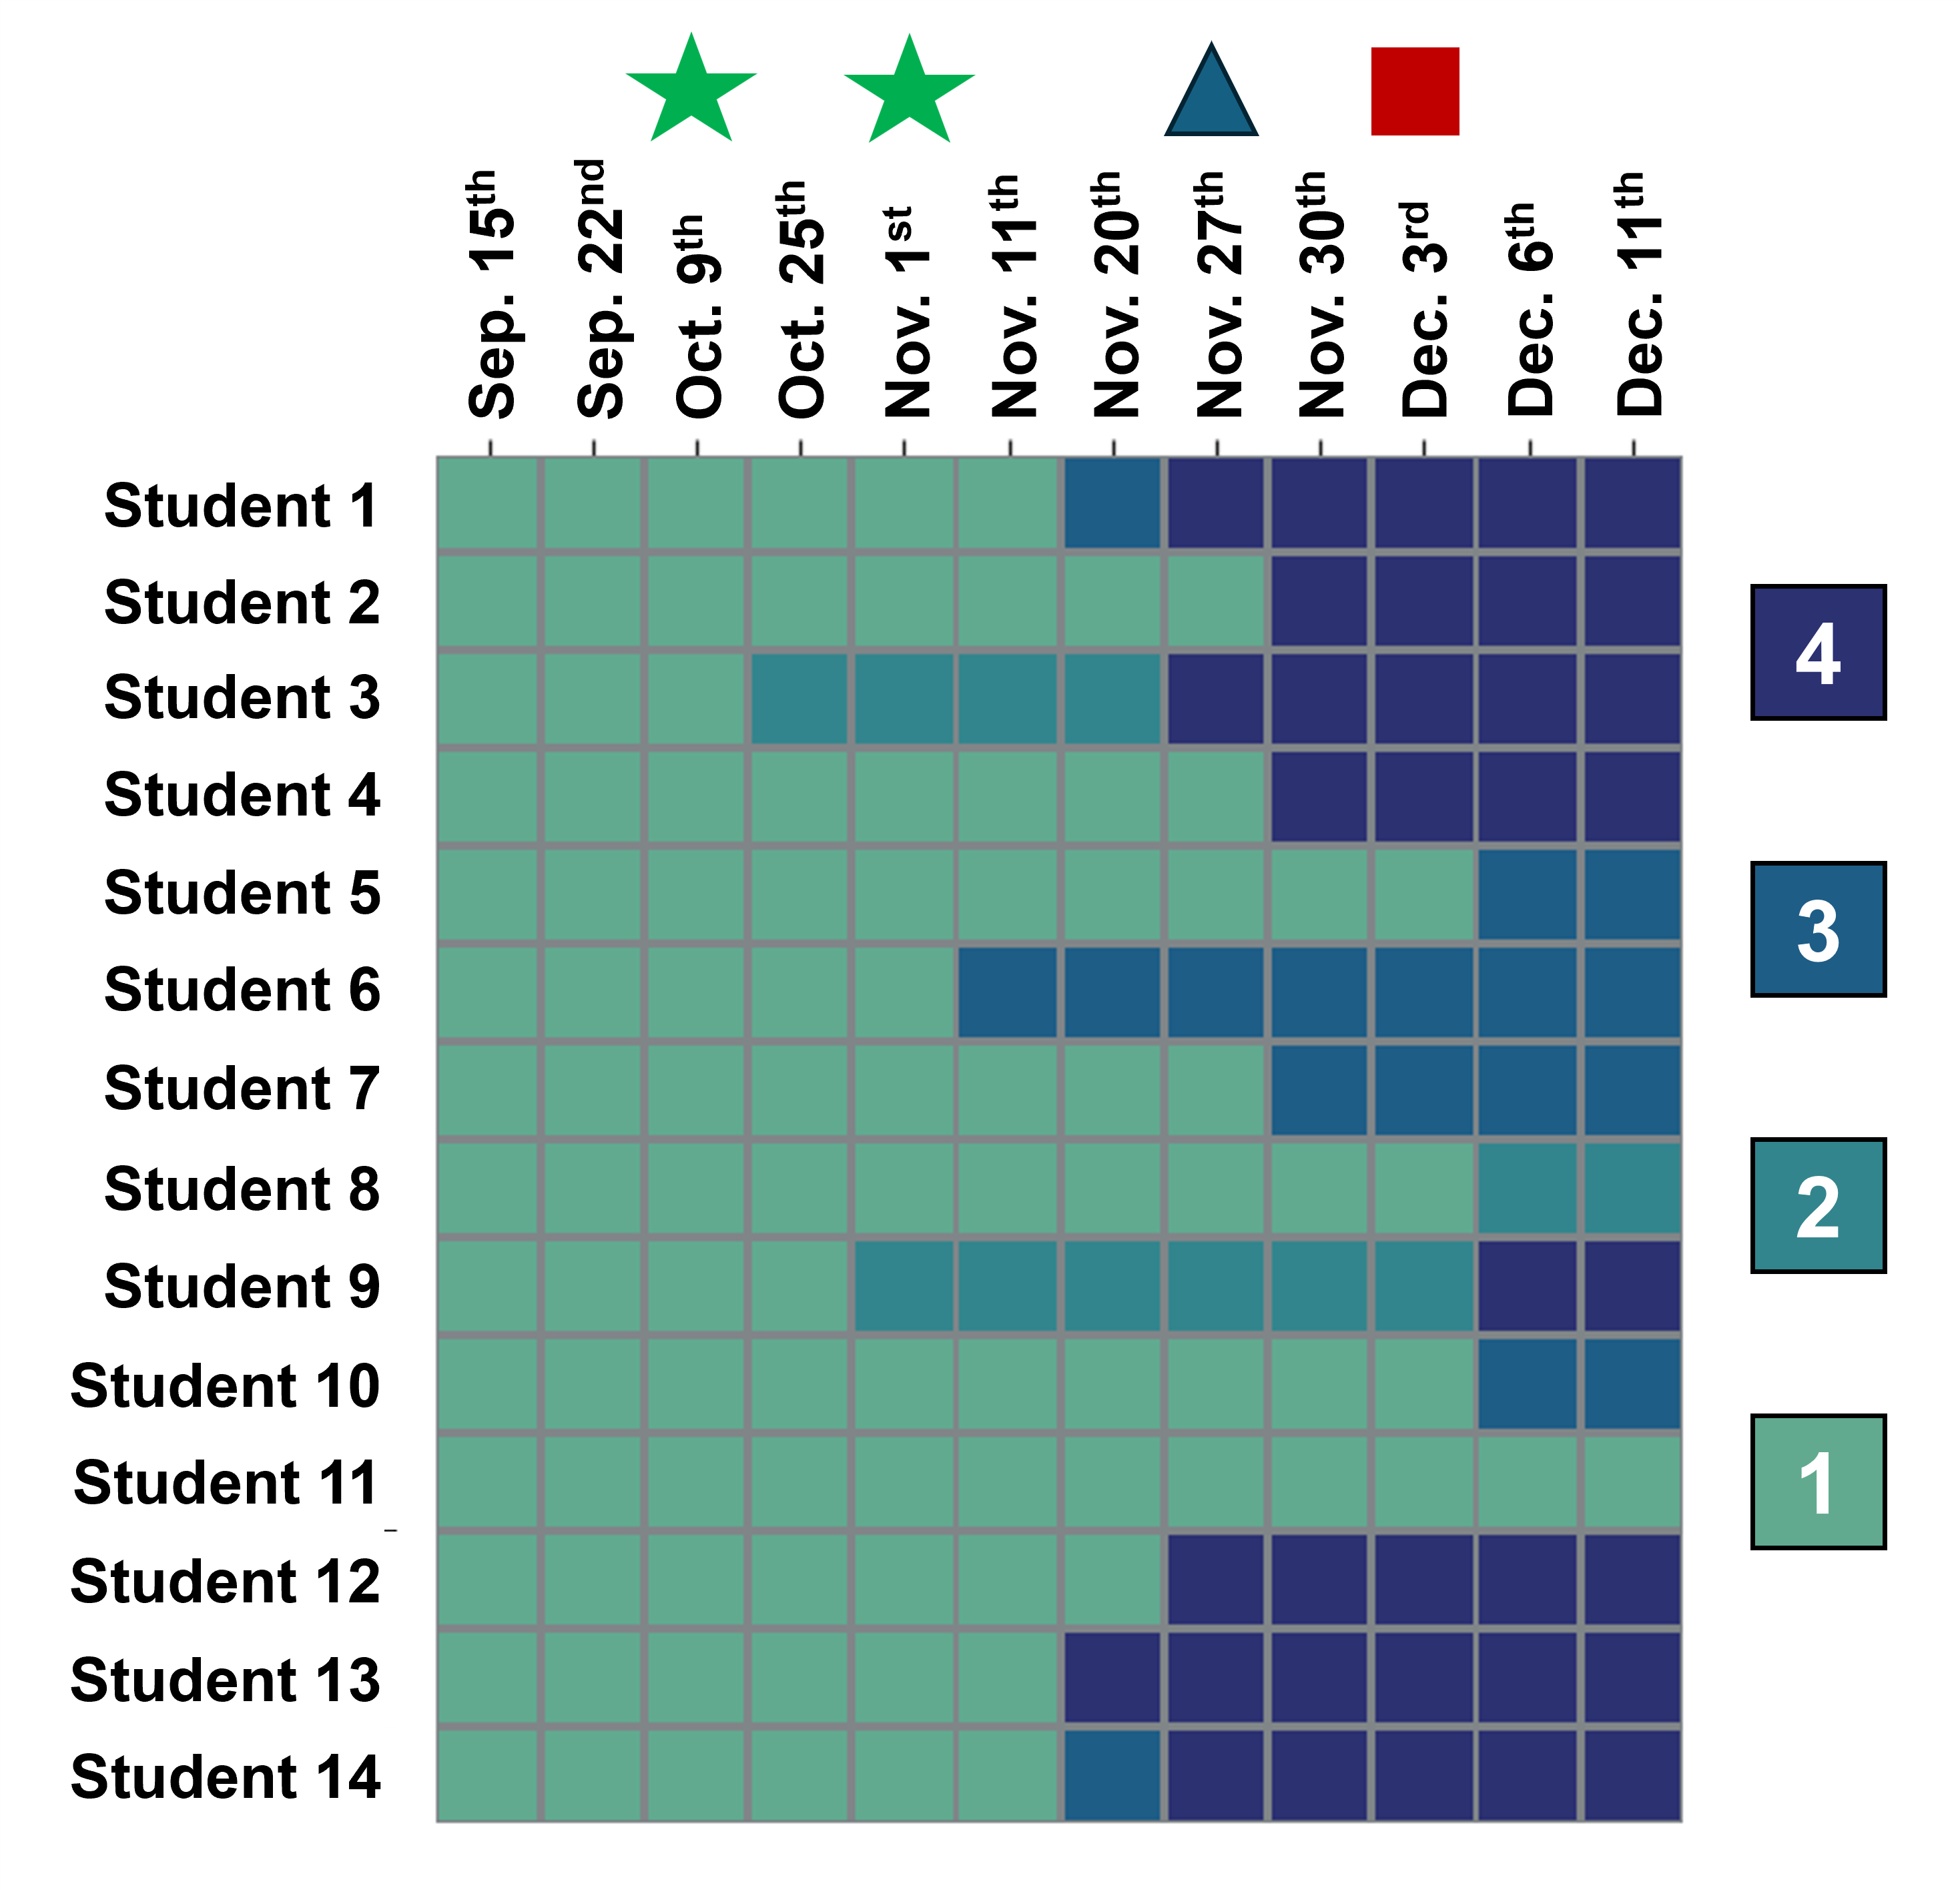
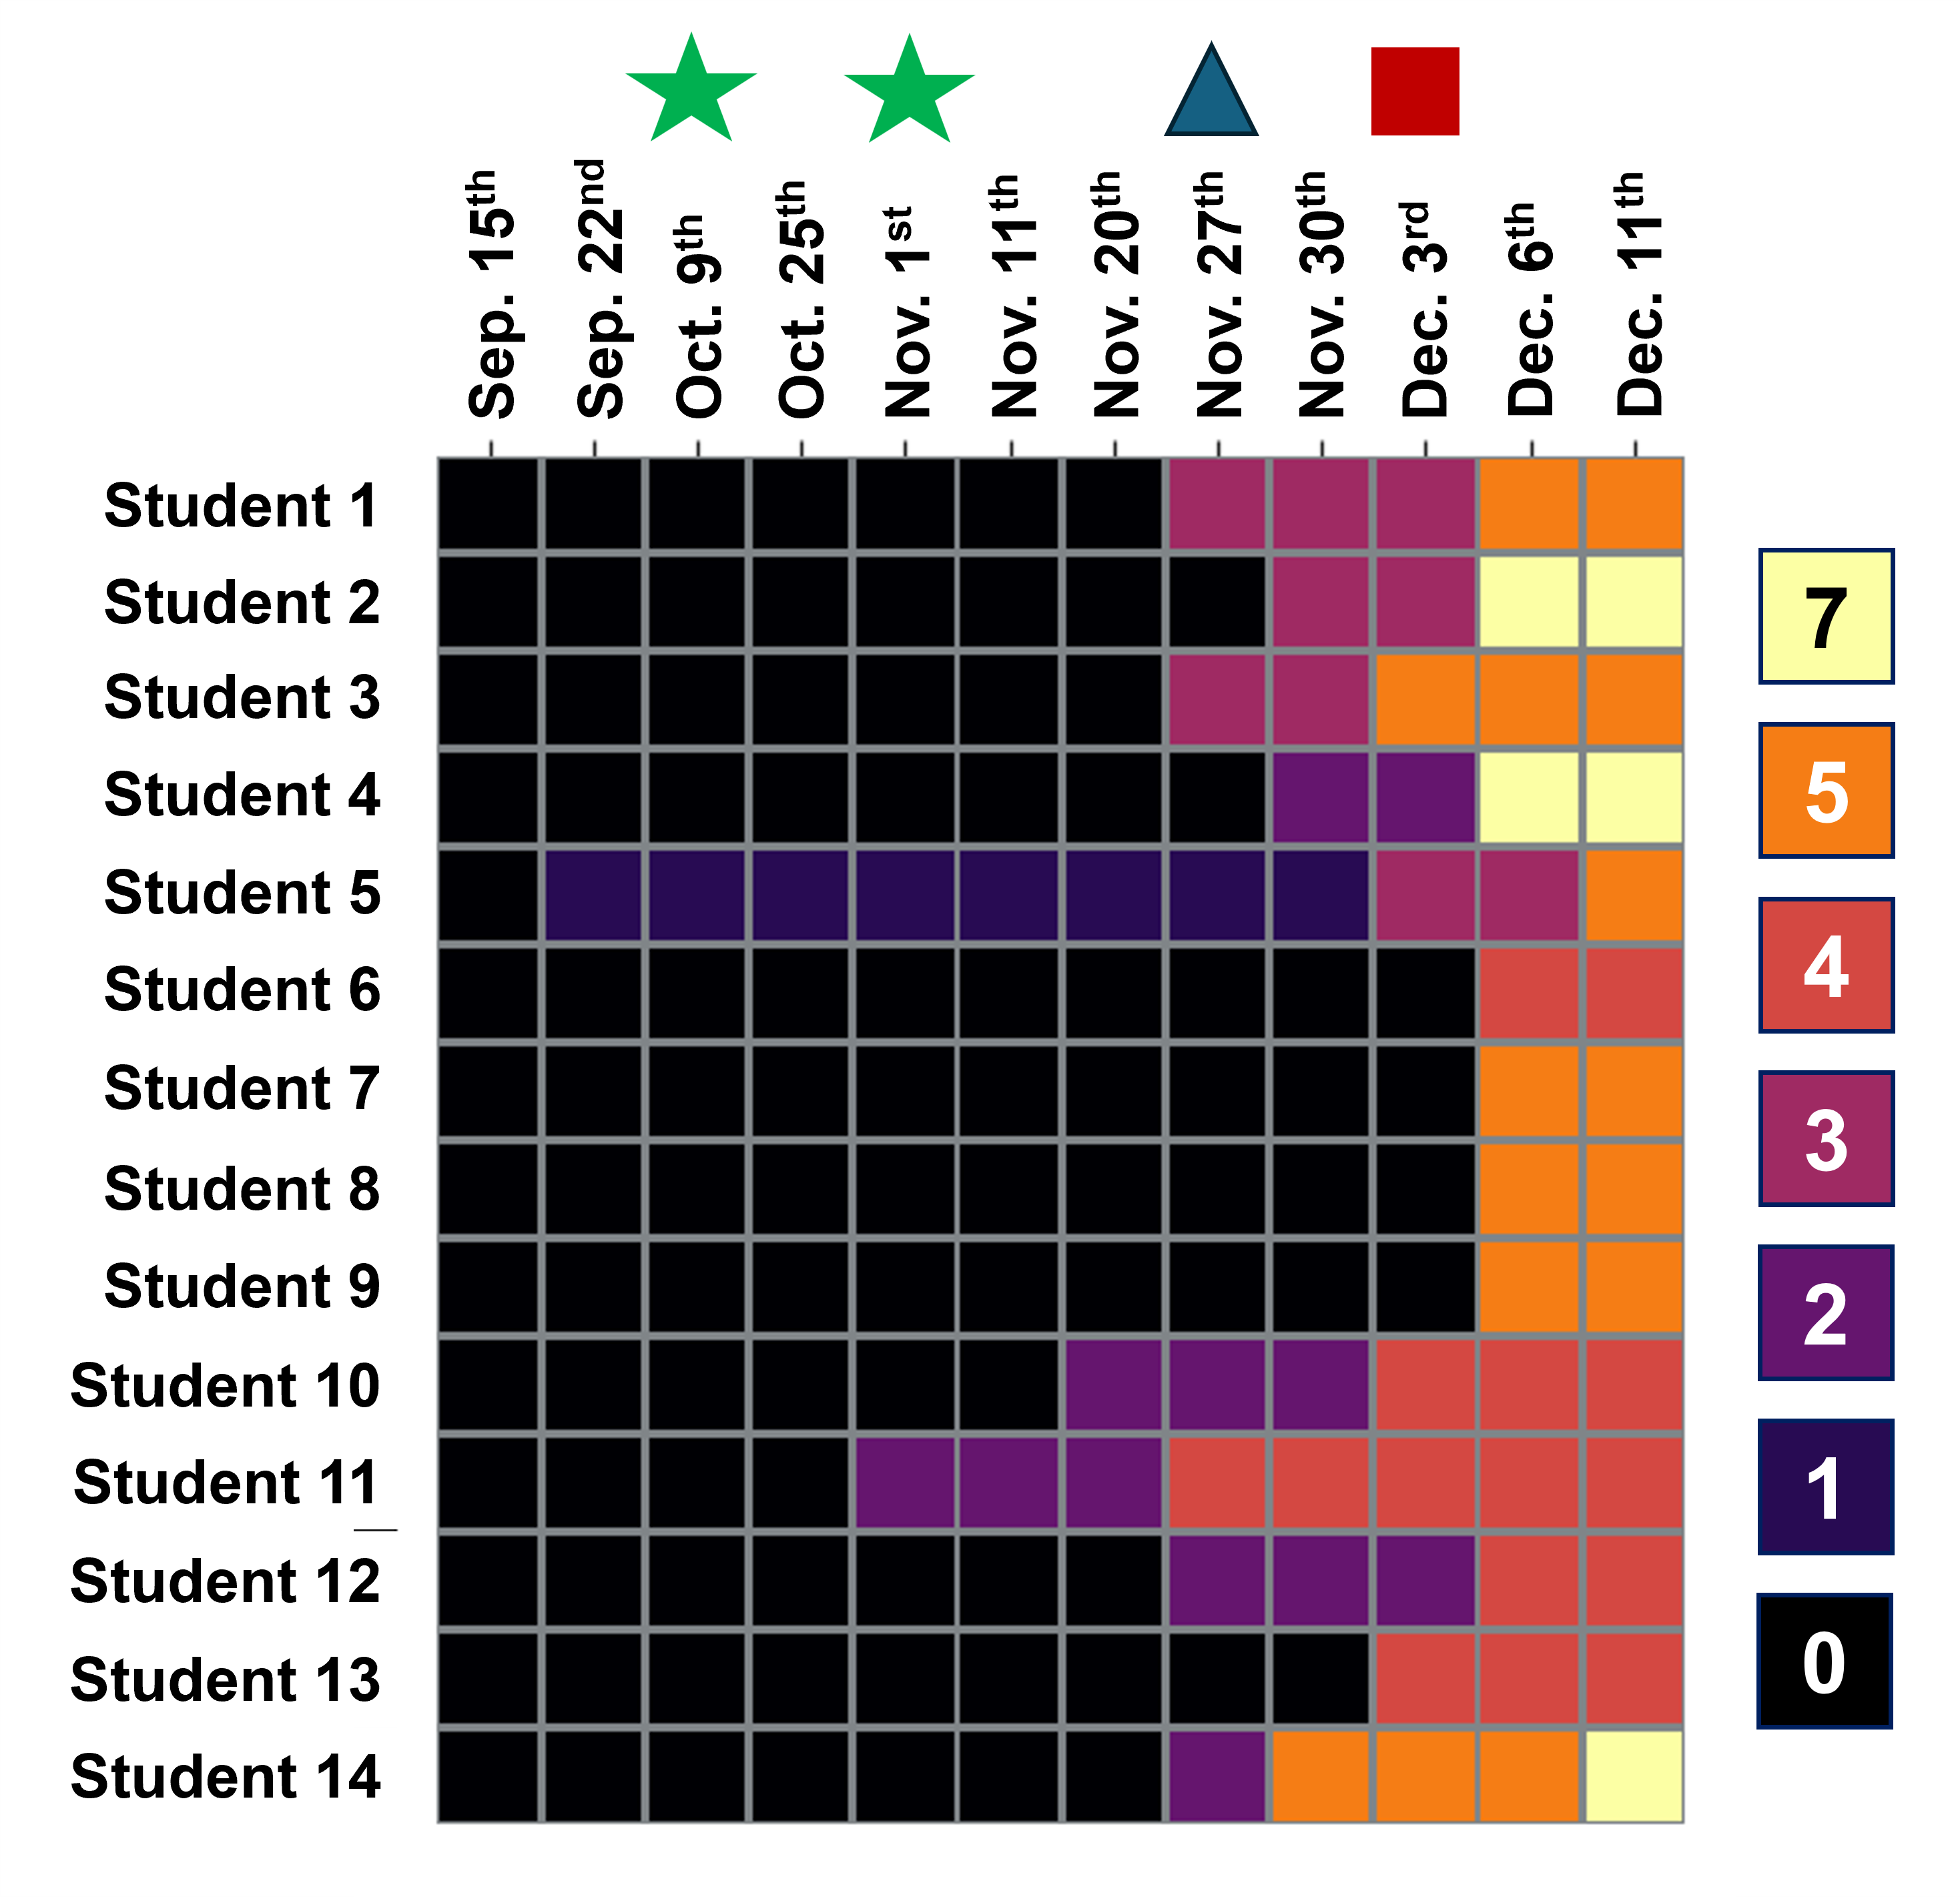
Student token balances experienced highest activity near the end of the semester
# of Tokens Earned Over Time
# of Tokens Exchanged Over Time
Midterm
Exam
Last Quiz
Grade
Released
Last HW
Grade
Released
Sharpest changes in token numbers occurring around when the last assignment grades were published.

Slide 9

Shortcomings of a frequency-based exchange schedule
# of Tokens Exchanged Over Time
Limiting the frequency of exchanges but not the time for transactions encouraged token “hoarding”.
Exchange Description | Exchange Production Schedule
Resubmit 1 homework to recover 1/2 of all missed points | Up to maximum token count
Resubmit 1 quiz to recover 1/2 of all missed points | One-time
Drop 1 homework score from Homework grade calculation | One-time
Drop 1 quiz score from Quiz grade calculation | One-time

Slide 10
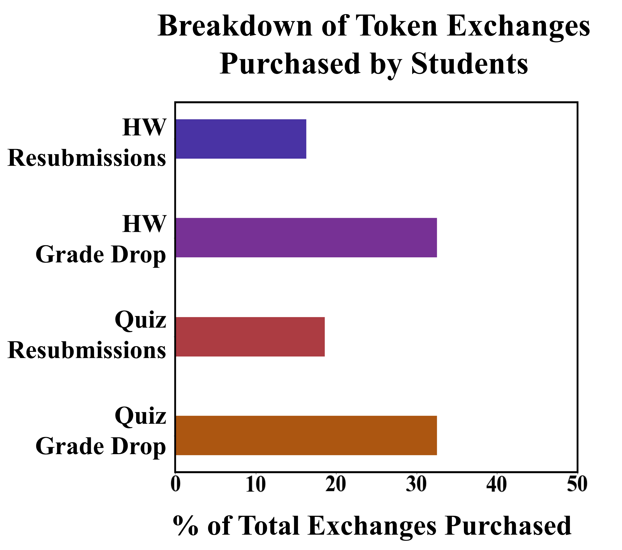
Students favored purchasing exchanges that offered higher reward values
Exchange Description | # of Unique Students Who Purchased Exchange
Resubmit 1 homework to recover 1/2 of all missed points | 4
Drop 1 homework score from Homework grade calculation | 14
Resubmit 1 quiz to recover 1/2 of all missed points | 8
Drop 1 quiz score from Quiz grade calculation | 14
Component | Weight Toward Final Grade | Final Grade Weight Per Assignment
Homework | 15% | 1.9%
Quiz | 12% | 3.0%
Midterm | 30% | 15%

Slide 11
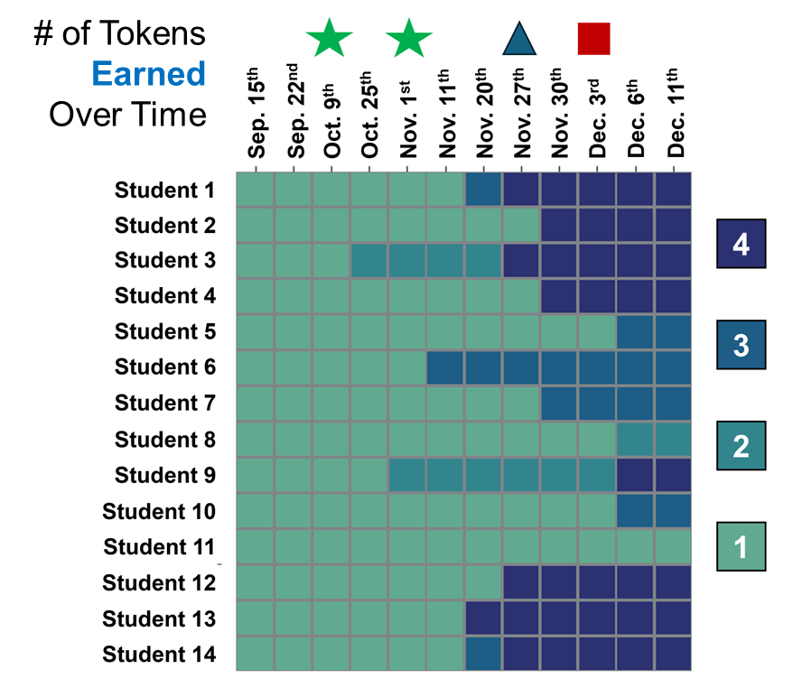

Fewer students completed token production events that required extended participation
Token Production Milestones | # of Unique Students Declaring Milestone
Signed team contract | 14
Attended & participated in iClicker polls for 18 lectures | 13
Attended & participated in iClicker polls for 27 lectures | 10
Submitted at least 2 Writing Reflection assignments | 9
Engaged with & posted messages 2x to the class Piazza discussion board | 1
As students had to self-report completing the production events, it is also possible students lost track of their progress.
Instructors also had the least involvement in generating opportunities for discussion posts.
Notes:
Dissecting the “supply” what tokens students earned

Slide 12
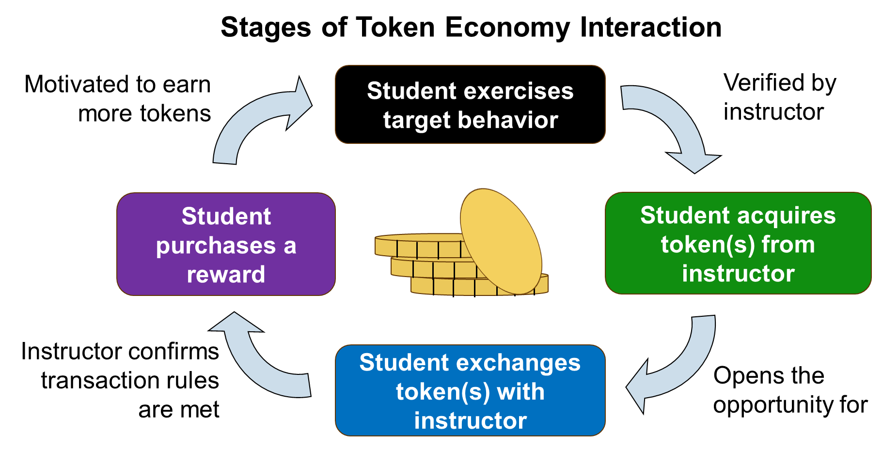
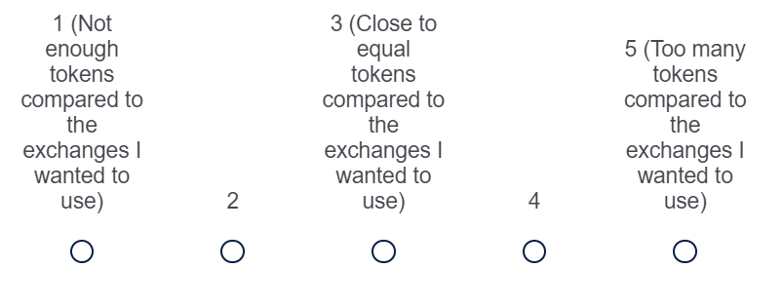
TE exchange production schedule & rewards did not motivate regular token generation
From End of Semester Survey:
“How would you characterize the relationship between the number of tokens you received and the number of token exchanges you wanted to use?”
Homework resubmissions lacked the reward incentive to motivate students to earn tokens.
71% of students (n = 10) describing that they had acquired close to equal or more tokens to use for the exchanges they wanted to purchase.

Slide 13
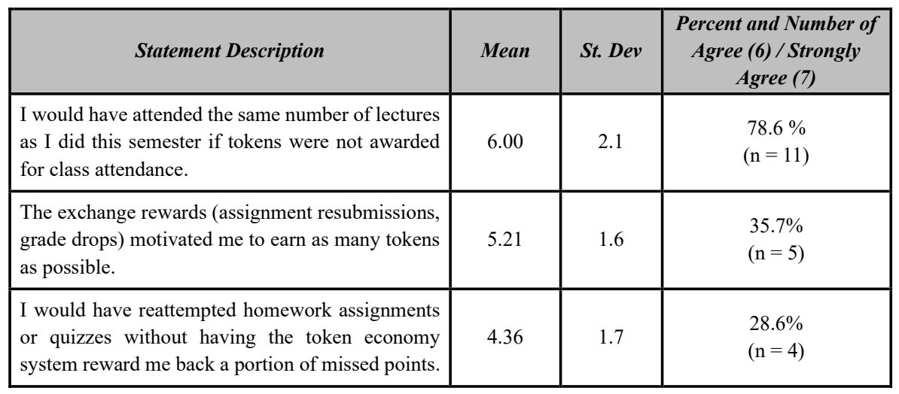
TE influences on student motivation
Likert questions (scale 1-7) were presented to students addressing if the TE incentivized:
Lower consensus agreement suggests that TE rewards motivated behaviors that would have otherwise not been practiced by some students.
Attending classes
Acquiring
tokens
Reattempting homework assignments or quizzes
Notes:
This (homework resubmissions having low reward) scenario is also supported by Likert question responses students submitted during their end-of-semester survey. Here we offered students levels 1-7 to characterize how a statement applies to them.

Slide 14
Takeaways of TE as a strategy to motivate concept practice
The extrinsic motivation of TE rewards can get students to exercise a goal-directed practice outside of assignments and in-class instruction.
In a TE, the inclination for students to perform the target behavior (concept practice) is tied to the schedules of token production and exchange availability.

Slide 15
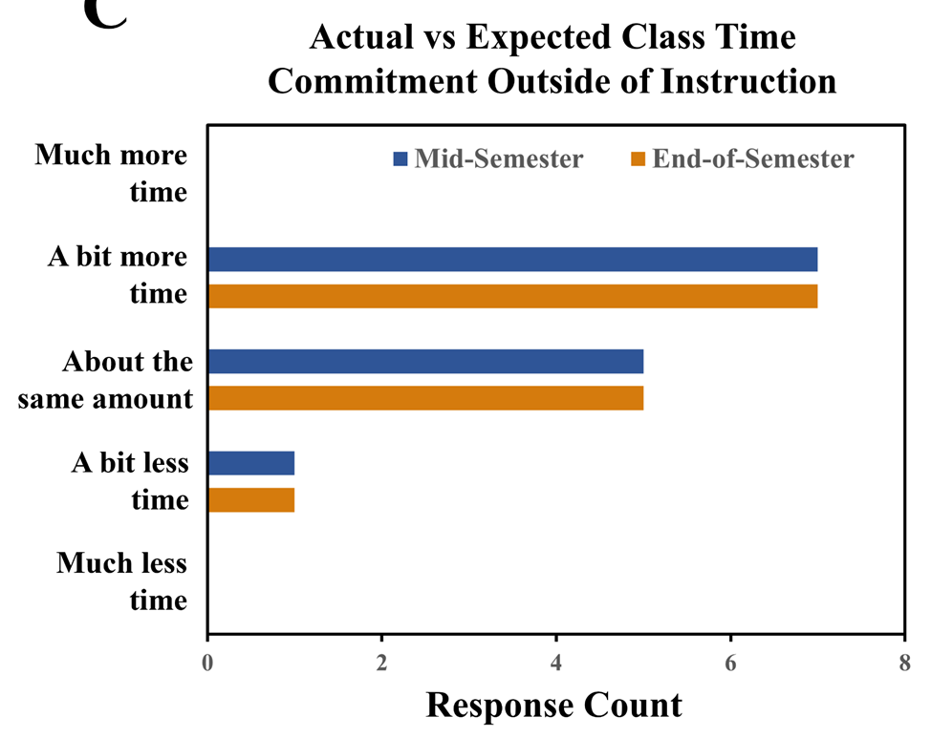
TE did not drastically shift class time commitment away from student expectations
Students who performed more resubmissions also self-reported committing more time outside of instruction preparing for the class as the semester progressed.
Sporadic interactions among students may have also reduced the perception of added commitments caused by the TE.
Notes:
Regardless of the wide range of times that students delegated to the class, they fell within or close to the amount of time students originally expected to commit.

Slide 16
Majority of students did not perceive the TE as impacting how they learn in the class
How, if at all, did the TE influence how you approached or perceived homework problem sets during your first assignment attempt? No effect (n = 8) | “I still treated each homework assignments as seriously as I would if I had no tokens available”
How, if at all, did the TE influence how you approached or perceived studying for quizzes? No effect (n = 12) | “I always still tried my best on quizzes with the hope that I would not have to use a token”
How, if at all, did the TE influence your learning experience outside of homework and quizzes? No effect (n = 11) | “I don’t think the TE influenced my learning experience outside of homework and quizzes because tokens weren’t what motivated me to come to class.”
Responses align with most TE interactions occurring after assignments were completed and graded.
Further emphasizes that concept practice behaviors had to be done more frequently by students for the TE to change learning experiences.

Slide 17
Students that noted perceivable TE impacts frequently cited stress reduction
How, if at all, did the TE influence how you approached or perceived homework problem sets during your first assignment attempt? Perceivable effect (n = 6) | “It was definitely a safety net when doing assignments… encouraged me to attempt the assignments first without worrying as much.”
How, if at all, did the TE influence how you approached or perceived studying for quizzes? Perceivable effect (n = 2) | “It also made taking quizzes less stressful… It’s reassuring to know that if you fumble one quiz you can still recover it.”
How, if at all, did the TE influence your learning experience outside of homework and quizzes? Perceivable effect (n = 3) | “It made it a lot less stressful to complete the assignments and allowed me to devote more energy towards learning the concepts.”
Similar unprompted responses were reported by Gomez et al. 2020 studying a TE & undergraduate students in a human physiology course.
In an interval grading system, methods for reducing how early mistakes impact academic evaluation may result in a:
  Less stressful course experience
  A more equitable assessment demonstrating how students improved.
Gomez C. J. et al. J. Scholarship of Teaching and Learning, 2020

Slide 18
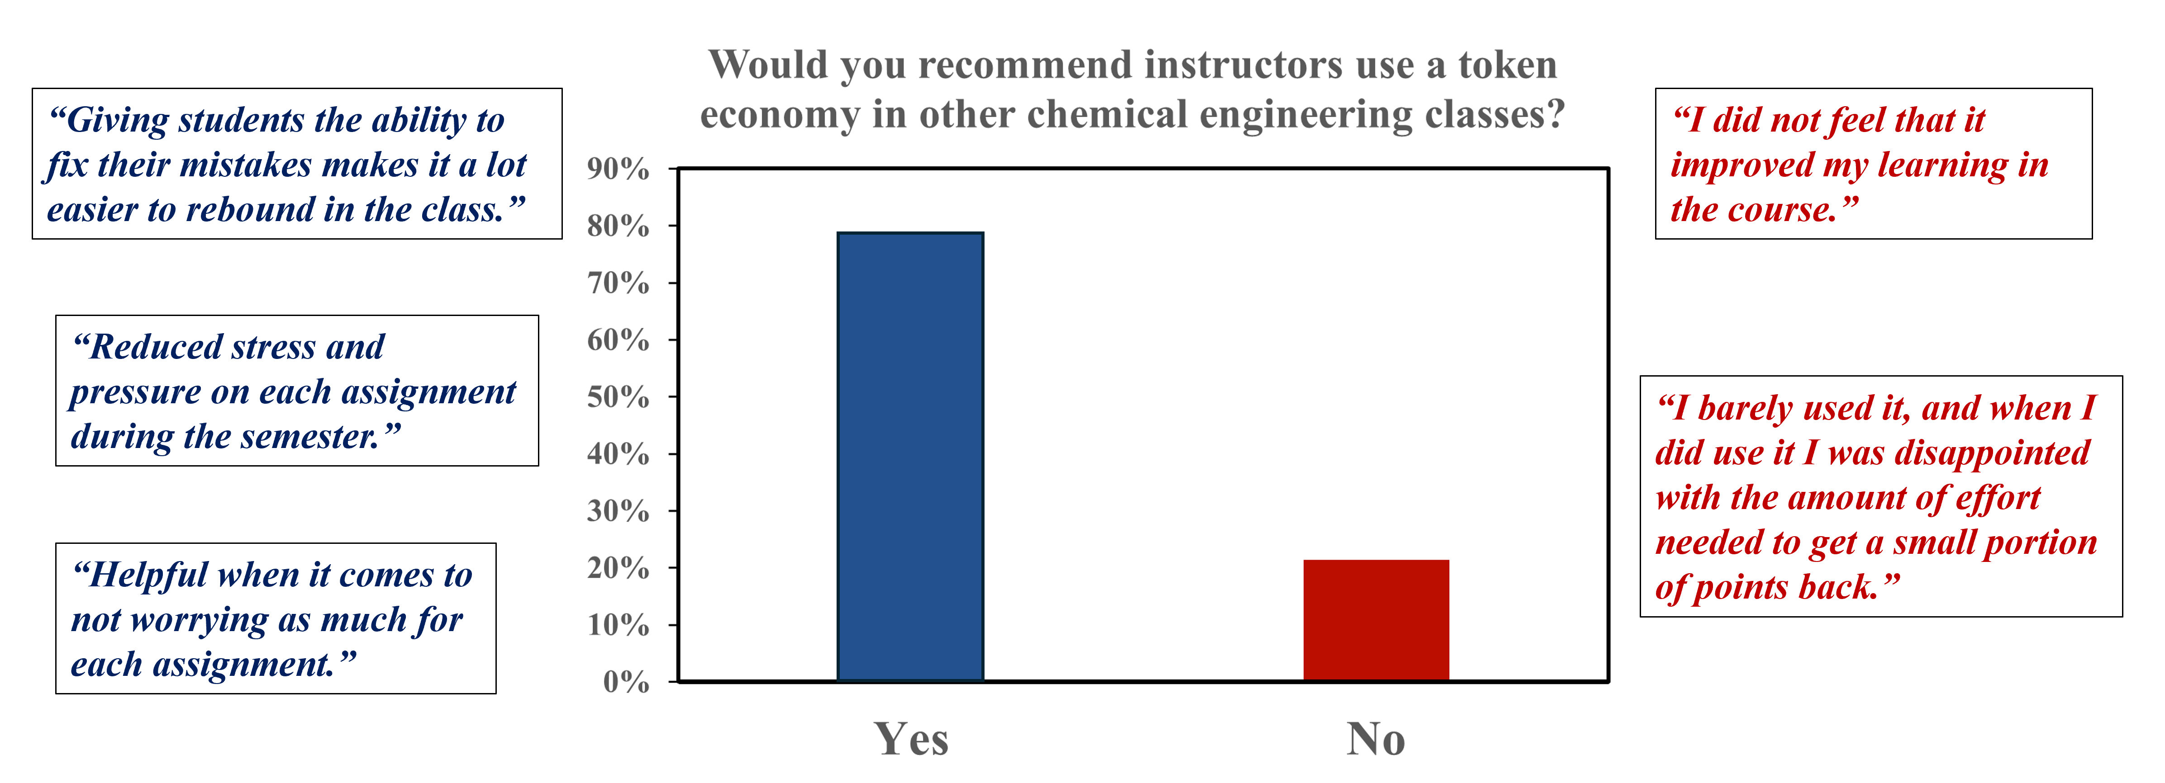
Student perspectives on continuing TE implementation
79% of students (n = 11) were receptive to the TE being a more widely used strategy in the ChE department

Slide 19
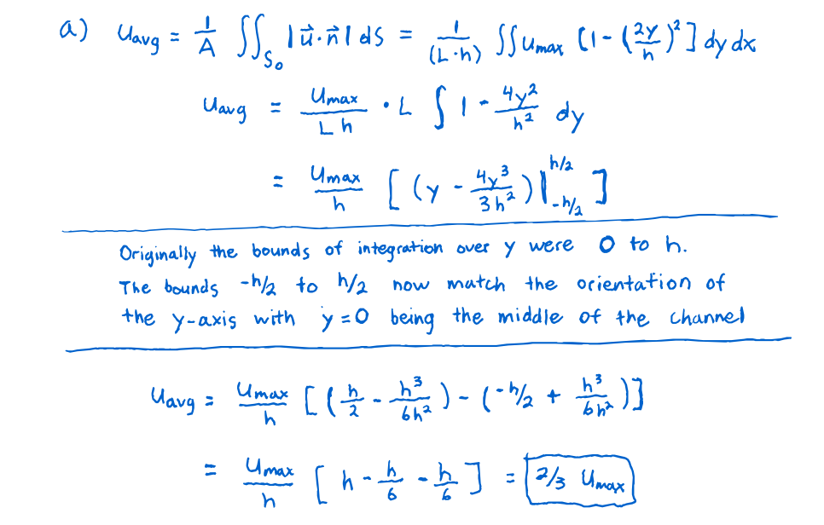
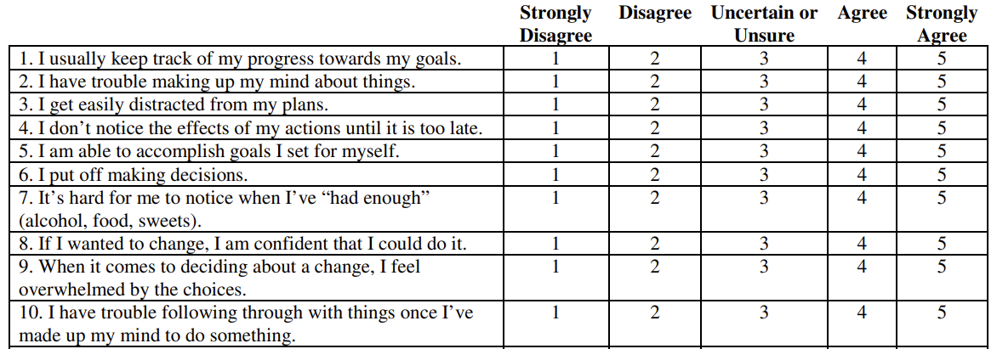
Planned future work
Refine TE schedules
Introduce time limitations around when exchanges can be performed.
Include concept practice in token generation through worked examples.
Refine methods to assess student motivation
Academic Self-Regulation Questionnaire
Notes:
Worked examples asking students to identify purposefully designed errors.
Implemented Likert questions were non-specific in how students could report motivation. Self-regulation questionnaires being able to dissect how students are natively extrinsically and intrinsically motivated. Valuable to determine if the TE strategy is more beneficial for to one learning style vs another

Slide 20





Acknowledgements
The Instruction Team
Advisor:
Prof. Roseanne Ford
Support from:
School of Engineering & Applied Science - Teaching Fellowship Program
Professor Steven Caliari
Teaching assistant:
Riley Dickson
Grading assistant: Olivia Wilkinson
All FA23 CHE 3321 students
Dr. Jessica Taggart

Slide 21
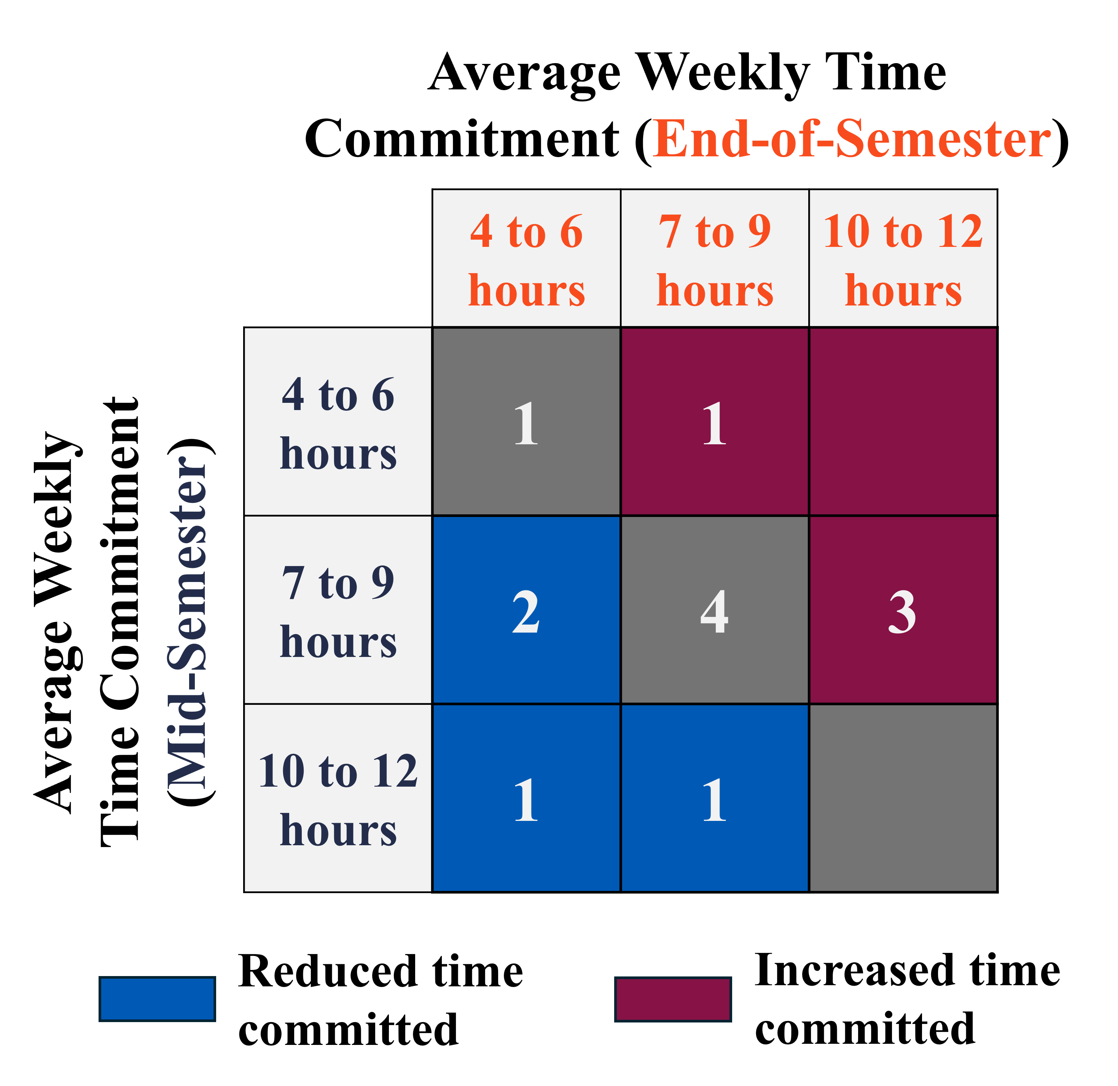
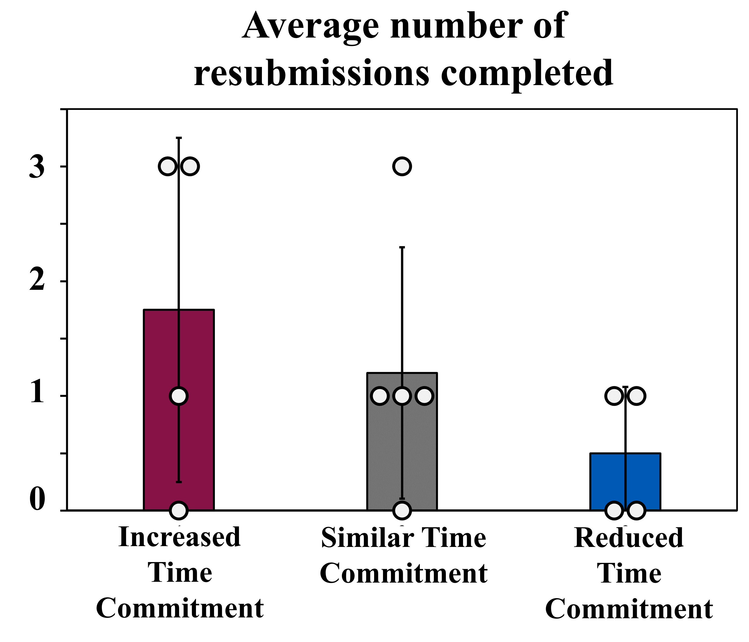
Holistic impacts of the TE – Student time commitment
Mid-Semester & End-of-Semester Survey Question:
The average number of hours I spent outside of class preparing for this course was: ______

Slide 22
Instruction of a content-packed curriculum constrains time to practice said content
Ideally, students receive frequent practice opportunities that:
  Expose students to concepts under different contexts
  Help recall previous material and maintain older concepts over the semester
Can we increase a student’s motivation to practice concepts without tying it to another assessment?
How can this be actualized?
  Adding more summative assessments would likely overwhelm students.
  Adding to homework problem sets takes away opportunities to practice concepts currently being taught.
Homework
Quizzes
Midterms
1
2
1
3
4
2
1
5
3
6
4
7
2
8
Enter class
Final Exam
Ambrose S. A. et al. “How learning works: Seven research-based principles for smart teaching. John Wiley & Sons, 2010
Notes:
Major momentum transfer concepts (Navier Stokes) that we wish to pass on to students are context dependent.
Practice is not only necessary to illustrate different contexts but valued if there are older concepts that should be maintained

