Slide 1
Word for Dissertation & Document Formatting
Maria Panepinto, GWL Consultant
Kelly J Cunningham, Director
Graduate Writing Lab
School of Engineering & Applied Science, University of Virginia
This work is CC-BY and must include full citation & DOI. Individual images and examples & materials from other sources are not CC-BY. Blue dino is a GWL icon & not CC-BY.

Slide 2
What will we talk about today?
How to use Word to its fullest capacity
Things you may not know Word can do
Formatting a dissertation & other documents
General outline

Slide 3
General Article Flow
Introduction
Methodology/Experimental Section
Results/Discussion
These may have separate sections
Conclusion
References

Slide 4
General Dissertation Flow – article based
Standard title page
Varies by discipline
Acknowledgements
Abstract
Table of Contents
List of Figures
List of Tables
General Introduction
Lit Review (optional)
Topic/Aim 1:
Specific Introduction
Methodology
Results/Discussion
Conclusion
Topic/Aim 2:
Topic/Aim 3:
Conclusion
Appendix
Notes:
Each of the three body chapters is set up as a standalone but related article with its own IMRD set up. It does not need to be an actual submitted or published article. Check with your committee on specific requirements for your dissertation. If you are including published content, be sure to check with your committee and the publisher on what you may need to do. References for each chapter may be listed in the chapter itself or at the end of the dissertation. Check with your advisor/committee for which dissertation set up they expect from your work and where the references should be listed.
It is vital that the general intro and the conclusion show how the three body chapters/studies/papers come together in a cohesive whole.
Note- the number of body chapters (topic/aim/paper) is not set at 3. It could be a higher or lower number depending on local requirements and the nature of the work.
Work through an outline of what you feel would best fit your work with your advisor.
This is NOT the same by dissertation by/through publication that may be more common outside the US
Looking through the table of contents for past dissertations or theses in your lab or program may give you ideas for possible structures for your own. You might also ask your advisor for examples of particularly successful examples or examples they felt were well organized, formatted, or written to give you ideas.

Slide 5
General Dissertation Flow – traditional
Standard title page
Varies by discipline
Acknowledgements
Abstract
Table of Contents
List of Figures
List of Tables
General Introduction
Lit Review (Optional)
Methodology
Results/Discussion 1
Results/Discussion 2
Results/Discussion 3
Discussion/Conclusion
Appendix
Notes:
The dissertation as a whole is set up like a long IMRD(or other common research article structure in your area) with areas of results split into chapters. Discussion may be part of the results chapters (results & discussion 1,2,3 + conclusion) or could possibly be its own chapter or with the conclusion. The intro and conclusion cover the entire dissertation and help it to be a cohesive whole. References are listed at the end of the dissertation. Check with your advisor/committee for which dissertation set up they expect from your work and where they want the references listed.
The results are usually labelled meaningfully by content, not literally results 1,2,3
Note- the number of results chapters is not set at 3. It could be a higher or lower number depending on the nature of the work. It may also be a single results and a single discussion chapter. Work through an outline of what you feel would best fit your work with your advisor.
A masters thesis could look like a version of this. Always check with your advisor/committee to identify and clarify expectations for your work and deliverables. There may be additional guidelines.
Looking through the table of contents for past dissertations or theses in your lab or program may give you ideas for possible structures for your own. You might also ask your advisor for examples of particularly successful examples or examples they felt were well organized, formatted, or written to give you ideas.

Slide 6
Before You Start
Choose a style guide (IEEE, APA, etc.)
Covers more than citations and references
Covers all aspects of a document: language, voice, formatting
Use that style guide to make formatting decisions

Slide 7
Notes-
Use built in features such as numbered headings to improve navigation
Include captions
Be mindful of color choices and contrast throughout

Slide 8
How to Start
Want to make sure all your formatting/styling is done first
This way the product doesn’t require much rearranging
But you can go through and format after if need be

Slide 9
Margins
Layout > margins
Top/bottom: 1 inch
Left/right: 1.5 inches (bound margin needs to be 1.5”)
This depends on if you will print double sided
Typically printed single-sided when binding so only left margin needs to be wide
If printing double sided, left and right margins need to alternate large width (mirror-margins)
Or just make both wide

Slide 10
Fonts
Serif fonts (ones with little feet) are recommended for dissertations & any body text
Constantia (font specifically made to be easily readable on screen & in print), Times New Roman, Cambria, etc
Can use sans-serif for headings, if desired
Arial, Calibri
Must use sans-serif for text within figures
Serif font for captions- must match body text, may be smaller in some style guides

Slide 11
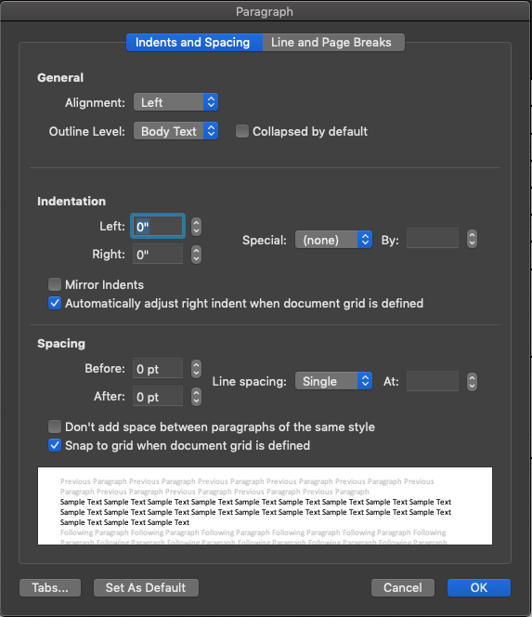
Paragraph Formatting
Very customizable
Shows preview
Usually same paragraph style throughout the document

Slide 12
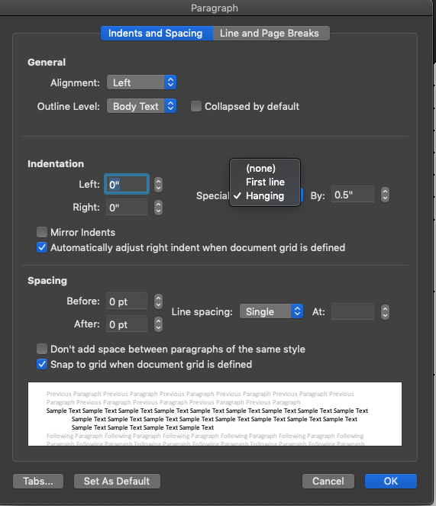
Paragraph Formatting
.5” is a standard indent
Check your style guide
Can also do a hanging indent (top line left, rest indented)
Useful for lists
This is used in APA reference list for instance

Slide 13
Paragraph Formatting
Standard – left justified with ragged right
Check your style guide
Sometimes you need a space between paragraphs
Again, check your style guide

Slide 14
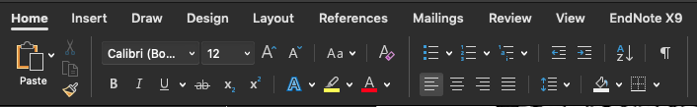
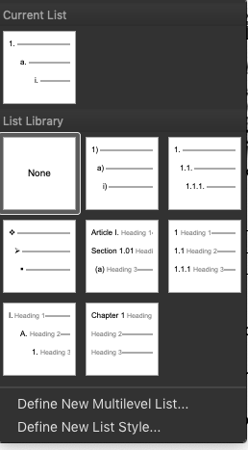
Bullets/Lists
You can insert bullets/numbered bullets
Format > bullets and numbering to restart list/continue with previous
Multi-level lists
You can define your own multi-level list
Which can then be used in your headings

Slide 15
Headings
Home tab > styles pane > headings
Select the text that is the heading & select the numbered heading style to apply it
Use numbered layers of headings (heading 1,2,3) for sections, subsections, etc.
Use heading styles to
Keep uniform formatting
Autogenerate a navigable outline
Autogenerate a table of contents
Allow for figure/table chapter/section specific numbering
Make a document accessible

Slide 16
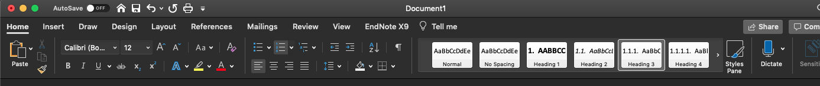
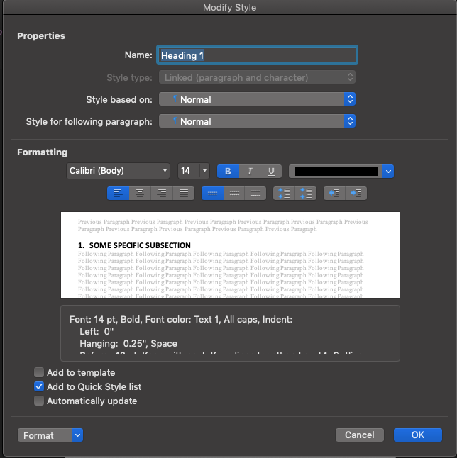
Headings- to change heading styles
Home Tab > styles pane > headings
Right click on the heading > modify
Match the heading styles to the style guide guidelines

Slide 17
Headings
Home Tab > styles pane > headings
Right click on the heading > modify

Slide 18
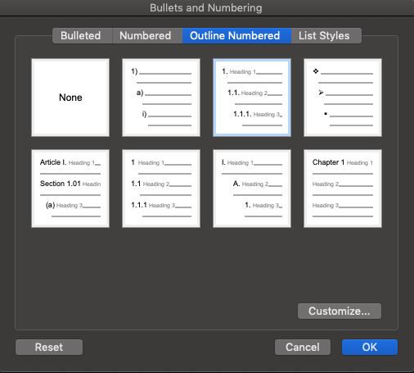
Headings
Home Tab > styles pane > headings
Right click on the heading > modify

Slide 19
Headings
Home Tab > styles pane > headings
Right click on the heading > modify
Choose outline numbered & select the same numbering system each time you alter a different heading level (heading 1,2,3)

Slide 20
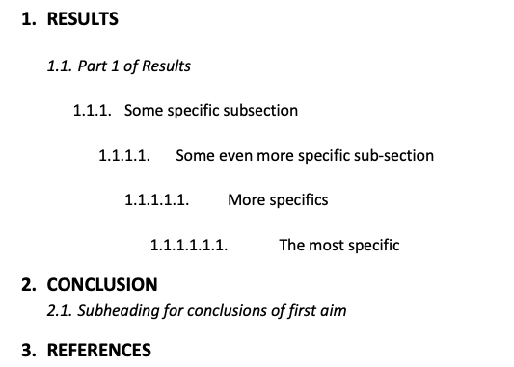
Headings - Example

Slide 21
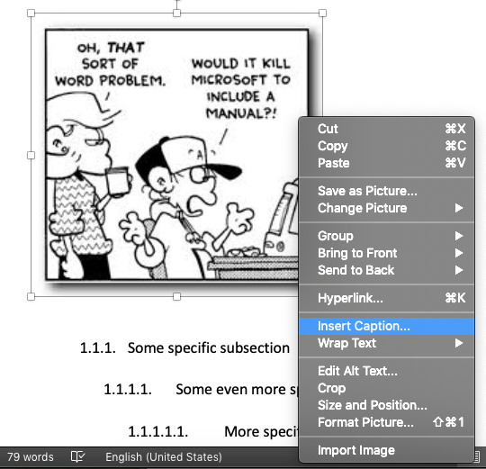
Figure Captions allow for
Automatic numbering of figures
Automatic generation of table of figures
Automatic numbering of references to those figures

Slide 22
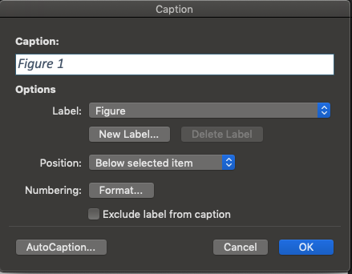
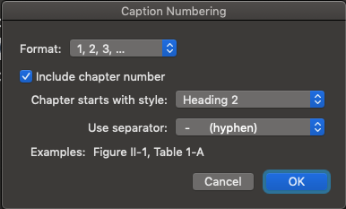
Figures and Captions
Insert figure in your document
Right click the figure> insert caption
Make sure you select “Include Chapter Number” and the correct heading so it automatically numbers your figures
Notes:
Note- you don’t have to do chapter numbers, but in a Dissertation it is very helpful. This is how you can get figure 2.1, 2.2 etc. Some journals have section numbered figures and you can use this for that as well. Otherwise it will just go figure 1, figure 2, throughout the whole paper.

Slide 23
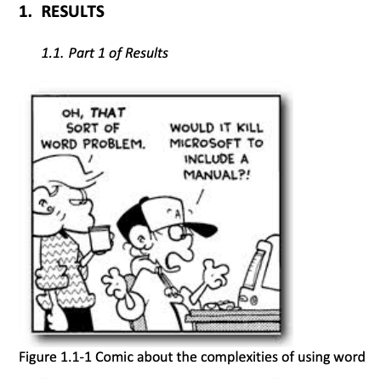
Caption Example
Pro-Tip: Edit the “Caption” style in the styles pane so you don’t have to reformat the caption each time

Slide 24
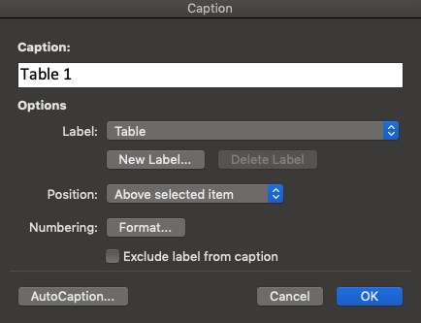
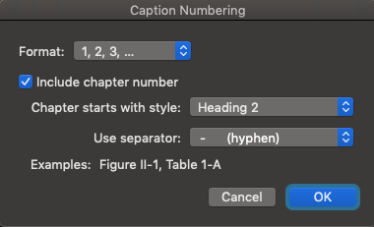
Tables and Captions
Same procedure to caption Tables
Note: Figure captions have traditionally gone below the figure & table captions go above the table, but some style guides (APA7) have changed so both go above

Slide 25
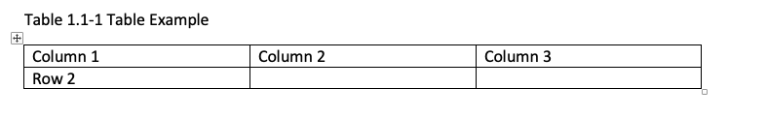
Table Example

Slide 26
Table Formatting
Make sure you check with your style guide about how to format tables properly
Word gives you a lot of presets, most do not adhere to guidelines
Allows you to easily add/delete/adjust cell/column/rows
ProTip: You can make your tables in excel and paste them into word
Notes:
While we’re on the topic of tables
Not going to go through this in depth because it very much depends on preference, just know you have options that are easily accessible
Can go into this more if there are questions

Slide 27
Cross-Referencing
Automatic numbering & updating of in text references to tables, figures, chapters, sections, etc.
Hyperlinked
Must use captions on tables/figures or numbered heading styles to use this feature

Slide 28
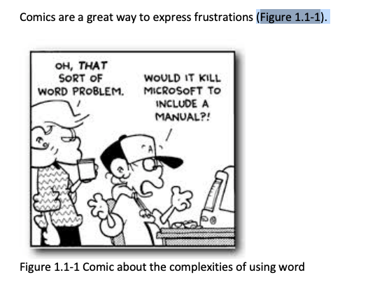
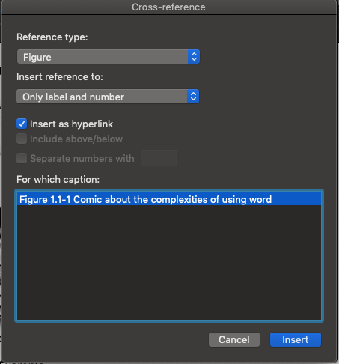
Cross-Referencing
Inserts reference as hyperlink so that as the figure #’s update, they update in-text too

Slide 29
Table of Contents, Figures, Tables, etc.
Automatically generate a table of figures, table of tables, table of contents that can be refreshed to update page numbers and contents as you revise your document
Must use captions on tables/figures or numbered heading styles to use this feature
I wouldn’t do this until you’re done with your dissertation – last step
Refresh it at the very end to update any edits
Notes:
Insert->index & tables-> table of contents
Show the number of levels you want, can format here
The table of figures tab will let you generate a table of figures or table of tables, etc.
the page numbering can be refreshed to update as you move things around in the text.

Slide 30
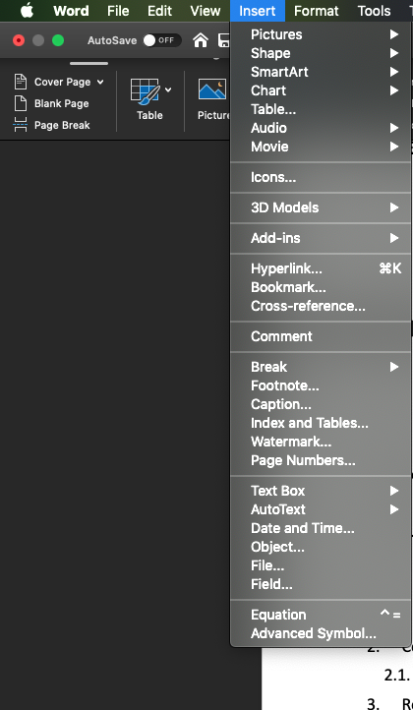
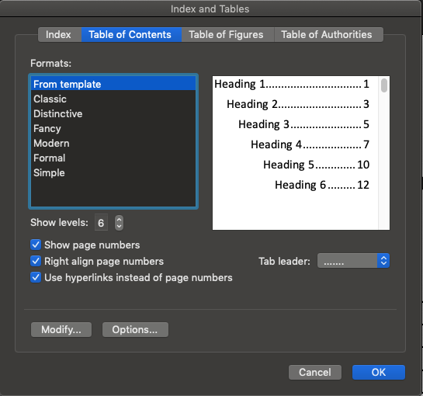
Table of Contents, Figures, Tables, etc.
I wouldn’t do this until you’re done with your dissertation – last step
Notes:
Insert->index & tables-> table of contents
Show the number of levels you want, can for mat here
The table of figures tab will let you generate a table of figures or table of tables, etc.
the page numbering can be refreshed to update as you move things around in the text.

Slide 31
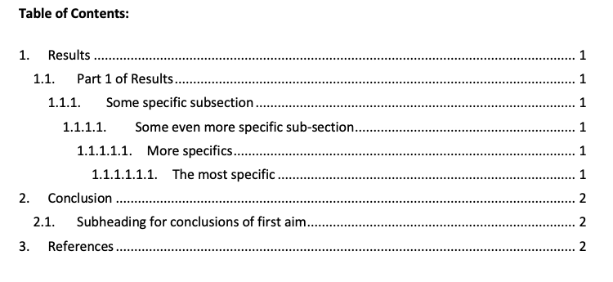
Example of Table of Contents

Slide 32
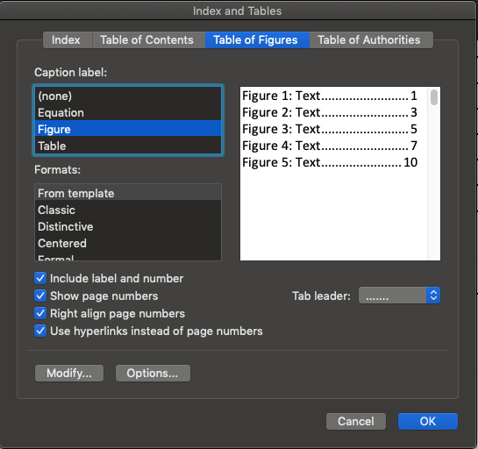
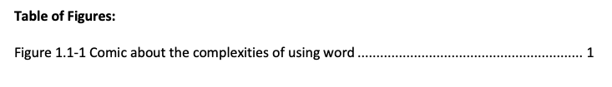
Table of Figures Example
I did not edit anything in this menu, all defaults

Slide 33
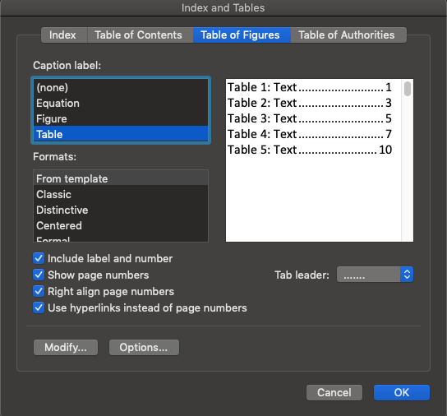

Table of Tables Example
I did not edit anything in this menu, all defaults

Slide 34
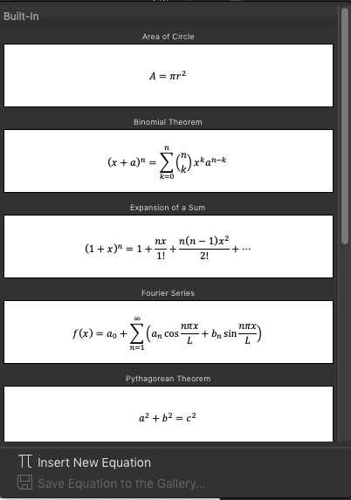
Inserting Equations
Opens up a new tab for equation formatting/options
Notes:
Insert->equation
<there may be other plug ins or ways of doing this as well but we will not cover them>

Slide 35
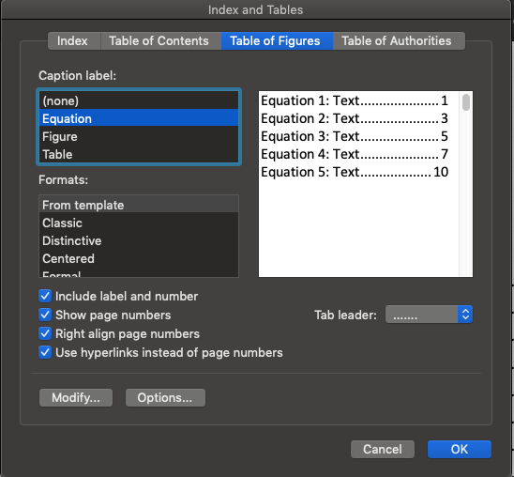
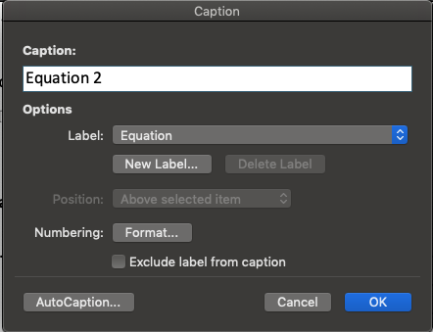
Equation Captions
Notes:
You can insert captions for equations the same way you would for tables and figures
Be sure to select equation for the label type
You can then also generate a table of equations using the same procedure as a table of figures, only select equation from the caption label menu

Slide 36
Reminder that all these figures, tables, cross-references, table of contents, etc. are hyperlinks so their numbers update on their own as you continue writing and add headings/subheadings and more figures/tables To force update, edit > select all > right-click on of the hyperlinks > update field

Slide 37
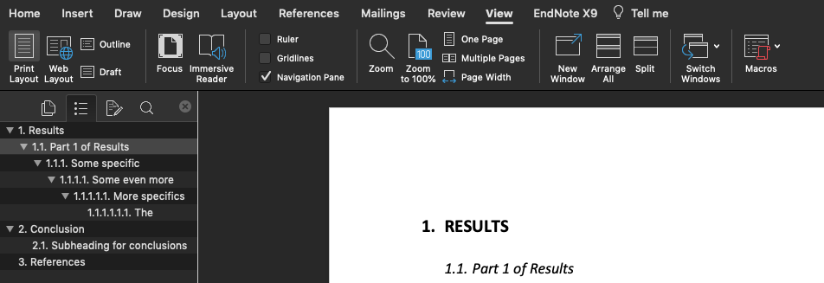
Navigation Pane
Allows you to see an outline of the dissertation and to jump to different sections

Slide 38
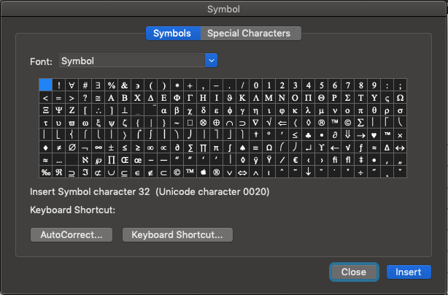
Inserting symbols
Mac users may have to type “Symbol” into font menu
Notes:
Insert->advanced symbol

Slide 39
Headers/Footers
Header: top margin of each page
Footer: bottom margin of each page
Useful for including material that you want to appear on every page of a document
Typically includes
Name
Title of the document
Page numbers
Style guides usually tell what information should go in header/footer and what format it should be

Slide 40
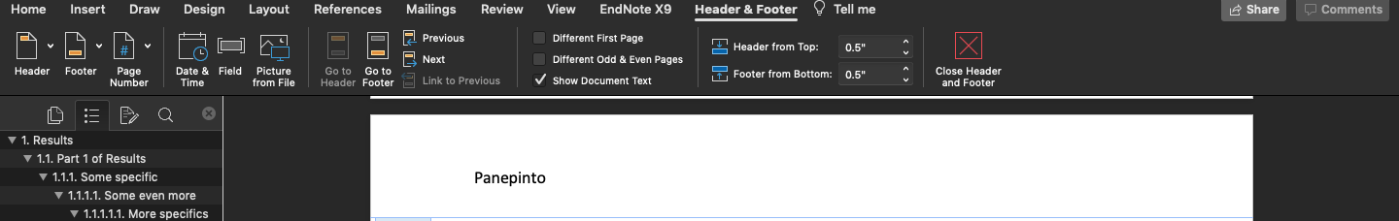
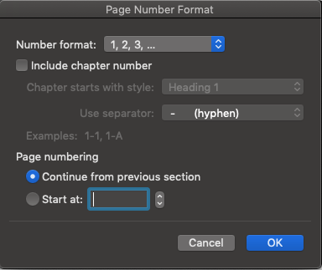

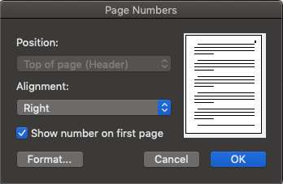
Headers/Footers
Opens up a new tab
I can type my name into the header and it will appear on every page
Notes:
Insert->header or footer
Addition ribbon menu pops up with options for page numbers etcpage number->format-> continue from previous section or start at ___ to start numbering differently
You can adjust these settings within sections to get different numbering for different sections if applied between section breaks

Slide 41
Page Number Formatting
Use this option if you want one part of the dissertation to have a different page format than the other
One section to be numbers vs. roman numerals
To do this insert a section break
Insert > break > section break (next page)
Notes:
You might do this if you want your table of contents, figures, tables, equations to have roman numeral formatting and the rest to have regular numbers

Slide 42
Breaks
Section breaks & page breaks are the most common
Page break-
Insert->pages->page break
Layout->breaks
Many options

Slide 43
Section Breaks
Partitions between bodies of text and their formatting
Allows you to alter some formatting by section-
Page numbers (example: roman numerals for table of contents pages but 1,2,3 for the main text)
Margins
Headers
Footers
Allows you to insert a landscaped page in the middle of your document
Useful if you have a large table
Does not seem to affect heading numbers

Slide 44
Page Breaks
Brings you to a new page automatically at a given point in the text
If new text should always start on a new page, use a page break to get it there
Do not hit enter many times to move to a new page
Formatting remains the same as previous page

Slide 45
Review Tab
Make comments to a document you’re reviewing
Turn on track changes if you want to make changes, but also want to preserve previous version
Usually if you’re editing a document
This gives the option to accept/reject changes
Spelling and grammar check
Useful but probably will recognize technical terms as misspellings – recommend adding those to dictionary
Protect->remove author details
To deidentify a manuscript prior to double blind peer review

Slide 46
Speech to Text
Allows you to speak to your computer and it will write it down for you
Can help if you have trouble getting words on page
Notes:
Requires internet
Click File > Options > Trust Center > Trust Center Settings > Privacy Options > Check the box “Let Office can connect to online services from Microsoft to …”

Slide 47
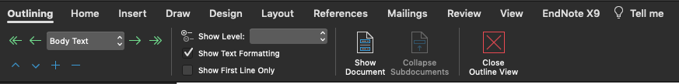
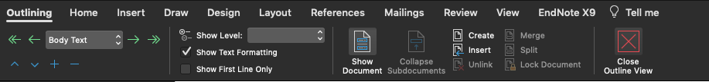
Combining Documents
If your thesis is large, create a master document with sub-documents
Notes:
Allows you to insert other documents into this document
Creates a section break before and after
Inserts the document as it is formatted in its original document
Linked vs embedded
“Embedded objects become part of the Word file or email message and, after they are inserted, they are no longer connected to any source file. Linked objects can be updated if the source file is modified. Linked data is stored in the source file. The Word file or email message (the destination file) stores only the location of the source file, and it displays a representation of the linked data. Use linked objects if file size is a consideration.”

Slide 48
Combining Documents
Often people just write different sections in different files then copy/paste them all together as they finish each section

Slide 49
ALWAYS have backups

Slide 50
Backup! Backup! Backup!
Email it to yourself, save it to the cloud, etc.
Save a new version as you add/edit/make large changes
If you decide you hate a section DO NOT DELETE IT
Save it as a new version
You never know when you might want to go back to it
Use a clear numbering/naming system for drafts
Maintain backups in a folder and the version you are working in separately
Notes:
Use dates and number to help keep your versions in order

Slide 51
Use a Reference Manager
VERY useful
Mendeley/Zotero are free
Endnote (one time ~$100 purchase)
Create a section break to restart reference numbering
Word also has a referencing software built in if you want to try that (or if you’re desperate) but you will get more out of using a proper reference manager
Notes:
Librarians are happy to help you with reference management software
Check the library past workshop materials for slides, videos, etc and for presenters you can contact for one on one training

Slide 52
Use a Reference Manager
Maintain database of pdfs
Automatically download reference info for citing
Auto generation of reference list based on in-text citations
Can automatically update to new styles (IEEE, APA, etc.)
Mendeley, Endnote, & Zotero (Zotero needs separate plugin) all interface with Word

Slide 53
PDF Conversion
File > Export
File > Save as > PDF
File > Print > PDF

Slide 54
Binding
University print shop
Many online printing companies
One that one of our consultants has used- http://www.bohemiobookbindery.com/dissertations.html

Slide 55
Reminder: ALWAYS have backups

Slide 56
General Guidance
10-12 point standard serif fonts for nearly all text
Constantia, times new roman
Maintain all formatting consistently throughout the entire document- do not change chapter by chapter
Include page numbers and at least 1 inch margins
Use the standard title page (auto generated using the form)
Use numbered heading styles for all sections/subsections
Use captions/references for figures, tables, & equations
Use a reference manager
Follow a single style guide for the entire dissertation
Indent paragraphs or use a blank line between paragraphs (use paragraph styles)

Slide 57
Additional Resources:
Carter, M. (2013) Designing Science Presentations: A Visual Guide to Figures, Papers, Slides, Posters, and More. https://doi.org/10.1016/C2010-0-67985-5
Irish, R. (2015) Writing in Engineering a Brief Guide
Library staff
Your disciplinary style guide
GWL Writing & Reference Management Software Showcase- May & September

