Slide 1

Tips for Giving & Receiving Feedback
This work is CC-BY and must include full citation & doi. Individual images and examples & materials from other sources are not CC-BY. Blue dino is a GWL icon & not CC-BY.
Kelly J Cunningham, PhD
Director, Graduate Writing Lab
School of Engineering & Applied Science, University of Virginia
kellyc@virginia.edu | bit.ly/SEASGWL

Slide 2
During this workshop…
-Identify 1 or 2 things you could actually use
-Identify 1 thing you could share
Notes:
Challenge for the session
Find one or two things that will be useful for your
And identify one thing you could share
Not everything in the workshop will be useful or new to you but it can be useful if you can find at least 1 thing that may help you now or in the future
What you learn is also not only about being immediately useful for you, but to be useful for yourself in the future and to prepare you to be able to shared what you learned to help someone else

Slide 3
Overview
Feedback that moves you forward
Feedback Focus
Sources of Feedback
Asking for Feedback
Giving & Receiving feedback

Slide 4
For technical & research writing keep in mind:
Audience, purpose, context
Clarity
Conciseness
Accuracy
Precision (& level of detail)- dialed in for audience/purpose/context
Notes:
Clarity includes readability, lack of ambiguity, etc.

Slide 5
We will approach Feedback as
Constructive
Conversation
Aimed at improving work
Helpful
Needed
Common place
Part of academic culture & processes
& recognize that feedback often has significant emotional & interpersonal components

Slide 6
What’s helpful depends on where we’re at

Slide 7
Monster bugs →

Slide 8
Stage 1: Unaware
You’ve got a monster bug…
Hmm? Everything’s good
No, You’ve got a monster bug, on your head!
OK… and?

Slide 9
Stage 1: Unaware
No idea there’s a monster bug
When pointed out, no idea why it’s a problem
No idea what to do about it

Slide 10
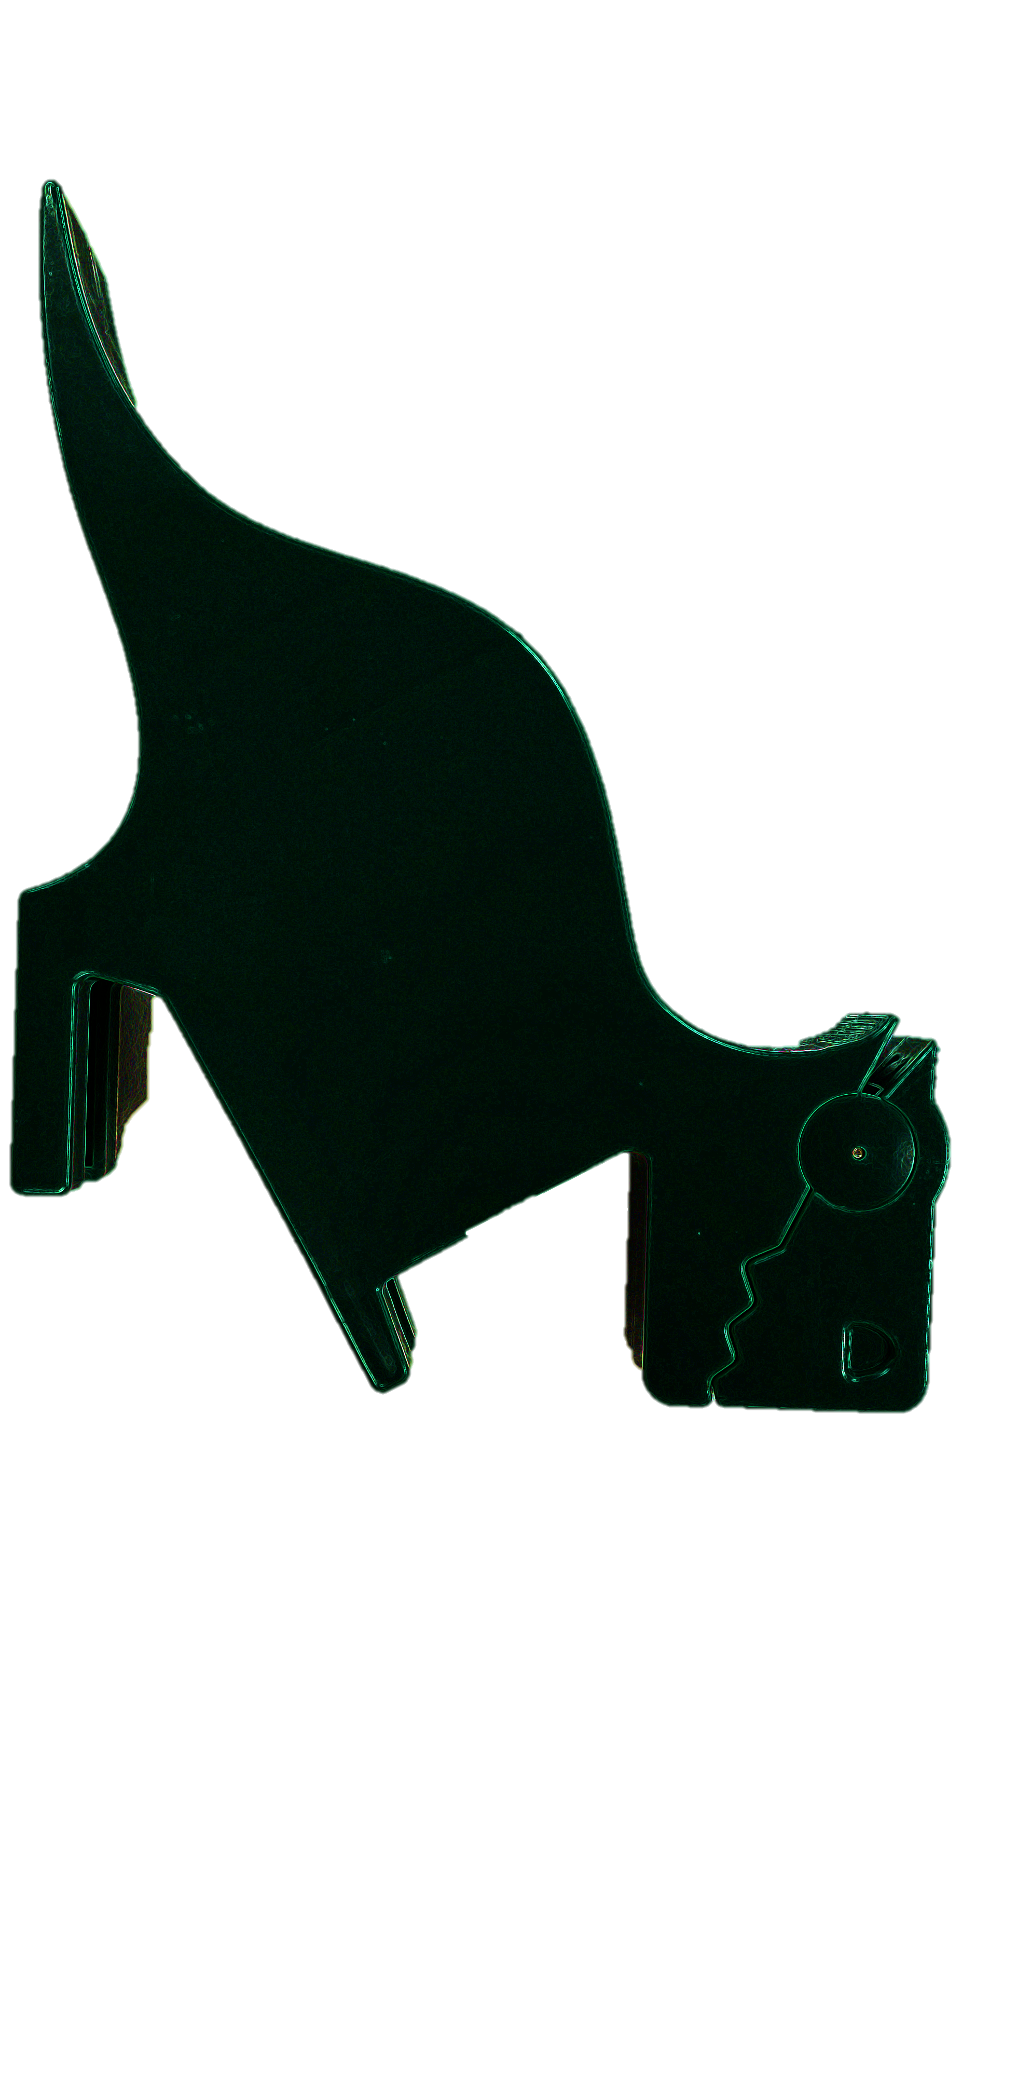
Stage 1: Unaware | Training
Help them learn to identify monster bug
Explain WHY a monster bug is an issue (it eats your brain & you need your brain to live)

Slide 11
Stage 2: Semi-aware
Hmm.. Something doesn’t seem right…
Is there something on your head?
Oh, is it a monster bug? I remember those…
Ahhh!!!! Help!!! Help!

Slide 12
Stage 2: Semi-aware
May sense something is off
May be able to ID it when pointed out
Doesn’t know what to do

Slide 13
Stage 2: Semi-aware | Training
Help them consistently ID monster bugs on their own
Provide solutions for addressing the issue (flyswatter)

Slide 14
Stage 2.5: Semi-aware
More able to ID monster bugs on others
Monster bug!
?

Slide 15
Stage 3: Aware
Can clearly ID monster bug problem
Generally understands
  Why it’s an issue
  What it is doing
Can name the issue
May be able to try to get rid of monster bug after it has landed

Slide 16
Stage 3: Aware | Training
Illustrate various monster bug control options
Encourage future preparedness
Share expectation that they will not have monster bugs issues in future

Slide 17
Stage 4: Explicit Avoidance
Can see monster bugs coming
Can take some preventative measure
Always on alert for monster bugs
Consciously avoid or work around them

Slide 18

Stage 4: Explicit Avoidance | Training
Praise if they have overcome monster bugs
Further training may not be needed

Slide 19
Stage 5: Implicit Avoidance
Internalized challenge & ways to address it
Changed techniques to tacitly/implicitly avoid monster bugs
  Ex. bug zapper, environment, pet bird
GOAL

Slide 20
Notes
Monster bugs come in a wide variety
Preparedness may vary by species

Slide 21
Stages of feedback: moving forward

Slide 22
Stage 1: Unaware
Where you’re at
Cannot sense issue
Uncertain why it is an issue
Don’t know how to address it
Example
Someone underlines or has you reread a sentence but you don’t see an issue.
I like this sentence, however, my friend does not.

Slide 23
Stage 1: Unaware
Where you’re at
Cannot sense issue
Uncertain why it is an issue
Don’t know how to address it
What’s helpful
Help learning to ID the issue independently
Explanation of WHY the issue is an issue
Notes:
So in “I like this sentence, however, my friend does not.” the issue is that this is in a piece of writing and however can’t be used to join two complete clauses into one sentence.

Slide 24
Stage 1: Unaware
Example
So in “I like this sentence, however, my friend does not.” the issue is that this is in a piece of writing and however can’t be used to join two complete clauses into one sentence.
What’s helpful
Help learning to ID the issue independently
Explanation of WHY the issue is an issue

Slide 25
Stage 2: Semi-aware
Where you’re at
May sense an issue
May be able to ID it when pointed out
Not sure how to address it
Example
Have an idea that something is not right with a paragraph.
You know however can’t join two sentences, but still not sure on how to use it

Slide 26
Stage 2: Semi-aware
Where you’re at
May sense an issue
May be able to ID it when pointed out
Not sure how to address it
What’s helpful
Help learning to consistently ID the issue independently
Solutions for addressing the issue

Slide 27
Stage 2: Semi-aware
Example:
You can’t have however as the only thing joining two main clauses. So if you see you have basically ‘sentence however, sentence.’ Then you probably have an issue.
To fix it, put a period at the end of the first sentence, then start the new one with However and put a comma after.
What’s helpful
Help learning to consistently ID the issue independently
Solutions for addressing the issue

Slide 28
Stage 3: Aware
Where you’re at
Can clearly ID an issue
Can generally understand it, label it, &/or correct it after writing
Example
You can mostly scan your own work for however and know how to check the punctuation around it.

Slide 29
Stage 3: Aware
Where you’re at
Can clearly ID an issue
Can generally understand it, label it, &/or correct it after writing
What’s helpful
Demonstration of various field-specific contextualized options for addressing the issue
Encouragement/reminder on how to apply these techniques in future work

Slide 30
Stage 3: Aware
Example
Looks like you’re getting better with however. You actually have a few choices-
Sent. However, sentence.
Sent; however, sentence.
Sent. Sent, however, ence.
What’s helpful
Demonstration of various field-specific contextualized options for addressing the issue
Encouragement/reminder on how to apply these techniques in future work
Notes:
OK so this would be more context specific and stuff but space

Slide 31
Stage 4: Explicit Avoidance
Where you’re at
Can clearly ID an issue before it happens
Can consciously avoid it or work around it during writing
Example
You are going to write however, and in your head you are going period, however, comma. Or you are actively thinking or reminding yourself it doesn’t join two sentences.

Slide 32
Stage 4: Explicit Avoidance
Where you’re at
Can clearly ID an issue before it happens
Can consciously avoid it or work around it during writing
What’s helpful
Praise/confirmation that development has happened and that the issue is no longer present in latest draft
May not need anything if it wasn’t an issue before

Slide 33
Stage 4: Explicit Avoidance
Example
It looks like you’ve got this however thing down. In this draft you used it a few different ways and they all look good.
What’s helpful
Praise/confirmation that development has happened and that the issue is no longer present in latest draft
May not need anything if it wasn’t an issue before

Slide 34
Stage 5: Implicit Avoidance
Where you’re at
Internalized the issue & ways to address it
Changed writing techniques to implicitly/tacitly avoid issue during writing
(you don’t even have to think about it)
You’re all set.
You use however without having to think about it.

Slide 35

Notes
There are many issues you might encounter in writing
You can be at any stage with any given issue
Recognize the stage you are at
Think it through
Ask for feedback that might match where you are at
Use as reflective device to chart progress
Notes:
When someone points something out- can you think through the stages to figure out where you are at, why you might react the way you do and what you might need to most effectively move forward?
Use as a reflective device to chart your progress

Slide 36
Feedback Focus

Slide 37
Stage of Work
Ideas Outline Rough draft Revised draft Just about to submit
 | Organization
 | What to include
 |  | Level of detail
 |  |  | Clarity
 |  |  | Conciseness or Cutting for word count
 |  |  | Flow
 |  |  |  |  | Language use & vocabulary
 |  |  |  |  | Grammatical concerns
 |  |  |  |  |  | Last looks Editing/proofing (hire an editor) | Last looks Editing/proofing (hire an editor)
Feedback
Notes:
animations

Slide 38
Additional Areas to Consider…
Main Message? Key Take Aways?
Figures & Tables
Stand alone?
Key Take Away?
Clarity
Ordering
Level of Detail
Captions
Titles
Posters
Organization
Layout
Level of detail
Visuals
Readability
Stand alone?
Color
Main message?
Presentations
Organization
Layout
Visuals
Clarity
Level of Detail
Transitions
Delivery
Questions
Fit for Audience, Context & Format
Notes:
And at all stages & for all types of work, consistently can ask for/reflect on the fit for audience, purpose, context and format
Can always ask what they saw as main message or key take away

Slide 39
SOURCES of Feedback

Slide 40
Advisor/ Major Professor/ PI
Content
Breakdown
Discipline appropriateness
Choosing outlets
Also the other areas mentioned

Slide 41
Peers in discipline
How have they done similar work
Discipline specific feedback
Context specific feedback (lab, dept, conference)
Notes:
Someone in your lab prob tell you more about what advisor is looking for or a dept poster fair for instance

Slide 42
Peer debriefers
Feedback on your plan
Check ins
Ask difficult questions
Especially useful in proposal stage
How are you handling ABC?
What if … ?
Notes:
For difficult questions on content

Slide 43
Other engineering grad students
Audience
Clarity
Engineering audience perspectives
Notes:
Also all the writing concerns

Slide 44

One-on-One Consultations
50 min appointment
Bring writing, presentation, poster (any stage)
Specific concerns (clarity, flow, verb tense, etc.)
Organization, writing, not rigor/content/editing
Book Online
Notes:
Only for current UVA Engineering graduate students & postdocs
Our writing consultants are graduate students from outside of engineering
Not instructional or tutoring necc, work through issues students face in something they are already working on
Can/happy to work with esl, but writing center can be more involved with that and is a better resource for those with greater need or who want tutorials/instruction
NOT editing or rewriting or checking

Slide 45
One-on-One Consultations
UVA Writing Center
  Especially for ESL consultations
    Schedule with a tutor who has ‘ESL’ next to their name
    On going tutoring
Notes:
UVA writing center works with anyone at UVA
Does not show in the booking system if a tutor is a grad or undergrad student though
ESL tutors are specially trained for working with ESL students and will do more tutoring than the GWL on these areas

Slide 46
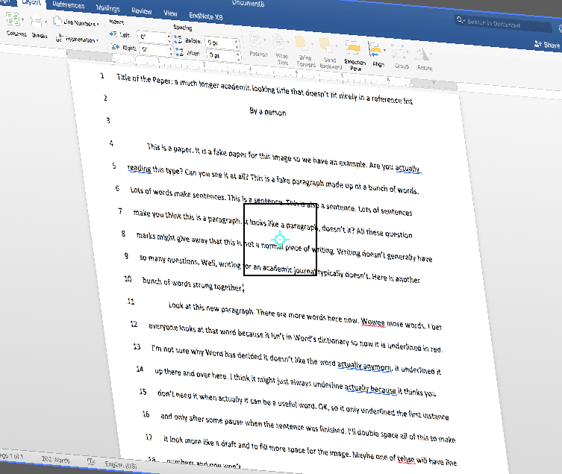
Peer Review Groups
Meet weekly
Sign up to bring your work for review
  Set mini deadlines
Get live feedback
Give/get feedback
Notes:
Build a supportive disciplinary community through discussion based feedback

Slide 47
Peer Review Groups
Groups of 4-10 grad students & post docs
meet 1.5 hours/week
1-2 reviews/meeting
No reviewing outside of meetings
Constructive discussion-based feedback
in a supportive group environment
47
Notes:
Sign up for summer -> groups begin meeting in May or June ( will have sign ups end/start of each semester)
They put a paper (or figure, presentation, poster, etc) up on the screen. Give bkgrnd- what kind of paper, the journal its going to audience, stage in process, key concerns to focus on. They read aloud p by p and group discusses/gives feedback targeting concerns; facilitator present too
I can help new groups get started or help profs set up something like this for their lab groups as well
Group calendar can help with goal setting, accountability/motivation in longer projects, students get to see what students in other labs, stages of prgm are working on. We’d like to keep somewhat similar disciplines or types of research together when possible

Slide 48
Outsiders
Editors
Friends, family, others
Audience specific
Notes:
Also posting preprints

Slide 49
Software
Spell/grammar check
Grammarly
Notes:
Useful but be wary & use wisely

Slide 50
Journal/conference reviewers
Fit for venue
Rigor

Slide 51
Find a feedback partner/community
Exchange papers
Continue beyond grad school
Who will you go to for feedback?

Slide 52
Asking for Feedback

Slide 53
Consultations & PRGs
Sign up online
Scheduled
Introduce your work
Identify your concerns/focus
Direct your review as needed

Slide 54
This is a research paper I want to submit to Journal A.
Readers of Journal A know about Topic X, but Topic Y might be new.
I’ve got a solid draft of this section and I mostly want feedback on clarity & flow.

Slide 55
Ask for what you need
What should they focus on?
What’s your main concern?
What’s the timeline?
What stage is the work?
Be polite but direct

Slide 56
I’m working on ____ for ____. I have a draft of _____ done and I’ve revised it a few times, but I’m not sure about ____. If you have time, I’d really appreciate your feedback on ____.
I still have some time before the deadline, but it’d be most helpful to have comments some time in the next two weeks/before June 5th…
Let me know if this is something you could do.

Slide 57
I’m working on revising a draft of ____ for ____. If you have time, I’d really appreciate your feedback on __the methods__. I want to make sure they are clear and have enough detail.
I still have some time before the deadline, but it’d be most helpful to have comments some time before June 5^{th .} I anticipate having the draft ready by ____, but could get it to you sooner if needed.
Let me know if this is something you could do.
Notes:
Set up timelines with your PI/advisor & stick to it. If you are supposed to submit a draft by a certain date to get feedback, stick to it, be early even.
Often if you ask for feedback on a very short deadline, faculty may tell you they may not have time etc. it’s not a slight to you, often that is simply reality.

Slide 58
I’m applying for ABC position at XY university. They are really interested in someone who can do stuff. I tried to highlight by ability to do stuff, but I’m not sure if I put too much or not enough. Can you read it for me?
I have to submit it on Sunday, so I understand if you don’t have time before then.
Let me know.
Example to a friend
If they say yes, immediately send the position description & your draft
Notes:
To a friend
If they say yes, send position description and your draft

Slide 59
Include supporting materials
Job docs: position description, related materials (mission statement), application materials
Journal Paper: overview of journal, link to guidelines, highlight key points
If applicable

Slide 60
Leave your own comments in draft
Areas you have questions about
Things you still plan to do
Tentative but uncertain plans
  (I’m considering adding a section on ABC here)
(note not everyone appreciates this)

Slide 61
Giving & Receiving Feedback

Slide 62
IN giving Feedback
Clarify and ask questions
Make sure you know the context & audience of the work
What is it?
Where’s it going? (audience & format)
Timelines
What stage is it in
Feedback Focus
What’s most important?
Notes:
,multiple concrete suggestion

Slide 63
IN giving Feedback
Clearly identify concerns, areas of confusion, etc.
Offer suggestions and options for how to improve
Be specific (sentences, phrases, examples)
Explain, give reasons, examples etc.
  Why are you suggesting something?
  How is it coming across to you & why?
  If they implement a suggestion, what would that do for the work? (impact)
Notes:
,multiple concrete suggestion
ID, Offer, Explain
Be specific and clear
Opportunity, action, consequence

Slide 64
IN giving Feedback
On line 147, I wasn’t sure what “this” was referring to. Can you put a noun with it? Like is it the experiment or an issue? Something like that would make it easier to follow.
Notes:
,multiple concrete suggestion

Slide 65
IN giving Feedback
specific
clearly ID the concern
On line 147, I wasn’t sure what “this” was referring to. Can you put a noun with it? Like is it the experiment or an issue? Something like that would make it easier to follow.
Offer open but concrete suggestion
Explain why & how it might improve the work
Notes:
,multiple concrete suggestion

Slide 66
IN giving Feedback
Here – “increasing flexibility greatly reduces fire resistance”. Is that results or general knowledge? Because it’s in the simple present, I read it as general knowledge. But then, in this section and the other things you talk about, I’m not sure if it is.
If it’s general knowledge, maybe add something that shows the relationship between this information to the other/your work- how it explains it.
If it is your results, something you found, I generally see that in the past tense
Notes:
,multiple concrete suggestion

Slide 67
IN giving Feedback
Highlight what works as well as what doesn’t
Be constructive, aim for improving
Consider it a conversation
Read the room, be thoughtful, never condescending
  Try not to overwhelm
  But maintain honesty
Try to be context appropriate & timely
Stay focused on what was asked for
  (don’t proofread a rough draft if asked to ignore grammar)
Notes:
If someone is doing a last minute run through and is going to present in 10 minutes, focus on positive to give a confidence boost rather than trying to get them to redo their entire presentation

Slide 68
Receiving Feedback
In Person/Synchronously
Listen, take notes, make changes
Clarify, ask questions, ask for a moment to write it down
Written/Asynchronously
Take time to process
Follow up to clarify if needed (not always possible)
Fill out the presenter info form
Oh, so do you mean _____?
So if I say ________ is that clearer?

Slide 69
Receiving Feedback
Try to be appreciative- say thank you
Take time to cool off if needed
Assume the feedback is meant to help you
& improve the final product
Fill out the presenter info form

Slide 70
Receiving Feedback
Position feedback as a conversation about the work
Try to see other perspectives
Consider possible courses of action & what they’d do for the work
Fill out the presenter info form

Slide 71
Receiving Feedback
Multiple sources will conflict
If multiple sources mention the same thing
      -> pay attention
Fill out the presenter info form

Slide 72
Receiving Feedback
It’s your work.
You decide what to do
  How to revise
What to set aside
Fill out the presenter info form

Slide 73
Questions?
bit.ly/SEASGWL
gradwritinglab@virginia.edu

