Slide 1

Project Briefing: Expanding Research Data Services | CNI Fall 2016 Meeting | December 13, 2016
Bigger on the Inside:
Integrating Research Data Services
in Campus-
Wide Networks
Michele Claibourn
mclaibourn@virginia.edu
’ Oh, that box … big and little at the same time. Brand new and ancient and the bluest blue ever.’¹
-- The Doctor

Slide 2
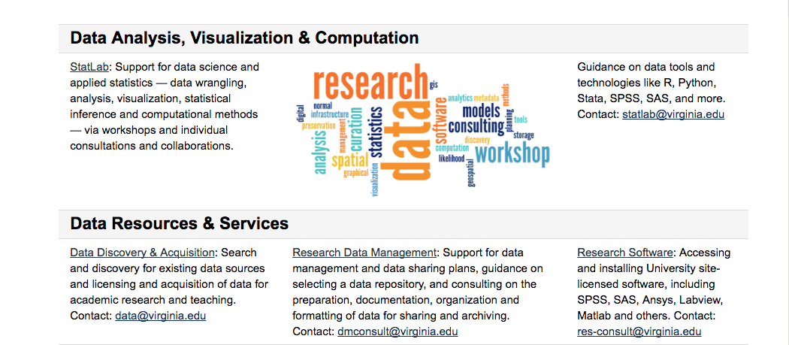
Research Data Services at UVA
data.library.virginia.edu
’People assume that time is a strict progression of cause to effect. But actually from a non-linear,
non-subjective viewpoint it's more like a big ball of wibbly-wobbly, timey-wimey... stuff.’²
-- The Doctor

Slide 3
First Three Years: Consultations & Collaborations
’There’s a lot of things you need to get across this universe. Warp drive, wormhole refactors.
You know the thing you need most of all? You need a hand to hold.’³
-- The Doctor

Slide 4
First Three Years: Workshops & Training
’To the rational mind, nothing is inexplicable; only unexplained.’⁴
-- The Doctor

Slide 5
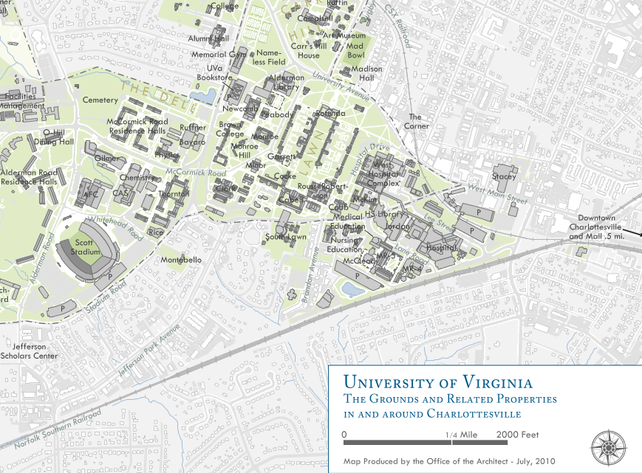
Meanwhile,
elsewhere on grounds…
Rivanna: HPC
Ivy: Secure Compute
VP for IT
School of Medicine
Research Computing
Data Science
Institute
’Never ignore a coincidence. Unless you’re busy, in which case always ignore a coincidence.’⁵
-- The Doctor

Slide 6
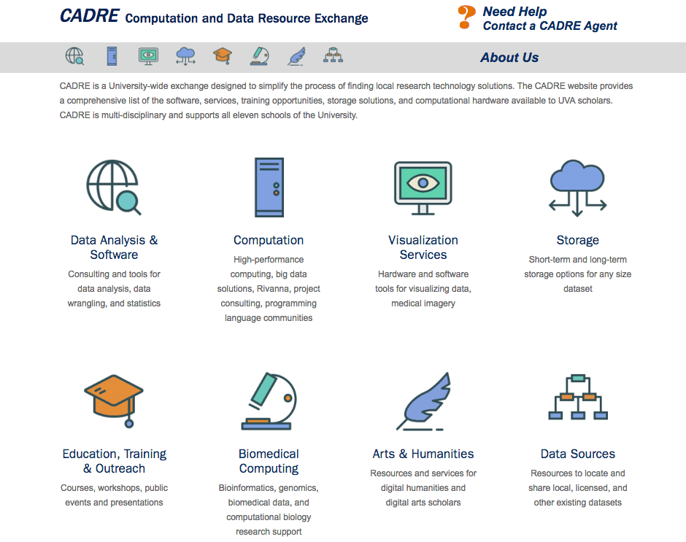
CADRE
(Not just a revolutionary vanguard,
or DC Comics supervillain group)!
cadre.virginia.edu
Partner Organizations
VPIT
ARCS
RDS
DSI
ITS-RCI
BioConnector/HSL
SOM-RC
’The universe is big. It’s vast and complicated and ridiculous. And sometimes, very rarely,
impossible things just happen and we call them miracles.’⁶
-- The Doctor

Slide 7
Partnerships & Programs: The Upside of Bigger on the Inside
VPR
(funding discovery, COS)
UVaR, DataFest
CADRE
(training, consults)
COS
(OSF for Inst., workshops)
RDS/Library
DSI
(short courses, bootcamps, fellows)
Scholars’ Lab/DH
ITS-RCI
(Ivy)
Health, Law Libraries
’This is one corner, of one country, in one continent, on one planet that’s a corner of a galaxy that’s
a corner of a universe that is forever growing and shrinking and creating and destroying and never
remaining the same for a single millisecond.’⁷ -- The Doctor

Slide 8
Challenges: The Downside of Bigger on the Inside
Maintaining relationships (e.g., external partnerships and internal teams)
Differing cultures across units (e.g., sharing information and credit)
Diffusing responsibility (and credit)
Shifting work versus expanding work
Obscuring resource needs
How can library leadership help?
’Just do what I do. Hold tight and pretend it’s a plan!’⁸
-- The Doctor

Slide 9
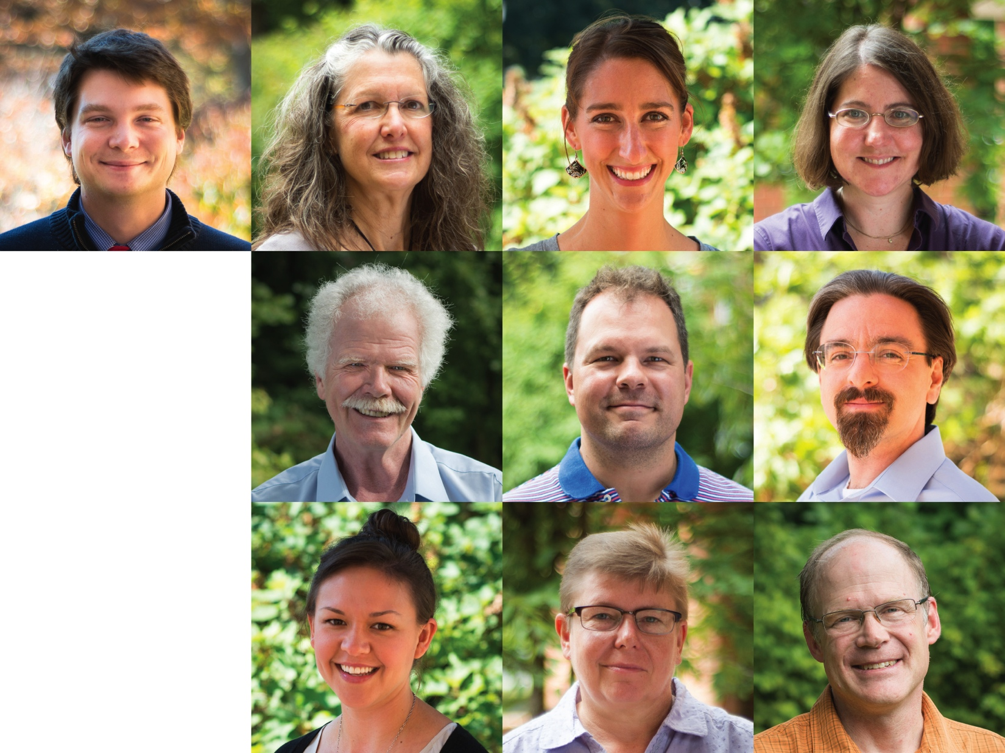
The Team
Our Librarians and Data Scientists
(or Data Librarians and Library Scientists)
5 MLIS
3 Masters (Statistics, Sociology, Instructional Technology)
4 Doctorates (Political Science, Astronomy, Physics, Physiology)
’We’re all stories, in the end. Just make it a good one, eh?’⁹
-- The Doctor

Slide 10
What’s Next?
For UVA Library’s RDS?
Integrating Data Services and Social, Natural, & Engineering Science teams
Imagining possibilities for space
Branching into the qualitative arena
Internally developed projects: Data for Democracy Lab
For us today?
Enlightening discussion!
’You want weapons? We’re in a library! Books! The best weapons in the world!’¹⁰
-- The Doctor

Slide 11
References
Title Figure: The TARDIS, BBC America, 7 December 2016 <http://www.bbcamerica.com/anglophenia/2012/12/doctor-who-the-magic-of-the-tardis>
Doctor Who, Season 5, 'The Big Bang’
Doctor Who, Season 3, ‘Blink’
Doctor Who, Season 2, ‘Fear Her’
Doctor Who, Original Season 14, ‘The Robots of Death’
Doctor Who, Season 5, ‘The Pandorica Opens’
Doctor Who, Season 5, 'The Pandorica Opens’
Doctor Who, Season 7, ‘The Power of Three’
Doctor Who, Season 7, ‘The Doctor, The Widow, and The Wardrobe’
Doctor Who, Season 5, ‘The Big Bang’
Doctor Who, Season 2, ‘Tooth and Claw’
With apologies to The Doctor…

