Slide 1
Introduction to
Open Educational Resources
Fall 2021

Slide 2
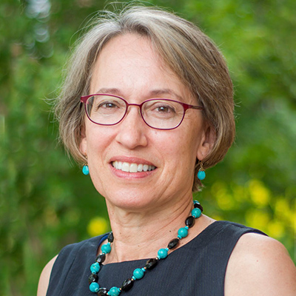
Haley Gillilan
Student Success Librarian hg4ub@virginia.edu
Judy Thomas
Director of Faculty Programs jet3h@virginia.edu
Bethany Mickel
Instructional Design Librarian bbm9u@virginia.edu

Slide 3
Session Overview
Define the foundations of an OER – "the five Rs"
Discover the potential impact of OER on affordability and student success—both nationally and at UVA.
Identify the challenges and benefits of using OER in the classroom.
Notes:
This is part of a series: general overview today.
Other sessions (https://bit.ly/3bkV7g6):
Finding, Evaluating, and Reviewing OER– including information on how to review a textbook from the Open Textbook Library and receive remuneration for your efforts.
Intellectual Property and Copyright
Open Pedagogy
We’ll offer sessions on editing and authoring OER next semester. We are currently working with our Technology Solutions Group to identify and suggest tools and methods for those activities.

Slide 4
What do you like about the course materials
you currently use?

Slide 5
What do you dislike about the course materials
you currently use?

Slide 6
“OER are teaching, learning, and research resources that reside in the public domain or have been released under an intellectual property license that permits their free use and re-purposing by others. Open educational resources include full courses, course materials, modules, textbooks, streaming videos, tests, software, and any other tools, materials, or techniques used to support access to knowledge.”
William and Flora Hewlett Foundation
Notes:
This is a widely accepted definition of OER.
If it meets the basic criteria, that is, it allows free use and re-purposing, we consider it an open educational resource

Slide 7
The Five Rs of OER
Notes:
OER are characterized by these permitted activities.
Retain - Copies of content can be retained for personal archives or reference - the right to make, own, and control copies of the content (e.g., download, duplicate, store, and manage)
Reuse - Content can be reused in various ways in its unaltered original format (e.g., in a class, in a study group, on a website, in a video)
Revise - Content can be modified or altered to suit specific needs, including translation.
Remix - Content can be combined with other resources to create something new (e.g., incorporate the content into a mashup)
Redistribute - Content can be shared with anyone else in its original or altered format

Slide 8
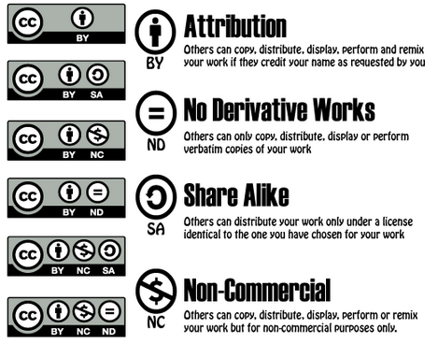
Notes:
These permissions are conferred by the application of a Creative Commons license.
Copyright must clearly allow the kind of sharing and repurposing that we’re describing.
These creative commons licenses that cover a wide range of uses and allow for the sharing of open content while giving the author the option of controlling to some degree the uses of the work. The most common CC license is CC-BY, which covers the 5Rs. Other variations impose conditions on use. The one requirement they all share is attribution: credit must be given to the author.
Brandon Butler will cover this terrain in the Intellectual Property and Copyright session. He can also discuss such issues as:
Control - author's rights – who owns what, and what does it mean to give up control of downstream use
Students - student rights and privacy, anonymity.
Fair use – enabling the use of copyrighted material within OER. https://guides.lib.virginia.edu/oer/faculty#s-lib-ctab-23287548-0

Slide 9
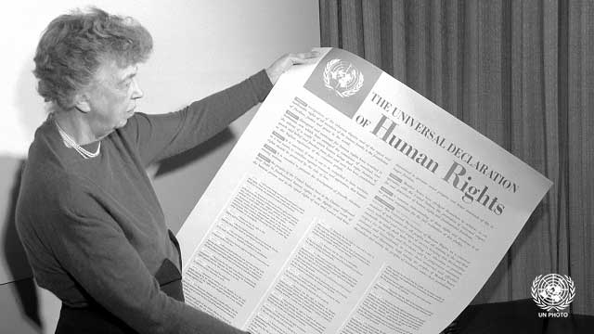
OER fulfills our commitment to higher education
“...higher education shall be equally accessible to all...”
Notes:
This is a values-driven conversation. It is anchored in a social justice issue that is much broader than just textbooks: the equitable access to knowledge, to education.
However, faculty will have many perfectly good reasons for choosing commercial course materials over open resources. There might not be anything that meets your needs, the quality might not be high enough, the barriers for successful use might be too high. Faculty autonomy in choosing course materials is another value that we fully support.

Slide 10
In compliance with Virginia Code § 23.1-1308
Open Educational Resources
E. The governing board of each public institution of higher education shall implement guidelines for the adoption and use of low-cost and no-cost open educational resources in courses offered at such institution. Such guidelines may include provisions for low-cost commercially published materials.
https://law.lis.virginia.gov/vacode/title23.1/chapter13/section23.1-1308/
Notes:
The legal and policy landscape:
This code also calls for identifying courses in the course catalog as low-cost or no-cost.
The registrar’s survey request asks if your course can be described as low-cost or no-cost. Included is a question asking if you’d like library help in finding affordable materials. If you answer yes, your subject librarian will contact you.

Slide 11
In alignment with the University’s mission
Guided by a founding vision of discovery, innovation, and development
of the full potential of talented students from all walks of life.
We are defined by:
Our enduring commitment to a vibrant and unique residential learning environment marked by the free and collegial exchange of ideas;
Our unwavering support of a collaborative, diverse community bound together by distinctive foundational values of honor, integrity, trust, and respect;
Our universal dedication to excellence and affordable access.
https://www.virginia.edu/statementofpurpose
Notes:
This initiative align with the University’s commitment to affordable access.

Slide 12
And with the Library’s Strategic Directions
Collaborate with faculty to develop or
identify course-related materials that are
free to the student.
https://confluence.lib.virginia.edu/display/SLT/Strategic+Plan+2019-2024
Notes:
It is also one of the Library’s Strategic Directions.

Slide 13
“Open education is not a short-term fix to a passing problem—it is a long-term solution to ensuring equitable, inclusive access to effective educational resources and learning opportunities. ” | Cable Green, “Education in Times of Crisis and Beyond: Maximizing Copyright Flexibilities”
Notes:
There has been a lot of positive attention paid to open resources during the pandemic: they are free, mostly online, with a high potential to span the digital divide, since copies can also be printed and distributed.
Can also be seen as a solution to an enduring problem of access to high quality learning.

Slide 14
Are you already using low-cost or no-cost resources?
Any other questions at this point?
Notes:
Discussion

Slide 15
Let's Talk About Affordability...
Notes:
What is the problem that OER can help to address?

Slide 16
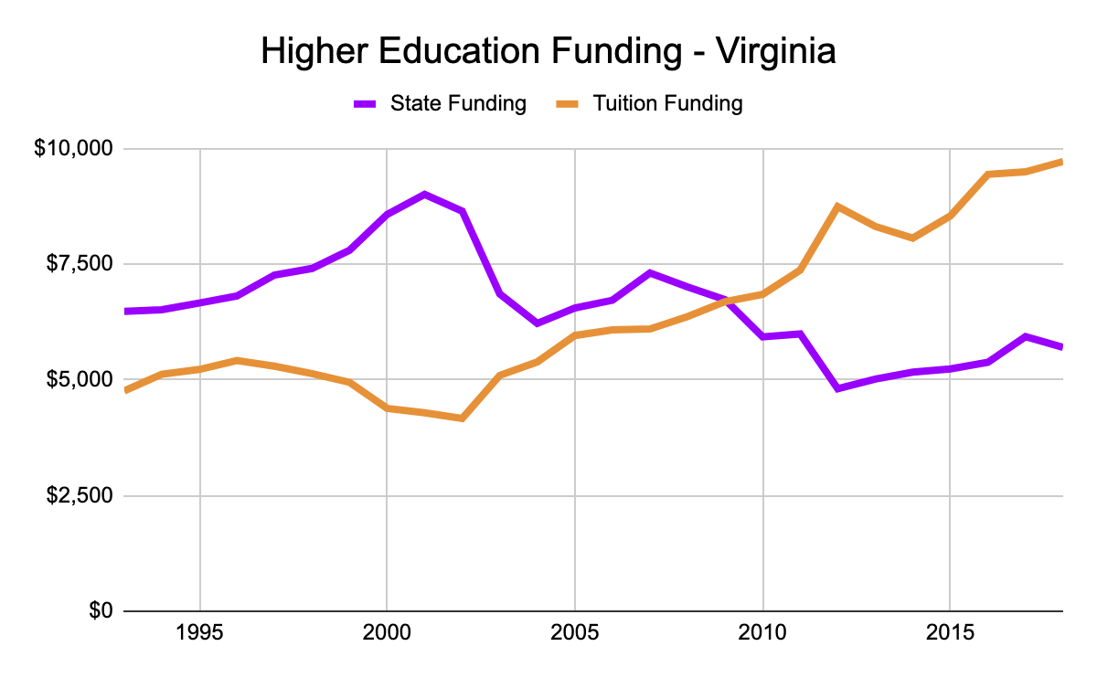
Burden of paying continues to shift from the state to the student
Academic Division Budget Sources | FY 1989-90 | FY 2019-20
State Funds | 33% | 9%
Tuition, Fees | 19% | 33%
Other* | 48% | 58%
* Externally sponsored research; sales, services, and other; endowment distribution; expendable gifts.
State Higher Education Executive Officers Association (SHEEO) ; UVa 2019-20 Operating Budget Report
Notes:
Regarding the shifting economics of higher ed: here’s the UVA picture. As is the case elsewhere, the burden of financing the university has shifted from the state to the student.
This has resulted in an affordability crisis for some of our students.
Data from SHEEO, graph from OTN’s files (https://docs.google.com/presentation/d/1dn-FSqd8volSQDjxTnacOLGCRXFGgofkLJuIOHZ13EI/edit#slide=id.g6288ff92fd_0_841)
UVA academic division budget figures from: https://financialplanning.vpfinance.virginia.edu/sites/financialplanning.virginia.edu/files/FY2020%20Final%20Operating%20Budget%20060419.pdf
Comparison with 2015 figures from: https://uvamagazine.org/articles/dollars_and_cents
For clarification as to “Other” sources of revenue, see https://digital.uvamagazine.org/articles/funding-academic-excellence/
* Note that financial model in Virginia was updated in 2019 to favor schools with higher concentrations of low-income students (UVA’s proportion of low-income students is low, at 9% of total student body). For details, see https://www.insidehighered.com/news/2019/11/05/virginia-restructures-financial-aid-help-todays-students ; https://www.cavalierdaily.com/article/2019/12/state-council-of-higher-education-for-virginia-recommends-statewide-change-to-financial-distribution

Slide 17
Maintaining our dedication to excellence and affordable access
College of Arts and Sciences
First-, Second-, and Fourth-Year Students | Virginian | Non-Virginian
Tuition | 14,188 | 48,036
Fees | 3,230 | 3,912
Subtotal | 17,418 | 51,948
Additional Categories (including $1396 for books) | 17,142 | 17,142 to 18,615
Total | 34,560 | 69,090 to 70,563
* Eligibility for financial aid is based on this standard estimated allowance
UVa Student Financial Services, estimated cost of attendance
Notes:
Looking at the estimated cost of attendance at Arts & Sciences, you can see that although the estimated cost for books and supplies is a small percentage of the whole, about 4% for in-state, it’s still a hefty amount, especially for those who are financially struggling.

Slide 18
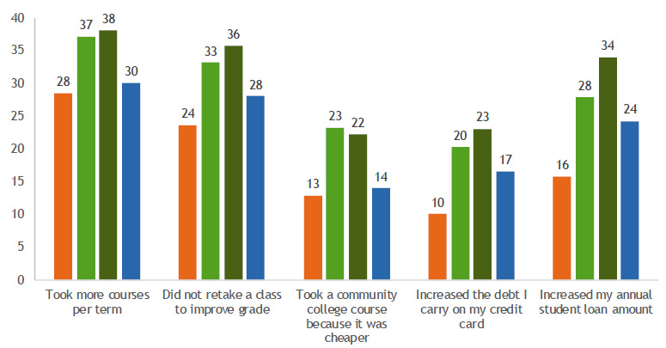
Strategies for meeting college expenses vary (%)
Data based on SERU (UVA) 2016
Notes:
The prevailing narrative at UVA is that our students are all well-off, not concerned with finances. Data from SERU surveys reveal that 57% express concerns about paying for their education; 13% are very concerned. 35% strongly disagree, disagree, or somewhat disagree with the statement, ”Given the grants and scholarships, if any, that you receive, the total cost of attending UVA is manageable.” https://ira.virginia.edu/university-stats-facts/seru-2020-core-survey
Students here on balance are certainly better off than those at many other schools in Virginia. However, 36% of our students have a family income of less that $50,000. There is a significant degree of financial need.
This graph is based on data provided by our SERU survey 2016 (Student Experience at Research University) and analyzed by a group in the Office of the Dean of Students. Students adopt a range of measures to address their college costs that disproportionately affect our financially disadvantaged students. Note how much higher is the percentage the Pell, URM, and first-gen students who are forced to take such measures. (The graph is based on 2016 responses by 4,440 students (30% response rate), evenly distributed across years (22-28%)).
There are groups of students for whom the measures they must take to address financial need further compromise their academic success.

Slide 19
What can we do?
Tuition and Fees
Room and Board
Books and Supplies
Personal Expenses
Transportation
Notes:
We understand that books and supplies are a small percentage of overall cost. Still, it’s the one that we as faculty and service providers can do something about.
And it has a broader impact on the students’ academic success than you might expect, as we’ll discuss.

Slide 20
College Textbook Prices
College Board data, 2018-19
Notes:
The textbook market is broken.
Despite the growing online markets for discounted books, the average cost of college textbooks has risen four times faster than the rate of inflation over the past 10 years. It has increased faster than the consumer price index for tuition, healthcare, or housing..

Slide 21
Academic publishers are, “transforming themselves into data analytics companies built atop their content, effectively adding ways to monetize it.”
Claudio Aspesi & SPARC “The Academic Publishing Industry In 2018.”
Notes:
The textbook market is controlled by three primary publishers: MgGraw Hill, Pearson, and Gale. RedShelf and VitalSource are aggregators that provide access to the publishers’ catalogs. Textbook publishers have controlled and driven up prices for decades – analogous to the crisis in scholarly publishing, where publishers charge ruinous prices because they can. Publishers are now primarily data collection companies involved in the harvesting and analysis of student data.
Worthy of note in this context is a new generation of digital course materials offered by the major courseware publishers, licensed either directly by the student or by the institution, often available to students through the LMS, often referred to as ‘inclusive access’ or, more accurately, ‘automatic billing.’ Currently price point is low, seemingly affordable *for now*. However, watchdog organizations have scrutinized the licenses and contracts and have pointed out all kinds of loopholes – a third have the potential of uncapped price increases, 70% include a clause that eliminates the discounts if the school misses the enrollment quota.
https://uspirg.org/feature/usp/automatic-textbook-billing https://www.inclusiveaccess.org
https://sparcopen.org/our-work/automatic-textbook-billing/contract-library/
https://sparcopen.org/our-work/automatic-textbook-billing/contract-library/
Lack of faculty autonomy, student choice, threat of escalating prices with a captive market, ubiquitous capture of student data, destruction of used book market: this is a problematic situation that the open ed movement is trying to address.

Slide 22
Students are told to budget $1240 - $1440 for books and supplies each year. What they actually spend is closer to $415 per year.
Why the difference?
Notes:
Note that the College Board data (and our own admissions data) reflects what students are asked to budget for books and supplies each year. It’s not what they actually spend. Nationally, Students are more likely to spend about between $400 and 600 on books and supplies.
https://www.nacs.org/student-spending-on-course-materials-continues-to-decline

Slide 23
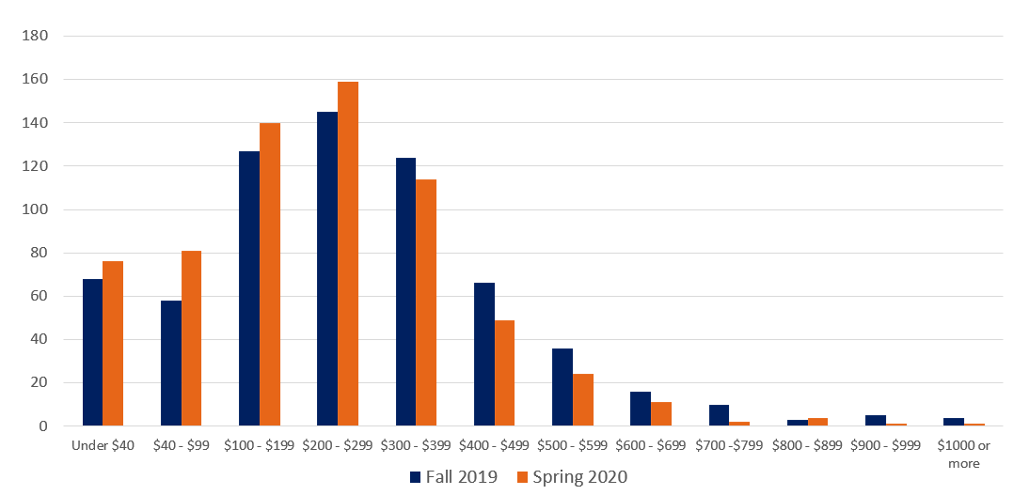
UVA spending on books and supplies matches national trends
Impact of Cost of Course Materials on UVA Students (Spring 2019)
Notes:
These data are reflected in our own internal study – a small-scale survey of students, conducted in the library in 2020 in collaboration with Student Council. What explains the difference between the cost of assigned materials and what students actually pay?

Slide 24
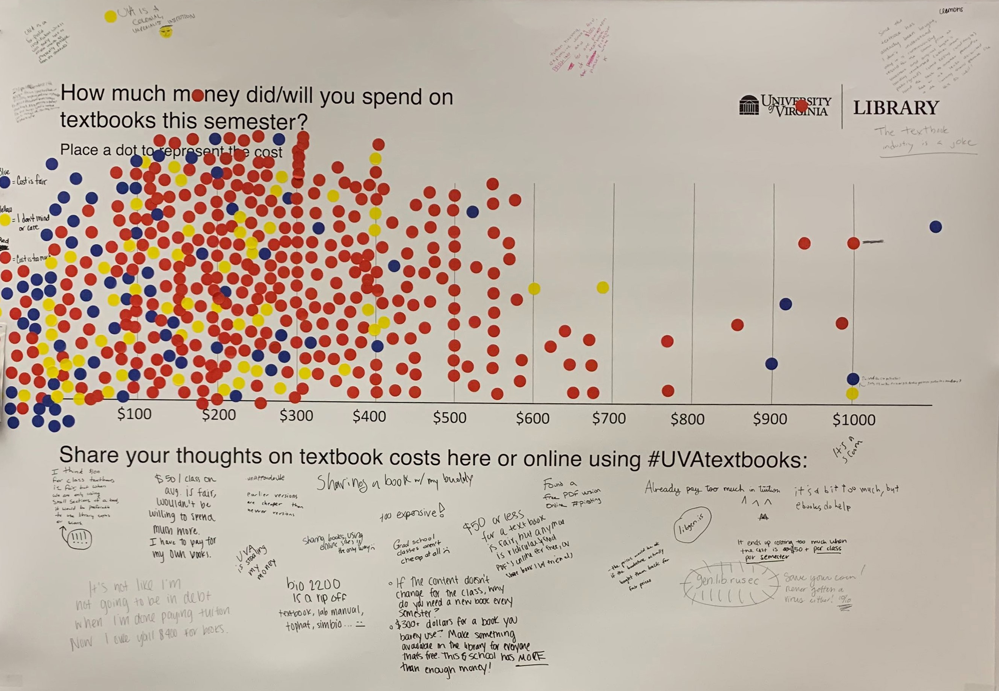
UVA Student Survey
(Spring 2020)
Conducted by the Library, in partnership with Student Council

Slide 25
UVA students are finding alternatives
to manage the cost of required course materials
30%
24%
22%
10%
Did not purchase required course materials
Took these measures
Utilized materials available through the Library
Registered for another course
Photocopy/scan materials
Read Amazon previews
Get an extra job/shift
Share with someone
Borrow from a friend
Rent
Download illegal copies
5%
4%
Dropped a course
Earned a poor grade
3%
Took fewer courses
Impact of Cost of Course Materials on UVA Students (Spring 2019)
Notes:
National surveys have shown that 65 percent of students skip buying required texts at some point in their college career because of their high costs.
When we asked students (small sample size consisting of library patrons), 30% reported that they didn’t purchase required materials.
The measures on the right show the lengths to which some students go, suffering academically in ways that they are attributing to courseware costs.
This an equity issue, affecting our students who are least able to deal with the burden, most likely to feel like they don’t belong here. Their strategies for addressing their financial need make it ever harder for them to succeed
Notes on other alternatives:
Used library materials
Interesting finding, considering that the students were likely not referring to textbooks per se: the library does not collect textbooks.
New expensive editions are issued frequently, sometimes every year: the library cannot keep up with those costs.
The new generation of digital courseware is licensed either directly to students or by the institution, bypassing the library entirely: publishers won’t sell these licenses to libraries.
The market for shared, downloaded illegal copies is flourishing.
This is an equity issue. This affects our students who are least able to deal with the burden, most likely to feel like they don’t belong here.

Slide 26
Any questions or comments?
Notes:
Discussion

Slide 27
Let's Talk About Discovery...

Slide 28
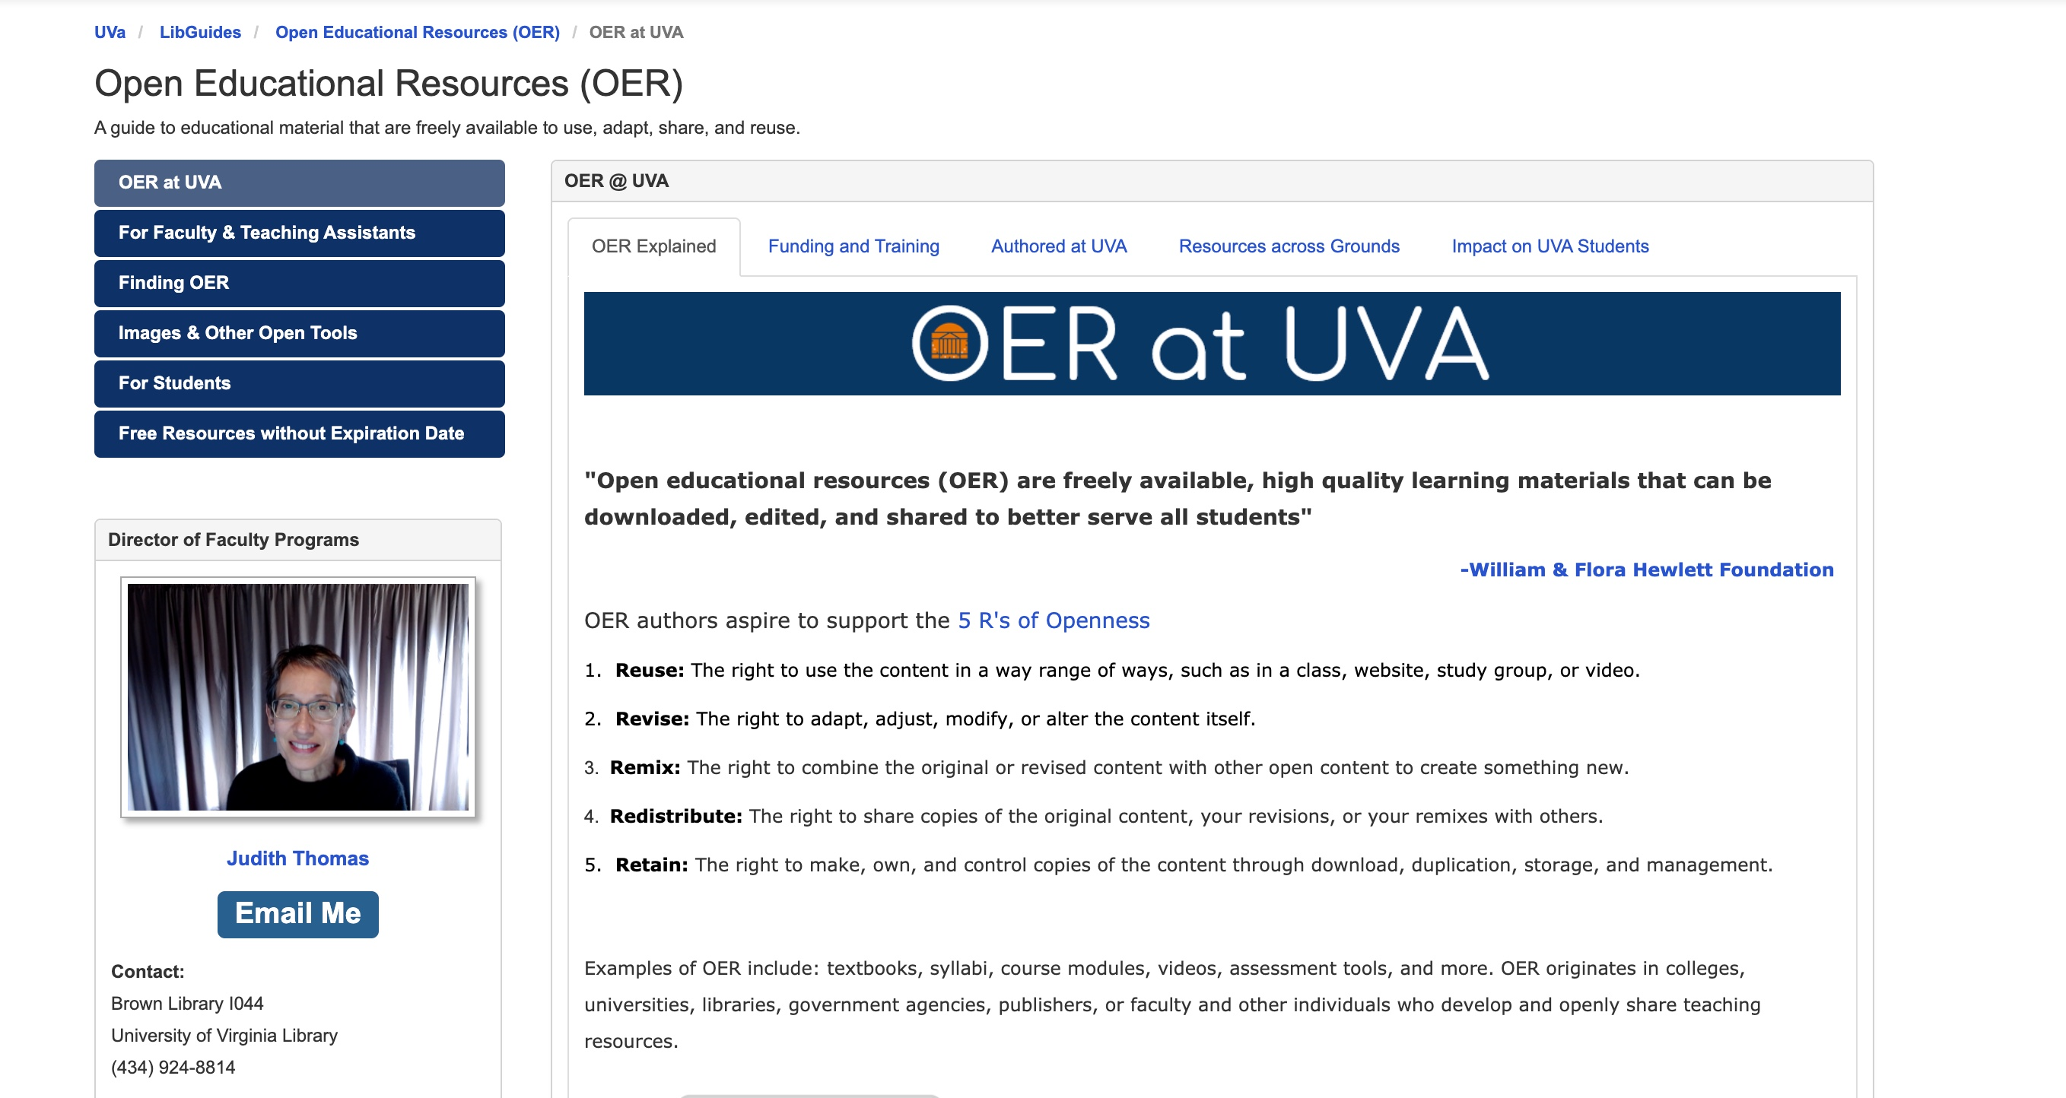
Finding OER, Tools, Support, and more...
The Library’s OER guide contains information about:
OER at UVA
Faculty funding
Student advocacy
Finding OER
Tools for OER creation
OER adoption support
https://guides.lib.virginia.edu/oer​
Join us for an upcoming workshop on Finding & Evaluating OER
Notes:
A great starting point is this library guide. It includes links to repositories, metafinders, and directories, spanning a wealth of materials.
Contact Judy or Bethany or your subject librarian for help if navigating the complex world of OER discovery.

Slide 29
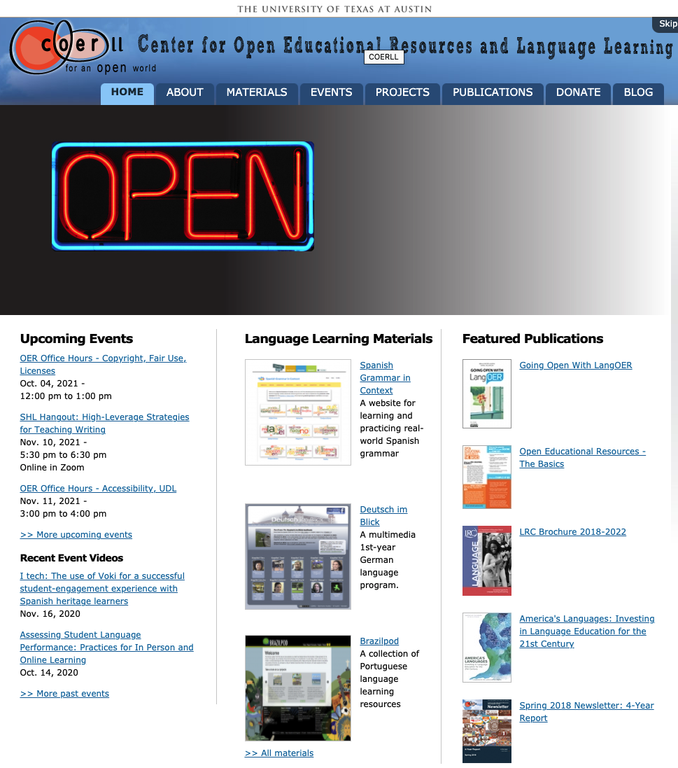
Discipline-Specific Repositories, Communities
Notes:
This is one example of a discipline-specific repository, which also is the locus for an online community built around open education in foreign language disciplines.

Slide 30
Open textbooks are available in many formats;
some come with ancillary resources
Introductory, algebra-based, two-semester college physics (1272 pages)
Formats: Online, Print, PDF, Bookshare (accessible), iBooks
Canvas/Blackboard Course Cartridge
Getting Started Guide (Instructor & Student versions)
Instructor Solutions Manual and Student Solution Guide
Sample Syllabus Language and PowerPoint Slides
Concept Trailers (1-min videos)
Diversity and Representation Development Guidelines
Errata Release Notes
Expert TA Study
OpenStax community Resources
“How to Succeed in Physics” Guide by Veritas Tutors
Reading/Notetaking and Student Time Management Guide
Over 20 technology partners (iClicker, Perusall, and more)
https://openstax.org/details/books/college-physics
Notes:
Open Stax is a major OER textbook repository and publisher.
This is the #1 adopted Physics book in the nation. This is a two-semester book, available free for download; the cost of a print version is about 20% of that of a similar commercial text.
Some faculty rely heavily on commercial digital courseware because it includes a host of ancillary resources: test banks, homework assignments, assessments, etc. A growing number of OER include these resources as well.
Just because a book is open, don’t assume it doesn’t come with ancillary resources.
Besides those that are part of the open textbook package, there are often third party ancillary resources from proprietary vendors that are usable with open textbooks – still at a fraction of the cost of a regular textbook.

Slide 31
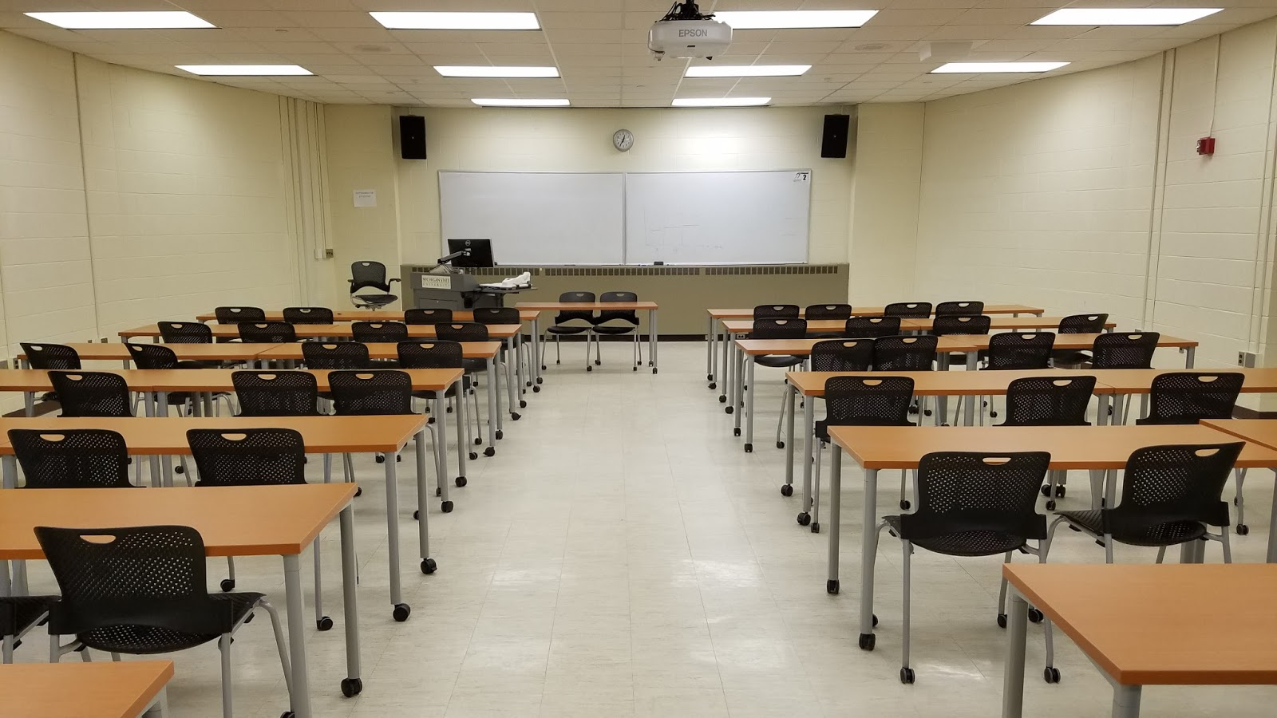
Let's Talk About Pedagogy...
Notes:
What can you do with OER in the classroom to improve the learning experience?

Slide 32
Open educational practices...
empower the creation of safe, inclusive, and respectful learning environments that embrace all learners and provides equal access to opportunities and information.
support instructors as they guide students to contribute to the knowledge commons, not just consume from it, in meaningful and lasting ways.
“Come for the cost savings, stay for the pedagogy.”
Notes:
Open educational practices guide students to curate and create new knowledge, empowering them as public contributors of ideas. http://openpedagogy.org/open-pedagogy/
There have been many studies of student outcomes using OER; most reveal that students achieve the same or better learning outcomes using OER, while saving money.
https://bit.ly/3bgDr5k

Slide 33
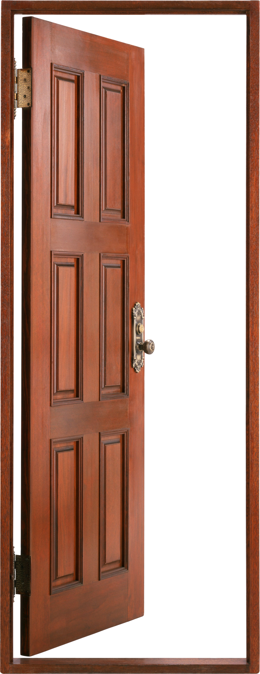
OER opens the door to...
Customization
Contextualization
Active Learning
Notes:
There are other dimensions to the inequity problem in higher education, at this school.
Students at the margins need to see themselves as belonging in the school. These students sometimes report feeling like “imposters”. This school is not for them. 19% of UVA students report that they strongly disagree, disagree, or somewhat disagree with this statement “I feel that I belong at UVA.” https://ira.virginia.edu/university-stats-facts/seru-2020-core-survey
Open textbooks can used as part of inclusive teaching, helping to remove some barriers to learning, enhancing a sense of ‘belongingness.’

Slide 34
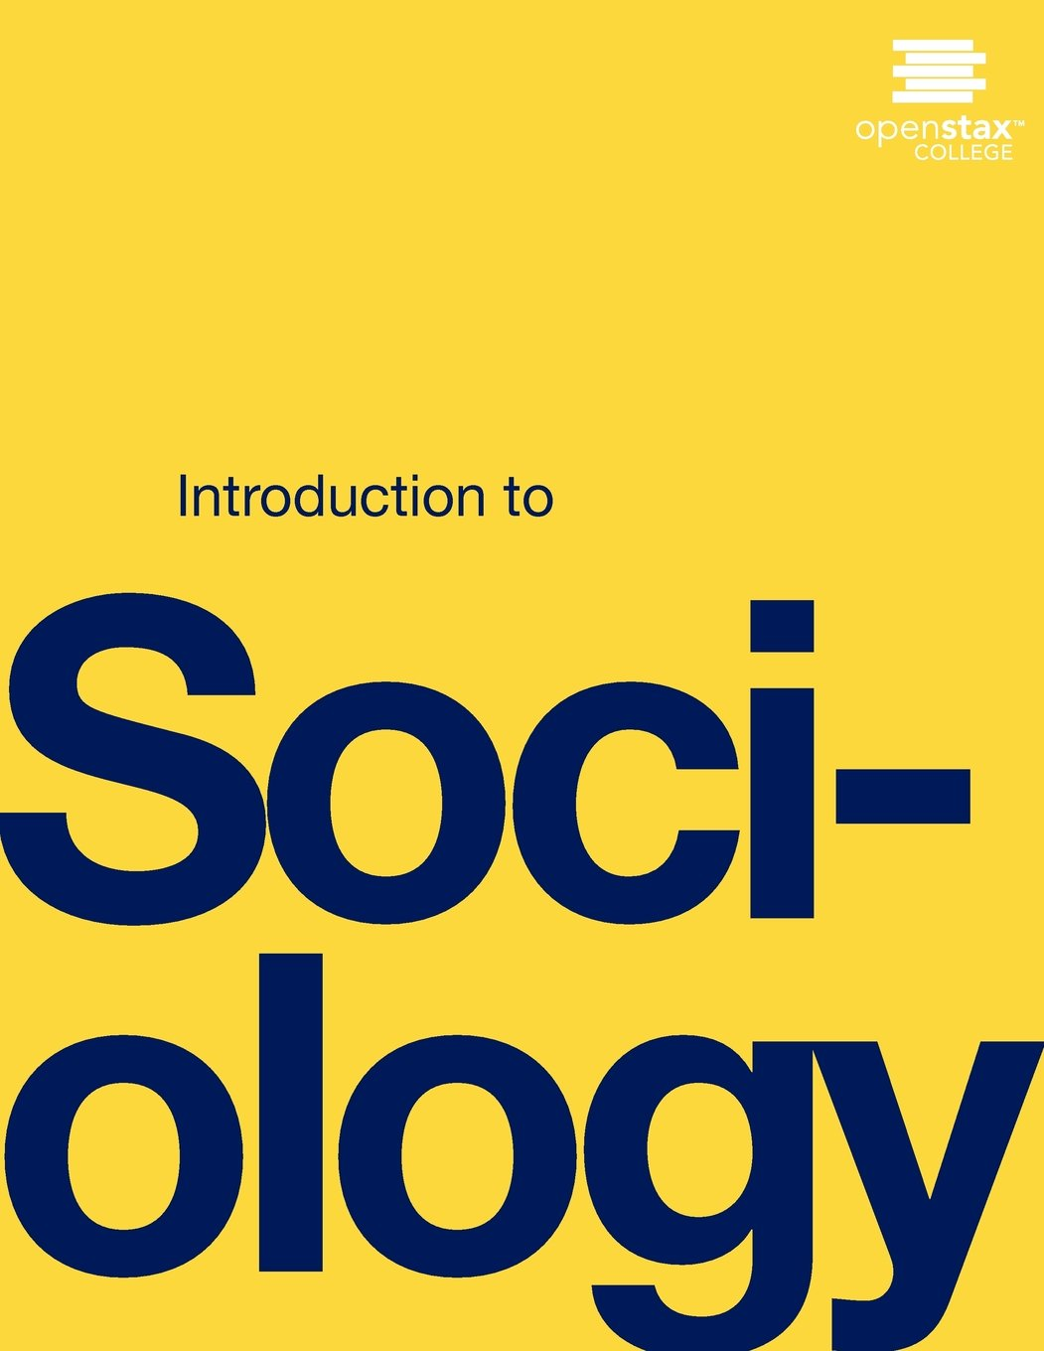
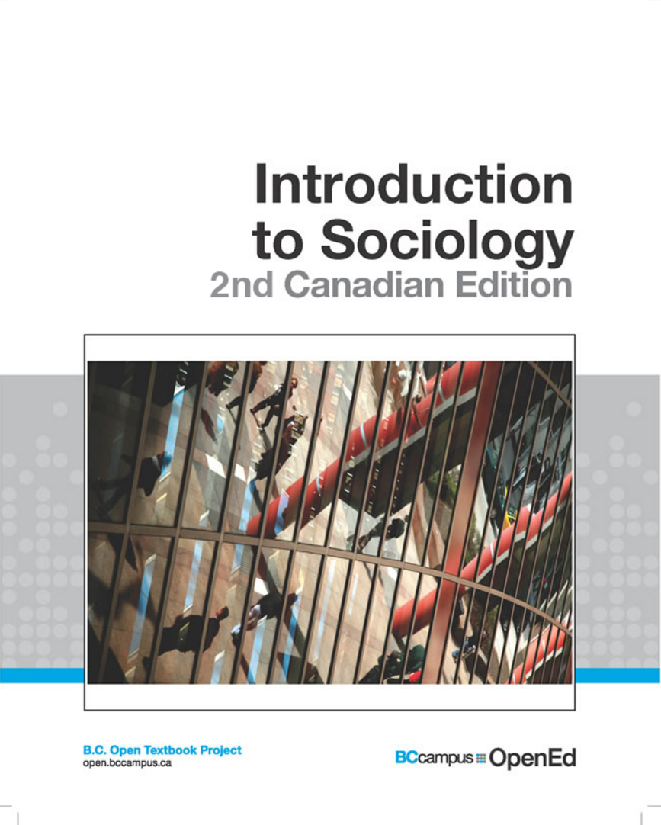
Open textbooks can be contextualized to reflect your students’ experience
Localizing a sociology text to account for Canadian spelling, measurements, societal context
Revising an astronomy textbook for the Southern hemisphere
Notes:
Two examples:
A sociology text localized to create a Canadian edition, including spelling, measurements, different government systems, the context of Canadian society. It’s now relevant to Canadian students.
An astronomy textbook revised for the southern hemisphere; now the star charts in the book match the night sky in their hemisphere.
Use of OER as part of culturally responsive teaching practices can engage students on the margins. Students can be part of this process, examining texts for bias and then providing social annotations or revisions.
https://www.facultyfocus.com/articles/equality-inclusion-and-diversity/how-open-education-enables-culturally-responsive-teaching/

Slide 35
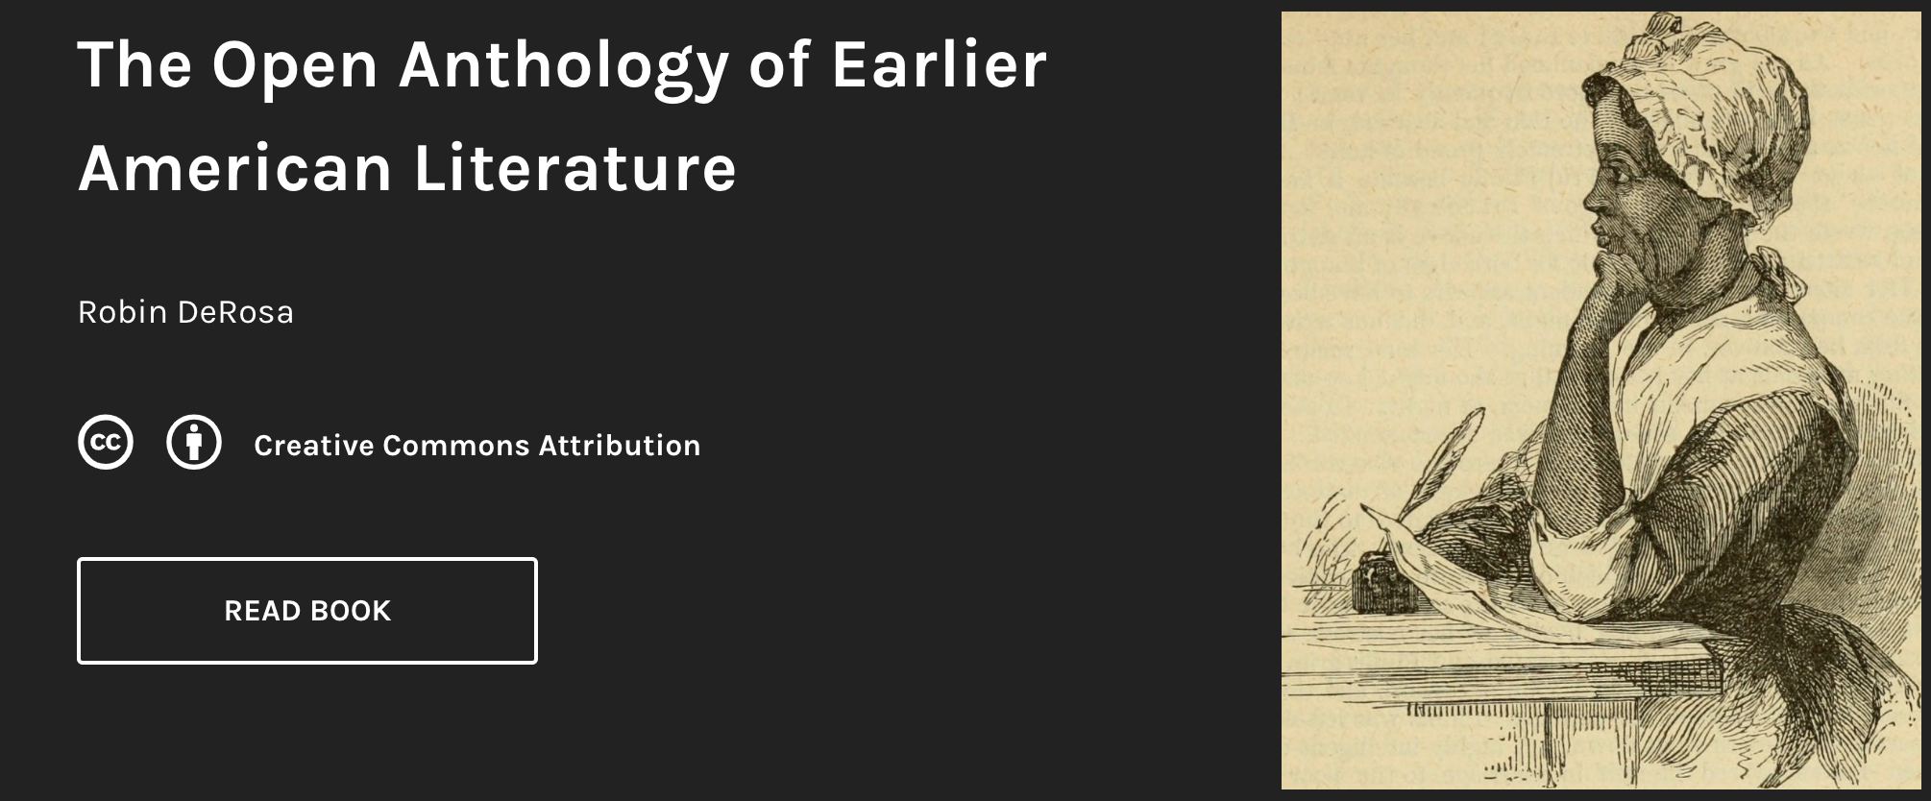
Open pedagogy can create a new relationship between learners and course content
https://openamlit.pressbooks.com/
Notes:
This resource was created by Robin deRosa (digital humanities scholar, English faculty, Plymouth State University). Her students created shareable introductions, discussion questions, assignments and occasionally short films related to the text.. Another group is now adding in native voices.
“Open textbooks save money, which matters deeply to our students. But they can also create a new relationship between learners and course content, and if teachers choose to acknowledge and enable this, it can have a profound effect on the whole fabric of the course.” Robin DeRosa http://robinderosa.net/uncategorized/my-open-textbook-pedagogy-and-practice/

Slide 36
Renewable assignments may be originally developed or remixed or adapted
Students create a test bank to earn class credit
Students adapt an open textbook, earn authorship credit
Notes:
Rajiv Jhangiani’s students crafted and peer reviewed questions for a test bank for an open educational textbook; an example of active learning that turned into a shareable resource. http://openpedagogy.org/assignment/why-have-students-answer-questions-when-they-can-write-them-by-rajiv-jhangiani/
David Wiley’s book, Project Management for Instructional Designers, includes student contributions: they helped to revise the work and added features, e.g., assessments, videos of interviews with instructional designers. Students could choose to have authorship credit. https://pm4id.org/front-matter/about-this-book/

Slide 37
The Open Pedagogy Notebook offers a space for faculty to share, discuss, and develop renewable assignments
http://openpedagogy.org/
Notes:
There are growing communities of practice to support open pedagogy. The Open Pedagogy Notebook is a space for faculty to share, discuss, and develop assignments, materials, activities, assessments.
http://openpedagogy.org/

Slide 38
Different publishing models: traditional and open
College / University
Publisher
Author
Author
Foundations
Government
Consortia
Academic institutions
$
$
$
$
Students
Students
Textbook
Textbook
Notes:
Implied in the shift to open education is a different business model. The model on the left is the traditional approach: (1) A publisher invests in publishing a textbook; (2) students buy the books; (3) the publisher makes its money back, and a profit; (4) I then pays royalties to the author (typically single-digit percentage). As a general rule, the publisher controls the copyright
But the right shows another model: (1) A college or university publishes a textbook - they might put out an RFP to their faculty; (2) part of the funding is paying faculty up front for their efforts; (3) at times, funding comes from the outside (from foundations, government, consortia), but schools are increasingly deciding to self fund these efforts. This model allows the work to be to be free and openly shared.
Note that aspects the publishing process can be exactly the same in the two models, including peer review, copy editing, etc., making it possible to publish a free textbook while also respecting the effort of the author.
A new grant program at the Library, Affordability and Equity, funded by the Jefferson Trust, offers awards to faculty for adopting, adapting, or creating OER. https://bit.ly/3mlUNUv
We can also offer support and resources: that is, the tools and staff time (subject librarians, instructional designers and technologists) to help you adopt, adapt, and ultimately to create OER.

Slide 39
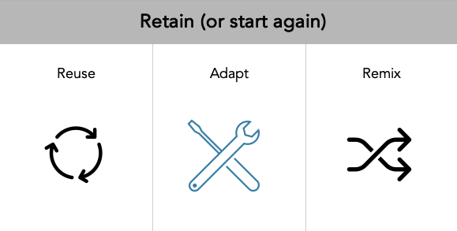
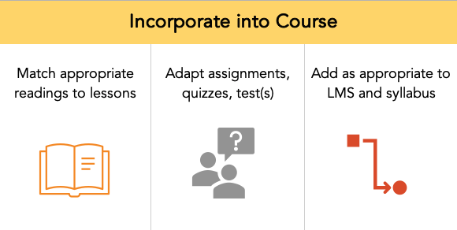
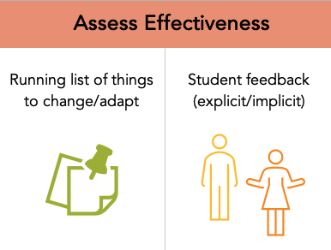
OER Selection
Faculty Journey Map
Notes:
Draft diagram of the process for finding and incorporating OER into courses.. We have plotted out the journey for faculty who are looking to adopt or adapt existing resources in order to help us think about what are the critical steps and what kind of support is needed for each step. If you consult with us about using OER, we’ll attempt together to move through this process and your responses will help us to refine our understanding of what’s needed and develop the right support structures.

Slide 40
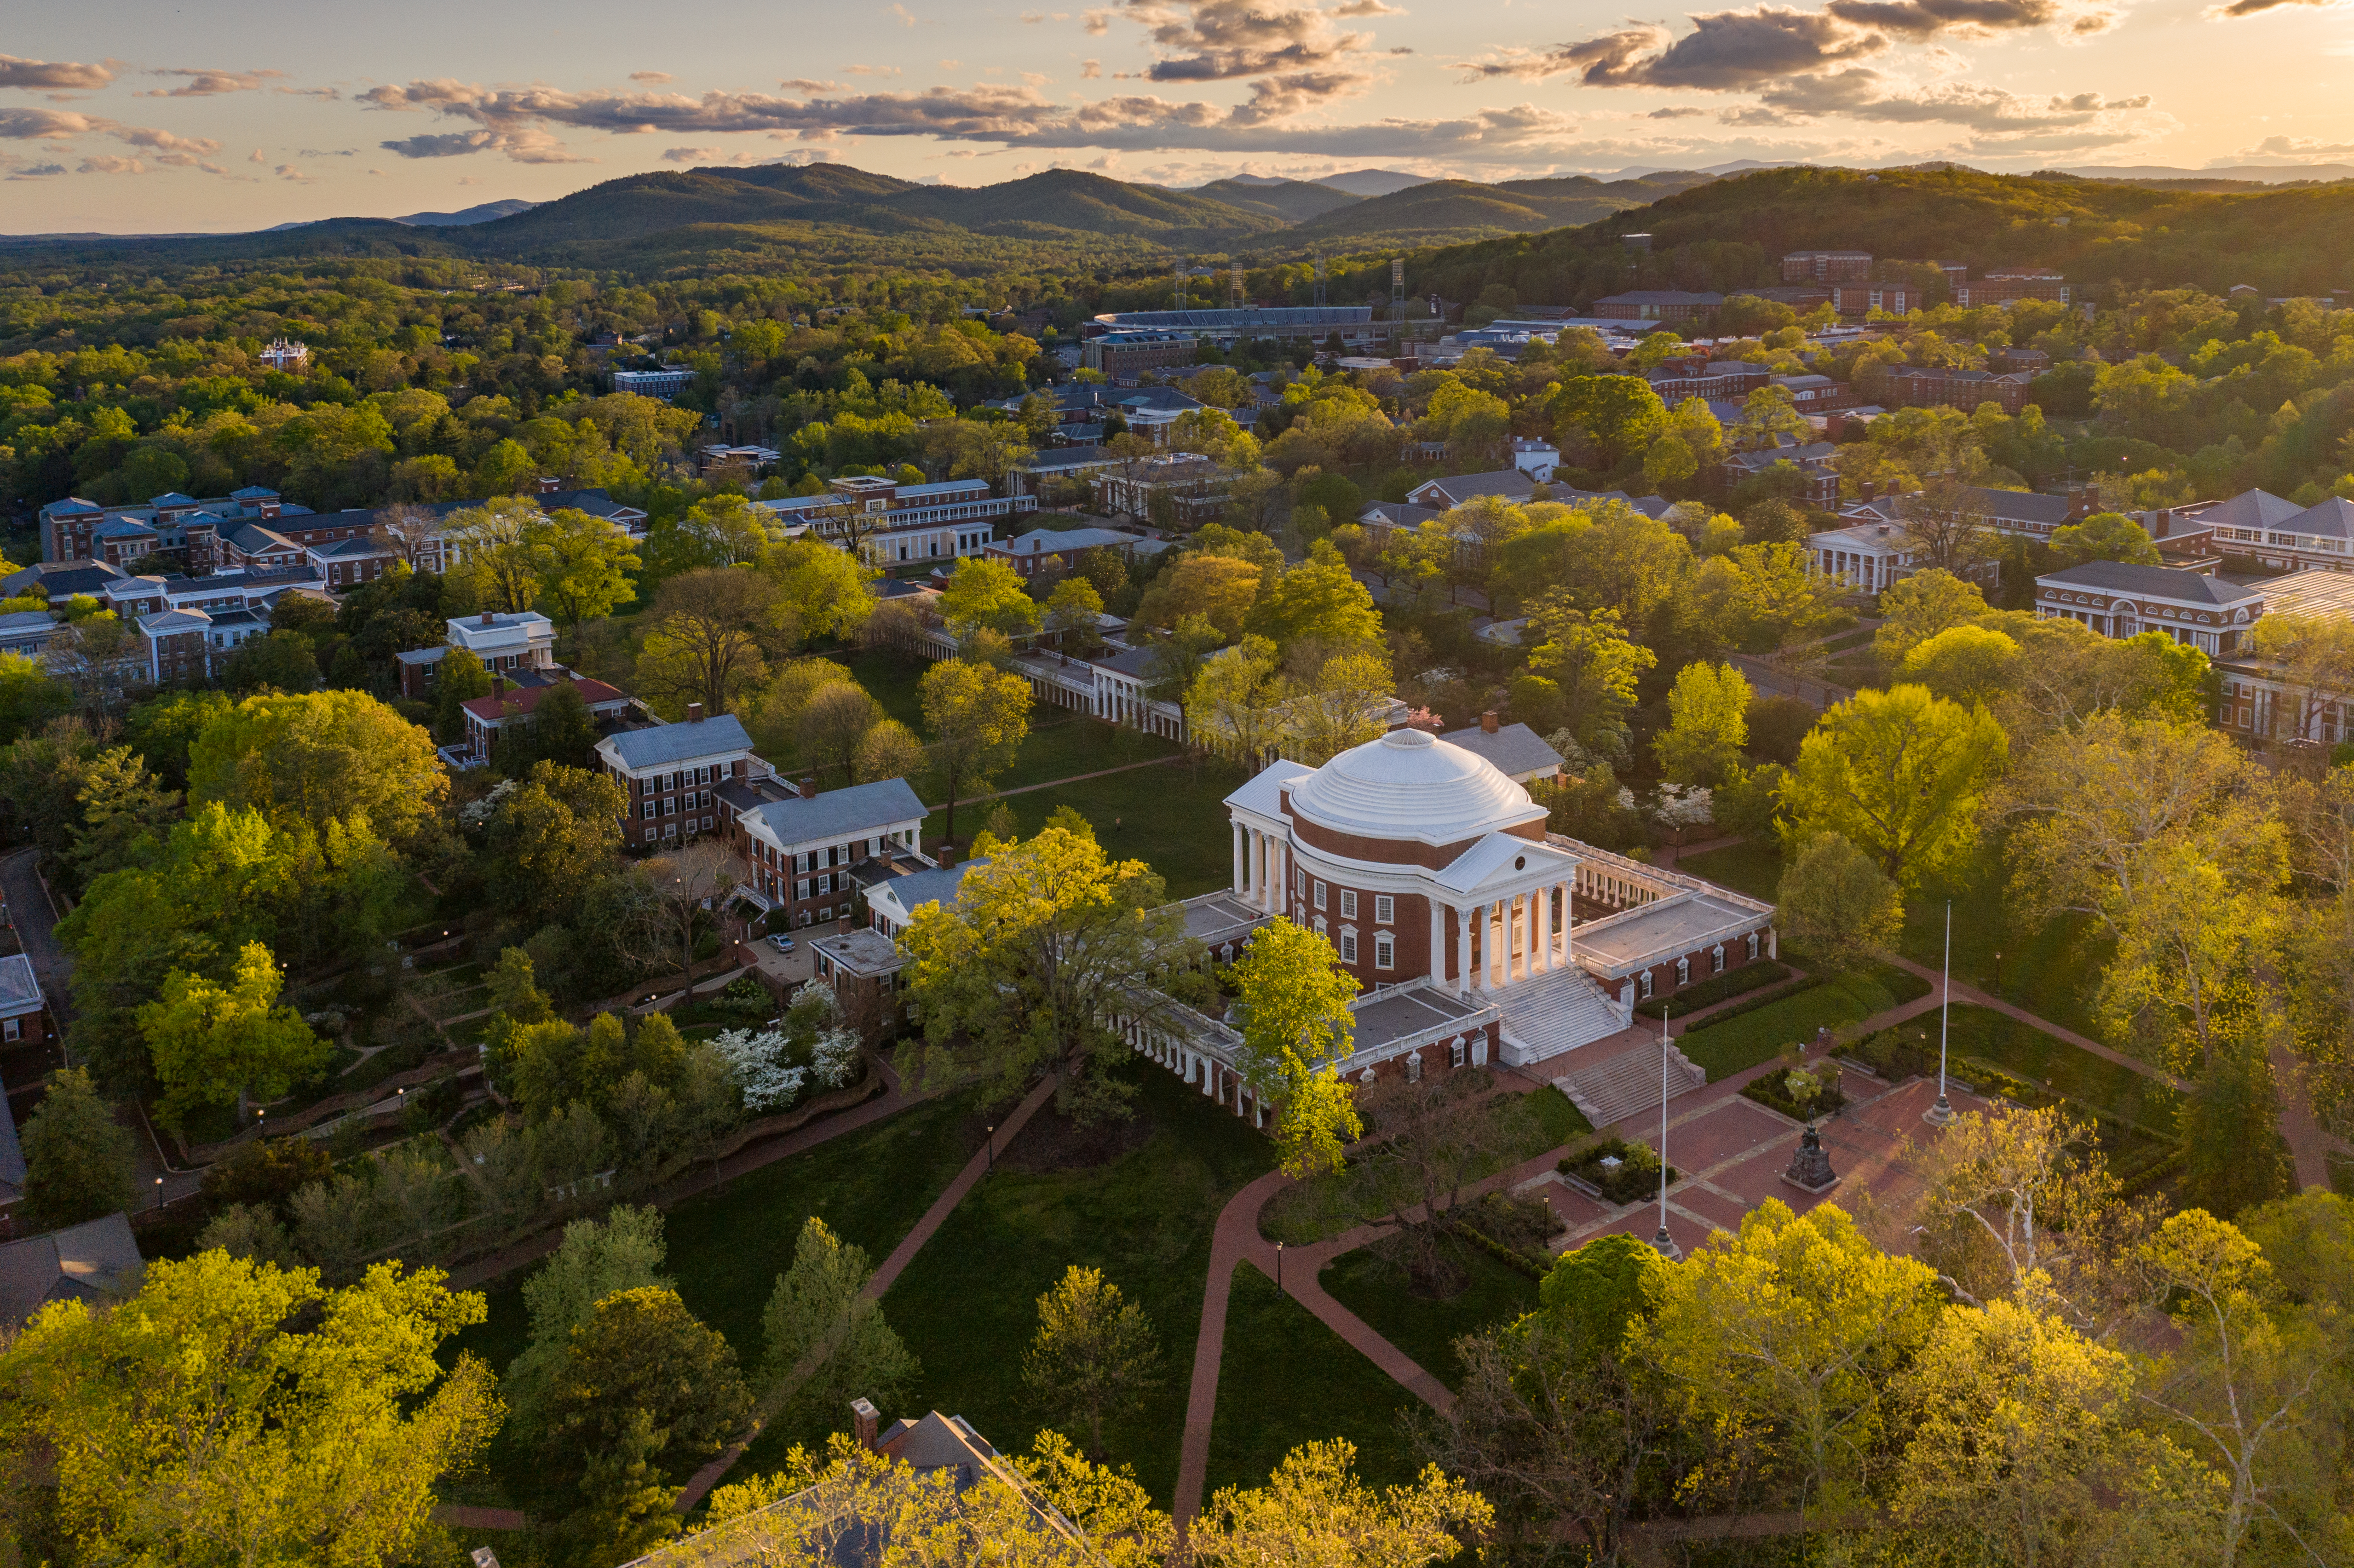
What is UVa already doing?
Faculty
Many individual efforts
Departmental efforts including
Spanish Language involvement with AAC&U OER Institute
Students
Student Council advocacy
Librarians and support staff
Gaining and sharing knowledge
Identifying tools and strategies for creating and disseminating content
Participating in initiatives such as AAC&U Institute
Hosting the Affordability & Equity Grant program funded by the Jefferson Trust
Notes:
Call for proposals for the Affordability and Equity Grant Program: https://bit.ly/3mlUNUv

Slide 41
What more can we do?
Faculty
Explore open educational resources
Review an open textbook
Adopt/adapt, if materials meet your needs and those of your students
Librarians and support staff
Help in the discovery of materials
Support adoption and adaptation
In the future, support creation of new content
Notes:
To learn more about reviewing and open textbook and receiving remuneration, please attend the Finding, Evaluating, and Reviewing OER session or contact Judy Thomas.
https://bit.ly/3bioVdd
The Open Educational Resources guide is at: https://guides.lib.virginia.edu/oer

Slide 42
Questions? We are here to help!
Judith Thomas (jet3h)
Bethany Mickel (bbm9u)
Haley Gillilan (hg4ub)
Adapted in 2021 from Open Textbook Network (2019).
Except where otherwise noted, this work is licensed under the Creative Commons Attribution 4.0 International License.

