Slide 1
Authors’ Rights: Use the Law, Share Your Scholarship, Change the World
Brandon Butler
Presented at Univ. of Richmond
9/27/17

Slide 2
Roadmap
Copyright Basics
Copyright provisions in a publishing agreement
Things to think about
Reclaiming Rights
Changing the world
Resources

Slide 3
Copyright Basics
Automagical - no more “formalities” (notice, registration); just “fixation in a tangible medium”
Ownership vests initially in author(s) - note the unusual status of scholarship vis-a-vis work for hire rules.
“Bundle” of rights: divisible, licensable, transferrable
Term of protection: Life of the author+70 years

Slide 4
Common © Provisions in Author Agreements
Transfer or License to the publisher
Transfer vs. license - does it matter? Look to bottom line: who can do what.
Inclusion of 3rd-party material - three typical provisions:
Author affirms there is no 3rd party material in the work
Author affirms she has permission to use all 3rd party material
Author affirms all 3rd party material is included lawfully
Author indemnity of journal

Slide 5
Things to Think About
Funder open access requirements (NIH, e.g.)
Your own goals for the piece—P&T, engage your field, impact a public debate, support teaching, etc.
What uses you’d like to make with the work after it’s published
What uses you’d like others to be able to make of the work after it’s published

Slide 6
Rights you might reserve for yourself
Right to deposit/publish a version of the article:
in your institutional repository (scholarship.richmond.edu)
in a subject archive/preprint server - e.g., arXiv, SSRN, Humanities Commons
on your personal website/departmental site
on a social network (e.g., academia.edu)
Right to use article in teaching, conference presentations, etc.
Right to reuse/reprint portions of article in future books, articles
Other ideas?

Slide 7
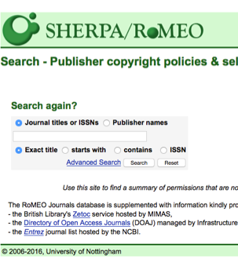
Key resource: SHERPA RoMEO
Massive archive of author agreements for major publishers
Links to full text of agreements
Categorizes publishers’ default policies re author reuse
Nomenclature:
“pre-print”
“post-print”
“publisher PDF”
Notice/Citation Requirements

Slide 8
Flavors of Open, and a note about “predatory publishers”
Open Access in two flavors:
Green: author publishes in traditional journal, but archives a version of her article with an open license in an open repository
Gold: article is published by the journal with an open license
Funding OA: Institutional memberships, author processing charges
“Predatory” publishers

Slide 9
Reclaiming Rights
Older works (often out of print) may be reclaimed by an author or heirs
Three ways:
Statutory Termination of Transfer - Complex!
Contractual reversion - Authors Alliance Guide
Informal negotiation w/ publisher - Same
Why? Typically to re-publish online, free, and often open access…

Slide 10
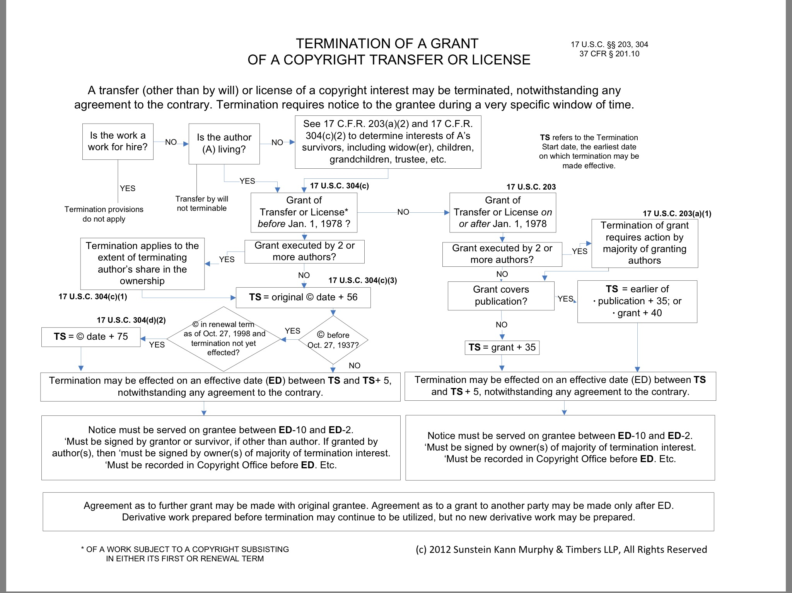

Slide 11
Changing the World
Use open licenses - CreativeCommons.org
Open Access - lowering price barriers to scholarship
Open Educational Resources (OER) - promote affordability, innovation in teaching
Open Data/Open Science/Open Workflows - for reproducibility, transparency, collaboration
Use fair use - American University Best Practices

Slide 12
Resources
Authors Alliance - http://www.authorsalliance.org
Guides to Open Access, Rights Reversion, and more
By and for academic authors
Authors Guild - https://www.authorsguild.org
For book deals, agents, etc.
Termination flow chart: https://www.sunsteinlaw.com/media/2012_01%20Copyright_Chart.pdf
“Principles of the JCEL Publication Agreement” - https://journals.ku.edu/index.php/jcel/article/view/5913
Thoughtful breakdown of a modern publishing agreement written with authors’ rights and public access as key goals

Slide 13
Resources (cont’d)
SPARC - https://sparcopen.org
All things Open - OA, OER, Open Data
SPARC Author’s Addendum for journal contracts
Center for Open Science - http://cos.io
Open workflows, open data, pre-print repositories
Center for Media and Social Impact - http://cmsimpact.org/codes-of-best-practices/
Fair Use Best Practices and Supporting Materials

Slide 14
Any questions?
Brandon Butler
bcb4y@virginia.edu
@bc_butler
based in part on “Negotiating Publishing Contracts: Journal Articles” by Ana Enriquez, University of Michigan Library, CC-BY 4.0 Int’l

