Slide 1
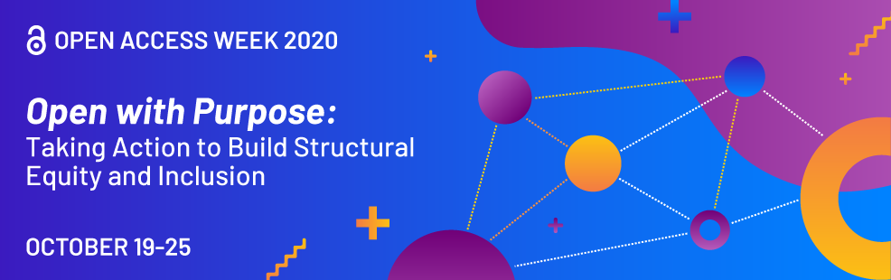
Notes:
Welcome to this presentation on Libra - UVa's Institutional Repository
I'm Sherry Lake, Scholarly Repository Librarian.
1 -This talk is part of International Open Access Week is a yearly event - it's a time for the wider research community to coordinate in taking action to make openness the default for research and to ensure that equity is at the center of this work.
This year's theme is "Open with a Purpose: Taking Action to Build Structural Equity and Inclusion". I hope my brief introduction to Libra and UVa Library's Open services will initiate discussions on how you can make your research more open and how you can be part of a more equitable system of sharing knowledge.
Before I start my presentation, I want to give a definition for "Open Access"
With Open Access = Information is available immediately to "all" and free from costs to "get" it.
Making research open, makes it transparent and timely, with no publisher delays.
Open works are free from cost for everyone - the reader, such that works are not behind a subscription paywall, or the provider - an institution, like UVa who pays in order for its researchers to have access.
Let's get started.

Slide 2
Libra – UVa’s Scholarly Repository
Sherry Lake
Notes:
Again.......
Welcome to this presentation on Libra - UVa’s Scholarly or Institutional Repository
I'm Sherry Lake, Scholarly Repository Librarian at the UVa Library
So let's talk about Libra UVa's Scholarly Repository and how you can use it to make your research Open and freely available to all

Slide 3
Libra
What is it?
Why use it?
WHERE is it?
Who can use it?
  How to Search what’s in libra?
How to get help?
Libra: Sherry Lake/ Open Access Week 2020
Notes:
In this presentation:
I’ll cover: what is Libra, why should you use it, how do you get to it ( to deposit works and/or search for Open works). I’ll cover who can use Libra , and finally how to get help and learn more about Libra.

Slide 4
libra
UVa’s institutional repository provides open access to the scholarship and research of UVa Faculty, Staff and Students:
dissertations, theses
general scholarship
  open access articles (pre-prints)
  books
  conference materials
  presentations
  etc.
datasets (and other products of research)
Notes:
4 - What is Libra????
Libra is a set of repositories that provides open access to publicly available content such as journal articles, monographs, conference proceedings, presentations, posters, reports, pre-prints. It also contains data and other products of research. AND Libra is the online source for UVA's Theses and dissertations.
Libra, as the institutional repository for UVa, is the place for UVa’s faculty, staff and students to upload and share a broad range of scholarship.
Items in Libra are readily discoverable because they are indexed by search engines, like Google Scholar, and the Library’s online catalog

Slide 5
Benefits of libra
Immediate availability of UVa scholarship
“Free” from subscriptions
Persistent URL via Digital Object Identifier (DOI) registration
Connect your scholarship using ORCID iD
Preservation of works in Libra as part of the record of UVA scholarship
Notes:
5
So why should you care or use Libra?
- Libra is the perfect place to self-archive your research that you want to share openly, without barriers (including costs). Works that you put in Libra are immediately available, there is no waiting for reviewers and publisher delays. And if you have reports, white papers, or other research that you may not necessarily want to submit to journals, but you still want to share, then Libra's the place.
Do you have funder or journal requirements for sharing research data? LibraData is the perfect place for that.
Works deposits in Libra get a persistent URL - DOI - Digital Object Identifier that you can include in your CV, or link to in other works.
STOP……
[Note this are the bullets from slide, need to not read them]
- Immediate availability of UVa scholarship, without the delays necessary for binding and cataloging paper copies. “Free” from subscriptions
- Persistent URL via Digital Object Identifier (DOI) registration provides a simple, durable link to include in your CV, on your personal web site, and other places where you share your scholarship.
- Optional ORCID iD linking to connect your scholarship to you via persistent digital identifier, in addition to your name.
- Preservation of works in Libra as part of the record of UVA scholarship

Slide 6
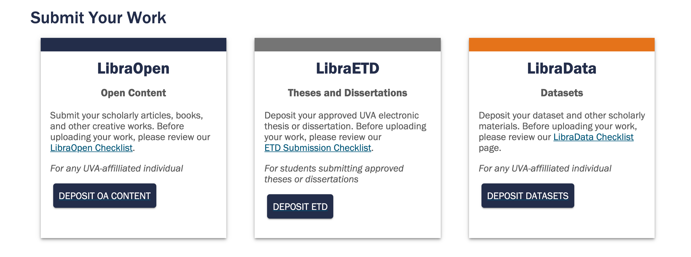
http://libra.virginia.edu
libra@virginia.edu
Notes:
6 -Where is it?
Since Libra is really three separate servers, we have created one landing page that gets you to all the information for the repositories; The page has links to deposit your works AND a search box to search Libra's Open Access items.
[Click the slide: GO to the web page scroll down to show more info on each.]
At the bottom of the Libra landing page there are links to more information on the repositories.
[Scroll back to top]
And the all IMPORTANT email address libra@virginia.edu
[Go back to slides]

Slide 7
http://libra.virginia.edu
libra@virginia.edu
Notes:
7 -Who can use it?
[GO BACK TO WEB]
Any faculty/staff or student can deposit works in LibraOpen or LibraData
LibraOpen is for scholarly articles, books, and other creative works openly licensed by UVA authors. Do you have papers behind paywall?? – deposit an open version in Libra. Did you participate in a Conference online this year? – submit your poster or recorded presentation or paper to LibraOpen.
To make sure your scholarship is Open and available to a wider audience, you can deposit your pre-print or post print of a research article, most publishers allow a version to be put in an institutional repository.
[Click on LibraOpen deposit]
You will see dashboard of your works uploaded to LibraOpen
LibraData is UVa’s institutional version of Datavese, created by Harvard, UVa’s Dataverse is maintained and supported here locally at UVa.
[Click on LibraData - log in]
It is for data and other products of research that supplement a paper OR for research that needs to be shared per funder and/or journal requirements.
you can also deposit your products of research just for the good of being open and transparent – for the good of Open Science 74
[Go back to landing web page]
LibraETD is for departments that required thses or dissertation per graduation requirement. It is also used by several departments that have Honor’s programs and Distinguished Major Programs. Access to deposit to LibraETD is limited to those specific students.
Check out the ”Checklist” for steps to deposit in each repository.
[go back to slide]

Slide 8
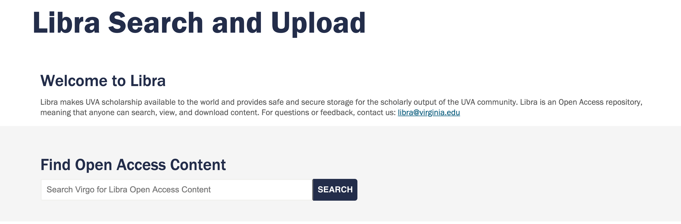
http://libra.virginia.edu
To find individual collections: https://v3.lib.virginia.edu/catalog?f[source_facet][]=Libra+Repository&sort_key=received
Notes:
8 - How to search?
Since we have three separate systems, searching is done in Virgo, UVa's Library catalog. If you start from Virgo, Libra items will appear in your search along with items from the Library's other digital and physical collections.
To search Libra items specifically, use the search box on the Libra Landing page
The Search box searches the newest instance of our Library catalog discovery system, which, at this time, puts all Libra content under the “Theses” pool. Separating our Libra systems for easier discovery is currently being worked on.
[Click on V3 search link.]
But in the meantime, we still have access to our previous search system. Here's the link to search Libra content directly and see each collection.
https://v3.lib.virginia.edu/catalog?f[source_facet][]=Libra+Repository&sort_key=received
All Libra content is discoverable, but in this version you can narrow down your view based on the repository (ETD, Open, Data).
Point out Collections - click on one LibraOpen, one LibraETD and
[Although you can search in Uva’s Dataverse.]
one LibraData (2nd one Geospatial)

Slide 9
http://libra.virginia.edu
libra@virginia.edu
Thanks
Sherry Lake
Notes:
That concludes my brief look at Libra.
Please contact us at Libra@virginia.edu if you have any questions about depositing or discovering open content.
Thanks!

