Slide 1

Verb Tense and Passive Voice in Research Articles
This work is CC-BY and use must include full citation & DOI. Individual images, examples, and materials from other sources are not CC-BY. The blue dinosaur icon is a GWL icon and not CC-BY.
Natalie Thompson | Consultant, Graduate Writing Lab
Kelly J. Cunningham, PhD | Director, Graduate Writing Lab
School of Engineering & Applied Science, University of Virginia
gradwritinglab@virginia.edu | bit.ly/SEASGWL
Notes:
Contains images that require alt text, including text-based screenshots.
None of the images, screenshots, or examples may be extracted for other use. CC-BY license does not apply to these components individually.
The dinosaur image is a GWL icon.

Slide 2
Overview
  Verb Tense Principles
  Verb Tense Refresher (Grammar Terms)
  Guidelines for Choosing the Right Tense
  Passive Voice and Active Voice
  Examples: Verb Tense Distribution
  Verb Tense Examples by Section

Slide 3
Principles

Slide 4
Principles for Choosing the Right Tense
Prioritize Clarity. If you have the choice to make a sentence simpler, more straightforward, or less ambiguous, be kind to your reader and do so.
Use the appropriate verb tense to send helpful signals, like signposts, to your reader. Tense can help make it clear whether you’re talking about previous work, accepted info, or your novel contribution to the field.
Match your verb tense to the goal of each section. Tense can distinguish between results you’re reporting and conclusions you’re drawing, or between general background facts and new ideas.

Slide 5
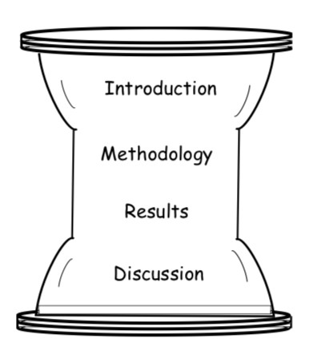
Matching Tense to Content and Section
Since research articles follow the same general structure, we can make some generalizations about what kind of content each section conveys and what tense is most used.
For example, Results and Methods sections mostly use past tense since you’re reporting specific things you did and their outcomes.
Image: Writing Research Articles for Publication, AIT: http://languages.ait.ac.th/wp-content/uploads/sites/18/2018/08/Writing-Research-Articles-for-Publication1.pdf
Notes:
Image: Writing Research Articles for Publication, AIT: http://languages.ait.ac.th/wp-content/uploads/sites/18/2018/08/Writing-Research-Articles-for-Publication1.pdf

Slide 6
Follow the Structure and Conventions of Your Field
But keep in mind—your sub-field, or even the specific journal you’re submitting a paper to, may have slight variations to this general structure.
Read a sampling of articles from the most popular journals in your field to become familiar with variations in sections and structure.
Related Work
“The Proposed Model”
“Case Study 1”
Conclusion
Image: Writing Research Articles for Publication, AIT: http://languages.ait.ac.th/wp-content/uploads/sites/18/2018/08/Writing-Research-Articles-for-Publication1.pdf
Notes:
Image: Writing Research Articles for Publication, AIT: http://languages.ait.ac.th/wp-content/uploads/sites/18/2018/08/Writing-Research-Articles-for-Publication1.pdf

Slide 7
CAUTION
CAUTION
CAUTION
CAUTION
CAUTION
CAUTION
CAUTION
CAUTION
  “Be Consistent”
  Some verb tense advice says that the most important principle is to be consistent with the tense you employ—but this advice can be misinterpreted
Being consistent with your verb tense does NOT mean you must use only one tense in a given paragraph or section
Instead, be consistent in choosing the right tense for the idea you’re trying to convey
You can use more than one verb tense in the same paragraph, or even in the same sentence

Slide 8
Refresher: Terms for Verb Tenses

Slide 9
Useful Verb Tenses
SIMPLE PRESENT: the model is successful
SIMPLE PAST: the model was successful
PRESENT PERFECT: the model has been successful (so far)
PAST PERFECT: the model had been successful (until…)
FUTURE: The model will be successful (with further calibration)

Slide 10
Helpful Questions & Guidelines

Slide 11
Use Present Tense for…
General, accepted facts
  Water quality decreases in periods of extreme flooding
  Stormwater control systems are important for managing flooding in coastal urban environments
  Many recent stormwater studies focus on improving or expanding conventional infrastructure
Definitions
Atemporal facts; things that will always be true
  Our environmental model uses precipitation and soil data to predict overtopping
  In this algorithm, x represents…
References to the paper itself (including figures)
  This study investigates the use of Real Time Control methods for augmenting traditional stormwater control infrastructure in urban coastal areas
  Figure 1 presents the results of our Norfolk, VA case study.
Conclusions and interpretations
  We conclude that Real Time Control is an appropriate addition to conventional stormwater management systems
  Our findings support the hypothesis…

Slide 12
Introductions: Outlining Purposes & Aims
Present tense: when referring to written product (article, paper, thesis)
Past tense: when referring to abstract concepts (study, investigation, experiment)
  In this paper, we aim to…
  Here, we present…
  (The purpose of this work was…)
  (The goals of this study were to…)
  Our method simplifies…
  This model uses…
  In this model, we used…

Slide 13
Use Past Tense for…
Reporting past methods or findings using the AUTHOR
  Nguyen found that biochar reduces nitrogen adsorption by 20% compared to compost (2019).
  Chen (2011) addressed the data scarcity problem by…
  Jones (2018) employed a Hawkes process model to…
Use present tense when you report past work by referring to the study or project instead of the author:
  Garcia’s 2017 study demonstrates the drawbacks of compost as a best management practice for reducing nutrient runoff.
Methods
We designed a prototype to take advantage of the line-of-sight blockage.
The samples were centrifuged and then classified according to geographic origin.
Reporting Results
  Water quality decreased with flooding in each of the six study areas.
  JupyterHub was the most effective method for online data sharing.
Notes:
If you’re using the author as the subject of your sentence, you’re referring to something they did in the world—in the past. If you refer to a study or a paper—it still presents whatever it did when it was first written; it always will because it still says the same thing.

Slide 14
Perfect Tense
Reporting past work more generally; multiple studies, trends
  Researchers have studied the use of visual light technology for communications purposes…
  Biochar has been shown to be effective in runoff control (Nguyen 2019, Smith 2020, Jones 2016).
  Previous systems have employed natural language processing to improve the model (Davis 2020, Martin 2019).
  Recently, latent factor methods have achieved great success.
  In the age of climate change, scientists have become more interested in…
Occasionally: showing the order of past actions
After the samples had been lysed, we examined them. (past perfect + past tense)
Before Hosseinianfar et al’s groundbreaking study, these methods had never been successful.

Slide 15
Findings vs Interpretations
Results
  Our design reduced overheating by 60%, 58%, and 45% in each of our three trials, respectively.
Discussion/Conclusion
  Microfluidic cooling is a cost-effective solution to the problems posed by increasing memory capacity.
Future Directions (Discussion)
  Our software will improve researchers’ ability to reproduce and replicate the work of their colleagues.

Slide 16
Ask Yourself
Am I talking about a specific past finding
or an accepted fact?
Am I referring to a study or its author?
Am I reporting results or drawing conclusions?
Past tense
Present tense
Past tense
Present tense
Present tense
Past tense

Slide 17
Ask Yourself
Am I talking about the basics of a model or algorithm, a definition of what it does and how it works?
present tense
Our algorithm produces more accurate recommendations than existing models.
This model predicts…

Slide 18
A Note on Passive Voice & Active Voice

Slide 19
Passive Voice vs. Active Voice
Active Voice = when the subject of the sentence or phrase does the action:
“We calibrated the model using our preliminary findings.”
Subject: “We” Verb: “calibrated” Object: “the model”
Passive Voice = when the subject is acted upon:
“The model was calibrated using our preliminary findings.”
By whom? By the authors? By our research assistant?
Present tense: We calibrate the instrument every day.
Present tense: The instrument is calibrated every day.

Slide 20
Passive Voice vs. Active Voice
Active voice is often more specific, less ambiguous, and more concise—and it gives credit to the scientist or highlights the action.
Passive voice can get wordy and confusing, and active voice is often more transparent and open (it’s okay to acknowledge that people do science, it’s not just done by some invisible inhuman force)
Passive voice can also make it unclear what the subject of your sentence or phrase actually is. Often this leads to confusion—but occasionally it’s simpler and clearer to use a passive, as long as there’s not too much ambiguity.

Slide 21
Passive Voice vs. Active Voice Mneumonic
Passive Voice
(Sometimes seems like a politician’s answer)
“Mistakes were made in collecting the samples.”
Active Voice
“When I collected the samples, I accidentally dropped them all. (I made mistakes).”
Notes:
Of course, this might be what you want to do in certain situations: “Errors in sampling led to X…” (you wouldn’t actually say “we made errors with the sampling, which caused…”

Slide 22
Passive Voice vs. Active Voice
Active Voice
We calibrated the model using our preliminary findings.
We calibrate the instrument every day
Passive Voice
The model was calibrated using our preliminary findings.
The instrument is calibrated every day.
The instrument is calibrated by the lab manager once a month.
The lab manager calibrates the instrument once a month.

Slide 23
Passive Voice vs. Active Voice
“In this investigation, it was found that…”
Passive Voice = “it was found that…”
Active Voice = “we found…”
Also Active Voice: “This investigation found…”
.

Slide 24
Passive Voice vs. Active Voice
Passive Voice = It was found that…
Active Voice = We found…
Passive Voice = The risk of model failure was increased by our method of preprocessing.
Active Voice = Our method of preprocessing increased the risk of model failure.
Passive Voice = A strong correlation was found between nitrogen concentration and the presence of E. coli.
Active Voice = We found a strong correlation between nitrogen concentration and the presence of E. coli.
Active Voice = The presence of E. coli was strongly correlated with nitrogen concentration.
But we could also just say: There was a strong correlation between E. coli and nitrogen concentration.

Slide 25
Passive Voice is sometimes okay!
“The samples were lysed and then evaluated.”
Simple, streamlined—and maybe it was your undergrad intern who actually did this part.
Using passive voice may allow you to follow certain principles of clarity, like putting new information at the end of a sentence, or keeping repeated words physically close together.
“We performed a complex and daunting meta-analysis. This meta-analysis was completed using a number of techniques…”

Slide 26
Passive/Active Voice Guidelines:
Check Your Journal’s Style Guide
From Nature:
“Nature journals prefer authors to write in the active voice (‘we performed the experiment...’) as experience has shown that readers find concepts and results to be conveyed more clearly if written directly. We have also found that use of several adjectives to qualify one noun in highly technical language can be confusing to readers. We encourage authors to ‘unpackage’ concepts and to present their findings and conclusions in simply constructed sentences.”
Notes:
https://www.nature.com/nature-portfolio/for-authors/write

Slide 27
Verb Tense Distribution

Slide 28
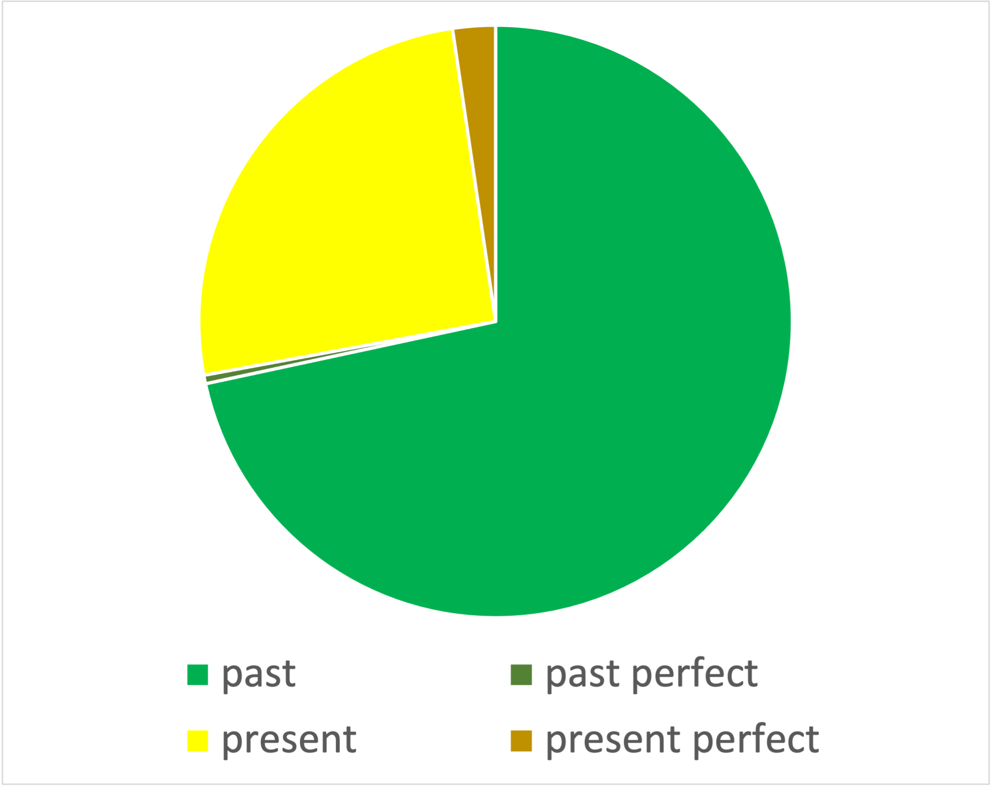
Verb Tenses (CEE Article)
Notes:
Analysis of verb tense usage in a single article from the field of Civil and Environmental Engineering
NOT meant to be representative of the sub-field—just one example from it
This is an example of an experiment-based paper

Slide 29
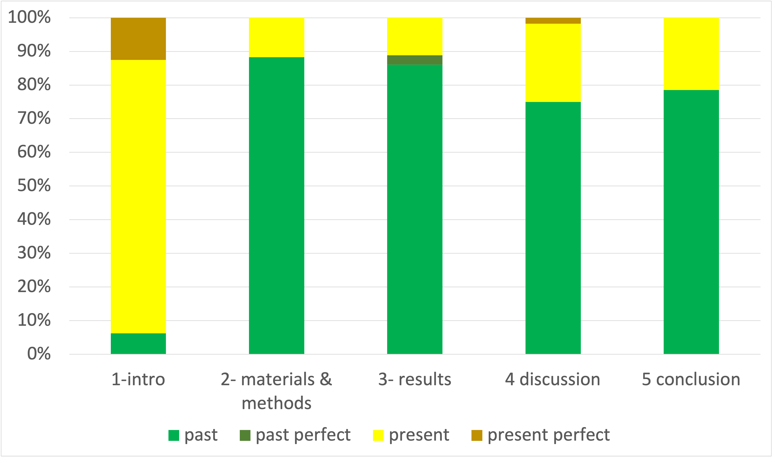
Verb Tenses By Section (CEE Article)
Notes:
Analysis of verb tense usage in a single article from the field of Civil and Environmental Engineering
NOT meant to be representative of the sub-field—just one example from it

Slide 30
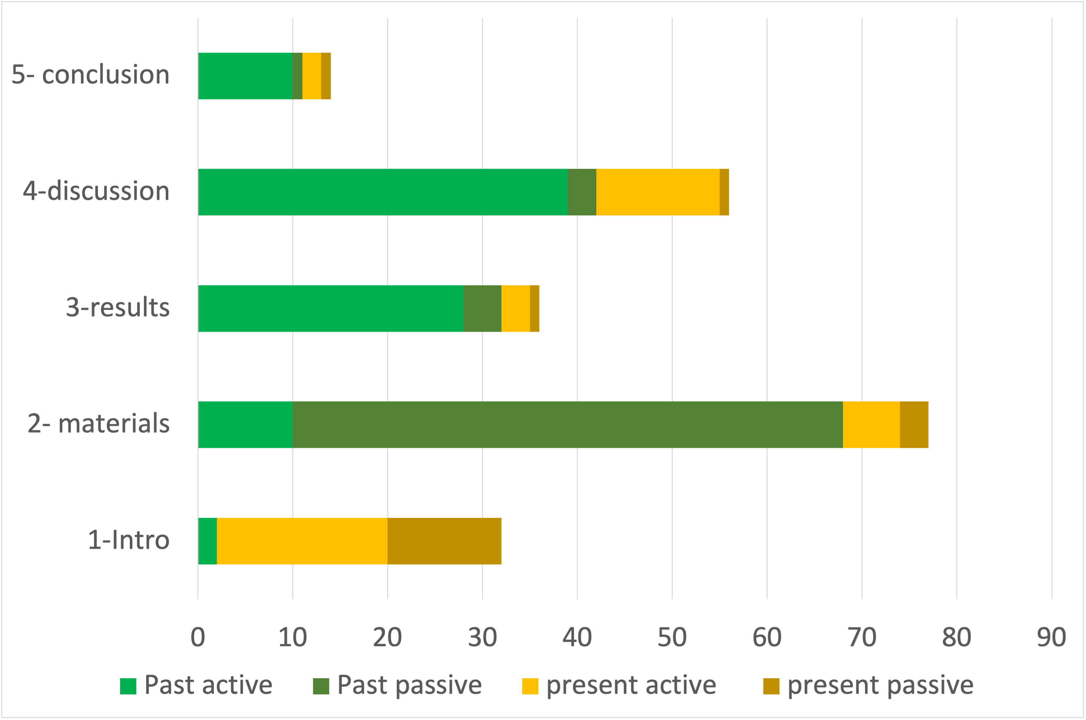
Active vs. Passive Voice By Section (CEE Article)
Notes:
Analysis of verb usage in a single article from the field of Civil and Environmental Engineering
NOT meant to be representative of the sub-field—just one example from it
This seems like a lot of passive voice to us—not typical

Slide 31
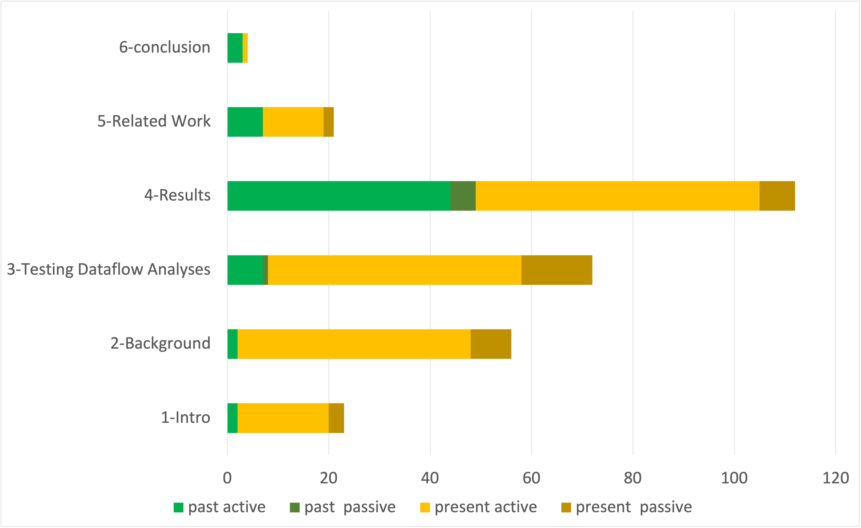
Active vs. Passive Voice By Section (CS Article)
Notes:
Analysis of verb tense usage in a single article from the field of Computer Science
NOT meant to be representative of the sub-field—just one example from it

Slide 32
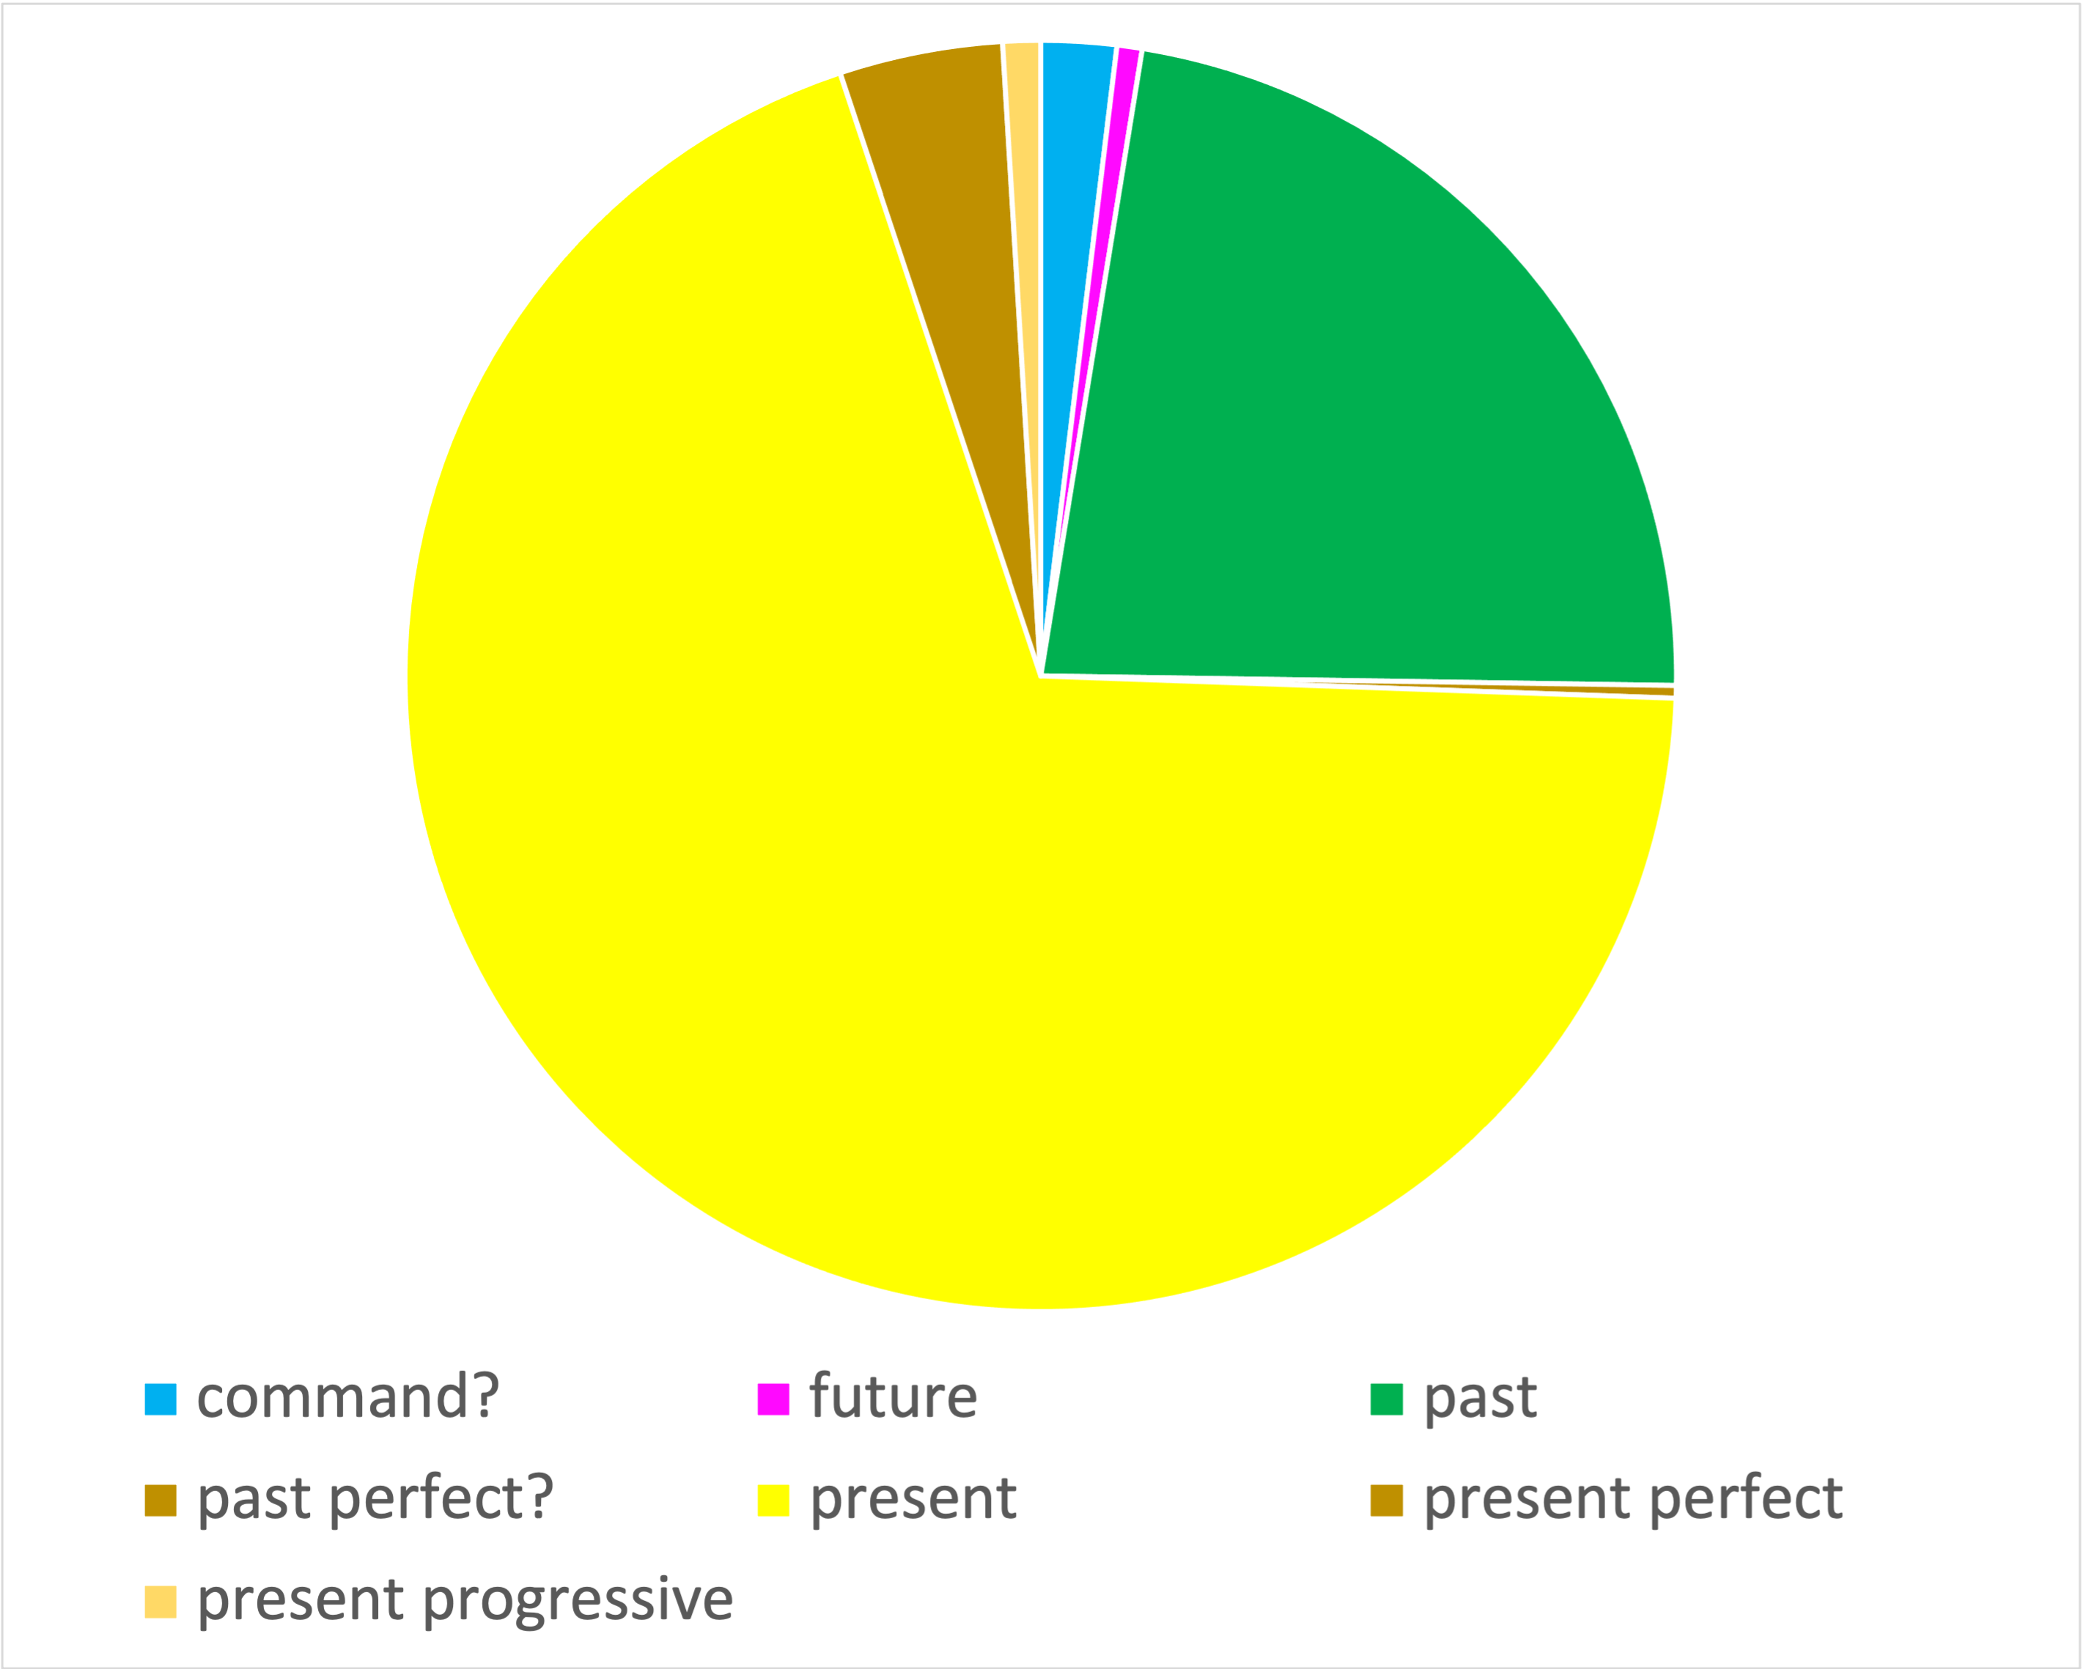
Verb Tenses (CS Conference Paper)
Notes:
Analysis of verb tense usage in a single conference paper from the field of Computer Science
NOT meant to be representative of the sub-field—just one example from it
**This is only ONE type of CS writing**
But CS does tend to use more present tense, especially in proof-based work like this (more math language = more present tense)
Command: e.g.: “Let X represent…” “Take Y as…”
A lot of “the model does this, does that, uses this,” etc.

Slide 33
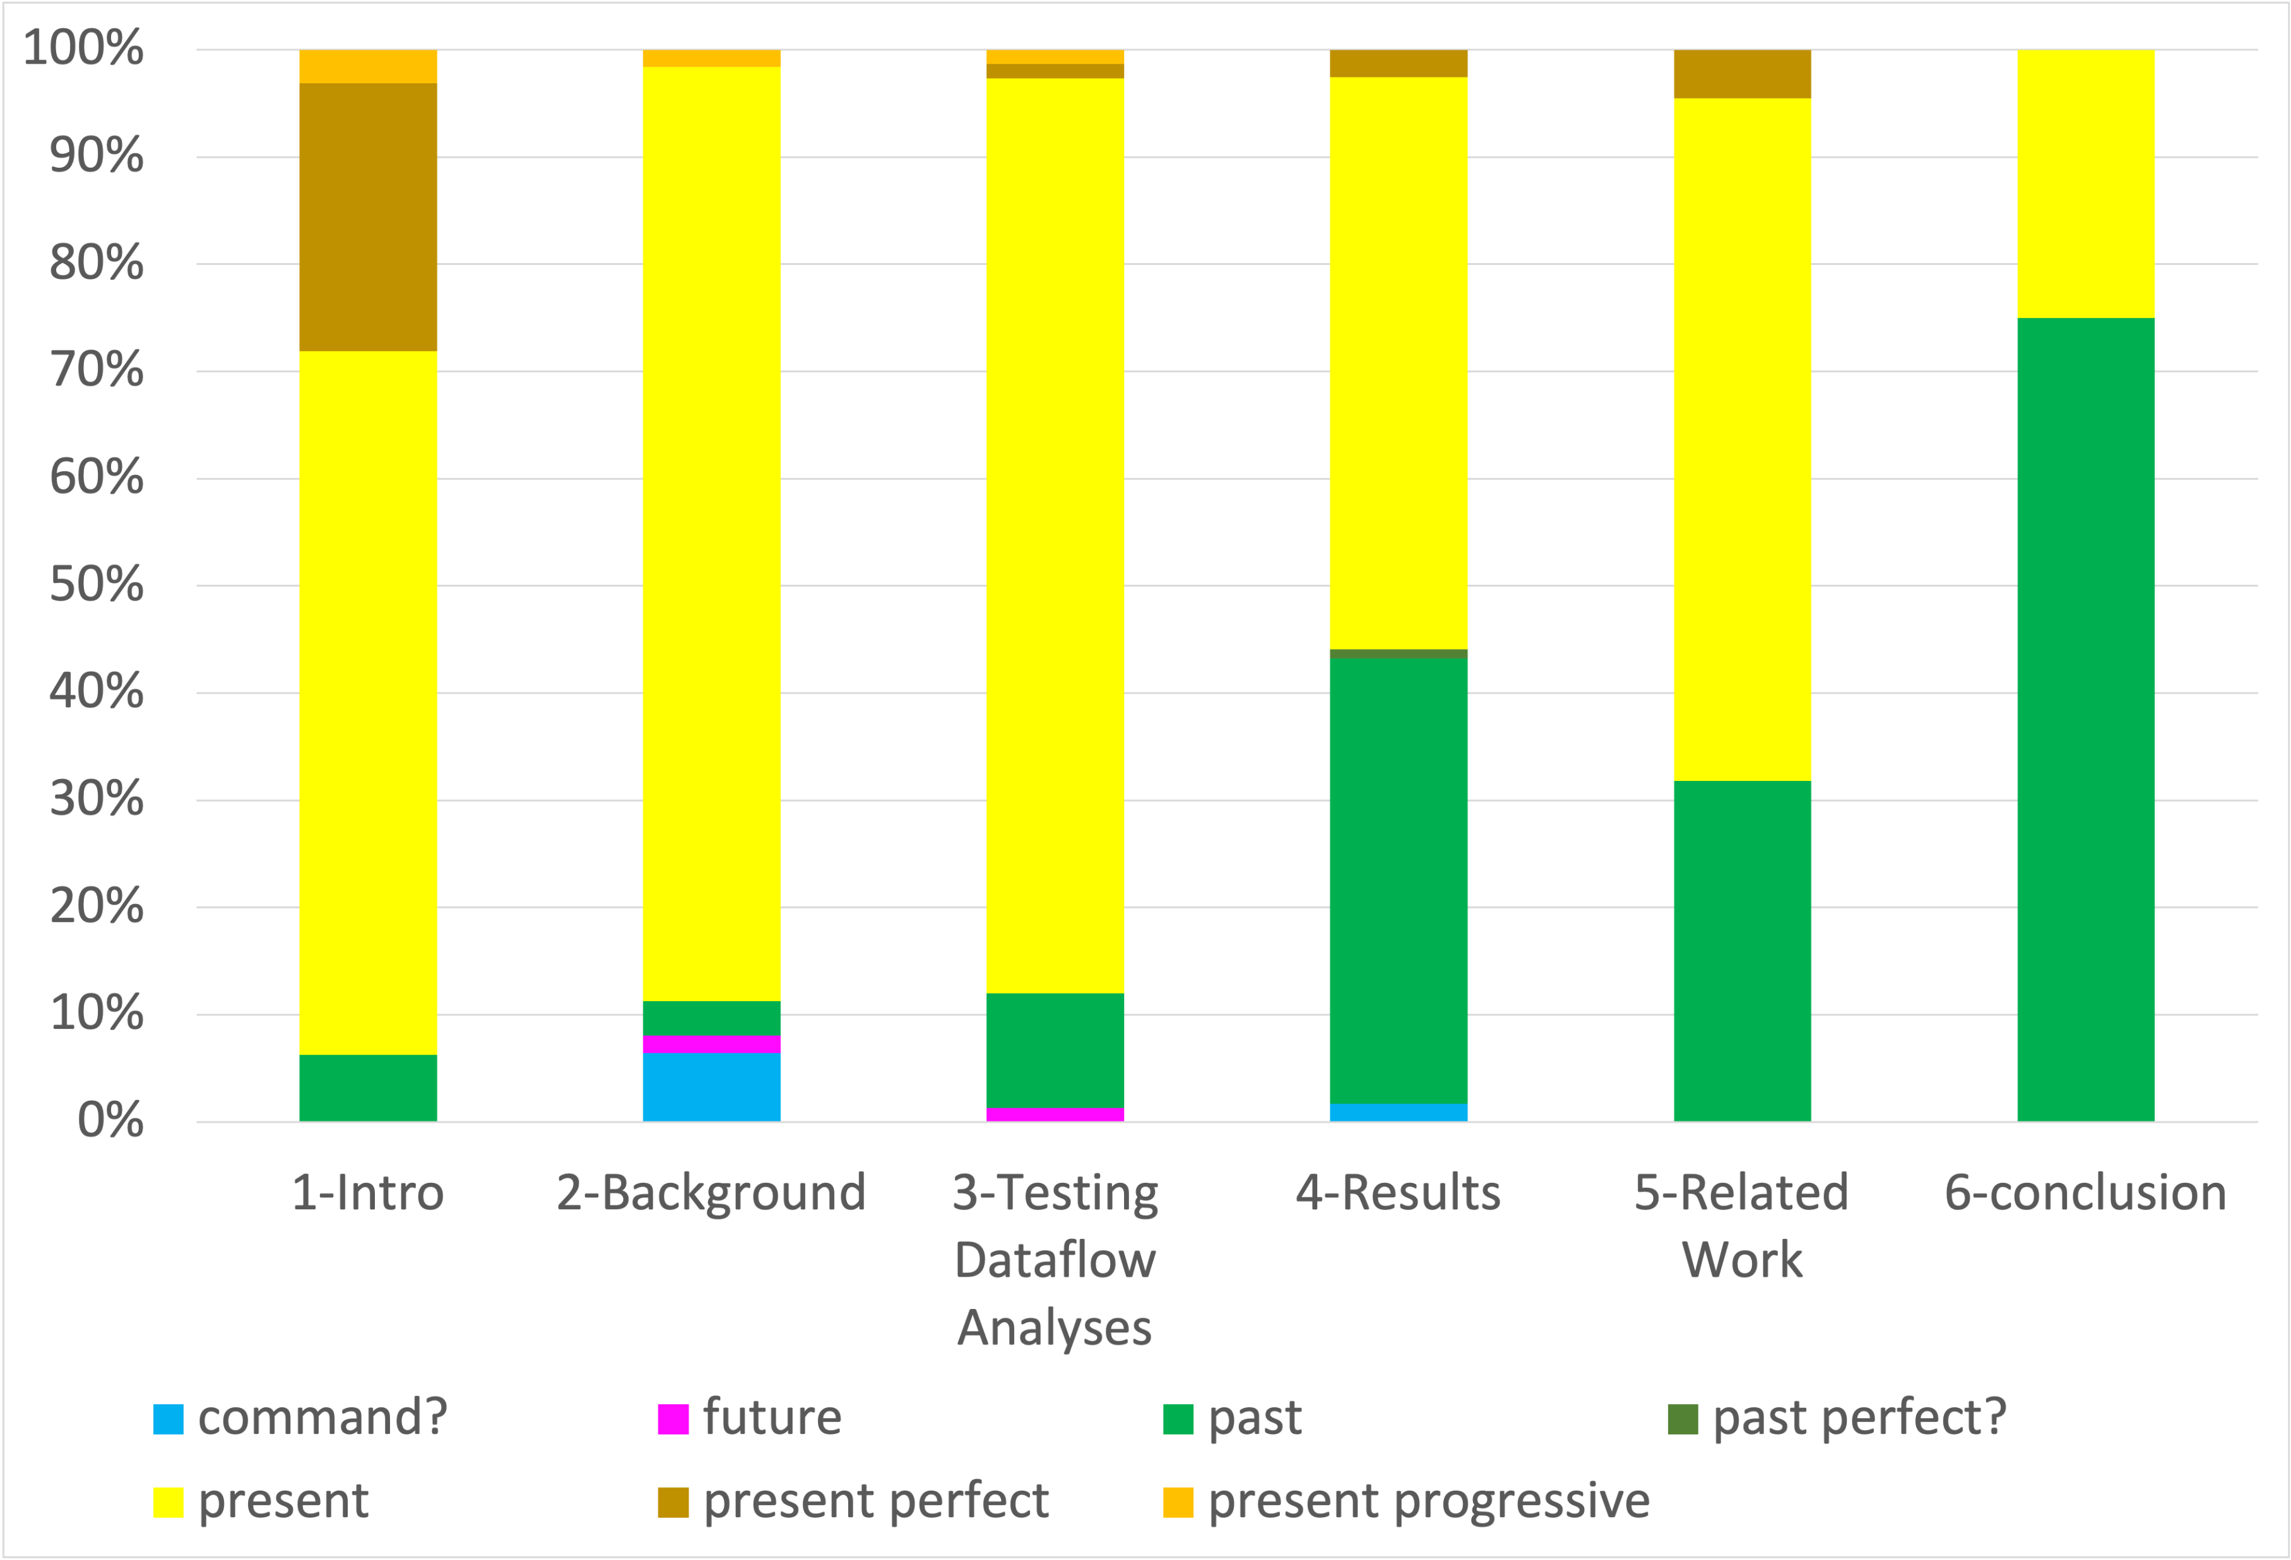
Verb Tenses By Section (CS Conference Paper)
Notes:
Analysis of verb tense usage in a single conference paper from the field of Computer Science
NOT meant to be representative of the sub-field—just one example from it
In intro: simple present, some present perfect (see next slide)

Slide 34
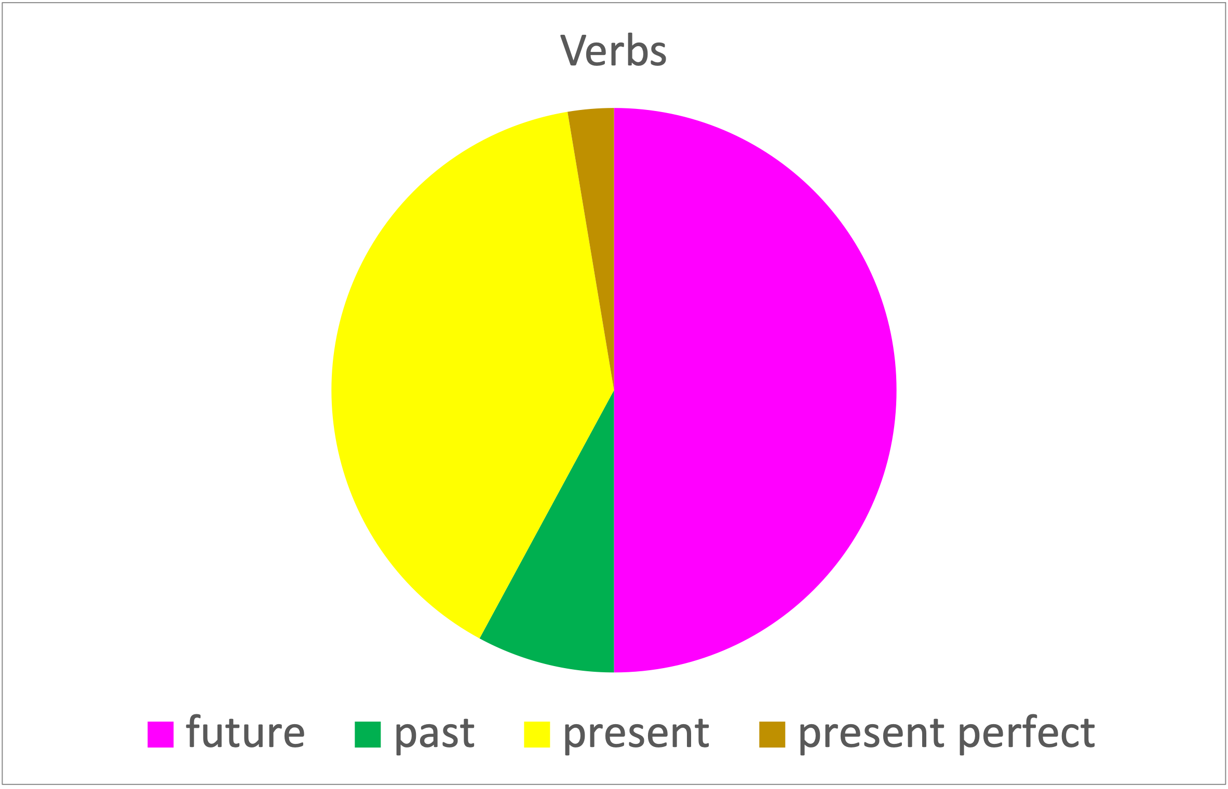
From a Fellowship Proposal (BME)
Notes:
Analysis of verb tense usage in a fellowship proposal statement (Biomedical Engineering)
Verb tenses: overall
Here, since it’s a proposal, we see a lot of what would usually be past tense replaced by future (since the study hasn’t been done yet)

Slide 35
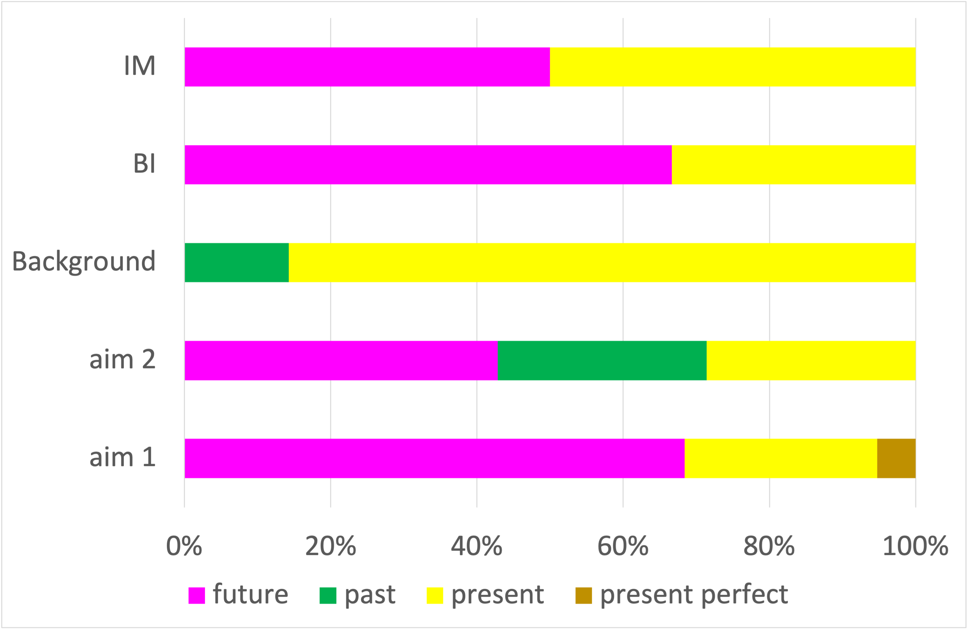
From a Fellowship Proposal (BME): Tense by Section
Notes:
Analysis of verb tense usage in a fellowship proposal statement (Biomedical Engineering)
*IM and BI are the National Science Foundation categories “Intellectual Merit” and “Broader Impacts,” often separate sections in NSF proposals
Here, since it’s a proposal, we see a lot of what would usually be past tense replaced by future (since the study hasn’t been done yet)—talking about the methods will be future tense here

Slide 36
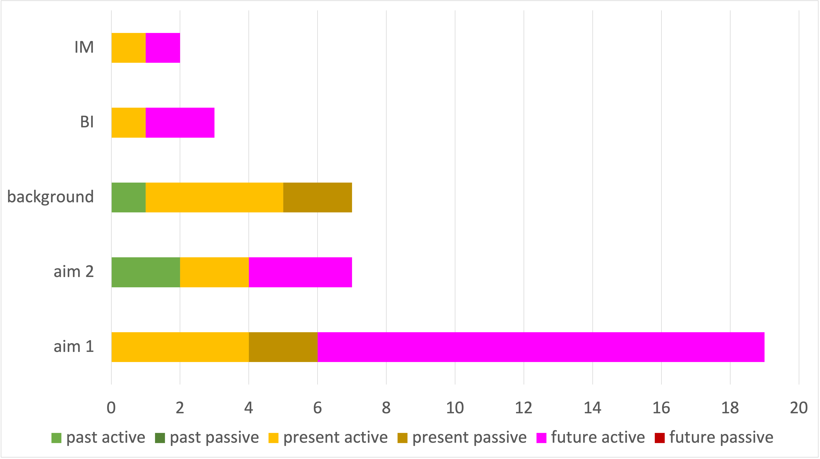
Fellowship Proposal (BME): Active vs. Passive Voice
Notes:
Analysis of verb usage in a fellowship proposal statement (Biomedical Engineering)
No past passive
A little bit of present passive
A lot of future active & present active

Slide 37
Examples: Verb Tense in Sections of an Article

Slide 38
Introductions: Examples of Present Simple and Present Perfect
“Static analysis is one of the basic technologies that enables compilers to generate optimized executables for code in highlevel languages.”
“Our algorithms work on concrete code fragments, which we gather by compiling real applications. For each such fragment, we compute a sound and maximally precise dataflow fact and then compare this against…”
“Since 2010, 55 soundness bugs in LLVM’s forward bit-level analyses have been fixed.”
“We have reported several precision errors to the LLVM developers, and some of these have been fixed.”
“Finally, we have created a version of LLVM that uses our dataflow results instead of its own. This compiler is very slow, but it demonstrates the value of increased precision by sometimes creating binaries that are faster than those produced by the default version of LLVM.”
Taneja et al (2020)

Slide 39
Methods
Methods (Environmental Engineering)
“The contaminated soil sample in this study was derived from wetland of Dongting Lake. The local climate is abundant sunshine and rainfall of 1200 mm per year, and thus provide ideal habitat for various species.”
Liang et al (2017)
Methods (Mechanical Engineering/Aeronautics)
“To detail the kinematics of maneuvering by mantas, scaled stereo video recordings (30 frames s−1) of mantas were made.”
“A three-dimensional calibration device was positioned within the center of the field of view for both cameras at a distance of approximately 6 m. The calibration device consisted of six aluminum rods (9.7 mm diameter, 0.61 m long) that were screwed into each face of a 50 mm nylon cube, providing an orthogonal arrangement of the rods.”
“Because this dimension was not consistent between trajectories, the points were projected from three dimensions into the two-dimensional turn using principal component analysis (PCA).”
Fish et al (2018)

Slide 40
*Methods: Model- and Algorithm-based Research
Methods (Electrical Engineering: called “System Description”)
“To develop the proposed positioning algorithm, we first divide the indoor area into a grid and then create a database of the channel impulse responses for different positions of the user on the grid, Ck = (xk, yk), k ∈ {1, 2, . . ., MN}, for a known height h.”
Hosseinianfar et al (2017)
Methods (Computer Science: called “A Detailed Description of the Model”)
“Next we must generalize our approach to simultaneously learn multiple types of relationships.”
“Instead we decide to extend the model from the previous section so that it can predict multiple types of relations simultaneously. We do this by discovering a single set of topics that work well with multiple logistic predictors.”
McAuley et al (2015)

Slide 41
Introductions
“Unsteady swimming is a vital aspect of the locomotor repertoire of aquatic animals (Webb, 1997, 2006; Fish and Domenici, 2015).” (Fish 2018)
“The majority of studies of turning performance by marine vertebrates (e.g. fish, turtles, penguins, sea lions, dolphins) have been confined to animals that were examined in laboratory or aquarium settings (Webb and Keyes, 1981; Webb, 1983; Hui, 1985; Blake et al., 1995; Webb et al., 1996; Domenici and Blake, 1997; Gerstner, 1999; Schrank et al., 1999; Walker, 2000; Webb and Fairchild, 2001; Fish et al., 2003, 2012; Domenici et al., 2004; Rivera et al., 2006; Cheneval et al., 2007; Danos and Lauder, 2007; Parson et al., 2011). In certain cases, these studies were able to determine maximal performance in terms of maneuverability and agility by manipulation of the test environment or through training.”
(Fish 2018)

Slide 42
Introductions
“In the last few years, researchers have found or argued that explanations in recommendation systems could be very beneficial.” (Zhang 2014)
“FPMC models third-order relationships between u, i, and j by the summation of two pairwise relationships: one for the compatibility between u and the next item j, and another for the sequential continuity between the previous item i and the next item j.” (McAuley 2017)
“The key idea behind TransRec is presented in Figure 1: Items are embedded as points in a (latent) ‘transition space’; each user is represented as a ‘translation vector’ in the same space.” (McAuley 2017)
In an attempt to address the problems, some recent work conducted topic discovery from the reviews to estimate user preferences for personalized recommendations [20, 21, 36]. (Zhang 2014)

Slide 43
Introductions
“In order to reinforce the effect of two effective soil repair agent, compost and biochar can be mixed thoroughly to improve each other’s properties. Because biochar surface is able to be oxidized by humus and microorganism in compost and biochar has an influence on compost humification process and provide[s] favorable environment for microbial growth (Jindo et al., 2012; Wu et al., 2016a, 2016b). Combination of compost and biochar to restore soil has been researched widely in recent years.” (Liang 2017)
“Ubiquitous use of light-emitting diodes (LEDs) alongside their fast modulation capability paves the way for introducing new indoor services such as internet of things, visible light communications (VLC) and positioning through lighting. In comparison with radio-frequency (RF) indoor networks, visible light communication systems are considered as a viable approach for indoor wireless data access providing higher security and larger multiuser capacity [1].” (Hosseinianfar 2017)

Slide 44
Results vs. Discussion
Results
“The mantas swam slowly at 1.42±0.50 m s⁻¹ (range: 0.46–2.51 m s⁻¹). Speed changed through the maneuver, which was associated with active fin movements interspersed with glides. Glides were executed at the end of the up-stroke. During periods of gliding, the pectoral fins were held with a dihedral orientation (Fig. 2).”
“Frequency histograms for the estimated ω and R are shown in Fig. 3. The data show a very skewed right distribution for both ω and R. Neither mean nor median values for ω and R were significantly correlated with swimming speed.”
Discussion
“Despite the advantages, there are also limitations to the use of stereovideography in the field.”
“The data support the general conclusion that the rigid body of manta rays limits turning performance compared with flexible-bodied animals.”
(Fish 2018)

Slide 45
*Results vs. Discussion (Computer Science)
Section 4.7 “User Study” [Methods]
“Finally we perform a user study to evaluate the quality of the recommendations produced by Sceptre.”
“We used Mechanical Turk to compare Sceptre’s recommendations to Amazon’s ‘also viewed’ and ‘also bought’ suggestions, for a random sample of 200 Clothing items. Human judges identified which recommendations they felt were acceptable substitutes and complements (surfaced in a random order without labels; a screenshot is shown in Fig. 6d). Judges evaluated the top recommendation, and top-5 recommendations separately, yielding results shown in Figure 5.”
Conclusion
“We have presented Sceptre, a model for predicting and understanding relationships between linked products. We have applied this to the problem of identifying substitutable and complementary products on a large collection of Amazon data, including 144 million reviews and 237 million ground-truth relationships based on browsing and co-purchasing logs.”
(McAuley 2015)

Slide 46
Recap by Section

Slide 47
INTRODUCTIONS
PRESENT TENSE
background info, motivation, stakes:
“coastal cities are facing”
research gap:
“inundation does not regularly reach”
“Developing these methods, however, requires”
“is a largely unrepresented factor”
lit review: “approaches are being increasingly used”
PRESENT PERFECT
lit. review, state of the field:
“models based on the physical principles of groundwater flow have traditionally been some of the main tools for understanding”
“Several studies have applied NN models”
PAST TENSE
lit review: “LSTM was found to outperform”
Notes:
all examples from Bowes et. al (2019)
*Intros might use past tense if there’s a preview of methods/summary of the study in the last intro paragraph

Slide 48
METHODS
PRESENT TENSE
study area: “The city covers 121 km² of land”
description/definition: “is generally done by”
explanation: “special techniques are needed”
PRESENT PERFECT
explanations/descriptions of methods
“have been specifically designed”
PAST TENSE
things you did:
“was applied to”
“was based on”
“was used”
“were bootstrapped”
“training was carried out”
“post-processing consisted mainly of”
Notes:
all examples from Bowes et. al (2019)

Slide 49
RESULTS
PAST TENSE
reporting specific results:
“outperformed the models”
“had RMSE values”
“was true for”
“was greater”
“decreased”
“ranged from”
PRESENT TENSE
talking about the paper itself
“the results in this subsection address hypotheses...”
“are shown in Figure 8”
“is available in Appendix A”
stating trends
“correspond to hypotheses E-H”
“tends to be overly impacted”
the model “has greatly increasing error as the forecast horizon…”
Notes:
all examples from Bowes et. al (2019)

Slide 50
DISCUSSIONS
PRESENT TENSE
drawing conclusions:
“illustrate the trade-off”
“may be accurate enough”
assessing & excusing:
“seems reasonable”
a “reason for this difference could be”
applications, contributions:
“are not suitable for use in”
“has implications beyond”
PAST TENSE
summarizing results:
“performed much worse”
“demonstrated predictive skill”
“influenced the accuracy”
FUTURE TENSE
predictions, applications, contributions:
“will become an increasingly important part”
Notes:
all examples from Bowes et. al (2019)

Slide 51
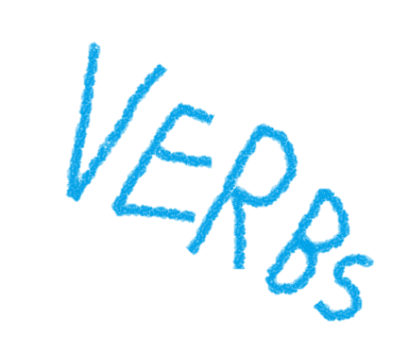
THANK YOU!

Slide 52
Graduate Writing Lab
School of Engineering & Applied Science, University of Virginia
bit.ly/SEASGWL
gradwritinglab@virginia.edu

Slide 53
Verb Tense Resources
Nature: Effective Writing (Verbs & Passive Voice)
https://www.nature.com/scitable/topicpage/effective-writing-13815989/
APA Style: Verb Tense
https://apastyle.apa.org/style-grammar-guidelines/grammar/verb-tense

Slide 54
Examples From Published Articles
Berger, A. W., Valenca, R., Miao, Y., Ravi, S., Mahendra, S., & Mohanty, S. K. (2019). Biochar increases nitrate removal capacity of woodchip biofilters during high-intensity rainfall. Water research, 165, 115008.
Bowes, B. D., Sadler, J. M., Morsy, M. M., Behl, M., & Goodall, J. L. (2019). Forecasting groundwater table in a flood prone coastal city with long short-term memory and recurrent neural networks. Water, 11(5), 1098.
Fish, F. E., Kolpas, A., Crossett, A., Dudas, M. A., Moored, K. W., & Bart-Smith, H. (2018). Kinematics of swimming of the manta ray: three-dimensional analysis of open-water maneuverability. Journal of Experimental Biology, 221(6), jeb166041.
Hosseinianfar, H., Noshad, M., & Brandt-Pearce, M. (2017, May). Positioning for visible light communication system exploiting multipath reflections. In 2017 IEEE International Conference on Communications (ICC) (pp. 1-6). IEEE.
Liang, J., Yang, Z., Tang, L., Zeng, G., Yu, M., Li, X., ... & Luo, Y. (2017). Changes in heavy metal mobility and availability from contaminated wetland soil remediated with combined biochar-compost. Chemosphere, 181, 281-288.
McAuley, J., Pandey, R., & Leskovec, J. (2015, August). Inferring networks of substitutable and complementary products. In Proceedings of the 21th ACM SIGKDD international conference on knowledge discovery and data mining (pp. 785-794).
Taneja, J., Liu, Z., & Regehr, J. (2020, February). Testing static analyses for precision and soundness. In Proceedings of the 18th ACM/IEEE International Symposium on Code Generation and Optimization (pp. 81-93).
Zhang, Y., Lai, G., Zhang, M., Zhang, Y., Liu, Y., & Ma, S. (2014, July). Explicit factor models for explainable recommendation based on phrase-level sentiment analysis. In Proceedings of the 37th international ACM SIGIR conference on Research & development in information retrieval (pp. 83-92).

