Slide 1

Word Choice in
Research Writing
Presentation includes elements adapted & expanded from the EAL Graduate Writing Camp, Writing Services, University of Guelph
by Kelly Cunningham for the UVA Engineering Graduate Writing Lab
This work is CC-BY and must include full citation & doi. Individual images and examples & materials from other sources are not CC-BY. Blue dino is a GWL icon & not CC-BY.
Kelly J Cunningham, PhD
Director, Graduate Writing Lab
School of Engineering & Applied Science, University of Virginia
kellyc@virginia.edu | bit.ly/SEASGWL
Notes:
Please fill out the post event survey

Slide 2
Word Choice is a Language Choice
Based on
Audience- Who are you communicating with? What do they know? What do they expect in this context?
Context- situation, text type, field, domain
Purpose- What does the language need to do? What do you want to accomplish?
Depends on available options
We will focus on tendencies & informed choices more than right/wrong
Notes:
Also where are we, who are we talking to, why?
Available options- all the parts of the language you know, all the ways you have of talking about something
Whenever possible be intentional with your choices
We will also talk about language choices beyond the word level
Really we make choices of lexicogrammar, phraseology, etc.

Slide 3
Technical/Research/Engineering Writing
Focus on being
Precise
Concise
Direct
Purpose driven
Whenever possible-
Easy for the intended audience to understand
Notes:
We don’t want the way something is written to get in the way of the content

Slide 4
Uncommon Choices

Slide 5
UnCommon Choices- Clichés
Avoid clichés
Over used words/phrases that lack specific meaning or have lost their meaning
May be idiomatic
When comments say
Too general or be more specific
-> may be relying on clichés
Notes:
When you get comments that say too general or be more specific, it is possible this is due to relying on clichés or over used phrases that don’t give enough specificity to your meaning
Why avoid cliches?- technical writing is expected to be precise, concise, and direct- cliches don’t further that goal

Slide 6
UnCommon Choices- Clichés
Examples of Clichés
In this day and age
In the current climate
Good things come to those who wait
Little did I know
Since the beginning of time
Avoid these in most academic/technical writing

Slide 7
UnCommon Choices
Avoid outdated or archaic words
No longer in common use
In dictionary may be labelled as
Archaic
Old English
obsolete
Notes:
Why avoid these?
Most readers won’t be familiar with these terms and will get hung up on why they appear in the text, derailing focus from your work. They typically do not follow the goals of technical writing or meet audience expectations
Could lead to misunderstanding

Slide 8
UnCommon Choices
Examples of outdated or archaic words:
Wither (meaning wherever)
Circumjacent
Behold
Heretofore
Howbeit
Not common in contemporary usage-> Avoid

Slide 9
UnCommon Choices
Typically avoid words/phrases that are too ‘informal’
Not/no longer used in most academic/technical writing
Not specific enough for academic use
Assumptions that are not reader friendly (ex. obviously)
Often common in conversation & less formal contexts
Less common in academic, technical or research writing
Notes:
These are typically things we have in our early drafts that get revised later on
if you have a reason to use a particular style for a point, there may be a place for it. You are making informed language choices to suit your purposes, so there isn’t a right or wrong if it accomplishes that purpose.
Note you can still use a more spoken, easy to read style while continuing to avoid phrasing more often used in informal contexts
Always test choices against your audience, purpose, and context

Slide 10
UnCommon Choices
Examples
Actually
Obviously
Clearly
Suddenly
Besides (as a conjunction)
Really (as an intensifier like very)
Notes:
Examples that are typically seen in less formal contexts
Clearly and obviously can also alienate readers who do not find it obvious

Slide 11
Instead of | Use
A lot
Big
Got larger
Hard (not easy)
Little (size)
Nowadays
People (unless general reference)
Proper methods
To get
To handle a problem
To happen
To keep at room temperature
To look at/see
Notes:
What options might we see used more frequently in published research writing?

Slide 12
Instead of | Use
A lot | Many, much, frequently…
Big | large
Got larger | increased
Hard (not easy) | difficult
Little (size) | small
Nowadays | Currently, recently
People (unless general reference) | Individuals, participants, etc.
Proper methods | Appropriate/suitable methods
To get | To obtain
To handle a problem | To solve a problem
To happen | To occur
To keep at room temperature | To maintain at room temp
To look at/see | To examine, observe, determine, investigate
Notes:
Little small though- context dependent

Slide 13
Some negative forms may be more common in technical/ academic writing
Instead of | Use
Not … any The analysis did not yield any results. | No The analysis yielded no results.
Not much The agency did not allocate much funding for the program. | Little The agency allocated little funding for the program.
Not many This problem does not have many sustainable solutions. | Few This problem has few sustainable solutions.
Source: Swales, John M., and C. B. Feak. Academic Writing for Graduate Students, 3rd edition. Ann Arbor: University of Michigan, 2012, p. 22.
Notes:
Also note this shortens the sentence making it more direct and more concise
The forms that can be replaced can also be used as contractions. So if you have a negative form that works as a contraction, consider if there might be a shorter way to convey that negative

Slide 14
Less formal & more common in speaking (colloquial)
More Academic & more common in writing
Phrasal verbs
Ex. bring up, find out, leave out, look into,
Got passives
Ex. got damaged
General terms
Ex. great, nice
Single word verbs
Ex. mention/discuss, discover, omit, investigate
Standard passives
Ex. were damaged
Specific terms & numbers
Increased by 50%,
Notes:
Speaking here= conversations
This is what we tend to see

Slide 15
Less formal & more common in speaking (colloquial)
More Academic & more common in writing
More words
More clauses
Less precise language
More concise
More phrasal elements
More precise
Why?
Notes:
In speaking we tend to use more words to say things, use less precise language, add more clauses-> it is time sensitive & we are speaking on the fly in casual conversation- we use constructions that are easiest to get our ideas out, and we can followup to explain them more because the person is right there- but also subject matter, purpose, etc.
In writing we have the time to change what we write so we make it denser-> more phrases, fewer clauses, more precise and often concise wording; esp in academic or rsch writing; and we don’t get a chance for the reader to ask us questions, so we try to be precise enough that they don’t have any ; and we revise to try to make the writing more friendly to the reader to help them understand what we are saying since we cannot follow up
* do not mistake these descriptions for rules or prescription. This is what we tend to come across and we know why
Keep in mind-
That does not mean that you should strive to put as many phrases and as few verbs and clauses as possible in academic or technical writing.
If you are told your writing is too informal for the context, these are areas that you can focus on revising. But if you overdo it, it can become unclear. So still follow the revision strategies for clarity.

Slide 16
Less formal & more common in speaking
More Academic & more common in writing
Less time to plan
Easier to get out quickly
Can quickly update
Responsive to audience
More planning
Revision
Stands alone
Must anticipate audience
Writing might start this way
Revision moves it closer to this
Notes:
In speaking we tend to use more words to say things, use less precise language, add more clauses-> it is time sensitive & we are speaking on the fly in casual conversation
In writing we have the time to change what we write so we make it denser-> more phrases, fewer clauses, more precise and often concise wording
But don’t go too far, too dense, etc.
Could less formal elements be appropriate for some audiences even in writing?
You will see more academic in some presentations as well

Slide 17
Try Activity
1-4: choose the more ‘academic’ expression
5-9: replace italicized expressions

Slide 18
Activity 8.3
Voice recognition is really important for/an integral part of artificial intelligence.
Funding agencies have shown considerable/a lot of interest in internet of things applications for education and intelligence.
The temperature of the material went up/increased over time.
We employed a good/robust 4-step analysis process to predict the outcome pretty nicely/with 90% certainty.
Modelled on Swales & Feak p. 21

Slide 19
Activity 1.3- circle
Voice recognition is really important for/an integral part of artificial intelligence.
Funding agencies have shown considerable/a lot of interest in internet of things applications for education and intelligence.
The temperature of the material went up/increased over time.
We employed a good/robust 4-step analysis process to predict the outcome pretty nicely/with 90% certainty.
Modelled on Swales & Feak p. 21

Slide 20
Activity 8.3
5. Competition for funding has gotten more intense in recent years.
6. Accidental sharing of personal information probably won’t happen with this device.
7. In order to stabilize the results, we had to make the amount of salt in the water less than what it was.
Modelled on Swales & Feak p. 21

Slide 21
Activity 1.3- rephrase
5. Competition for funding has gotten more intense in recent years.
6. Accidental sharing of personal information probably won’t happen with this device.
7. In order to stabilize the results, we had to make the amount of salt in the water less than what it was.
intensified
is unlikely
decrease the salinity
Modelled on Swales & Feak p. 21
Notes:
These are not the only answers
Also shows the possibility that as we gain understanding of a domain, we acquire more precise words that can replace longer descriptive phrasing
-note the use of such terms and whether or not to gloss them, will depend on the context, audience, and purpose

Slide 22
Activity 1.3- rephrase
doubled the amount of
8. We put in two times as much reactor in trial 2 and behold, we were able to run the process with an OK margin of error.
9. In humans, similar reactions to the protein do not happen very often.
acceptable
the process ran with an acceptable margin of error
are uncommon
Modelled on Swales & Feak p. 21
Notes:
These are not the only or necc even the best options

Slide 23
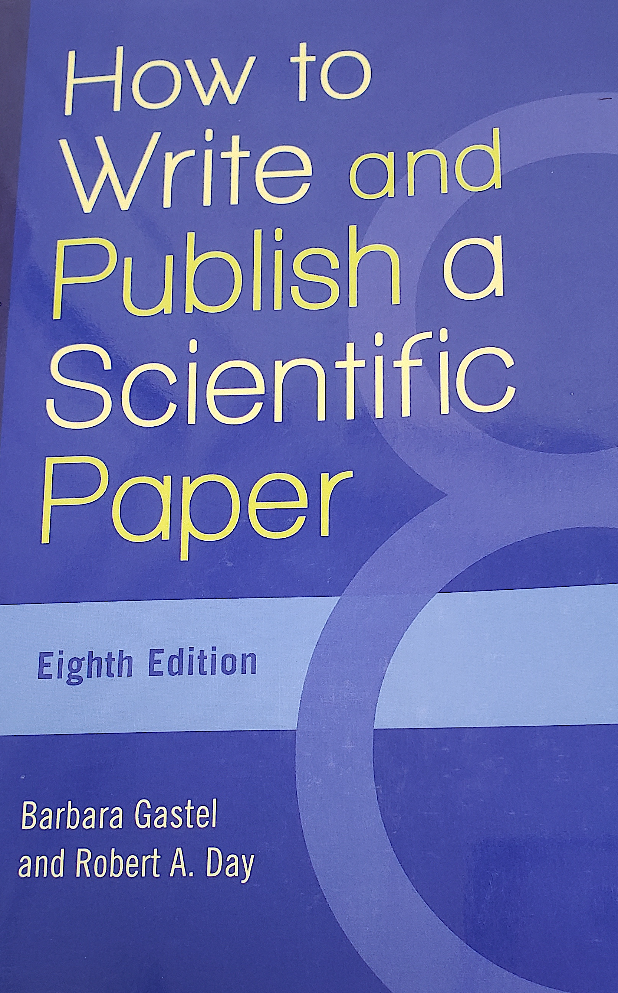
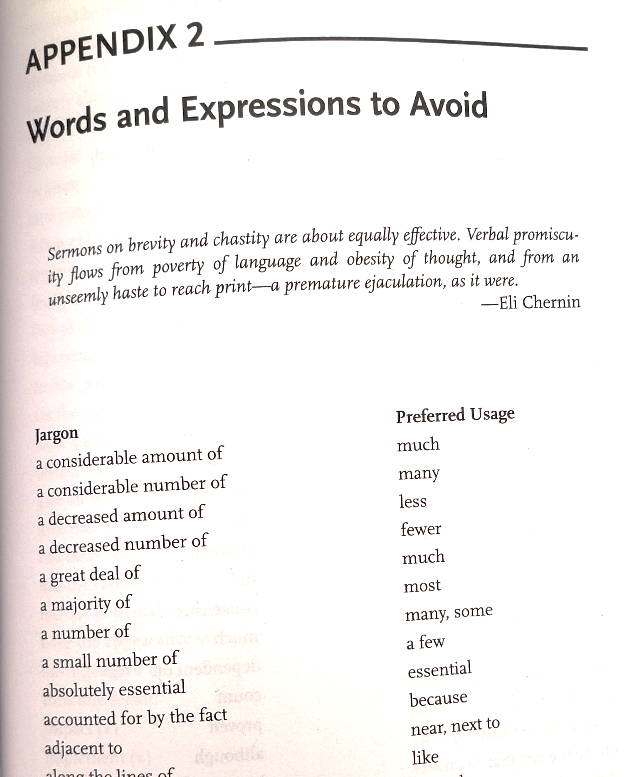
See similar charts for Jargon vs preferred
How to Write and Publish a Scientific Paper 8th edition- Gastel & Day- appendix 2, words & expressions to avoid
Can help reduce #
of words
<be more concise>
Notes:
Wouldn’t say these are jargon but there are shorter versions that can be used instead

Slide 24
Also consider…

Slide 25
Can the subject do it?
Make sure the subject can logically do or be what the verb suggests.
Ex. Virtual reality preferred the indoor scenario while augmented reality preferred the outdoor setting.
Can VR prefer something?
Consider revising:
Virtual reality participants preferred the indoor scenario while augmented reality participants preferred the outdoor setting.
The virtual reality group preferred the indoor scenario while the augmented reality group preferred the outdoor setting.
Notes:
Some profs or editors are very into this and insist on certain things
Good to check because sometimes the complexity of rsch writing lets us lose sight of some of these

Slide 26
Activity 1.4: revise
Reaction times analyzed the relationship between prominence factors and noticing.
Reaction times were used to analyze the relationship between prominence factors and noticing.
We analyzed the relationship between prominence factors and noticing.
We used reaction times as a proxy for noticing when analyzing the effect of prominence factors.
Notes:
Other possibilities too- might not include in stand alone

Slide 27
Working with technical terms & complex concepts

Slide 28
Technical Terms & Phrases
Be precise, follow disciplinary conventions
Must use the term or phrase- not synonyms or thesaurus
Using a different word could
signal unintended difference
Cause misunderstanding
Define & scope terms as needed
Clearly identify relationships between terms
Notes:
Key technical terms and phrases should be consistent
Using another word or phrase for the same thing may incorrectly signal to the reader that you are talking about something new.

Slide 29
The ubiquitous use of light-emitting diodes (LED) for lighting purposes has motivated researchers to consider visible light communications (VLC) technology in future developments of indoor wireless access networks because of its potential to establish high throughput, secure, and low latency data transmission [2]–[4]. Due to the micronscale wavelength of light signals, VLC systems facilitate the emergence of other promising technologies, such as indoor localization [5]–[7] and occupancy detection [8]. However, VLC systems are mostly dependent on the line-of-sight (LOS) between transceivers because their signals cannot penetrate through or diffract around ordinary objects such as furniture and humans. This feature makes these systems susceptible to shadowing and blockage of opaque objects in the room, where this effect can lead to nearly 70 dB of extra signal attenuation [9].
Hosseinianfar, H., & Brandt-Pearce, M. (2020). Cooperative Passive Pedestrian Detection and Localization Using a Visible Light Communication Access Network. IEEE Open Journal of the Communications Society, 1, 1325-1335.
Notes:
This example repeats VLC systems as it needs to. Note the final use replaces it with ‘these systems
We see a similar replacement happen with ‘this feature’
Rather than using a synonym, these replacement act as a placeholder that references the more complex idea without having to write out the whole thing again. Replacements like this are sometimes called shell nouns since they are not complete without the thing they are referencing. They work in some ways as more precise pronouns- you need to know what they are replacing for the meaning to be conveyed
Note also that this is more precise then simply saying (in example)
This makes them susceptible to shadowing
We may not know what ‘them’ or ‘this’ refers back to, but adding that noun makes it more precise, while still being concise, fulfilling the goals for technical writing
Start looking for these kinds of replacements as you read and you’ll find a lot of them.

Slide 30
Shell nouns
Use as short reference to a more complex idea
Helps with flow/cohesion
Often this + noun to signal back
This procedure/experiment/concept/problem/goal/fact
Reference must be clear, unambiguous, and near by
More precise than standalone ‘this’ or pronoun substitution while still being concise
Notes:
Note that the case of shell nouns in grammatical discussion is more than what we cover here and some examples may be conflated with other grammatical terms.

Slide 31
Shell nouns- maintain wording
Of the reconstructions of human metabolism that have appeared to date, perhaps the most widely used is Recon 1 (ref. 7), which represents a knowledgebase and has also been converted into many predictive models. These models have been used for various biomedical applications, including the prediction of biomarkers for inborn errors of metabolism (IEMs)8 , cancer drug targets 9,10 and off-target drug effects11 .
Thiele, I., Swainston, N., Fleming, R. M., Hoppe, A., Sahoo, S., Aurich, M. K., ... & Thorleifsson, S. G. (2013). A community-driven global reconstruction of human metabolism. Nature biotechnology, 31(5), 419-425.
Notes:
Predictive models- but not just predictive models- predictive models based on Recon 1

Slide 32
Shell nouns- maintain wording
In the rest of this paper, Section II describes the method to derive an expression of the phase noise spectrum of dividers, starting from the calculation of the time jitter. This method is applied to the SCL frequency dividers in Section III, where a closed-form expression of the phase noise in the white region is obtained.
Levantino, S., Romanò, L., Pellerano, S., Samori, C., & Lacaita, A. L. (2004). Phase noise in digital frequency dividers. IEEE Journal of Solid-State Circuits, 39(5), 775-784.

Slide 33
Shell nouns- maintain wording
The tendency of cells to swim adjacent to the surface is shown in computer-generated reproductions of cell traces. The attractive interaction potential between the cells and the solid surface is offered as one of several possible explanations for this tendency.
Frymier, P. D., Ford, R. M., Berg, H. C., & Cummings, P. T. (1995). Three-dimensional tracking of motile bacteria near a solid planar surface. Proceedings of the National Academy of Sciences, 92(13), 6195-6199.
Notes:
Maintaining wording makes it easier to refer back over slightly longer distances

Slide 34
Shell nouns- avoid ambiguity
The tendency of cells to swim adjacent to the surface is shown in computer-generated reproductions of cell traces. The attractive interaction potential between the cells and the solid surface is offered as one of several possible explanations for this
What does this refer to?
Frymier, P. D., Ford, R. M., Berg, H. C., & Cummings, P. T. (1995). Three-dimensional tracking of motile bacteria near a solid planar surface. Proceedings of the National Academy of Sciences, 92(13), 6195-6199. ALTERED for example
Notes:
Maintaining wording makes it easier to refer back over slightly longer distances
Shell nouns offer precision over standalone this

Slide 35
Shell nouns- change verb to noun
We assume a user's overall star ratings about an item (i.e.
an element in matrix A) is based on her underlying opinions
over various product aspects. Based on this assumption, we
estimate the rating matrix using the latent representations U1 and U2, which captures the user attentions and item qualities on the explicit product features.
Zhang, Y., Lai, G., Zhang, M., Zhang, Y., Liu, Y., & Ma, S. (2014, July). Explicit factor models for explainable recommendation based on phrase-level sentiment analysis. In Proceedings of the 37th international ACM SIGIR conference on Research & development in information retrieval (pp. 83-92).
Notes:
Establish the assumption and then add information in a new sentence
Very common pattern
Can help avoid very long phrases like the assumption that abcd
Note that you start with the verb assume and then turn it into a noun to reference back to the bigger idea. Assume->assumption

Slide 36
Shell nouns- change verb to noun
However, a closer examination for the peak around 140 cm⁻¹ (inset figure 6) shows that the Raman peak of the bilayer structure shifts to a lower wavenumber and appears to be more intense and narrower when compared to the single layer HfO₂ sample. This shift can be attributed to the stress caused by the ZrO₂ layer and is clearly visible from the peak shift in spectra (inset figure 6).
Notes:
Submitted example

Slide 37
Shell nouns- create a package
The shape of the object is also detected and reconstructed using the variation in reflected signals. This technique, which is optimized for the highest achievable shape reconstruction accuracy, deploys a huge set of fixed sensors surrounding the object.
Hosseinianfar, H., & Brandt-Pearce, M. (2020). Cooperative Passive Pedestrian Detection and Localization Using a Visible Light Communication Access Network. IEEE Open Journal of the Communications Society, 1, 1325-1335.
Notes:
Sometimes you may not have a word to reuse

Slide 38
What is ‘these algorithms referring to?’
Meanwhile, Latent Factor Model (LFM), such as Matrix Factorization (MF), [14] techniques have gained much attention from the research community and industry due to their good prediction accuracy on some benchmark datasets.
However, recommender systems based on these algorithms encounter some important problems in practical applications.
Zhang, Y., Lai, G., Zhang, M., Zhang, Y., Liu, Y., & Ma, S. (2014, July). Explicit factor models for explainable recommendation based on phrase-level sentiment analysis. In Proceedings of the 37th international ACM SIGIR conference on Research & development in information retrieval (pp. 83-92).
Notes:
Saying ‘Models’ or ‘techniques’ might make the reference more clear since it would maintain terminology

Slide 39
What is ‘these algorithms referring to?’
Meanwhile, Latent Factor Model (LFM), such as Matrix Factorization (MF), [14] techniques have gained much attention from the research community and industry due to their good prediction accuracy on some benchmark datasets.
However, recommender systems based on these algorithms encounter some important problems in practical applications.
Zhang, Y., Lai, G., Zhang, M., Zhang, Y., Liu, Y., & Ma, S. (2014, July). Explicit factor models for explainable recommendation based on phrase-level sentiment analysis. In Proceedings of the 37th international ACM SIGIR conference on Research & development in information retrieval (pp. 83-92).
Notes:
Saying ‘Models’ or ‘techniques’ might make the reference more clear since it would maintain terminology
Original version had an s on models which made it confusing for the example, s removed for slides

Slide 40
What is ‘this compendium’ referring to?
To benchmark the models derived from both reconstructions against an independent data set, we used a manually assembled compendium of IEMs8 as a gold standard. This compendium accounts for 330 IEMs, such as phenylketonuria and orotic aciduria, along with their known metabolite biomarkers.
Thiele, I., Swainston, N., Fleming, R. M., Hoppe, A., Sahoo, S., Aurich, M. K., ... & Thorleifsson, S. G. (2013). A community-driven global reconstruction of human metabolism. Nature biotechnology, 31(5), 419-425.

Slide 41
What is ‘this compendium’ referring to?
To benchmark the models derived from both reconstructions against an independent data set, we used a manually assembled compendium of IEMs8 as a gold standard. This compendium accounts for 330 IEMs, such as phenylketonuria and orotic aciduria, along with their known metabolite biomarkers.
Thiele, I., Swainston, N., Fleming, R. M., Hoppe, A., Sahoo, S., Aurich, M. K., ... & Thorleifsson, S. G. (2013). A community-driven global reconstruction of human metabolism. Nature biotechnology, 31(5), 419-425.

Slide 42
Resources for Academic Words & Phrases

Slide 43
Academic word lists
Academic Wordlist (Coxhead 2000) also here in different format
May be useful for word forms
Ex.
Success - noun
Successful - adj
Successfully – adv
Succeed - verb
Notes:
For word forms

Slide 44
Phrase-based resources
WORD & PHRASE search for chunks of language (phrases) in your writing and see examples from other texts in context; from the Corpus of Contemporary American English (COCA) by BYU
Phraseum chunks of language for speaking
Academic Phrasebank-Examples of some of the phrases used in British dissertations organized according to the main sections of a research paper and the functions in academic writing
Free website, 5$ searchable pdf includes American English
Notes:
Phraseum- learn chunks of language for speaking
Academic phrase bank- mentioned in previous workshops, this pdf with phrases by function and section of research paper is probably one of the more useful list based resources- caution- British dissertations, phrases may be different in American varieties of English

Slide 45
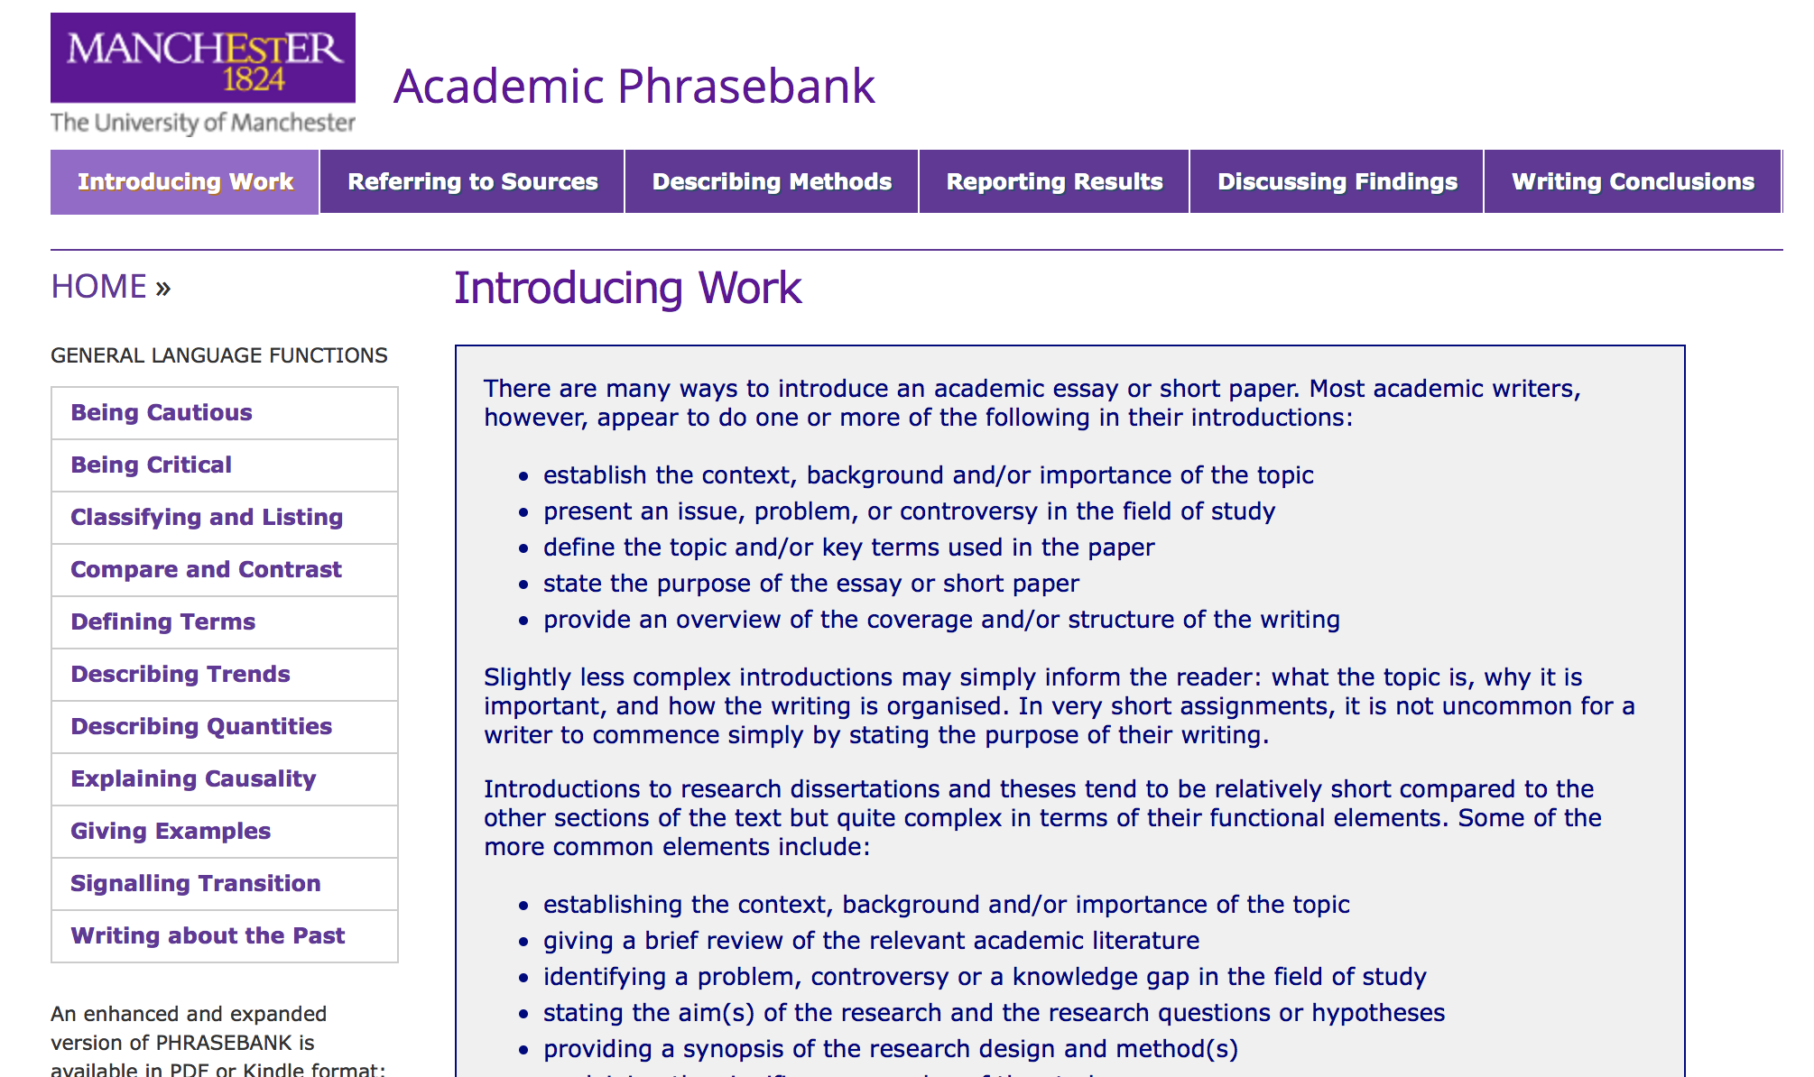
Academic Phrasebank
Phrases by article section & function
General functions

Slide 46
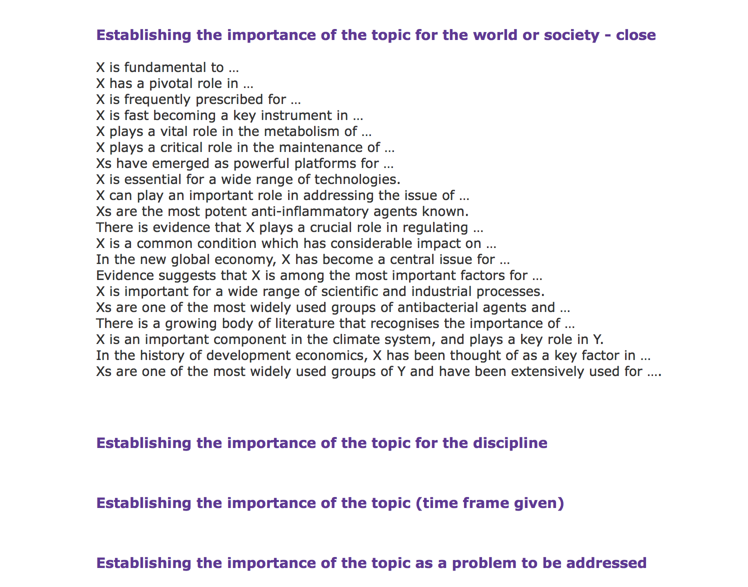
Academic Phrasebank
Notes:
After selecting a section on the top, scroll down
There are different functions listed
Clicking a function will give a list of phrases used for that function

Slide 47
Using Phraseology in Context
Academic Terms: What do others write?
Check Google Scholar, AntConc, CoCA (academic)
NonAcademic term
Check Google
Phraseum
CoCA
Notes:
Change term in title?
ANTCONC

Slide 48

Using Phraseology- Corpus Resources
Corpus of Contemporary American English (COCA)
Speaking, fiction, magazines, newspapers, academic journals
Complex search with parts of speech (POS), regular expressions, wild cards, synonyms etc.
Compare speaking vs academic writing
See context of use- what prepositions w/this verb? What verbs with this noun in journal papers?
Tutorials on GWL Resources page & in collab
Notes:
See separate slides in collab & links to online video & pdf tutorials
You can also use COCA- an online corpus covering contemporary American English in speaking, fiction, magazines, newspapers and academic journals
You can choose which section you search or search them all
The corpus is tagged for parts of speech and supports wildcards allowing for a lot of detailed searches
It has a number of different features (see tutorials on each feature/tool on the gwl resources page and in collab)
Kwic lines allow you to search and line up all the examples of what you searched so you can see patterns in how particular phrases are used in real contexts
Compare
Chart allows you to see usage across the different sections- useful for questions like is this academic or mostly in spoken?

Slide 49
Is this common in academic texts?
Use the chart function
Compare across different subcorpora
(ex. spoken vs academic)
Compare frequency of different options

Slide 50
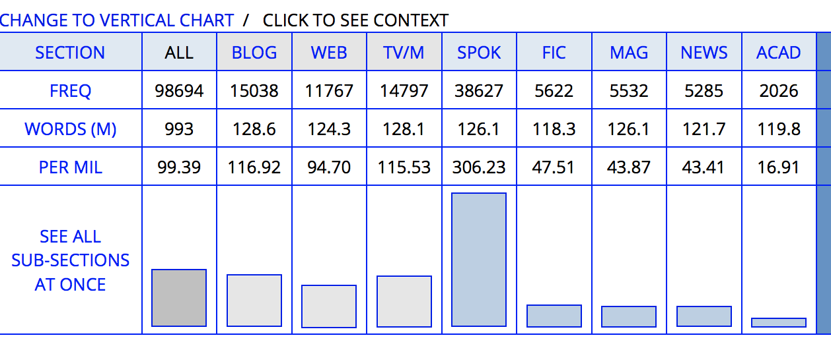
Absolutely
Notes:
Per mil is the number of times the thing you searched occurs per million words in a given subcorpus
Here really occurs 306.23 times per million words on spoken American English and only 16.91 times per million in academic (journal articles). Really is also more common in informat texts like blogs. This together suggests that really is more common in informal and spoken contexts that written academic contexts and is likely not the best choice if you want a research article to look like existing research articles.

Slide 51
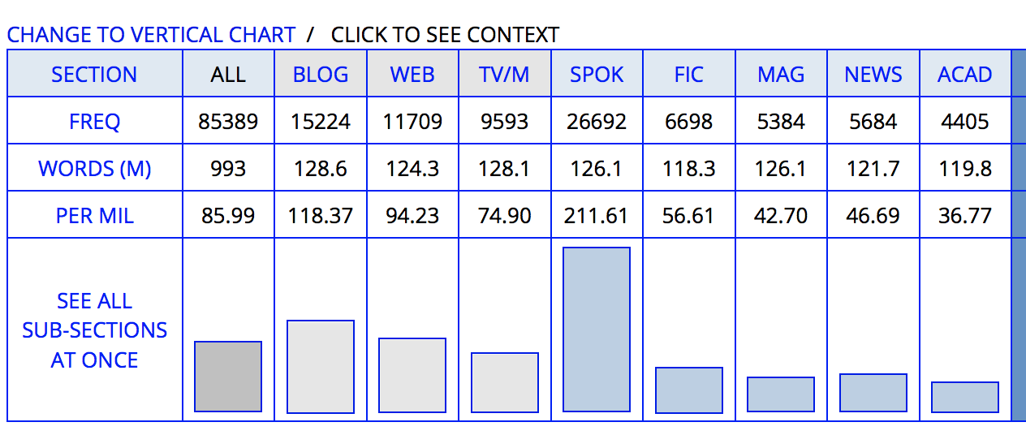
Obviously
Notes:
Similar pattern

Slide 52
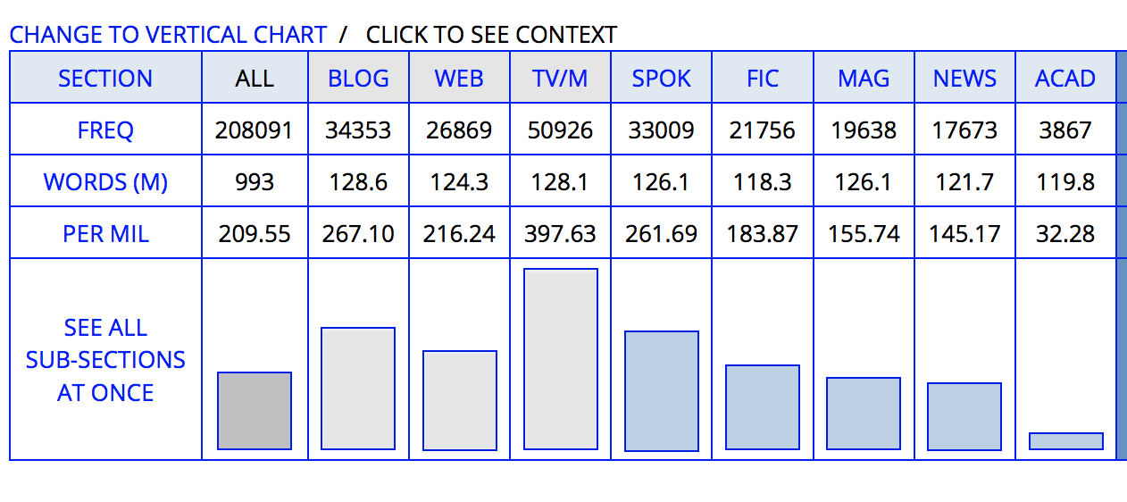
Get passives

Slide 53
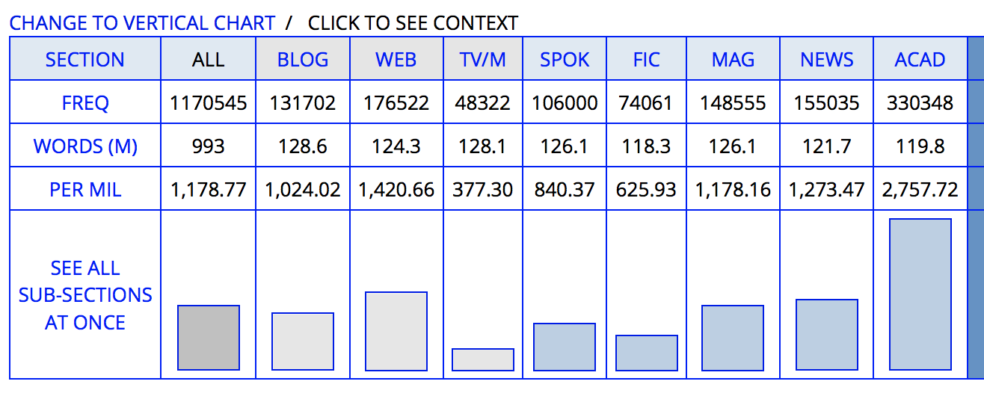
Be Passives

Slide 54
Get passives vs Be passives

Slide 55
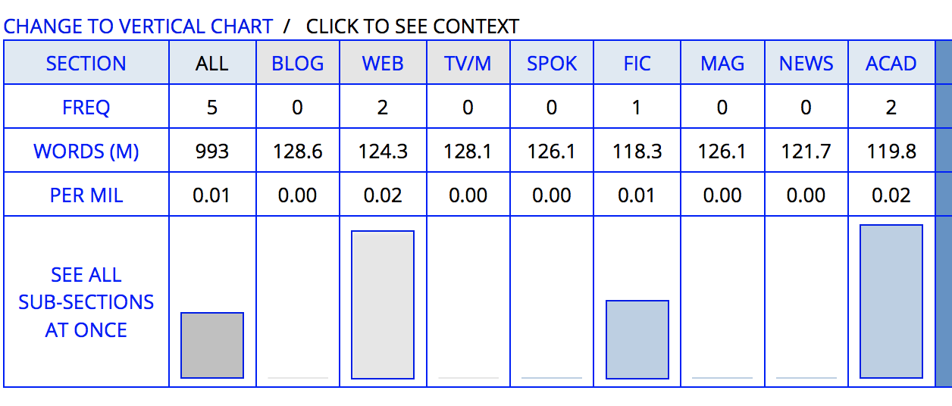
circumjacent

Slide 56
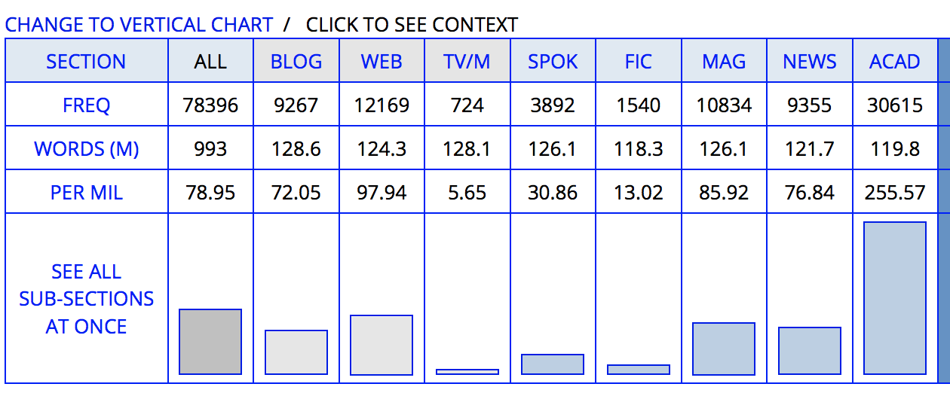
In Addition
Notes:
For in addition, we see a different pattern. It is much more common is academic writing then in other types of writing and much more common than in spoken language

Slide 57
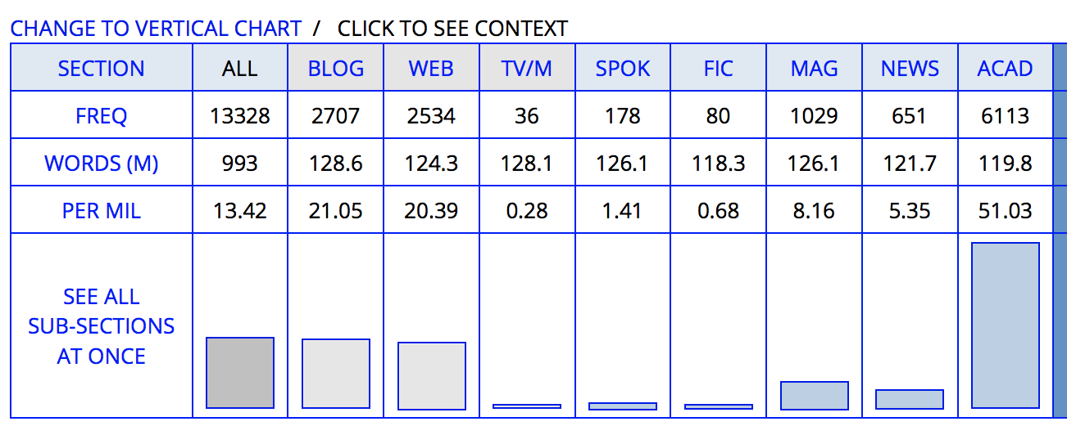
Additionally

Slide 58
In addition vs Additionally

Slide 59
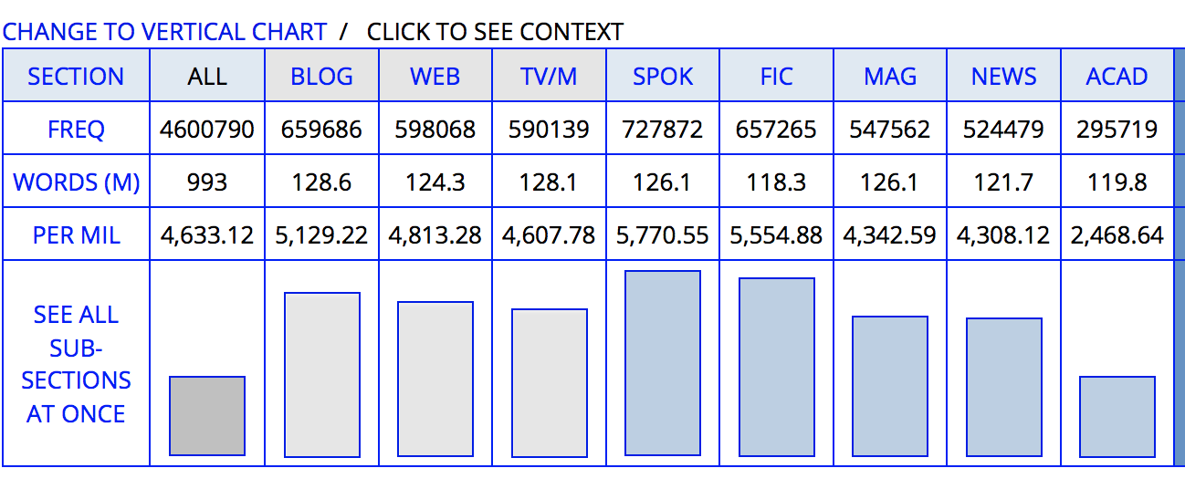
but

Slide 60
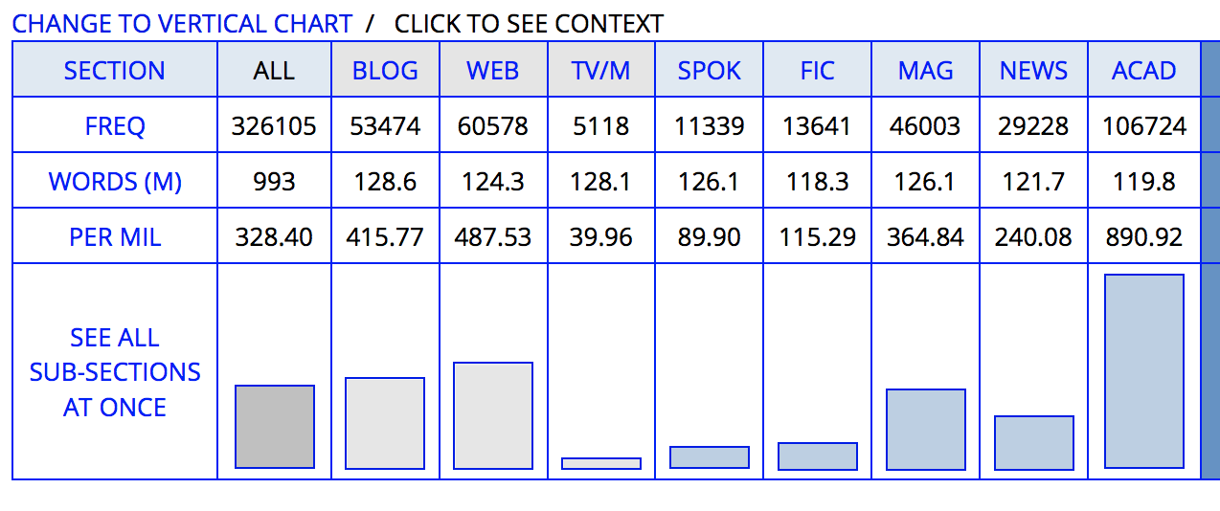
However

Slide 61

AntConc (free software)
You give the program .txts of the type of writing to explore
Ex. Chemical engineering research paper abstracts
Concordance/KWIC lines, Plots, Collocations, N-Grams
Find common phrases, patterns of use, etc
Big picture view of where terms/phrases occur in the text
Terms/usage in context: what prepositions w/this verb?
Slides, tutorials, download links in collab
Notes:
See slides in collab & online tutorials
Refer to 2 other workshops on this software

Slide 62
Collocation & Technical Dictionaries
BABYLON 10 SCIENCE & ENGINEERING DICTIONARY
JUST THE WORD Collocation dictionary - see which words go together
OZDIC COLLOCATION DICTIONARY Shows common constructions, collocations, and grammatical context for the word you look up; note: may not show some very common uses.
Collocation Dictionary (Oxford)
Forvo – pronunciation dictionary, includes many technical terms
Write Better- new plug in for Word, chrome & phone- highlight words & look up corpus examples, patterns, definitions & translation- check their privacy policy & data source
Notes:
See slides in collab (and tech demo session)- but also this are fairly easy to use compared to the others
Ozdic groups the words that go with the word you look up into similar meaning groups; shows the grammatical constructions & common words that go with the word you look up

Slide 63
What next?

Slide 64
Try It
Other exercises in collab
Options in 1.5 Going Further
Use Checklists for your writing
Try resources & practice in additional resources in Collab
Try using CoCA or AntConc to help with choices

Slide 65
Going Further- Self Study
Maintain an instead of… Try.. list
Following the table, keep your own personal list of words and phrases that you find to be useful replacements.
Refer to the Word Choice Cheat Sheet

Slide 66
Books
Swales & Feak – Academic Writing for Grad Students - https://www.press.umich.edu/2173936/academic_writing_for_graduate_students_3rd_edition
Gastel & Day- How to Write and Publish a Scientific Paper-
https://www.amazon.com/How-Write-Publish-Scientific-Paper/dp/1440842809/ref=pd_lpo_1?pd_rd_i=1440842809&psc=1

Slide 67
bit.ly/SEASGWL
gradwritinglab@virginia.edu

Slide 68
References from Guelph presentation
Cottrell, Stella. (2011). Critical Thinking Skills. New York: Palgrave MacMillan.
◼Davies, Martin. (2011). Study Skills for International Postgraduates. New York: Palgrave MacMillan.
◼Raimes, Ann. (1998). How English Works. New York: Cambridge University Press.
◼Swan, Michael. (2005). Practical English Usage. Oxford: Oxford University Press.
Alley, M. 1996. The craft of scientific writing. 3rd ed. New York: Springer.
Babington, D, LePan, D. 2005. The Broadview Guide to Writing. 3rd ed. Peterborough: Broadview Press.
Baker, S. 1998. The Canadian Practical Stylist. 4th Canadian ed. Toronto: Pearson Education Canada.
Hacker, D, Sommers, N. 2011. A Canadian Writer’s Reference. 5th ed. Scarborough: Bedford Books.
LePan, D. 2003. The Broadview Book of Common Errors in English. 5th ed. Peterborough: Broadview Press.
Rosa, A, Eschholz, P, Roberts, J. 1999. The Writer’s Brief Handbook. 2nd Cdn. ed. Scarborough: Allyn and Bacon Canada.
Strunk, W, Jr., and White, EB. 1999. The Elements of Style. 4th ed. New York: Longman.
Thurman, S. 2003. The Only Grammar Book You’ll Ever Need. Avon, MA: Adams Media Corporation.
Truss, L. 2006. Eats, Shoots and Leaves. New York: Gotham Books.

