Slide 1


Interdisciplinary Teaching and Learning from Perspectives of Psychology and Visual Communication
Yanbin Barbara Li, Ph.D. & Feixue Mei, M.F.A.
Department of Psychology & School of Art, Design, and Art History
James Madison University
April 30 2025
Notes:
Today's topic is interdisciplinary teaching and learning from perspectives of psychology and visual communication.

Slide 2
Structure
(1) Interdisciplinary Framework: Psychology and Visual Perspectives
3 principles
(2) Application in Classrooms
6 strategies
Notes:
applying the interdisciplinary teaching and learning frameworks incollege classrooms, including some teaching strategies and a briefteaching demo (10 minutes).

Slide 3
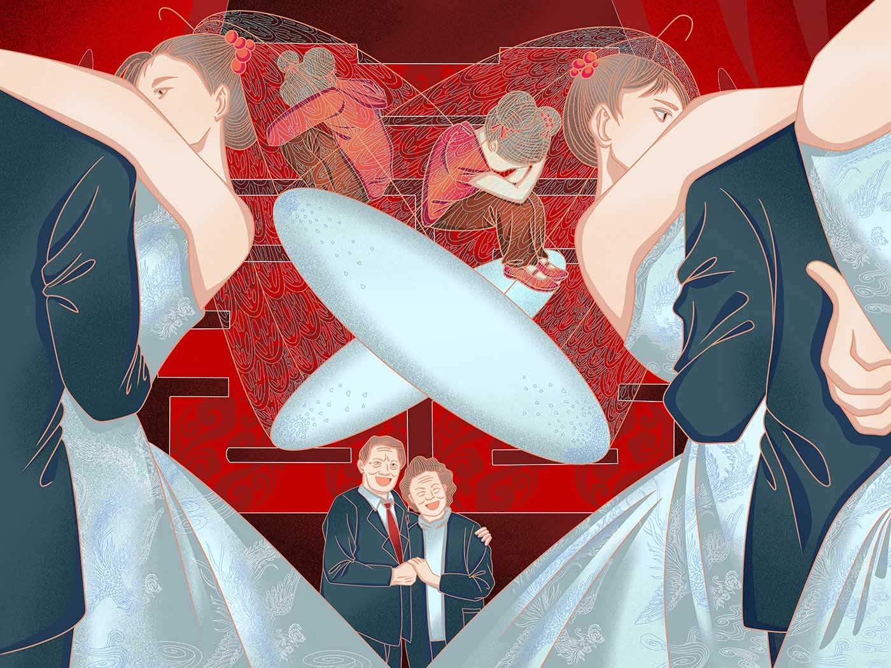
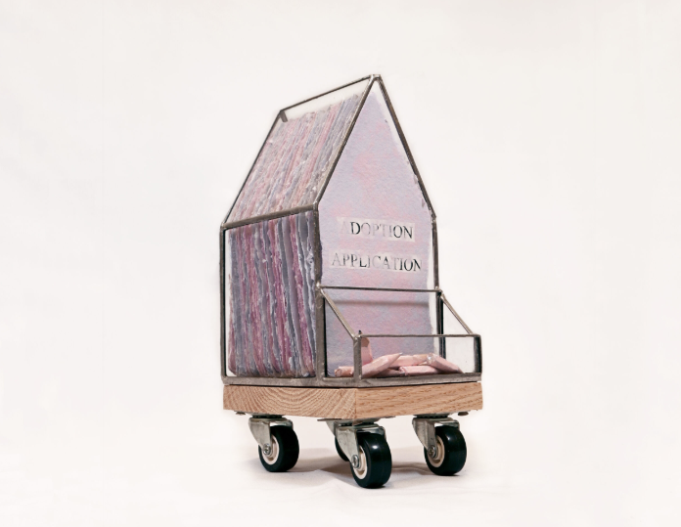
Mei, Feixue. The Cage of Perpetua. 2025, digital illustration.
Yuan, Yulin. Respons(e)ibility. 2025, handmade paper, adoption documents, found objects.
What are these?
Notes:
The second is an artist book by another collaborator about motherhood and adoption.

Slide 4
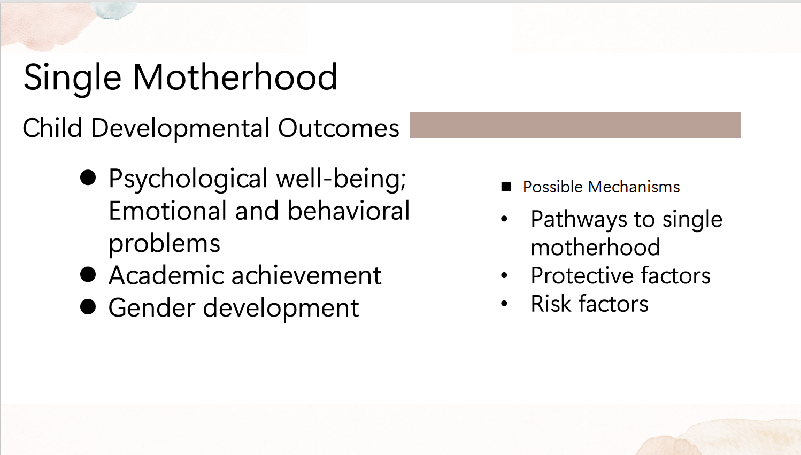
When I teach Family Issues in Psychology
Li, Y. (2025)
Notes:
When I first talked with my collaborators about what we study and teach, we were like, ohhhh, you also teach about this! You also teach about that!

Slide 5
Li, Y. (2025)
Mei, Feixue. The Cage of Perpetua. 2025, digital illustration.
Yuan, Yulin. Respons(e)ibility. 2025, handmade paper, adoption documents, found objects.
Common topics and goals; different approaches and tools
Let’s do some cool interdisciplinary teaching!

Slide 6
Theoretical Frameworks
Based on the scaffolding theory (Van Der Stuyf, 2002; Vygotsky, 1978; Wood et al., 1976)
Woods’ (2007) conceptual framework of Interdisciplinary Communicative Competence for interdisciplinary teaching in college classrooms
Notes:
We used theoretical frameworks from psychology of learning and communication studies,
More specifically, Based on the scaffolding theory (Van Der Stuyf, 2002; Vygotsky, 1978; Woods et al., 1976) and Woods’ (2007) conceptual framework of Interdisciplinary Communicative Competence for interdisciplinary teaching in college classrooms

Slide 7

A framework from perspectives of psychology and visual communications
Principle One: Roles of Collaborators as Mutual Mentor-Mentee.
Principle Two: High Challenge and High Support (Mariani, 1997).
Principle Three: Critical Interdisciplinary Awareness (Woods, 2007).
Knowledgeable Other
Notes:
One: Based on the scaffolding theory (Vygotsky, 1978; Woods et al., 1976), collaborators (i.e., collaborating teachers and students) from different disciplines serve as the Knowledgeable Other for each other in teaching and learning, facilitating each other’s teaching and learning with tailored guidance.
Two: In light of Mariani’s work (1997) defining scaffolding as “high challenge: high support,” we proposed that both collaboratingteachers and students can achieve high-level learning outcomes through the high challenge of interdisciplinary assignments with high support from educators across disciplines.
Three: Through designing, completing, reflecting on, and discussing interdisciplinary assignments, such as designing creative artworks based on empirical psychological studies.

Slide 8
Application in Classrooms
(1) Talking concepts and using tools of each discipline in class and through assignments.
Notes:
(1) Talking conceptsand using tools of eachdiscipline in class and through assignments.
(4) Reflecting onthe epistemology of knowledge and underlyingassumptions,norms, andpowerdynamics

Slide 9
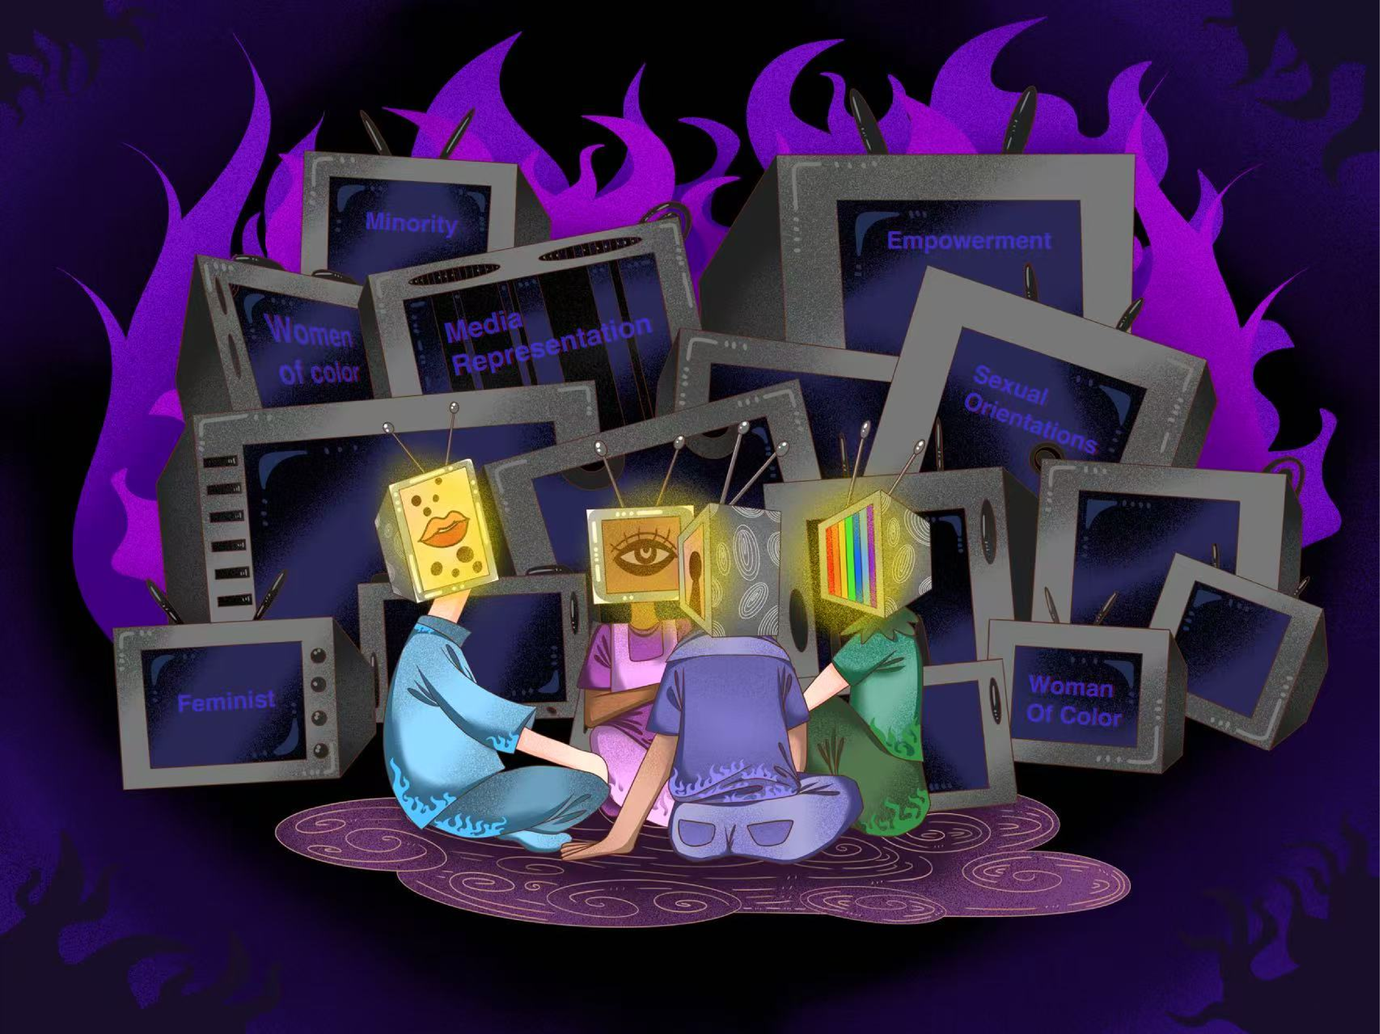
(1) Talking concepts and using tools of each discipline
Mei, Feixue.
Illuminating Identities: Media and Empowerment in Reclaiming Narratives. 2025, digital Illustration.
Notes:
(1) Talking concepts and using tools across disciplines in class and through assignments.
This is an example illustration of an interdisciplinary course we have worked on about Women of Color’s Development, Well-being, and Empowerment
Students may be instructed to create visual presentation of concepts and ideas they learned and developed in class.

Slide 10
Application in Classrooms
(1) Talking concepts and using tools of each discipline in class and through assignments.
(2) Forming shared understanding and strategies
Notes:
(1) Talking conceptsand using tools of eachdiscipline in class and through assignments.
(4) Reflecting onthe epistemology of knowledge and underlyingassumptions,norms, andpowerdynamics

Slide 11
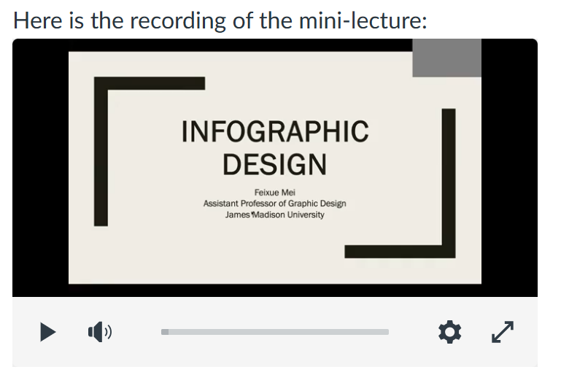
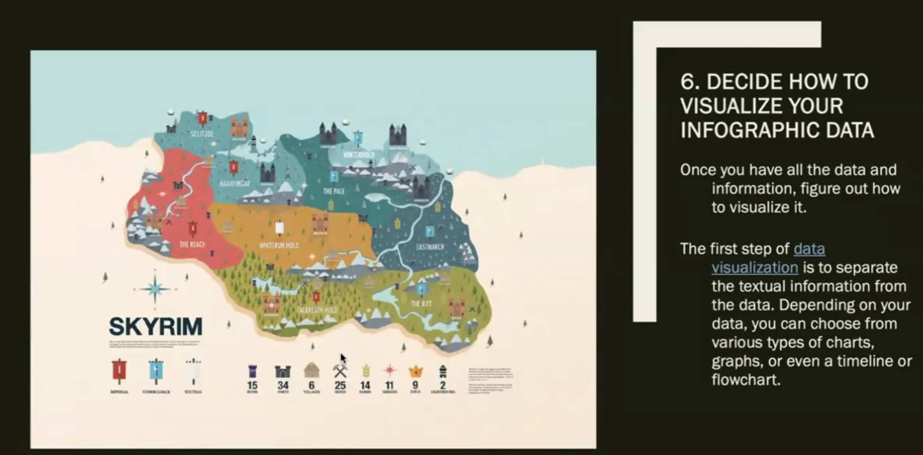
(2) Forming shared understanding and strategies
for instance, exploring how to co-create infographics based on empirical data.
Notes:
Here is screenshot of a mini-lecture given by my collaborator Professor Feixue Mei from the school of art about infographic design for my students in my community psychology and developmental psychology classes. Students now have this resource from my collaborator, an expert in graphic design, when they practice presenting psychological empirical data in the visual form of infographics, forming shared understanding and strategies across the disciplines of psychology and visual communication.

Slide 12
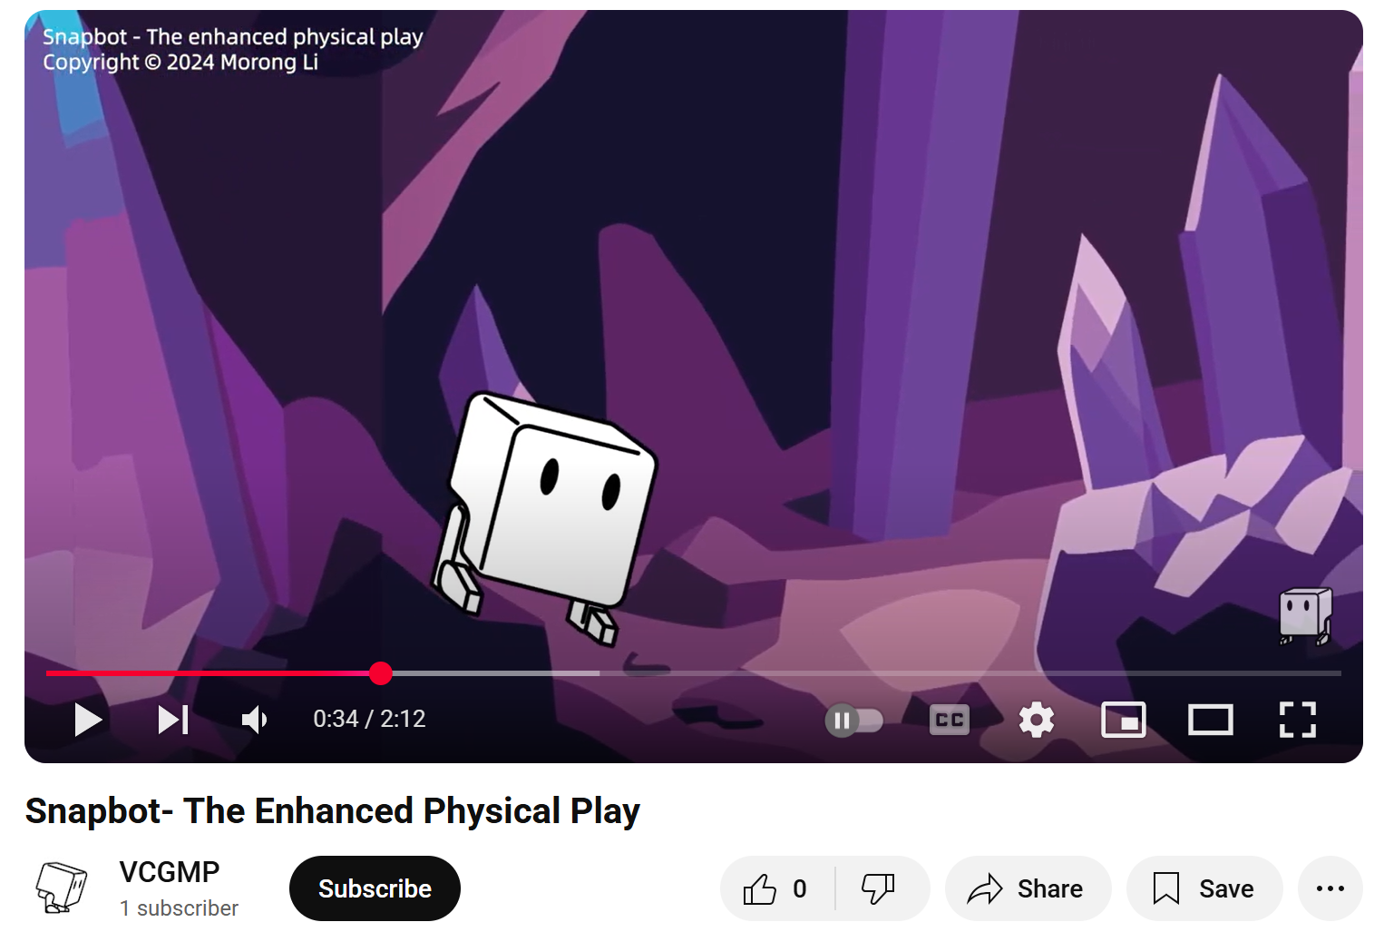
Children's Book
Traditional & Non-traditional
Designing a Children's Book Objective: To create a children's book that aligns with the stages of language development in early childhood, fostering both engagement and linguistic growth. Background: Understanding the progression of language development is crucial in crafting age-appropriate content for children's books.
Li, Morong. 2024. https://www.youtube.com/watch?v=ANfkt9JRThY&t=34s
Notes:
First, you are seeing a clip from a psychology class assignment on language development, Designing a Children's Book– when students are writing some simple scripts
Now, you are seeing an artwork by a collaborator of Industrial Design, which can be used by psych students too for designing a creative form of children's book
Prelinguistic communication  Phonological development  Semantic development  Protowords (10-12 months)  Syntactic development  One word phase (12-18 months)  First sentences (18-28 months); two- and three-word sentences  Later development; by 4 or 5 years of age, almost complete acquisition of grammar  Pragmatics, language as communication Activity Instructions: 1. Select a Target Age Group Choose an age range (e.g., 12–18 months, 2–3 years) to focus your book's content appropriately. 2. Develop a Central Theme or Storyline Create a simple, relatable theme that resonates with everyday experiences of children in your selected age group. 3. Incorporate Age-Appropriate Language Features For 12–18 months: Use single, familiar words accompanied by clear images. For 18–24 months: Introduce two-word phrases (e.g., "big truck"). For 2–3 years: Formulate short sentences with basic syntax. For 3–5 years: Utilize more complex sentences and introduce simple dialogues. 4. Design Engaging Illustrations Ensure illustrations are colorful, clear, and directly related to the text to aid comprehension and maintain interest.

Slide 13
Application in Classrooms
(1) Talking concepts and using tools of each discipline in class and through assignments.
(2) Forming shared understanding and strategies
(3) Producing interdisciplinary products
Notes:
(1) Talking conceptsand using tools of eachdiscipline in class and through assignments.
(4) Reflecting onthe epistemology of knowledge and underlyingassumptions,norms, andpowerdynamics

Slide 14
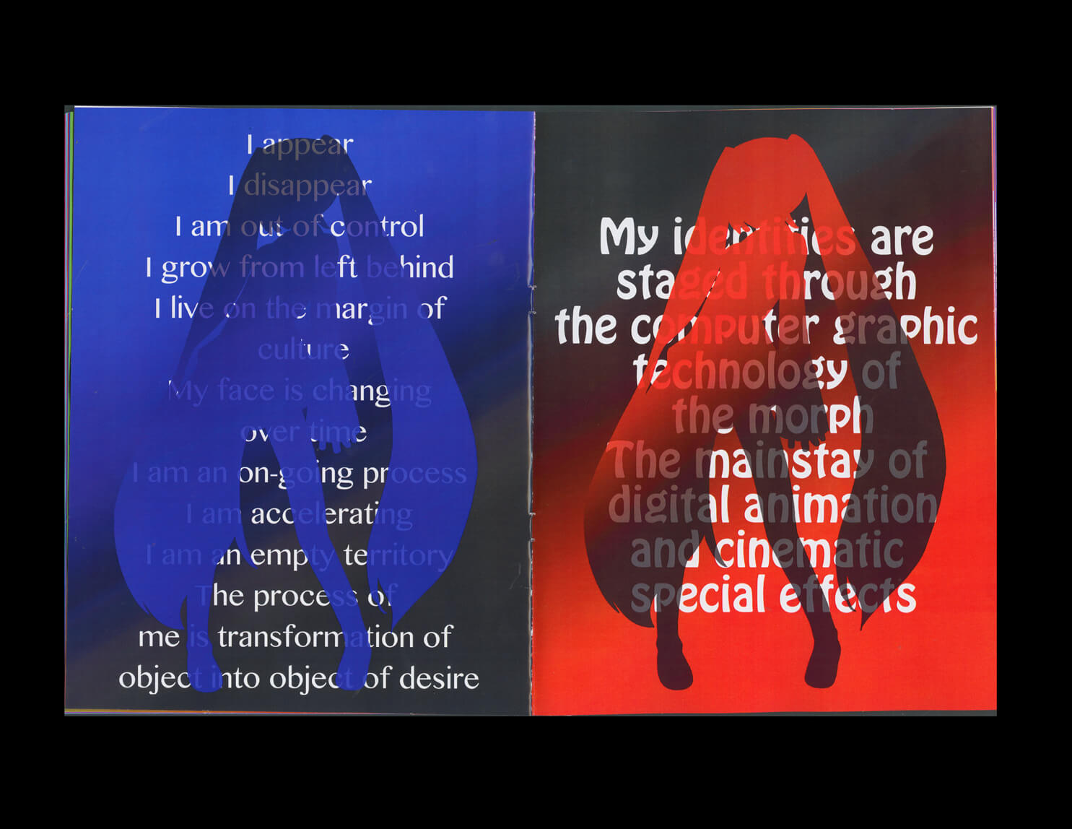
(3) Producing interdisciplinary products
For example, thesis and presentation in scholarly and creative forms.
Visual Essay
Risograph
Mei, Feixue. Plastic Existence. 2019, Zine.
Notes:
Remixing Authorship: Fan Art, Ethics, and the Evolution of Digital Creation

Slide 15
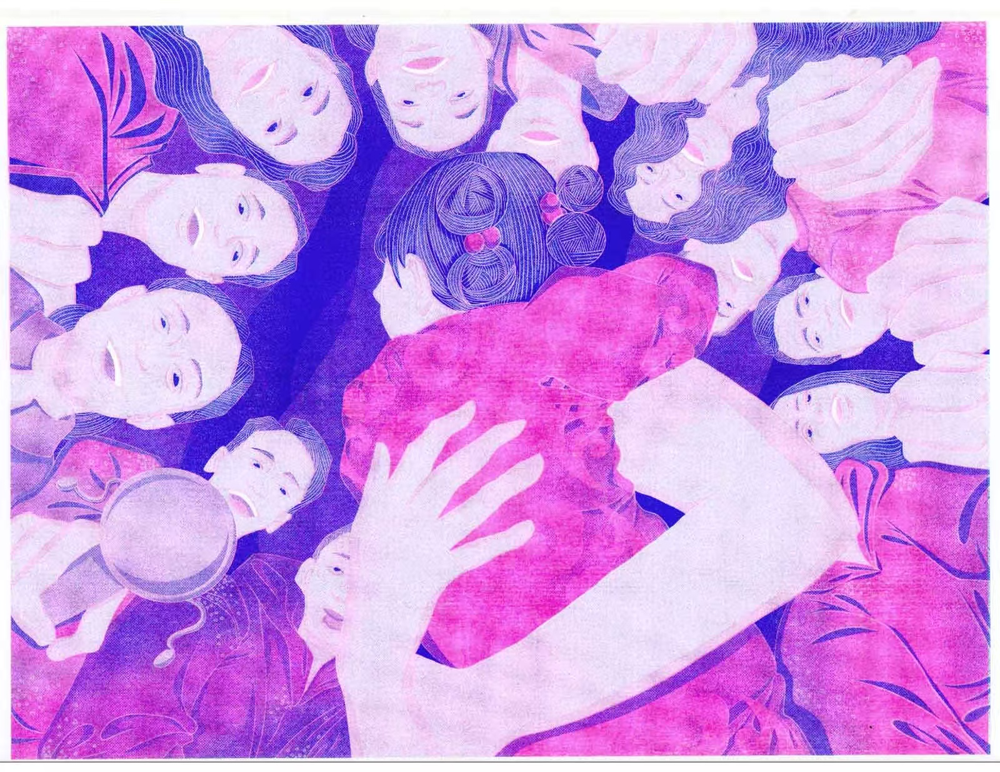
(3) Producing interdisciplinary products
For example, thesis and presentation in scholarly and creative forms.
Visual Essay
Risograph
Mei, Feixue.
Thanks for Being Born. 2024, Risograph print.

Slide 16
Application in Classrooms
(1) Talking concepts and using tools of each discipline in class and through assignments.
(2) Forming shared understanding and strategies
(3) Producing interdisciplinary products
(4) Reflecting on the epistemology and underlying assumptions, norms, and power dynamics
Notes:
(1) Talking conceptsand using tools of eachdiscipline in class and through assignments.
(4) Reflecting onthe epistemology of knowledge and underlyingassumptions,norms, andpowerdynamics

Slide 17
(4) Reflecting on the epistemology and underlying assumptions, norms, and power dynamics
Creative artworks
Artist’s Book
Zines – grassroot
Yuan, Yulin. Respons(e)ibility. 2025, handmade paper, adoption documents, found objects, https://yulinyuanart.com/publishing/
Notes:
Reflecting on the epistemology of knowledge and underlying assumptions, norms, and power dynamics in each of the collaborating disciplines and their intersection.
Labor (2025)
What makes one a mother?
This question rests at the heart of my sculptural artist’s book, a fragile, glass house on wheels that cradles pastel handmade paper sheets, each embedded with jumbled, fragmented cutouts from adoption applications.
In this work, I draw on theorist Judith Butler’s reflections on kinship, Butler writes that “what makes a family is not simply biology or legality, but the acts of responsibility, care, and recognition that structure human relations.” My piece responds to that and a reimagine motherhood as a condition not of origin but of orientation. The house structure suggests the long, uncertain journey many faces in the process of adoption and for the adoptee. It also emphasizes that motherhood is a continuous movement, one of becoming rather than being.
Inside this shelter, pages of soft, handmade cotton fibres wrap around cutouts of adoption documents. This artist’s book questions who gets to be a mother and who decides.

Slide 18
Application in Classrooms
(1) Talking concepts and using tools of each discipline in class and through assignments.
(2) Forming shared understanding and strategies
(3) Producing interdisciplinary products
(4) Reflecting on the epistemology and underlying assumptions, norms, and power dynamics
(5) Becoming the interdisciplinary expert: New Schemas for problem-solving
Notes:
(1) Talking conceptsand using tools of eachdiscipline in class and through assignments.
(4) Reflecting onthe epistemology of knowledge and underlyingassumptions,norms, andpowerdynamics

Slide 19
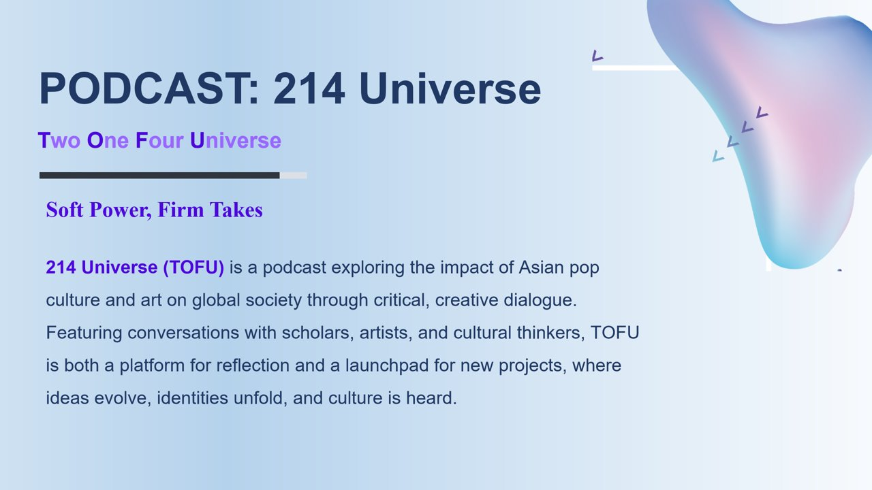

(5) Becoming the interdisciplinary expert: New Schemas for problem-solving (Piaget;Lipshitz, Levy, &Orchen, 2006; Yan & Lavigne, 2014)
Yuan, Yulin. 2025. Podcast: 214 Universe.
Notes:
Developing and using new Schemas for problem-solving
This is an example initiated by one of collaborators in studio art, Yulin Yuan
Creating a podcast channel or a podcast episode is an example of forming new mental frameworks (schemas) for how to understand, communicate, and address cultural issues.

Slide 20
Application in Classrooms
(1) Talking concepts and using tools of each discipline in class and through assignments.
(2) Forming shared understanding and strategies
(3) Producing interdisciplinary products
(4) Reflecting on the epistemology and underlying assumptions, norms, and power dynamics
(5) Becoming the interdisciplinary expert: New Schemas for problem-solving
(6) Fostering a growth mindset, mutual curiosity, and openness
Notes:
(1) Talking conceptsand using tools of eachdiscipline in class and through assignments.
(4) Reflecting onthe epistemology of knowledge and underlyingassumptions,norms, andpowerdynamics

Slide 21

(6) Growth mindset and mutual curiosity
Fostering a growth mindset among educators and students (Cheng et al., 2021; Kolyda, 2023; Sahagun et al., 2021)
Mutual curiosity and openness (Woods, 2007)
Creativity (e.g., Liu et al., 2022)
Knowledgeable Other
Notes:
Keep learning from each other
Ask questions; the most recent question I asked my collaborators: what is riso graph printing? Can psych students also use this for their assignment?
Be creative: my collaborator and I recently talk about the possibility of using and developing serious/educational games for teaching psych and interdisciplinary classes.
We also work together on an interdisciplinary publishing initiative, which we hope can also bring to the students some more interdisciplinary learning experiences.

Slide 22
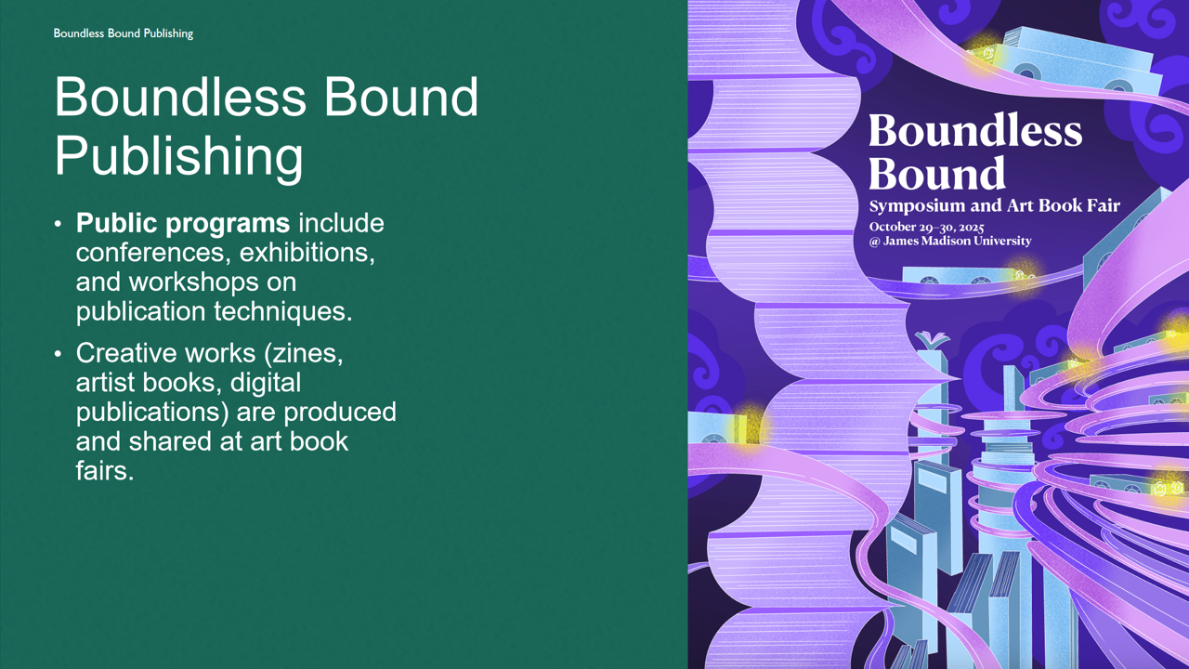
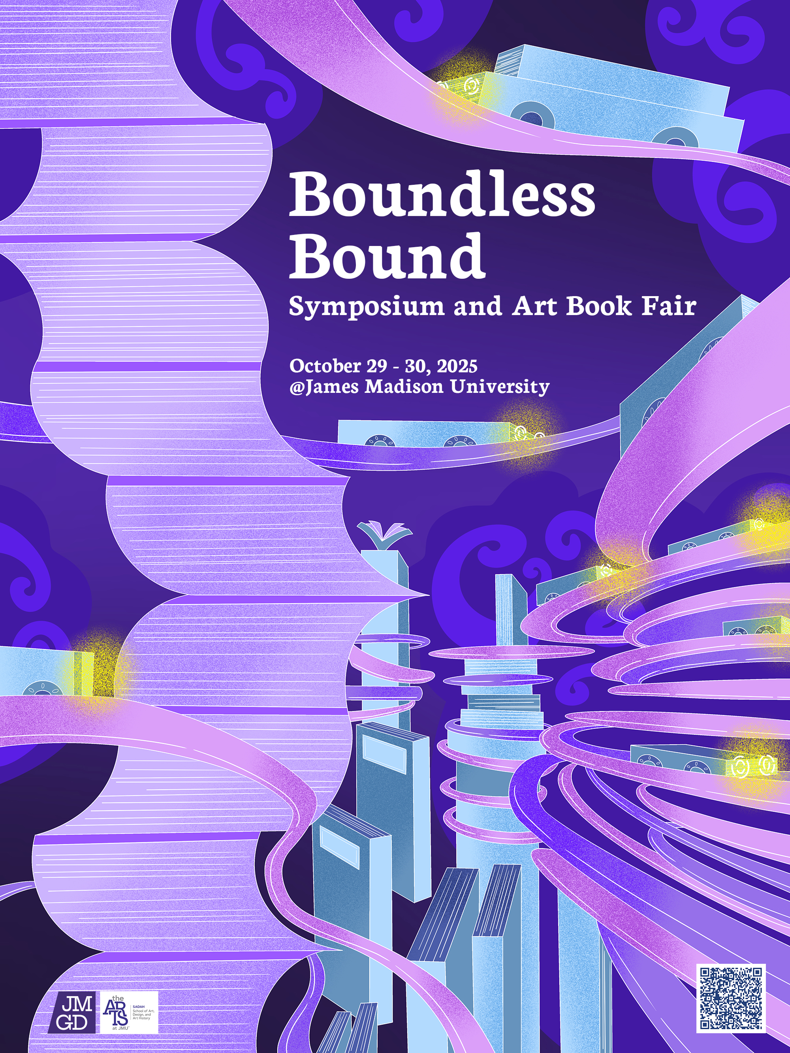

https://feixuemei.info/design/boundless-bound/boundless-bound-publishing-publications.html

Slide 23
Key Takeaway
Find and work with collaborators as Mutual Mentor-Mentee.
Don't be afraid. High Challenge and High Support will bring High Achievement .
Together, we can foster Critical Interdisciplinary Awareness and develop New Schemas for problem solving.
Notes:
One: Based on the scaffolding theory (Vygotsky, 1978; Woods et al., 1976), collaborators (i.e., collaborating teachers and students) from different disciplines serve as the Knowledgeable Other for each other in teaching and learning, facilitating each other’s teaching and learning with tailored guidance.
Two: In light of Mariani’s work (1997) defining scaffolding as “high challenge: high support,” we proposed that both collaboratingteachers and students can achieve high-level learning outcomes through the high challenge of interdisciplinary assignments with high support from educators across disciplines.
Three: Through designing, completing, reflecting on, and discussing interdisciplinary assignments, such as designing creative artworks based on empirical psychological studies.

Slide 24
Acknowledgement
We want to thank our collaborators Yulin Yuan, Morong Li, and Yibin Wei in supporting this interdisciplinary teaching initiative.

Slide 25
References
Cheng, M. W., Leung, M. L., & Lau, J. C. H. (2021). A review of growth mindset intervention in higher education: the case for infographics in cultivating mindset behaviors. Social Psychology of Education, 24(5), 1335-1362. https://doi.org/10.1007/s11218-021-09660-9
Kolyda, F. (2023). Fostering a growth mindset in higher education for inclusive learning for all. Journal of Learning Development in Higher Education, (27). https://doi.org/10.47408/jldhe.vi27.929
Liu, H. Y., Hsu, D. Y., Han, H. M., Wang, I. T., Chen, N. H., Han, C. Y., ... & Huang, D. H. (2022). Effectiveness of interdisciplinary teaching on creativity: A quasi-experimental study. International Journal of Environmental Research and Public Health, 19(10), 5875. https://doi.org/10.3390/ijerph19105875
Mariani, L. (1997).Teacher support and teacher challenge in promoting learner autonomy. Perspectives, 23(2). http://www.learningpaths.org/papers/papersupport.htm
Sahagun, M. A., Moser, R., Shomaker, J., & Fortier, J. (2021). Developing a growth-mindset pedagogy for higher education and testing its efficacy. Social Sciences & Humanities Open, 4(1), 100168. https://doi.org/10.1016/j.ssaho.2021.100168
Van Der Stuyf, R. R. (2002). Scaffolding as a teaching strategy. Adolescent learning and development, 52(3), 5-18.
Vygotsky, L. S. (1978). Mind in society: The development of higher psychological processes. Harvard University Press.
Wood, D., Bruner, J. S., & Ross, G. (1976). The role of tutoring in problem solving. Journal of Child Psychology and Psychiatry, 17(2), 89-100.
Woods, C. (2007). Researching and developing interdisciplinary teaching: Towards a conceptual framework for classroom communication. Higher Education, 54, 853-866. https://doi.org/10.1007/s10734-006-9027-3

Slide 26
References
Li, Morong (VCGMP). Snapbot- The Enhanced Physical Play. 2024. https://www.youtube.com/watch?v=ANfkt9JRThY&t=34s
Mei, Feixue. The Cage of Perpetua. 2025, digital illustration.
Mei, Feixue. Illuminating Identities: Media and Empowerment in Reclaiming Narratives. 2025, digital Illustration.
Mei, Feixue. Plastic Existence. 2019, Zine.
Mei, Feixue. Thanks for Being Born. 2024, Risograph print.
Yuan, Yulin. Podcast: 214 Universe. 2025.
Yuan, Yulin. Respons(e)ibility. 2025, handmade paper, adoption documents, found objects.

