Slide 1

Planning for Productive Writing
This work is CC-BY and must include full citation & doi. Individual images and examples & materials from other sources are not CC-BY. Blue dino is a GWL icon & not CC-BY.
Kelly J Cunningham, PhD
Director, Graduate Writing Lab
School of Engineering & Applied Science, University of Virginia
kellyc@virginia.edu | bit.ly/SEASGWL

Slide 2
During this workshop… -Identify 1 or 2 things that are useful for you -Identify 1 thing you could share
Notes:
Challenge for the session
Find one or two things that will be useful for your
And identify one thing you could share
Not everything in the workshop will be useful or new to you but it can be useful if you can find at least 1 thing that may help you now or in the future
What you learn is also not only about being immediately useful for you, but to be useful for yourself in the future and to prepare you to be able to shared what you learned to help someone else

Slide 3
Goals & Planning Practices Regularity Getting Words on the page Time structures Starting points Organization, Structure & Apps Tracking Community & Accountability

Slide 4
Goals & Planning
Notes:
Three-Part Elsevier Series: How to Prepare a Manuscript for International Journals
SIX THINGS TO DO BEFORE WRITING YOUR MANUSCRIPT
11 STEPS TO STRUCTURING A SCIENCE PAPER EDITORS WILL TAKE SERIOUSLY
WRITING THE FIRST DRAFT OF YOUR SCIENCE PAPER - SOME DOS AND DON’TS
PUBLISHING FROM THE PHD- MAKE A PUBLICATION PLAN A Patter article explaining practical steps to making a research publication plan and why you may want to

Slide 5
What are your writing goals?
What do you want to get done? By when?
What progress do you want to make on a larger goal?
What habits do you want to start?
Write some of them down

Slide 6
Big goals
Graduate by XXXX
Finish Dissertation
Submit paper by Aug 15

Slide 7
Break them down
What has to get done for that goal to be done?
What are the stages/parts?
What does that look like on your calendar?
What can you do when?
What can you do now?

Slide 8
Break down goals/deadlines
Submit paper by Aug 15th
Finish analysis
Make figures
Intro (written)
Revise to match conclusion
Methods (partial draft)
Update
Results (need to start)
Discussion/Conclusion (need to start

Slide 9
Break down goals/deadlines
Submit paper by Aug 15th
1-Finish analysis
1.5-Make figures
4-Intro (written)
Revise to match conclusion
1-Methods (partial draft)
Update
2-Results (need to start)
3-Discussion/Conclusion (need to start)

Slide 10
Break down goals/deadlines
Submit paper by Aug 15th
1-Finish analysis- Jun 10
1.5-Make figures- Jun 15
4-Intro (written)
Revise to match conclusion- July 10
1-Methods (partial draft)
Update-end of May
2-Results (need to start)
Write- June 20
3-Discussion/Conclusion (need to start) – end June
9/10
8/20
8/8
7/19
7/9
6/25
6/15
6/6
6/10

Slide 11
Feedback?
Jun 1- methods PRG
Jun 15th- figures to PRG
June 21- Results to consultation
July 1- intro/conclusion consultation or PRG
July 12- consultation or PRG
July 25- consultation just in case
Submit paper by Aug 15th
1-Methods (partial draft)
Update-end of May
1-Finish analysis- Jun 10
1.5-Make figures- Jun 15
2-Results (need to start)
Write- June 20
3-Discussion/Conclusion (need to start) – end June
4-Intro (written)
Revise to match conclusion- July 10
Notes:
Add time for feedback and revision
Add in buffer time
Make sure your plan ends well in advance of your deadline
You will be working on overlapping things
Check in with ppl along the way

Slide 12
Set it up
Calendars- google, paper
Focus poster
Checklists or other apps
Reminders, deadline, contingencies
Set up slackbot reminders
Auto emails
Buddy/shared calendar/ check ins
Make appointments/sign up

Slide 13
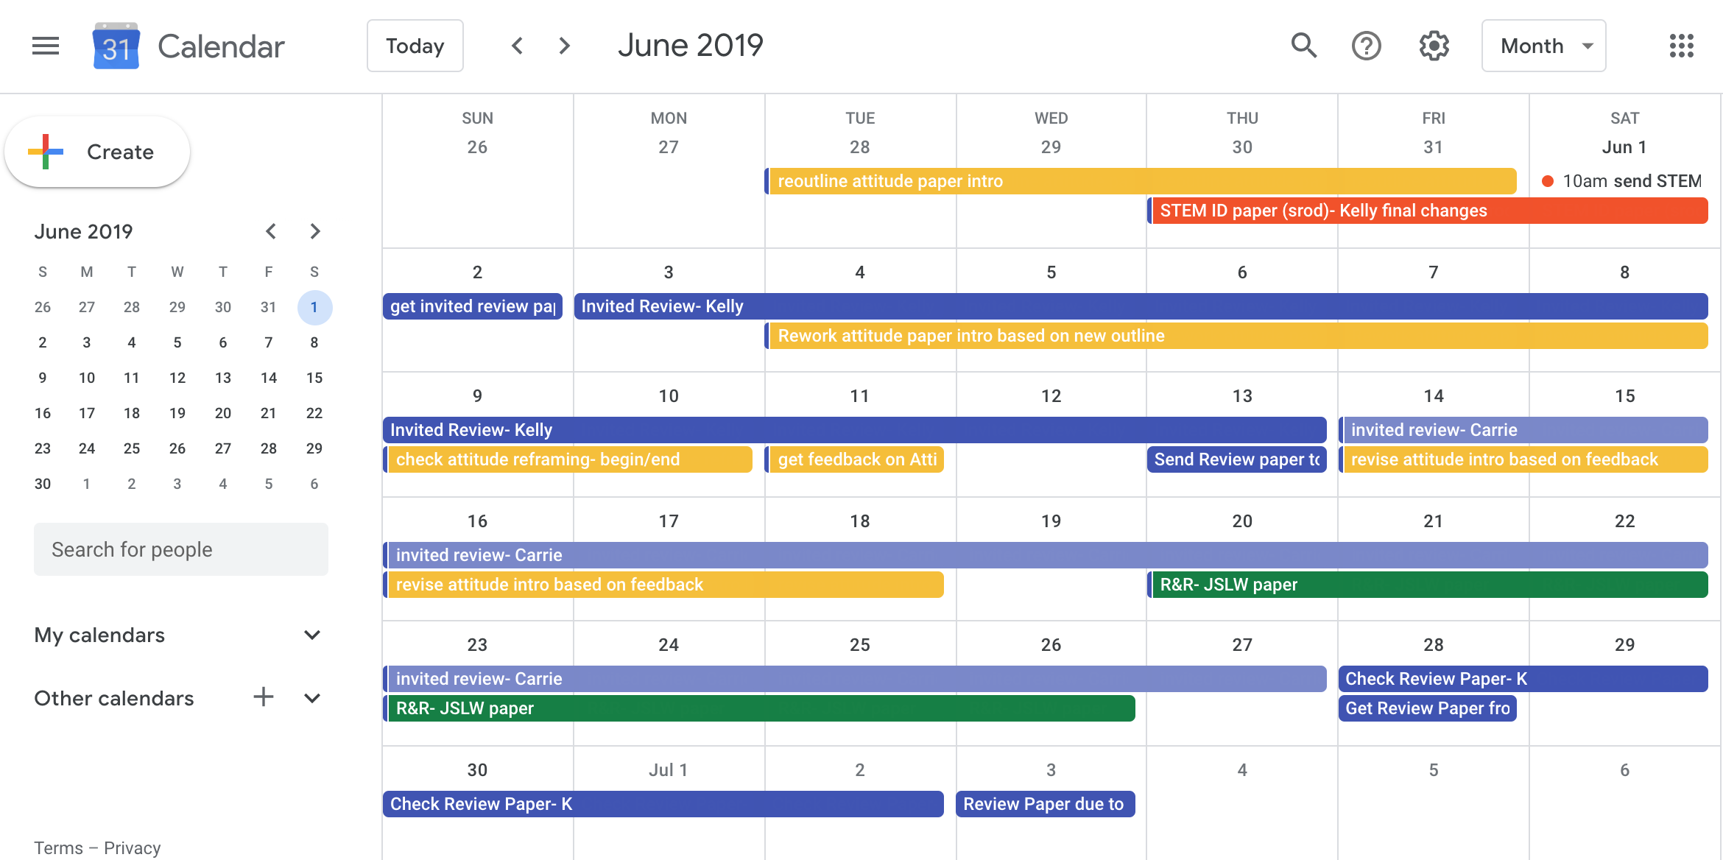
Notes:
Use color coded and shared google calendars to track your focus and papers- especially important with coauthors to know who has paper when, when expected handoffs are etc.

Slide 14
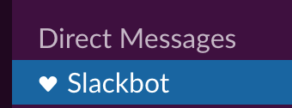
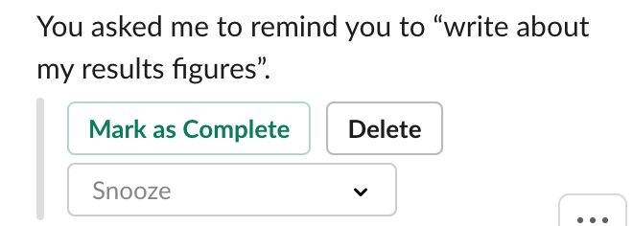
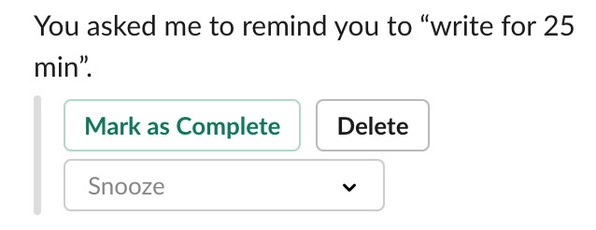
Slack reminders
/remind me to write about my results figures on Monday at 10am
/remind {person} to {do something} {when}
Forget? Just ask slackbot
-how do I set reminders?

Slide 15
Mini/session goals
June 16- revise figures based on PRG feedback
June 17th- write about 3 results figures
June 18th – reread/edit/revise results
Jun 20: write 1 hour on discussion/conclusion
Jun 21: reread/revise & write 300 more words
Be concrete
Tie to time
Notes:
Each work session, define ahead of time a focus, a session goal you can work on then. A what can I make progress on now

Slide 16



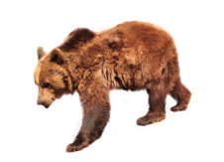
But also
Allow buffer time
Expect things to change
Notes:
See also PUBLISHING FROM THE PHD- MAKE A PUBLICATION PLAN A Patter article explaining practical steps to making a research publication plan and why you may want to
Additional considerations for health, moving, etc.

Slide 17
Stay Focused
Create a basic proposal/dissertation poster

Slide 18
Practice
Plan & Prioritize
Write regularly
Get feedback regularly
Revise regularly
Self edit
Track
Development
Community
Support
Tools & Workflow
Write & Revise regularly

Slide 19
Practices

Slide 20

Identify what works & what doesn’t – for you

Slide 21
How do you write? Independently or in a group Private, shared or public space? Morning, afternoon, evening? Short &/or long durations
Notes:
Do you even have a choice?
Try different things
May need to change over time

Slide 22



Location
Notes:
Or by beach/pool
Public private; coffeeshop, library, home, office, desk, couch, by a lake, under a tree, on the quad, unfamiliar academic building, different places, same places, cubicle, university, public library, friend’s house, hotel, on bus, on train, on plane,

Slide 23

Key accessories?
Notes:
Headphones?
Water?
Keyboard, mouse/track pad,
Notes, paper
Style manual
Tablet?

Slide 24

Devices?

Slide 25

Setup/Screens?

Slide 26
Understand how you write
Group/alone?
Music, silence, noise
Paper, apps, programs
Googledocs, word, scrivener, latex, overleaf
Device(s)
What combinations have
you tried/not tried/want to try?
Worked? Didn’t work?
Notes:
When might you strategically use different combinations?
Could trying something new work better for you?

Slide 27
Write Regularly

Slide 28
Practices
Find a routine & a habit that work for you
30 mins min daily
Build up over time
Each morning b4 email
Schedule time to write
Set concrete mini goals
Connect with support
Write regularly
Notes:
If you are currently at nothing, start at 30 and add 5 mins a day or week, get to 1 hour? More?

Slide 29
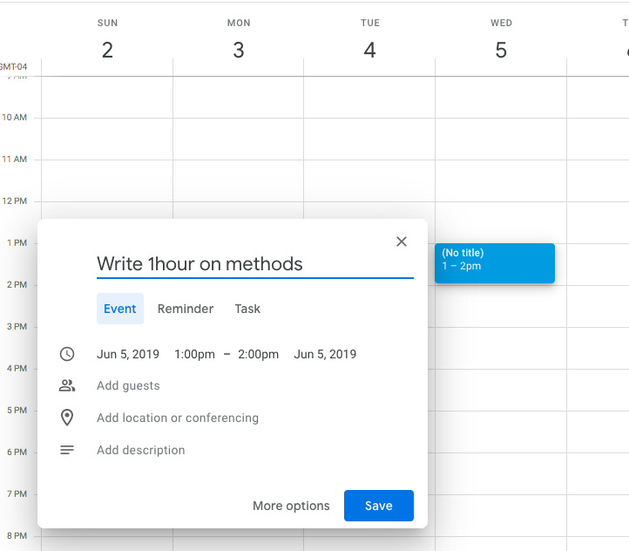
Schedule Your Work
Put writing/revising time on your schedule
Stick to it
Be specific

Slide 30
5/5/5
Restart your count daily
1k words Mon. & 1k words Tues. = 2 days
No roll over
500 words written or
5 pages edited
5 days a week
Idea shared on twitter- citation lost
Notes:
That’s min 500 words or 5 pages edited each of 5 days in a week
From someone on twitter – lost citation

Slide 31
Get Words on the Page
Notes:
Try tangible differences to help create routine
Be intentional about whether your goal is to get words on a page or work through what you have

Slide 32
Separate writing & revising
Try different
Spaces/environments
Chairs (or sit vs stand)
Devices
Playlists
Hats/wrist bands /reminder
Times of day
Days of the week
Write
edit
Notes:
Try tangible differences to help create routine
Be intentional about whether your goal is to get words on a page or work through what you have
Sep in tangible recognizable ways to train yourself

Slide 33
During Writing: Just Write
Ugly is good
Write whatever, however
Do what is easiest to get ideas from your brain to the page
get words on a page
Notes:
Your goal is put something on the page NOT end up with a published article

Slide 34
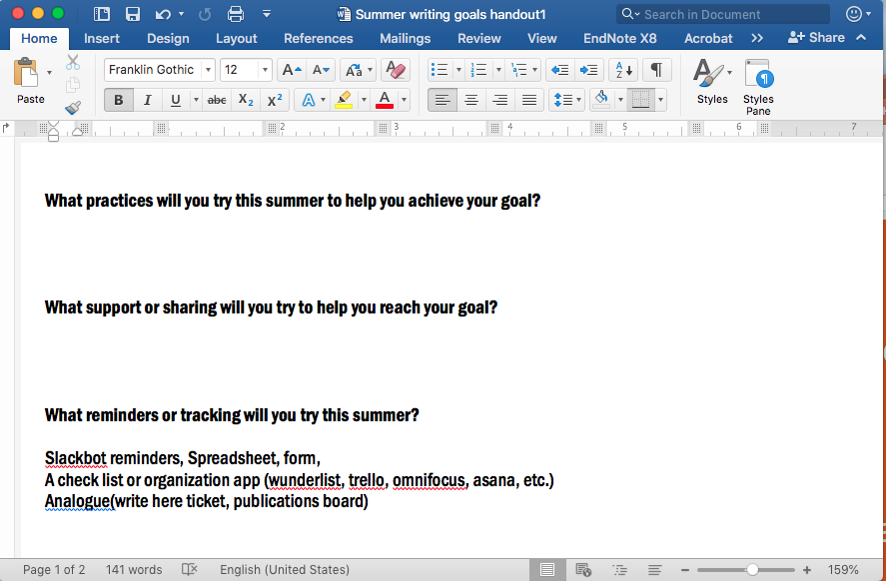
Just Write
Try speech to text
Try paper
Try an App
Want a challenge?->
get words on a page

Slide 35
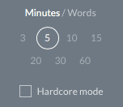
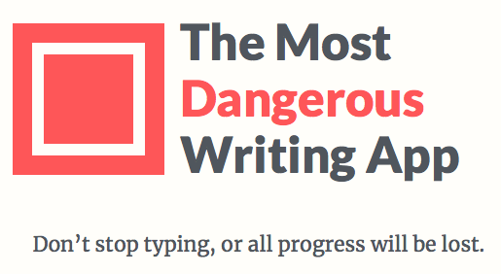
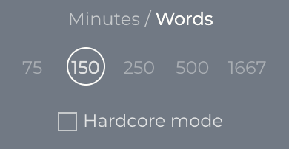
The Most Dangerous Writing App
https://www.themostdangerouswritingapp.com
Train yourself to not lookback/edit while writing
Write the whole time
or it gets deleted
Notes:
The most dangerous writing app
Set a timer for 3-60 minutes or set a words quota
Start typing, if you stop it will start to flash and then close you out , tell you you failed. If you sign up for the newsletter you can recover your work or you can start over
Can be helpful practice
Hardcore mode fades out your work and only shows you the letter you typed as you type it, nothing else
Should help train you to stop looking back at your work
Nothing is stored or read
Open source so improve it 5 sec break= delete

Slide 36
Use time as a structure

Slide 37
Time-based
Start with a 5 minute timer & just write
Email 1 page an hour to someone
5 pages in 3 hours
Etc.
Set up accountability during writing
strategies

Slide 38
Pomodoros
Bite size chunks of time
Promotes focus
Your email can wait 25 mins
Physical activity encouraged during the 5 min breaks
25 min writing/5 min break
WriteHere! uses this structure
Notes:
Min 2/day
Or adjust the time to what works- need longer break? Need 30 min block instead?

Slide 39
Where to start? Not the 1st sentence

Slide 40
Start in the middle
Write what you can, when you can
Words, bullets, sentences
Notes:
HOW TO WRITE A MANUSCRIPT A short post on order of steps and strategies in writing an article
Three-Part Elsevier Series: How to Prepare a Manuscript for International Journals
SIX THINGS TO DO BEFORE WRITING YOUR MANUSCRIPT
11 STEPS TO STRUCTURING A SCIENCE PAPER EDITORS WILL TAKE SERIOUSLY
WRITING THE FIRST DRAFT OF YOUR SCIENCE PAPER - SOME DOS AND DON'TS

Slide 41
Start with methods
You know what you did
Write it down
If you had a proposal, convert it
Check for accuracy
Update verb tense, etc.

Slide 42
Start with Slides
Make slides first
Arrange
Put slides in doc
Write about each one
Notes:
Over even talk about (speech to text each one)
Don’t have to be good slides- use basic slides to outline
Can use images of slides

Slide 43
Start with figures
Write bullets about each figure
Put figures in order

Slide 44
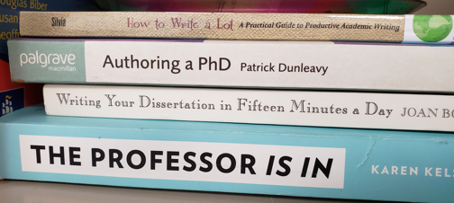
Books
How to Write a Lot
Authoring a PhD
Writing Your Dissertation in Fifteen Minutes a Day
Writing Your Journal Article in 12 weeks-Wendy Belcher
Notes:
Others have found these useful
https://wendybelcher.com/writing-advice/writing-your-journal-article-in-twelve/ writing your article in 12 weeks- wendy belcher’s website has other things as well- includes some support forms for the book

Slide 45
Organize & Structure your writing

Slide 46
Organize your ideas
Tools in Scrivener
Outline
Mindmap (paper, scrapple)
Concept piles
Blurbing- write what you can
Write what you should write
Do things that will make it easier for future you
Intro
I should write things about ABC here
Write about XYZ
Methods
blahblahblahblahblahblahblhablhablhabl

Slide 47

Scrivener
Optimized for writing long multipart documents
Keep notes, bits of writing, full documents, figures, refs, etc. in one organized place
Artisan software
Mac, windows, iOS
Free trial by days of use
~$40 (look for ed discounts & sales)
Writing, planning writing, organizing, etc.

Slide 48
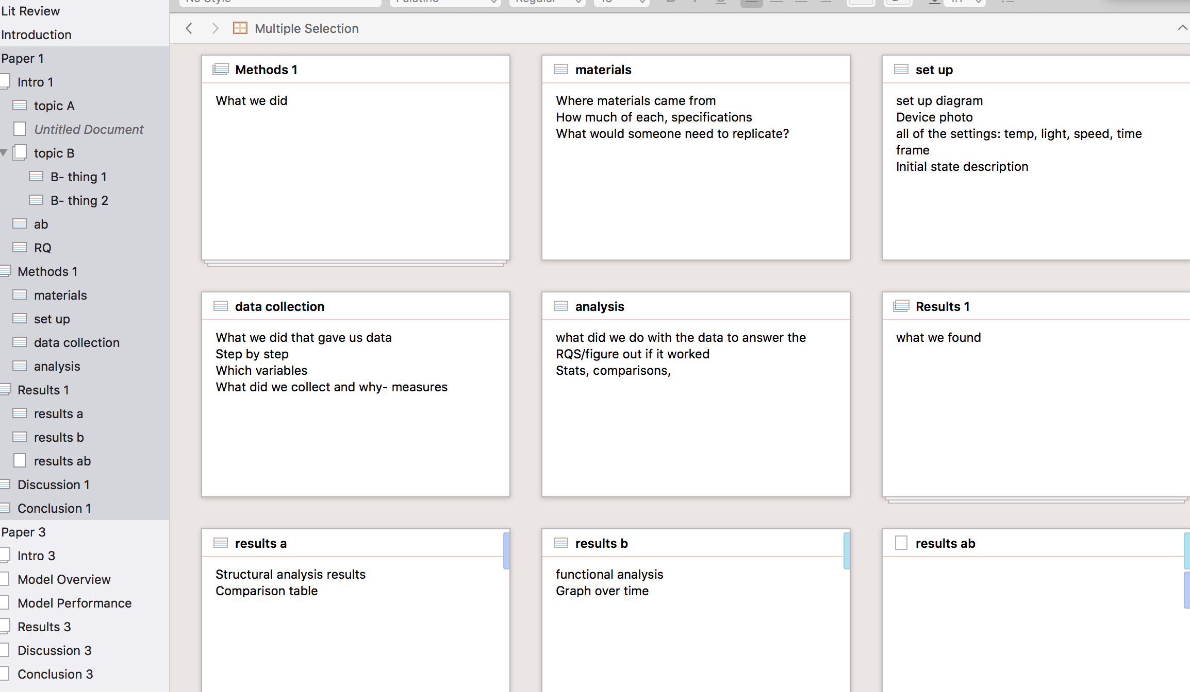
Notes:
This is the corkboard or index card view. It has a number of views and tools that are focused on the planning, writing and revising phases.
It supports math type and multimark down and you can compile whole and partial drafts to a variety of other formats and platforms. I usually go to word, but you could go to latex, ebook formats, etc.
Works with reference managers
Has a snap shot feature to save name versions of segments of documents all within the file.
Can add cross ref, notes, comments, etc.
Supports packaged back ups
Some cloud save, but because of the complexity of files, it seems safer to work locally and use auto back ups toa cloud drive instead.
Supports tagging, robust search, and many many more things

Slide 49
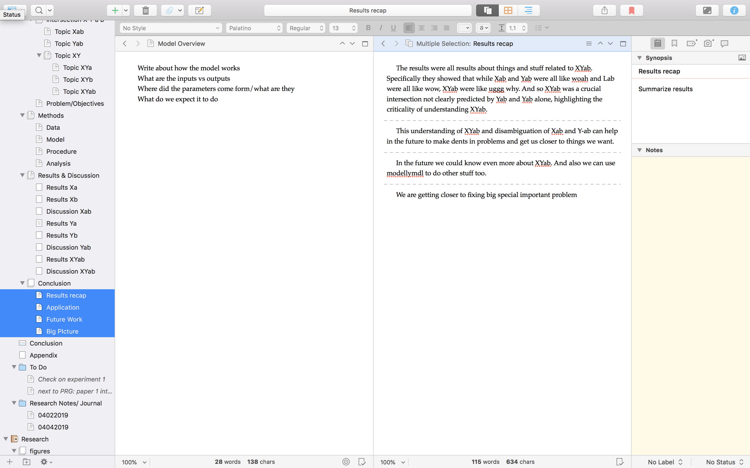
Notes:
Side by side view can show more than 1 part of a document at a time side by side or on top and bottom.
I use this a lot for have the what I should write or the guidelines in one pane and the section I am writing in another
The modular system makes it easy to write little blurbs on things and move them around and combine them. You can easily combine and separate sections of the write on the fly.

Slide 50
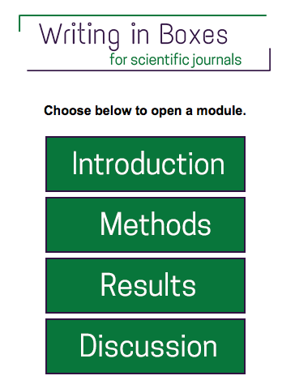
Writing in Boxes
WRITING IN BOXES An interactive tutorial and tool to get you started on writing the different sections of an IMRD article from JPHMP Direct; outlines what goes in each section; includes a video overview of how the tool works. While it is public health specific, you can adapt it to your field as well.
Notes:
Website not an app
Online tool to help with the most basic imrd article planning

Slide 51


Slide 52
Tips
Reference Manager
Endnote, Mendeley, Zotero
Saves time later
Use a reference manager
Notes:
Don’t devote your time to remembering and formatting citations- use a ref manager

Slide 53
Tips
Organize your notes
Use a form->matrix
Sortable balanced info
Make notes searchable
Saves time later
Lit Review Matrix
Notes:
See also LITERATURE REVIEW WRITING GUIDE - from the University of Waterloo on writeonline.ca, a well organized multipart step by step guide for planning, writing & revising lit reviews; includes a section outlining the key parts of a lit review and tips for writing.
LITERATURE REVIEWS - posts from Raul Pacheo-Vega on various strategies and stages of writing a literature review
Includes 1 differentiating systematics/synthesis/metaanalysis
A variety of techniques for getting starting, reading->writing
Not engineering specific- find the useful strategies that apply to you

Slide 54
Lit Review Matrix
Title
Author
Year
Journal
Key finding
Method
Key attributes
Example info
Notes:
Use a form to make it easy and standardized- can also share entry with others

Slide 55
Tips
Set up Google Scholar alerts
Stay up to date on literature

Slide 56
Back Up your Work
Local
External drives
Multiple
Multiple locations
Cloud
UVA Box
multiple locations
Make it automatic
At several levels

Slide 57
Find Apps for your Workflow

Slide 58
Tips
LiquidText, ihighlight, etc.
Livescribe
Make notes searchable
Saves time later
Put notes in scrivener for each project
Organize notes
Notes:
See also LITERATURE REVIEW WRITING GUIDE - from the University of Waterloo on writeonline.ca, a well organized multipart step by step guide for planning, writing & revising lit reviews; includes a section outlining the key parts of a lit review and tips for writing.
LITERATURE REVIEWS - posts from Raul Pacheo-Vega on various strategies and stages of writing a literature review
Includes 1 differentiating systematics/synthesis/metaanalysis
A variety of techniques for getting starting, reading->writing
Not engineering specific- find the useful strategies that apply to you

Slide 59


LiquidText
iOS
Mac & Windows soon
Free or
19.99 pro for students
Reading, annotating,
making connections
https://www.liquidtext.net
Notes:
Extremely responsive developers
Made by someone with a phd in hci
Very different than other apps
Can export notes
See website for videos

Slide 60
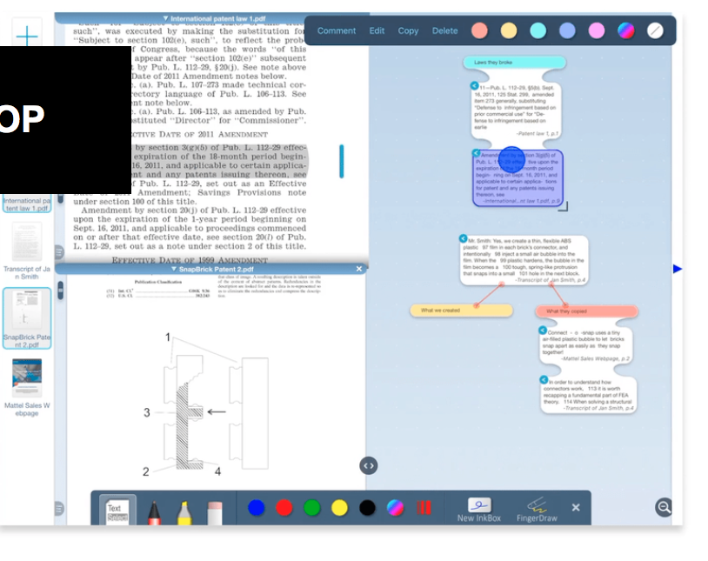
Excerpts & connections
Across multiple pdfs
Write/type notes
Export notes
Squish away sections
Active book marks
Multiple pdfs at once
Notes:
See website for videos

Slide 61
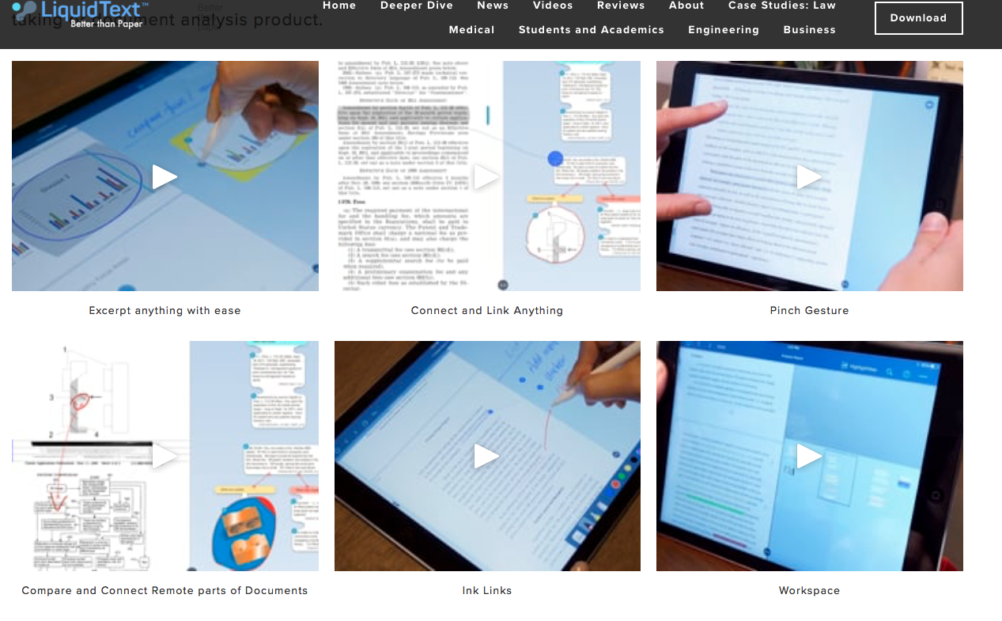
Notes:
Screenshot of liquid text website
Squish away text you don’t want to focus on
See website for videos and use cases

Slide 62

Noteability
iOS/Mac only ☹
8.99
+1.99 handwriting recognition
Notetaking w/ sound/playback
Notes:
One note may now have some similar features? But known for issues, not sure on sound
Noteability is helpful because of its inclusion of audio tied to your notes
Integration text, audio, writing/drawing, photo, pdf, etc.
Notes with play back on screen along with audio, can tap any place in notes to hear audio at that point

Slide 63
Find Apps for your Workflow
Software showcase
Reviews
Word of mouth
Search based on need
Ask the data services librarians

Slide 64
Tracking
Notes:
If you are doing all this work, it can be motivating to track it
See also word count targets in scrivener

Slide 65
Track what you actually do
Time spent, time of day
Word written
Pages revised
Sections done
See your progress
Find patterns of when you are productive
Identify what progress is realistic & adjust

Slide 66
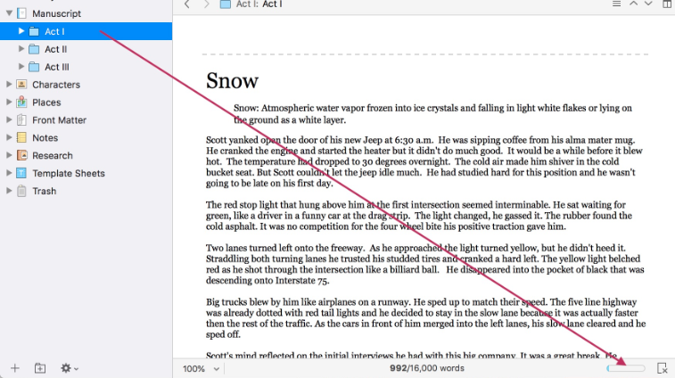
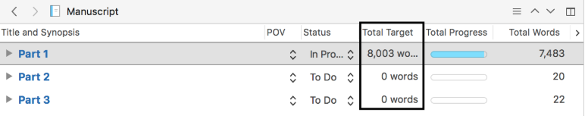
Scrivener built in tools
Notes:
In scrivener there are a number of tools for tracking
Setting targets by section, or session
tagging sections as done, needs revising, needs feedback etc

Slide 67
Analogue
Tracking: ____________1 square= ____________________
1 week
= ____________________
Notes:
For instance use each column as a week
What are you tracking?
What do you want each square to represent?

Slide 68
Analogue
Tracking: ____________1 square= ____________________
Goal
1 week
= ____________________
Notes:
What is your weekly goal, do this thing, this many times
Draw a line so you know if you reach it
Fill in the star if you reach it or use star for something else
Stars could be tital stars =you get a prize or so many stars ina row you get a prize (like go to the movies) or the stars could track something else or be unrelated

Slide 69
Analogue
Tracking: _write/revise____1 square= ____1 pomodoro____
Goal
= ____9 pomodoros a week___
Notes:
What is your weekly goal, do this thing, this many times
Draw a line so you know if you reach it
Fill in the star if you reach it or use star for something else
Stars could be total stars =you get a prize or so many stars in a row you get a prize (like go to the movies) or the stars could track something else or be unrelated
In this example say it is write/revise your research article and you want to have a minimum of 9 pomodoros a week because that is at least 45 minutes/day during the week
Each block is one pomodoro

Slide 70
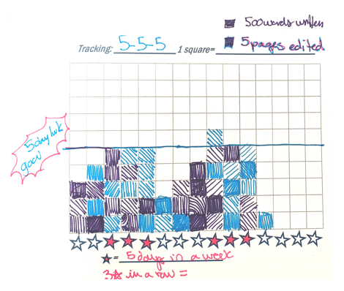
Analogue
5-5-5 tracking
1 color for writing
1 color for editing
Notes:
So you could track 555 this way
Each square is meeting a day’s 555: 1 color is wrote 500 words, another color for 5 pages edited if you want
Your goal like is at 5 blocks for 5 days a week
Fill in a star if you met the goal that week
3 stars in a row= do something fun
You don’t have to track with colors if you don’t care writing vs editing
But you don’t have to do it this way. You could use rows as days or not related to time, you could track something else

Slide 71
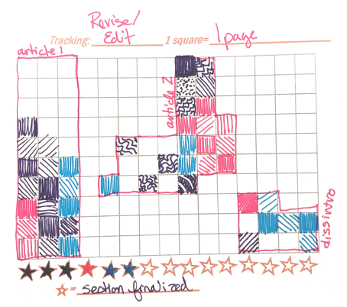
Analogue
Editing areas
Each area is a document
Color may or may not have meaning
Notes:
You can also use the squares to create different kinds of areas for projects. Like editing all of a paper or section. Color in one square per page or two pages etc.

Slide 72
Spreadsheet
Track & graph it
Use a form- google forms or others with live updating charts
Also things like paid services
https://academicwritingclub.com

Slide 73


Apps to help
Toggl- button push time tracker by task/project
Auto time by app & app regulation
Notes:
Toggl and rescue time
Seeing where an dhow you spend your time can help you plan and recapture time
Rescue time can also block websites for you for specified periods of time

Slide 74




Task Tracking
& management
Notes:
Task tracking apps: trello, asana, omni focus, wunderlist
Checklist and board maps
Omni focus can also do dependencies, location based lists (it reminds you or your lab tasks only when you are physically there)0 might be mac/ios only
Wunderlist- free multiplatform, but simpler
trello- board system
Asana- more complex, paid

Slide 75
Tracking – big picture

Slide 76
Publication Board
Wall, write & wipe board, bulletin board
Categories for different stages of work
Each piece of work on a post-it/index card etc.
Visible in your space reminder
of the big picture
Notes:
More common for faculty, but many start them as grad students too

Slide 77
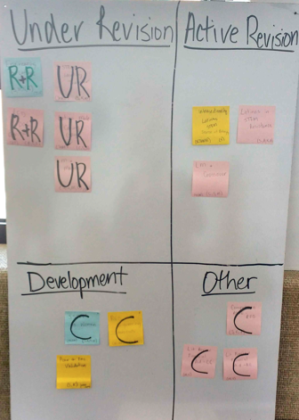
Example
C- conference
UR- under revision
R&R- revise & resubmit
Notes:
Each post it is a paper

Slide 78
Sample Board Categories
Ideas | Data collection (irb/funding) | Analysis | To write | Conference
Writing w/coauthors | Revising | R&R | Submitted | Published/ accepted
Notes:
This is more similar to mine- using foam floor tiles mounted to the wall as a big bulletin board
Gives a visual of everything. Helps identify where things are. Fun to move things on the board to solidify progress.
It helps you see if you have a steady healthy publication stream, and also gives you a place to put ideas
Even if it isn’t your board, have a place for ideas because you will have plenty but also need to get your current work done

Slide 79
Apps
Trello- digital card/board system
Check list apps
Notes:
You can do similar things with apps:
Trello is a digital card/board system common for tracking tickets etc. across teams
Some checklist apps will let you move lists so you can have folders and have a checklist for each pub where you break down tasks and can still movethe pub like you would on a board- omni focus ex. – I have a complex list for each article and move that list into a folder depending on if it is being worked on, rr, submitted, accepted etc. but this is in ADDITION to the publication board in physical space.
Draw backs to digital only system- lack of visibility- easy not to open it
But you can make calendars etc. which makes them useful for goal setting too
A combination of digital and analogue systems

Slide 80

Apps
Lucidchart.com
Cloud-based chart making
Many flow charts, gantt charts etc.
Extraordinarily limited on a free account?

Slide 81
Spread Sheet Tracking
Sheets for pubs, conference, proposals
Include dates to id how long decisions take
Track accept/reject rates
(>10%= ☺)
Useful to see what you’ve done
Longitudinal record

Slide 82
Ex. : Publications
# | journal | Title | Coauthors | Accepted | Rejected | Submitted | under review | Published | R& R, etc.
1 | ABC -J | thing | Sarah & Bob |  | x | 12/1/17 | 1/8/18 |  | 4/10- R&R, submitted 4/29, dec 6/2- rej
2 | J of XYZ | Thing | Sarah & Bob | x |  | 7/8/18 | 7/15/18 | 12/1/18 | R&r 10/10, submitted 10/30, accept 11/15
Notes:
Reminder when working with coauthors use an agreed upon schedule and a shared google calendar or similar to tarck who has it and whath they should do with it and where they should send it next.

Slide 83
Ex. : Conferences
Date | Conference | Title | Accepted | Rejected | Other | notes | Project category | notes
10/19-22 | sslw | stuff |  |  | poster | Didn’t present | stuffystuff
10/12-18 | slrf | things | x |  |  | presented | thingything | Terrible conference- don’t apply next year

Slide 84
Ex. : Conference Apps
deadline | Conf | Loc | Dates | Proposal | Submitted | Decision | Registered | Pres time | Link | notes
10/2 | ASEE | FL | 6/1-6 | thing | 9/25 | No 1/17 | no |  | http://
2/8 | AAAL | NY | Oct. 15 | Lots of stuff | 1/18 | Yes-4/18 | yes | Mon 10am | http://

Slide 85
Ex. : Funding Apps
$ | Grant | Proposal | Accepted | Rejected | Submitted | Decision
10k | Mini Granty grant | things |  | x | 10/2016 | 1/26/2017
5k | fellowshipA | stuff | x |  | 11/2/17 | 2/28/2018 | Got it ☺

Slide 86
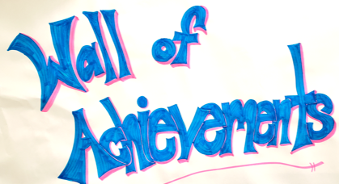
Celebrate
Submissions, milestones,
decisions, wins
Tell people
Do something
Take a break
Notes:
Paper wall in the GWL where you can share your achievements through markers, colored pens, stickers, etc.
Even small rewards and breaks can be helpful
-see also word bricks
Don’t forget to track thigns on your big picture board and spreadsheets and lists

Slide 87
It’s not just you

Slide 88
Community & Network
Support
Peers, advisor, mentors
Friends, family, pets
Staff, editors, services

Slide 89
Community & Network
PRGs
Consultants
Peers
In ENGR
Lab, events
At UVA, beyond UVA
Social networks (academic twitter)
Professional organizations

Slide 90
WriteHere!
Show Up on Zoom
(&/or follow on Slack)
No registration
Pomodoro Structure
Weekly structured
show up & write events
Lead one at a time/day useful for you

Slide 91

Other Writing Groups
Join a meet up
Join a global session on twitter
Variety of similar writing meet up groups
Or make your own
1 hr, at the park
Every other week
Zoom or Slack
http://www.shutupwrite.com

Slide 92
Accountability Groups
Small 3-4 ppl
Meet weekly
~15 min each to
Check in
Last weeks goals
Progress
Why
New goals
Find or Create One

Slide 93

Accountability Groups Online
Small 3-4 ppl group
Check in weekly online
Slack, Zoom
Find or Create One
Notes:
You’ll also find scholars groups like this or with a combo writing for different groups amongst grad students or professors online or through scholarly organizations, including some specifically for particular disciplines, groups, and under represented populations in academia

Slide 94
Accountability Buddies
Check in as often as needed
Share goals, schedules
Check in to see if your buddy is making progress
Email, text, slack, zoom, f2f
Find a Friendly Nag
Did you do the thing?
Grumble grumble
Notes:
Friendly nag- from one of those books- how to write a lot I think

Slide 95
Peer debriefers
Feedback on your plan
Check ins
Ask difficult questions
Especially useful in proposal stage
How are you handling ABC?
What if … ?
Notes:
For difficult questions on content

Slide 96
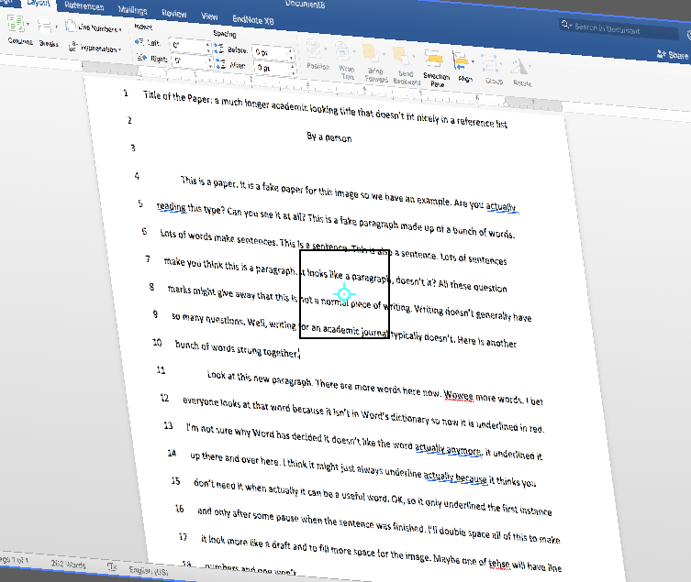
Peer Review Groups
Meet weekly
Join for a semester at a time
Sign up to bring your work for review
Set mini deadlines
Get live feedback
Give/get feedback
Notes:
Build a supportive disciplinary community through discussion based feedback
Commit for minimum of 1 semester

Slide 97
Get feedback
1on1 consultations with GWL
1on1 consultations w/university writing center
PRGs
Peers, friends, faculty, etc.
Notes:
Build a supportive disciplinary community through discussion based feedback
Commit for minimum of 1 semester

Slide 98
Set up a Check in
Use the handout to get started on your plan
Completely lost in managing a very large writing project? meet with me or a consultant
Slackbot:
/remind me to check in with ABC about xyz on July #
What do you want to have done?
What should someone ask you about?
Who else could check on you?
Find someone
to check in with in July

Slide 99

Writing Can be Scary
& lonely

Slide 100
But it doesn’t have to be

Slide 101
bit.ly/SEASGWL
gradwritinglab@virginia.edu

