Slide 1
Affordability & Equity:
A program supporting the use of OER
Fall 2021

Slide 2
Review the purpose and rationale of the program
Review the call for proposals
Review the application form
...and plenty of time for Q&A
Notes:
This is what we’re hoping to cover today, but we can take it in different directions depending on your interests..
After a brief overview, this session will be guided by your questions

Slide 3
Unmute or contribute via chat
Is there anything you want me to be sure to cover?
Notes:
This is a pilot program: we’ll be learning from you as you will be from us.
Many of our programs accept projects where the rationale for working with the library is strong. This one is different. We’ll be available to support through training and consultations, but it’s not a requirement that you work with us, beyond the community-based aspects of the program. The purpose of the program is to create a strong environment for open education.

Slide 4
“OER are teaching, learning, and research resources that reside in the public domain or have been released under an intellectual property license that permits their free use and re-purposing by others. Open educational resources include full courses, course materials, modules, textbooks, streaming videos, tests, software, and any other tools, materials, or techniques used to support access to knowledge.”
William and Flora Hewlett Foundation
Notes:
Let’s start with a definition of OER.
OER include a wealth of other materials. If it meets the basic criteria, that is, it allows free use and re-purposing, we consider it an open educational resource

Slide 5
The Five Rs of OER
Notes:
Retain - Copies of content can be retained for personal archives or reference - the right to make, own, and control copies of the content (e.g., download, duplicate, store, and manage)
Reuse - Content can be reused in its unaltered original format - the right to use the content in a wide range of ways (e.g., in a class, in a study group, on a website, in a video)
Revise - Content can be modified or altered to suit specific needs - the right to adapt, adjust, modify, or alter the content itself (e.g., translate the content into another language)
Remix - Content can be adapted with other similar content to create something new- the right to combine the original or revised content with other material to create something new (e.g., incorporate the content into a mashup)
Redistribute - Content can be shared with anyone else in its original or altered format - the right to share copies of the original content, your revisions, or your remixes with others (e.g., give a copy of the content to a friend)

Slide 6
Cost
Pedagogy
Notes:
This program balances cost savings with an impact on teaching and learning.

Slide 7
In compliance with Virginia Code § 23.1-1308
Open Educational Resources
E. The governing board of each public institution of higher education shall implement guidelines for the adoption and use of low-cost and no-cost open educational resources in courses offered at such institution. Such guidelines may include provisions for low-cost commercially published materials.
https://law.lis.virginia.gov/vacode/title23.1/chapter13/section23.1-1308/
Notes:
Regarding cost savings: Virginia Code 23.1-1308 states that "the governing board of each public institution of higher eduction shall implement guidelines for the adoption and use of low-cost and no-cost open educational resources in courses offered at their institution.
This code also calls for identifying courses in the course catalog.
The registrar’s survey request asks if you’d like library support in finding low-cost and no-cost materials. Liaisons are ready to help.

Slide 8
Diversity
Equity
Inclusion
Access
Notes:
Cost certainly speaks to elements of equity and accessibility. OER goes the distance in leveling the playing field in terms of access to materials—the economic burden is disproportionate amongst our students.
In addition, DEIA is addressed as content can be contextualized to go from being an abstract concept to reflecting students' lived experiences.
The integration of cultural inclusivity is also possible—name can be changed, stereotypes dismantled, and a sense of a reflective view of culture displayed.
https://www.cccoer.org/2018/10/09/on-equity-diversity-inclusion-and-open-education/#off-campus

Slide 9
ADOPT an open resource
Entire courses (MIT OpenCourseWare, Open CourseLibrary)
Texts (Pressbooks, VIVA Faculty Textbook Portal, LibreTexts, Open Textbook Library)
Multimedia (CreativeCommons, Mutopia Project)
Data sets (data.gov, U.S. Census Bureau)
Ancillaries/stand-alones (OER Commons, MERLOT, COERLL)
https://guides.lib.virginia.edu/oer/finding
Notes:
While there are a number of different places to search and locate these—reference our libguide—here are some popular spots.
Pressbooks: One of the more popular OER authoring tools. Includes a directory of all the books, texts, handbooks, and other text-based media.
VIVA Faculty Textbook Portal: The VIVA Faculty Textbook Portal is a catalog to assist Virginia public college and university faculty in finding and selecting open and affordable textbooks for their courses in one. The Portal contains over 200,000 titles from VIVA’s shared library collections, open access textbooks, and ebooks available for VIVA to purchase on behalf of public colleges and universities throughout the state.
LibreTexts: Created by UC Davis with the support of Dept of Education grants, LibreTexts contains open textbooks and other OER in subjects like Chemistry, Biology, Nutrition, Music Theory, Physics, Agriculture, and more!
OpenStax: OpenStax has created peer-reviewed, openly-licensed textbooks, which are available in free digital formats and for a low cost in print.
Open Textbooks Library : The Open Textbook Library provides an easy-to-use interface for locating and evaluating OER. Along with peer-reviewed textbooks, the OTL provides reviews from faculty who have adopted their texts for courses.

Slide 10
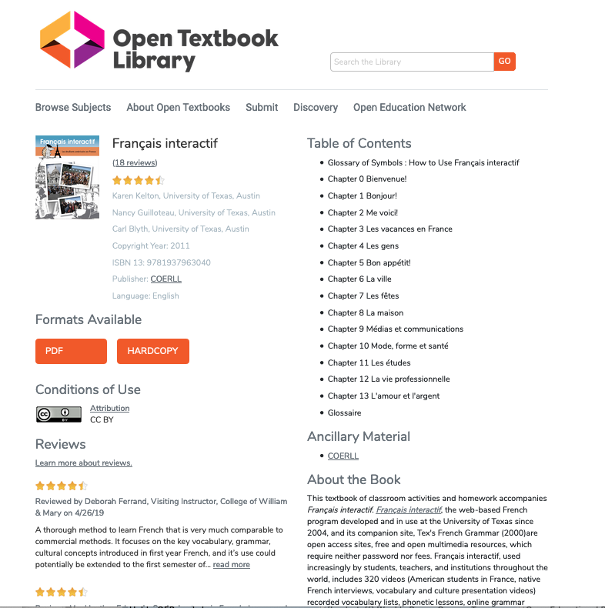
https://open.umn.edu/opentextbooks/textbooks?term=biology&commit=Go
Notes:
This is an example of an open textbook that can be easily downloaded and made available through the LMS. Or, a hard copy can be purchased for about $30. Note the CC-BY license.

Slide 11
ADAPT an open resource
For example: Customizing, updating, localizing, remixing, adding interactivity, creating ancillaries, e.g., quiz questions, slides, adapting an open data set
https://guides.lib.virginia.edu/oer
Notes:
By adapting, we mean making changes to an existing open resource or adding ancillary materials.

Slide 12
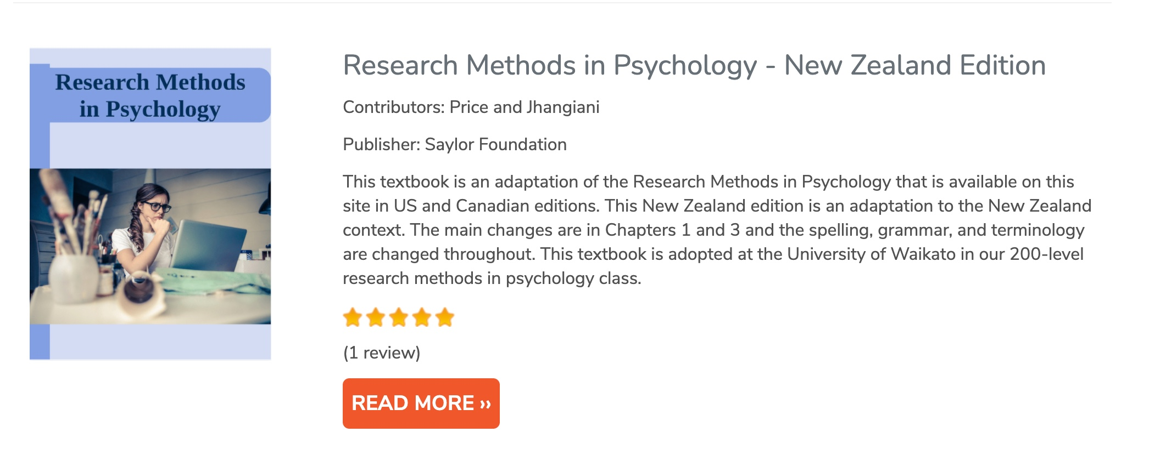
Open textbooks can be contextualized to reflect your students’ experience
Notes:
An example of textbook contextualization

Slide 13
Renewable assignments may be originally developed or remixed or adapted
Students create a test bank to earn class credit
Students adapt an open textbook, earn authorship credit
Notes:
Adapting also includes creating course materials as part of the active learning process.
For instance,
Rajiv Jhangiani’s students crafted and peered review multiple choice questions for a test bank for an open educational textbook. He provided them with guidelines for writing effective questions; the assignment included constructive peer feedback. http://openpedagogy.org/assignment/why-have-students-answer-questions-when-they-can-write-them-by-rajiv-jhangiani/. it’s an example of active learning that turns into a shareable resource.
David Wiley authored Project Management for Instructional Designers. He and his students spent a semester revising the textbook. In subsequent terms, his students added assessment items, recorded videos of instructional designers talking about project management, and continued to make improvements. When each term is over, the students have authorship credit.
https://pm4id.org/front-matter/about-this-book/

Slide 14
CREATE an open resource
For example: text, audio, video, interactivity, Wikipedia, map, data, app…
https://guides.lib.virginia.edu/oer
Notes:
Create a new resources where an acceptable option does not exist This category is for resources built from scratch. Applications must demonstrate need as well as significant impact on teaching and learning.

Slide 15
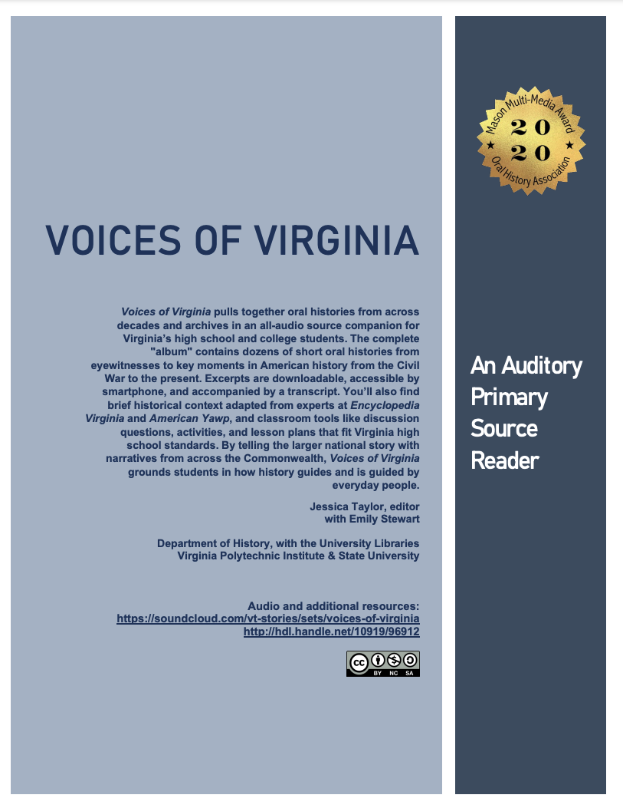
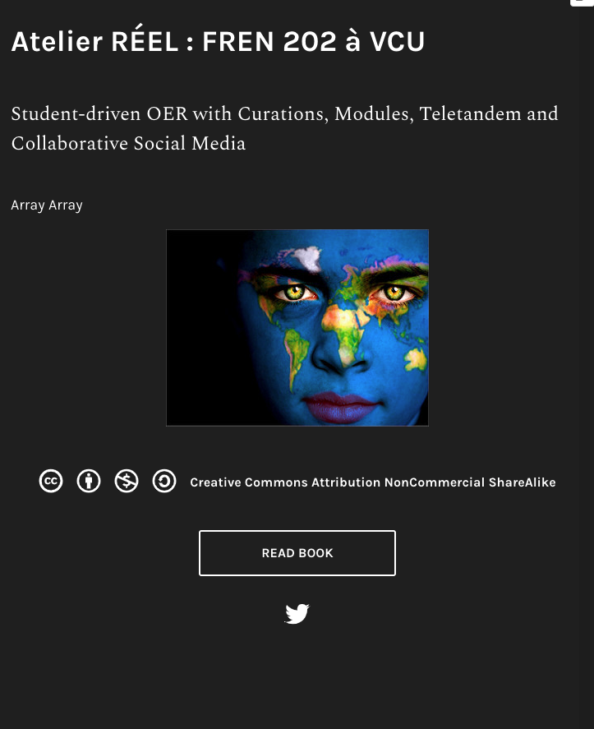
Notes:
Two examples from state colleagues: Virginia Tech (left); VCU (right).

Slide 16
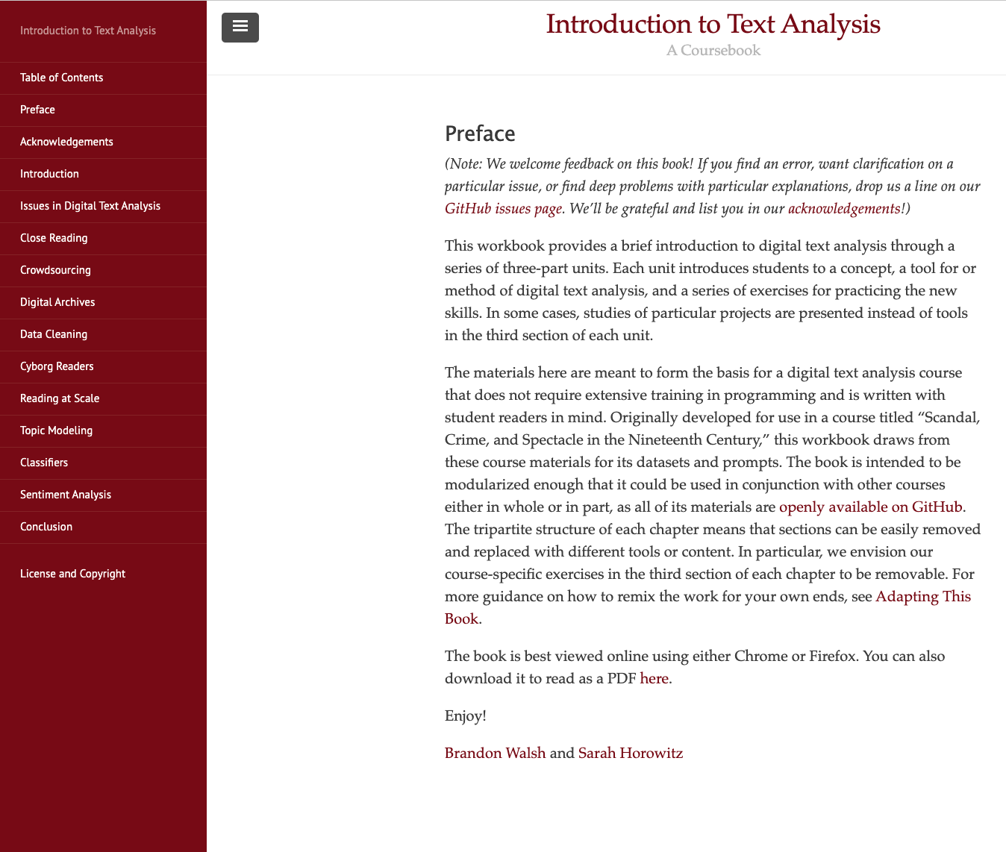
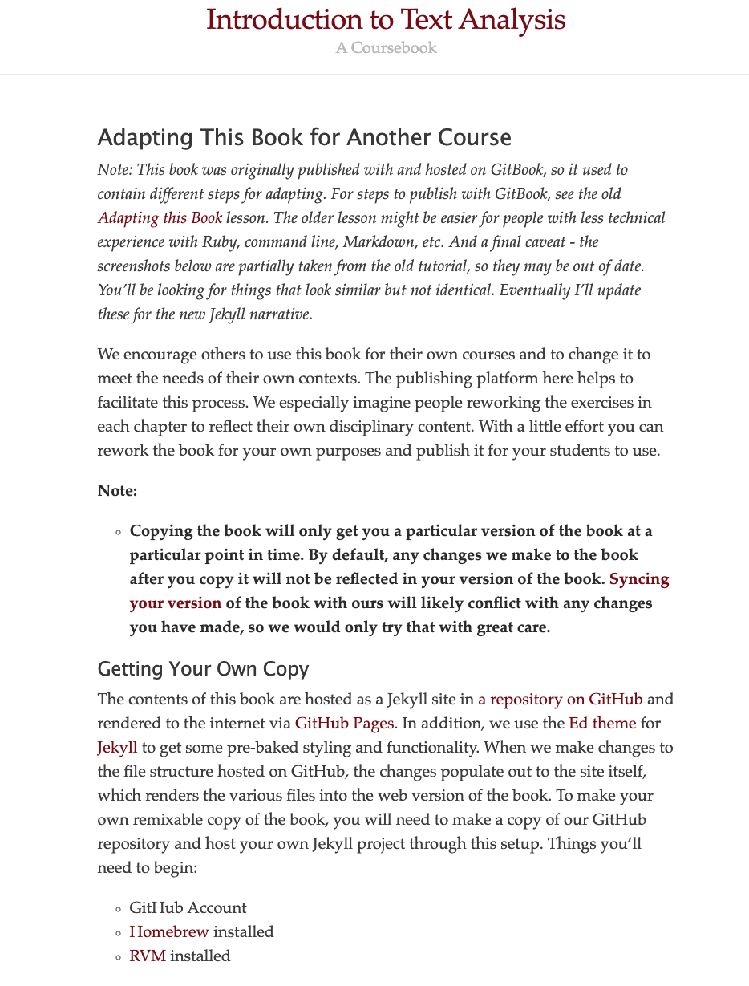
And at UVA…
Notes:
Brandon Walsh in the Scholars’ Lab has created Digital Humanities-oriented resources, available online and on github. - http://walshbr.com/textanalysiscoursebook/copyright/

Slide 17
The Call for Proposals
Notes:
Review the Call for Proposals: https://guides.lib.virginia.edu/oer/faculty#s-lib-ctab-23287548-0 and the
Program application: https://virginia.az1.qualtrics.com/jfe/form/SV_3O7j733mshr6BO6

Slide 18
Introduction to OER
Intellectual Property & Copyright in OER
Open Pedagogy
Find out more on this libguide
Notes:
We’re offering a number of OER Workshop sessions:
Introduction to OER, where we provide a more in-depth framework for what OER is and how UVA—both its students and faculty—are working towards shared goals and initiatives.
Finding, Evaluating, and Reviewing OER, where we will focus on strategies for finding materials that meet your needs.
Intellectual Property and Copyright, where Brandon Butler talks about copyright, authors’ rights, and the Creative Commons licenses.
Open pedagogy, where Bethany Mickel discusses how open pedagogy can increase student engagement and encourage diverse representation.

Slide 19
Questions? We are here to help!
Judith Thomas (jet3h)
Bethany Mickel (bbm9u)
Haley Gillilan (hg4ub)
Created by Bethany Mickel and Judith Thomas (2021).
This work is licensed under the Creative Commons Attribution 4.0 International License.

