Slide 1


Getting Ready for
Open Science
David Mellor
Director of Policy

Slide 2
Overview
Center for Open Science mission and strategy
New and upcoming open science requirements for federal funding
OSF: tools to enable open science practices

Slide 3

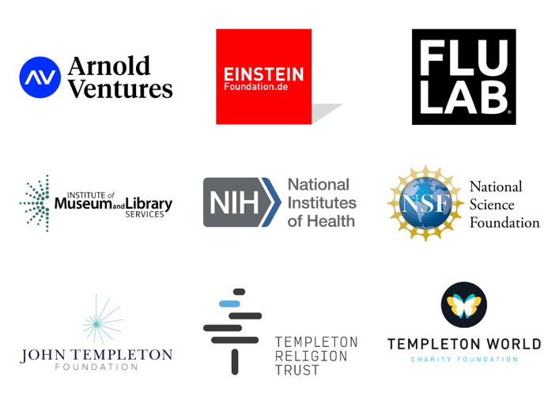
https://www.cos.io/about/supporters and https://osf.io/8km72/

Slide 4

Center for Open Science
Our mission is to increase openness, integrity, and reproducibility of research.

Slide 5
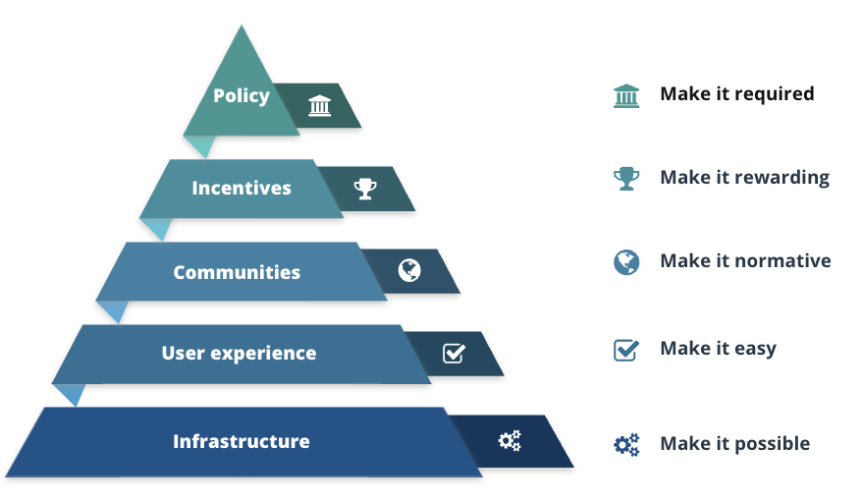

Slide 6
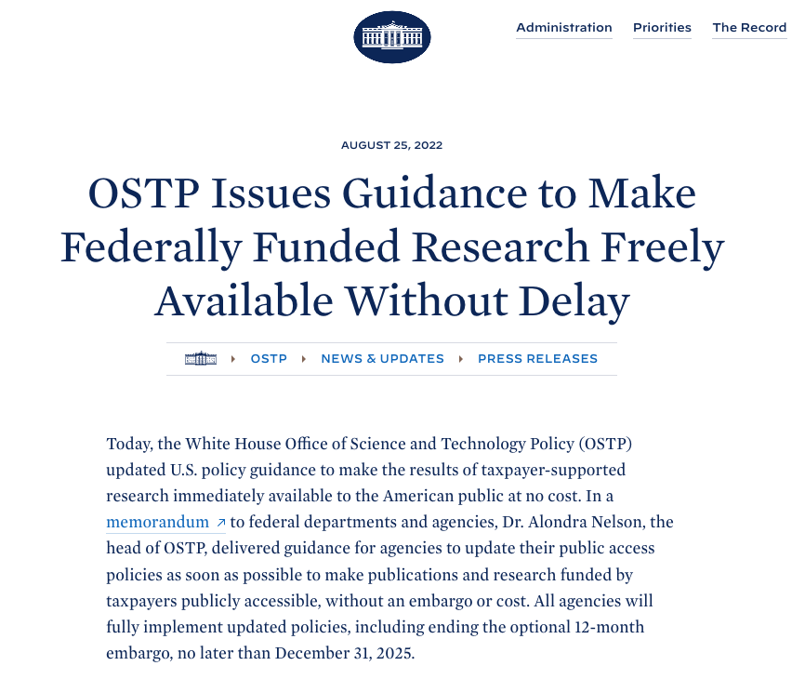

Slide 7
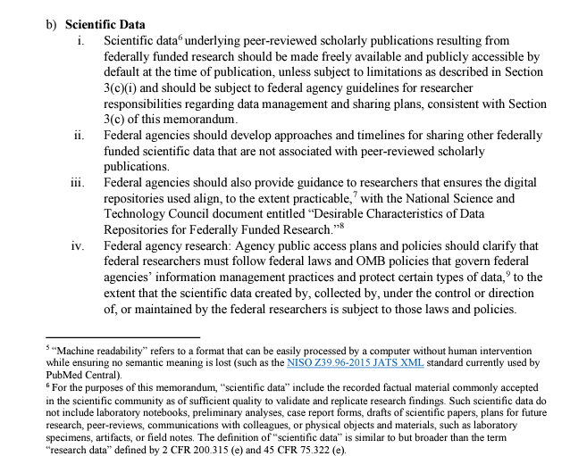
“Scientific data underlying peer-reviewed scholarly publications resulting from federally funded research should be made freely available and publicly accessible by default at the time of publication.”

Slide 8
“For the purposes of this memorandum, “scientific data” include the recorded factual material commonly accepted in the scientific community as of sufficient quality to validate and replicate research findings. Such scientific data do not include laboratory notebooks, preliminary analyses, case report forms, drafts of scientific papers, plans for future research, peer-reviews, communications with colleagues, or physical objects and materials, such as laboratory specimens, artifacts, or field notes.”

Slide 9




“Recorded factual material commonly accepted in the scientific community as of sufficient quality to validate and replicate research findings.”
Digital materials to conduct the work
Code to analyze the results
Data that underlies results with rich metadata to understand context
Preregistered with protocol to replicate methods
Notes:
The solution is to align through a standard framework that is flexible enough to adapt to these domains and stakeholders, specific enough to assert unambiguous standards and expectations for behavior, and progressive enough to create a durable and long-lasting roadmap for community growth over time. The Transparency and Openness Promotion Guidelines (TOP) provides that common framework.

Slide 10
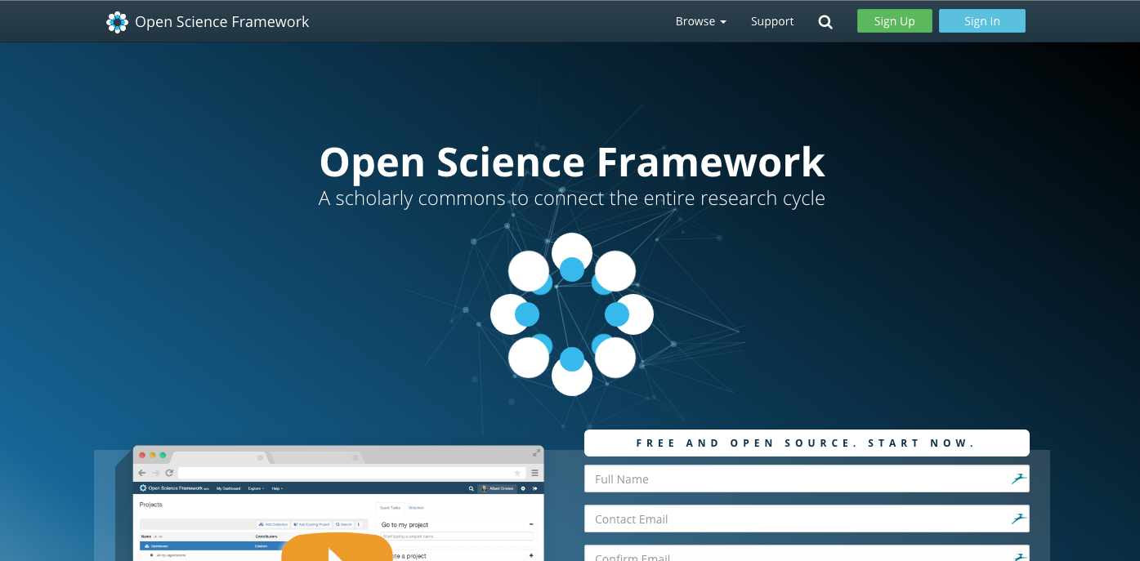
https://osf.io

Slide 11
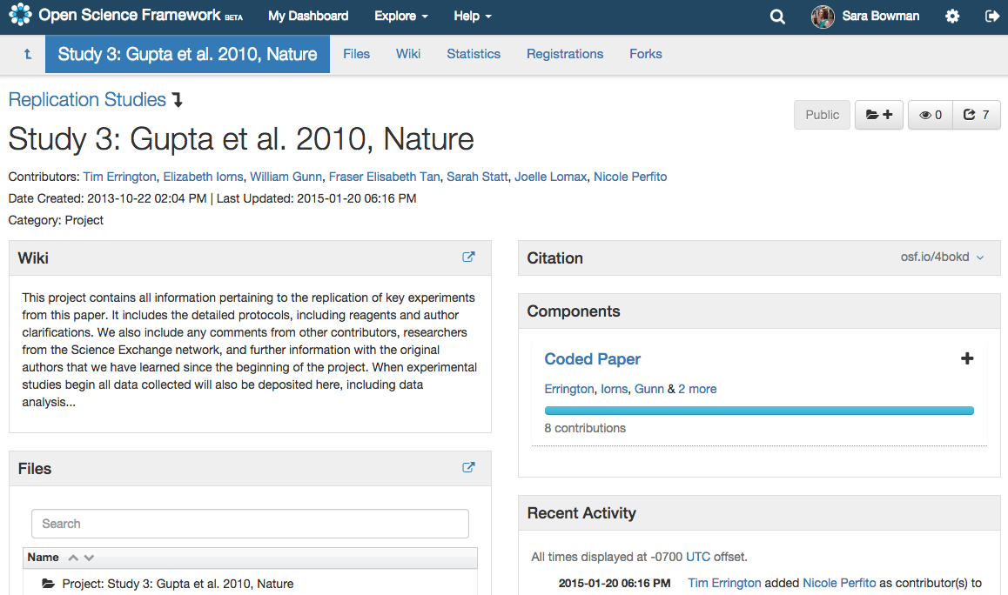
Notes:
Add collaborators within your own organization or across institutions/organizations

Slide 12
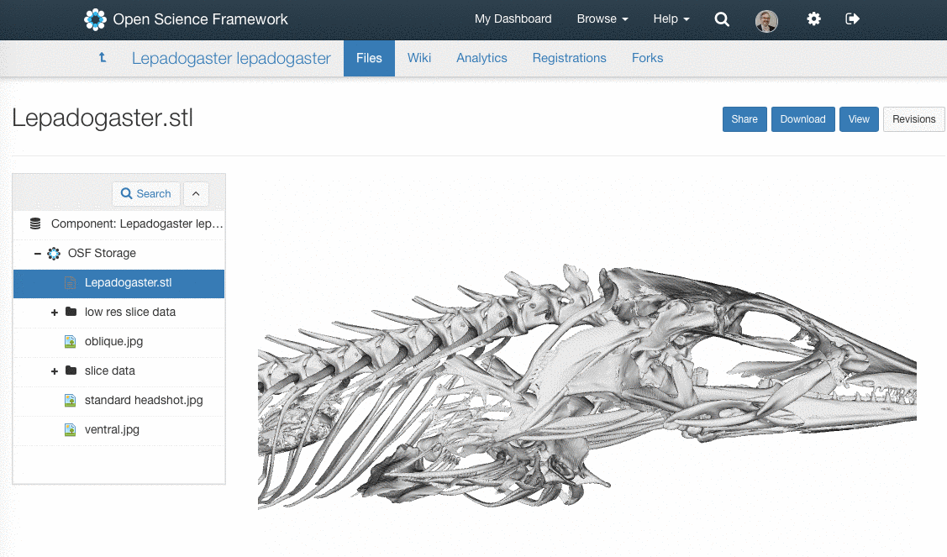
Put data, materials, and code on the OSF
Notes:
quite simply, it is a file repository that allows any sort of file to be stored and many types to be rendered in the browser without any special software. This is very important for increasing accessibility to research.

Slide 13
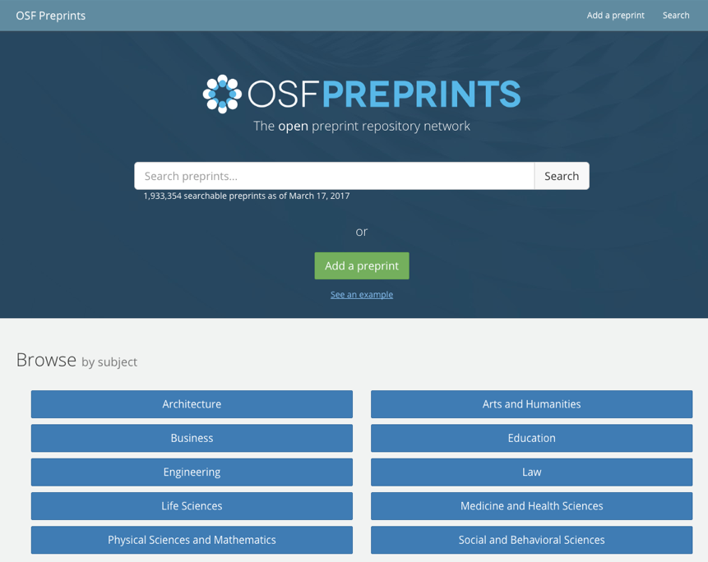
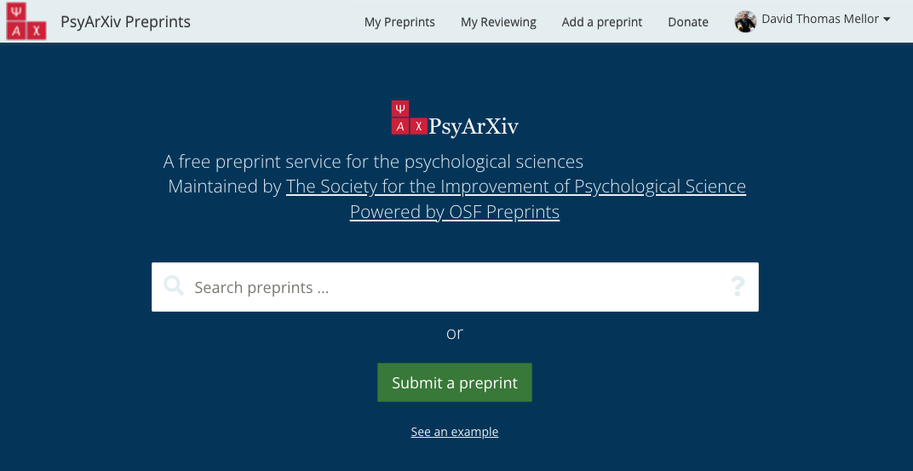

Slide 14

Thank you!
Slides: https://osf.io/5jhvd/
David Mellor
Director of Policy
Center for Open Science
Policy Memo:
https://fas.org/publication/data-sharing-management/
“Nullius in verba” ~ “Take no one’s word for it”

