Slide 1
Yet Another Higher Education Hidden Curriculum: Collaborating with SDAC
May 1st, 2024

Slide 2
S-D-A-C? S-dac?
What is that?
A Brief Introduction

Slide 3
What is SDAC?
Primary resource for students with disabilities.
Works with faculty and other University offices to secure reasonable accommodations that are individualized for each student.

Slide 4
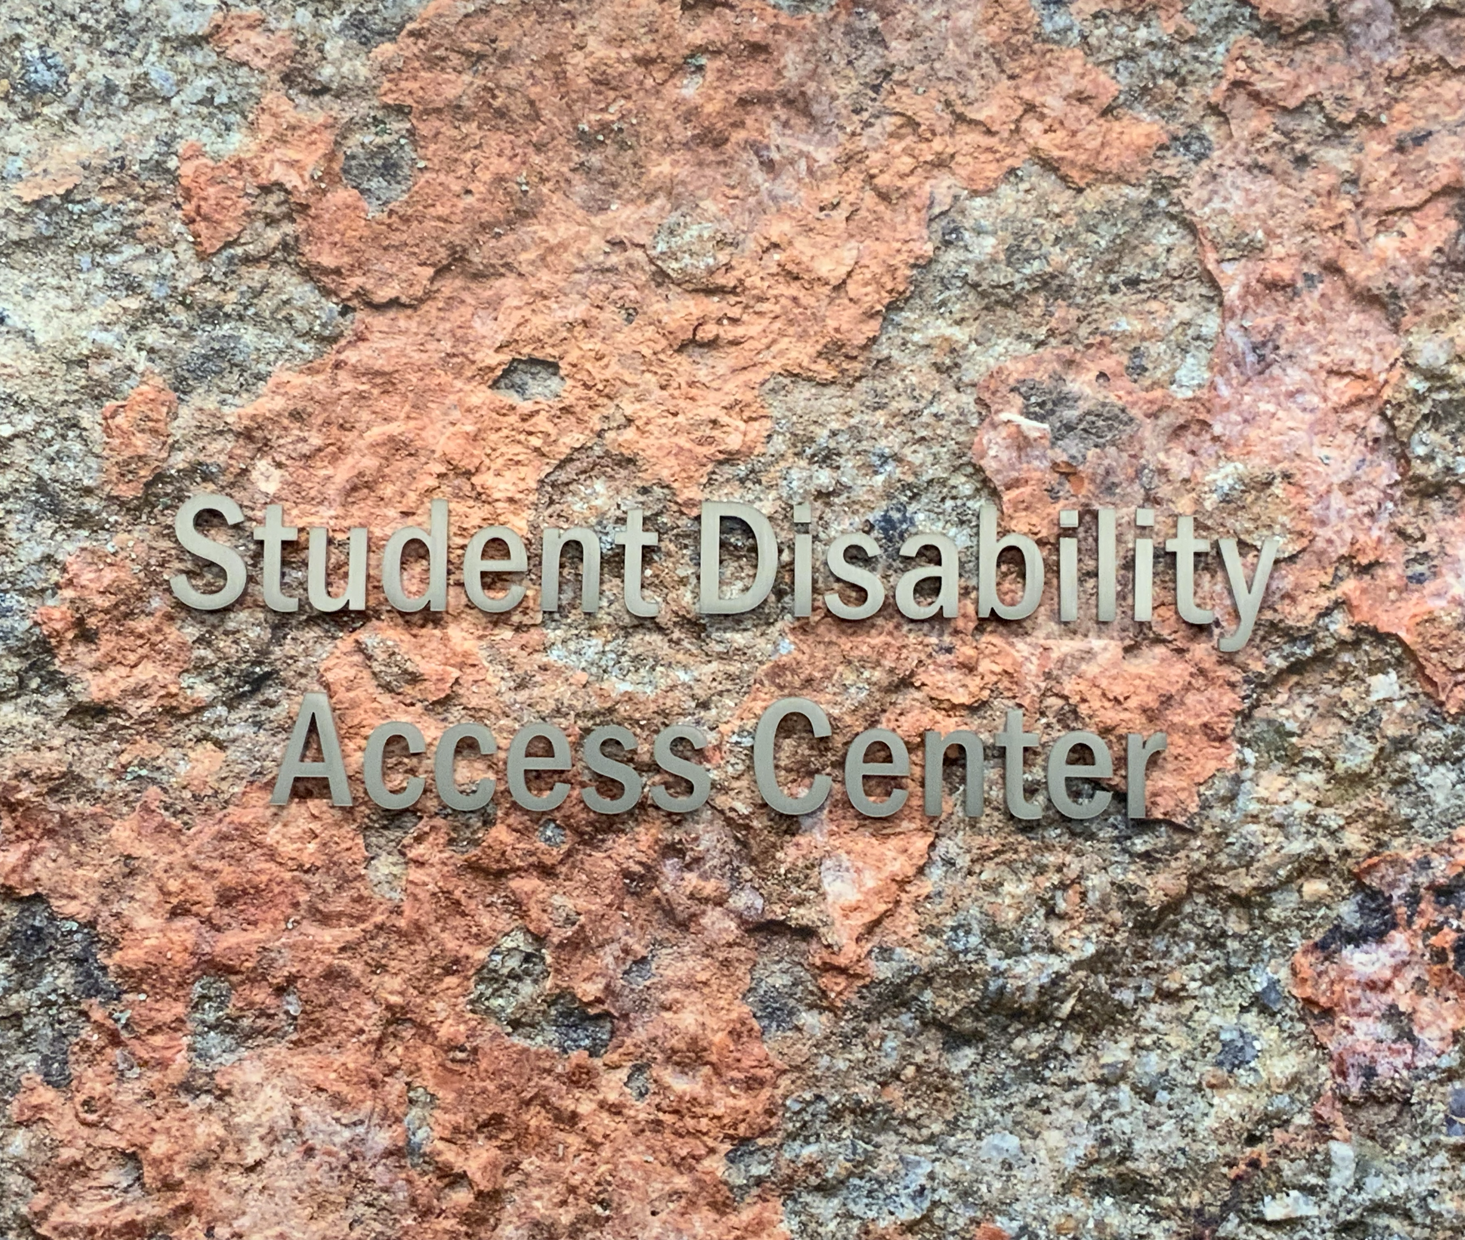
Martina Svyantek
Strategic Initiatives and Assistive Technology Manager

Slide 5

Participant Responses

Slide 6
Student Disability Access Center
SDAC
Academic Accommodations
  Undergraduate
  Graduate
Housing/Dietary Accommodations
Transportation Accommodations
Commencement
Orientation

Slide 7
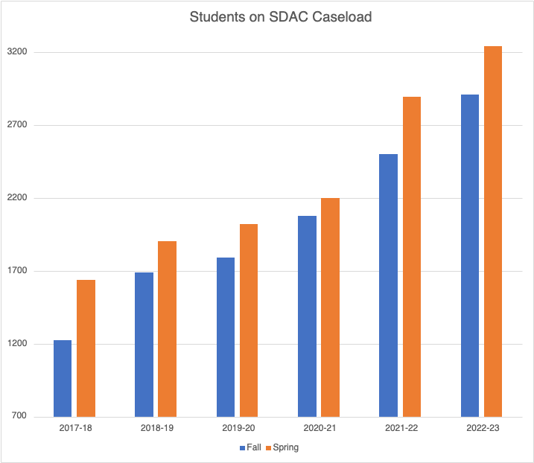
UVA Numbers

Slide 8
Invitation to Collaborate
SDAC: Experts in accommodations
Y’all: Experts in your content and your courses
Together: Supporting students and proactively addressing access issues

Slide 9
Accommodations Process
Intakes, Faculty Notifications, and common Academic Accommodations

Slide 10
Intake Process
Student applies for services
Student application assigned to SDAC Advisor
Advisor reviews: request for additional documentation, set up Intake Meeting
Intake Meeting!
Accommodations discussed and approved
Student requests Letter(s), SDAC Advisor sends
Faculty: Receives Letter

Slide 11
Faculty Notification Letters
Students have to request them, SDAC sends digitally to your UVA email
  Can happen at any point in the semester
  Accommodations ARE NOT retroactive
Can be reviewed in Instructor Portal (NetBadge)
Contain the listing of approved, formal academic accommodations

Slide 12
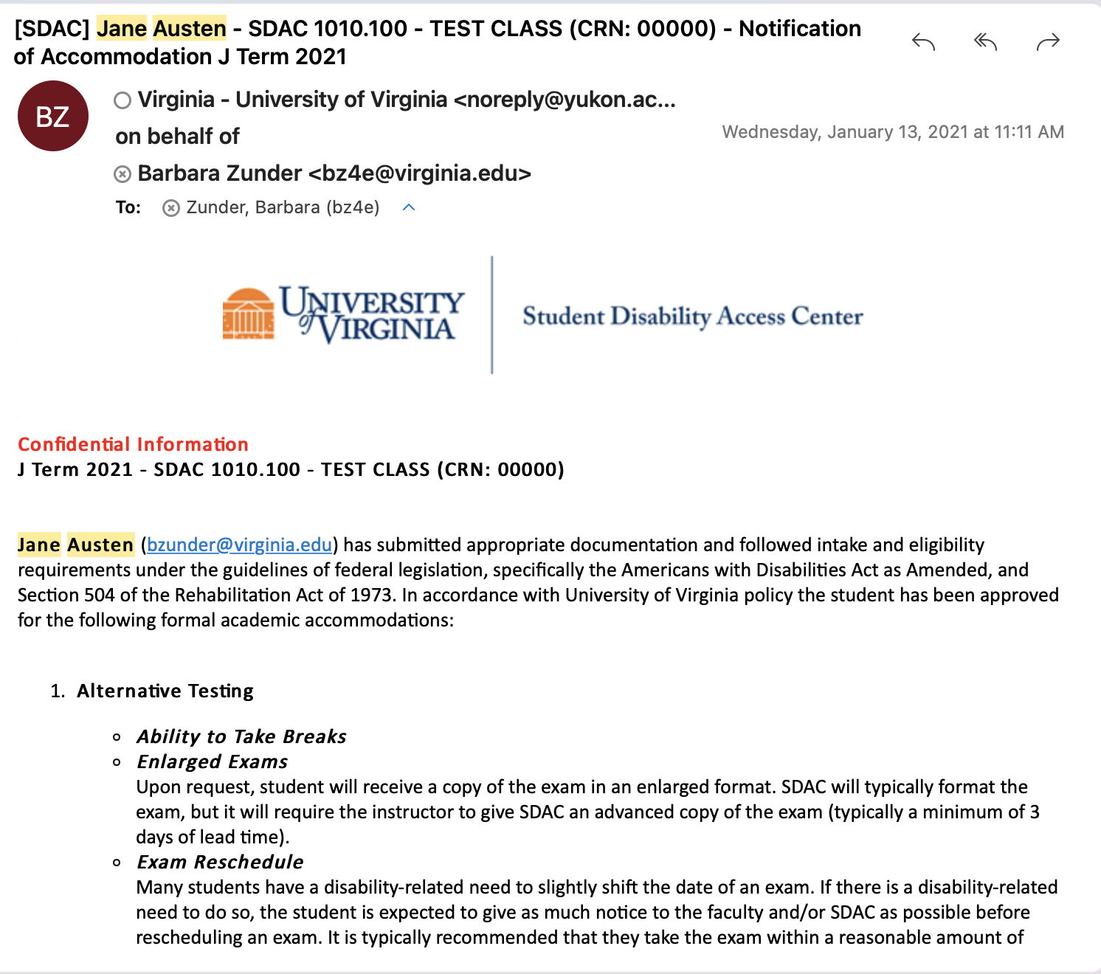
Faculty Notification Letters – Email

Slide 13
Common Academic Accommodations
Alternative Testing
  Extended Time
  Reduced Distraction
  Use of Computer
  Voice Dictation
  Enlarged Print
Notetaking
Classroom Access
  Permission to Record
  Seating
  *Reasonable Modification
    Assignments
    Attendance
Alternative Formats

Slide 14
Crisis Alert!
What to do when:
Implementing accommodations

Slide 15
Finals. And survival.
Testing Accommodations
  Scheduling Deadlines
  Medical Emergencies
Incompletes

Slide 16
Upcoming 2024 Spring Finals
Date | Number of Exams | Number of Classes
May 2 | 156 | 49
May 3 | 223 | 63
May 4 | 222 | 56
May 5* | 51 | 29
May 6 | 262 | 69
May 7 | 162 | 57
May 8* | 28 | 22
May 9 | 206 | 66
May 10 | 126 | 44

Slide 17
Mid-Semester Reactions
Lab Assistant
Reasonable Modification
  Assignment Deadlines
  Attendance/Participation
"Additional Notes"

Slide 18
Reasonable Modification
This IS:
This is NOT:
Limited flexibility
Opportunity for communication
Open to Individualization
Blanket approval
Retroactive
Applicable in all contexts

Slide 19

Proactive Planning
Testing Accommodations
Notetaking/Permission to Record
Seating/Facilities Concerns
Alternative Formats
Captioning/ASL

Slide 20
Classroom Facilities
Building Accessibility (link to UVA listing)
Classroom Access
  Seating
  Stairs
Bathroom Access

Slide 21
Notetaking/Permission to Record
Embed into course structure?
Technology use in classroom?
Unnecessary?
SDAC Notetaking Coordinator: notes@virginia.edu
Notes:
PROV 005 and PROV 008

Slide 22
Submit Proctoring Instructions
Exam Rules
Logistics
Contact Information
Additional Notes
Exam Dates

Slide 23
SDAC
Instructor
Portal
Using it now?
It's getting an update!

Slide 24
Summer 2024 – Updates!
Faculty Portal
  Testing Accommodations
    Students can schedule exams WITHOUT Proctoring Instructions submitted
    We CANNOT proctor those exams without instructions!
    Exam Dates - a new way to communicate with SDAC

Slide 25

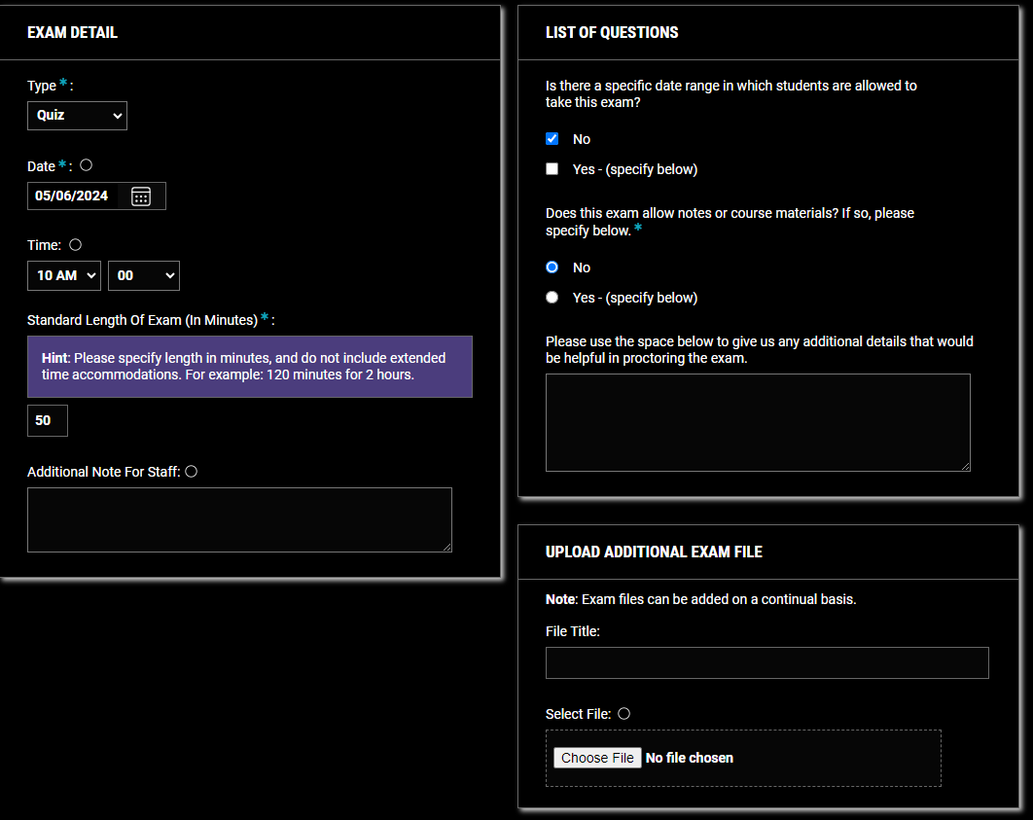
Exam Instructions for
INDIVIDUAL Exams

Slide 26
Questions?
Now, with added answers!

Slide 27
SDAC Consultations
Questions about accommodations that are recommended in the Faculty Notification Letter?
  Call or email SDAC or the direct Advisor immediately for clarification or guidance.
Usually, there is an easy answer or solution to your question.
  Other times, we may need to engage in a “deliberative process.”

Slide 28
Questions from Participants - Virtual

Slide 29
Resources
Let's Stay in Touch!

Slide 30
UVA
Student Disability Access Center
  Instructor Portal
  Email
    sdac@virginia.edu
    sdacAT@virginia.edu

Slide 31
Additional Resources
SDAC
SDAC Procedures and Guidelines for Student Accommodations
HRM-009: Preventing and Addressing Discrimination and Harassment
HRM-010: Preventing and Addressing Retaliation
UVA Office for Equal Opportunity and Civil Rights (EOCR)
UVA Accessibility Resources
Coordinator of Academic Accessibility
UVA Library Media Accessibility Resources.
UVA Collab Help - Video Guide
Sample Course Syllabus Statements
Report A Barrier (Disability)
IRM-008: University Information Technology Accessibility

