Slide 1
Structuring Paragraphs for Readability and Flow
Portions of this workshop are adapted from “Chapter 6: From Sentences to Paragraphs” in Scientific Writing and Communication by Angelika Hofmann (2017) and “Chapter 7: Developing Readable Style” in Writing in Engineering: A Brief Guide by Robert Irish (2015).
This work is CC-BY and use must include full citation & DOI. Individual images, examples, and materials from other sources are not CC-BY. The blue dinosaur icon is a GWL icon and not CC-BY.
Natalie Thompson
Consultant, Graduate Writing Lab
School of Engineering & Applied Science, University of Virginia
gradwritinglab@virginia.edu | bit.ly/SEASGWL
Notes:
Contains images that require alt text, including text-based screenshots.
None of the images, screenshots, or examples may be extracted for other use. CC-BY license does not apply to these components individually.
The dinosaur image is a GWL icon.

Slide 2
Overview
  Principles
    Writing and revising: very different mindsets
    Ways to look at your paragraphs with fresh eyes
    Make it easy for your reader and send them the right signals
  Structure and organization within paragraphs
    Topic sentences, concluding sentences
    One paragraph = one main idea
    Creating consistent structure: logical patterns of organization for supporting details
  How to be coherent and cohesive
    Relationships between sentences
    New and old information
    Usage of key terms
    Transitions
  How to condense and make paragraphs more concise
    What to omit
    How to emphasize what’s important

Slide 3
Principles

Slide 4
CAUTION
CAUTION
CAUTION
CAUTION
CAUTION
CAUTION
CAUTION
CAUTION
  Write first, revise later!
  Almost all of these strategies are for AFTER you have a rough draft
  Don’t let yourself get caught up in creating the perfect paragraph structure, or even section structure, when you’re trying to JUST WRITE!
  Get all your ideas out, in whatever way you can, and then come back later (after a coffee break! after a week!) to work on organizing and refining them.
Notes:
And part of the revision & writing process is getting FEEDBACK from helpful readers at different stages.
Plan for extra time to complete these cycles of draft, revision, feedback, revision, rewriting…add in this time to your writing plan. It may take longer than you expect—most authors go through many, many drafts to get to a finished product!
Also, you might have to adapt your process or your criteria for good paragraphs depending on the type of document, section, and audience!

Slide 5

Picture Your Imaginary Reader
A stressed grad student? A busy postdoc?
Reading fast, looking for essential information
Skimming headers and first sentences to find something that will apply to their own research
Think about how you read when you’re trying to do a literature review or a proposal
Micro Biz Mag: www.microbizmag.co.uk/burnout-statistics-uk/
Notes:
Image: A photograph depicting occupational burnout. Photo was created by Micro Biz Mag for use in a post on the topic of burnout and is now under Creative Commons Licensing with a request that any usage is attributed with a link to the source at: www.microbizmag.co.uk/burnout-statistics-uk/

Slide 6
Micro Biz Mag: www.microbizmag.co.uk/burnout-statistics-uk/
Remind yourself about THIS GUY!
When in doubt: make it clearer, easier to find the important stuff, and more explicit!
Notes:
Image: A photograph depicting occupational burnout. Photo was created by Micro Biz Mag for use in a post on the topic of burnout and is now under Creative Commons Licensing with a request that any usage is attributed with a link to the source at: www.microbizmag.co.uk/burnout-statistics-uk/

Slide 7
What do we need from a good paragraph?
Your reader should easily and immediately know:
What’s the takeaway message of the paragraph?
What information is most important?
What information is new?
How do these sentences (ideas) connect to each other?
What’s the relationship between these key terms?
Are you referring to the same thing you were talking about earlier? Or a new thing?

Slide 8
Common Paragraph Troubles
Too many ideas in one paragraph
Lack of “signposting” and signaling to readers
Readers are led to expect a pattern that isn’t followed
Unclear why this information is here—how does it relate to your main point?
Hard to find the most important point
Paragraph just ends abruptly with a minor detail—no concluding wrap-up to show importance
Paragraph begins with a sentence that really belongs in the previous paragraph, or is an empty transition that doesn’t announce the new paragraph’s topic

Slide 9
Tips and Tricks for Revising Your Own Writing
How do I see my own writing with fresh eyes, deconstruct its structure, and evaluate my paragraphs?
Read aloud
Post-draft Outline / Reverse Outline
  Texas A&M's University Writing Center: short video: https://www.youtube.com/watch?v=ica27SMkE6c
  Paragraph re-planning: https://medium.com/advice-and-help-in-authoring-a-phd-or-non-fiction/what-is-paragraph-re-planning-c9a7e694d4ec
Cut It Up
First and Last Sentences

Slide 10
Structure

Slide 11
What is a Paragraph?
“A paragraph is a group of sentences on a single topic.”
—Scientific Writing and Communication,
Angelika Hofmann (95)

Slide 12
Principles
Remember:
one paragraph = one main idea
Use “power positions” in each paragraph to clarify the main idea/key takeaway.
TOPIC SENTENCE
CONCLUDING SENTENCE
Notes:
Image: Depiction of a paragraph as a box with lines for sentences. Arrows point to the top (topic sentence) and the bottom (concluding sentence).

Slide 13
Principles
1
Be kind and make things easy for your reader. Don’t assume your reader will be able to follow your thoughts, even if they’re an expert in your field.
2
3
So: make sure to add structure so we can see when you’re changing ideas. And signal your transitions for your reader!
“With the advancement of data-acquisition systems, information technology (IT), and network technologies, manufacturing has entered the digital age.”
“The purpose of type reasoning on knowledge maps is to learn the relationship between instances and concepts in a knowledge map.”
“The quintuple cybersecurity knowledge base model [2] proposed in this paper contains the following five elements: concept, instance, relation, properties, and rule.”
Tao et al. (2019)
Jia et al. (2018)
Jia et al. (2018)
For example, use TOPIC SENTENCES to announce a paragraph’s purpose!
Notes:
Note the various ways you could create a topic sentence; three examples here
Image of a series of papers meant to symbolize structured writing
Images with the three topic sentences: “With the advancement of data-acquisition systems, information technology (IT), and network technologies, manufacturing has entered the digital age.” “The purpose of type reasoning on knowledge maps is to learn the relationship between instances and concepts in a knowledge map.” & “The quintuple cybersecurity knowledge base model [2] proposed in this paper contains the following five elements: concept, instance, relation, properties, and rule.”

Slide 14
Topic Sentences or “Setup”
Provides an overview of the paragraph
Tells the reader what to expect
Signals genre, section, audience, purpose
Each sentence in the paragraph clearly relates to this main idea
Often the first sentence of a paragraph

Slide 15

Principles
Signal which information is most important and which is subordinate.
Notes:
Use placement within the paragraph, relation to other sentences, and explicit signposting to do so
Image: depiction of a paragraph

Slide 16
Principles
Realize how your structure and the order of information sets up your reader’s expectations for where you’re going—don’t set up signals (a pattern of information, an explicit signposting sentence) and then go in a different direction.
Impose a fitting and logical pattern of organization on the details and subordinate information you include.
Big Picture
Details
Problem
Possible Solutions

Slide 17
The Middle: Pattern of Organization
Decide on the controlling logic (rhetorical pattern) for the order in which sentences appear:
Most to least important?
Least to most important?
Cause and effect?
Chronological?
Compare and contrast?
Problem and solution?

Slide 18
Another Arrangement
Volatile organic compounds (VOCs) are released from many manmade and natural sources. Manmade sources range from cars and industrial sources to construction materials, heaters, and other consumer products. Natural sources responsible for biogenic VOC emissions include mainly trees as well as fungi and microorganisms. The exact distribution of manmade versus natural sources of VOCs has not been determined, but clearly depends on locale and environment.
[manmade, then natural]
TS
CS
Hofmann, p. 96
Notes:
From Hofmann, Scientific Writing and Communication

Slide 19
Concluding Sentences: Not Transitions
DON’T make your final sentence a “transition sentence” to the next paragraph or topic
“It is always better to use the first sentence of a paragraph to make transition links than to do it at the end of a paragraph.” (Irish p. 159)
Notes:
Irish, Writing in Engineering: A Brief Guide

Slide 20
Concluding Sentences
A concluding sentence should…
conclude:
summarize, draw a conclusion, emphasize an important take-away

Slide 21
Detangle Topic/Concluding Sentences to Improve Clarity
This first sentence seems a bit complicated to me—it’s trying to do too much.
It seems like the PREVIOUS paragraph was all about how other efforts were unsuccessful. Could we move that part of the sentence to the previous paragraph as a concluding sentence?
Then we can start this paragraph by getting right to its main point—that MSC therapy has limitless self-renewal capacity and is multipotent, so it should be investigated.
Because efforts to control lung injury via pharmacological agents have been unsuccessful, mesenchymal stem cell (MSC)-based therapy is being investigated, based on MSC’s limitless self-renewal and multipotency. Furthermore, MSC-based therapies demonstrated promising effects in the experimental treatment of ARDS via inhibition of alveolar collapse, collagen accumulation, and cell apoptosis in lung tissue. Recently, Wilson et al. [31] found that administrating allogeneic MSCs in nine patients with ARDS resulted in no pre-specified adverse events, including hypoxaemia, cardiac arrhythmia, and ventricular tachycardia. Menstrual-bloodderived MSCs are currently attracting interest due to source potential, a high proliferation rate, and a painless procedure that is free of ethical issues [32–34].
From Chen et al. (2020)
Notes:
On the other hand, sometimes you can tell that the true conclusion sentence of one paragraph has been put at the beginning of the next paragraph.
This sentence is probably necessary to wrap up the previous paragraph!
If we really wanted to have a transition sentence here, before the topic sentence of the new paragraph, it should still emphasize what’s coming NEXT (i.e. “A promising new method that solves some of these problems is MSC therapy…”)

Slide 22
Principles
Show how your ideas relate to each other; create cohesion and flow between sentences.
Use word choice and your key terms with precision and consistency—these send signals and help your reader stay on track.
THEREFORE
Although…
However,
BECAUSE
MODEL
MODEL
MODEL
Simulation
Notes:
If you change the word you use to refer to something—like substituting “simulation” when before you were using “model”—your reader will pull up short, get confused, and wonder if you mean a different thing because you used a different term. This is especially important for complicated, key terms your research introduces.
Image: Transition words “although,” “therefore,” “because” arranged with arrows to indicate connection and flow.
Image: Three diamonds with the word “model” followed by a spazzy shape with the word “simulation.”

Slide 23
Cohesion

Slide 24
Cohesion
Parallel structure: lets the reader know what to expect
Familiar/known information first, then new information
Word location across sentences: shows relationships and allows easy flow
Key terms: create continuity
Transitions
Notes:
See Dr. Nathan Sheffield’s “Clarity: Strategies for Revising Scientific Writing” Presentation (find listed in Resources on GWL site and at http://databio.org/slides/scientific_writing.html#/)

Slide 25
Parallelism: Keep Your Pattern Consistent
If you list topics and then expand on each one, talk about each of them in the same order they were introduced, every time.
Keep your main topic as the focus of your sentences, grammatically as well as thematically.

Slide 26
Parallelism: Topic Order
In response to a foreign macromolecule, five different immunoglobulins can be synthesized: IgG, IgM, IgA, IgE, or IgD. IgG is the main immunoglobulin in serum. IgM is the first class to appear following exposure to an antigen. IgA…
Hofmann p. 97
Hofmann p. 97
Notes:
*Think especially about your methods & results sections…keep the same order each time you mention a sample, condition, test, etc.
From Scientific Writing and Communication

Slide 27
Parallelism and Sentences
To signal the main topic in a paragraph, use the key term as the subject of your sentence.
(Don’t hide the key term or de-emphasize it.)
[Subject + Verb + Object]

Slide 28
Parallelism: keep your subject consistent
These findings suggest that patients returning from tropical countries who show very itchy linear or serpiginous tracked skin eruptions should be tested for larvae of animal hookworms.
Topical ointments with an antiparasitic drug such as thiabendazole should be used to treat patients with this disease, known as cutaneous larva migrans.
These patients often also suffer from complications of the disease such as impetigo and allergic reactions (Heukelbach and Feldmeier, 2008).
S = patients returning from tropical countries
S = Topical ointments
S = These patients
Heukelbach and Feldmeier (2008), example adapted from Hofmann p. 98
Patients with this disease, known as cutaneous larva migrans, should be treated with an antiparasitic drug such as thiabendazole.
Notes:
Example from Scientific Writing and Communication, p. 98, original source:
Heukelbach, J., and Feldmeier, H. 2008. The Lancet infectious diseases, 8(5), 302-209.

Slide 29
Move from Familiar to New Info Within & Across Sentences
Old/familiar info at beginning of sentence
New info at end of sentence
Familiar X………………….new XY. XY…………………….new Z. Takeaway about Z.
Notes:
See Dr. Nathan Sheffield’s “Clarity: Strategies for Revising Scientific Writing” Presentation (find listed in Resources on GWL site and at http://databio.org/slides/scientific_writing.html#/)

Slide 30
Example Paragraph
Analysts are able to use more sophisticated shape metrics to describe objects. For instance, the shape proportion and encircled image-histogram (SPEI) algorithm produces two metrics: shape proportion (SP) and encircled image-histogram (EI). The SPEI algorithm essentially puts the object in the minimally encompassing circle. Next, the object is then placed inside the minimal encompassing square. Visual representations of the SPEI algorithm are provided in Figure X. The SP is the proportion of area of the object divided by the area of the square found by SPEI. The EI is the area of the object and the area of the square found by SPEI minus the area of the object.
Example adapted from the work of Billy F. Lamberti, PhD.
Notes:
Example adapted from the work of Billy F. Lamberti, PhD. See https://www.billyflamberti.com/

Slide 31
Example Paragraph
Example adapted from the work of Billy F. Lamberti, PhD.
1
2
3
4
5
6
7
Analysts are able to use more sophisticated shape metrics to describe objects.
For instance, the shape proportion and encircled image-histogram (SPEI) algorithm produces two metrics: shape proportion (SP) and encircled image-histogram (EI).
The SPEI algorithm essentially puts the object in the minimally encompassing circle.
Next, the object is then placed inside the minimal encompassing square.
Visual representations of the SPEI algorithm are provided in Figure X.
The SP is the proportion of area of the object divided by the area of the square found by SPEI.
The EI is the area of the object and the area of the square found by SPEI minus the area of the object.
Notes:
Example adapted from the work of Billy F. Lamberti, PhD. See https://www.billyflamberti.com/

Slide 32
Known Info vs. New Info?
Analysts are able to use more sophisticated shape metrics to describe objects. For instance, the shape proportion and encircled image-histogram (SPEI) algorithm produces two metrics: shape proportion (SP) and encircled image-histogram (EI).
The SPEI algorithm essentially puts the object in the minimally encompassing circle. Next, the object is then placed inside the minimal encompassing square. Visual representations of the SPEI algorithm are provided in Figure X.
The SP is the proportion of area of the object divided by the area of the square found by SPEI. The EI is the area of the object and the area of the square found by SPEI minus the area of the object.
(known) shape metrics → (new) SPEI algorithm → (new) SP & (new) EI → (known) SPEI.
Known A → New B. New C→ Known B. Known C.
Example adapted from the work of Billy F. Lamberti, PhD.
Notes:
Example adapted from the work of Billy F. Lamberti, PhD. See https://www.billyflamberti.com/

Slide 33
Example Paragraph
Example adapted from the work of Billy F. Lamberti, PhD.
Analysts are able to use more sophisticated shape metrics to describe objects. For instance, the shape proportion and encircled image-histogram (SPEI) algorithm produces two metrics: shape proportion (SP) and encircled image-histogram (EI).
To move from known information to new information smoothly, and not jump back and forth, we could rearrange the first two sentences.
To more accurately describe objects, analysts are able to use more sophisticated shape metrics such as shape proportion (SP) and encircled image-histogram (EI). These metrics are found using the shape proportion and encircled image-histogram (SPEI) algorithm…
Sentence 1: shape metrics → specific metrics SP & EI.
Sentence 2: These metrics (SP & EI) → algorithm.
Notes:
An even better revision might be to also add the definitions of SP & EI (currently the last two sentences) in between our two new sentences, so we define them right after they’re introduced.
Example adapted from the work of Billy F. Lamberti, PhD. See https://www.billyflamberti.com/

Slide 34
Word Location
Create “flow” and cohesion between sentences by putting similar words and ideas close together

Slide 35
Word Location
Yersinia contains several species. The cause of bubonic plague, also known as the “black death,” is one species, Y. pestis.
Yersinia contains several species. One species, Y. pestis, is the cause of bubonic plague, also known as the “black death.”
Hofmann p. 99
Notes:
Hofmann, Scientific Writing and Communication

Slide 36
Word Location
Important pathogens can be found in the genus Yersinia. Yersinia contains several species. One species, Y. pestis, is the cause of bubonic plague. The plague bacillus infects lymph nodes near the site of infection to produce buboes.
Hofmann p. 99
Notes:
Hofmann, Scientific Writing and Communication

Slide 37
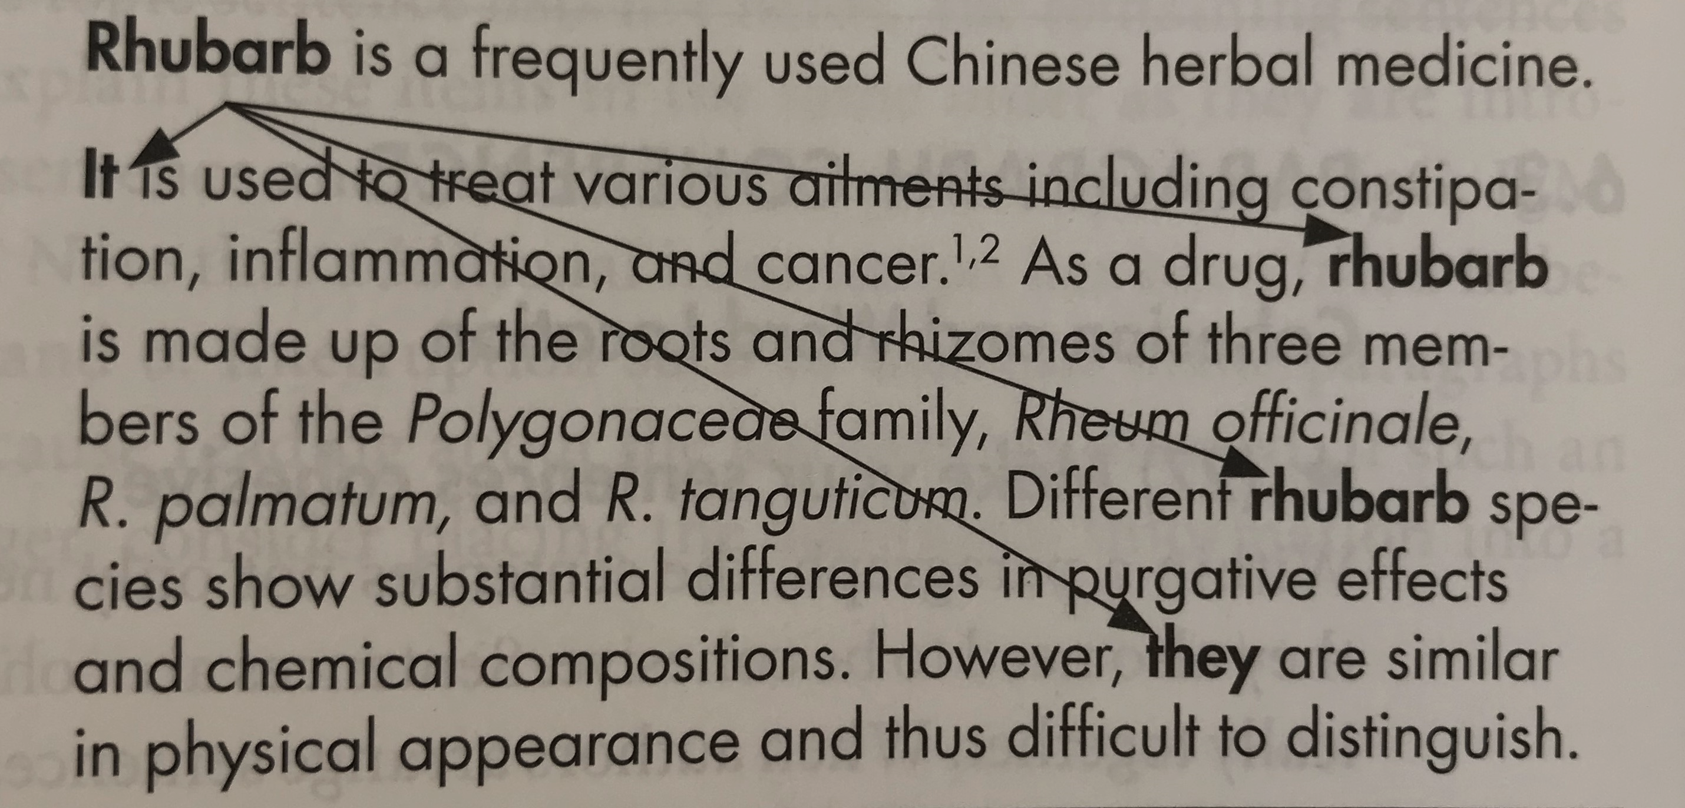
Word Location
Hofmann p. 100
Notes:
Image of a paragraph where “Rhubarb” is the first word of the first sentence, with neat and orderly arrows drawn between this first occurrence of the word and subsequent repetitions of “rhubarb,” “it,” “rhubarb species,” and “they” (referring to rhubarb species). The connecting lines don’t look messy.
Hofmann, Scientific Writing and Communication

Slide 38
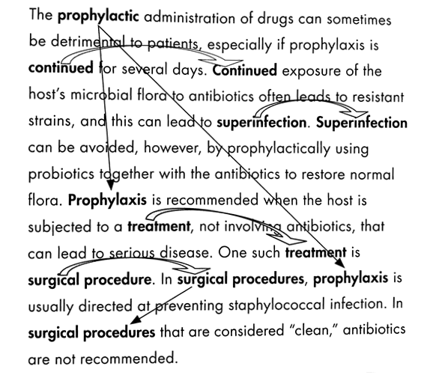
Word Location
Hofmann p. 100
Notes:
Image of a paragraph that begins with the subject “the prophylactic administration of drugs” with lines to indicate an orderly connection to subsequent mentions of “prophylaxis” and “one such treatment.” Curved arrows also show the closeness of words at the end of one sentence and the beginning of the next. The arrows don’t look messy or tangled.
Hofmann, Scientific Writing and Communication

Slide 39
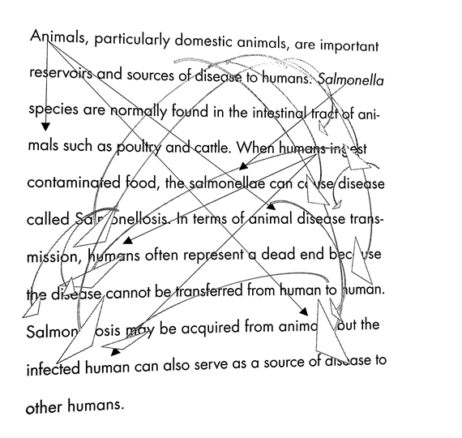
Word Location
Hofmann p. 101
Notes:
Image of a paragraph with a network of connecting lines to showing where the same or similar words appear. The knot of arrows appears messy.
Hofmann, Scientific Writing and Communication

Slide 40
Cohesion & Passive Voice
Most scientific writers strongly prefer active voice instead of passive voice, to convey ideas clearly and directly. However, sometimes using passive voice may allow you to follow some of our other rules, like putting new information at the end of a sentence, or keeping repeated words physically close together.
“We performed a complex and daunting meta-analysis. This meta-analysis was completed using a number of techniques…”

Slide 41
Key Terms
To assess original conditions of crystal nucleation and growth in metamorphic rocks, it is necessary to analyze crystal distribution quantitatively. Density could potentially provide insight into the time scale of mineral growth following the thermal peak of metamorphism.
To assess original conditions of crystal nucleation and growth in metamorphic rocks, it is necessary to analyze crystal distribution quantitatively. Crystal distribution could potentially provide insight into the time scale of mineral growth following the thermal peak of metamorphism.
Hofmann p. 103-4
Notes:
If “crystal distribution” is really the best, most accurate and precise term for what you’re talking about, then use that term. If you substitute a more general term like “density” just for variety, your reader will wonder if there’s a difference, or if you’re using the term in a different way than they’ve heard before.
Hofmann, Scientific Writing and Communication

Slide 42
Key Terms
Repeat them exactly and early
Don’t substitute with another term
Link related key terms when you shift focus or scale
“thesaurusitis” is bad
Notes:
And, of course, explicitly define new terms when you introduce them, especially if you have any doubt whether your audience will know the term—or whether they will automatically know the precise way it’s defined in this context.

Slide 43
Examples
Unpowered turns would rely on banking. Banking was required to generate the centripetal force to produce a curved trajectory. Banking is a rolling maneuver that provides a greater projected area facing the axis of the turn (Fish et al., 2003, 2012; Parson et al., 2011). Fish 2018
Scenario discovery is a data mining algorithm used to search the results of the impact assessment for all cases and identify decision-relevant clusters (Bryant and Lempert, 2010). These clusters are a subspace of the total input uncertainty space and are achieved by constraining one or more of the input uncertainties. The clusters contain a high proportion of ‘interesting cases’, which get flagged when impacts to the AAPE and AAD metrics are assessed as tolerable. Ramm 2018
Notes:
What are the key terms here? How are they used? How does word location and term usage within and across sentences create or impede clarity?

Slide 44
Example Paragraph
Nonetheless, nanofluidics has never attracted as much attention as it does now, owing to advances in nanofabrication, which give a boost to the recent growth of nanofluidics. The increased availability of nanofabrication methods over the past two decades allows the fabrication of well-defined nanofluidic geometries such as nanochannels and nanopores to form novel nanofluidic devices. Such devices, usually solid-state, planar, and transparent, are compatible with some available tools used in chemistry, physics, biology, and engineering.
Xu (2018)
Notes:
Note the progression from nanofluidics to nanofabrication, to nanofluidic devices, to “such devices”
Could we omit the crossed-out portion of the first sentence to promote clarity and avoid redundancy?

Slide 45
Key Terms and Shell Nouns
Link your key terms when you shift scale or introduce a new term:
Infectious diseases that arise due to travel may be caused by gram-positive organisms. One such organism, Staphylococcus aureus, can cause cellulitis, purulent arthritis, and suppurative lymphadentis.
Hofmann p. 103-4
Notes:
Hofmann, Scientific Writing and Communication

Slide 46
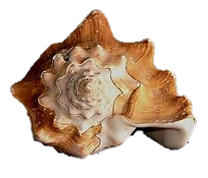
Shell Nouns
A shell noun is an abstract noun that, in a particular context, conveys or refers to a complex idea.
Shell nouns help you find elegant ways to vary your sentence structure and use of key words so your sentences don’t seem repetitive, and you don’t have to use weird non-synonyms
Some examples of shell nouns: fact, problem, idea, aim
That thing that I just mentioned…
Shell nouns: see https://www.thoughtco.com/shell-noun-definition-4105165
Notes:
Image: A conch shell with a speech bubble saying “That thing I just mentioned…”

Slide 47
Example
To more accurately describe objects, analysts are able to use more sophisticated shape metrics such as shape proportion (SP) and encircled image-histogram (EI). These metrics are found using the shape proportion and encircled image-histogram (SPEI) algorithm…
Example adapted from the work of Billy F. Lamberti, PhD.
Notes:
Example adapted from the work of Billy F. Lamberti, PhD. See https://www.billyflamberti.com/

Slide 48
Transitions
Transition words, phrases, and sentences show the logical relationship between sentences and ideas
Transition words create continuity especially when placed at the beginning of a sentence

Slide 49
Transitions: Specify the Relationship
To determine the effects of solid-solution ratio on K12 adsorption at fixed pH 7, K12 adsorption isotherm experiments were conducted. _____ Aqueous carbonate concentrations were measured.
What is the relationship between the two sentences?
In addition
For this purpose
First
Subsequently
From Hofmann, Chapter 6 Exercises, p. 104
Notes:
Hofmann, Scientific Writing and Communication

Slide 50
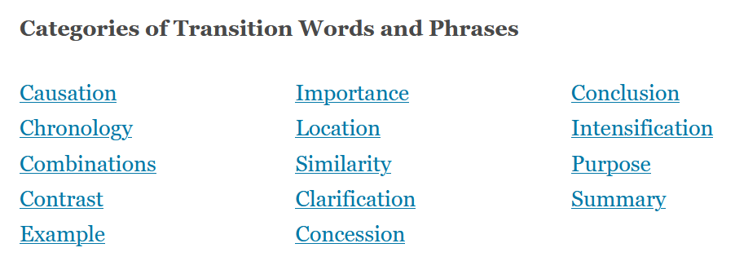
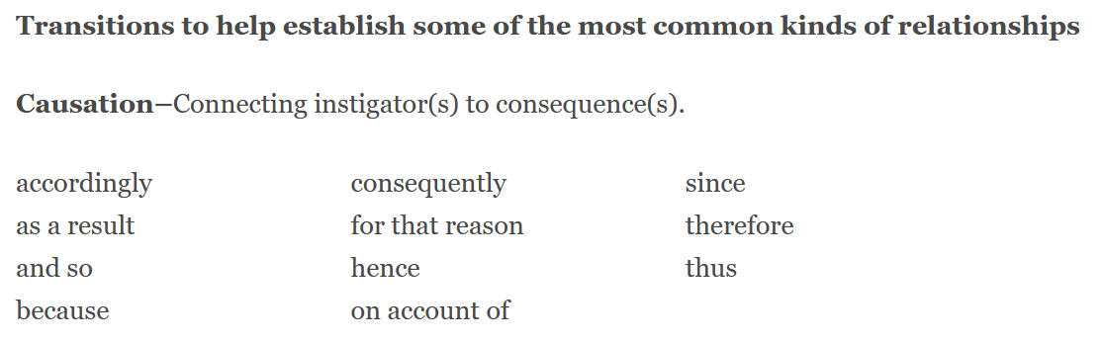

Transitions: Choosing the Relationship
For more on transitions and tips on how to choose the right word, see online resources with lists of words based on relationship:
https://writing.wisc.edu/handbook/style/transitions/
Notes:
https://writing.wisc.edu/handbook/style/transitions/

Slide 51
Transitions: Tone & Context
Some transition words are appropriate for speaking aloud or for casual situations, but not for scientific writing. Some are old-fashioned and no longer in use.
Casual/conversational:
besides, additionally, as a matter of fact, suddenly, admittedly, basically, ergo, at once
Outdated:
hitherto, aforementioned, henceforth, notwithstanding
firstly, secondly, lastly (just say first, second, last)

Slide 52
Corpus Software
AntConc: build your own corpus (group) of pieces of writing to search within
Search your own writing for articles, key terms, etc.
Search journal articles in your field for common phrases, check for spellings, determine usage
Use a pre-built corpus like Corpus of Contemporary American English (COCA): https://www.english-corpora.org/coca/ to check term usage, frequency, context
Check your writing and check a corpus of writing in your discipline

Slide 53
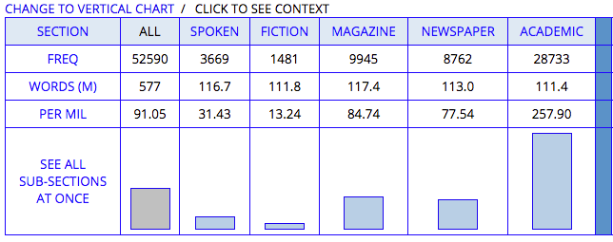
Example: COCA search “in addition”
Notes:
Table for usage of “In addition” in the COCA corpus.
Columns: All, Spoken, Fiction, Magazine, Newspaper, Academic
Rows: Frequency, Words (M), Per Mil, See All Sub-Sections at Once
Frequency of usage in Academic context is 28733, versus 3669 in spoken English and 1481 in fiction.

Slide 54
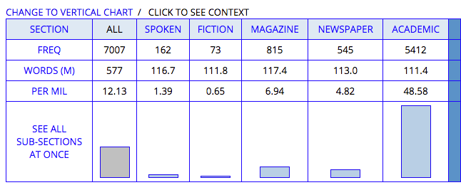
Example: COCA search “additionally”
Notes:
Table for usage of “Additionally” in the COCA corpus.
Columns: All, Spoken, Fiction, Magazine, Newspaper, Academic
Rows: Frequency, Words (M), Per Mil, See All Sub-Sections at Once
Frequency of usage in Academic context is 5412, versus 162 in spoken English and 73 in fiction.

Slide 55
“In addition” > “Additionally”
“In addition”
“Additionally”
Notes:
Comparison of stats from previous two slides
Portions of table for Academic usage
“In addition” Frequency is 28733
“Additionally” Frequency is 5412

Slide 56
Condensing
Notes:
OK—realize, when we’re thinking about what we can cut, it’s the flip side of most of what we’ve been saying so far. If you try to add a transition word or “controlling”/previewing sentence and it’s not specific enough or exactly appropriate, it can turn into one of these unnecessary things we should cut.

Slide 57
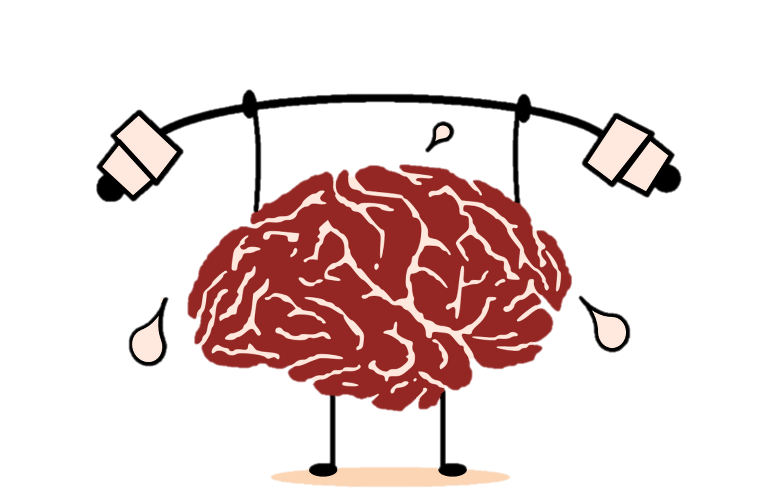
Be Concise
You might be under pressure to reduce your word count to fit a CFP or for publication…
But streamlining, cutting unnecessary words and ideas, and condensing your language is always an important way to improve clarity.
It should be noted that…
This certainly might prove…
Not unimportant
Notwithstanding
Notes:
Image: A cartoon brain lifting weights and sweating cutely, with empty phrases like “not unimportant,” “notwithstanding,” “it should be noted that…” and “this certainly might prove…” on top of the dumbbell.
*CFP = call for papers

Slide 58
How can your reader tell which information is important?
Place it in a “power position”
Use signaling phrases like “Most important…” or “The key finding…”
De-emphasize less important information (“Although…” and “While…”
See Hofmann p. 108
Notes:
Hofmann, Scientific Writing and Communication

Slide 59
What can we cut?
Master List
Excessive detail
Unnecessary redundancies
Jargon
Unnecessary “overview” words
Empty phrases
  “It…that” phrases
Negative expressions
Intensifiers and hedges
Notes:
OK—realize, when we’re thinking about what we can cut, it’s the flip side of most of what we’ve been saying so far when we’re saying transition words are helpful for clarity. If you try to add a transition word or “controlling”/previewing sentence and it’s not specific enough or exactly appropriate, it can turn into one of these unnecessary things we should cut.

Slide 60
Omit Excessive Detail
Find the right level of detail for the section, context, and audience
Notes:
Obviously—finding the right level is difficult. Not too much detail, but don’t leave it too vague!

Slide 61
“Overview” Words: Verbs to Omit
Just state the facts.
Jones et al. reported that intracellular calcium is released when adipocytes are stimulated with insulin.
[15 words]
Intracellular calcium is released when adipocytes are stimulated with insulin (Jones et al., 1996).
[10 words]
Jones (1996), adapted in Hofmann p. 109
described
noticed
noted
observed
was done
occurred
reported
seen
Notes:
This might be an example of a failed attempt at clarification
Example from Hofmann, Scientific Writing and Communication, p. 109, original source: Jones, B. H. et al. 1996. Am. J. Physiol. 270, E192-E196.

Slide 62
Empty Phrases
Products were verified by gel electrophoresis. The results are presented in Figure 1. [13 words]
Products were verified by gel electrophoresis (Fig. 1). [6 words]
To assess the purity of the gene product, many techniques were employed. [12 words]
To assess the purity of the gene product, many techniques were employed. [0 words]
Hofmann p. 109-110
Notes:
Hofmann, Scientific Writing and Communication

Slide 63
Empty Phrases
In regard to…
As far as X is concerned…
The experiment was done by…
Figure 6 shows that…
Notes:
These are probably failed attempts at previewing/signaling

Slide 64
“It…that” phrases are often empty fillers
It is interesting to note that…
In light of the fact that… (replace with “because”)
It is possible that… (reword as”may,” “perhaps,” “possibly”
It has been reported that…
Hofmann p. 110
Notes:
Hofmann, Scientific Writing and Communication

Slide 65
Concision Practice
Importantly, it should be noted that we do not train topic models and then perform link prediction, but rather we define a joint objective such that we discover topics that are informative for our link prediction task.
McAuley (2015)

Slide 66
Negative vs. Positive Expressions
Do not overlook Not different Not infrequently Not many Not the same Not unimportant | Note Similar Frequently Few Different Important
 | Hofmann p. 110
Notes:
Hofmann, Scientific Writing and Communication

Slide 67
Don’t Overuse Intensifiers
Always
Basic
Central
Certainly
Clearly
Crucial
Prove
Quite
Show
Very
Hofmann p. 110
Adjectives, adverbs, or verbs that are used to strengthen verbs or nouns
Notes:
Again—you could misuse these when you’re trying to do what we said (indicate importance, signal hierarchy)
Hofmann, Scientific Writing and Communication

Slide 68
Don’t Overuse Hedges
Actually
Appear
Could
Essentially
Indicate
Many
May
Most
Often
Perhaps
Possibly
Seem
Some
Suggest
Usually
Hofmann p. 110
Cautious adjectives, adverbs, or verbs
Notes:
Hofmann, Scientific Writing and Communication

Slide 69
Hedges and Intensifiers: Use Judiciously
Our results may indicate that chewing gum possibly reduces caries incidence.
Our results suggest that chewing gum reduces caries incidence.
Chewing gum may reduce caries incidence.
Figure 5 “clearly shows” vs. “shows”
Hofmann p. 111
Notes:
Hofmann, Scientific Writing and Communication

Slide 70
Useful Transitions vs. Empty Phrases
“It is interesting to note that…”
  This phrase doesn’t help your reader much, and doesn’t convey any information.
However…
  This transition word is very helpful in showing the relationship with the idea in the previous sentence
“Clearly, X is true…”
  Perhaps unnecessary: this intensifier might help to clarify and emphasize an important point, but often might be an extra word you don’t need
Notes:
This is confusing: it’s good to add certain kinds of signaling phrases, but other phrases are “empty” and don’t help to signal anything

Slide 71
Final Tip for Cutting
When you need to reduce words to fit a word count requirement:
Cut one word from each sentence
Then cut one sentence from each paragraph
Then cut one paragraph from each section

Slide 72
Principles Refresher

Slide 73
CAUTION
CAUTION
CAUTION
CAUTION
CAUTION
CAUTION
CAUTION
CAUTION
  Write first, revise later!
  Almost all of these strategies are for AFTER you have a rough draft
  Don’t let yourself get caught up in creating the perfect paragraph structure, or even section structure, when you’re trying to JUST WRITE!
  Get all your ideas out, in whatever way you can, and then come back later (after a coffee break! after a week!) to work on organizing and refining them.

Slide 74
Micro Biz Mag: www.microbizmag.co.uk/burnout-statistics-uk/
Remind yourself about THIS GUY!
When in doubt: make it clearer, easier to find the important stuff, and more explicit!
Notes:
Image: A photograph depicting occupational burnout. Photo was created by Micro Biz Mag for use in a post on the topic of burnout and is now under Creative Commons Licensing with a request that any usage is attributed with a link to the source at: www.microbizmag.co.uk/burnout-statistics-uk/

Slide 75

¶
THE END!
¶
¶
¶
¶
¶
¶
Notes:
Happy dinosaur surrounded by paragraph symbols. “The End!”

Slide 76
References
Hofmann, A. H. (2017). Scientific Writing and Communication: Papers, Proposals, and Presentations (Third ed.). New York: Oxford University Press.
Irish, R. (2015). Writing in Engineering: A Brief Guide. New York: Oxford University Press.

Slide 77
Examples from Published Articles
  Chen, J., Hu, C., Chen, L., Tang, L., Zhu, Y., Xu, X., ... & Li, L. (2020). Clinical study of mesenchymal stem cell treatment for acute respiratory distress syndrome induced by epidemic influenza A (H7N9) infection: a hint for COVID-19 treatment. Engineering, 6(10), 1153-1161.
  Fish, F. E., Kolpas, A., Crossett, A., Dudas, M. A., Moored, K. W., & Bart-Smith, H. (2018). Kinematics of swimming of the manta ray: three-dimensional analysis of open-water maneuverability. Journal of Experimental Biology, 221(6), jeb166041.
  Jia, Y., Qi, Y., Shang, H., Jiang, R., & Li, A. (2018). A practical approach to constructing a knowledge graph for cybersecurity. Engineering, 4(1), 53-60.
  Ramm, T. D., Watson, C. S., & White, C. J. (2018). Strategic adaptation pathway planning to manage sea-level rise and changing coastal flood risk. Environmental Science & Policy, 87, 92-101.
  Tao, F., Qi, Q., Wang, L., & Nee, A. Y. C. (2019). Digital twins and cyber–physical systems toward smart manufacturing and industry 4.0: Correlation and comparison. Engineering, 5(4), 653-661.
  Xu, Y. (2018). Nanofluidics: a new arena for materials science. Advanced Materials, 30(3), 1702419.

Slide 78
University of Virginia Engineering Graduate Writing Lab
bit.ly/SEASGWL
gradwritinglab@virginia.edu

Slide 79
More Examples & Practice
Notes:
OK—realize, when we’re thinking about what we can cut, it’s the flip side of most of what we’ve been saying so far. If you try to add a transition word or “controlling”/previewing sentence and it’s not specific enough or exactly appropriate, it can turn into one of these unnecessary things we should cut.

Slide 80
Sample Paragraph 1 (Hofmann pp. 93-5)
1 Volcanic ash adsorption poses a great environmental hazard. 2 The deposition of this ash and the subsequent draining of its volatiles is a rapid route by which elements and ions are delivered to the ground (3-5). 3 Due to similar magma types, leachate content from volcanoes in close proximity to each other appears alike. 4 The greatest hazard to the environment is posed by magmas with relatively high halogen content, and many hazardous leachate fluoride concentrations are found in volcanoes with high F/SO42- ratios. 5 Particles < 2mm across seem to have a greater adsorption, and therefore a high leachate hazard exists even with low ashfall (7, 8). 6 Under high humidity conditions, gas accumulation can be further increased as bigger sulphuric acid droplets make contact with ash particles more likely (12). 7 The measuring and reporting of leachate results should be standardized.
Witham, C. S. 2005. Journal of Volcanology and Geothermal Research 141 (3-4), 299-326
Notes:
Source of example: Witham, C. S. 2005. Journal of Volcanology and Geothermal Research 141 (3-4), 299-326.
Example appears in Hofmann, Scientific Writing and Communication, p. 93-95.

Slide 81
Sample Paragraph 1
Do you find this paragraph easy to read?
Do you have to read the paragraph more than once?
Could you re-state the main point of the paragraph?
Do you understand the topic?
Notes:
It’s not our fault! Even though each individual sentence of this paragraph is clear, not too long or complicated, and the vocabulary is at the right level, it’s still hard to understand what the author is saying.

Slide 82
Sample Paragraph 1
How to improve:
Re-structure the sentences
Find what links them together
Add logical connectors and transitions
What we need:
What information is most important?
How do these sentences (ideas) connect to each other?
What’s the takeaway message of the paragraph?
Notes:
It’s not our fault! Even though each individual sentence of this paragraph is clear, not too long or complicated, and the vocabulary is at the right level, it’s still hard to understand what the author is saying.

Slide 83
Sample Paragraph 1: First Revision
1 Volcanic ash adsorption poses a great environmental hazard. 2 The deposition of this ash and the subsequent leaching of its volatiles is a rapid route by which elements and ions are delivered to the ground (3-5). 2’ Adsorption can be influenced by magma type, particle size, and humidity conditions (7). 3 However, leachate content from volcanoes in close proximity to each other can appear alike due to similar magma types. 4 The greatest hazard to the environment is posed by magmas with relatively high halogen content; for example, many hazardous leachate fluoride concentrations are found in volcanoes with high F/SO42- ratios. 5 Aside from magma type, particles < 2mm across seem to have a greater adsorption, and therefore a high leachate hazard exists even with low ash deposition (7, 8). 6 In addition, under high humidity conditions, adsorption can be further increased as bigger sulphuric acid droplets make contact with ash particles more likely (12). 7 The measuring and reporting of leachate results should be standardized.
Witham, C. S. 2005. Journal of Volcanology and Geothermal Research 141 (3-4), 299-326
Notes:
Source of example: Witham, C. S. 2005. Journal of Volcanology and Geothermal Research 141 (3-4), 299-326.
Example appears in Hofmann, Scientific Writing and Communication, p. 93-95.

Slide 84
What did we do?
Identified the purpose of all the details in the middle of the paragraph and showed how they fit into three categories
added a controlling sentence (2’) to reflect the categories of information in the rest of the sentence:
“Adsorption can be influenced by magma type, particle size, and humidity conditions.”

Slide 85
What did we do?
Standardized the use of key terms:
  leaching (draining)
  ash deposition (ashfall)
  adsorption (gas accumulation)
Added transitions to clarify the relationship between sentences/clauses:
  for example
  in addition
  however

Slide 86
Sample Paragraph 1: Additional Revision
1’ Volcanic ash adsorption poses a great environmental hazard because adsorbed volatiles can be rapidly deposited and subsequently leached into the ground (3-5). 2’ Adsorption can be influenced by magma type, particle size, and humidity conditions (7). 3 However, leachate content from volcanoes in close proximity to each other can appear alike, making it difficult to know how much adsorption is taking place. 4 The greatest hazard to the environment is posed by high-adsorption magmas with relatively high halogen content; for example, many hazardous leachate fluoride concentrations are found in volcanoes with high F/SO42- ratios. 5 Aside from magma type, particles < 2mm across seem to have a greater adsorption, and therefore a high leachate hazard exists even with low ash deposition (7, 8). 6 In addition, under high humidity conditions, adsorption can be further increased as bigger sulphuric acid droplets make contact with ash particles more likely (12). 6’ Unfortunately, currently no uniform leachate analysis methods exist and thus data is difficult to compare. 7 The measuring and reporting of leachate results should be standardized.
Witham, C. S. 2005. Journal of Volcanology and Geothermal Research 141 (3-4), 299-326
Notes:
Source of example: Witham, C. S. 2005. Journal of Volcanology and Geothermal Research 141 (3-4), 299-326.
Example appears in Hofmann, Scientific Writing and Communication, p. 93-95.

Slide 87
What did we do?
Combined sentences 1 and 2 to make a clearer “because” connection
Added a linking sentence to connect the final sentence to the rest of the paragraph (6’)
Added a clarifying takeaway to 3 to show how it connects to paragraph’s purpose
Added “high-adsorption” to magmas to show how adsorption and hazard are connected

Slide 88
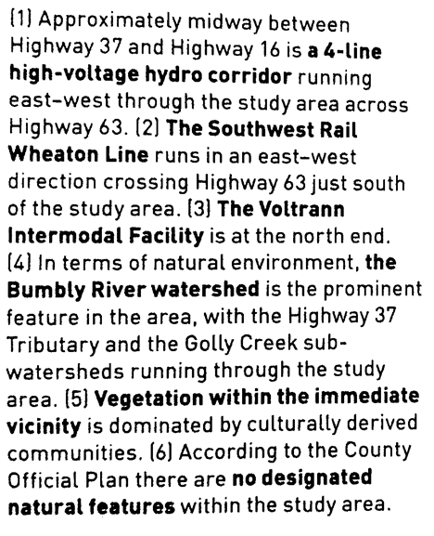
Example: Is this Cohesive?
Irish p. 153
Notes:
Paragraph: (1) Approximately midway between Highway 37 and Highway 16 is a 4-line high-voltage hydro corridor running east-west through the study area across Highway 63. (2) The Southwest Rail Wheaton Line runs in an east-west direction crossing Highway 63 just south of the study area. (3) The Voltrann Intermodal Facility is at the north end. (4) In terms of natural environment, the Bumbly River watershed is the prominent feature in the area, with the Highway 37 Tributary and the Golly Creek sub-watersheds running through the study area. (5) Vegetation within the immediate vicinity is dominated by culturally derived communities. (6) According to the County Official Plan there are no designated natural features within the study area.

Slide 89
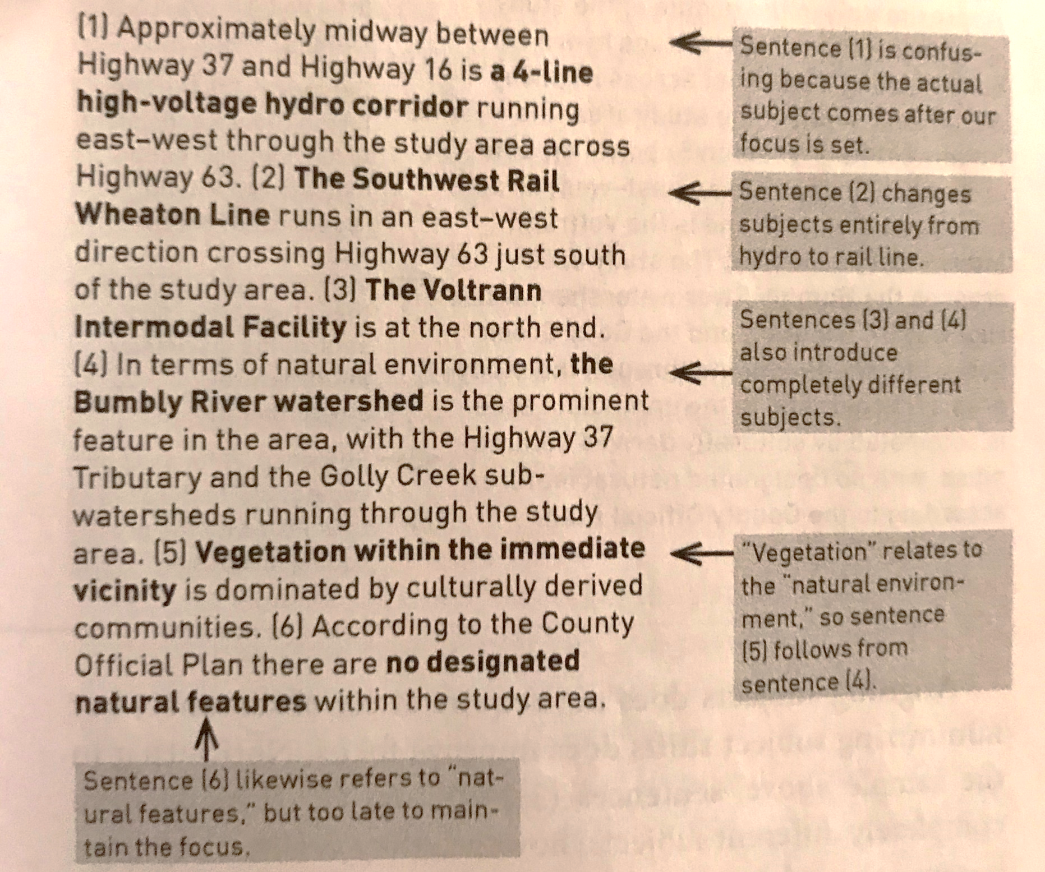
Irish p. 153
Notes:
Paragraph: (1) Approximately midway between Highway 37 and Highway 16 is a 4-line high-voltage hydro corridor running east-west through the study area across Highway 63. (2) The Southwest Rail Wheaton Line runs in an east-west direction crossing Highway 63 just south of the study area. (3) The Voltrann Intermodal Facility is at the north end. (4) In terms of natural environment, the Bumbly River watershed is the prominent feature in the area, with the Highway 37 Tributary and the Golly Creek sub-watersheds running through the study area. (5) Vegetation within the immediate vicinity is dominated by culturally derived communities. (6) According to the County Official Plan there are no designated natural features within the study area.
Commentary from Irish: Sentence (1) is confusing because the actual subject comes after our focus is set.
Sentence (2) changes subjects entirely from hydro to rail line.
Sentences (3) and (4) also introduce completely different subjects.
“Vegetation” relates to the “natural environment,” so sentence (5) follows from sentence (4).
Sentence (6) likewise refers to “natural features,” but too late to maintain the focus.

Slide 90
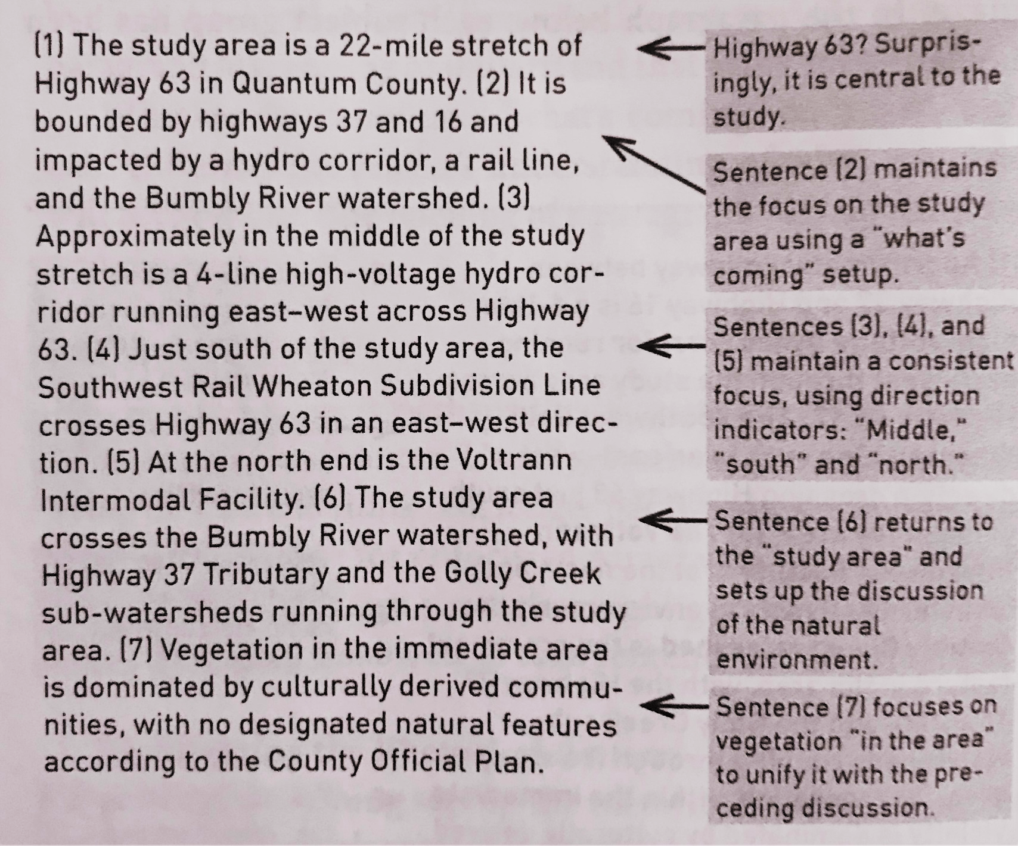
Possible Revision
Irish p. 153
Notes:
Paragraph: (1) The study area is a 22-mile stretch of Highway 63 in Quantum County. (2) It is bounded by highways 37 and 16 and impacted by a hydro corridor, a rail line, and the Bumbly River watershed. (3) Approximately in the middle of the study stretch is a 4-line high-voltage hydro corridor running east-west across Highway 63. (4) Just south of the study area, the Southwest Rail Wheaton Subdivision Line crosses Highway 63 in an east-west direction. (5) At the north end is the Voltrann Intermodal Facility. (6) The study area crosses the Bumbly River watershed, with Highway 37 Tributary and the Golly Creek sub-watersheds running through the study area. (7) Vegetation in the immediate area is dominated by culturally derived communities, with no designated natural features according to the County Official Plan.
Commentary from Irish: Highway 63? Surprisingly, it is central to the study. Sentence (2) maintains the focus on the study area using a “what’s coming” setup. Sentences (3), (4), and (5) maintain a consistent focus, using direction indicators: “middle,” “south” and “north.” Sentence (6) returns to the “study area” and sets up the discussion of the natural environment. Sentence (7) focuses on vegetation “in the area” to unify it with the preceding discussion.

Slide 91
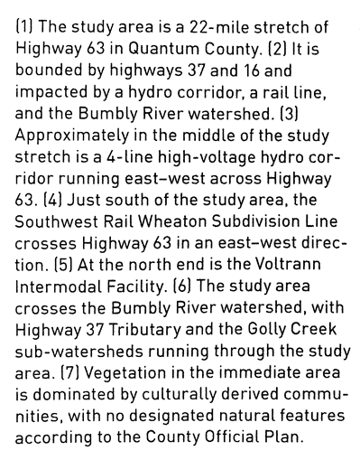
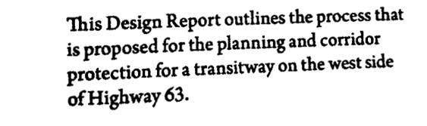
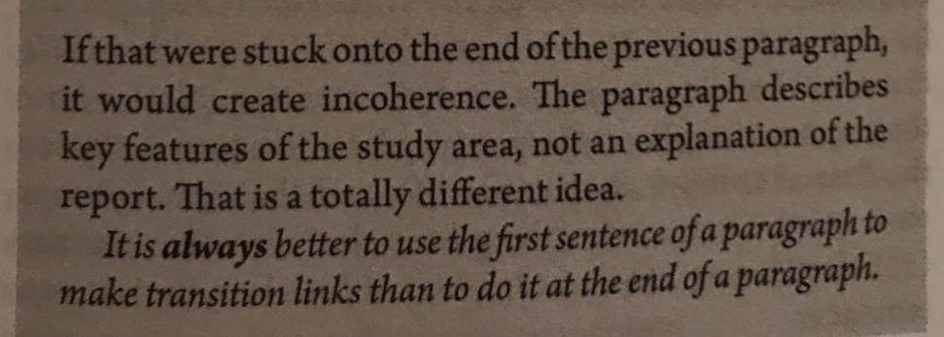
Should we add this sentence onto the end here? Or make it the first sentence of the next paragraph?
Irish p. 153 and 159
Notes:
Paragraph: (1) The study area is a 22-mile stretch of Highway 63 in Quantum County. (2) It is bounded by highways 37 and 16 and impacted by a hydro corridor, a rail line, and the Bumbly River watershed. (3) Approximately in the middle of the study stretch is a 4-line high-voltage hydro corridor running east-west across Highway 63. (4) Just south of the study area, the Southwest Rail Wheaton Subdivision Line crosses Highway 63 in an east-west direction. (5) At the north end is the Voltrann Intermodal Facility. (6) The study area crosses the Bumbly River watershed, with Highway 37 Tributary and the Golly Creek sub-watersheds running through the study area. (7) Vegetation in the immediate area is dominated by culturally derived communities, with no designated natural features according to the County Official Plan.
This Design Report outlines the process that is proposed for the planning and corridor protection for a transitway on the west side of Highway 63.
Should we add this sentence onto the end here? Or make it the first sentence of the next paragraph?
If that were stuck onto the end of the previous paragraph, it would create incoherence. The paragraph describes key features of the study area, not as an explanation of the report. That is a totally different idea.
It is always better to use the first sentence of a paragraph to make transition links than to do it at the end of a paragraph.
Example and commentary from Irish p. 153 and 159.

Slide 92
Example: Setup, Focus, and Arrangement
“The noise walls on the west side are generally in fair to good condition. The walls exhibited medium to wide cracking in all components and light efflorescence staining. Some posts have exposed reinforcing steel actively corroding. Some posts also showed minor spalling in the lower portions. The majority of posts were out of plumb by 25mm (towards the roadway), with the exception of one post which was 140mm out of plumb. All deflections to vertical posts were assessed over an 1829mm (6ft) height.”
Setup: The first sentence establishes the main claim that frames the rest: “fair to good.”
Focus: The paragraph establishes the single point that the walls are (only) fair to good.
Arrangement:
1. The rhetorical pattern is analysis.
2. The paragraph progresses from walls generally, to posts, to deflection of the posts.
Example and commentary from Irish p. 153

Slide 93
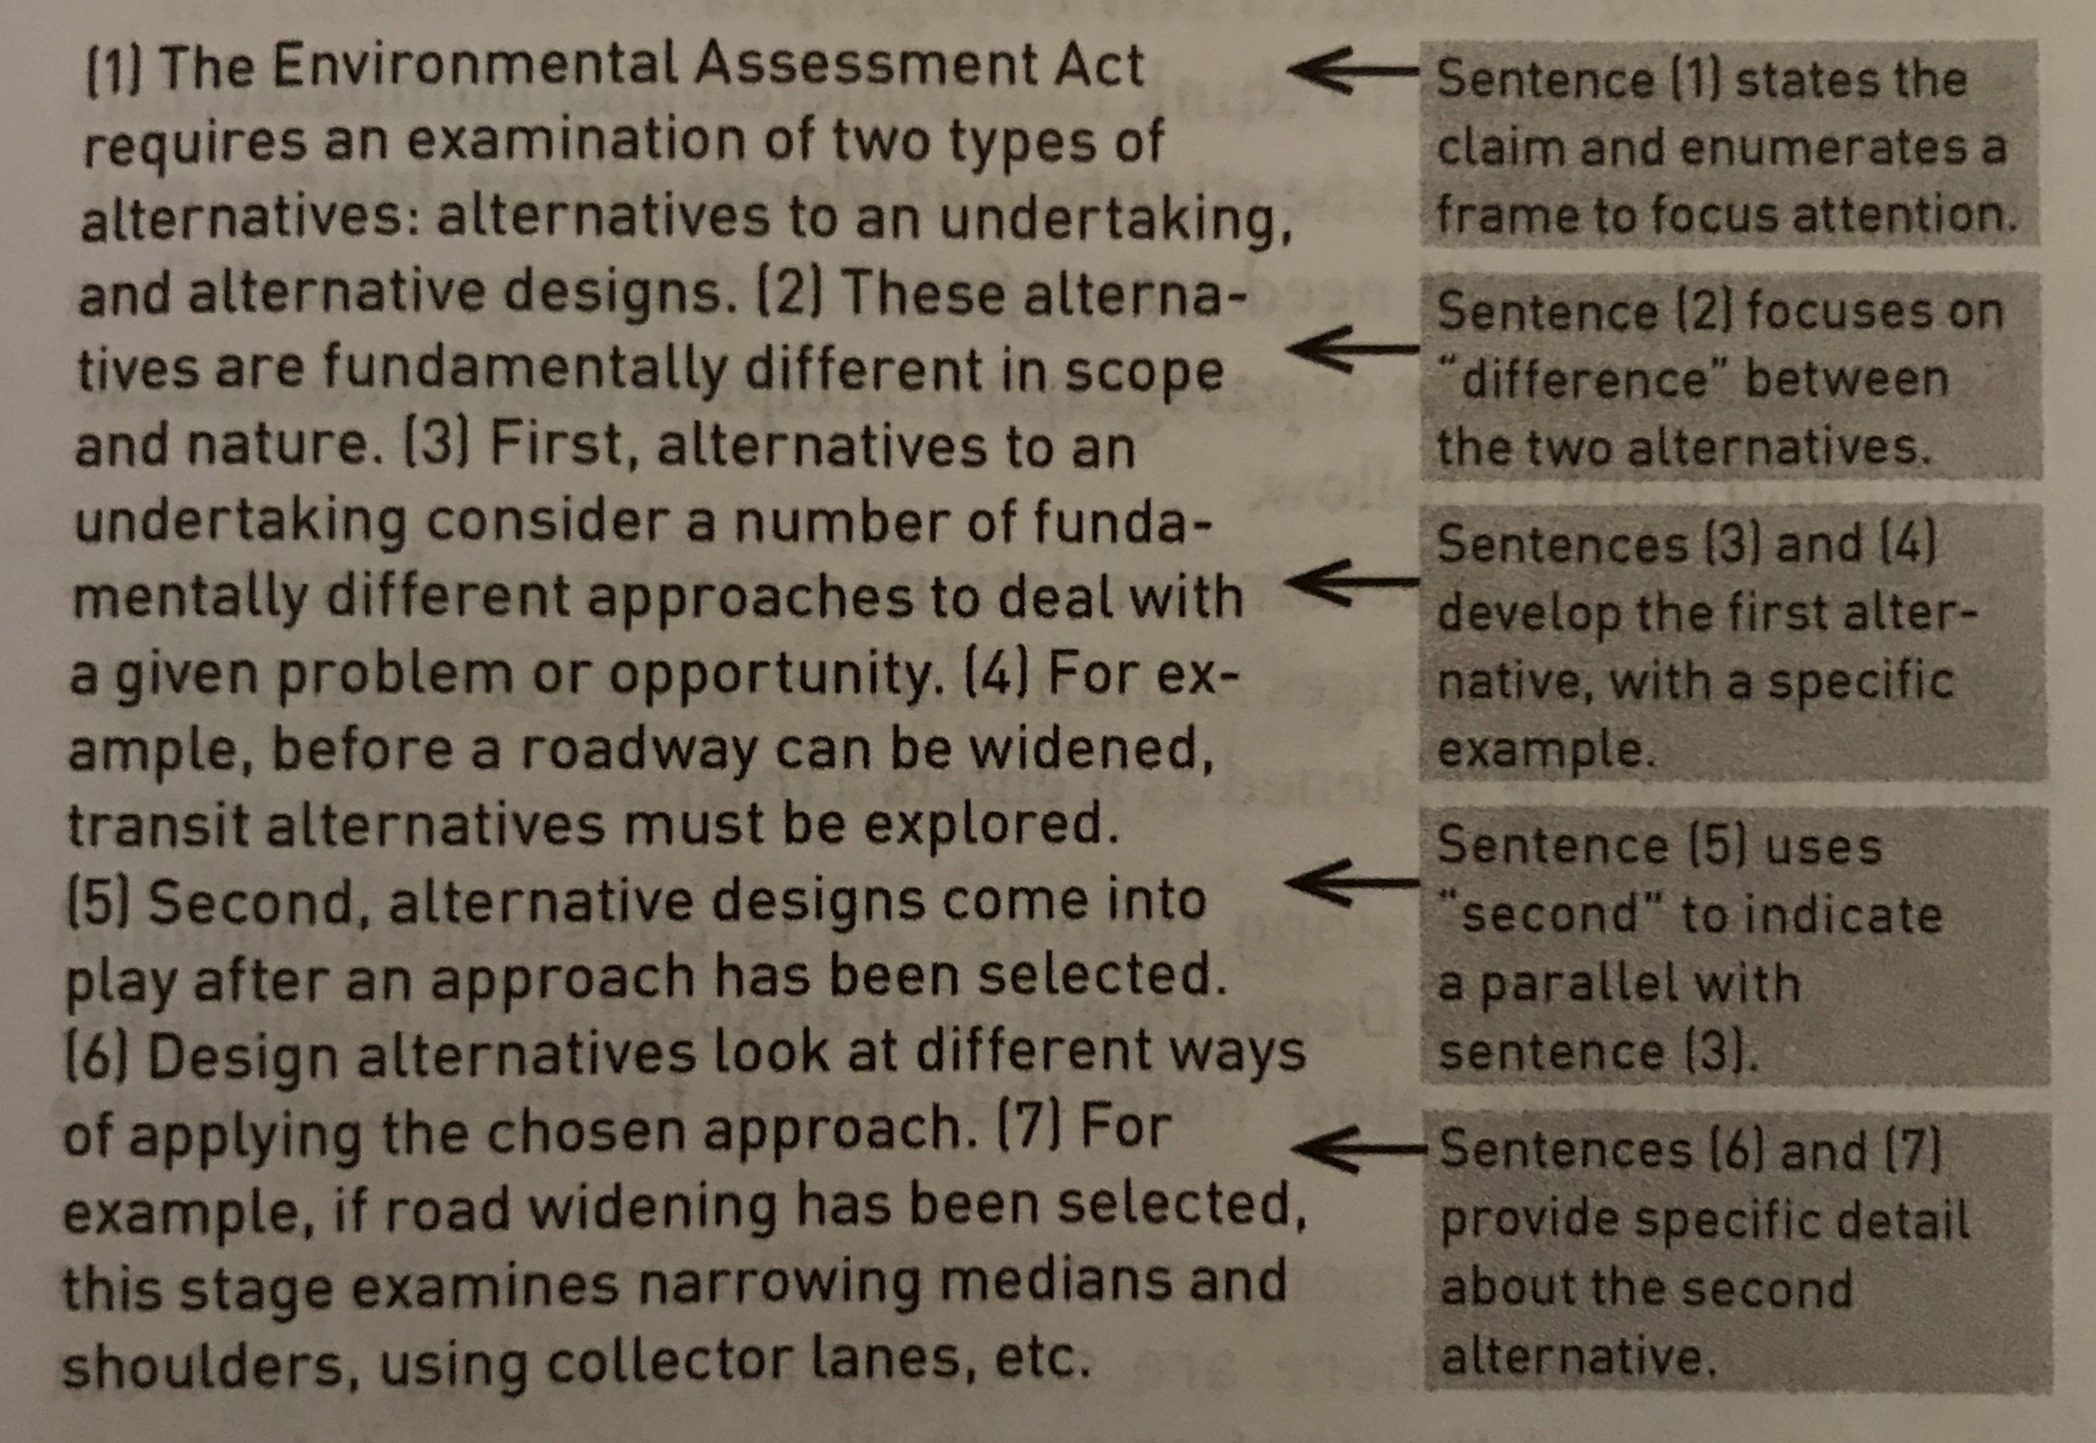
Example: Another
Arrangement
Irish p. 161
Notes:
(1) The Environmental Assessment Act requires an examination of two types of alternatives: alternatives to an undertaking, and alternative designs. (2) These alternatives are fundamentally different approaches to deal with a given problem or opportunity. (4) For example, before a roadway can be widened, transit alternatives must be explored. (5) Second, alternative designs come into play after an approach has been selected. (6) Design alternatives look at different ways of applying the chosen approach. (7) For example, if road widening has been selected, this stage examines narrowing medians and shoulders, using collector lanes, etc.
Sentence (1) states the claim and enumerates a frame to focus attention.
Sentence (2) focuses on “difference” between the two alternatives.
Sentences (3) and (4) develop the first alternative, with a specific example.
Sentence (5) uses “second” to indicate a parallel with sentence (3).
Sentences (6) and (7) provide specific detail about the second alternative.
Example and commentary from Irish p. 161.

Slide 94
Word Location and Linking Key Terms
Unclear paragraph:
During the Pleistocene (about 2.6 million to 12,000 years ago), a variety of large mammals, birds, and reptiles were extinct. The megafauna included dire wolves, mammoths, cave bears, giant condors, giant eagles, flightless birds, giant snakes and lizards, and many other animals. Palaeontologists are very interested in ice age species. Although the migration and expansion of the human population coincides with the extinction of large animals, it is unclear if early hunters caused the extinction of so many creatures. Environmental changes were also associated with the onset of the last glacial cycle.
megafauna = ice age species? Pleistocene = ice age? No clear links
Hofmann p. 102
Notes:
Hofmann, Scientific Writing and Communication p. 102

Slide 95
Practice Condensing: cut a word, then a sentence
A large variety of environmental models exists, with each model tailored to address specific challenges related to environmental science and natural resource management (Singh and Woolhiser, 2002, Singh et al., 2006). These models have grown in complexity, with many simulating increasingly detailed processes occurring within environmental systems. When scientists and engineers use models, they must devote significant effort to collect data, construct model inputs, and calibrate and validate model parameters. Many environmental models also require sophisticated data pre-processing routines, often with many manual steps (e.g., Billah et al., 2016). For this reason, many models come with supporting applications such as Geographic Information System (GIS) interfaces, calibration tools, visualization software, and other utility software systems to assist in the data preparation process (e.g., Winchell et al., 2007). These data pre-processing steps must be repeated each time a new model is created to simulate a system. This introduces a number of challenges. From a pragmatic perspective, it is an inefficient use of scientists' time. Perhaps more importantly, it inhibits scientists’ ability to reproduce studies that have a significant computational modeling component (David et al., 2016, Essawy et al., 2016, Gil et al., 2016).
[191 words]
Morsy, M. M., Goodall, J. L., Castronova, A. M., Dash, P., Merwade, V., Sadler, J. M., ... & Tarboton, D. G. (2017). Design of a metadata framework for environmental models with an example hydrologic application in HydroShare. Environmental modelling & software, 93, 13-28.
Notes:
Morsy, M. M., Goodall, J. L., Castronova, A. M., Dash, P., Merwade, V., Sadler, J. M., ... & Tarboton, D. G. (2017). Design of a metadata framework for environmental models with an example hydrologic application in HydroShare. Environmental modelling & software, 93, 13-28.

Slide 96
Condensed
Many types of environmental models exist, each tailored to address specific challenges in environmental science and natural resource management (Singh and Woolhiser, 2002, Singh et al., 2006). These models have grown in complexity, simulating increasingly detailed processes within environmental systems. When scientists and engineers use models, they must devote significant effort to collect data, construct model inputs, and calibrate and validate model parameters. Many environmental models also require sophisticated data pre-processing routines, often with many manual steps (e.g., Billah et al., 2016). For this reason, many models come with supporting applications to assist in the data preparation process (e.g. Geographic Information System (GIS) interfaces, calibration tools, visualization software, and other utility software systems) (Winchell et al., 2007). These data pre-processing steps introduce a number of challenges, and pre-processing has become an inefficient use of scientists' time. Perhaps more importantly, the complexity of current pre-processing protocols inhibits scientists’ ability to reproduce studies that have a significant computational modeling component (David et al., 2016, Essawy et al., 2016, Gil et al., 2016).
[170 words] [~11% reduction]
Morsy, M. M., Goodall, J. L., Castronova, A. M., Dash, P., Merwade, V., Sadler, J. M., ... & Tarboton, D. G. (2017). Design of a metadata framework for environmental models with an example hydrologic application in HydroShare. Environmental modelling & software, 93, 13-28.
Notes:
Morsy, M. M., Goodall, J. L., Castronova, A. M., Dash, P., Merwade, V., Sadler, J. M., ... & Tarboton, D. G. (2017). Design of a metadata framework for environmental models with an example hydrologic application in HydroShare. Environmental modelling & software, 93, 13-28.

Slide 97
Condensed with Markup
Many types A large variety of environmental models exists, with each model tailored to address specific challenges related to environmental science and natural resource management (Singh and Woolhiser, 2002, Singh et al., 2006). These models have grown in complexity, with many simulating increasingly detailed processes occurring within environmental systems. When scientists and engineers use models, they must devote significant effort to collect data, construct model inputs, and calibrate and validate model parameters. Many environmental models also require sophisticated data pre-processing routines, often with many manual steps (e.g., Billah et al., 2016). For this reason, many models come with supporting applications ^such as (Geographic Information System (GIS) interfaces, calibration tools, visualization software, and other utility software systems) *to assist in the data preparation process* (e.g., Winchell et al., 2007). These data pre-processing steps must be repeated each time a new model is created to simulate a system. This These data preprocessing steps introduces a number of challenges. From a pragmatic perspective, it is , and pre-processing has become an inefficient use of scientists' time. Perhaps more importantly, it the complexity of current pre-processing protocols inhibits scientists’ ability to reproduce studies that have a significant computational modeling component (David et al., 2016, Essawy et al., 2016, Gil et al., 2016).
[? Do we need the “for this reason…” sentence? Does it go here?] [170 words]
Morsy, M. M., Goodall, J. L., Castronova, A. M., Dash, P., Merwade, V., Sadler, J. M., ... & Tarboton, D. G. (2017). Design of a metadata framework for environmental models with an example hydrologic application in HydroShare. Environmental modelling & software, 93, 13-28.
Notes:
NOTE: it’s always easier to cut words and sentences from someone else’s writing than your own—but if you can compromise between what your reader wants to cut and what you think needs to stay, you’ll still be able to trim down. Ask multiple readers if this word/sentence is necessary for their understanding.
Morsy, M. M., Goodall, J. L., Castronova, A. M., Dash, P., Merwade, V., Sadler, J. M., ... & Tarboton, D. G. (2017). Design of a metadata framework for environmental models with an example hydrologic application in HydroShare. Environmental modelling & software, 93, 13-28.

