Slide 1






Advancing Hyku
End of Project Update
Ellen Ramsey, University of Virginia
Ilkay Holt, British Library
advancinghyku.io
https://github.com/samvera-labs/AdvancingHyku
Open Repositories, 7 June 2022
Notes:
I am Ellen Ramsey from UVA. At the University of Virginia Library in Charlottesville, we acknowledge that the land where we learn and work is the ancestral homeland and traditional territory of the Monacan Indian Nation. We pay respect to their elders and knowledge keepers — past and present. We acknowledge and pay respect to the enslaved Africans, enslaved laborers, and free Black laborers who built UVA, as well as their descendants.Today we acknowledge the land, we acknowledge labor, traditions, and knowledge, and we acknowledge lives.
Final grant report of Advancing Hyku project, which ran from October 2019 to March 2022, funded by Arcadia, a charitable fund of Lisbet Rausing and Peter Baldwin (2 and half years).

Slide 2
A Samvera Primer
Samvera is…
a grass-roots, open-source community of library and cultural heritage professionals, including repository managers, developers, metadata experts, content owners and users, working together to create best-in-class digital repository solutions.
Hyrax is…
a locally deployable digital repository structure that requires expertise in system administration as well as Ruby and Rails development to set up, operate and maintain. When customized, the need for an ongoing commitment to maintain and migrate the repository, its contents and its customizations is heightened.
Hyku is…
Samvera’s digital repository application developed with an orientation toward the provision of hosted services;
based on Hyrax, offering an easy-to-install, easy-to-configure, feature-rich solution supporting next-generation web technologies;
at release Hyku 4.0 as of May 2022.
Notes:
The name Samvera is an Icelandic term meaning “togetherness”.

Slide 3
Advancing Hyku: Open Source Institutional Repository Platform Development
The project WAS...
funded by a $1M grant from Arcadia.
from October 2019 - March 2022
supporting the growth of open access through institutional repositories by introducing significant structural improvements and new features to the Samvera Community’s Hyku Institutional Repository platform.
The project DID NOT...
focus on building new institutional repository solutions.
redirect resources from Hyrax codebase.
claim that institutional repository population and use is the singular path to the future of open and sustainable scholarly communication.
Notes:
Ellen: Reminder of scope (30 sec)

Slide 4




We Advanced Hyku, and You Can, too
Project deliverables introduced significant structural improvements and new features to the Samvera Community's Hyku platform. The following features are all available in community code. Our “Adoption Path” living document gives technical specifications.
Cross tenant search
Auto-expiration of embargoes and leases
DOI minting in deposit form (DataCite integration)
Auto-fill metadata fields with DOI in a single record
(both DataCite and Crossref)
Auto-population of records with bulk DOIs through Unpaywall
Auto-population of records with bulk /list of ORCID IDs
Mint DOIs while importing through Bulkrax
RIS (Research Information Systems) citation related export
Integration with ORCID, author identifier (WP3)
In-browser PDF display and annotation through Hypothes.is
Notes:
https://docs.google.com/document/d/1oB65bAWCoJtdiZqkeAOBFGpQXQTezMS7nm2UC8Nv3uc/edit

Slide 5
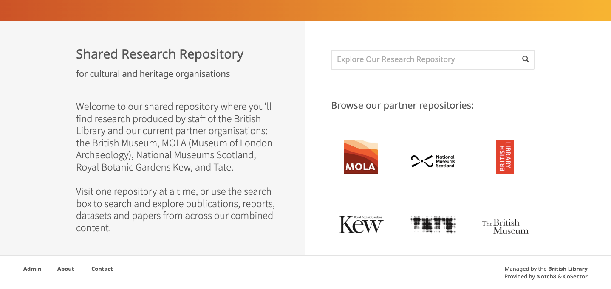
Cross Tenant Search
Shared search interface for live British Library customers (in Notch8’s UI). As a multi-tenant capable platform, Hyku is ideally suited to use in consortia or by other groups of institutions. Ubiquity Press initially developed a shared search layer for the British Library, and it was released in May 2022 with Hyku 4.
Notes:
https://github.com/samvera/hyku/releases/tag/v4.0.0

Slide 6
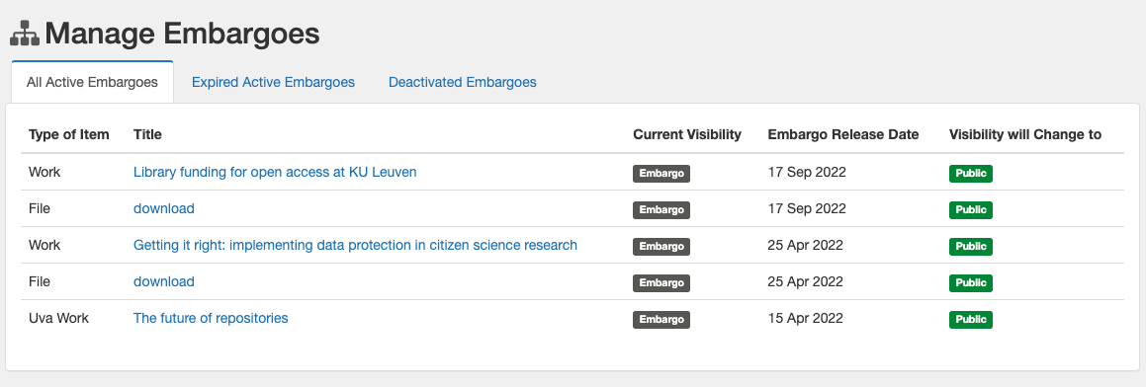
2. Auto-expiration of embargoes and leases
Embargo management page in standard Hyku dashboard (no change by UP to the interface, but embargoes/leases now auto-expire when date is reached). Previously Hyku supported the entry of embargo and lease dates for content, but did not automatically change the status of works at those dates. This feature ensures that embargoed and leased content is reliably made available and removed from public view, respectively, as expected by users.

Slide 7
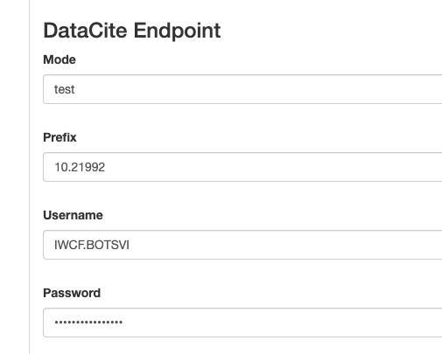
3. Toggle DOI minting in deposit form (DataCite integration)
Feature switch in a standard Hyku dashboard to enable/disable ability to mint DOIs.
Feature adding DataCite DOIs credentials added to a tenant ‘edit’ page in a standard Hyku instance admin interface.

Slide 8
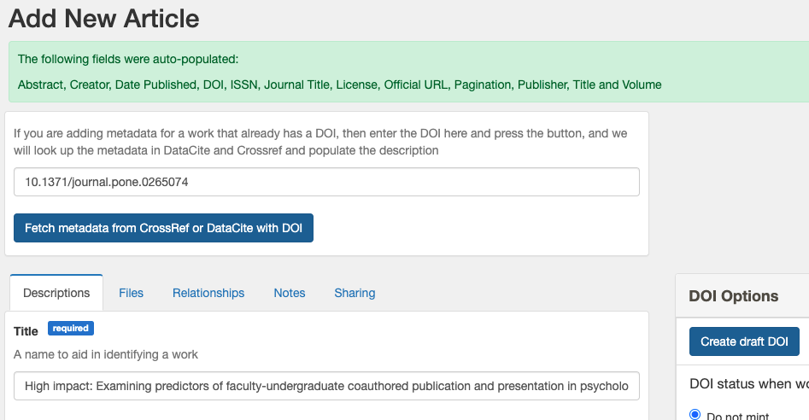
4. Auto-fill metadata fields with DOI in a single record
Portion of single Hyku tenant deposit form with message showing fields have been auto-populated into the form from Crossref (DataCite also supported), after pressing ‘fetch metadata’ button.

Slide 9
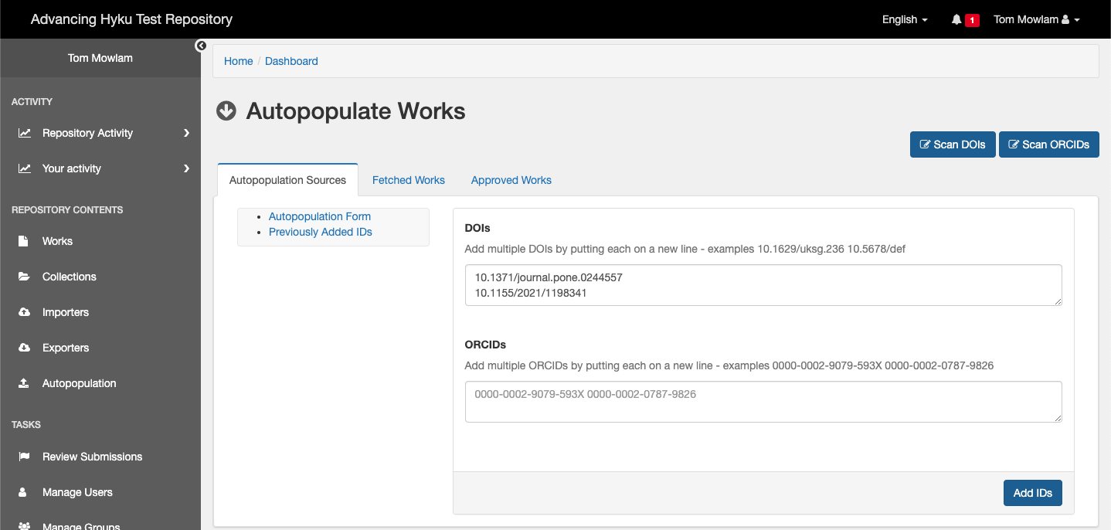
5. Auto-population of records with bulk DOIs through Unpaywall
Interface to new auto-population tool in the standard Hyku dashboard, with 2 DOIs (one PLoS, one Hindawi) entered into the form.
Notes:
Screen shot 1 of 2

Slide 10
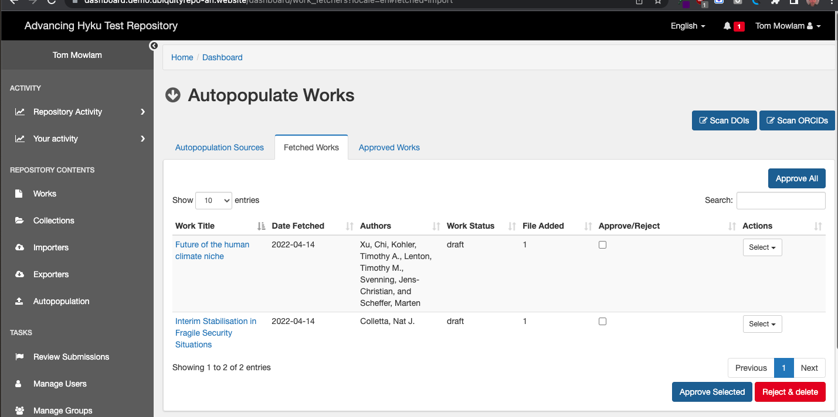
5. Auto-population of records with bulk DOIs (result)
Result of ‘fetch’ process in the standard Hyku dashboard, with two works with PDF files ready for review and approval.
Notes:
Screen shot 2 of 2

Slide 11
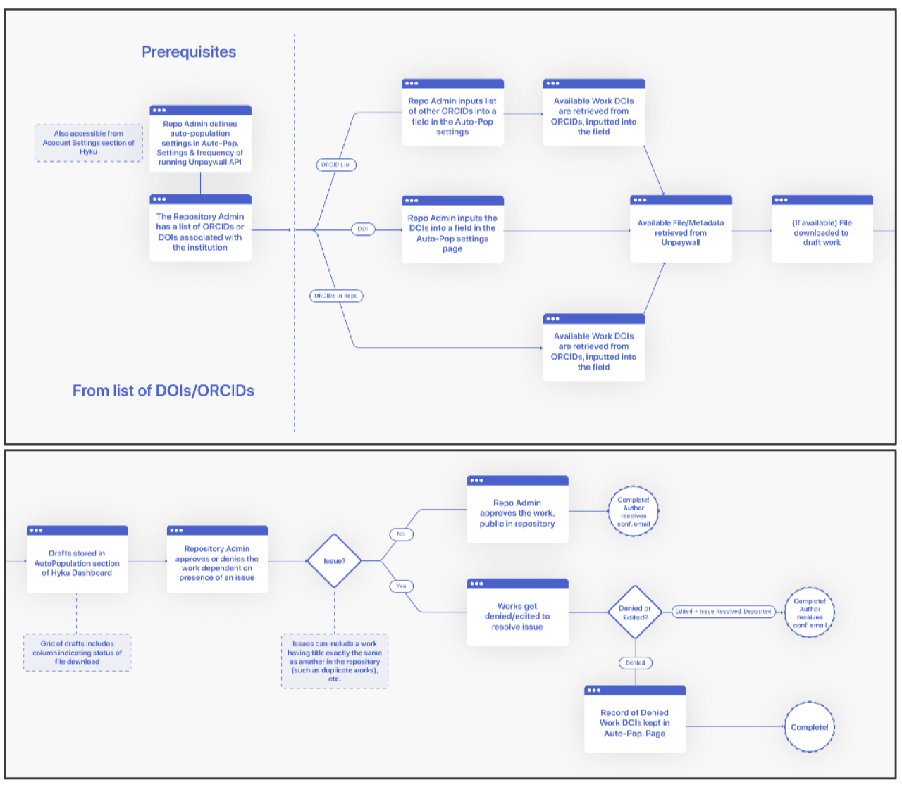
Bulk import and auto-population of records: 6. ORCID and 7. DOI
Workflows for auto-populating bulk records upon import with ORCID IDs and DOI assignments..
Notes:
Currently a Hyrax gem https://github.com/ubiquitypress/hyrax-autopopulation Bulkrax WG may decide it goes into Hyku 5 or later (did not make it into Hyku 4).

Slide 12
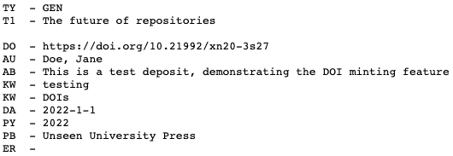
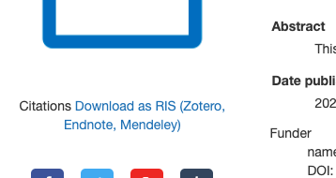
8. RIS (Research Information Systems) citation export
Portion of standard Hyku UI work landing page showing RIS download link.
RIS output for a test work.
This feature enables users to download citations for works in Hyku in the common RIS format. This is a standard repository feature that encourages correct citation using a work’s DOI, and thus makes it possible to track the citation.

Slide 13
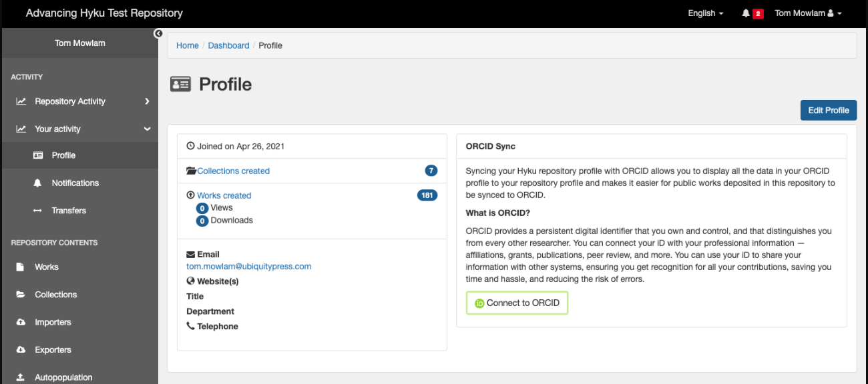
9. Integration with ORCID, author identifier
Feature switch added to the standard Hyku dashboard to enable/disable ORCID synchronisation interface.
Standard Hyku profile page extended with ORCID connection settings.
Notes:
Currently in Samvera Labs, hope it goes into Hyku 5 or later.
See final report for full shot of additional ORCID API account settings added to the standard Hyku dashboard.

Slide 14
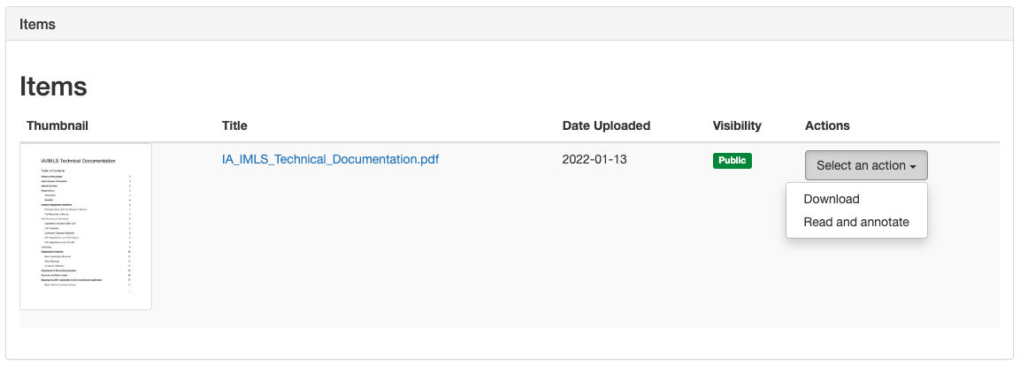
10. In-browser PDF display and annotation through Hypothes.is
Feature switch added to the standard Hyku dashboard to enable/disable PDF annotation.
Portion of standard Hyku work page showing new ‘Read and annotate’ option for PDF files.
Notes:
Requires Hypothes.is account. We used it for editing grant report.

Slide 15
Adoption path chart with options
3/Hyku add-ons
Shared Community Document:
Features and Adoption Paths
Option 1. Install Hyku (version listed) or later (what is the community code)
Option 2: Available in stand-alone gem (no need to install Hyku addons) (add a gem)
Option 3. Install Advancing Hyku-addons to your version of Hyku (add add-ons)
Want it all at once? Option 4 is to work with a service provider on a hosted version of Hyku (inclusive of Options 1 through 3).
Custom work types
In-browser PDF display and annotation
CSV Exports / imports -Bulkrax
File Availability Faceting
2/Stand-alone gem
DOI minting through
Bulkrax upload
RIS citation export
Auto-fill metadata with DOI
Integration with ORCID
Auto-population with bulk DOIs
DOI minting in deposit form
OAI-PMH
Auto-population with bulk
ORCID IDs
REST API
1/Install Hyku 2
Custom work types
Auto-expiration of embargoes and leases
Cross tenant search
Notes:
Ellen put this link in chat when jaw breaker/gobstopper introduced by Ilkay.
https://docs.google.com/document/d/1oB65bAWCoJtdiZqkeAOBFGpQXQTezMS7nm2UC8Nv3uc/edit

Slide 16
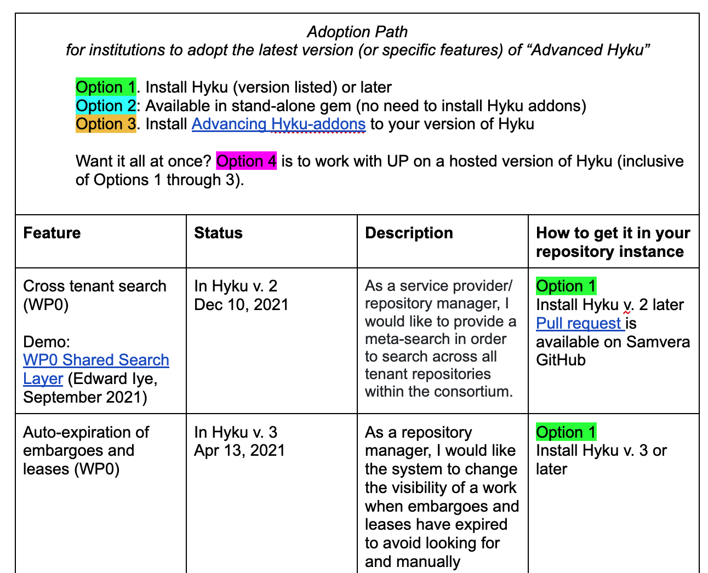
Adoption Path
Notes:
IH will add screen shot and link to https://bit.ly/AH_AdoptionPathCharth

Slide 17
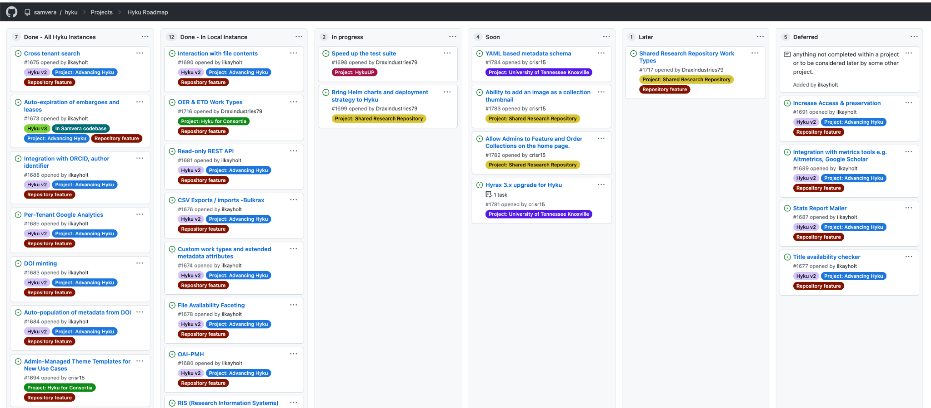
Community engagement: Hyku Roadmap
https://github.com/samvera/hyku/projects/1

Slide 18
Documentation Map
Code:
https://github.com/samvera/hyku/ and
https://github.com/ubiquitypress/hyku_addons/
Developer documentation:
https://github.com/ubiquitypress/hyku_addons/wiki
https://github.com/samvera/hyku/releases/tag/v4.0.0
https://bit.ly/AH_AdoptionPathCharth
Marketing/outreach:
https://advancinghyku.io/
https://samvera-labs.github.io/AdvancingHyku/ (archive)

Slide 19
Thank you!
Q&A
Open Repositories, 7 June 2022
Notes:
Ilkay, Ellen available for questions now or any time during OR.

