Slide 1

AI, Learning Health Systems, and Libraries
Bart Ragon, EdD, MLIS
University of Virginia
Director, Claude Moore Health Sciences Library
integrated Translational Health Research Institute of Virginia
Director of Strategic Development

Slide 2
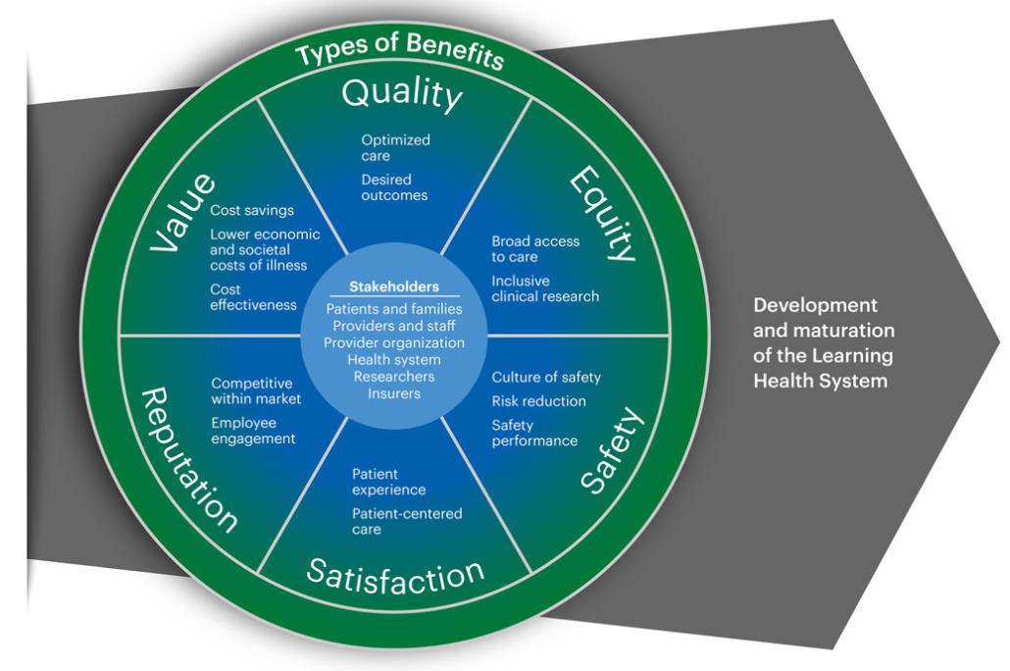
What is a Learning Health System
Translation of research findings into patient care
Embedding clinical research and evidence-based best practices into the delivery of care
Can enable innovation and support continuous quality improvement.
Implementing an LHS is complex
Requires participation and resources of a wide range of stakeholders (healthcare leaders, clinical care providers, patients and families, payers, and researchers…and librarians
I added that
Welch, L. C., Brewer, S. K., Schleyer, T., Daudelin, D., Paranal, R., Hunt, J. D., ... & Gatto, C. L. (2024). Learning health system benefits: Development and initial validation of a framework (Vol. 8, No. 1, p. e10380).
DOI: 10.1002/lrh2.10380

Slide 3
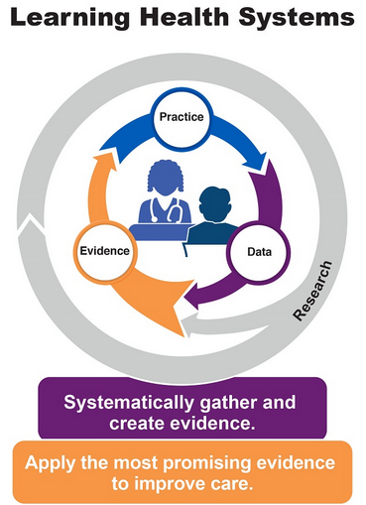

Another Learning Health System Model
https://www.ahrq.gov/learning-health-systems/about.html

Slide 4
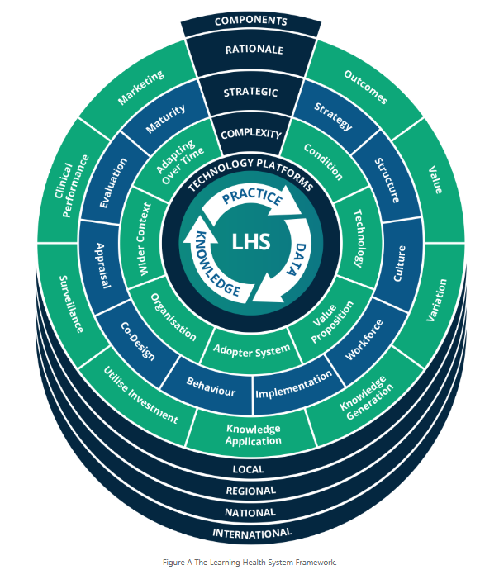
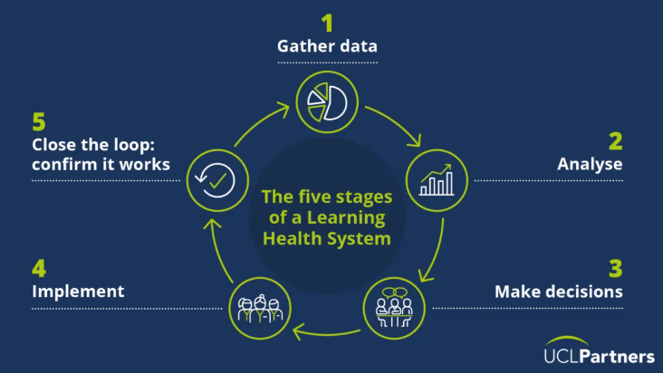
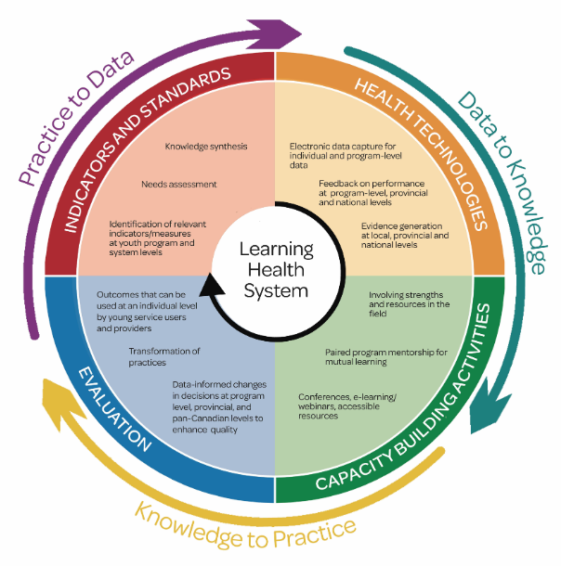
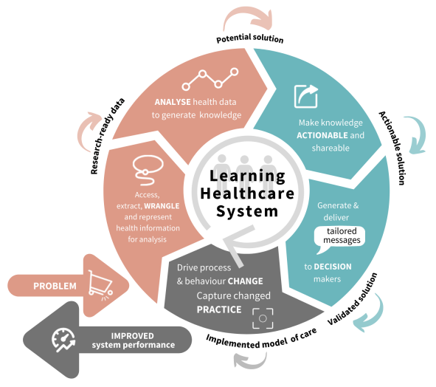
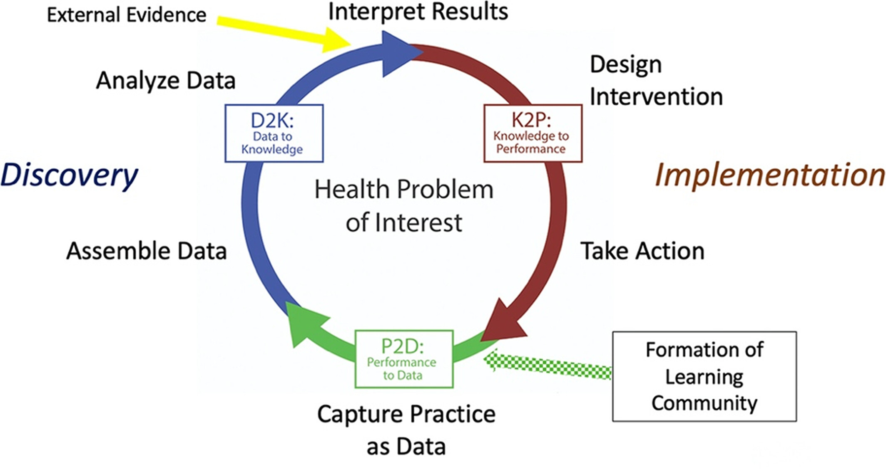
…and a few more Learning Health System Models
https://learninghealthcareproject.org/background/learning-healthcare-system/
https://uclpartners.com/blog-post/the-five-features-of-a-successful-learning-health-system/
https://www.mcgill.ca/mappro/information-hub/learning-health-systems
https://mdhs.unimelb.edu.au/digitalhealth/learn/learning-healthcare-system-academy
https://onlinelibrary.wiley.com/doi/full/10.1002/lrh2.10405

Slide 5

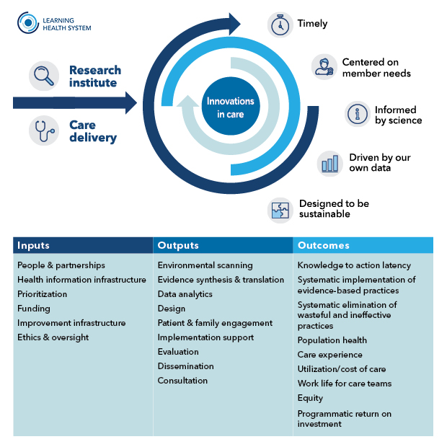
Kaiser Permanente Model
https://kpwashingtonresearch.org/index.php/news-and-events/blog/2021/practical-roadmap-guide-learning-health-systems

Slide 6








iTHRIV Lens of Learning Health Systems
Partners
Collaborators
Support for
LHSs

Slide 7
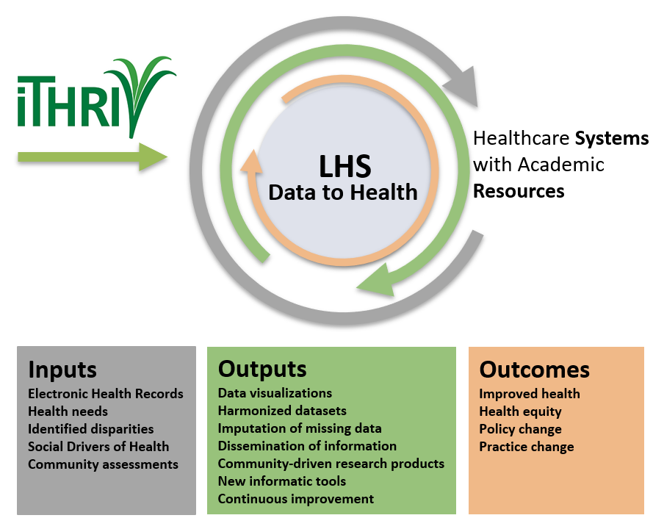
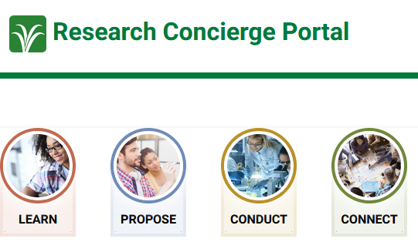
The iTHRIV Model
iTHRIV supports our Learning Health Systems, which are systems where knowledge is put into practice through the systematic integration of internal data and experience with external evidence (per AHRQ). iTHRIV contributes to bringing inputs, producing outputs, and improving outcomes.
https://portal.ithriv.org

Slide 8
Many paths, many Connections
EHR
PRACTICE CHANGE
HEALTH NEEDS
IDENTIFY DISPARITIES
HARMONIZED DATA
NEW INFORMATICS TOOLS
SDoH
COMMUNITY ASSESSMENTS
DATA VISUALIZATIONS
IMPUTATION OF MISSING DATA
CONTINUOUS IMPROVEMENT
POLICY CHANGE
HEALTH EQUITY
IMPROVED HEALTH
DISSEMINATION OF INFORMATION
COMMUNITY-DRIVEN RESEARCH PRODUCTS
Health System
Libraries
iTHRIV

Slide 9
AI and Libraries
LIBRARY INNOVATION ARC
  COPILOT CHAT VS COPILOT M360 PILOT
  HISTORICAL BIOGRAPHY WRITING PILOT
  GenAI Best Practices
  AI IN CODING (R, PYTHON, ETC)
  CRITICAL APPRAISAL
  PROMPT ENGINEERING
  FAIRNESS & ETHICS

Slide 10

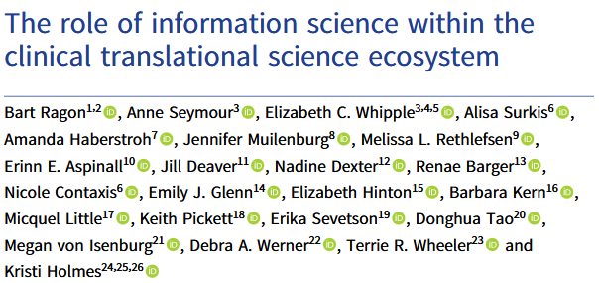

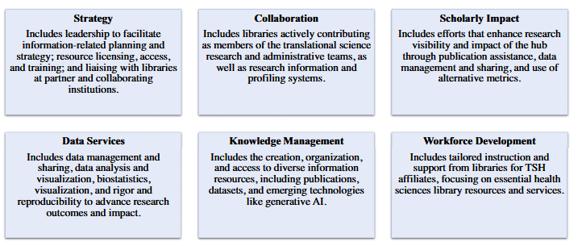
The Value Proposition of Libraries
doi: 10.1017/cts.2024.664

Slide 11
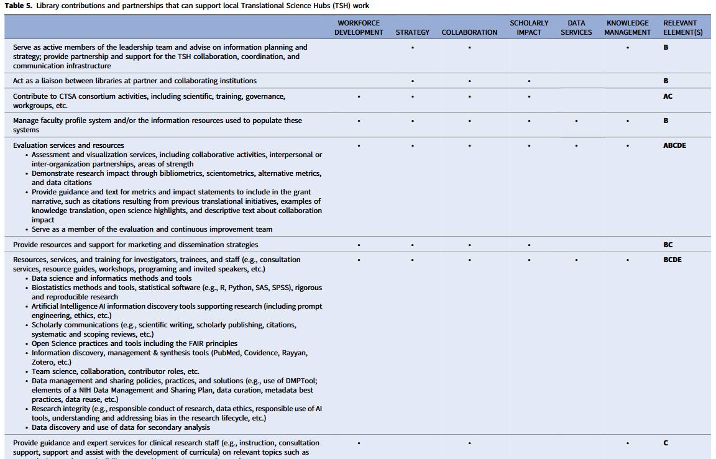
Menu of possibilities
ALL THINGS LIBRARIES DO, BUT NOT ALL LIBRARIES DO ALL THINGS

Slide 12

THANK YOU
Acknowledgements - Claude Moore Health Sciences Library Team
Dr. David Martin, Innovation and Data Strategy Lead
Brenna Kent, Research Data Specialist
Allison Cruise, School of Medicine Liaison Librarian
David Moody, IT Director
iTHRIV is funded by the National Center for Advancing Translational Science of the National Institutes of Health Awards UL1TR003015/ KL2TR003016. Contents of this website do not necessarily reflect the views of the institution and/or the National Institutes of Health.

