Slide 1


2024 Postdoctoral Symposium
Lightning Talk – Final Competition
Preventing Sudden Unexpected Death in Epilepsy
by understanding impairments on breathing function
Irene Sanchez Brualla (she/her)
Department of Anesthesiology

Slide 2
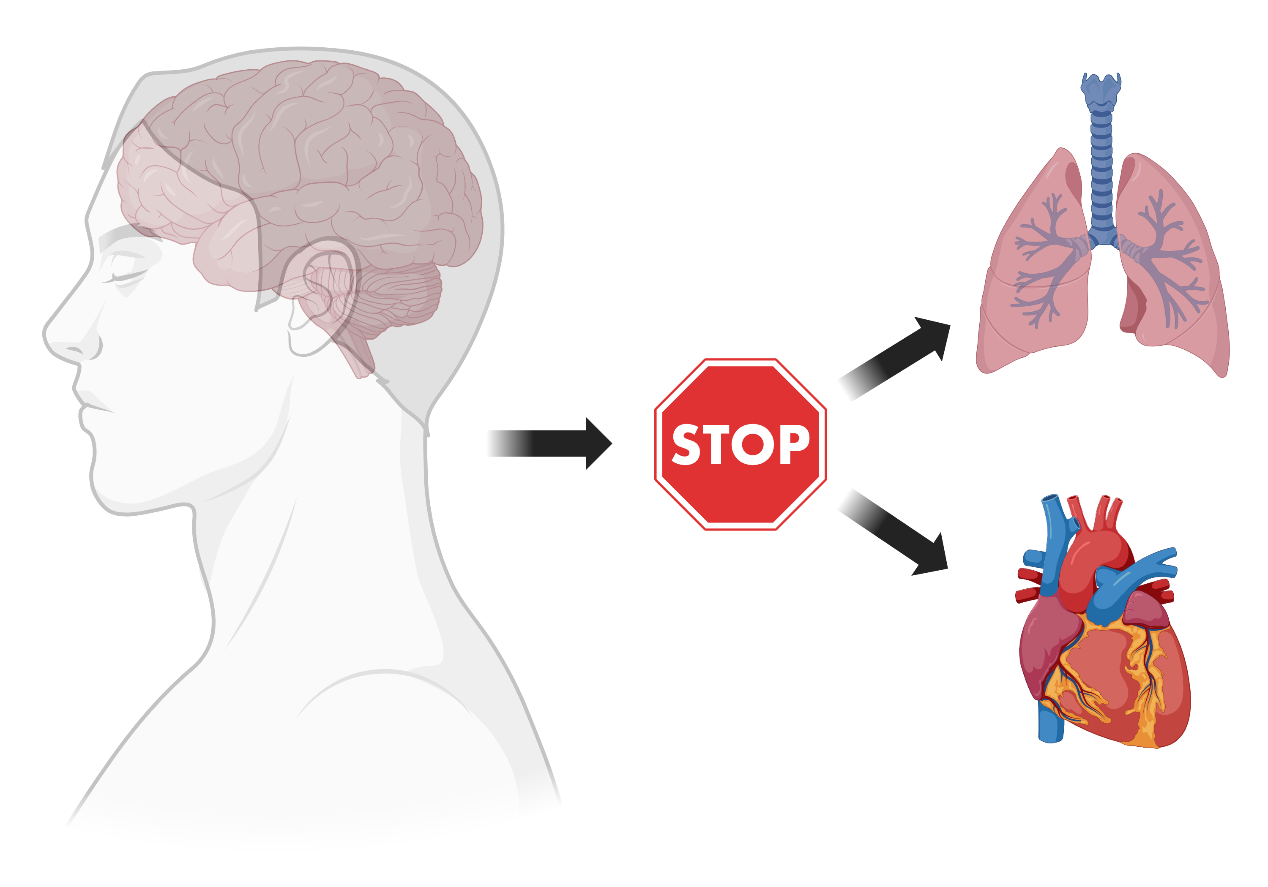
Epileptic seizures can stop breathing
Created with BioRender.com
Notes:
Introduce apnea.

Slide 3
Epileptic seizures can stop breathing
Created with BioRender.com
Notes:
Introduce apnea.

Slide 4
Epileptic seizures can stop breathing
Created with BioRender.com
Notes:
Introduce apnea.

Slide 5
Epileptic seizures can stop breathing
Created with BioRender.com
Notes:
Fist one, second heart

Slide 6
Epileptic seizures can stop breathing
This is called Sudden Unexpected Death in Epilepsy (SUDEP)
Created with BioRender.com

Slide 7
Epileptic seizures can stop breathing
This is called Sudden Unexpected Death in Epilepsy (SUDEP)
3,000 people per year across the USA
Created with BioRender.com

Slide 8
In most cases, SUDEP starts by an apnea
Created with BioRender.com
Notes:
Introduce apnea. Titles not in all caps

Slide 9
In most cases, SUDEP starts by an apnea
But we don’t know how seizures affect the breathing network…
Created with BioRender.com

Slide 10
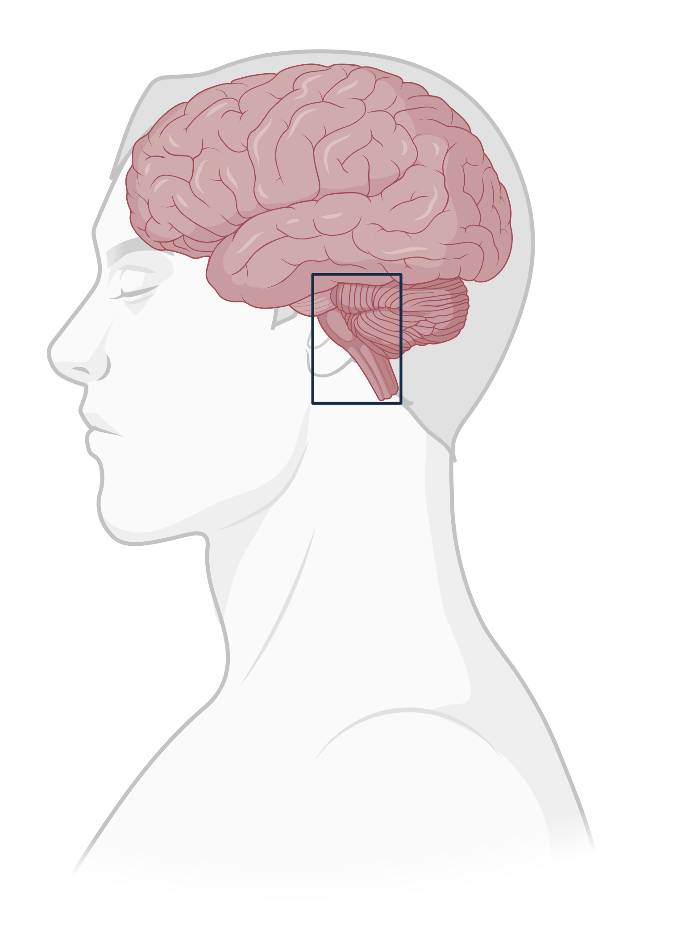
In most cases, SUDEP starts by an apnea
But we don’t know how seizures affect the breathing network…
Created with BioRender.com

Slide 11
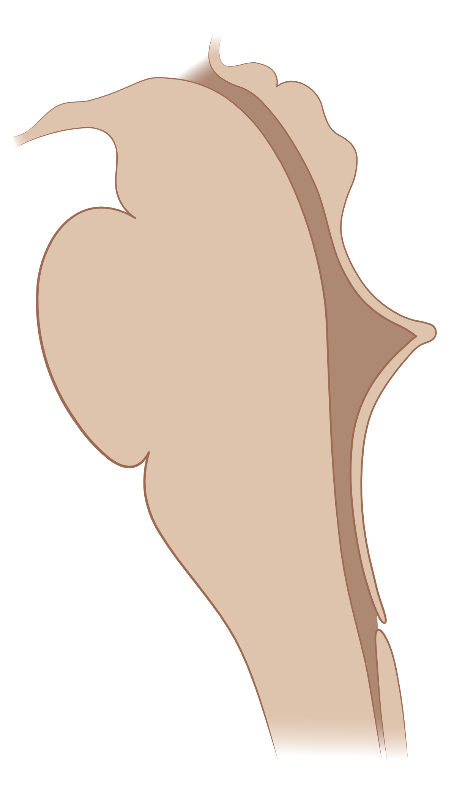
In most cases, SUDEP starts by an apnea
But we don’t know how seizures affect the breathing network…
Created with BioRender.com

Slide 12

In most cases, SUDEP starts by an apnea
But we don’t know how seizures affect the breathing network…
Every element of the network is a suspect
Created with BioRender.com

Slide 13

In most cases, SUDEP starts by an apnea
But we don’t know how seizures affect the breathing network…
Every element of the network is a suspect
Created with BioRender.com
Notes:
Is it the red? The blue r=neurons?...

Slide 14
In most cases, SUDEP starts by an apnea
But we don’t know how seizures affect the breathing network…
Hypercapnic ventilatory response
Main suspect: green neurons, Retrotrapezoid Nucleus
Every element of the network is a suspect
Created with BioRender.com
Notes:
Is it the red? The blue r=neurons?...

Slide 15
We have our suspect… What could be their motive?
Created with BioRender.com

Slide 16
We have our suspect… What could be their motive?
Neuronal activity depends on many pathways in and out of the neuron
Created with BioRender.com

Slide 17
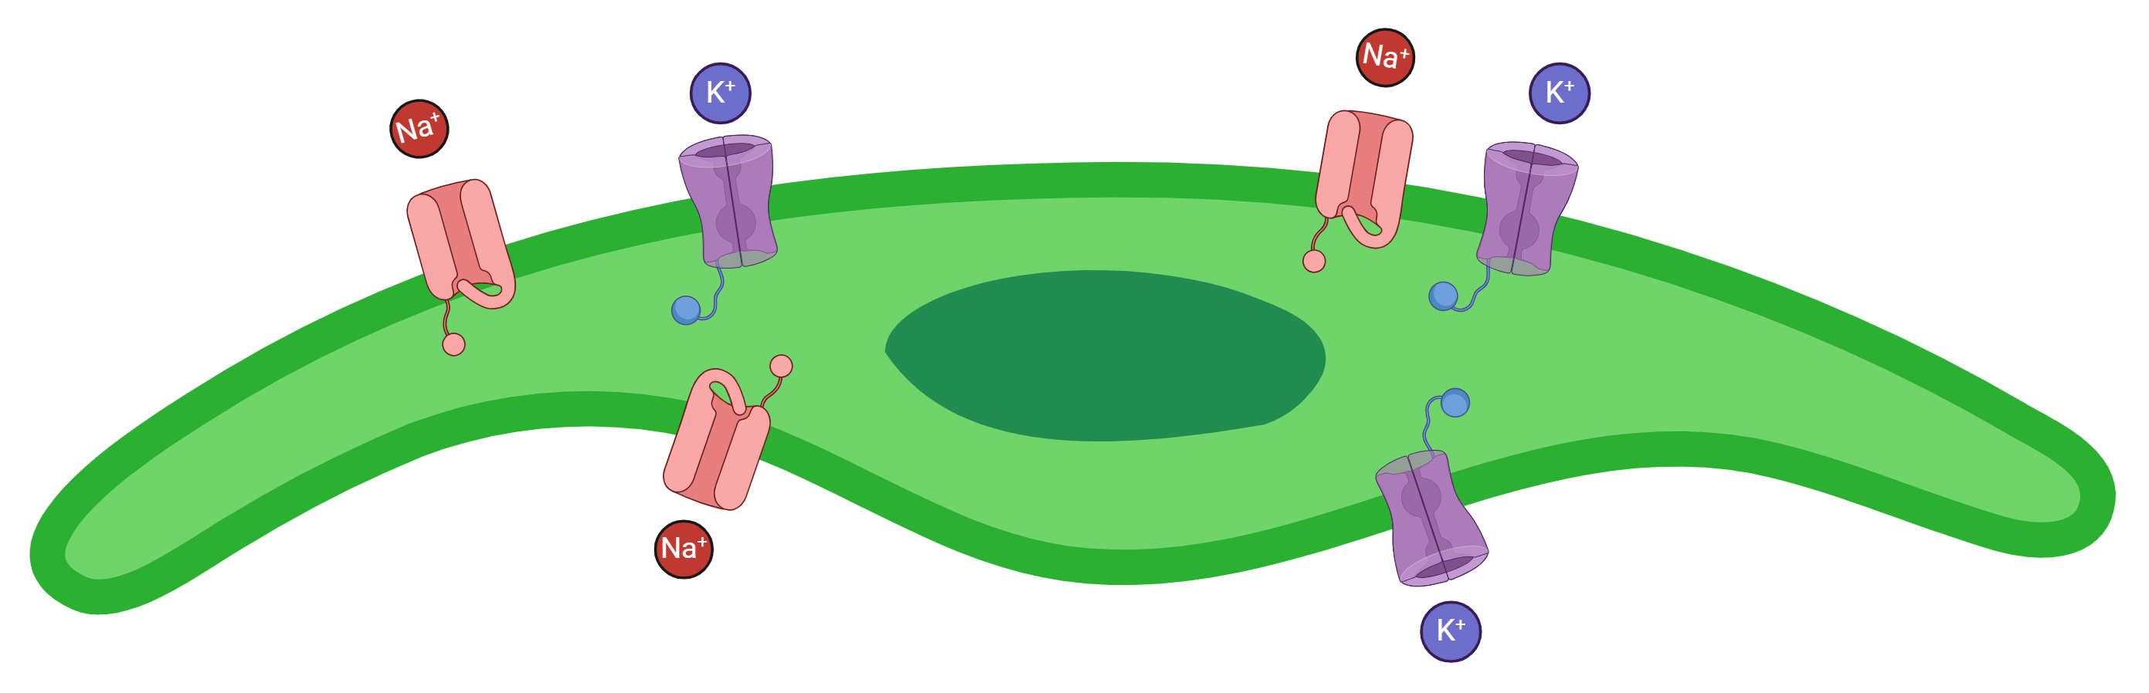
We have our suspect… What could be their motive?
Neuronal activity depends on many pathways in and out of the neuron
Created with BioRender.com

Slide 18
We have our suspect… What could be their motive?
Neuronal activity depends on many pathways in and out of the neuron
Mutations in voltage-activated sodium channel type 1.6 (NaV1.6) cause SUDEP
Created with BioRender.com

Slide 19
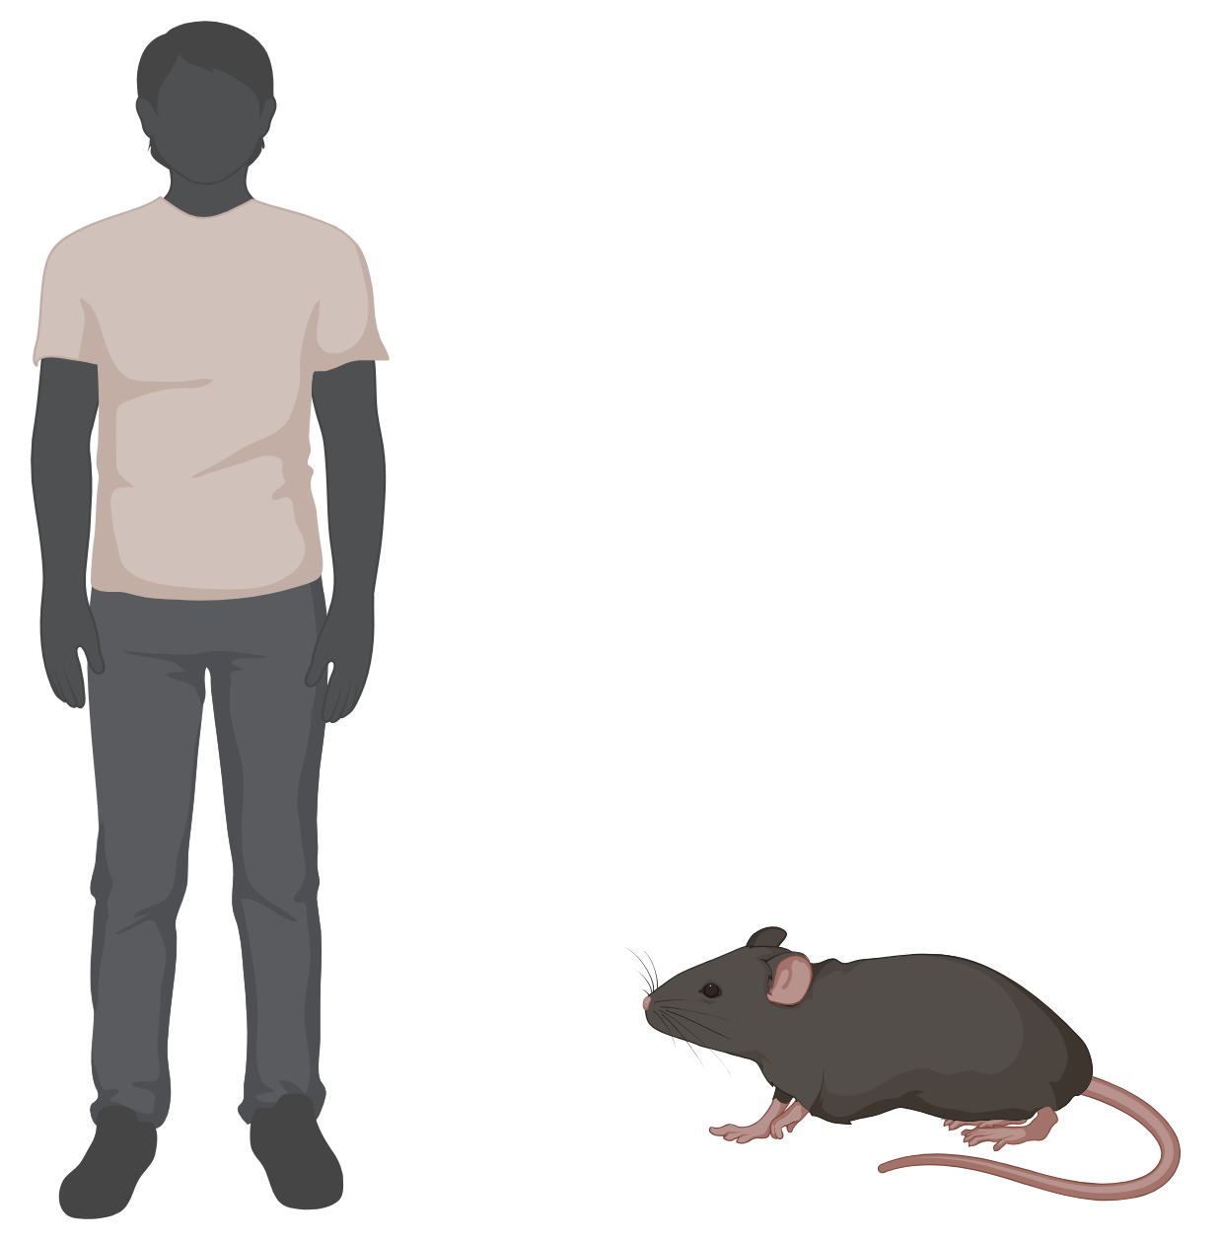
We have our suspect… What could be their motive?
Neuronal activity depends on many pathways in and out of the neuron
Mutations in voltage-activated sodium channel type 1.6 (NaV1.6) cause SUDEP
Created with BioRender.com

Slide 20
I am studying mice breathing and RTN neuronal activity
Created with BioRender.com

Slide 21
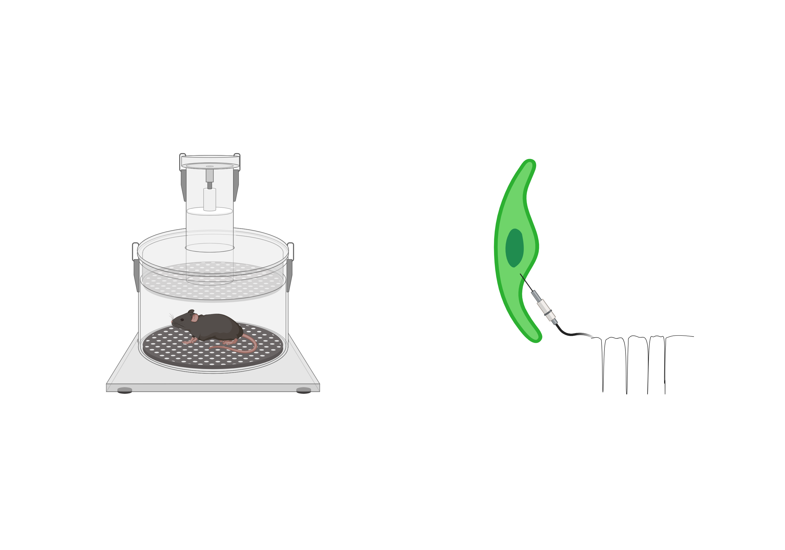
I am studying mice breathing and RTN neuronal activity
CO₂
Created with BioRender.com
Notes:
I vs. we. My contribution

Slide 22
I am studying mice breathing and RTN neuronal activity
CO₂
Created with BioRender.com

Slide 23
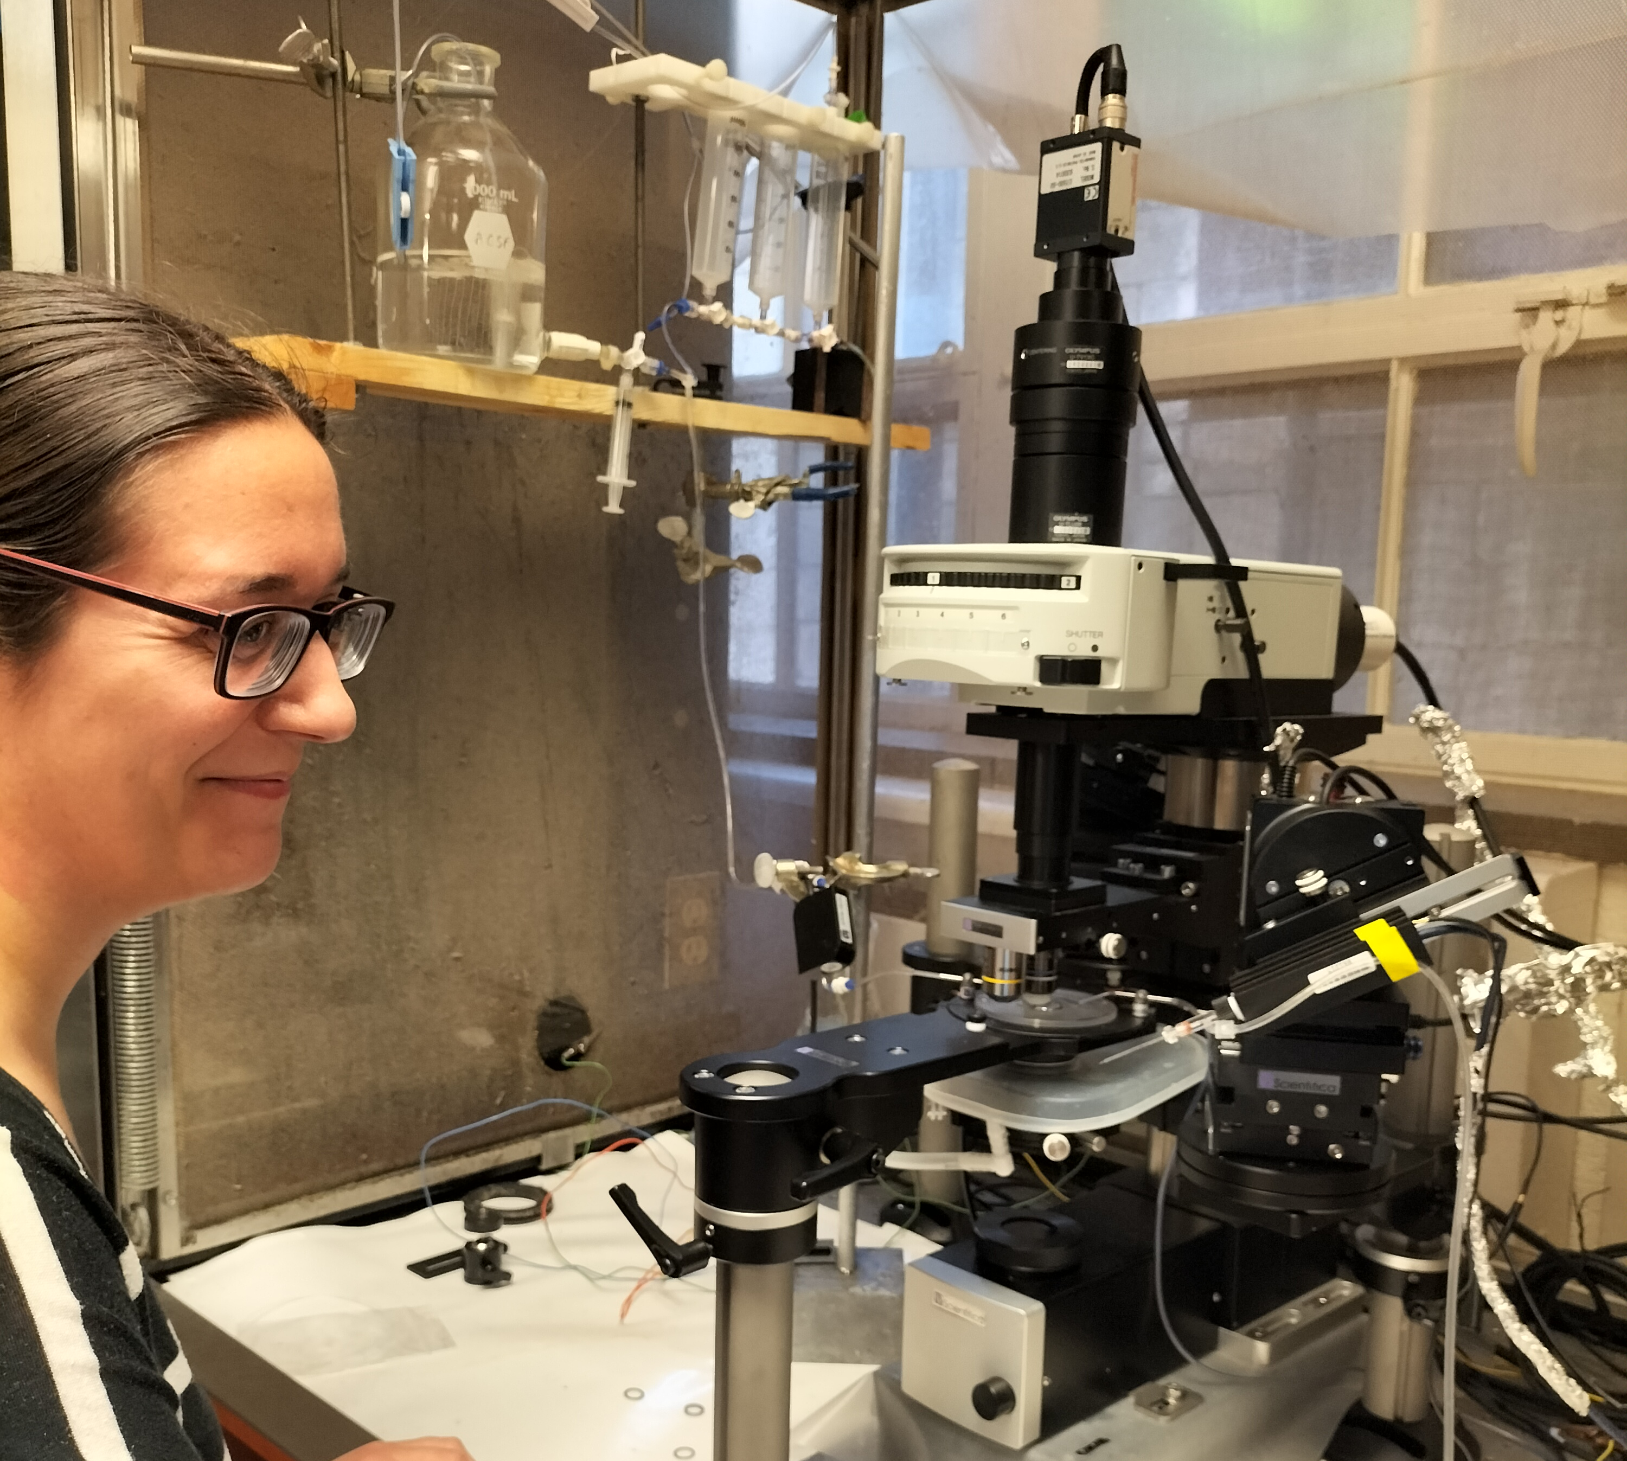
I am studying mice breathing and RTN neuronal activity
CO₂
Created with BioRender.com
Notes:
Chamber experiments. Neurologial recording. Chamber: have CO2 in with an arrow. Take away the name of the plethysmography

Slide 24
I am studying mice breathing and RTN neuronal activity
CO₂
To find out if mutations on NaV1.6 cause SUDEP by impairing RTN neurons
Created with BioRender.com

Slide 25
Our final goal
Created with BioRender.com

Slide 26
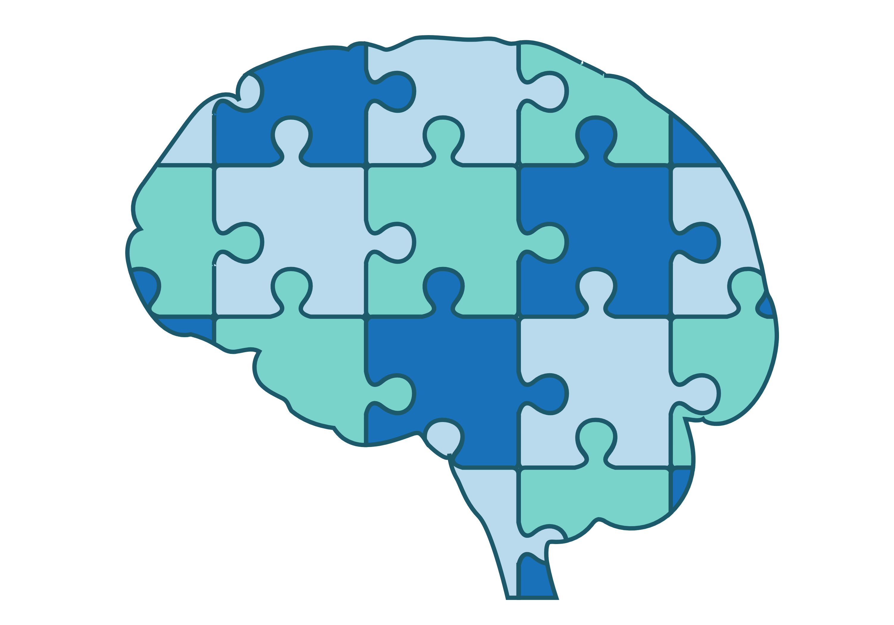
Our final goal
Created with BioRender.com

Slide 27
Our final goal
Looking for
We are
To be able to completely avoid SUDEP one day
Collaborators
HIRING
Created with BioRender.com

